Slide 1
Tiny HTTP Client and Server over C++
Kai Li

Slide 2
Agenda
Introduction
Team
Description & Goals
Technologies
Background
Challenges/Tasks
Extensions
Management
Milestones
Timeline

Slide 3
Introduction
Team
Individual project
Challenges ☹
Learn more ☺
Description & Goals
HTTP 1.0/1.1, C++, Linux
Small codebase, low complexity
Extensible, cloud storage

Slide 4
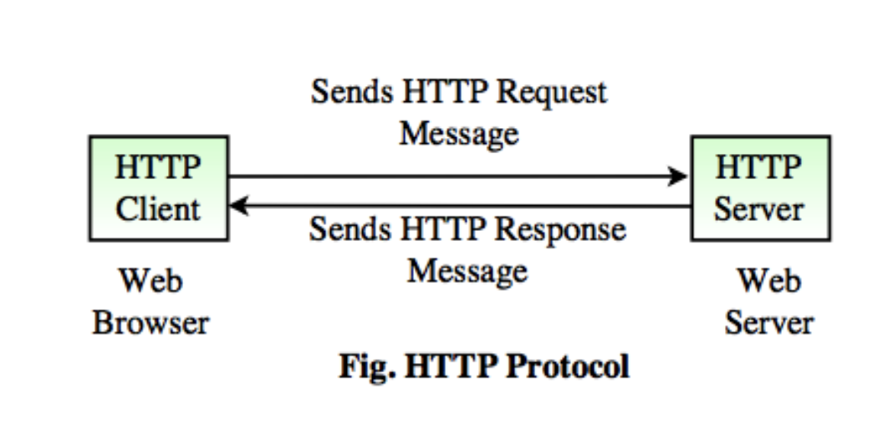
Background
What is HTTP?

Slide 5
HTTP Request
Get
Head
PUT
POST
DELETE
TRACE
OPTIONS
CONNECT
PATCH

Slide 6
HTTP Response
1XX
200
301, 302, 303
304
404
500, 502

Slide 7
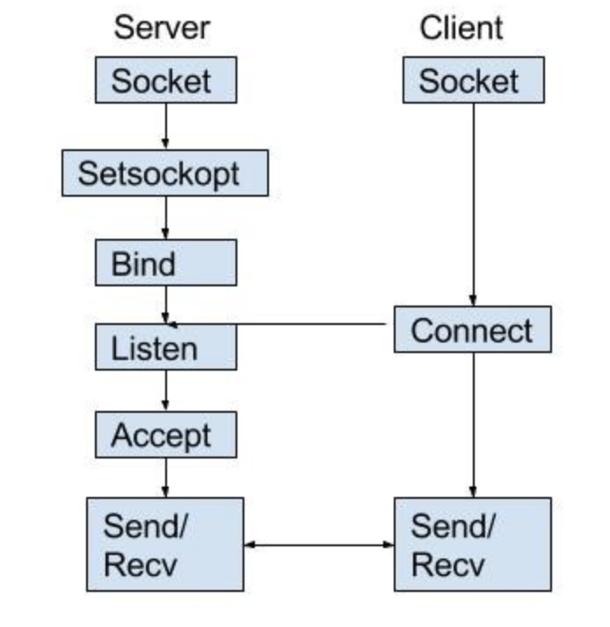
HTTP atop Socket
Socket
Client:
Construct request
Socket
Server:
Socket
Parse the request
Fetch the resource
Construct response

Slide 8
Challenge/Tasks
Sockets
Client
Methods (Post, Get, Head…)
Set Headers
Support HTTP 1.0/1.1
Server
Status codes (1xx, 2xx, 3xx, 4xx …)
Set Headers
Support HTTP 1.0/1.1
Multi-threads
Command line
IP/Port, Root Path
Integrate cloud storage (Amazon S3FS)

Slide 9
Multi-thread
pthread:
Initialize:
pthread_attr_init(&attr);
pthread_attr_setdetachstate(&attr, PTHREAD_CREATE_JOINABLE);
Create:
pthread_create();
Synchronize
pthread_attr_destroy(&attr);
pthread_join();
Exit:
pthread_exit(NULL);

Slide 10
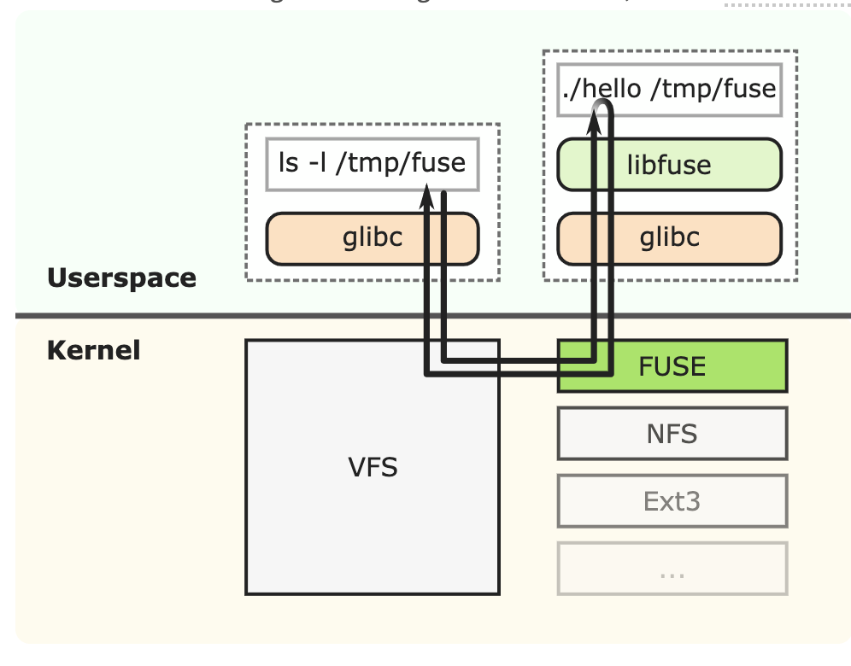
Amazon S3FS
S3FS: A FUSE file system that allows you to mount an Amazon S3 bucket as a local file system.
FUSE

Slide 11
Amazon S3FS

Slide 12
Timeline & Milestones
Demo
Final
Debug & Test
Programming
Semi-Demo
Probe
Multi-thread, Command line,
Integrate S3FS
Programming
Code Design, Socket, HTTP Header, Methods, Status code
Tech
HTTP, Socket, Amazon S3FS
Start
Selection
Investigate
1/31
3/1
3/19
4/9
4/20
4/27
2019

Slide 13
References
HTTP Made Really Easy
HTTP Headers for Dummies
HTTP Server: Everything you need to know to Build a simple HTTP server from scratch
Hypertext Transfer Protocol
FUSE Structure
Amazon S3FS

Slide 14
Thanks!

