Slide 1
Automated Agriculture System
Wenzong Tong

Slide 2
Introduction
Modern Agriculture needs more accurate techniques to keep high crop yield.
To achieve these goals, the farmland itself should provide a lot of information so farmers can react properly.
In our project, I am going to build an automated agriculture system with nodejs and MongoDB database.
And users will also be able to monitoring their farming information by web application.

Slide 3
Introduction
Should use MongoDB to store farmland information
Should use node server to retrieve sensor data from BeagleBone Black
Should use web application to deliver the project
Should have user login
Should use BeagleBone Black RESTful Service to send data to Database

Slide 4
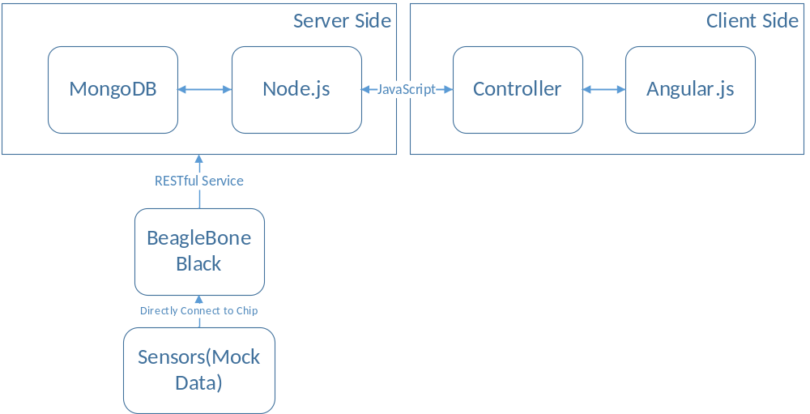
Introduction

Slide 5
NodeJS
Runs on JavaScript framework
Server-side Scripting
Based on Chrome’s V8 engine
Runs a single-threaded apartment model
Notes:
Node.js is an open-source, cross-platform JavaScript run-time environment for executing JavaScript code server-side. Historically, JavaScript was used primarily for client-side scripting, in which scripts written in JavaScript are embedded in a webpage's HTML, to be run client-side by a JavaScript engine in the user's web browser. Node.js enables JavaScript to be used for server-side scripting, and runs scripts server-side to produce dynamic web page content before the page is sent to the user's web browser. Consequently, Node.js has become one of the foundational elements of the "JavaScript everywhere" paradigm,[5] allowing web application development to unify around a single programming language, rather than rely on a different language for writing server side scripts.
REpresentational State Transfer (REST), or RESTful, web services provide interoperability between computer systems on the Internet. REST-compliant web services allow the requesting systems to access and manipulate textual representations of web resources by using a uniform and predefined set of stateless operations. Other kinds of web services, such as WSDL and SOAP, expose their own arbitrary sets of operations.[1]

Slide 6
Mongo DB
Open source
Cross-platform
Classified as a NoSQL

Slide 7
Comparsion between SQL and NoSQL
NoSQL | SQL
Offers flexibility as not every record needs to store same properties | Great for solutions where every record needs to have same properties
New properties can be added on fly | Adding property require altering schema and backfill data
Relationships are often captured by de-normalizing data | Relationships are often captured in normalized model
Good for semi-structured, complex or nested Data | Good for structured data

Slide 8
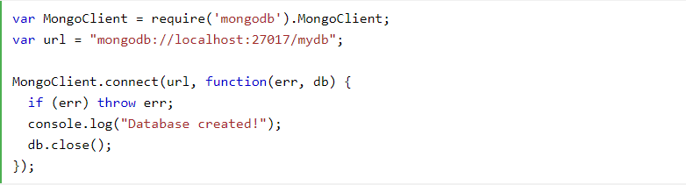
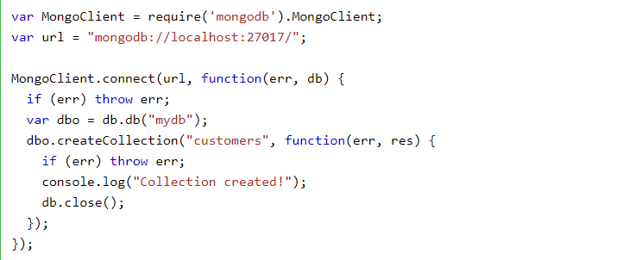
Create MongoDB Database with Nodejs
Create MongoDB database
Creating a Collection and insert into Database

Slide 9
AngularJS
create user interfaces and connect software components
adapts and extends traditional HTML to present dynamic content through two-way data-binding that allows for the automatic synchronization of models and views
AngularJS de-emphasizes explicit DOM(Document Object Model) manipulation with the goal of improving testability and performance.
Notes:
AngularJS (commonly referred to as "Angular.js" or "AngularJS 1.X") is a JavaScript-based open-source front-end web application framework mainly maintained by Google and by a community of individuals and corporations to address many of the challenges encountered in developing single-page applications.
“AngularJS is a structural framework for dynamic web apps. It lets you use HTML as your template language and lets you extend HTML’s syntax to express your application’s components clearly and succinctly. Angular’s data binding and dependency injection eliminate much of the code you currently have to write. And it all happens within the browser, making it an ideal partner with any server technology

Slide 10
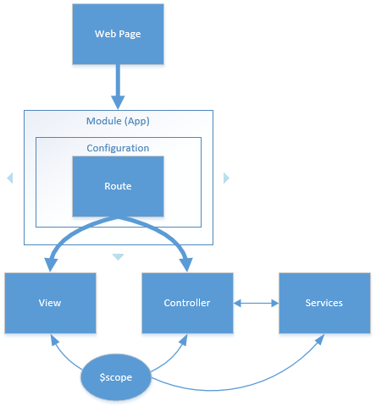
AngularJS
Notes:
Web page loads
Web page loads the application module
The module is configured with routes
The routes execute and loads the View and the Controller
Services are created and injected into the Controller
The view is added to the web page
The scope is bound to the view and the Controller

Slide 11
Project Tasks
Should collect information from sensors (temperature, soil PH value, humidity, illumination information)
  Using beaglebone black to mock data and send it to mongoDB through RESTful service.

Slide 12
Project Task
Should display farming information in a real map (google map).
  Using google map API
  Draw heatmap information to display retrieved sensor data.
  Using GeoJSON provided by google.
  Heatmap for PH level across the farmland

Slide 13
Project Task
Should control farming equipment such as sprinkler Irrigation system, greenhouse temperature.
  The system should be able to do climate control in small area (greenhouse)
  The irrigation system is set to be triggered at certain time of a day

Slide 14
Project Task
Should push notification to farmer if the farmland needs action.
  Weather alert
  Abnormal soil PH value

Slide 15
Project Task
Should collect and save sensor information for further data analyze.
  Big data analyze to conclude area climate change pattern.

Slide 16
Team
Wenzong Tong

Slide 17
Time
3/16
Setup MongoDB and test database.
3/31
Beaglebone Black RESTful service fully tested
4/13
Build web application
4/30
Combine backend and frontend
Start debugging whole system

Slide 18
Reference
https://www.w3schools.com/nodejs/nodejs_mongodb.asp
https://www.w3schools.com/nodejs/nodejs_mongodb_create_db.asp

