Slide 1
Tech Presentation
Cross-Platform GUI using Chrome and Tiny HTTP Server
Ziyi Zhao
Wenchang Tan

Slide 2
Agenda
Introduction
Technology
  HTML 5
  JavaScript
  AJAX
Project Tasks

Slide 3
Introduction
CrossPlatform
  Windows & Linux
One Intergrated Declarative Layout GUI Famewok
Communicate with Sever
Partial Rrefresh

Slide 4

Technology

Slide 5
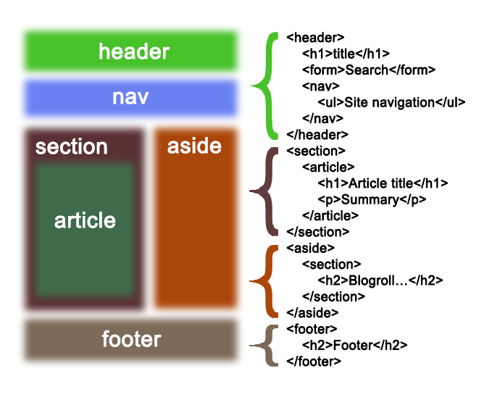
HTML 5--Hyper Text Markup Language

Slide 6
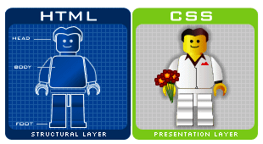
CSS
CSS (Cascading Style Sheets) allows us to apply formatting and styling to the HTML that builds our web pages.
CSS can control many elements of our web pages: colors, fonts, alignment, borders, backgrounds, spacing, margins, and much more.

Slide 7
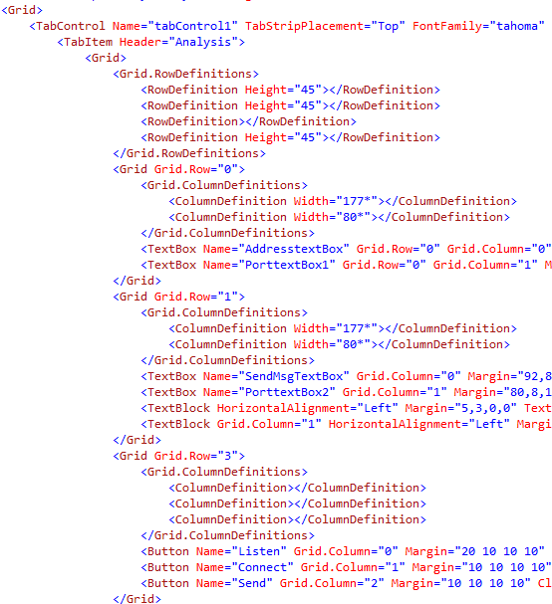
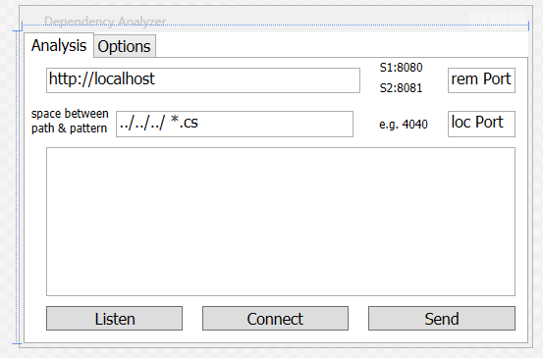
HTML 5 Vs Xaml

Slide 8
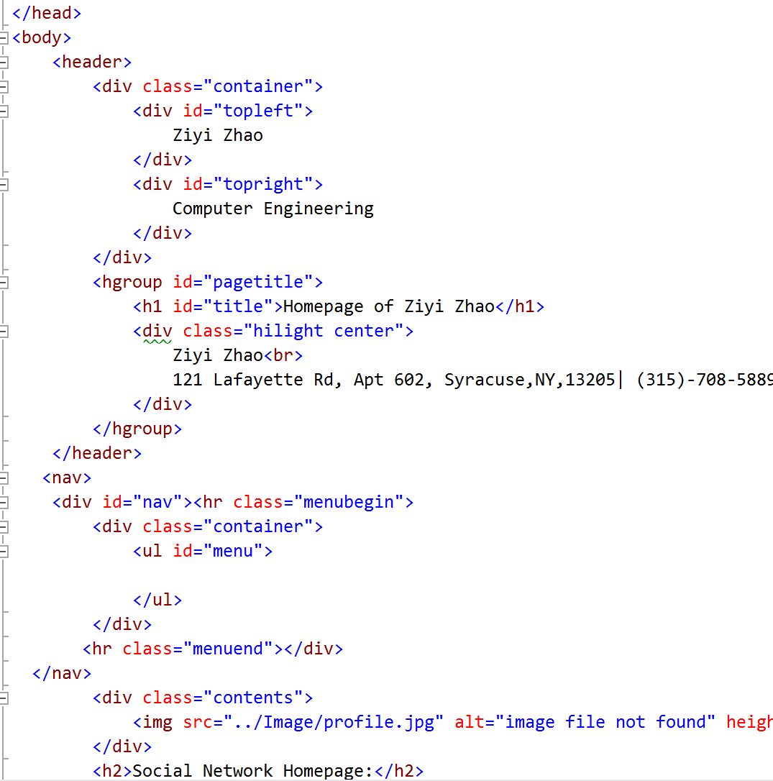
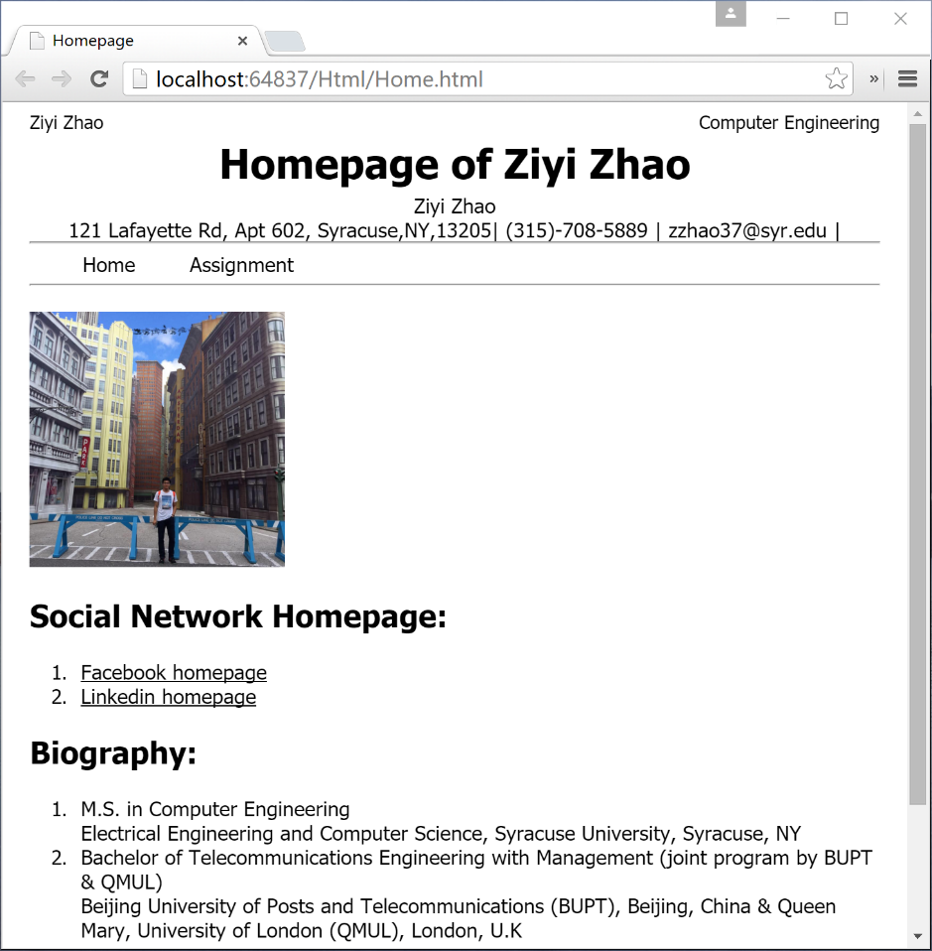
HTML 5 Vs Xaml

Slide 9
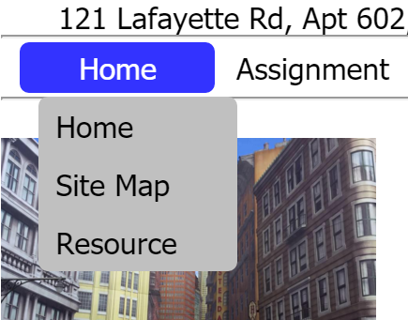
HTML 5 Vs Xaml

Slide 10
JavaScript Handler
HTML events are "things" that happen to HTML elements.
When JavaScript is used in HTML pages, JavaScript can "react" on these events.
Event handlers can be used to handle, and verify, user input, user actions, and browser actions:
  Things that should be done every time a page loads
  Things that should be done when the page is closed
  Action that should be performed when a user clicks a button
  Content that should be verified when a user inputs data
  And more ..

Slide 11
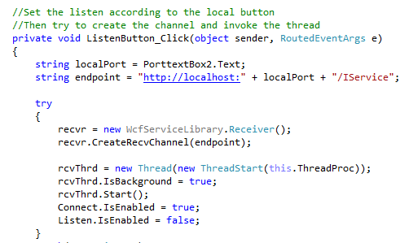
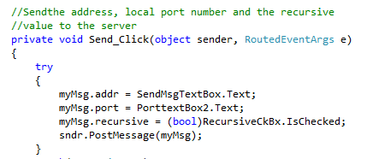
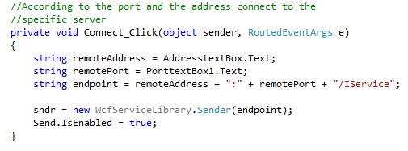
JavaScript Vs C# Handler

Slide 12
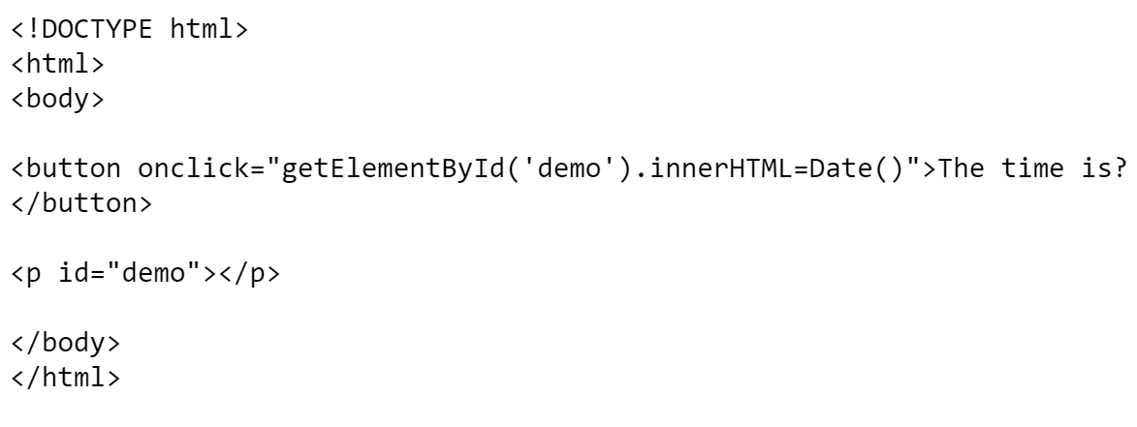
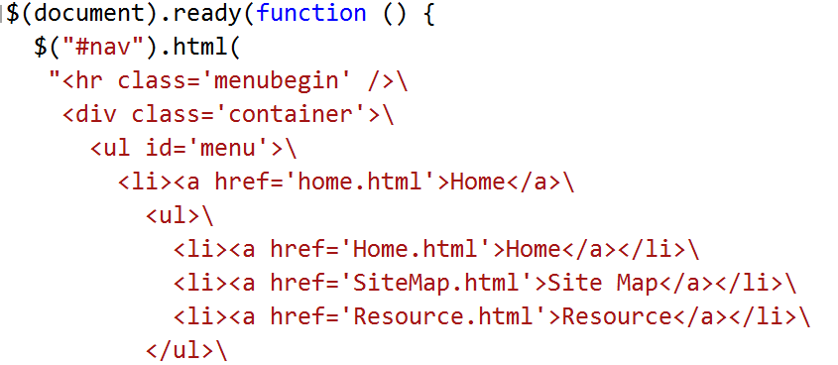
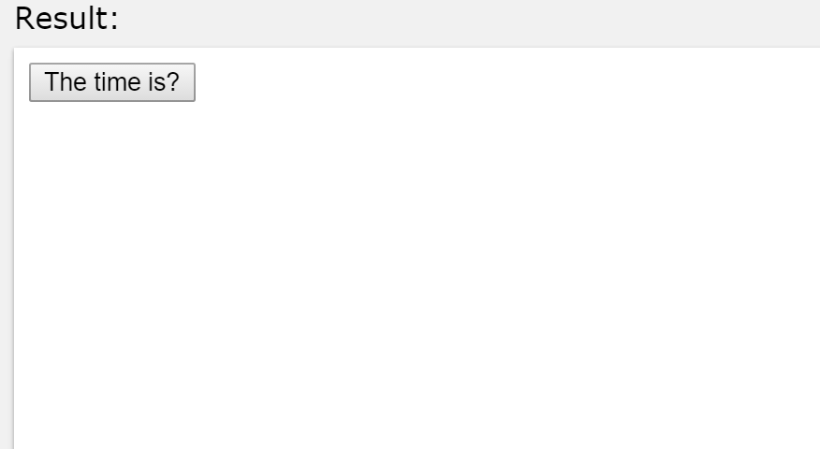
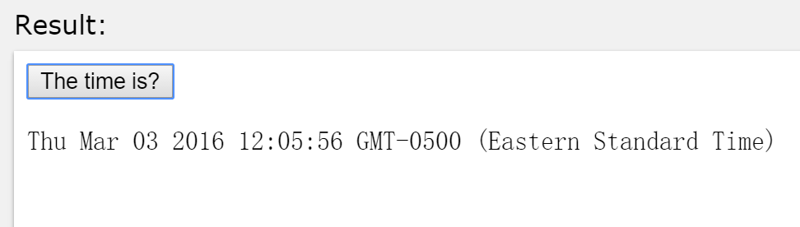
JavaScript Vs C# Handler

Slide 13
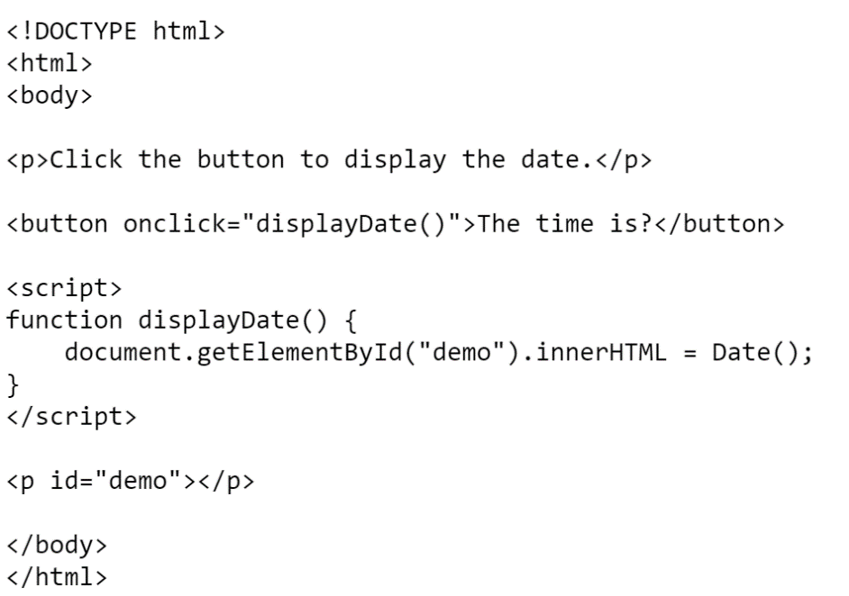
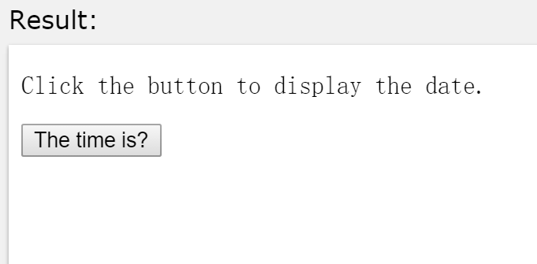
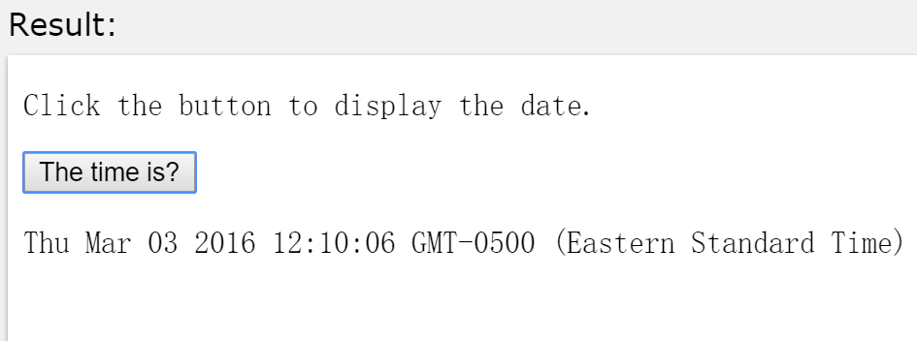
JavaScript Vs C# Handler

Slide 14
JavaScript Event
Event | Description
onchange | An HTML element has been changed
onclick | The user clicks an HTML element
onmouseover | The user moves the mouse over an HTML element
onmouseout | The user moves the mouse away from an HTML element
onkeydown | The user pushes a keyboard key
onload | The browser has finished loading the page

Slide 15
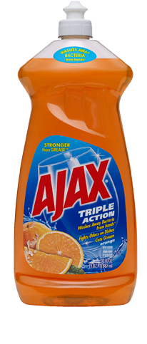



AJAX

Slide 16
AJAX
AJAX = Asynchronous JavaScript and XML.
Update a web page without reloading the page
Request data from a server - after the page has loaded
Receive data from a server - after the page has loaded
Send data to a server - in the background

Slide 17
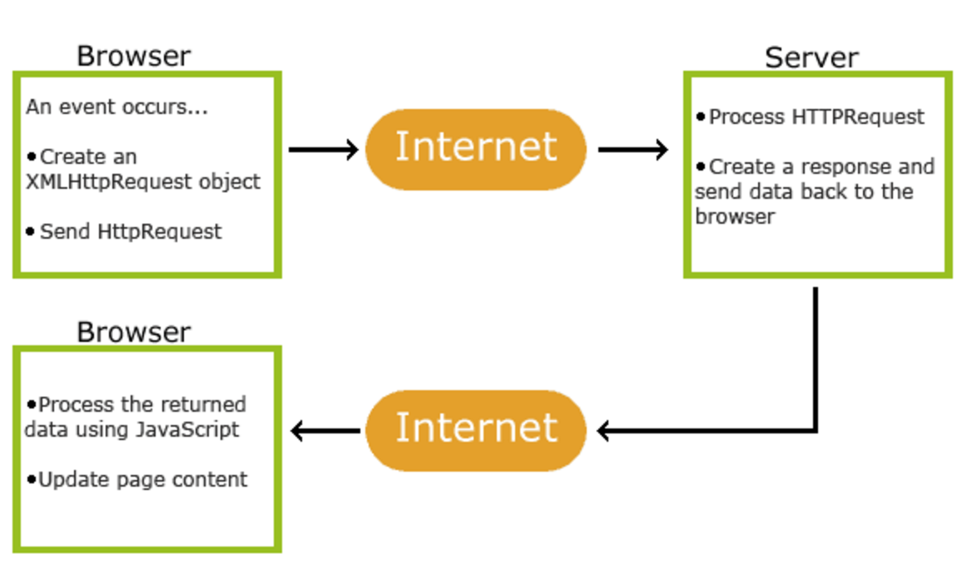
AJAX

Slide 18
Tasks
HTML 5 to build the GUI
JavaScript to handle the event
HTTP message to control the communication
Tiny Server to process the request
AJAX to reload the data

Slide 19
Thank You!

