Slide 1
Application with
Cross-Platform GUI
Zhuo Zhang

Slide 2
Agenda
Technique Overview
  Document Object Model (DOM)
  HTML5
  JavaScript
  AJAX
Project Plan

Slide 3
Technique Overview
DOM, HTML5, JavaScript, AJAX

Slide 4
Document Object Model (DOM)
The Document Object Model is a platform- and language-neutral interface that will allow programs and scripts to dynamically access and update the content, structure and style of documents. The document can be further processed and the results of that processing can be incorporated back into the presented page. This is an overview of DOM-related materials here at W3C and around the web.
https://www.w3.org/DOM/
Example: HTML, XML
Notes:
-If pick up one character as essential: O – Object
-The object model behind allow us to easily access and manipulate the document
-We use DOM a lot like HTML and XML, we made a related project in OOD course
-Next: html example

Slide 5
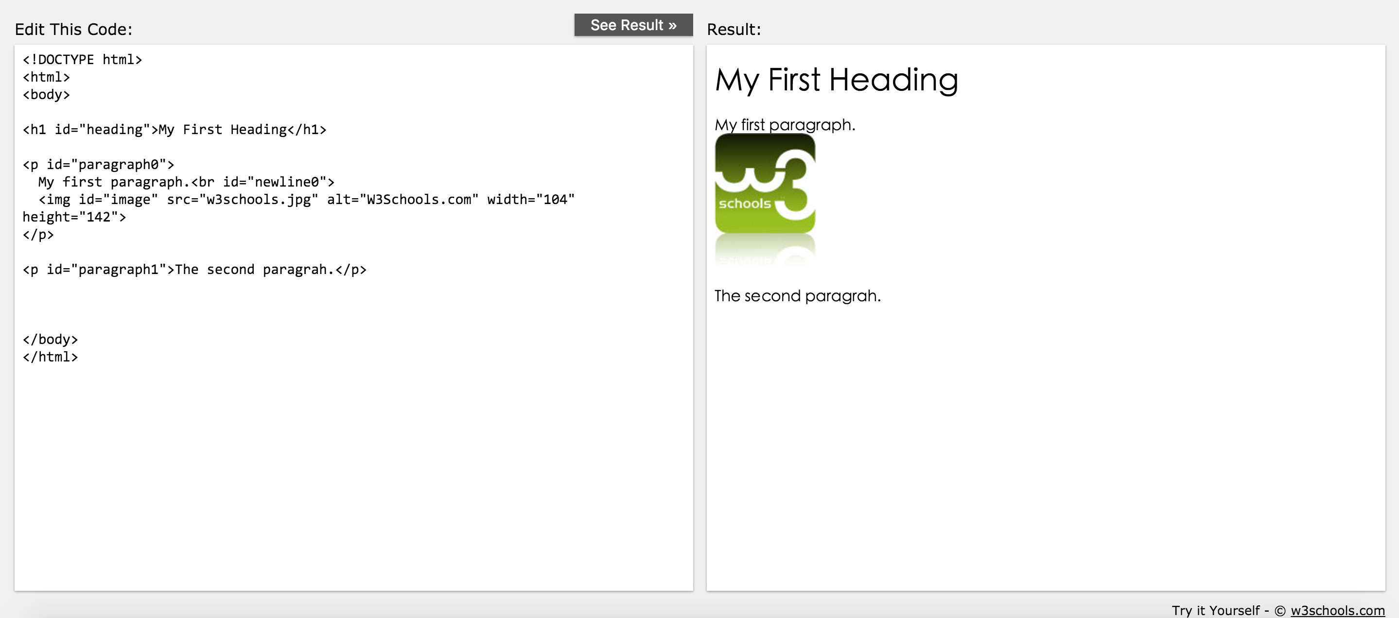
DOM HTML Example
Notes:
-A simple HTML page
-The page is ranged by different tags and relationships among the tags.
-Using DOM, HTML is easy to be read by both human and interpreter, because it is using linear structure to store tree structure
-DOM supports some universal attributes like id. Id attribute could be applied to any DOM tags, and it allows us to find a specific tag

Slide 6
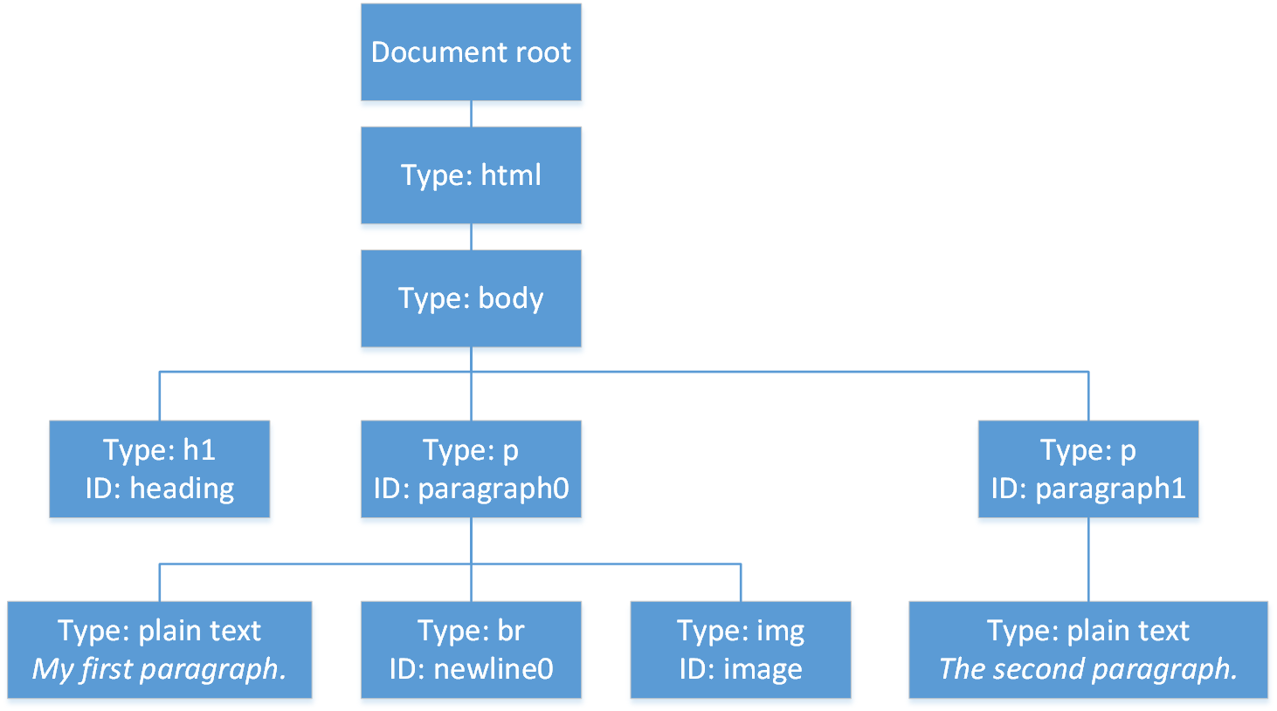
DOM Internal Structure
Notes:
-Tree structure
-The parent and children relationship make it easy to add, remove or change nodes inside
-Also such tree structure is easily being changed to linear ones

Slide 7
HTML5
Finalized and published, on 28 October 2014
Previous version: HTML4 (1997)
Aims
  improve the language with support for the latest multimedia
  keep it easily readable by humans and consistently understood by computers and devices (web browsers, parsers, etc.).
Notes:
-It was a long gap between previous version and HTML5
-A lot of alternative technologies appeared trying to fill the gap, like JAVA(Applet), Flash, Silverlight
-They all requires browser plug-ins and are not very stable to use.

Slide 8
HTML5 New Features (partial)
New semantic elements like <header>, <footer>, <article>, and <section>.
New form control attributes like number, date, time, calendar, and range.
New graphic elements: <svg> and <canvas>.
New multimedia elements: <audio> and <video>.
New APIs: Geolocation, Drag and Drop, Local Storage, Application Cache, Web Workers, SSE
Notes:
-Graphic elements: allow us to dynamically draw graph on the web page
-Multimedia elements: allow us to get rid of plug-ins
-Geolocation: location
-Web Workers: background thread
-SSE: Server-Sent Events, A server-sent event is when a web page automatically gets updates from a server.

Slide 9
JavaScript
JavaScript is the programming language of HTML and the Web.
It is part of DOM, interpreted by JavaScript engine (included by all modern browsers)
It could
  Do programmatic operations like other languages
  Manipulate DOM
Notes:
-Operations with DOM bring us ways to change the appearance of the page dynamically
-JavaScript is interpreted by browser, what means it is running on the client side. Once the code is sent, the execution do not involve the server side, providing a significant execution speed.
-JavaScript is a part of DOM, what means it can manipulate itself, or could be replaced by new content sent from server

Slide 10
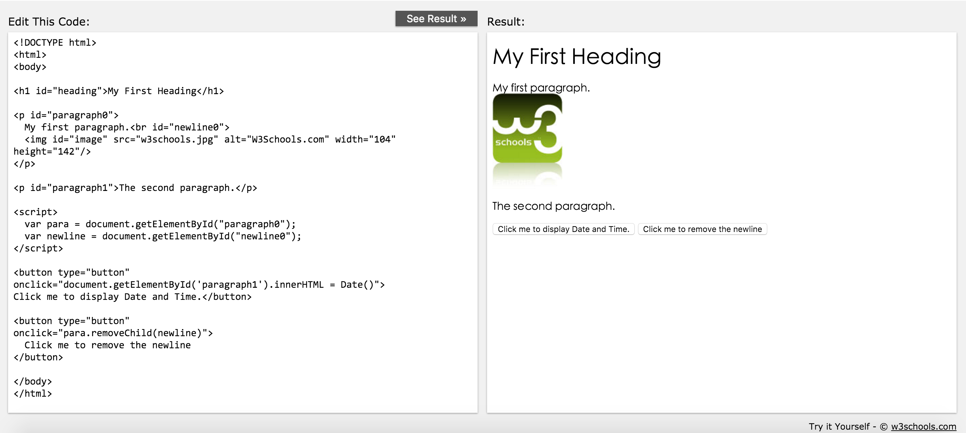
JavaScript Example

Slide 11
JavaScript Example

Slide 12
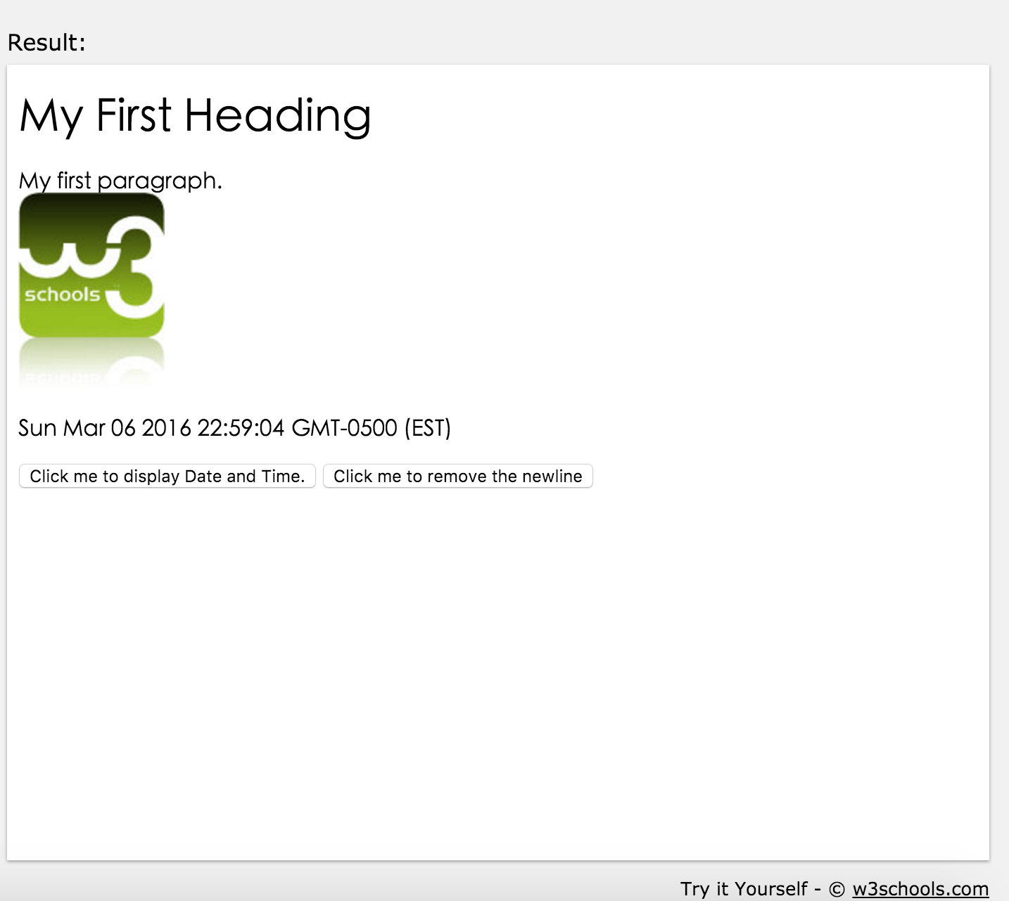
JavaScript Example

Slide 13
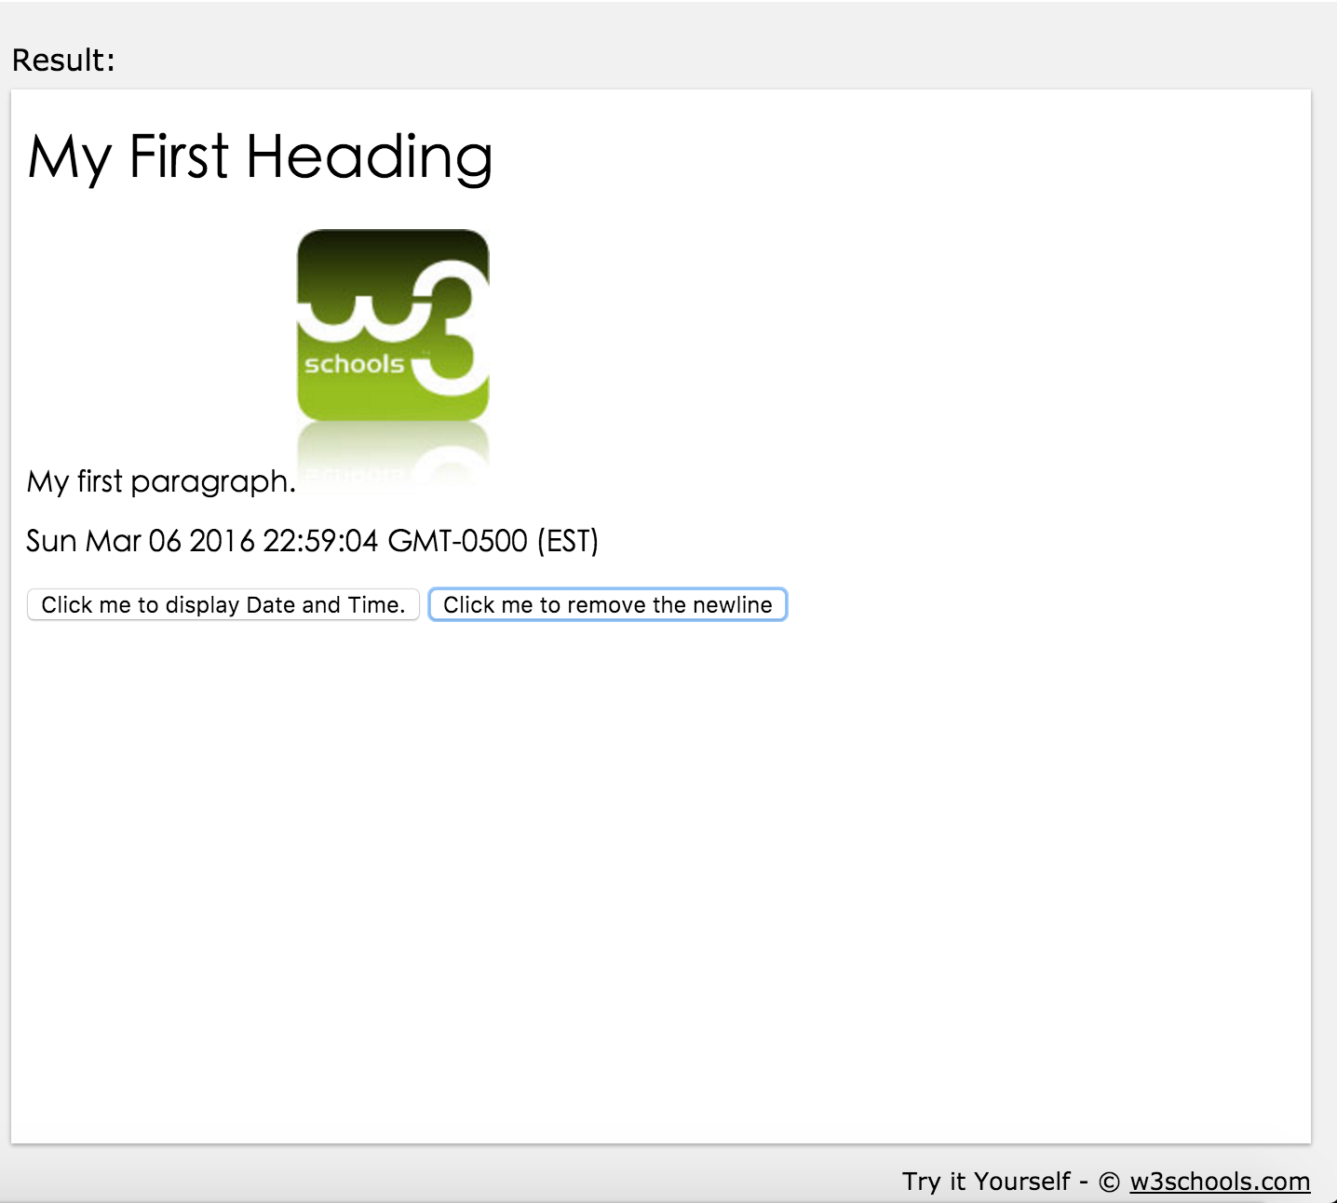
JavaScript Example

Slide 14
AJAX
Asynchronous JavaScript and XML
A technique for creating fast and dynamic web pages
Examples of applications using AJAX: Google Maps, Gmail, YouTube, and Facebook.
Notes:
-it is possible to update parts of a web page, without reloading the whole page using AJAX
-Due to time limitation, AJAX will be explained in detail with demonstration in next presentation.

Slide 15
Project Plan
Cross-Platform GUI Application

Slide 16
Goals
Give Project1 a cross-platform graphic user interface
Make new glue code for Project1
Develop a GUI using techniques introduced previously
Make a wrapper for HTTP pluggable servers
Notes:
-New glue code for project 1: so it knows how to interact with HTTP server
-Wrapper: can use any HTTP server to handle the communication

Slide 17
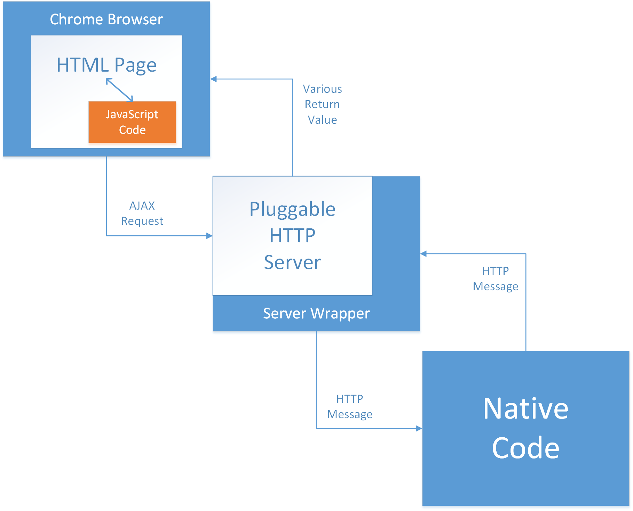
High-Level Structure

Slide 18
References
[1] https://en.wikipedia.org/wiki/HTML5
[2] http://www.w3schools.com/html/html5_intro.asp
[3] http://www.w3schools.com/js/default.asp
[4] http://www.w3schools.com/ajax/ajax_intro.asp

