Slide 1
Standard Template Library

Slide 2
Some Definitions
vector, string, deque, and list are standard sequence containers.
set, multiset, map, multimap, unordered_set, unordered_multiset, unordered_map and unordered_multimap are standard associative containers.
Iterators:
  Input iterators are read-only—each iterated element may be read only once.
  Output iterators are write-only—each iterated element may be written only once.
  Forward iterators can read or write an element repeatedly. They don’t support operator--() so they can only move forward.

Slide 3
Some Definitions (cont.)
  Bidirectional iterators are like forward iterators except that they support moving in both directions with operator++() and operator--().
  Random access iterators are bidirectional iterators that add the capability to do iterator arithmetic—that is, they support *(it + n).
Any class that overloads the function call operator—operator()—is a functor class, and we refer to its instances as functors or function objects.

Slide 4
Computational Complexity
Constant time refers to operations that do not depend on the number of elements stored in a container.
  Adding an element to a list end is a constant time operation. Finding the location at which to insert is a linear time operation.
Logarithmic time refers to operations that need time to run that grows as the logarithm of the number of elements in the container.
  A logarithmic operation on a container with 1,000,000 elements takes three times as long to complete as that operation of a container with 1,000 elements.
Linear time refers to operations that require computation time that grows proportionally to the number of elements in the container.

Slide 5
STL Supports Guaranteed Complexity for Container Operations
Vectors and Deques:
  Insertion is a linear time operation.
  Accessing a known location is constant time.
  Searching an unsorted vector or deque is a linear time operation.
  Searching a sorted vector or deque should be a logarithmic time operation (use binary_search algorithm to ensure that it is).
Lists:
  Insertion is a constant time operation.
  Accessing a known location and searching, whether sorted or not, is linear time, with the exception of the end points, which can be accessed in constant time.

Slide 6
STL Supports Guaranteed Complexity for Container Operations (cont.)
Sets and Maps:
  Insertion and accessing are logarithmic time operations.
  Searching should be a logarithmic time operation (use member function find, etc., to ensure that it is).
Unordered_set and Unordered_map
  Lookup, insertion, and deletion are constant time operations.
  They are hashed containers, so we get access to an element by computing a hash function on a key which maps to an address in the table. This is constant time. If there is more than one element that hashes to that address, then we search a linked list rooted at that address (the elements on this list are referred to as a bucket).
  So access is nearly constant time.

Slide 7
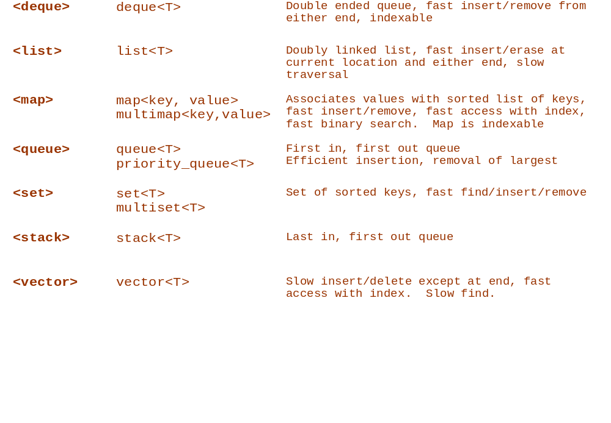
STL Header Files for Containers

Slide 8
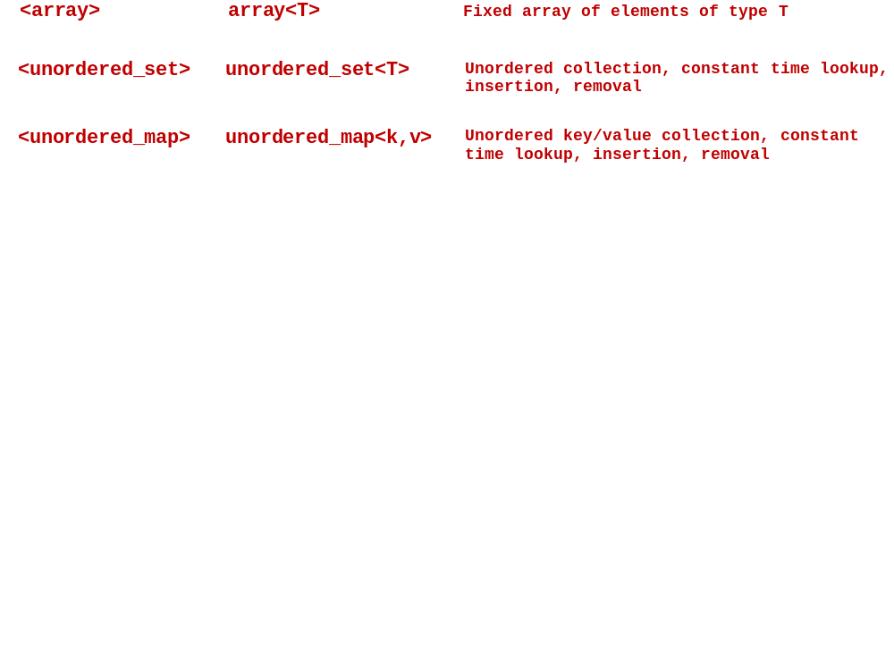
STL Header Files for Containers

Slide 9
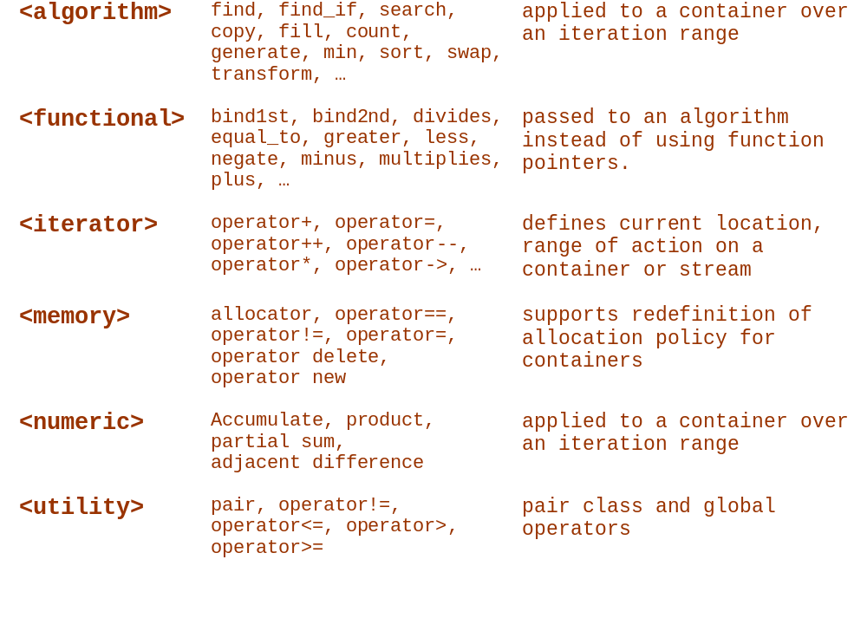
Other STL Header Files

Slide 10
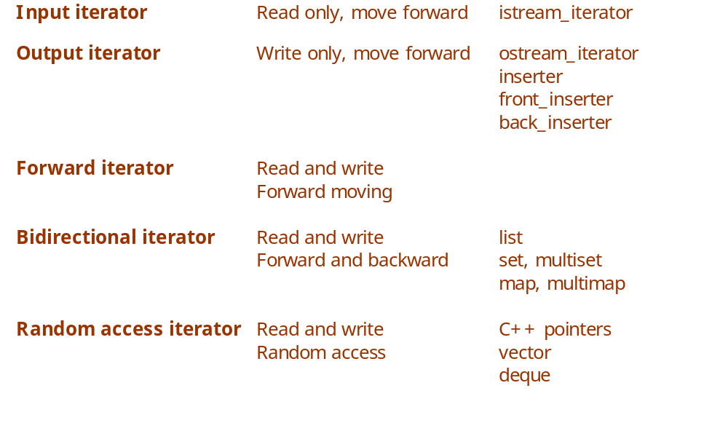
STL Iterators

Slide 11
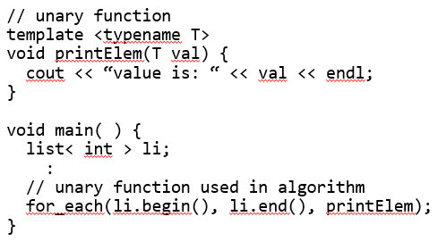
STL Functions
Unary functions:
  Take single argument of the container’s value_type

Slide 12
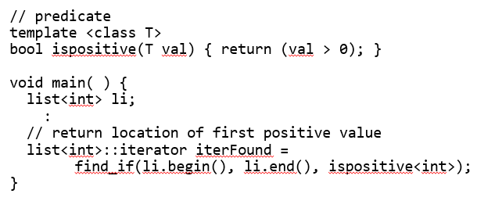
STL Functions
Predicate:
  Function taking a template type and returning bool

Slide 13
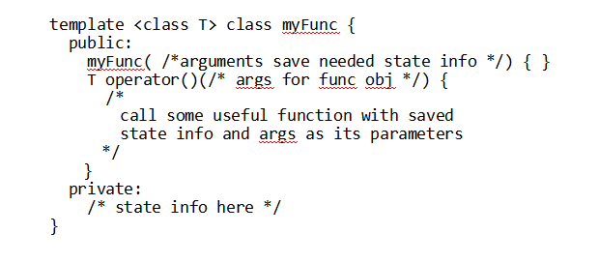
STL Function Objects
Function objects:
  class with constructor and single member operator()

Slide 14
unary_function Type
The unary_function type serves as a base class for functors that will be used in adapters like not1. It supplies traits needed by the adaptors.
An example use follows on the next slide.
#include <functional>
template <class Arg, class Result>
struct unary_function{
typedef Arg argument_type;
typedef Result result_type;
};

Slide 15
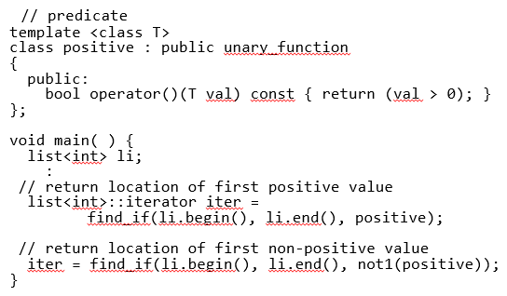
STL Function Adapters
Negators:
  not1 takes unary_function predicate and negates it
  not2 takes binary_function predicate and negates it

Slide 16
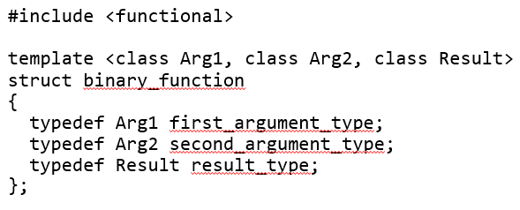
binary_function Type
The binary_function type provides traits needed by binary function adapters, as illustrated on the next slide.

Slide 17
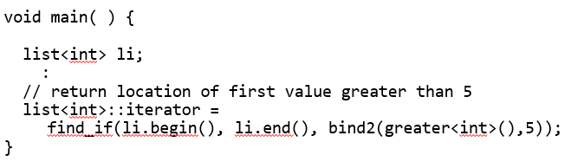
STL Function Adapters
Binders:
  bind1 binds value to first argument of a binary_function
  bind2 binds value to second argument of binary_function

Slide 18
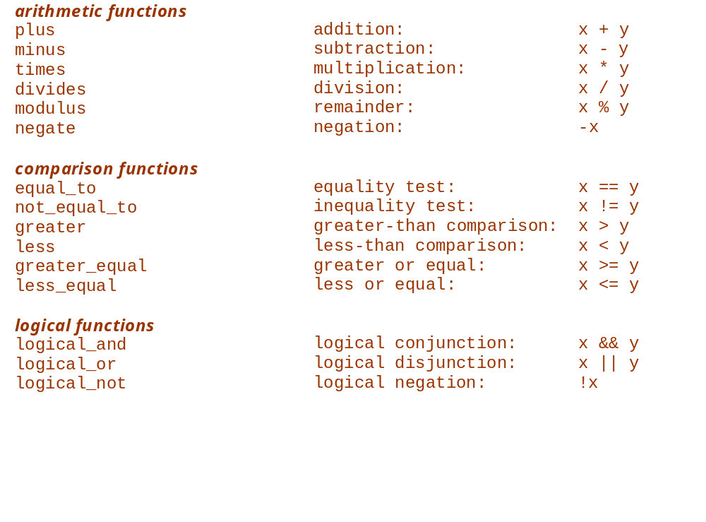
STL Function Objects

Slide 19
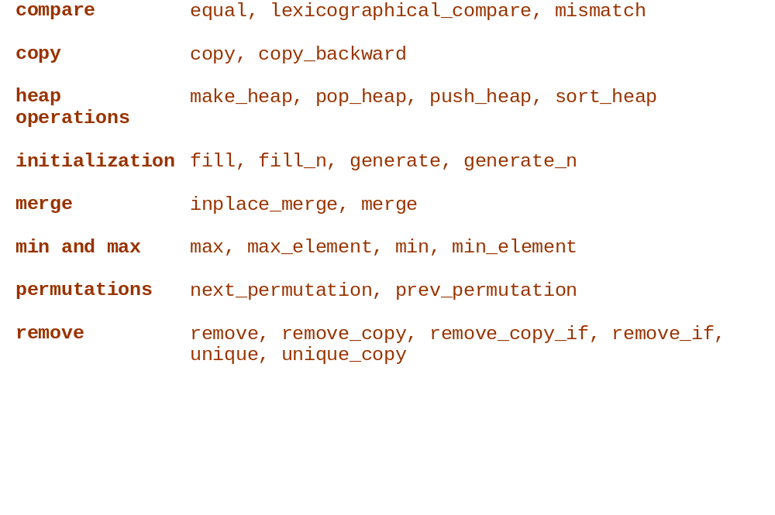
Algorithms by Type

Slide 20
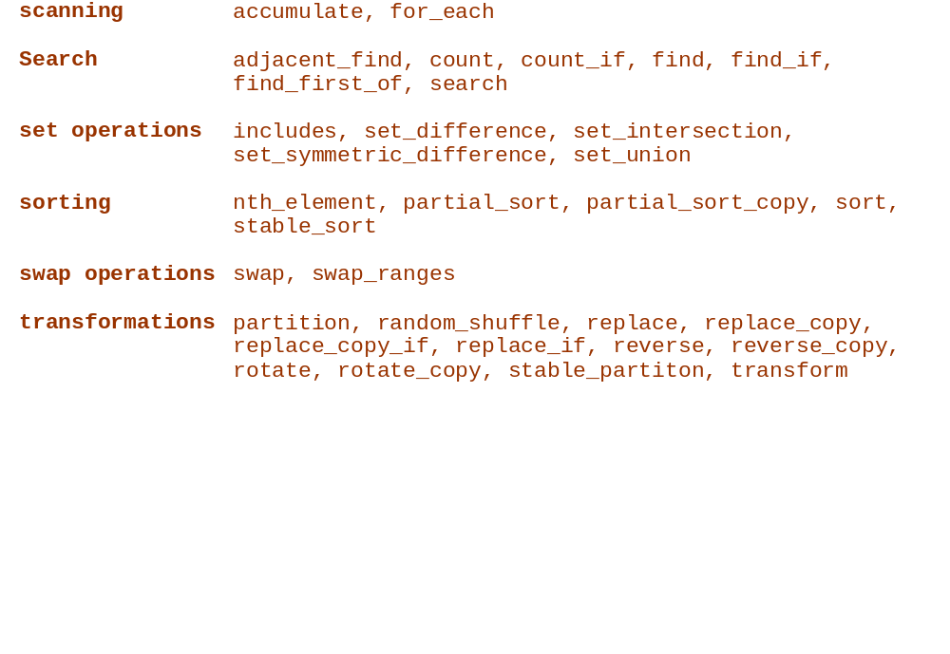
Algorithms by Type (continued)

