Slide 1
Streams Reference

Slide 2
Streams Library Classes
Streams:
Part of the standard C++ library. They are a family of related classes designed to insert and extract data from devices and memory buffers. The most important classes are:
  ios which controls formatting and manages error state for all streams
  streambuf abstracts buffering of data during insertion and extraction from streams
  istream provides the basic client interface for extraction from a stream
  ostream provides the basic client interface for insertion into a stream
  iostream simply merges istream and ostream

Slide 3
Streams Library Classes (cont.)
  ifstream derives from istream specialized for input streams that extract from files
  ofstream derives from ostream specialized for output streams that insert to files
  filebuf derives from streambuf specialized for file buffering
  istringstream derives from istream specialized for input streams that extract from buffers in memory
  ostringstream derives from ostream specialized for output streams that insert to buffers in memory
  stringbuf derives from streambuf specialized for in-memory buffers
  stdiobuf provides compatibility with stdio
Global objects:
  cin, cout, cerr, and clog

Slide 4
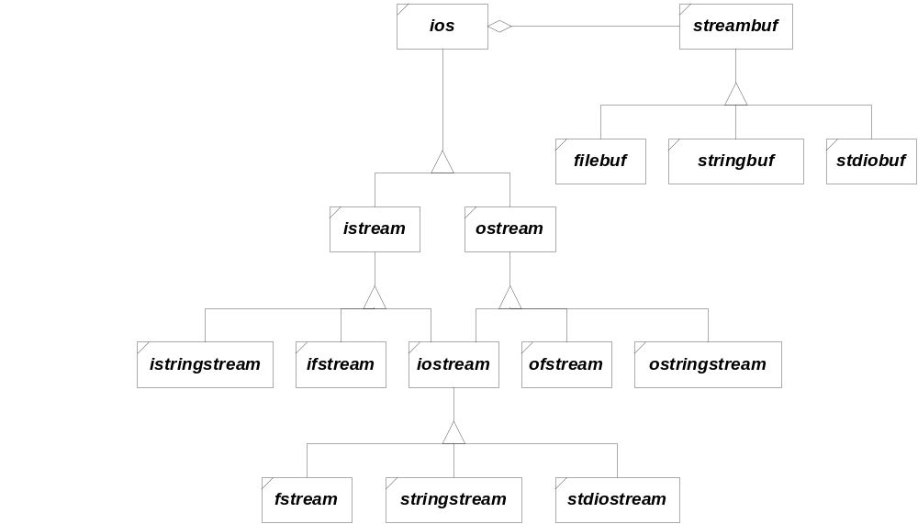
iostream Hierarchy

