Slide 1
Win32 Sockets

Slide 2
References
Socket Routines, MSDN help
Network Programming for Microsoft Windows, Jones & Ohlund, Microsoft Press, 1999 (a later edition is in print)
C# Network Programming, Richard Blum, Sybex, 2003
http://tangentsoft.net/wskfaq

Slide 3
What Are Sockets?
Sockets provide a common interface to the various protocols supported by networks.
They allow you to establish connections between machines to send and receive data.
Sockets support the simultaneous connection of multiple clients to a single server machine.

Slide 4
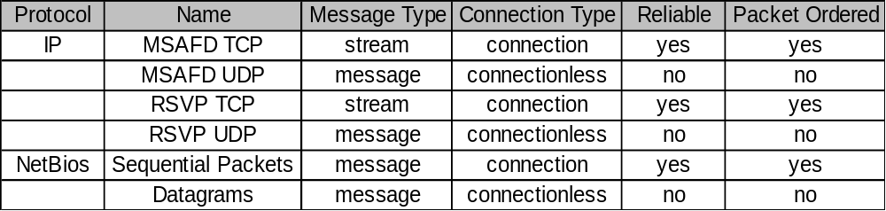
Network Protocols
Socket applications can adopt communication styles supported by a specific underlying protocol; e.g.:
We will focus on sockets using TCP/IP, that is, reliable, packet-ordered, connection-oriented communication with streams.

Slide 5
TCP Protocol
TCP/IP stands for Transmission Control Protocol/ Internet Protocol.
TCP/IP is the most important of several protocols used on the Internet. Some others are: HyperText Transport Protocol (HTTP), File Transfer Protocol (FTP), Simple Mail Transfer Protocol (SMTP), and Telnet, a protocol for logging into a remote computer. Sockets provide a standard interface for a variety of network protocols. TCP/IP is, by far, the most commonly used protocol for sockets. Here are the main features of TCP/IP:
  IP is a routable protocol.
  That means that TCP/IP messages can be passed between networks in a wide area network (WAN) cluster.

Slide 6
TCP Protocol (cont.)
  Each device using TCP/IP must have an IP address.
  This address is a 32-bit word, organized into four 8-bit fields, called octets. Part of the IP address identifies the network, and the rest identifies a specific host on the network.
  IP addresses are organized into three classes.
  Each class has a different allocation of octets to these two identifiers. This allows the Internet to define many networks, each containing up to 256 devices (mostly computers), and a few networks, each containing many more devices.
  A single machine can run multiple communications sessions using TCP/IP.
  That is, you can run a web browser while using Telnet and FTP simultaneously.

Slide 7
TCP/IP-Based Sockets
Connection-oriented means that two communicating machines must first connect.
All data sent will be received in the same order
as sent.
    Note that IP packets may arrive in a different order than that sent.
    This occurs because all packets in a communication do not necessarily travel the same route between sender and receiver.
Streams mean that, as far as sockets are concerned, the only recognized structure is bytes of data.

Slide 8
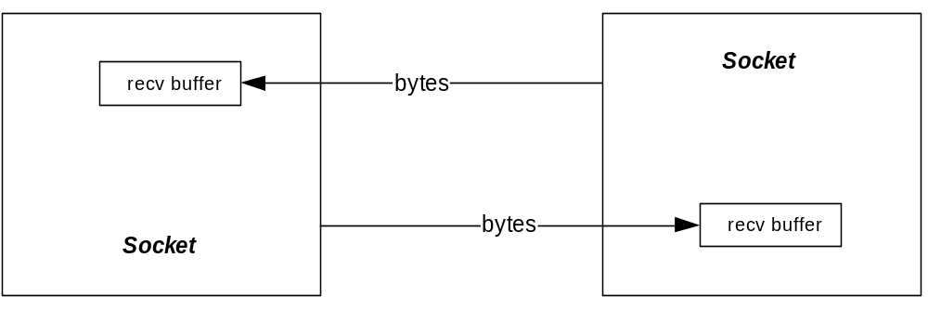
Socket Logical Structure

Slide 9
Socket send Behavior
Sockets API provides functions:
    int send(SOCKET s, char *buff, int len, int flags)
    Request to send up to len bytes from buffer buff
    int recv(SOCKET s, char *buff, int len, int flags)
    Request to receive up to len bytes, stored in buffer buff
If receive buffer has space for len bytes, then len bytes are sent and send call returns with value len.

Slide 10
Socket send Behavior (cont.)
If receive buffer has free space, but less than len bytes, then the receive buffer is filled and send returns the number of bytes actually sent.
If receive buffer is full, send will block until space becomes available.

Slide 11
Socket recv Behavior
Sockets API provides functions:
    int send(SOCKET s, char *buff, int len, int flags)
    Request to send up to len bytes from buffer buff
    int recv(SOCKET s, char *buff, int len, int flags)
    Request to receive up to len bytes, stored in buffer buff
If receive buffer has at least len bytes of content, then len bytes are copied to buff and call returns with value len.

Slide 12
Socket recv Behavior (cont.)
If receive buffer has content, but less than len bytes, then the receive buffer contents are moved to buff and recv returns the number of bytes actually copied.
If receive buffer is empty, recv will block until content becomes available.

Slide 13
We look at more of the socket interface in the next segment.

