Slide 1
Run-Time Type Identification
Jim Fawcett
CSE687 – Object Oriented Design
Spring 2007

Slide 2
Typeid
The function: const typeinfo typeid(arg) returns a const typeinfo object when passed an object, reference, or pointer.
Typeinfo: class type_info { public: virtual ~type_info(); int operator==(const type_info& rhs) const; int operator!=(const type_info& rhs) const; int before(const type_info& rhs) const; const char* name() const; const char* raw_name() const; private: ... };

Slide 3
Examples of typeid() use
class foo { … }; typeid(foo).name() returns “foo”
foo *ptr; typeid(ptr).name() returns “foo*” typeid(*ptr).name() returns “foo”
class derived : public base { … }; typeid(base).before(typeid(derived)) returns true

Slide 4
Shape *sp = new circle; typeid(shape) == typeid(*sp) returns false typeid(shape).before(typeid(*sp)) returns true typeid(sp).name() returns “circle*” typeid(*sp).name() returns “circle”

Slide 5
dynamic_cast<…>(…)
Dynamic casts support safe down-casting (casting down an inheritance hierarchy): Line* lptr = new line; circle* cptr = new circle; rectangle* rptr = new rectangle; shape* array[3] = { lptr; cptr, rptr }; for(int i=0; i<3; i++) if(dynamic_cast<circle*>(array[I])) cout << “circle” << endl; else cout << “non-circle” << endl;

Slide 6
Caution
Typeid and dynamic_cast information is carried in a class’s virtual function pointer table and is intended to be used only with polymorphic classes, e.g., those with at least one virtual function.
Typeid works for non-polymorphic classes, but returns only static type info, e.g., based on the static pointer type, not on the type of the object pointed to.
You must enable run-time type information (RTTI) in your project settings (C/C++ tab, C++ language category). Your program will crash if you use dynamic_cast or RTTI and forget to do this.

Slide 7
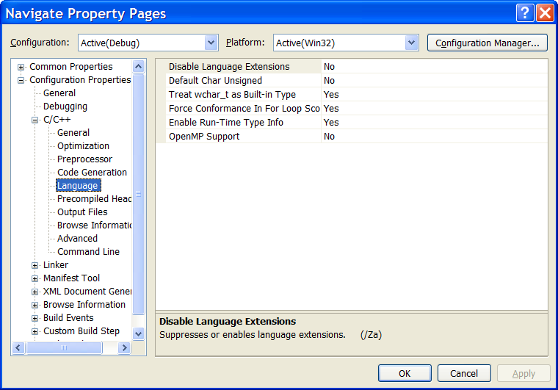
Enabling RTTI
On by default

Slide 8
End of Presentation

