Slide 1
Asp.Net Core MVC
Jim Fawcett
CSE686 – Internet Programming
Spring 2019

Slide 2
What is Asp.Net Core MVC?
Framework for building web applications
Based on Model-View-Controller pattern
Model manages the application data and enforces constraints on that model.
Often accessed through persistent objects
Views are mostly passive presentations of application state.
Views generate requests sent to a controller based on client actions.
Controllers translate requests into actions on the data model and generate subsequent views.

Slide 3
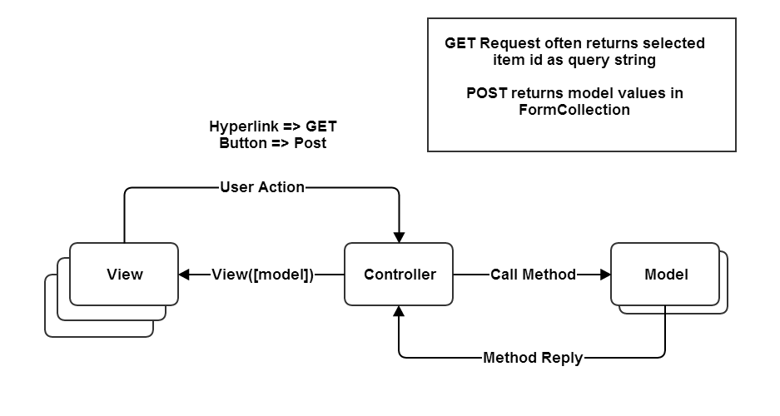
MVC Structure

Slide 4
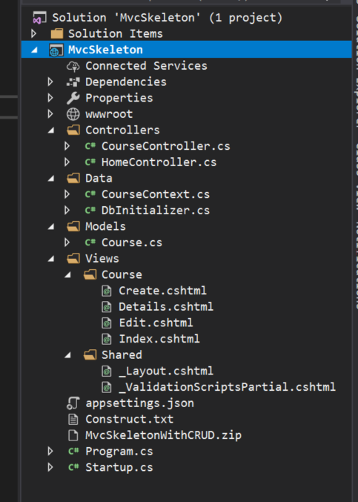
Mvc Structure
Controllers
Connect Views to Data
Models
Provide structured data, usually persisted to a db
Accessed through C# class instances
Views
Combine markup and C# code to display and accept data.

Slide 5
MVC Life Cycle
Clients request a named action on a specified controller, e.g.:
http://localhost/aController/anAction
The request is routed to aController’s anAction method.
That method decides how to handle the request, perhaps by accessing a model’s state and returning some information in a view.
User actions in the view, e.g., data entered, button presses, result in get (ActionLink) or post (Button) requests to a specific controller action.
That process may repeat for many cycles.

Slide 6
What is a Model?
A model is a file of C# code and often an associated data store, e.g., an SQL database or XML file.
The file of C# code manages all access to the application’s data through objects.
Linq to SQL and Linq to XML can be used to create queries into these data stores
This can be direct
More often it is done through objects that wrap db tables or XML files and have one public property for each attribute column of the table.

Slide 7
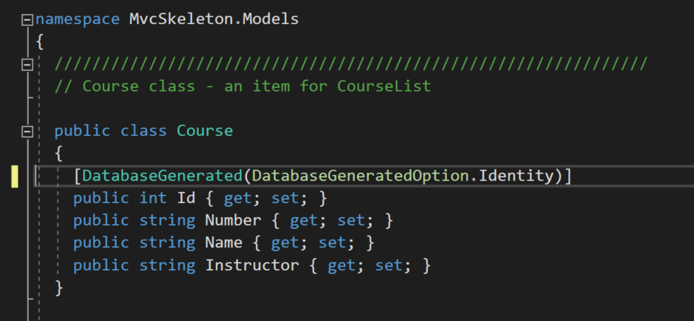
MvcSkeleton with CRUD Model

Slide 8
Adding a Model
Right-click on Model folder and select Add Class.
Populate the model class with public properties that represent data to be managed.
Usually the model is persisted to an XML file or SQL database using LINQ or the Entity Data Framework.

Slide 9
What is a View?
Views are cshtml files with only HTML and inline C# code, e.g., <td>@crs.Number, @crs.Name
Code is used just to support presentation and does no application processing.
The HTML is augmented by HTML Helpers, provided by Asp.Net Core MVC that provide shortcuts for commonly used HTML constructs, e.g.: @Html.ActionLink(“Edit”, “Edit”, new { id = crs.Id })
Asp.Net MVC also provides tag helpers that translate into pure markup, e.g.: <input asp-for=“Name” />

Slide 10
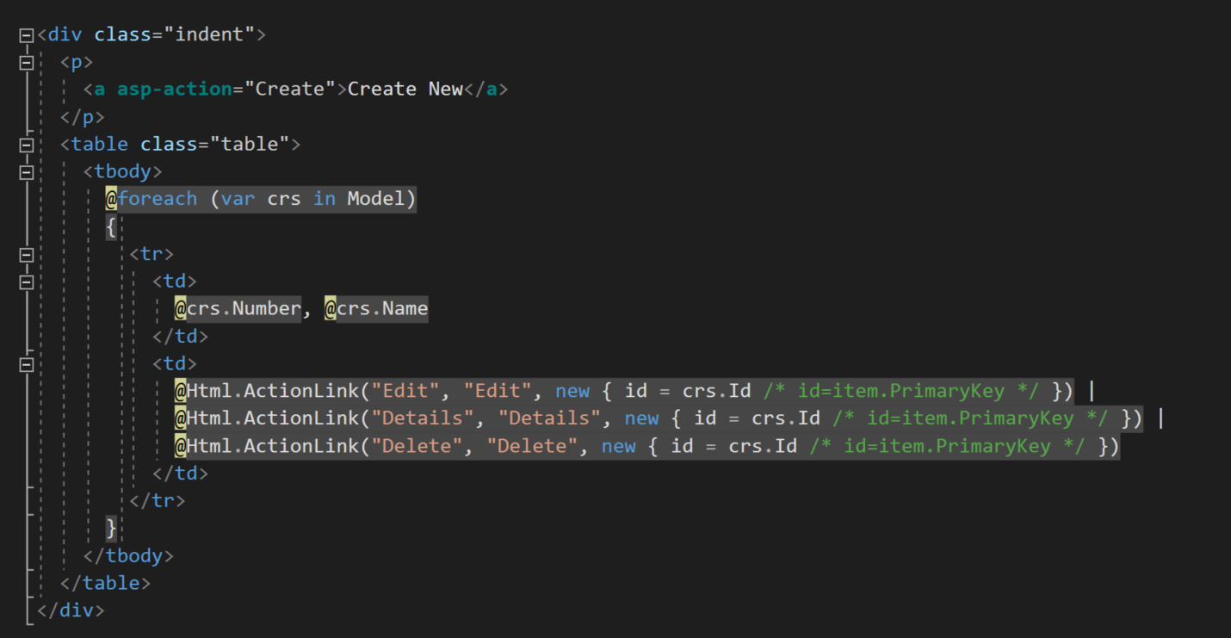
Create View

Slide 11
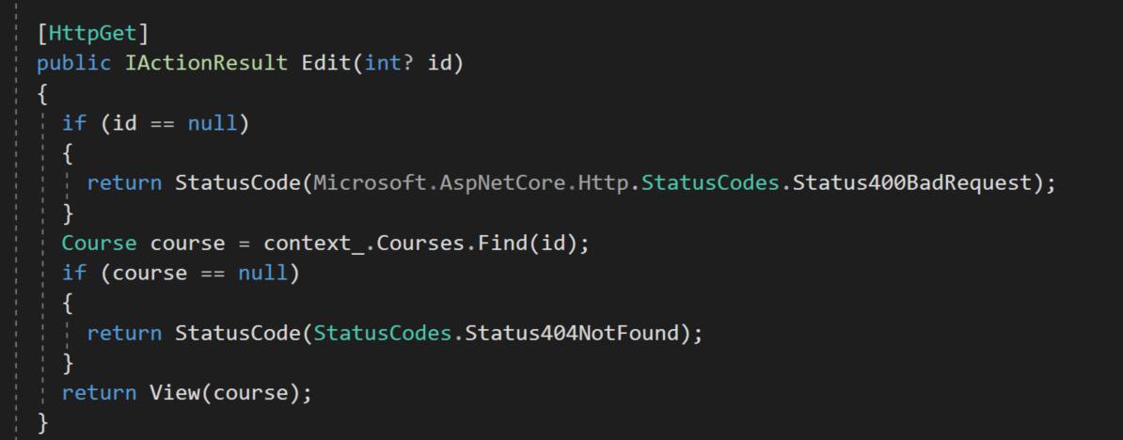
Views are results of Controller actions (methods)

Slide 12
Html Helpers
ActionLink: links to an action method
CheckBox
DropDownList
EditTextBox
Hidden
ListBox
Password
RadioButton
TextArea
TextBox

Slide 13
Adding a View
Right-click on View folder select Add View and configure view from the resulting dialog.
It’s easy to generate tables and lists that can be edited and posted back to the controller to effect changes to its model.
The HTML helpers on the previous page make building a view a fairly simple process.
The wizard for Strongly Typed views does most of the work in rendering model details.

Slide 14
What is a Controller?
A controller is a C# class that derives from the class Controller.
A controller defines some category of processing for the application.
Its methods define the processing details.
Routing to a controller is defined in Startup.Configure method.

Slide 15
Data Binding
If a controller method takes a model class as a parameter, then the MVC infrastructure will instantiate an instance and pass to the controller method when requested via a url.
On postback, if View parameters have the same names as model names, then the MVC infrastructure uses reflection to bind current view values to the model.

Slide 16
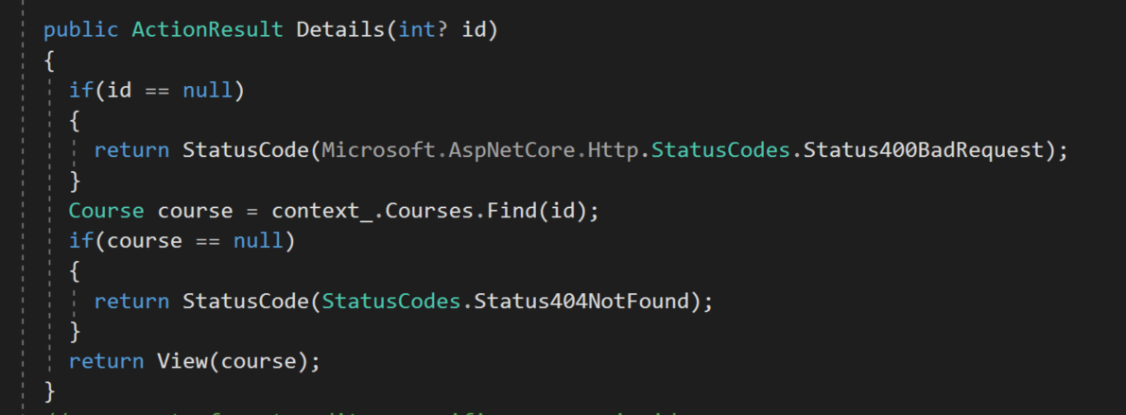
MvcSkeleton with CRUD Controller
Action methods

Slide 17
Action returns ActionResult
ActionResult: base class
ContentResult: user defined object to Response
EmptyResult: Nothing to Response
FileResult: Send binary file to Response
RedirectResult: redirect to url
RedirectToRouteResult: redirect using routes
JasonResult: send json to Response
JavaScriptResult: send Javascript to Response
ViewResult: Render a view

Slide 18
Adding a Controller
Right-click on the Controller folder and select Add Controller.
Populate controller with methods whose names will become views and that take model parameters to supply views with data and react on postback to data changes made in view.

Slide 19
Web Application Development
Create a new Asp.Net Core MVC project
Delete any part of that you don’t need
Add a controller for each category of processing in your application:
A category is usually a few pages and db tables that focus on some particular application area
Add methods to each controller for each request you wish to handle.
Add views as needed for each controller action
Add Model classes to support the application area:
Each model class has public properties that are synchronized with data in the model db or XML file.

Slide 20
An Opinion
This Asp.Net Core MVC structure is very flexible:
You can have as many application categories as you need, simply by adding controllers.
The controllers keep the application well organized.
You can have as many views as you need. The navigation is simple and provided mostly by the MVC infrastructure, e.g., routing.
You can have as many models as you need. Just add classes and use Linq to access the data.

Slide 21
Things you may use
LINQ – Language integrated query
Linq to XML and Linq to SQL are commonly used by models to provide data needed by a controller for one of its views.

Slide 22
That’s All Folks

