Slide 1
Segments
Introduction: slides 2-6, 8 time 10 minutes
Illities: slides 9-16 time 15 minutes

Slide 2
Enterprise Architecture
Jim Fawcett
CSE681 – Software Modeling and Analysis
Fall 2015

Slide 3
References
Beautiful Architecture, O’Reilly, 2009
Will become required reading for this course
Interesting examples:
Massive Multi-player on-line games
Facebook data management
Surfing business data like surfing web pages using REST
Beyond Software Architectue, Luke Hohmann, Addison-Wesley, 2003
Places software architecture in the context of a business process (concept, plan, marketing, development, deployment, extension, security)

Slide 4
Need for Architecture
Driven by:
System complexity
Performance requirements
Need for flexibility
To accommodate changing business objectives
To replace aging technologies
To cooperate with other applications
Security
Visibility and mutability based on authorization
May need audits to prove compliance with regulations

Slide 5
Needs driven by Size
Longevity
Enterprise system are expensive to build and deploy.
We want them to last a long time to get significant return on investment.
Stability:
We want the core system to remain stable as development proceeds and later as maintenance adds new features

Slide 6
First Questions (BA)
The first questions an architect asks are not about functionality:
Who are the stakeholders?
On what platform will the system be built?
How many concurrent users?
Load model
latency
How secure does the system need to be?
Intranet or internet?
How sensitive is the information?
How scalable must the system be?
Orders of magnitude?

Slide 7
Architectural Principles (BA)
One fact in one place
both value and behavior
Automatic propagation
Performance may dictate duplication, so propagate from single source (data record or object factory) – one place to change.
Architecture includes construction
Describes not only run-time, but how to build.
Use tools to build the system.
Minimize mechanisms
Use a few “good” mechanisms rather that many “perfect” ones.
Construct engines
Flexible architectures rely on use of virtual machines, e.g., engines that are programmed by data provided by higher layers.
Each layer is a cohesive abstraction
Use Principles and Metaphors to resist entropy

Slide 8
Goals of an Architecture (BA)
Build systems that:
Satisfy project goals
Are:
friendly and responsive to the user
free of critical errors
maintainable
easy to install
reliable
Communicate in standard ways

Slide 9
Architecture Quality Factors
Usability
Free of critical errors
Metaphors
Performance
Security
Safe
Traceable
Scalability
Add more functions
Add more users
Add more data
Maintainability
Changeable
Stable

Slide 10
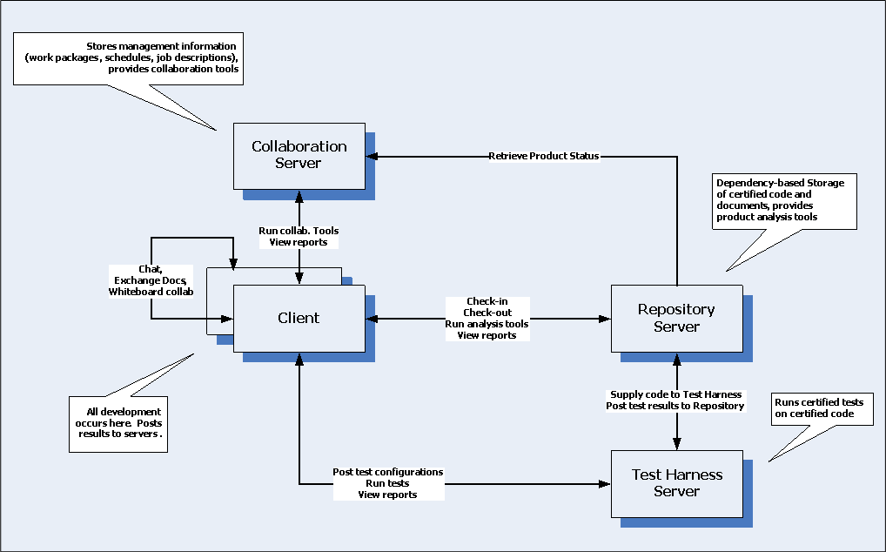
Software Collaboration Federation

Slide 11
Usability Software Collaboration Federation (SCF)
Users don’t wait for anything
All tasks are asynchronous
Simple models
Everything is immutable
Only control is check-in
Concurrency models are simple and hidden from user
All work is task driven:
Check-in products
Test code products
Analyze results

Slide 12
SCF Security
Use platform-based authentication
Asp.Net like authentication and roles
Use secure communication
WSHttp encrypts transmissions
Products contain encrypted hash to prevent tampering
Message logs support traceability if needed

Slide 13
SCF Scalability
Test Harness (prime load – test execution)
Concurrent test suites use available cores
File caching avoids unnecessary network traffic
Tests are independent so very little is required to support load-balancing of multiple Test Harness servers
Repository (prime load – builds)
Check-ins are independent so each can run on own thread, using available cores for building
File caching avoids unnecessary network traffic
Fine-grained availability is not important, so can host on multiple servers, synchronized at night.

Slide 14
SCF Maintainability
Test Harness:
Functions are configuration, testing, reporting, notification, and communication
Test development is a client activity
Notification can be supported by Test Harness but implemented by tests, e.g., tests use T.H. notification facilities to report to client.
These are all cohesive, easily encapsulated, easy to change without breaking other parts
Only configuration and reporting are likely to change
Functions are conceptually simple, and so, likely to be stable and free of critical errors

Slide 15
SCF Maintainability
Repository:
Functions are check-in, versioning, metadata management, building, publishing, and communication.
Check-in and versioning will use different policies for Project, Company, and Developer Repositories.
Should make these rule-based. How?
These are all cohesive, easily encapsulated, and independent, so easy to change without breaking other parts.
Check-in and Versioning are conceptually the most complicated parts of SCF, and so will need a lot of attention.

Slide 16
SCF Maintainability
Client:
Functions are check-in, building tests and Test Suites, reviewing results and logs, processing notifications, and communication.
Users will want to configure Client UI to support their own work activities.
Could make part of the UI a web portal like construct that will allow users to paste gadgets into portal regions, e.g., team test history for month, work calendar.
Creating and using Queries into test data need to be flexible, language driven, and invocable by name and scheduled.
Clients will be central to running SCF, so must have core functionality running early.

Slide 17
End of Presentation

