Slide 1
C++ Vs. C# Presentation Notes
Segments
  Introduction: slides 2-9, 15 minutes
  Types: slides 10-14 10 minutes
  Special Types: slides 15-19 10 minutes
  Assemblies: slides 20-23 12 minutes
  Interfaces & libs: slides 24-35 10 minutes

Slide 2
Comparison of C++ and C#
Jim Fawcett
CSE681 – Software Modeling and analysis
Fall 2016

Slide 3
Both are Important
C++ has a huge installed base.
  C++ provides almost complete control over the allocation of resources and execution behavior of programs.
C# is the dominant .Net language.
  C#, a managed language, is simpler than C++, takes over control of memory resources and manages the execution of programs.
CSE681 – Software Modeling and Analysis
  Focuses almost exclusively on C# and .Net.
CSE687 – Object Oriented Design:
  Focuses almost exclusively on C++ and the Standard Library.

Slide 4
C# Language
Looks a lot like Java.
  A strong similarity between:
    Java Virtual Machine & .Net CLR
    Java bytecodes & .Net Intermediate Language
    Java packages & CRL components and assemblies
    Both have Just In Time (JIT) compilers
    Both support reflection, used to obtain class information at run time
    Both languages support generics (not as useful as C++ templates)
Differences:
  Java and C# do have significant differences
    C# has most of the operators and keywords of C++
    C# code supports attributes – tagged metadata, Java uses annotations
    C# provides deep access to the Windows platform through FCL
    Java supports network programming and GUI development on many platforms

Slide 5
C# Hello World Program
using System;
namespace HelloWorld
{
class Chello
{
string Title(string s)
{
int len = s.Length;
string underline = new string('=',len+2);
string temp = "\n " + s + "\n" + underline;
return temp;
}
string SayHello()
{
return "Hello World!";
}
[STAThread]
static void Main(string[] args)
{
Chello ch = new Chello();
Console.Write(ch.Title("HelloWorld Demonstration"));
Console.Write("\n\n {0}\n\n",ch.SayHello());
}
}
}

Slide 6
Differences Between C# and C++
In C# there are no global functions. Everything is a class.
  Main(string args[]) is a static member function of a class.
The C# class libraries are like Java Packages, not like the C and C++ Standard Libraries.
  System, System.Drawing, System.Runtime.Remoting, System.Text, System.Web
  C# class hierarchy is rooted in a single “Object” class
C# does not separate class declaration and member function definitions.
  Every function definition is inline in the class declaration – like the Java structure.
  There are no header files.
  Instead of #include, C# uses using statements:
    using System;
    using System.ComponentModel;

Slide 7
Differences between C++ and C#
The C# object model is very different from the C++ object model.
  Illustrated on the next slide
C# supports only single inheritence of implementation, but multiple inheritance of interfaces
C# does not support use of pointers, only references, except in “unsafe” code.
Use of a C# variable before initialization is a compile-time error.

Slide 8
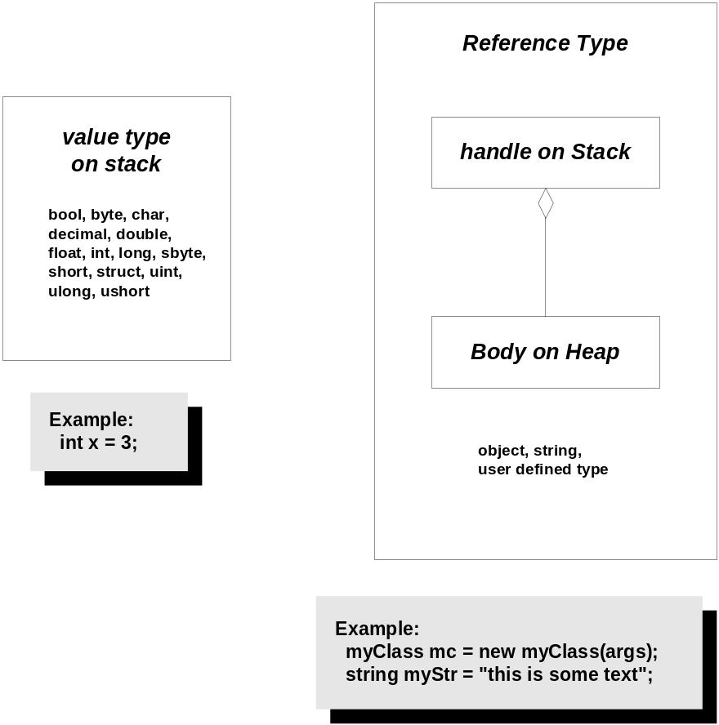
C# Object Model

Slide 9
Comparison of Object Models
C++ Object Model
  All objects share a rich memory model:
    Static, stack, and heap
  Rich object life-time model:
    Static objects live for the duration of the program.
    Objects on stack live within a scope defined by { and }.
    Objects on heap live at the designer’s discretion.
  Semantics based on a deep copy model.
    That’s the good news.
    That’s the bad news.
  For compilation, clients carry their server’s type information via headers.
    That’s definitely bad news.
    But it has a work-around, e.g., design to interface not implementation. Use object factories.
.Net Object Model
  More Spartan memory model:
    Value types are static and stack-based only.
    Reference types (all user defined types and library types) live on the managed heap.
  Non-deterministic life-time model:
    All reference types are garbage collected.
    That’s the good news.
    That’s the bad news.
  Semantics based on a shallow reference model.
  For compilation, client’s use their server’s meta-data.
    That is great news.
    It is this property that makes .Net components so simple.

Slide 10
C# Primitive Types
.Net Base Class
  System.Byte
  System.SByte
  System.Int16
  System.Int32
  System.Int64
  System.UInt16
  System.UInt32
  System.UInt64
  System.Single
  System.Double
  System.Object
  System.Char
  System.String
  System.Decimal
  System.Boolean
C# Types
  byte
  sbyte
  short
  int
  long
  ushort
  uint
  ulong
  float
  double
  object
  char
  string
  decimal
  bool

Slide 11
C# Object Type
Object is the root class of the C# library
Object’s members:
  public Object();
  public virtual Boolean Equals(Object obj);
    Returns true if obj and invoker handles point to the same body.
  public virtual Int32 GetHashCode();
    Return value identifies object instance.
  public Type GetType();
    Type object supports RTTI – see next page
  public virtual String ToString();
    Returns namespace.name
  protected virtual void Finalize();
    Called to free allocated resources before object is garbage collected.
  protected Object MemberwiseClone();
    Performs shallow copy
    To have your class instances perform deep copies you need to implement the ICloneable interface.

Slide 12
Common Type System
Reference Types
  Classes
    methods
    fields
    properties
    Events
    Member adornments:
    public, protected, private, abstract, static
  Interfaces
    Class can inherit more than one
    Must implement each base interface
  Delegates
    Instances used for notifications

Slide 13
Common Type System
Value Types
  Primitive types
    See page 13
  Structures
    methods
    fields
    properties
    Events
    Member adornments:
    public, protected, private, abstract, static
  Enumerations

Slide 14
Type Class
You get type object this way:
Type t = myObj.GetType();
Type t = Type.GetType(“myObj”);
Some of Type’s members:
  IsAbstract
  IsArray
  IsClass
  IsComObject
  IsEnum
  IsInterface
  IsPrimitive
  IsSealed
  IsValueType
  InvokeMember()
  GetType() returns Type Object
  FindMembers() returns MemberInfo array
  GetEvents() returns EventInfo array
  GetFields() :
  GetMethods() :
  GetInterfaces() :
  GetMembers() :
  GetProperties() :
An instance of Type is a container for reflection information, and has many methods to use that information.

Slide 15
More Differences
The CLR defines a new delegate type, used for callbacks.
event is a keyword in all CLR languages.
  Events modify the delegate interface, eliminating actions by a subscriber that might affect other subscribers.
All memory allocations are subject to garbage collection – you don’t call delete.
There are no #includes in C#. There are in both managed and unmanaged C++.
In C# all class data members are primitive types or C# references. In managed C++ all class data members are either primitive value types, C++ references, or C++ pointers. Nothing else is allowed.
The CLR provides directory services, and remoting. The Standard C++ Library provides neither of these, although they are relatively easy to provide yourself.

Slide 16
Delegates
Delegates are used for callbacks:
  In response to some event they invoke one or more functions supplied to them.
  Library code that generates an event will define a delegate for application developers to use – the developer defines application specific processing that needs to occur in response to an event generated by the library code.
  A delegate defines one specific function signature to use:
  public delegate rtnType delFun(args…);
  This declares a new type, delFun whose instances can invoke functions with that signature.
  The developer supplies functions this way:
  libClass.delFun myDel = new libClass.delFun(myFun);
  This declares a new instance, myDel, of the delFun type.

Slide 17
Events
Events are specialized delegates that are declared and invoked by a class that wants to publish notifications.
The event handlers are functions created by an event subscriber and given to the delegate.
Many C# events use the specialized delegate event handler of the form:
public delegate void evDelegate(
object sender, userEventArgs eArgs
);
userEventArgs is a subscriber defined class, derived from System.EventArgs. You usually provide it with a constructor to allow you to specify information for the event to use.
The event is then declared by the publisher as:
public event evDelegate evt;
Either publisher or subscriber has to create a delegate object, eveDel, and pass it to the other participant.
The event is invoked by the publisher this way:
evDel(
this, new userEventArgs(arg)
);
The subscriber adds an event handler function, myOnEvent, to the event delegate this way:
Publisher.evDelegate evDel +=
new Publisher.evDelegate(myOnEvent);

Slide 18
Threads
A C# thread is created with the statement:
Thread thrd = new Thread();
System.Threading declares a delegate, named ThreadStart, used to define the thread’s processing.
  ThreadStart accepts functions that take no arguments and have void return type.
You define a processing class, MyProc that uses constructor arguments or member functions to supply whatever parameters the thread processing needs.
To start the thread you simply do this:
MyProc myProc = new myProc(args, …);
Thread thrd = new Thread();
ThreadStart thrdProc = new ThreadStart(myProc);
thrd.Start(thrdProc);

Slide 19
Thread Synchronization
The simplest way to provide mutually exclusive access to an object shared between threads is to use lock:
lock(someObject) {
// do some processing on
// someObject
}
While a thread is processing the code inside the lock statement no other thread is allowed to enter the lock.

Slide 20
Assemblies
An assembly is a versioned, self-describing binary (dll or exe)
An assembly is the unit of deployment in .Net
An assembly is one or more files that contain:
  A Manifest
    Documents each file in the assembly
    Establishes the assembly version
    Documents external assemblies referenced
  Type metadata
    Describes all the methods, properties, fields, and events in each module in the assembly
  MSIL code
    Platform independent intermediate code
    JIT transforms IL into platform specific code
  Optional resources
    Bitmaps, string resources, …

Slide 21
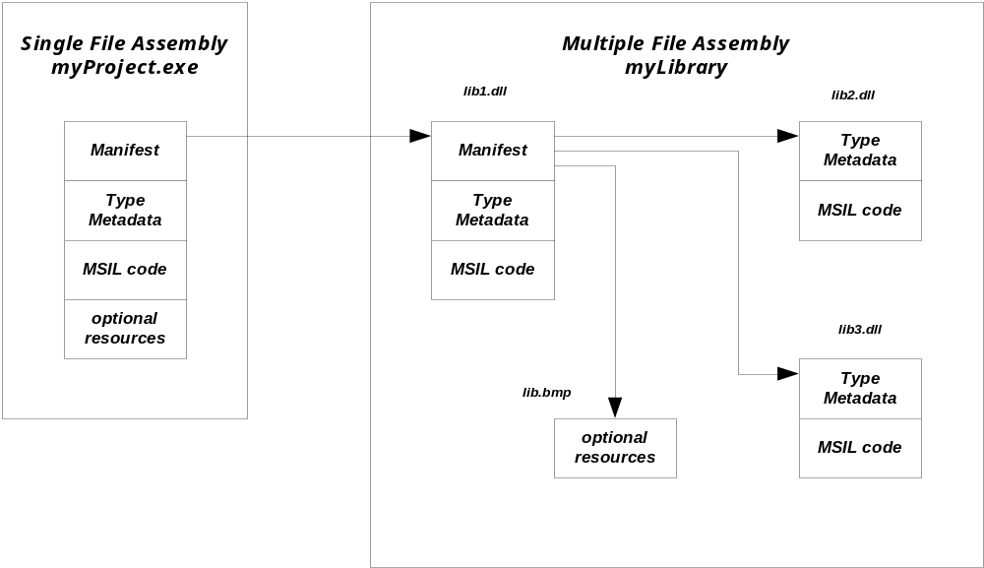
Assembly Structure
Visual Studio does most of the work in configuring an assembly for you.

Slide 22
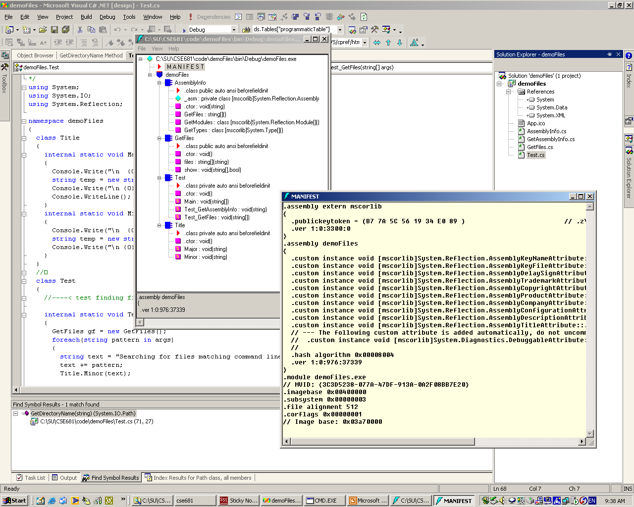
Metadata in demoFiles.exe

Slide 23
Versioning
Assemblies can be public or private:
  A private assembly is used only by one executable, and no version information is checked at loadtime.
    Private assemblies are contained in the project directory or, if there is a config file, in a subdirectory of the project directory.
  A shared assembly is used by more than one executable, and is loaded only if the version number is compatible with the using executable.
    Shared assemblies reside in the Global Assembly Cache (GAC), a specific directory.
    Version compatibility rules can be configured by the user.
  Since no registry entries are made for the assembly, each user executable can attach to its own version of the assembly. This is called side-by-side execution by Microsoft.
  A shared assembly is created from a private assembly, using one of Microsoft’s utilities provided for that purpose.

Slide 24
Useful Interfaces
IComparable - method
  Int CompareTo(object obj);
    Return:
      Negative => less
      Zero => equal
      Positive => greater
ICloneable - method
  object clone();
ICollection – properties and method
  int count { get; }
  bool IsSynchronized { get; }
  object SyncRoot { get; }
  void CopyTo(Array array, int index);

Slide 25
Useful Interfaces
IEnumerable - method
  System.Collections.IEnumerator GetEnumerator();
IEnumerator – property and methods
  object Current { get; }
  bool MoveNext();
  void Reset();

Slide 26
Useful Interfaces
IDictionary
  bool IsFixedSize { get; }
  bool IsReadOnly { get; }
  object this[ object key ] { get; set; }
  ICollection keys { get; }
  ICollection values { get; }
  void Add(object key, object value);
  void Clear();
  bool Contains(object key);
  System.Collections.IDictionaryEnumerator GetEnumerator();
  void Remove(object key);
IList
  bool IsFixedSize { get; }
  bool IsReadOnly { get; }
  object this[ object key ] { get; set; }
  void Add(object key, object value);
  void Clear();
  bool Contains(object key);
  int IndexOf(object value);
  void Insert(int index, object value);
  void Remove(object value);
  void RemoveAt(int index);

Slide 27
C# Libraries
System
  Array, Attribute, Console, Convert, Delegate, Enum, Environment, EventArgs, EventHandler, Exception, Math, MTAThreadAttribute, Object, Random, STAThreadAttribute, String, Type
System.Collections
  ArrayList, HashTable, Queue, SortedList, Stack
System.Collections.Specialized
  ListDictionary, StringCollection, StringDictionary
System.ComponentModel
  Used to create components and controls
  Used by WinForms
System.ComponentModel.Design.Serialization
  Used to make state of an object persistant
System.Data
  Encapsulates use of ADO.NET

Slide 28
More C# Libraries
System.Drawing – GDI+ support
  System.Drawing.Drawing2D – special effects
  System.Drawing.Imaging – support for .jpg, .gif files
  System.Drawing.Printing – settings like margins, resolution
System.Net – support for HTTP, DNS, basic sockets
  System.Net.sockets – sockets details
System.Reflection
  view application’s metadata including RTTI
System.Runtime.InteropServices
  Access COM objects and Win32 API

Slide 29
Remoting Libraries
System.Runtime.Remoting
  System.Runtime.Remoting.Activation
    Activate remote objects
  System.Runtime.Remoting.Channels
    Sets up channel sinks and sources for remote objects
  System.Runtime.Remoting.Channels.HTTP
    Uses SOAP protocol to communicate with remote objects
  System.Runtime.Remoting.Channels.TCP
    Uses binary transmission over sockets
  System.Runtime.Remoting.Contexts
    Set threading and security contexts for remoting
  System.Runtime.Remoting.Messaging
    Classes to handle message passing through message sinks
  System.Runtime.Remoting.Meta data
    Customize HTTP SoapAction type output and XML Namespace URL
  System.Runtime.Remoting.Proxies
  System.Runtime.Remoting.Services

Slide 30
You must be joking – More Libraries!
System.Runtime.Serialization
  System.Runtime.Serialization.Formatters
    System.Runtime.Serialization.Formatters.Soap
System.Security
System.ServiceProcess
  Create windows services that run as Daemons
System.Text.RegularExpressions
System.Threading
  AutoResetEvent, Monitor, Mutex, ReaderWriterLock, Thread, Timeout, Timer, WaitHandle
  Delegates: ThreadStart, TimerCallBack, WaitCallBack
System.Timers
  Fire events at timed intervals, day, week, or month

Slide 31
Web Libraries
System.Web
  System.Web.Hosting
    Communicate with IIS and ISAPI run-time
  System.Web.Mail
  System.Web.Security
    cookies, web authentication, Passport
  System.Web.Services – close ties to ASP.NET
    System.Web.Services.Description
    System.Web.Services.Discovery
    System.Web.Services.Protocol – raw HTTP and SOAP requests
    System.Web.SessionState – maintain state between page requests
  System.Web.UI – access to WebForms

Slide 32
WinForms and XML Libraries
System.Windows.Forms – Forms based GUI design
System.Xml – XML DOM
  System.Xml.Schema
    Authenticate XML structure
  System.Xml.Serialization
    Serialize to XML
  System.Xml.XPath
    Navigate XSL
  System.Xml.Xsl
    Support for XSL – XML stylesheets

Slide 33
So How do we Learn all this stuff!
ClassView -> Class Browser -> Help
to the rescue!

Slide 34
Language Comparison
Standard C++
  Is an ANSI and ISO standard.
  Has a standard library.
  Universally available:
    Windows, UNIX, MAC
  Well known:
    Large developer base.
    Lots of books and articles.
  Programming models supported:
    Objects
    Procedural
    Generic
  Separation of Interface from Implementation:
    Syntactically excellent
      Implementation is separate from class declaration.
    Semantically poor
      See object model comparison.
.Net C#
  Is an ECMA and ISO standard.
  Has defined an ECMA library.
  Mono project porting to UNIX
  Relatively new, but popular in Windows ecosystem
    Large developer base.
    Lots of books and articles.
  Programming models supported:
    Objects
    Generic
  Separation of Interface from Implementation:
    Syntactically poor
      Implementation forced in class declaration.
    Semantically excellent
      See object model comparison.

Slide 35
End of Presentation

Slide 36
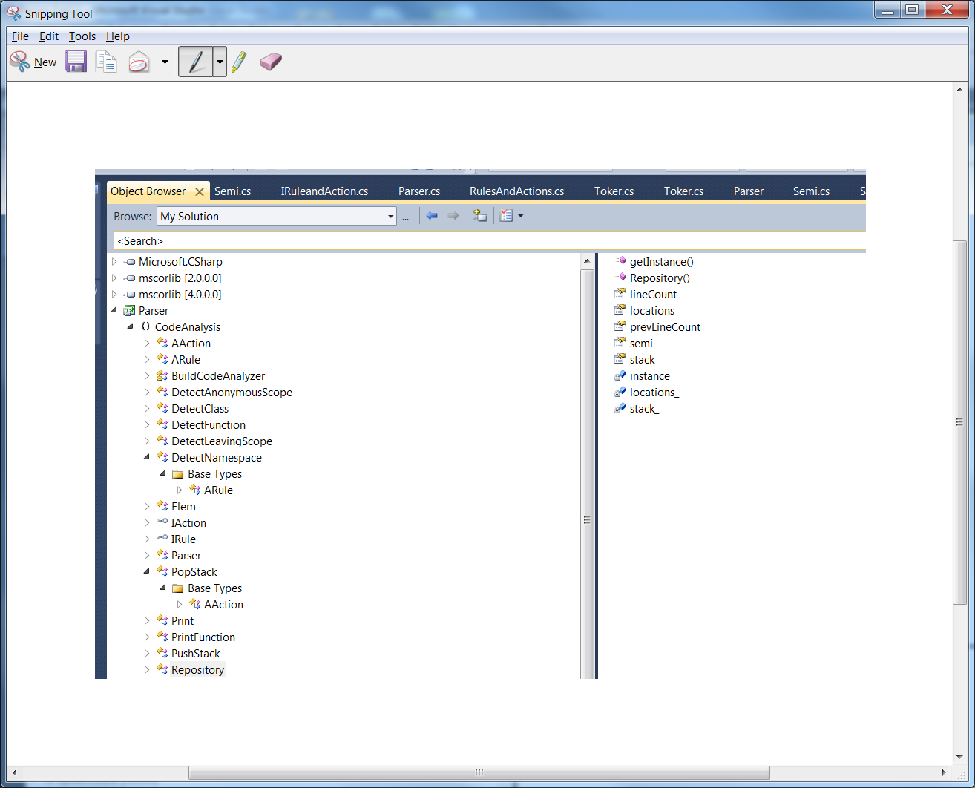
Class Browser in IDE

Slide 37
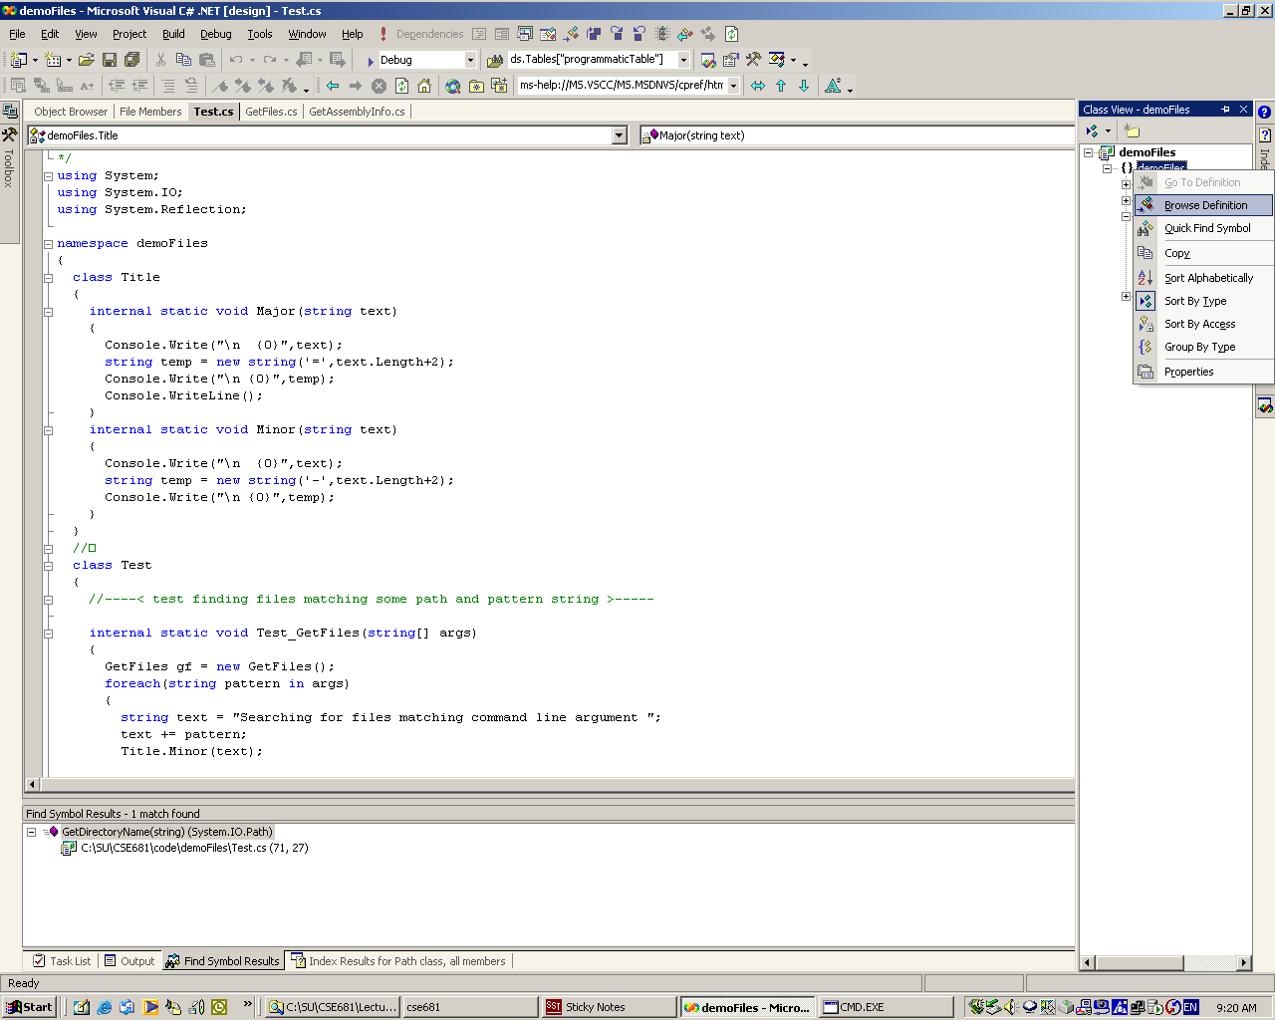
Access Class Browser from class View

Slide 38
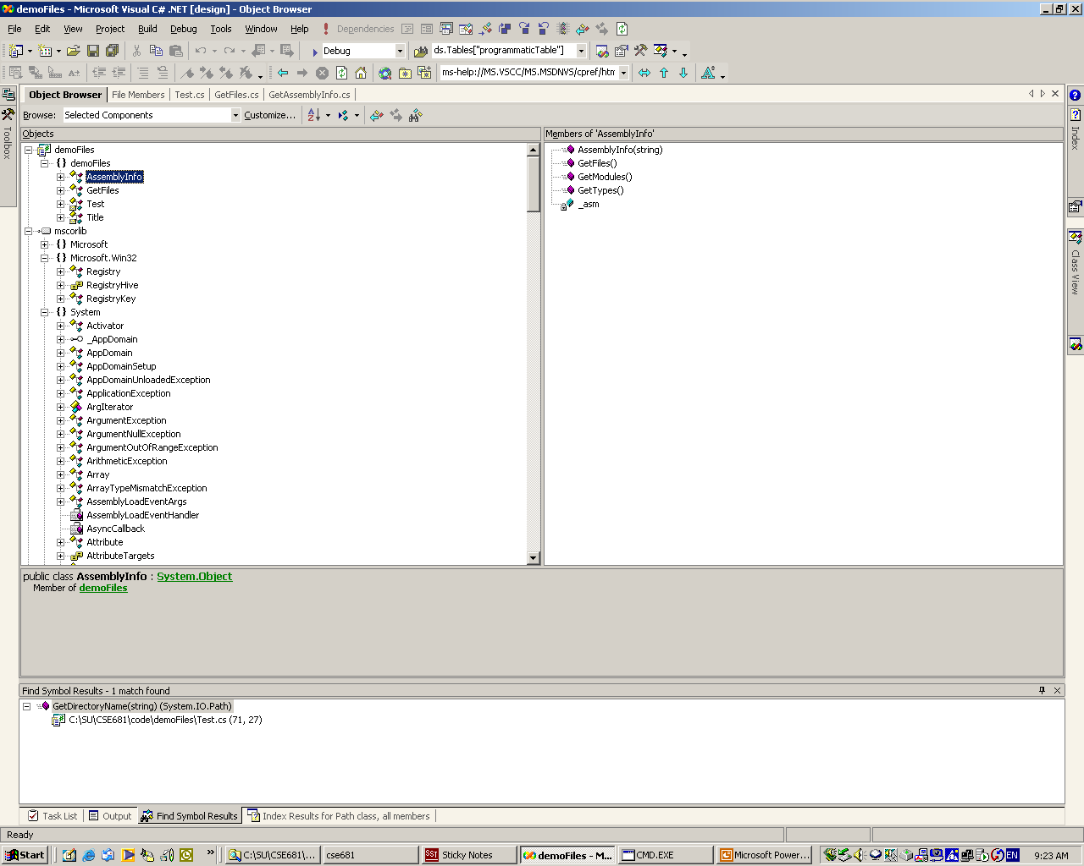
Select Type to see its Members

Slide 39
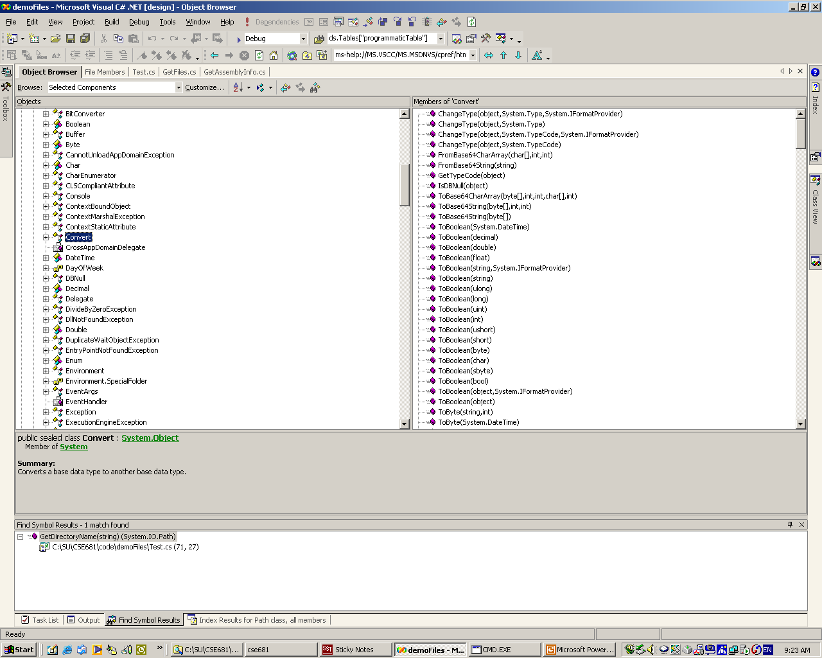
Browsing System.DLL

Slide 40
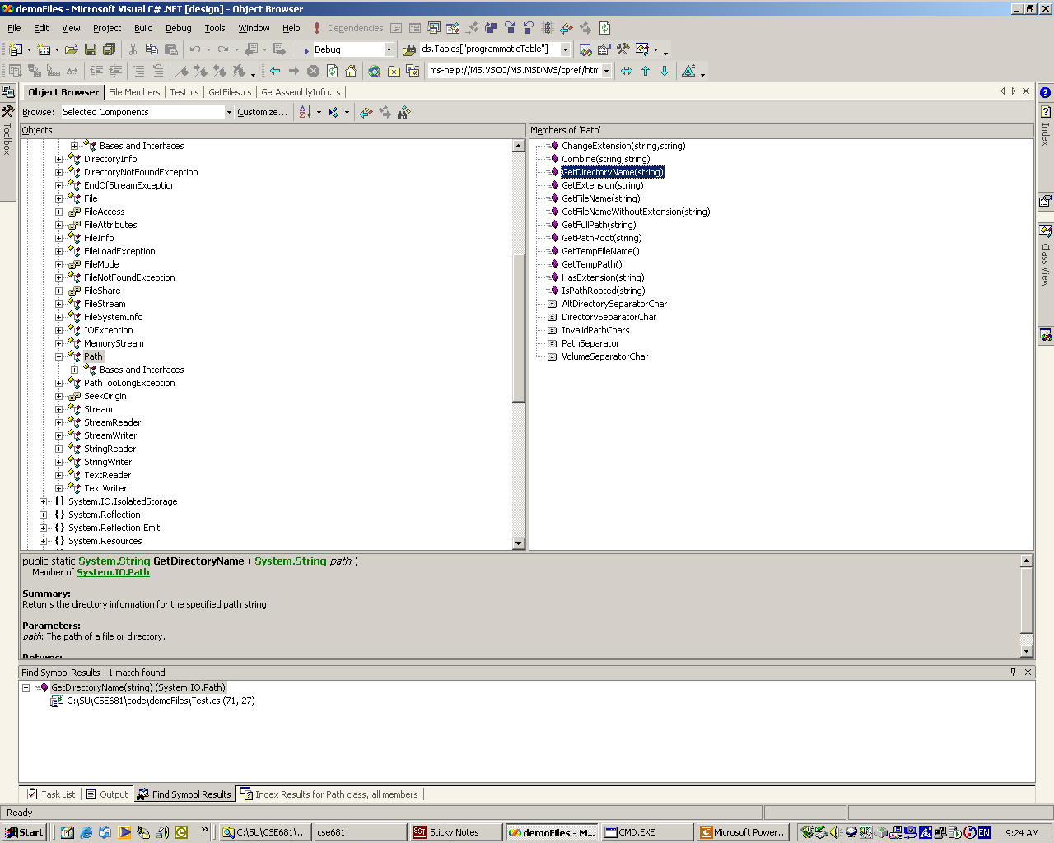
Getting Help on a Selected Type or Member – Just hit F1

Slide 41
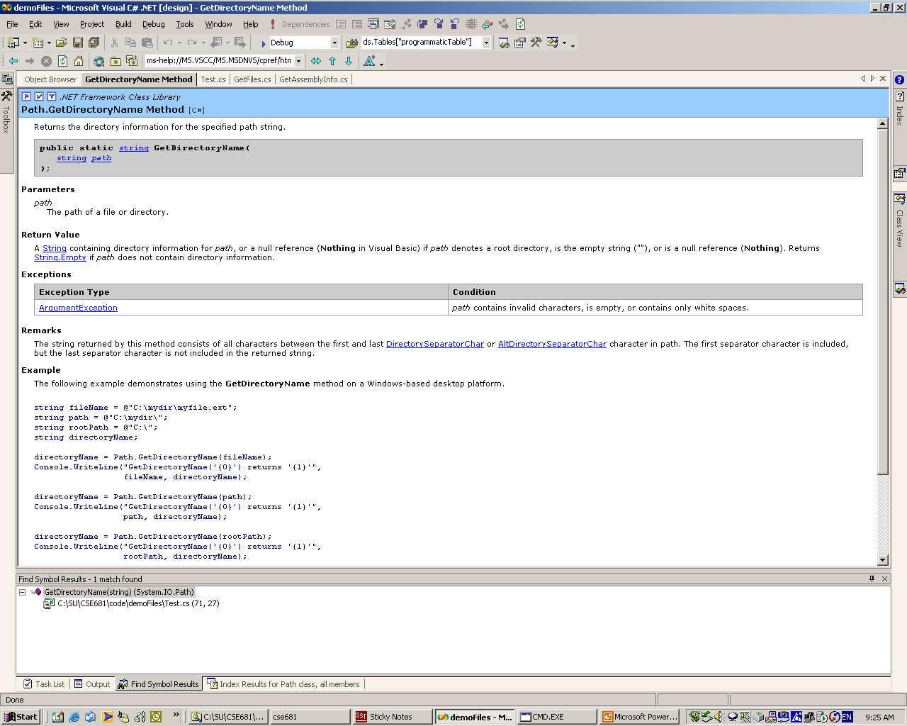
Takes you Immediately to Help Documentation for that Identifier

Slide 42
Components
Because C# classes are reference types, they expose no physical implementation detail to a client. What the client creates on its stack frames are simply handles to the class implementations.
  The compiler does type checking for a client from metadata in an accessed assembly.
  No header file is included, so the client is not dependent on implementation details of the class.
  Consequently, any C# library dll can serve as a component for local access.
  To make a component remotely accessible, you need to derive from System.MarshalByRefObject

