Slide 1
Strategy Pattern
Jim Fawcett
CSE776 – Design Patterns
Fall 2014

Slide 2
Motivation
Code analysis requires parsing of code text that entails detection of specific language constructs and storing results. Placing the detection and storage in one class isn’t desirable for several reasons:
Each grammatical construct needs a specific rule for detection and there are many such rules.
The actions required after detection depend on which rule matches the current context.
Actions may depend on the results of the actions of other rules.

Slide 3
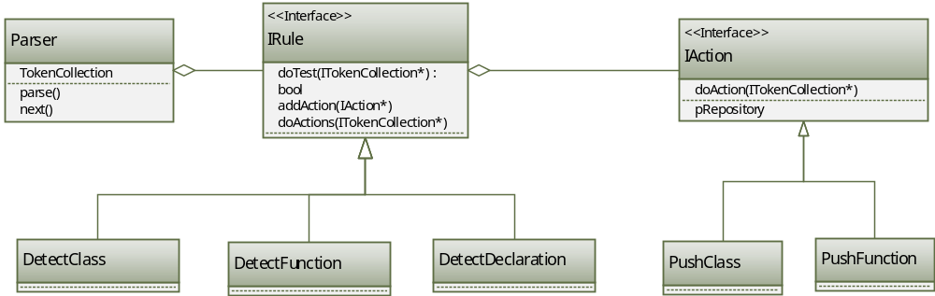
Parser uses Strategy

Slide 4
Applicability
Use the Strategy Pattern where:
Many related classes differ only in their behavior (rules, actions)
You need variants of an algorithm (rules, actions)
An algorithm uses data a client shouldn’t know about (Token Collections)
A class defines many behaviors and these appear as multiple conditional statements in its operations. Instead, move related conditional branches to their own Strategy class.

Slide 5
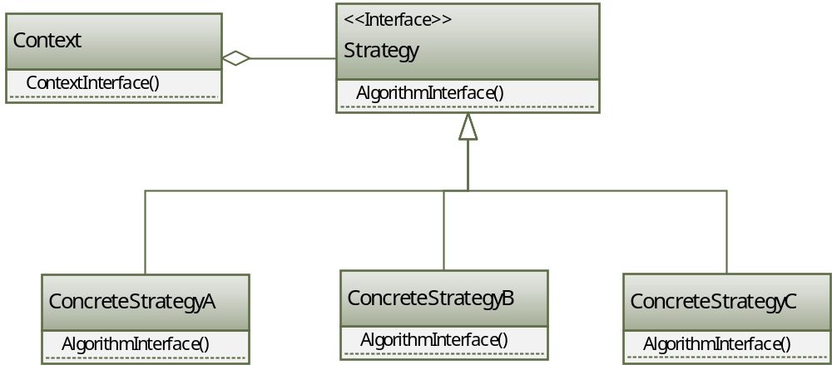
Structure

Slide 6
Participants
Strategy (IRule, IAction)
  Declares interface common to all ConcreteStrategies
  Context uses this interface to call the algorithm defined by a ConcreteStrategy
ConcreteStrategy (DetectClass, PushClass)
  Implements the algorithm using the Strategy interface
Context (Parser for rules, Rule for actions, Repository)
  Is configured with Concrete Strategy objects (rules, actions)
  Maintains references to Strategy objects
  May define an interface that lets Strategy access its data (Repository)

Slide 7
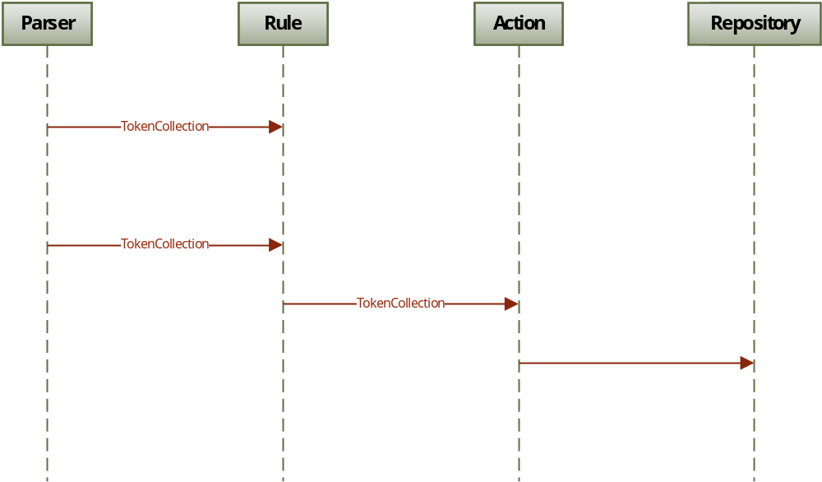
Collaborations

Slide 8
Collaborations
Strategy (Rule, Action) and Context (Parser) interact to implement the chosen algorithm.
A Context (Parser) may pass all data required by the algorithm (TokenCollection) to the Strategy (Rule) when the algorithm is called.
Alternately the Context may pass a reference to itself to the Strategy. That lets the Strategy call back on the Context as required.
A Context forwards requests from its clients to its Strategy. Clients usually create and pass a ConcreteStrategy object to the Context (Builder); Thereafter clients interact exclusively with the Context.

Slide 9
Consequences
The Strategy Pattern has the following benefits and drawbacks:
  Hierarchies of Strategy classes define a family of algorithms or behaviors for Contexts to reuse. Inheritance can help to factor out common functionality of the algorithms.
  Encapsulating the algorithm in separate Strategy classes lets you vary the algorithm independently of its Context, making it easier to switch, understand, and extend.
  Strategies eliminate large sets of conditional statements.
  Clients must be aware of different Strategies (can use Builder to mitigate)
  Communication overhead between Strategy and Context
  Increased number of objects

Slide 10
Implementation
The Strategy and Context interfaces must give a ConcreteStrategy efficient access to data it needs from the Context.
Strategies as template parameters
  Templates can be used to configure a class with a Strategy. This makes sense when only one Strategy, selected by the client, is used for the duration of the processing of an algorithm. Sorting is one example.

Slide 11
Code Examples
Flight Strategy
  StrategyPatternCode
Sorting Strategy

Slide 12
Know Uses
Parsers used in CSE681 – SMA and CSE687 – OOD
Control systems where the processing for an operation depends on the operation’s context, e.g., flight navigation control.
Games where player’s may choose one or more strategies to achieve some objective.
Software tools like Code Analyzers that use parsers.
Graphical processors that build parse trees, e.g., browser and its HTML parse tree

Slide 13
Related Patterns
Decorator
  Both Decorator and Strategy can dynamically add new behaviors
Template Method
  Template method provides algorithm steps defined by a template
Composite
  Both Composite and Strategy build processing out of predefined parts

Slide 14
End of Presentation

