Slide 1
Bridge Pattern
Jim Fawcett
CSE776 – Design Patterns
Fall 2011

Slide 2
Intent
“Decouple an abstraction from its implementation
so that the two can vary independently.”
  Multiple Dependent Implementations.
  Single Independent Interface.

Slide 3
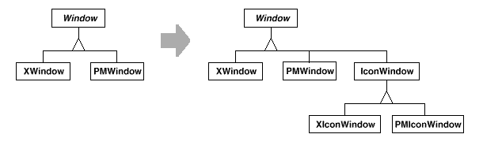
Motivation

Slide 4
Motivation
When an abstraction can have several implementations inheritance is used to accommodate them.
But inheritance binds an implementation to the abstraction permanently, hence its difficult to modify, extend and reuse abstraction and implementations independently.
It’s inconvenient to extend the abstraction to cover different kinds of windows or new platforms (window abstraction example in the text).
Inheritance without a Bridge makes client code platform dependent.

Slide 5
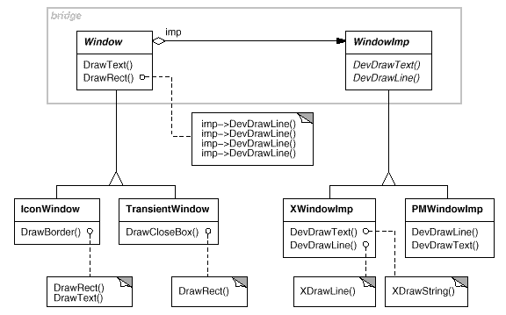
Motivation

Slide 6
Motivation
Bridge Pattern addresses these problems:
  Puts the Window Abstraction and its implementation in separate class hierarchies.
  One class hierarchy for window interfaces and a separate hierarchy for platform specific window implementation with WindowImp as its root.
  All operations on Window subclasses are implemented in terms of abstract operations from WindowImp interface. Decouples the window abstraction from the various platform specific implementations.
  We refer to the relationship between Window and WindowImp as a bridge.

Slide 7
Forces
We want to avoid binding clients to an implementation
Separating abstraction from implementation adds complexity
Well suited to cross-platform development
Easy to provide stubs for early development without breaking clients when real code is inserted

Slide 8
Applicability
Use the bridge Pattern when:
You want to avoid a permanent binding between an abstraction and its implementation. Implementation may be selected or switched at run time.
Both the abstraction and their implementation should be extensible by subclassing.
Changes in the implementation of an abstraction should have no impact on the clients (that is their code should not be recompiled).

Slide 9
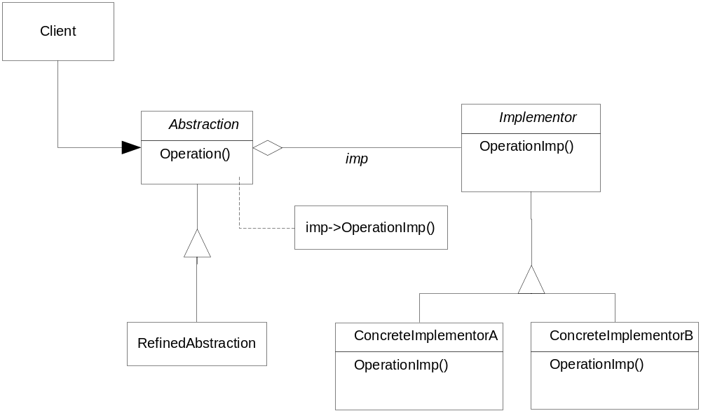
Structure

Slide 10
Participants
Abstraction (Window)
  defines the abstraction interface
  maintains a reference to an object of type implementor.
Refined Abstraction (Icon Window)
  Extends the interface defined by Abstraction (optional) .
Implementor (WindowImp)
  defines the interface for the implementation classes.
ConcreteImplementor (XWindowImp)
  implements the implementor interface and defines its concrete implementation.

Slide 11
Collaborators
“ Abstraction forwards client requests to its Implementor object.”
  Client interface with the abstraction class.
  Abstraction class uses the implementor class interface to make use of the specific concrete class interface.

Slide 12
Consequences
Decoupling interface and implementation.
  An implementation is not bound permanently to the interface. The implementation of an abstraction can be configured at run time.
Improved Extensibility
  You can extend the Abstraction and Implementation hierarchies independently.
Hiding Implementation details from the client.
  You can shield clients from implementation details like the sharing of implementor objects.

Slide 13
Implementation
Only One Implementor (Authors’ advice)
  Start with single abstraction and implementation, but allow for Additional Implementations.
Creating the right Implementor object.
  How, when and where to chose which implementor ?
  Can be instantiated by parameter passed to constructor.
  Chose default implementation when constructed and change later, based on usage.
  Delegate the decision to another object (Abstract factory).

Slide 14
Implementation (continued)
Sharing Implementors
  How to share implementations among several objects?
  Can use the Handle/Body Idiom. Clients share a reference counted implementation.

Slide 15
Unique Point-of-View
Bridge allows you to decouple an implementation so that it is not bound to an abstraction
  A party guest can wear several masks
  Abstraction is changed at run-time
  Different user interfaces for normal operation and critical operations.
Abstraction is not bound to a specific implementation
  One mask can be worn by several party guests
  Implementation is changed at run-time
  Fault-tolerant system reconfigures, but preserves the same user interface, under partial failure

Slide 16
Windows is a Bridge
The Bridge Pattern allows a designer to provide a simple interface in the abstraction, while providing a powerful, but complex interface for the implementation.
That is essentially what windows does:
  Win32API is the abstraction’s interface
  Kernel language is the implementation’s interface

Slide 17
The .Net Run-time is a Bridge
C#, Visual Basic, Managed C++ are all abstractions
MSIL is the implementation
Mono and dotGnu are other implementations

Slide 18
Known Uses
“Design Patterns” authors cite the example:
  Windows example (from ET++).
    WindowImp is called WindowPort and has subclasses such as XWindowPort and SunWindowPort.
    Window Object creates its corresponding Implementor by requesting it from an abstract factory called Window System.
    Window/WindowPort design extends the Bridge Pattern in that WindowPort also keeps a reference back to the window.

Slide 19
Related Patterns
Abstract Factory
  Can create and configure a particular bridge
Adapter Pattern
  geared towards making unrelated classes work together.

