Slide 1
Using Inheritance
Jim Fawcett
CSE687 – Object Oriented Design
Spring 2014

Slide 2
Topics: Using Inheritance
Protocol Classes
Hooks
Mixin Classes
Sharing common code
Reusing Implementation

Slide 3
Liskov Substitutability (LS)
Public inheritance is a contract for substitutability.
  Any base class reference or pointer may be bound to an instance of any class derived from that base.
  The compiler will ensure that derived public interfaces support LS syntactically:
    Derived classes inherit all of the inheritable methods of the base class and so can receive its messages.
  It is up to you to ensure semantic LS.
    Your class must be a semantic specialization of the base.

Slide 4
Protocol Classes
A protocol class (C++ interface) provides a language for clients to use when interacting with any of its derived class instances. It has:
  No data
  No declared constructors
  A virtual destructor
  A set of pure virtual functions that define the hierarchy’s language.
All classes are derived from the protocol base class using public inheritance.

Slide 5
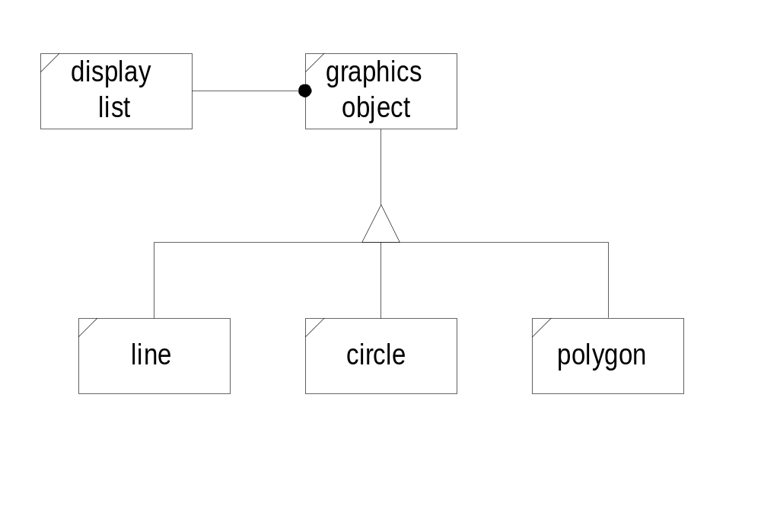
Protocol Example

Slide 6
Hooks
A hook is a base class that supports modification of a library’s behavior by applications designed to use the library, without modifying any of the library’s code.
The Hook class provides a protocol for application designers to use and a set of virtual methods that are overridden to provide required application behavior.
One very common usage provides a way for applications to respond to events that occur within the library.

Slide 7
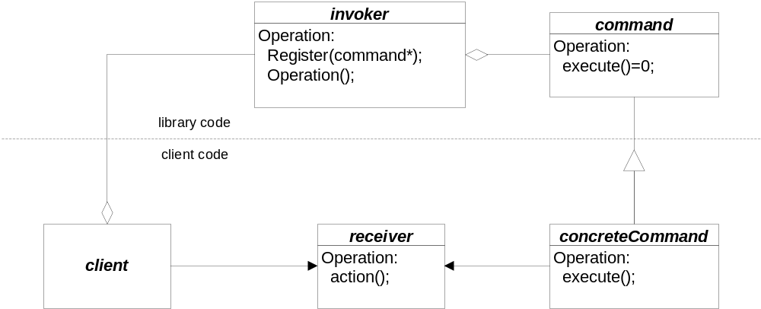
Hook Example
The Hook
Library code invokes the hook when specific events occur.
What’s actually called

Slide 8
Mixins
A mixin class provides a specialized set of behaviors intended to be used through multiple inheritance with other classes.
Mixins can be used to provide reference counting, locking, memory management, and other specialized behaviors as services to any class that needs them.

Slide 9
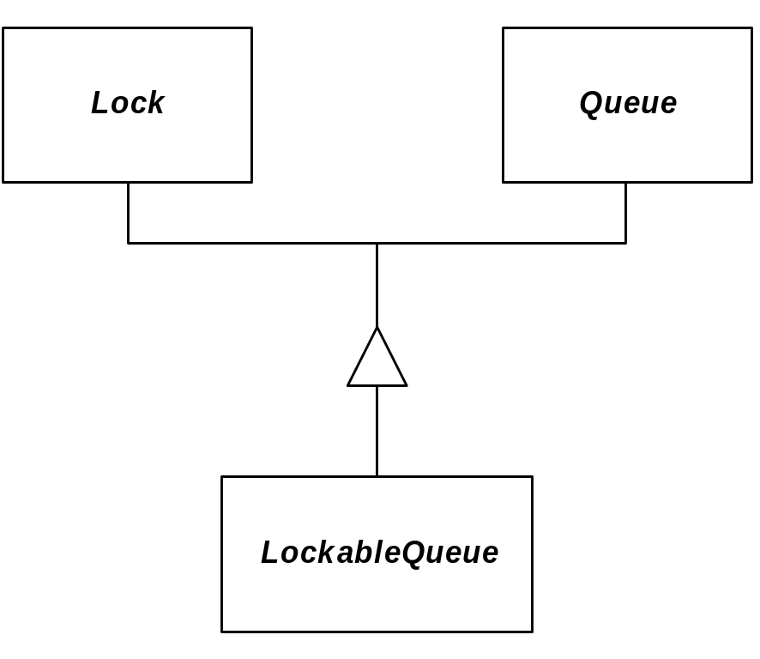
Mixin Example

Slide 10
Share Common Code
A base class may provide default implementations of some or all of the base class protocol. These, then, are shared by all derived classes that do not override the defaults.
When using concrete base classes, however, you need to be careful that you support reasonable semantics:
  Disallow assignment of derived instances to base instances or derived instances of one type to an instance of another type through base pointers or references.
    You can make the base class abstract by including a pure virtual function and make the base assignment private.
    Provide assignment operators for each of the derived classes.

Slide 11
Reusing Implementation
C++ supports reuse of implementation with public, private, and protected inheritance.
You should prefer composition unless:
  You need access to protected data from the base class, or:
  You want to support polymorphic operations in member functions of the derived class, perhaps to bind to any derived object passed to a member function by base reference or pointer without knowing the concrete class of the object.

Slide 12
End of Presentation

