Slide 1
C++ Models
Jim Fawcett
CSE687 – Object Oriented Design
Summer 2017

Slide 2
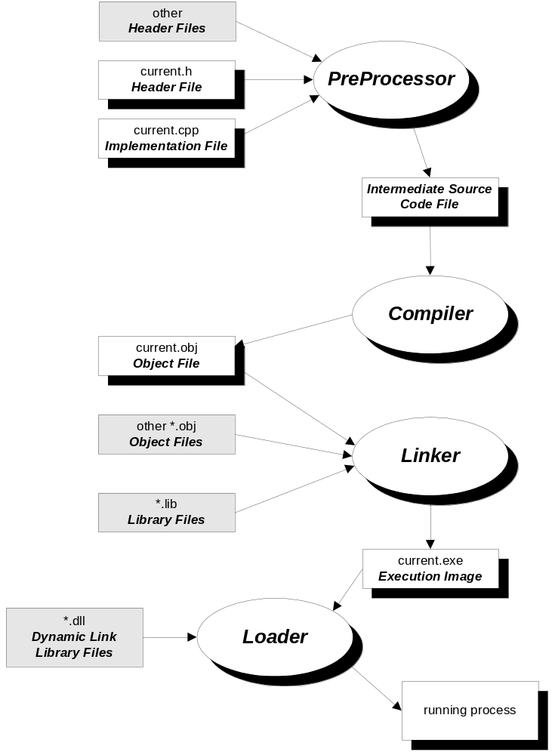
C/C++ Compilation Model

Slide 3
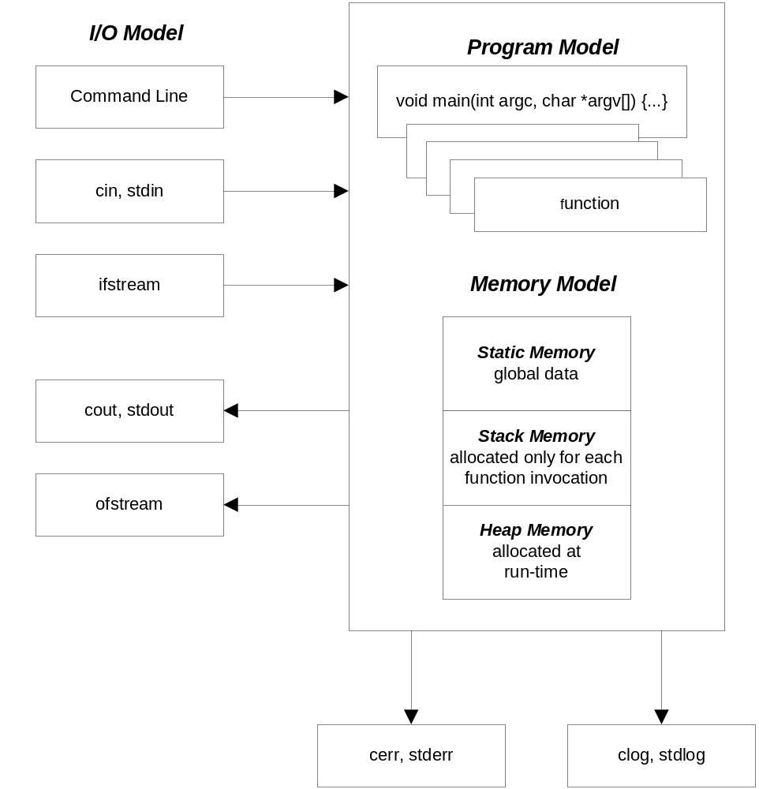
C/C++ Computational Model

Slide 4
C/C++ Memory Model
Static memory: - available for the lifetime of the program
public global functions
and data
defined outside any function (globals)
Initialized before main is entered
global data and functions, made private by
qualifying as static, otherwise public
memory allocations local to a function, but
qualified as static
private global functions
and data
local static data
Stack memory: - temporary scratch pad
main stack frame
- defined only while computational thread passes
through a function or control scope.
- holds input parameters, local data, and return
values, used as scratch-pad memory
- guaranteed to be valid during the evaluation of
a containing expression, won’t be valid after
- expression evaluation starts with function eval-
uation first, then expression evaluation as alge-
braic combination of terms
- stack frame is destroyed when expression eval-
uation is complete
function called by main
stack frame
more stack frames
:
current function
stack frame
heap memory: - valid from the time of allocation to deallocation
allocated heap memory
- allocated/deallocated at run time by invoking
operators new /delete (or functions malloc/free)
- memory is available to anyone with a pointer
to the allocated memory from the time of
allocation until deallocated.
free heap memory
free memory

