Slide 1

Structural Models for Large Software Systems
Excerpts from Research Presentation
by
Murat Kahraman Gungor
Ph.D. Candidate
Advisor: James W Fawcett, Ph.D.

Slide 2
Introduction
Software is expensive.
Software projects typically consist of many parts.
Interdependency between parts of a project is necessary.
However, excessive dependency reduces:
    Testability
    Maintainability
    Reusability
    Understandability
Monitoring current state of a project is critically important.
Notes:
Expensive: Software is an expensive product – it’s creation involves intensive labor.
Interdependency between parts of a project is desirable. Needed for one component to use another.
Excessive dependency reduces;
Testability
Maintainability
Reusability
Understandability
Monitoring: Large projects grow complex silently. At integration time, everything falls apart
Observing current state of a project is critically important, since early detection of quality defects will avoid delays, difficulties and costs associated with development evolution later in project lifecycle.

Slide 3
Goals of this Research
Understand how to detect problems in large software development projects.
Generate algorithms and methods to diagnose specific structural flaws.
Provide tools needed to support:
  Analysis
  Project monitoring
Explore possible corrective procedures and simulate their application, monitoring improvements in observed defects
Notes:
Tools: Analysis:
Provide methods to diagnose structural errors.
Monitor progress in large software projects.
Provide tools for continuous extraction of structural quality from source code.
Provide means to improve software system’s dependency structure.
Another objective is to provide tools that support both the analysis and
subsequent correction of discovered software flaws,
in a rapid and precise way.
(handout: from p.14, p.15)
Why do we need tools? Due to size of system:
6183 files – no human can handle this task.

Slide 4
A Real System
Open Source Mozilla Project
  Browser
    Grew out of Netscape Navigator
  We studied Mozilla, Windows build, version 1.4.1
    This code base was abandoned.
    Great opportunity to investigate why code fails.
    After surviving serious problems, some of this code migrated into Firefox, an obviously successful implementation.
  Windows build consists of 6193 files – for a browser!
Notes:
A large open source system,
A large commercial system, and our own tool

Slide 5
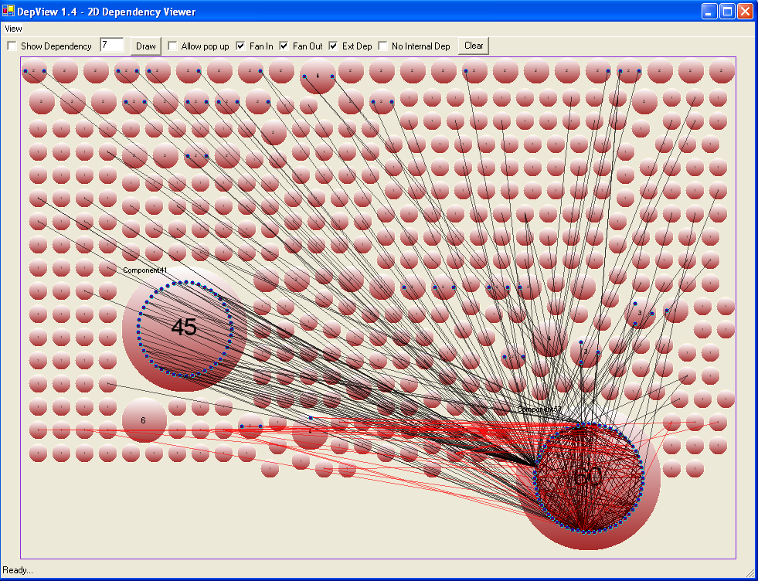
Dependencies in GKGFX
Mozilla Rendering Library – One of many libraries
Smallest disks are single files
Lines indicate dependency
Large disks are mutually dependent files, strong components of the dependency graph

Slide 6
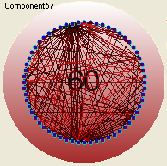
GKGFX Component Internals
Here are the internal dependencies for largest strong component.
We show, in the dissertation document using Product Risk Model, that high density of dependencies within a strong component is a serious design flaw.
What’s the problem? We don’t know. With DepAnal and DepView, we find out.

Slide 7
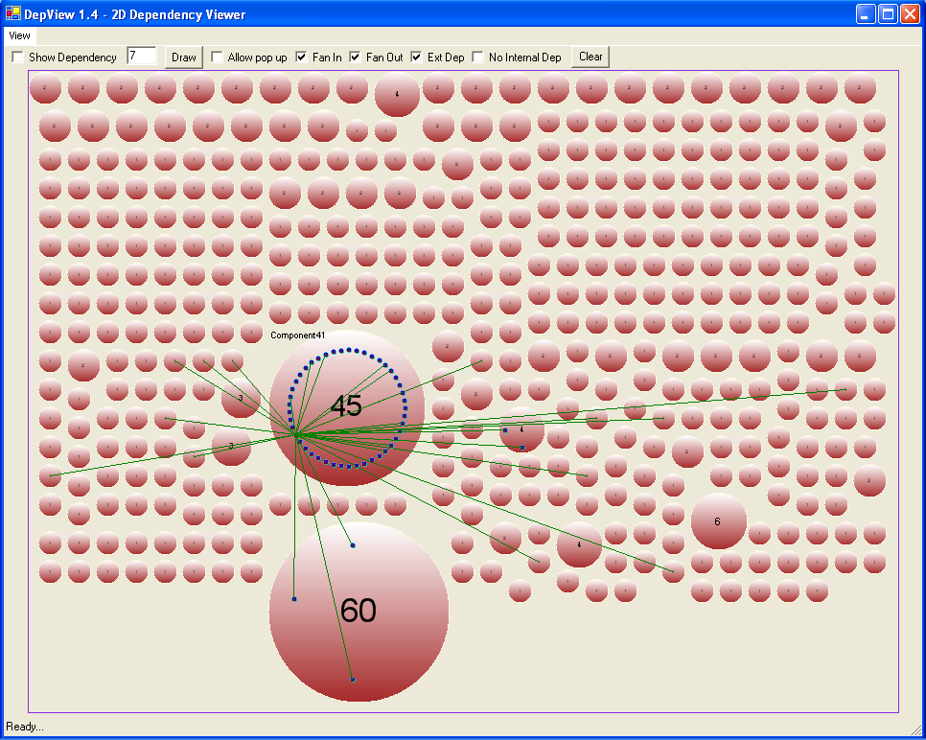
This is Mozilla, Version 1.4.1, Windows Build
Plot for GKGFX Library shows some very large mutual dependencies
DepView shows that the GKGFX Library does indeed have significant structural problems, as predicted by the preceding views.
Note that these problems, made visible by our tools, are normally invisible!
DepView provides precise definition of each strong component.
Notes:
This plot shows that many files outside of component 52 depend upon it. In fact it shows all the external files that depend on only one of the many files in that component. If we showed them all there would be some many lines it would be hard to interpret.
This is a very dangerous situation for a software system: Many files depend on a cluster of mutually dependent files. Mutual dependencies are very difficult to test effectively because they all depend on each other. We find an error, change it, and it may affect many other files in the mutually dependent set. So large strong components are hard to test, e.g., hard to make correct, e.g., subject to a lot of changes. This in turn may affect many of those external files shown in the view above.

Slide 8
Problem Definition
s
Dependencies between software files are essential.
However, dependencies complicate process of making changes.
Excessive dependency degrades flexibility.
A change may cause new changes in dependent files.
Notes:
Dependencies between software files are essential so that one component may provide services to another.
However, dependencies complicate process of making changes, perhaps to fix latent errors or performance problems, because of effects a change may have on other files.
When files each bind to many other files and mutual dependencies exist between them, maintenance and testing may become quite difficult to carry out effectively.
It is not uncommon for a change in one file to precipitate a cascade of changes in other files, especially in the presence of mutual dependencies

Slide 9
Exploring Dependency Structure
s
The next few slides explain our representation of dependency
  We discuss several kinds of dependencies that will be important later in the presentation.

Slide 10
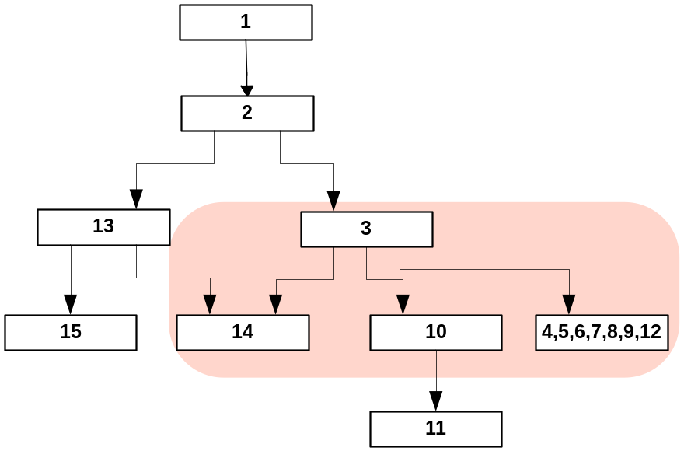
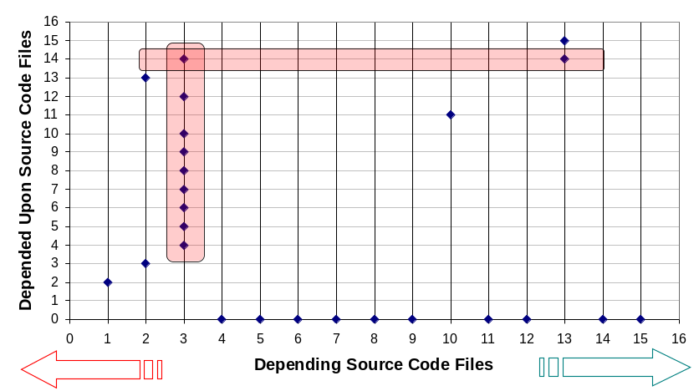
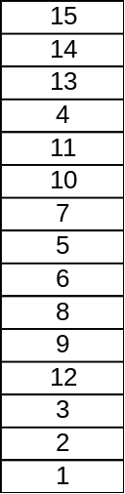
File Dependency Relationships
How to Read
After topological sort
Fan-in
Fan-out
Dependency Graph
Numbered files to the right depend only on files above them, but do not necessarily depend on every file above.
Above shows file dependencies.
Upper right shows another view:
  All dots on the vertical line rooted at 3 are files that file 3 depends on. We call this Fan-Out.
  Both dots on horizontal line rooted at 14 are files that depend on 14. We call this Fan-In.
Top. Sorted Files
Notes:
1 depends on 2, 2 depends on 3…
Do not elaborate too much.

Slide 11
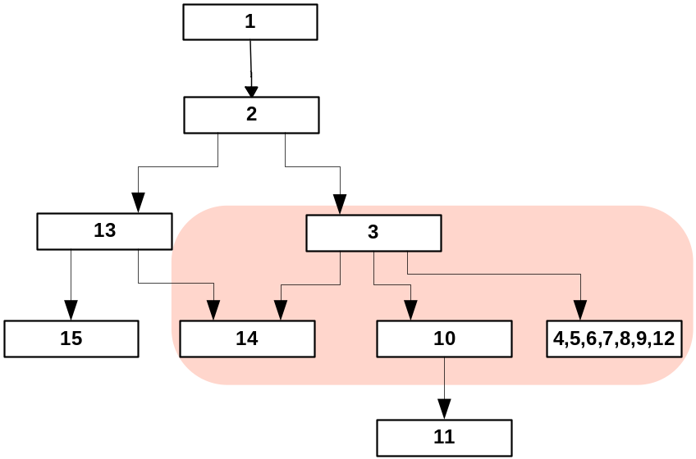
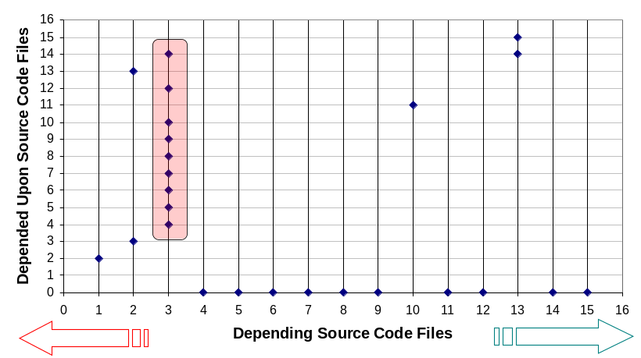
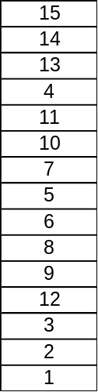
Problem: Large Fan-out
After topological sort
Dependency Graph - Large Fan-out
Depending on scores of other files (large fan-out) may indicate a lack of cohesion – the file is taking responsibilities for too many, perhaps only loosely related, tasks and needs the services of many other files to manage that.
Numbered files at the left depend only on files above them, but do not necessarily depend on every file above.
Top. Sorted Files
Notes:
“Level” : Define (level 1… level 2…)

Slide 12
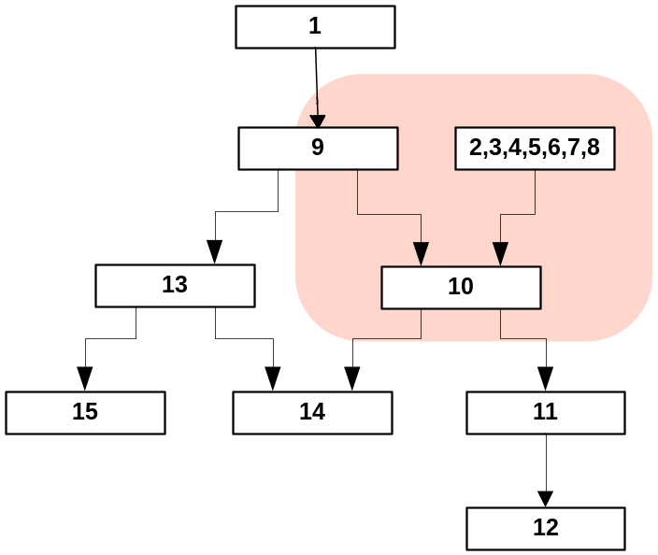
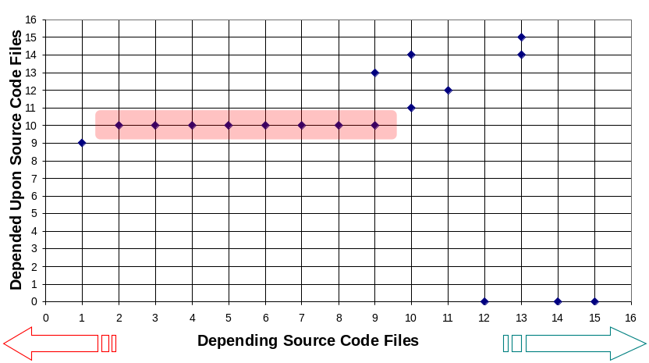
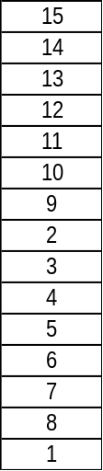
Problem: Large Fan-in
After topological sort
Top. Sorted Files
Dependency Graph
High Fan-in is not inherently bad. It implies significant reuse which is good. However poor quality of the widely used file will be a problem.
High fan-in coupled with low quality creates a high probability for consequential change. By consequential change we mean a change induced in a depending file due to a change in the depended upon file
Notes:
A file with large fan-in is desirable from the perspective that it demonstrates high reuse of the types defined in that file. For example, we would expect to see high fan-in for some utility library routines. However, should that file have less than desirable quality attributes one would expect to see a high probability of change, not only for that file, but also for many of the large number of files that depend upon it. If you need to change file C such as for enhancement, bug fixing or adding new functionality; you need to test all the files which are depend upon that file to make sure, you did not break the code. File C should be important target for quality analysis, in order to effectively manage the change process during development.

Slide 13
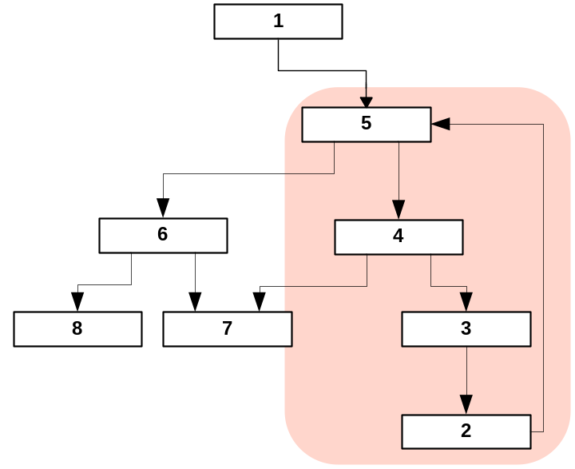
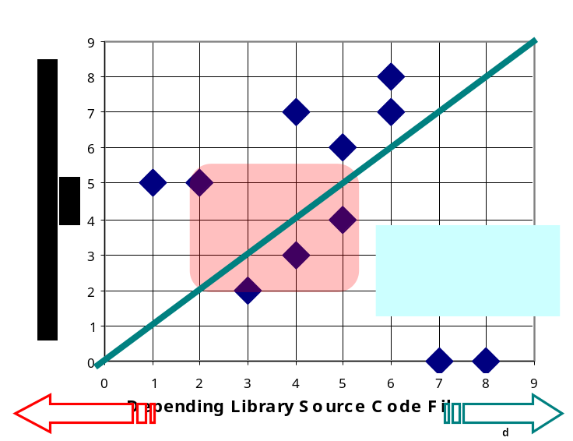
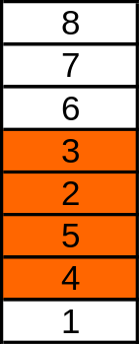
Problem: Large Strong Components Strong component is a set of mutual dependencies
After topologically sorting, strong components are expanded
Top. Sorted Files
Files 2, 3, 4, and 5 cannot be ordered.
The order given is as good as possible.
Strong Comp. Size
# of SC with this size
Dependency Graph
1
4
4
1
Ideal testing process:
Test those files with no dependencies, then test all files depending only on files already tested.
For testing, a strong component must be treated as a unit. The larger a strong component becomes, the more difficult it is to adequately test.
Change management becomes tougher, due to consequential changes to fix latent errors or performance problems
Notes:
Upper left needs better statement.

Slide 14
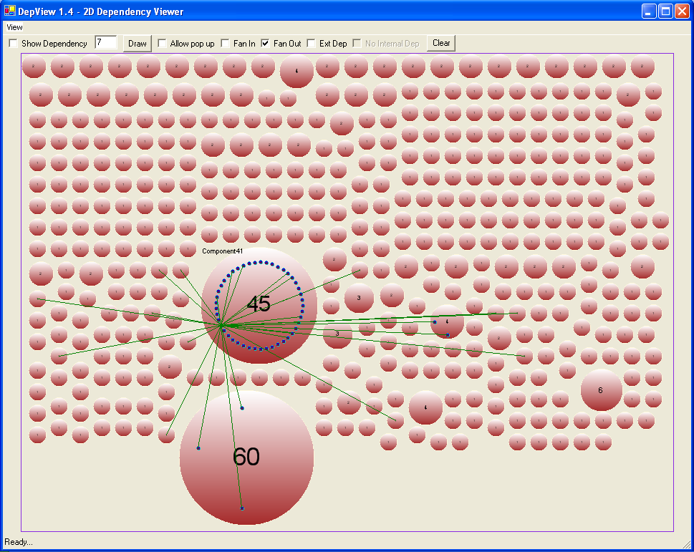
This is Mozilla’s GKGFX Rendering Library
Plot shows some very large mutual dependencies
Our dependency analyzer tool
This view is generated by our tools:
  DepAnal
  DepView
This library has 598 files.
It shows a file in a second largest strong component that depends on many other files.
Our interactive dependency visualizer
Size of bubble proportional to number of files in strong component.
Green lines show Fan-Out of one file in a large strong component. Note dependencies both inside and outside component.
Notes:
This plot shows that many files outside of component 52 depend upon it. In fact it shows all the external files that depend on only one of the many files in that component. If we showed them all there would be some many lines it would be hard to interpret.
This is a very dangerous situation for a software system: Many files depend on a cluster of mutually dependent files. Mutual dependencies are very difficult to test effectively because they all depend on each other. We find an error, change it, and it may affect many other files in the mutually dependent set. So large strong components are hard to test, e.g., hard to make correct, e.g., subject to a lot of changes. This in turn may affect many of those external files shown in the view above.

Slide 15
GKGFX Component Internals
Here are the internal dependencies for largest strong component.
We show, in the dissertation document using Product Risk Model, that high density of dependencies within a strong component is a serious design flaw.
What’s the problem? Without DepAnal and DepView, we don’t know.

Slide 16
Visibility
The dependencies shown on the previous slide are, without our tools, invisible.
Developers know only a small part of the dependency structure based on their own reading of the code. The rest they may find by observing breakage when they change something.
Note that Mozilla, 1.4.1 is composed of 6193 files! Impossible to understand that dependency structure without effective tools.

Slide 17
Is Complex Dependency Really a Problem?
Mozilla was targeted for Apple OSX.10 but Apple switched to KHTML:
  “Apple snub stings Mozilla” – CNET News.com
    “Bourdon said Safari engineers looked at size, speed and compatibility in choosing KHTML.”
    "Translated through a de-weaselizer, (Melton's e-mail) says: 'Even though some of us used to work on Mozilla, we have to admit that the Mozilla code is a gigantic, bloated mess, not to mention slow, and with an internal API so flamboyantly baroque that frankly we can't even comprehend where to begin,'" Zawinski wrote.
    http://news.com.com/2163e+snub+stings+Mozilla/2100-1023_3-980492.html

Slide 18
Our Approach
Having seen the previous problems, here is what we are going to do.

Slide 19
Scope of Study
We are not analyzing syntactic correctness of code.
We are not analyzing logical correctness of code.
We are analyzing project code structure.
Our methods and tools are applicable to
C-based procedural and object oriented languages such as C, C++, C#, Java.
  DepAnal and DepView support both C and C++
Notes:
Why improve our tools?
We ran our tools on our own code, and we were not too happy.
Functionality is OK. Structure and flexibility may not be.

Slide 20
Contributions
Developed Source File Ranking Models
  Risk Model,
  Reusability Index.
Developed Analysis Methods
  Dependency Analyzer (DepAnal): C/C++ static source code dependency analyzer tool. Able to analyze thousands of files in reasonable time (Mozilla: 6193 files in approximately 4 hours – dependency and graph relationships).
  Dependency Viewer (DepView) – Interactive visualization of dependencies among files and components. Provides new views of complex information.
Designed and conducted an experiment to investigate the impact of change in one file on other files (results shown later).
Investigated corrective procedures and simulated their application, monitored improvements in observed defects.
Notes:
Developed source file ranking algorithms using notions of product risk, importance, and testability of a file.
Introducing a model that indexes software components according to their potential for reuse.

Slide 21
Dependency Model
summary
Focus is dependencies between files.
  Files are unit of testing and configuration management
Based on types, global functions and variables.
  Dependency Model - file A depends on file B if:
    A creates and/or uses an instance of a type declared or defined in B
    A is derived from a type declared or defined in B
    A is using the value of a global variable declared and/or defined in B
    A defines a non-constant global variable modified by B
    A uses a global function declared or defined in B
    A declares a type or global function defined in B
    A defines a type or global function declared in B
    A uses a template parameter declared in B
Outputs are presented as direct dependencies.
  We do not show transitive closure for ease of interpretation – otherwise, too dense.
Risk model accounts for transitive relationships, in an effective way.
Notes:
The dependency model used throughout this analysis is given below. There is one important qualification we have to make about this model. In much of the code base we’ve analyzed for this paper there is a significant amount of code duplication across the directory structures analyzed. If we accept duplicate code our tool is not strong enough to sort out which instance is being referenced by another file, and so we will misclassify some dependencies. We’ve found these misclassifications lead to larger predicted mutual dependencies than are actually present in the system. Our solution currently is to eliminate all duplicate code. This results in some missed detections, but we want to err on the side of conservative estimate of coupling rather than too pessimistic estimate. Part of our future work will be directed to a more thoughtful handling of these ambiguities.
Dependency Model - file A depends on file B if:
A creates and/or uses an instance of a type declared or defined in B
A is derived from a type declared or defined in B
A is using the value of a global variable declared and/or defined in B
A defines a non-constant global variable modified by B
A uses a global function declared or defined in B
A declares a type or global function defined in B
A defines a type or global function declared in B
A uses a template parameter declared in B

Slide 22
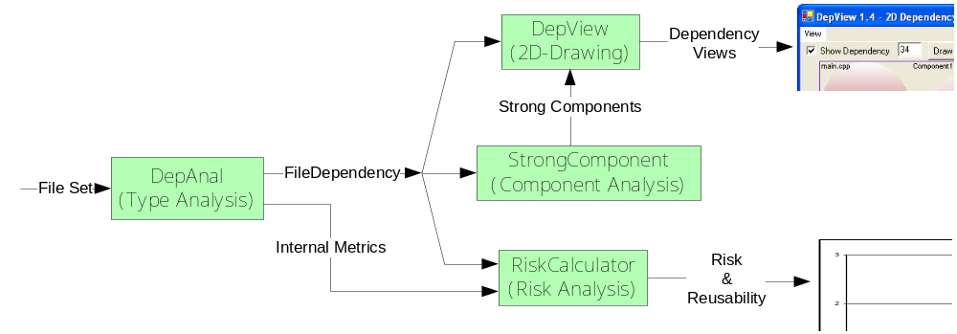
Data Gathering and Processing
summary
Figure below is the data gathering and processing flow used during our analysis of software.
We obtain data in two different granularities:
  Strong components.
  Individual source files.

Slide 23
An Analysis – Mozilla, Version 1.4.1
The Mozilla project is a very large project developing browser tools for many different platforms.
Win 32 Configuration
  Number of executables: 94
  Number of dynamic link libraries: 111
  Number of static libraries: 303
  Number of source files for Win32, v 1.4.1: 6193
Analysis of entire Mozilla project took approximately 4 hours on Dell Dimension 8300 with 1 G Memory
Can analyze individual libraries – few hundred files – in half hour.
Wow!
Notes:
We downloaded version 1.4.1 of the Mozilla Win32 configuration
The Windows-based version of this software was chosen for analysis, as we are familiar with that as a programming environment and have all the tools to execute the various builds required for this study. We have examined the entire Windows build as well as several constituent libraries and adjunct tools, 6193 files in total, generating builds for each before proceeding with our analysis.

Slide 24
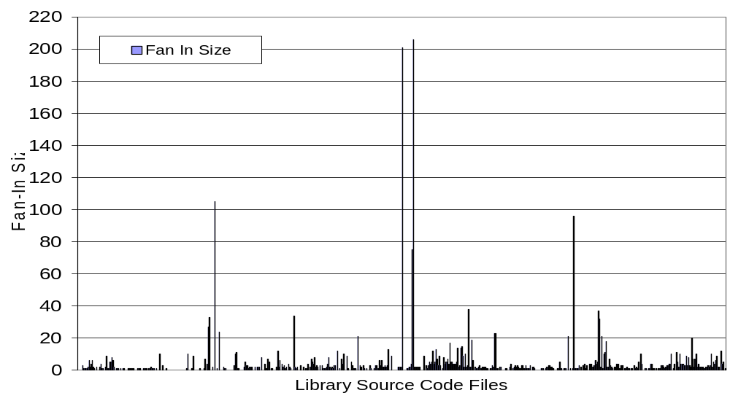
Fan-in Data
Mozilla GKGFX Library
Number of source files 598.
Dependencies from within the library.
When we analyze the entire build many of these fan-in numbers will increase.
Like others, we use Fan-in and Fan-out as important metrics.
High Fan-in implies reuse, which is good, but only if quality is also good.
High Fan-in coupled with low quality creates a high probability for consequential change.
Notes:
A file with large fan-in is desirable from the perspective that it demonstrates high reuse of the types defined in that file[1]. However, should that file have less than desirable quality attributes one would expect to see a high probability of change, not only for that file, but also for many of the large number of files that depend upon it
[1] We would expect to see high fan-in for some utility library routines, for example.
There are scores of files, shown in Figure 3, with very large fan-in. All of these should be important targets for quality analysis, in order to effectively manage the change process during development. High fan-in coupled with low quality creates a high probability for consequential[1] change : [1] By consequential change we mean a change induced in a depending file due to a change in the depended upon file.

Slide 25
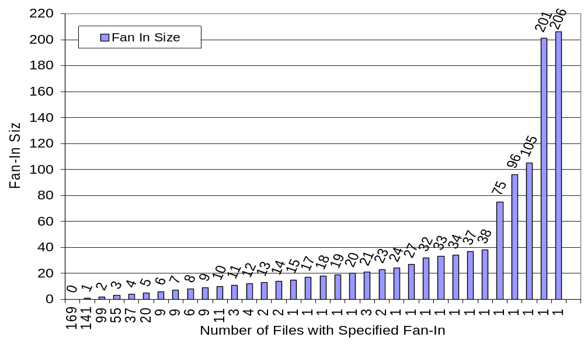
Fan-in Density
Mozilla GKGFX Library
This histogram shows that significant number of library source code files have high fan-in, characteristic of a widely used library.
A library with this profile should be given high priority for analysis by the test team and quality analysts.

Slide 26
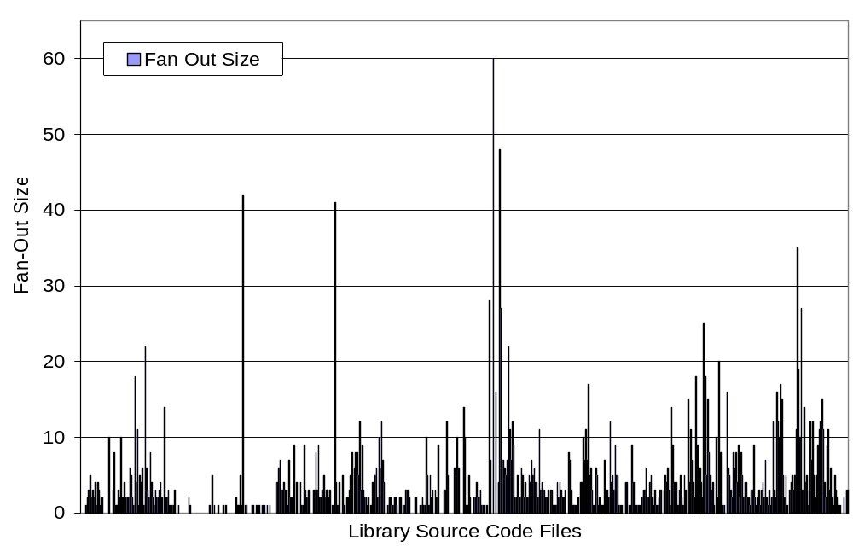
Fan-out Data Mozilla GKGFX Library
A file with large fan-out may be symptomatic of a weak abstraction.
Fan-Out of 60!
We expect that a well-designed source file should carry out its assigned tasks with the aid of a few trusted delegates and perhaps a few references to commonly used utilities.
Notes:
A file with large fan-out may be symptomatic of a weak abstraction. We expect that a source file may carry out its assigned tasks with the aid of a few trusted delegates and perhaps a few references to commonly used utilities. However, depending on scores of other files may indicate a lack of cohesion – that the file is taking responsibilities for many, perhaps only loosely related, tasks and needs the services of many other files to manage that.

Slide 27
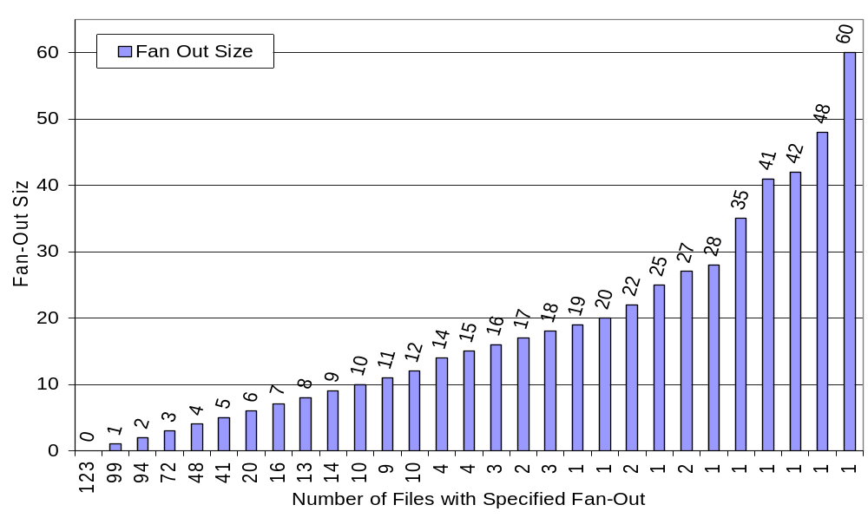
Fan-out Density Mozilla GKGFX library
Large Fan-Out may be symptomatic of weak abstraction. We’ve show elsewhere that High Fan-Out is correlated with large number of changes.
Large fan-out is likely to imply a lack of cohesion. Ideally, fan-out should be no more than a few other files.
There are a significant number of files with large fan-out.
Notes:
There are a significant number of files with large fan-out. If one follows the classic test model, testing code that only depends on already tested code, this profile suggests difficulty scheduling testing for this library. Automated test schedule planning tools can provide significant help for this, but we show below that there may still be persistent problems creating a satisfactory test sequence for libraries with many high fan-out files.

Slide 28
Summary for High Level Views
High Fan-in implies:
  Good reuse.
  Large testing effort if we need to make a change in file with high Fan-In.
High Fan-out implies:
  Weak abstraction.
  Need for redesign or refactoring of code.
Notes:
Reading this slide is ok

Slide 29
Problem: Large Strong Components Strong component is a set of mutual dependencies
reminder
After topologically sorting, strong components are expanded
Top. Sorted Files
Files 2, 3, 4, and 5 cannot be ordered.
The order given is the best we can achieve.
Strong Comp. Size
# of SC with this size
1
4
Dependency Graph
4
1
Ideal testing process:
Test those files with no dependencies, then test all files depending only on files already tested.
For testing, a strong component must be treated as a unit. The larger a strong component becomes, the more difficult it is to adequately test.
Change management becomes tougher, due to con-sequential changes to fix latent errors or performance problems
Notes:
This is just a reminder

Slide 30
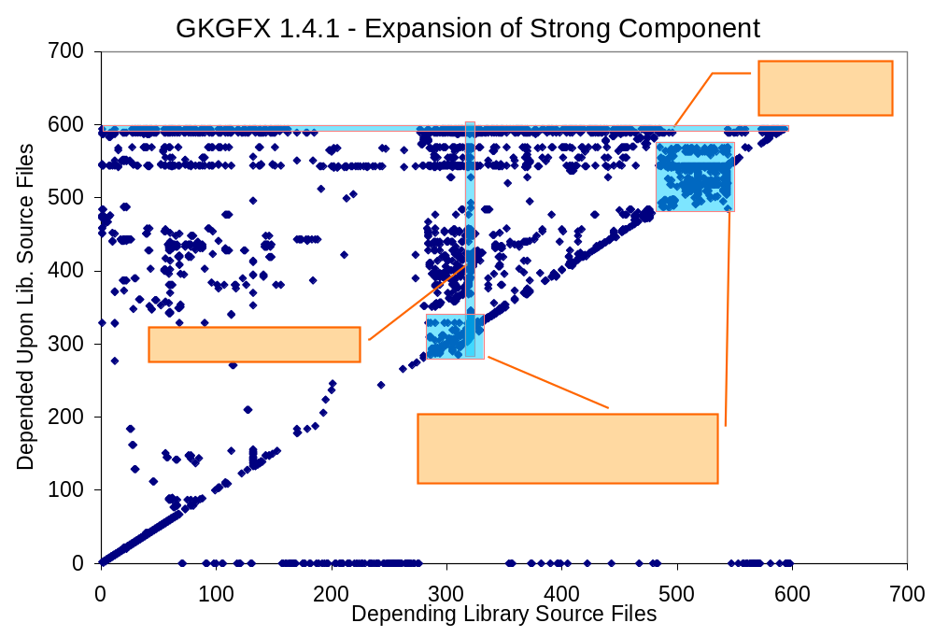
Analyzing Dependency Matrix
Topological sort gives best test order – important information!
Notes:
Mozilla guys don’t have any knowledge of this structure.

Slide 31
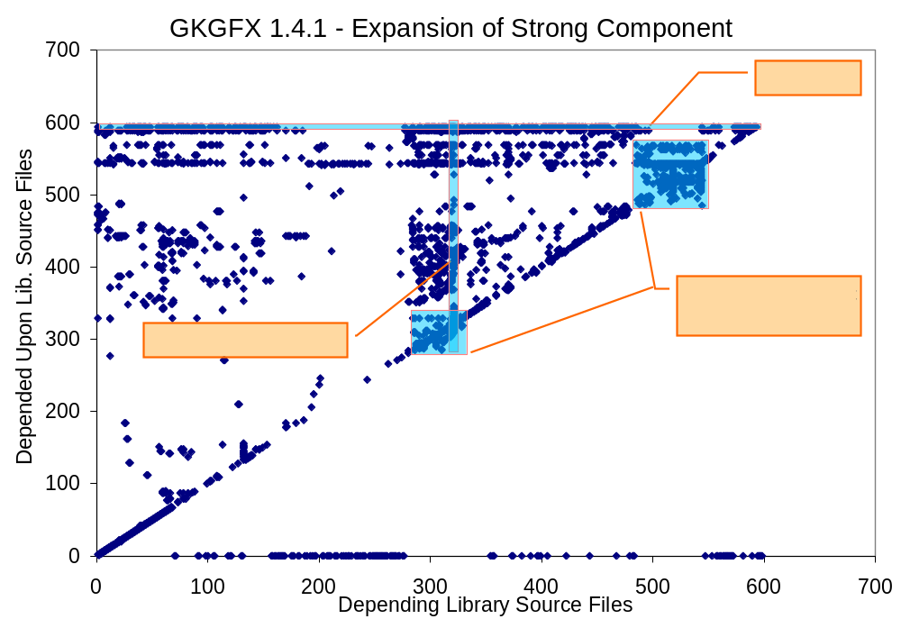
Expanded Topological Sort
GKGFX Library
s
If file belongs to a strong component and any other file in that component is changed, rigorous testing dictates that it be retested, e.g., need to retest every file in strong component for every change to any file! This makes a compelling argument in favor of continuous regression testing using test harnesses.
Many files in this library cannot be put into a classic testing sequence.
This indicates a high probability of repeatedly testing a given file.
Components below the diagonal are due to cycles in dependency graph, e.g. mutual dependencies.
Notes:
Mozilla guys don’t have any knowledge of this structure.
There is no topological order throughout, because individual files from a strong component can not be put into sorted order, due to their circular dependency relationships.
Ideally, we would like to see the data in Figure above clustered just above the diagonal. That would indicate that most dependencies were local, e.g, nearest neighbor in the sense of the sorted dependency graph. We also would like to see only a few dependencies below the diagonal, representing necessary mutual dependencies, perhaps due to event callbacks or intimately related class structures, as in the mutual dependency between a graph class and its node class.

Slide 32
GKGFX Component Internals
s
Here are the internal dependencies for largest strong component.
We show, in dissertation document, using Risk Model, that high density of dependencies within a strong component is a serious design flaw.

Slide 33
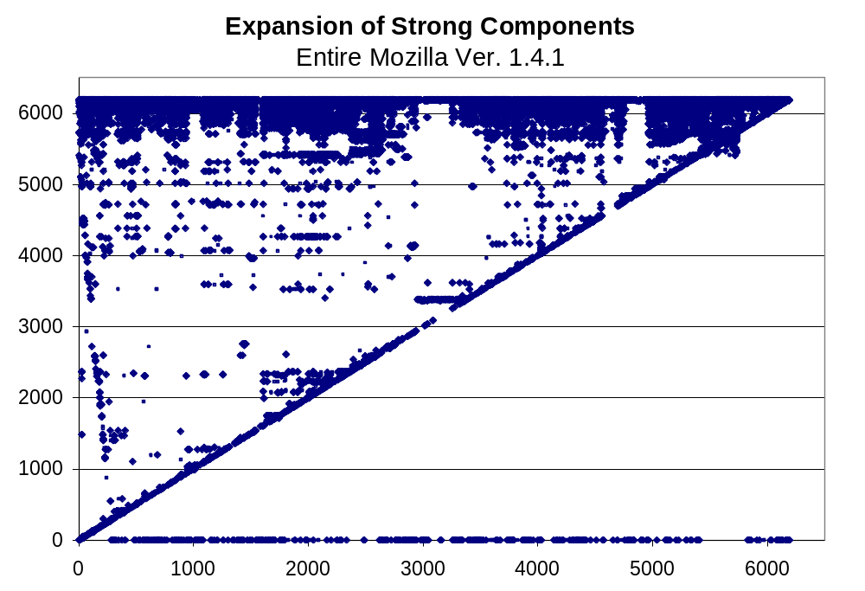
Dependency Data
For the Entire Windows-Based Mozilla Build
The plot below is a topological sorting of the dependency graph and then expanding strong components of the entire Mozilla build for windows.
Lots of libraries
This plot is so dense that it is becoming difficult to draw conclusions, but the plot clearly indicates test problems for the whole Mozilla project.
Size of the strong component is 325

Slide 34
So how do we make sense of all this?
We’ve now seen significant problems in the Mozilla 1.4.1 structure.
How can we find what is the cause of the problems?
How can we find ways to improve?

Slide 35
Product Risk Model
Product Risk Model is a file-rank procedure that orders the entire system’s file set by increasing risk.
  Provides direct support for management of large developing code bases.
  Indicates where attention should be focused.
  Enables developers to observe overall effect of a particular change (simulation)
    Removing global objects, interface insertion.
Notes:
What is risk “We have defined that We’ll go through our definitions in the next few slides”

Slide 36
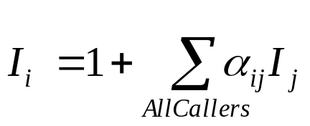
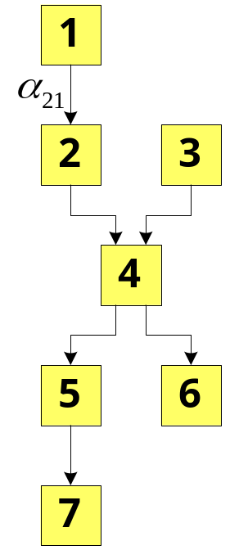


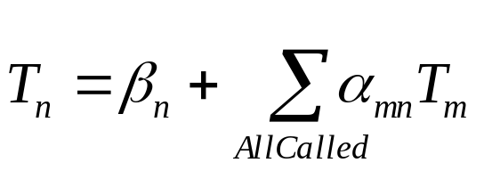


Product Risk Model
Definitions
Importance of a file is based on the number of other files that directly or indirectly depended upon it.
Test Difficulty is the degree of relative effort required for a file to be tested based on:
  Number of files it is using and its interconnectedness strength,
  Internal implementation quality
Notes:
Making the simplifying assumption that it alpha is constant for all files.
Thus, these results will be qualitatively useful, but not numerically precise

Slide 37
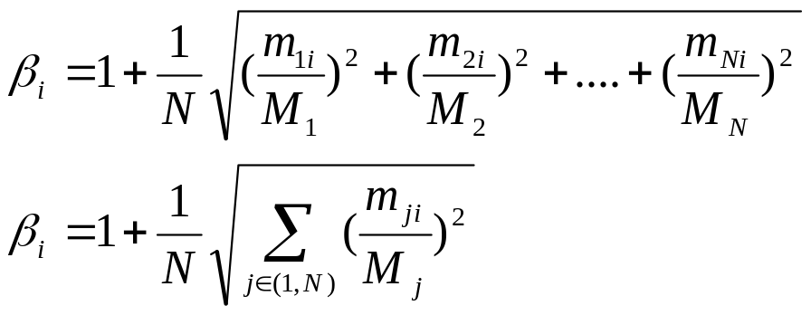
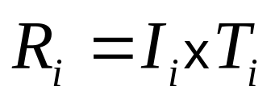

Product Risk Model
Definitions cont’d…
Implementation Metric Factor
M: Boundary metric value
m: Measured metric value
N: Number of metric involved
Small (m/M) is good.
Risk of a file is the product of its importance and test difficulty.
Low I and low T are good
Alpha represents the relative frequency of required consequential changes in files in the project.
Test difficulty of a file depends not only on its internal implementation quality, but also on the quality of the files that it depends on.
Notes:
Making the simplifying assumption that it alpha is constant for all files.
Thus, these results will be qualitatively useful, but not numerically precise

Slide 38
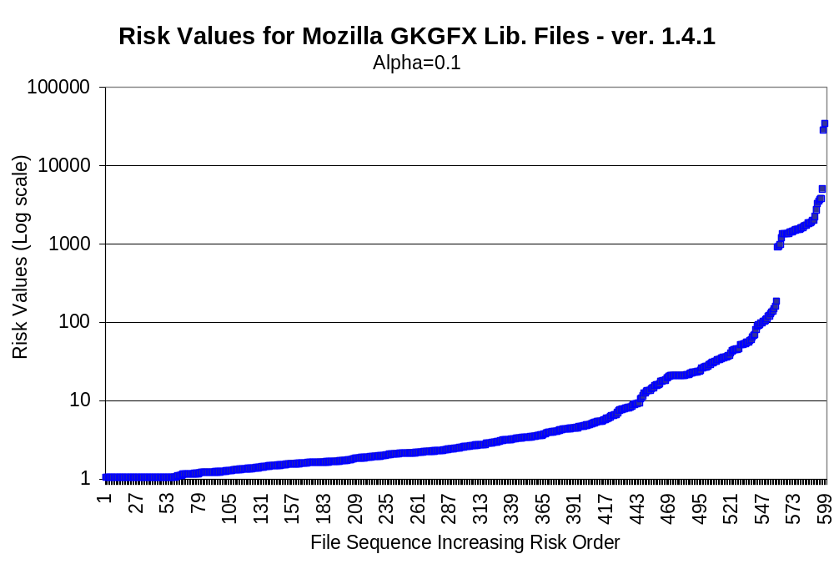
Risk Model Applied
Mozilla GKGFX Library

Slide 39
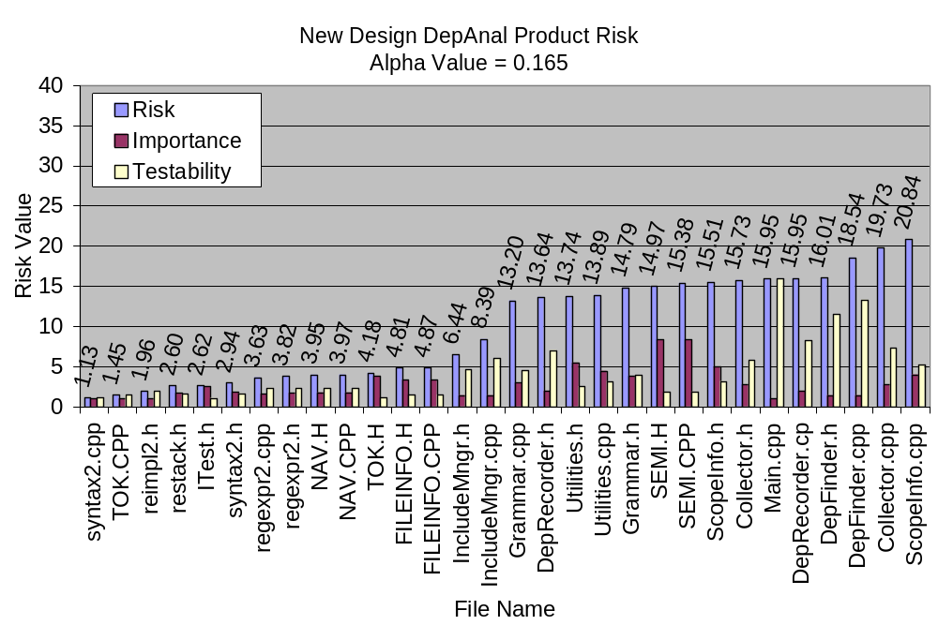
Risk Model Applied
Risk Values with File Names - New Design

Slide 40
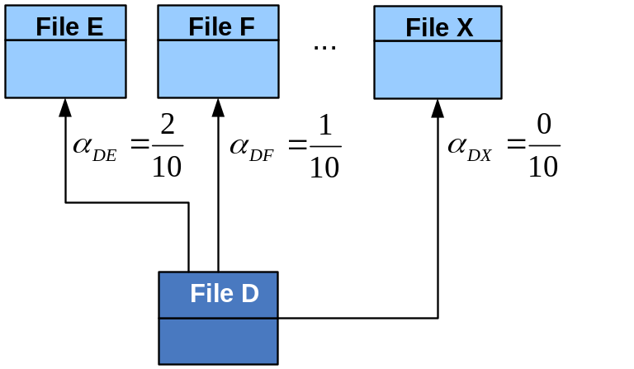
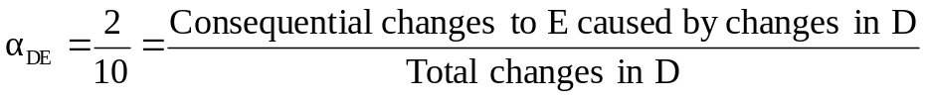
Change Impact Factor (α_{ij}) Estimation
Goals is to understand the impact of a change in a software source file to other source files
What we did?
  Designed an experiment,
  Described its application,
  Showed measured results of the change impact.
Redesigned DepAnal
  The analyzer’s first external release has 7796 lines of new code,
  5580 of these are code within functions.
  Implementation took three months, and
  503 changes were recorded.

Slide 41
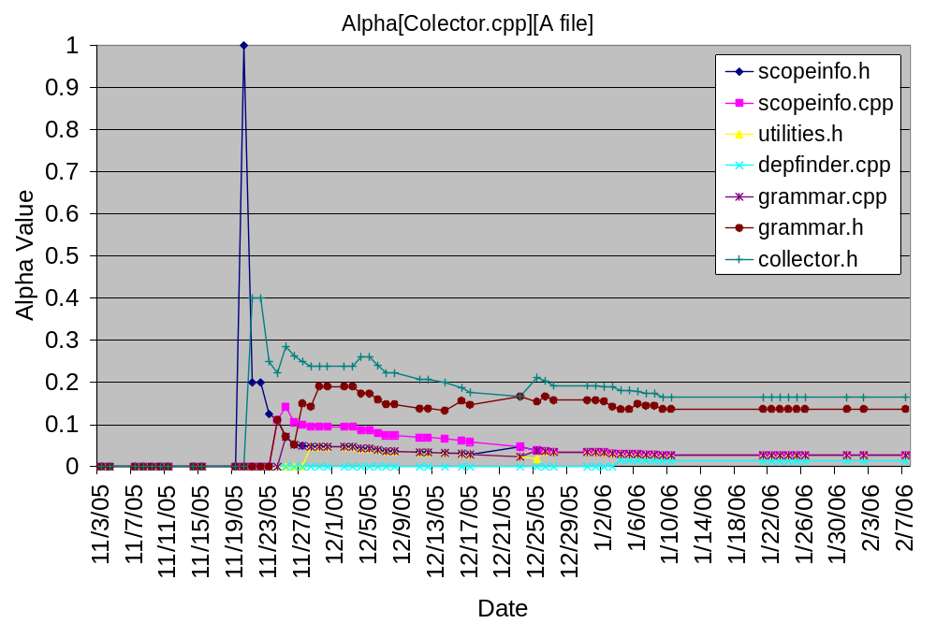
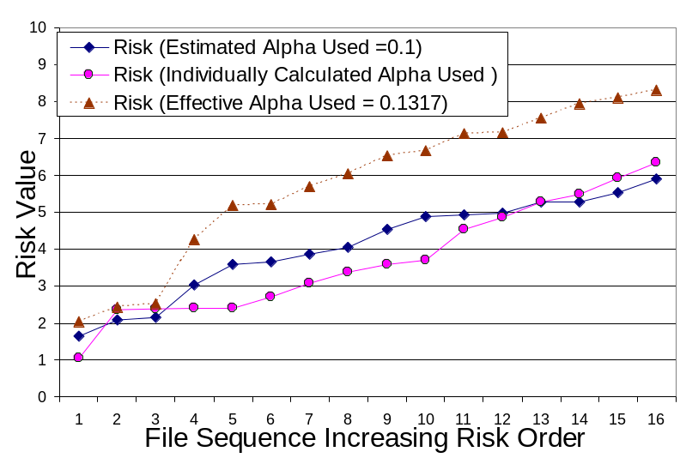
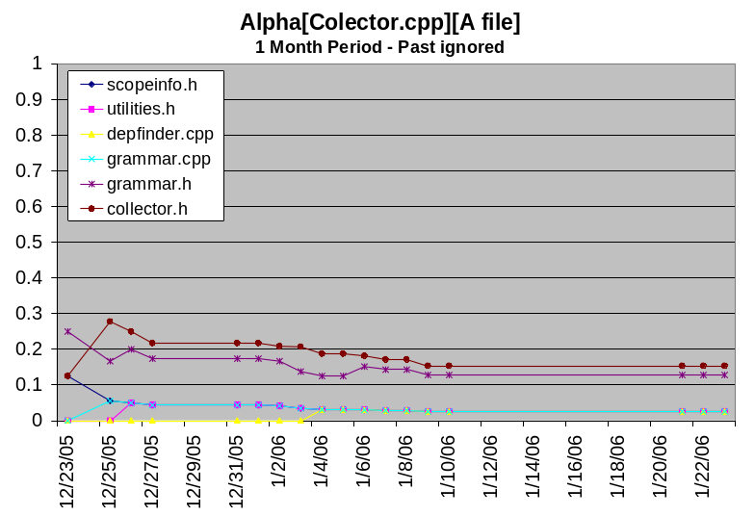
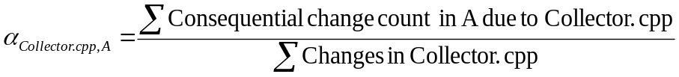
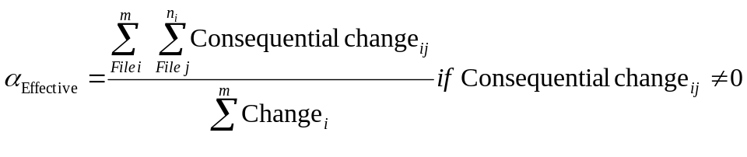
Results Change Impact Factor
Once reached a steady state the alpha values can be approximated by some constant factor
Notes:
1 Month Figure implies that once reached a steady state the alpha values are approximated by some constant factor
As we see, risk value calculated with semi-educated alpha and pruned average alpha have mostly the same slope but different values. Nevertheless, risk with individually calculated alpha shows the most accurate values, interestingly risk with semi-educated alpha are closer to them for this experiment.

Slide 42
File Reusability Ranking Model
Reuse of previously developed software components is desirable to take advantage of work on previous projects and to avoid development effort and cost that would otherwise be required.
This ranking model helps engineering organizations capture most important parts of a project to reuse in the future.
Enables developers to evaluate a file for reuse without initially looking at its code. Especially for the large projects, and may be almost impossible to accomplish manually due to complex interdependencies
There is no good way to do that without our methods and tools.
Notes:
The larger the software project gets, the more labor it demands due to numerous source code files with complex interdependencies.
This makes reuse of previously developed software components desirable to avoid some of the development effort and cost that would otherwise be required.

Slide 43
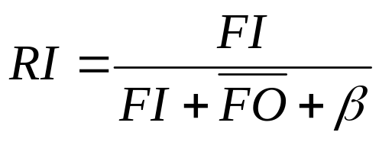



File Reusability Ranking Model Cont…
transitive closure of fan-out
High RI (close to 1) is preferred.
If a file is called by many others in the product, e.g., has a high fan-in, then it has demonstrated its usefulness, at least within that product by this in-situ reuse.
If, however, it has a high fan-out, then it depends on many other files, which makes it much harder to reuse.
Notes:
The larger the software project gets, the more labor it demands due to numerous source code files with complex interdependencies.
This makes reuse of previously developed software components desirable to avoid some of the development effort and cost that would otherwise be required.

Slide 44
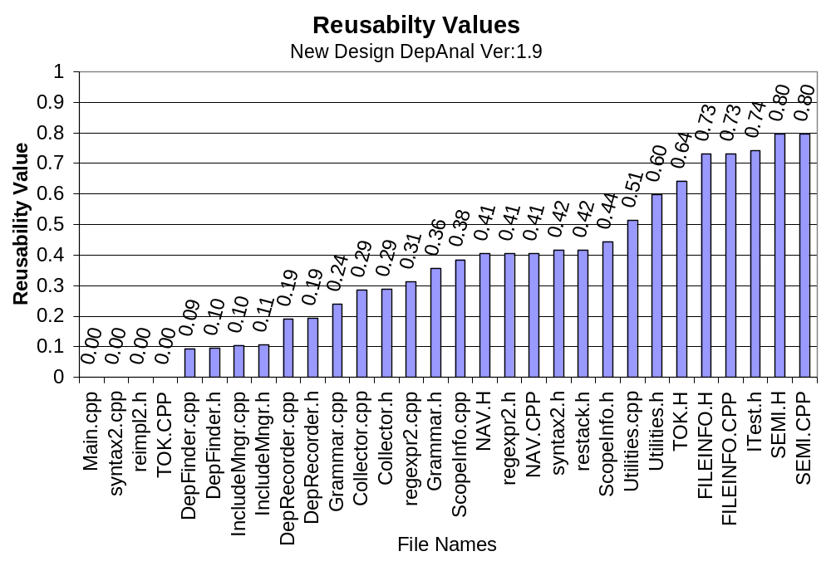
Reusability Model Applied
DepAnal

Slide 45
Simulating Constructive Changes
We examine the affect of changes we may make to improve the structure of systems analyzed with the help of DepAnal and DepView
We simulated (except for DepAnal) the effects of changes
  Elimination of global variables and
  Inserting interfaces between components.

Slide 46
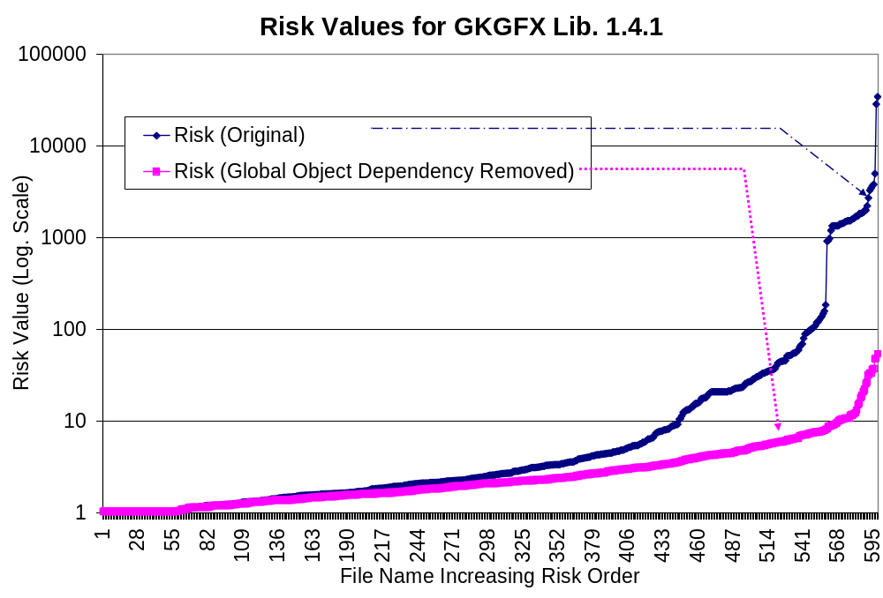
Change in Risk Values
Simulation of Global Data Elimination - GKGFX

Slide 47
Conclusions to this Point
The models and tools we’ve developed for this research have the power to find and display structural problems in large software systems.
Our work shows that specific constructive changes can significantly improve system structure and reduce risk.

Slide 48
Contributions
Developed Risk model which pinpoints problem files and supports comparisons before and after fixes.
We introduced a reusability model that indexes software components according to their potential for reuse.
We designed and conducted an experiment to investigate the impact of change in one file on other files, in terms of consequential changes they require.
We designed and developed tools implementing these algorithms and methods that are capable of analyzing very large sets of files (6193 files analyzed in 4 hours)
  DepAnal/DepView is our experimental apparatus needed to provide new results.
Demonstrated specific means to improve structural problems, using risk model and DepAnal/DepView.

Slide 49
Files - Unit For Analysis
s
In most development organizations, files are “unit” of testing and configuration management.
Dependencies between software files are essential so that one component may provide services to another.
If a file is using services of other files, it cannot be tested alone.
The larger the number of dependency between files,
the harder it is to:
test,
manage,
understand,
reuse
The situation gets worse if there are mutual dependencies.
Therefore, it is better to reduce dependencies between files, especially mutual dependencies.

Slide 50
Fine Grain Level Dependency
s
One file depends on another file, if it uses the other file’s services;
  Types
  Global Functions
  Global Variables
To solve the file dependency problems we need to find more than file to file dependency. We check type-to-type, type-to-global function or variable, global function-to- type, global function-to-global function or variable.
If we obtain this information, we have fine-grain level dependencies. Now we can relocate some existing code to reduce dependency density among files.

