Slide 1
Web Services
Jim Fawcett
CSE686 – Internet Programming
Summer 2004

Slide 2
References
Programming Microsoft .Net,
Jeff Prosise, Microsoft Press, 2002
Web Services, Mark Sapossnek, Powerpoint presentation available from www.gotdotnet.com

Slide 3
Web Service Definition
A web service is a set of methods exposed through a web interface.
  Accessible through HTTP
  Provides internet access to RPC-like calls that define the service
  Web service messages are encoded in an XML dialect called Simple Object Access Protocol (SOAP)
Service model assumes services are always available

Slide 4
Benefits of the Web Service Model
Web services use this special architecture because it:
  Can be used from any platform.
  Uses a standard, well-know channel.
  Is routable and will pass through most firewalls.
  Uses the same security mechanisms as any web site.

Slide 5
Service Oriented Architecture
Framework provides a set of fundamental operations via web services
  May also provide local services using Windows services
All applications based on that framework share the common services
  Don’t have to recreate the same functionality for each new application
Can provide those same services to Partner businesses, suppliers, and customers
Cloud-based services use web services for accessing platform facilities on cloud servers

Slide 6
Comparing MicroSoft
Web Service with ASP.Net
ASP.NET
  Uses ASP pipeline
  Applic.aspx
  Applic.aspx.cs
  Uses Session, …
  Visual Interface invoked from browser
Web Service
  Uses ASP pipeline
  Applic.asmx
  Applic.asmx.cs
  Uses Session, …
  RPC Interface invoked by ASP or Winform app through proxy

Slide 7
Web Service Protocols
Web services are based on four protocols:
  Extensible Markup Language (XML)
    defines complex data structures
  Web Service Description Lanaguage (WSDL)
    Specifies the interface of the web service
  Discovery Protocol (DISCO)
    Pointer to all web services on a particular web site
  Universal Description, Discovery, and Integration (UDDI)
    Central repository of web service descriptions

Slide 8
Web Service Structure

Slide 9
Underlying Technologies
Web Services Stack
UDDI
Directory
http://www.uddi.org
UDDI or
other
directory
service
Locate a Service
Link to Discovery Document (XML)
Inspection
http://www.ibuyspy.com/ibuyspy.disco
DISCO
Request Discovery Document
Return Discovery Document (XML)
Web Service Client
WSDL
Description
http://www.ibuyspy.com/ibuyspycs/InstantOrder.asmx?wsdl
Request Service Description
Web Service
Return Service Description (XML)
SOAP
Wire Format
Request Service
Return Service Response (XML)

Slide 10
SOAP Messages
A SOAP Message can be one of three types:
  Method call
    Contains name of method and parameters
  Method Response
    Return values
  Fault Message
    SOAP fault message if service throws an exception
    Will get standard HTTP message if transport fails.

Slide 11
SOAP
Message Structure
SOAP Message
The complete SOAP message
Headers
Protocol binding headers
SOAP Envelope
<Envelope> encloses payload
SOAP Header
<Header> encloses headers
Headers
Individual headers
SOAP Body
<Body> contains SOAP message name
Message Name & Data
XML-encoded SOAP message name
& data
Notes:
A SOAP message is an XML document that consists of a mandatory SOAP envelope, an optional SOAP header, and a mandatory SOAP body.
The envelope is the top element of the XML document representing the message.
The header is a generic mechanism for adding features to a SOAP message in a decentralized manner without prior agreement between the communicating parties. SOAP defines a few attributes that can be used to indicate who should deal with a feature and whether it is optional or mandatory. The Body is a container for mandatory information intended for the ultimate recipient of the message.
SOAP defines one element for the body, which is the Fault element used for reporting errors.

Slide 12
WSDL
WSDL Schema
<definitions> are root node of WSDL
<import> allows other entities for inclusion
<types> are data definitions - xsd
<message> defines parameters of a Web Service function
<portType> defines input and output operations
<binding> specifies how each message is sent over the wire
Interface
<definitions>
<import>
<types>
<message>
<portType>
<binding>

Slide 13
UDDI
UDDI Information Model
Provider: Information about the entity who offers a service
tModel: Descriptions of specifications for services.
1…n
Service: Descriptive information about a particular family of technical offerings
0…n
Bindings contain references to tModels. These references designate the interface specifications for a service.
Binding: Technical information about a service entry point and construction specs
0…n

Slide 14
Structure of a Microsoft WebService
MyService.asmx, MyService.asmx.cs
  Page Directive:
  <%@ Webservice Language=“C#” Class=“myService” %>
  Class [derived from System.Web.Services.WebService]
  Methods decorated with [WebMethod]
Virtual Directory hosting this Application

Slide 15
Consuming Web Services
Web Service
Developer
Web Application
Developer
Create with
WSDL.exe
Web Server S
Service App
Web Server C
.asmx
Service Application
Proxy
.cs
Web Form
.aspx

Slide 16
Structure of WebService Client
myService Proxy code
  Generated using disco.exe and wsdl.exe (see CalcClient.cs code comments)
myServiceClient code
  Ordinary ASP or Winform application
  myService Proxy = new myService();
  Result = Proxy.myMethod(args);

Slide 17
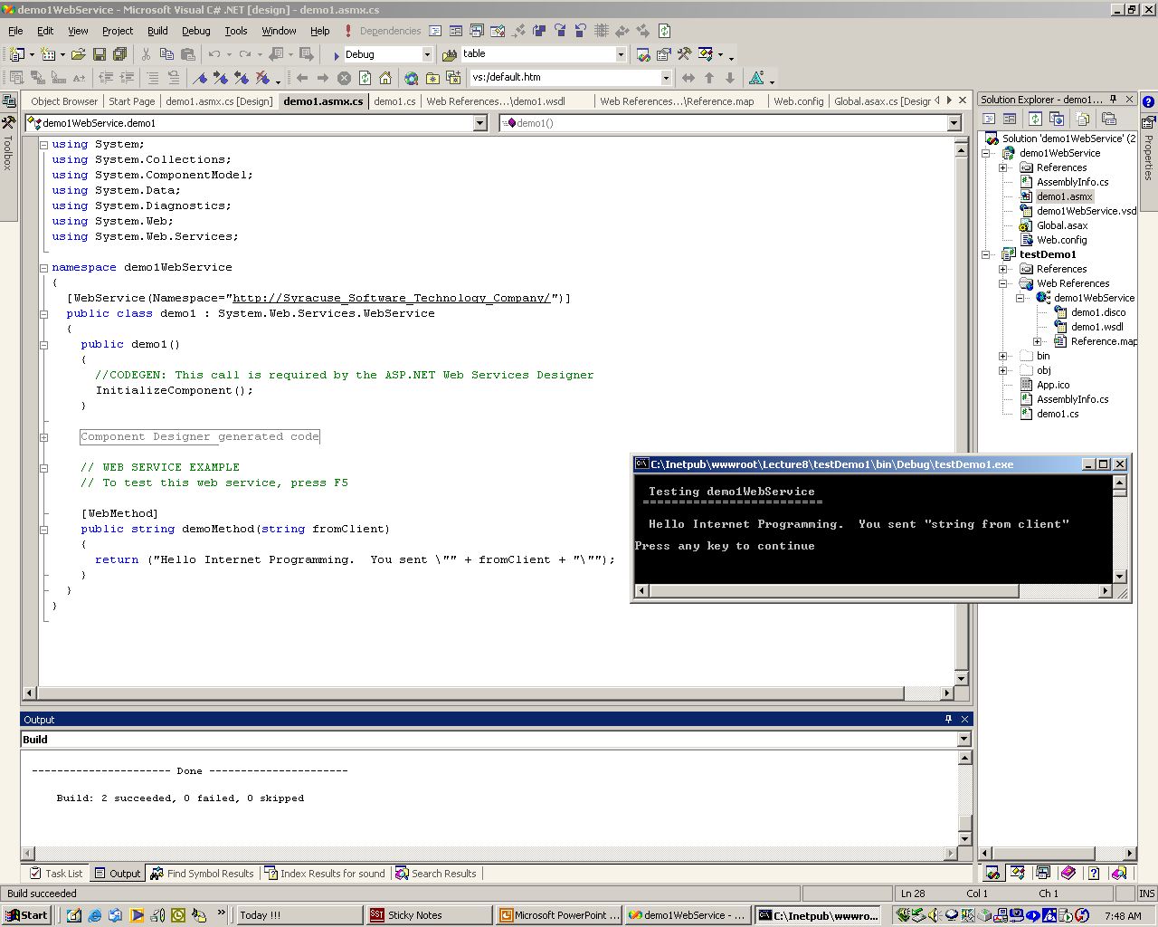
DemoWebService Running
Web service description
Public web method

Slide 18
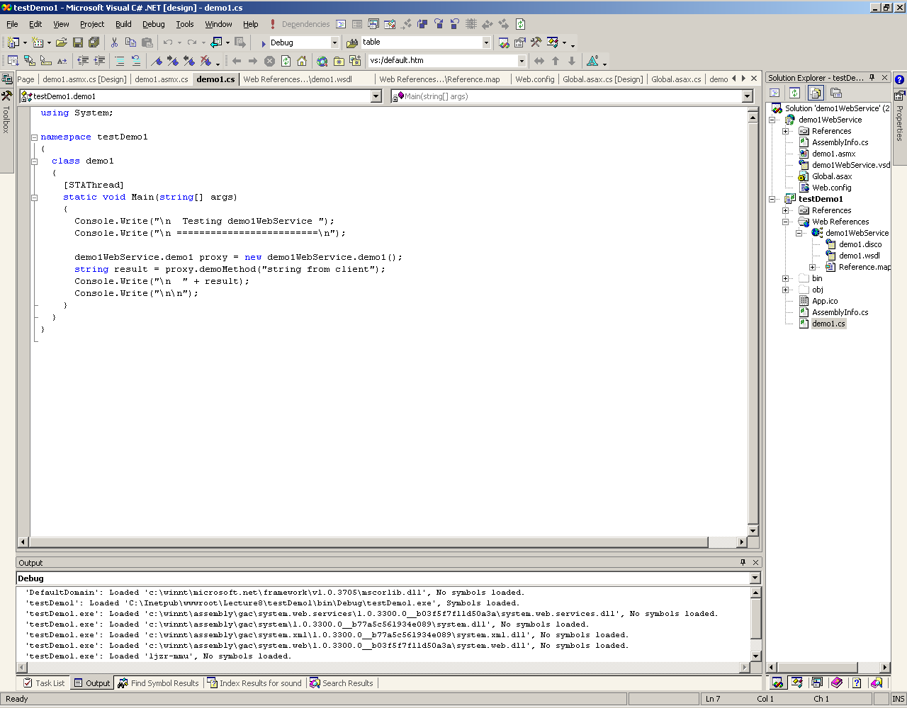
Client of DemoWebService
Instantiating web service proxy
Adding web reference creates proxy

Slide 19
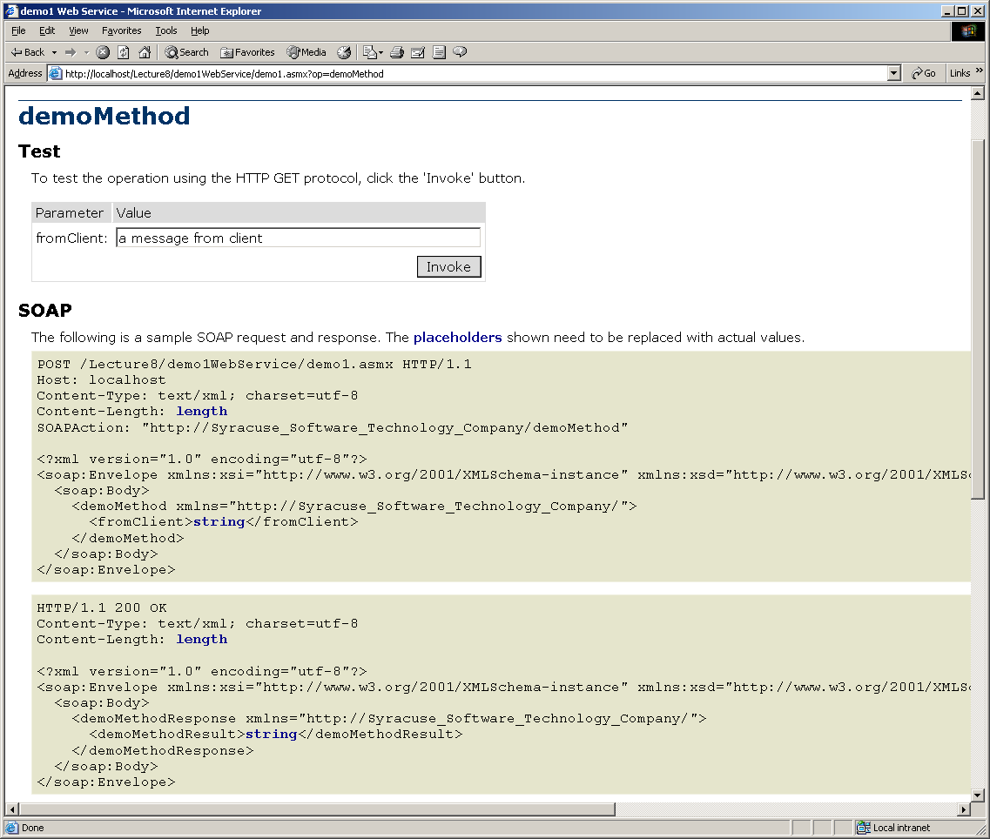
SOAP Request and Response

Slide 20
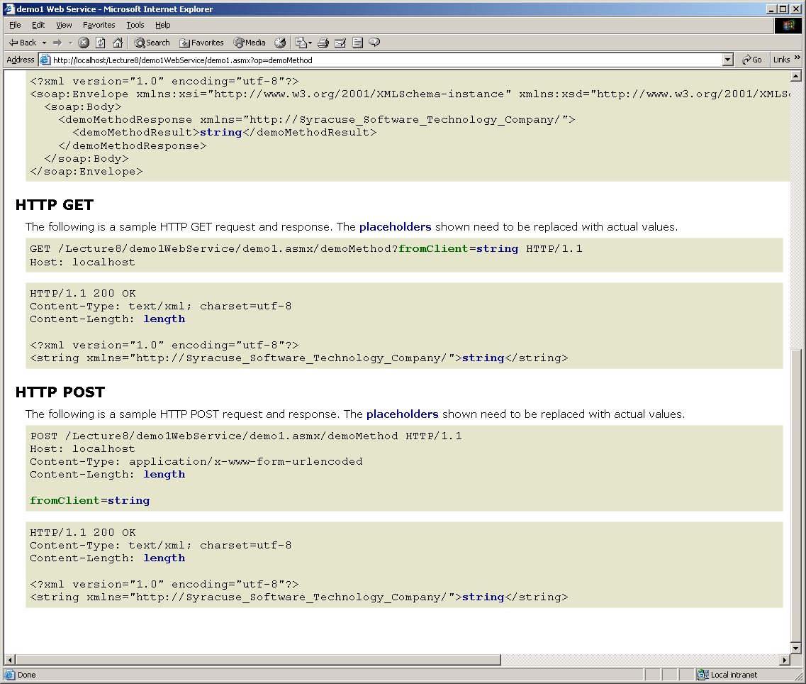
HTTP GET and POST exchanges

Slide 21
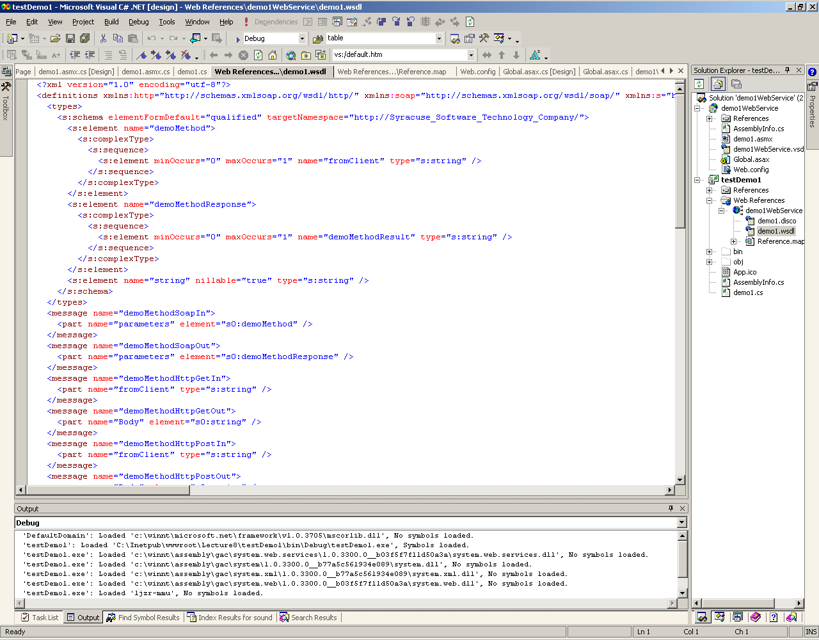
demo1.wsdl

Slide 22
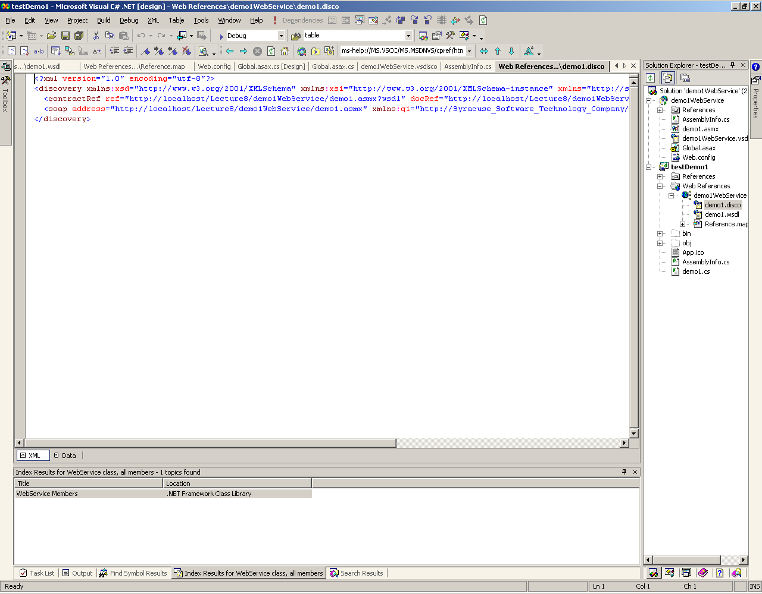
demo1.disco

Slide 23
Web Service Application Structure

Slide 24
WebService Properties
HttpApplicationState
  Share state among all users of an application.
HttpSessionState
  Share state from page to page for one user.
HttpContext
  Provides access to the server Request and Response objects.
HttpServerUtility
  Provides CreateObject, Execute, and MapPath methods.
User
  Supports authentication of user.

Slide 25
WebMethods
WebMethod methods can pass any of the C# and CLR types
User defined objects can also be passed if they are serializable:
  .Net XML serializer will not serialize non-public members
  User defined types can only be passed with SOAP. GET and POST won’t work.
  The WSDL contract contains a schema description of any user defined objects passed by a WebMethod

Slide 26
Web Service Clients
Web Service Clients use Web Service proxies to communicate with the remote service:
// create proxy instance
  demo1WebService.demo1 proxy = new demo1WebService.demo1();
  // use proxy
  string result = proxy.demoMethod("string from client");

Slide 27
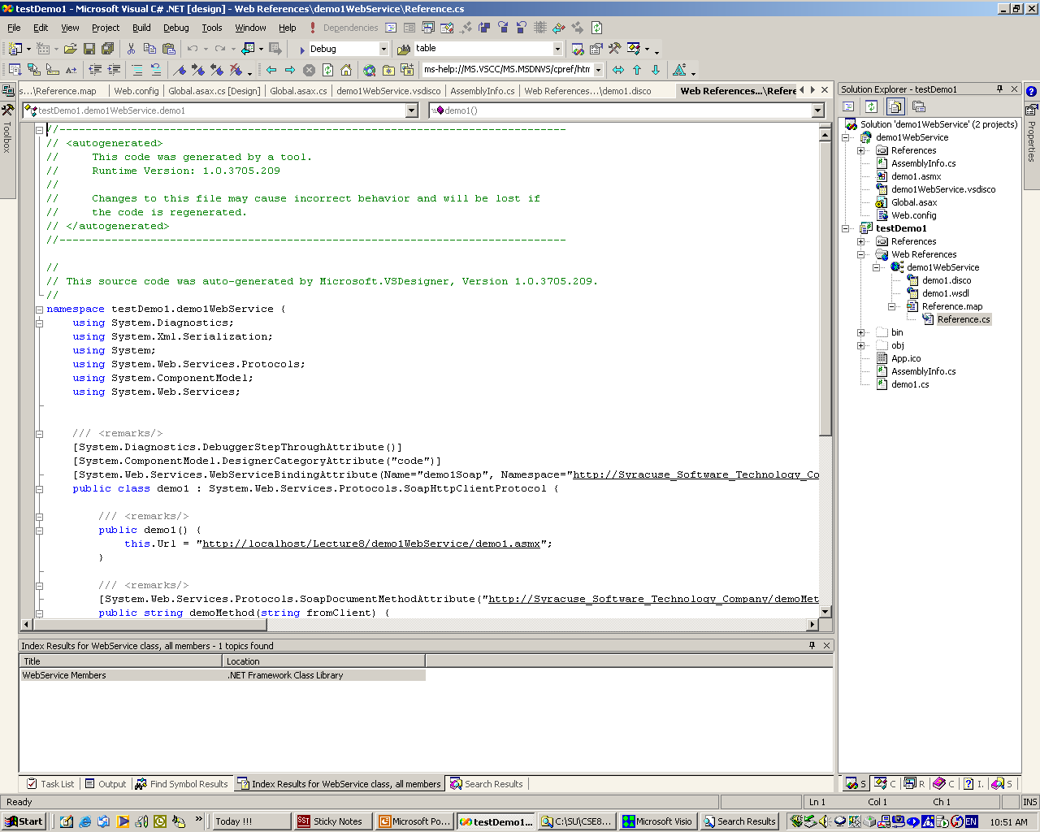
AutoGenerated Proxy
Created when you set a reference to web service

Slide 28
Web Services versus Remoting
Web Services:
  Can be used by any platform that understands XML, SOAP, and WSDL.
    Metadata (types) provided by WSDL
  Hosted by IIS and inherits ASP’s security model.
  Uses HTTP protocol so accessible by web pages and can pass through most firewalls.
  Can only pass a limited set of user-defined objects:
    Can’t serialize an object graph or all .Net containers.

Slide 29
Web Services versus Remoting
Remoting:
  Requires .Net platform on client as well as server.
  Requires custom security (notoriously hard to get right).
  Metadata provided by assembly.
    Can pass any .Net type, including object graphs and all .Net containers.
    Rich, but none portable types.

Slide 30
An Example
FileXferService
  Public Interface:
    string[] RequestFileNames();
    Byte[] RequestFile(string FileName);

Slide 31
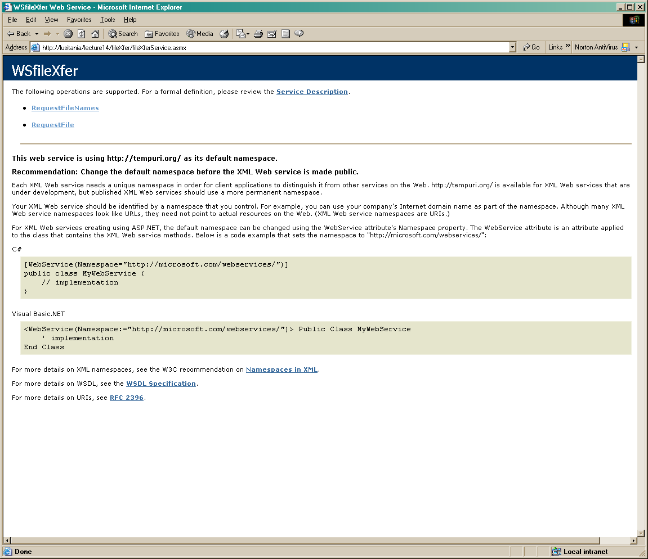
Browser View

Slide 32
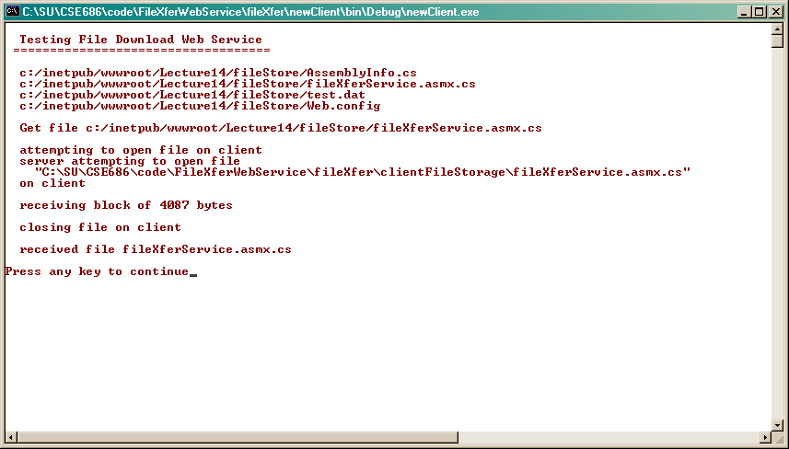
Client Application View

Slide 33
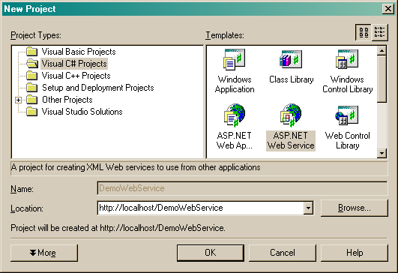
Creating a Web Service Project

Slide 34
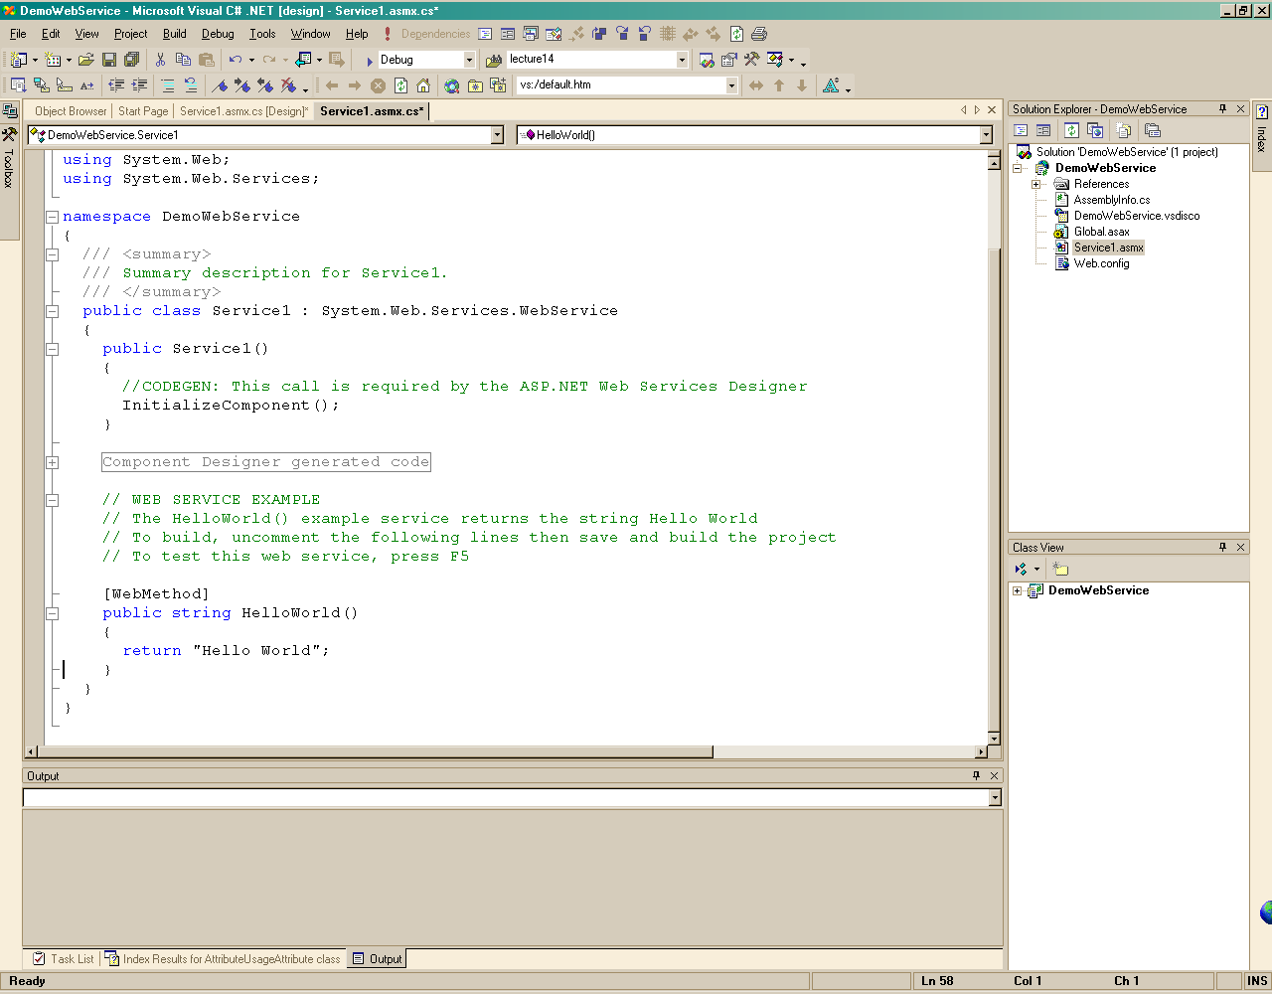
Resulting “Generic” Web Service

Slide 35
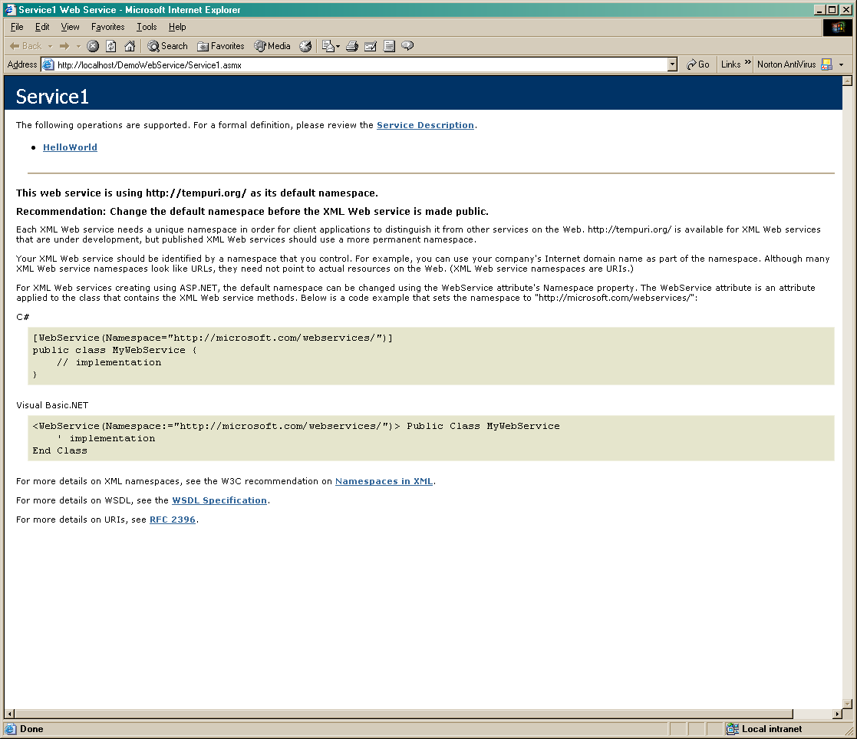
Resulting “Generic” Test

Slide 36
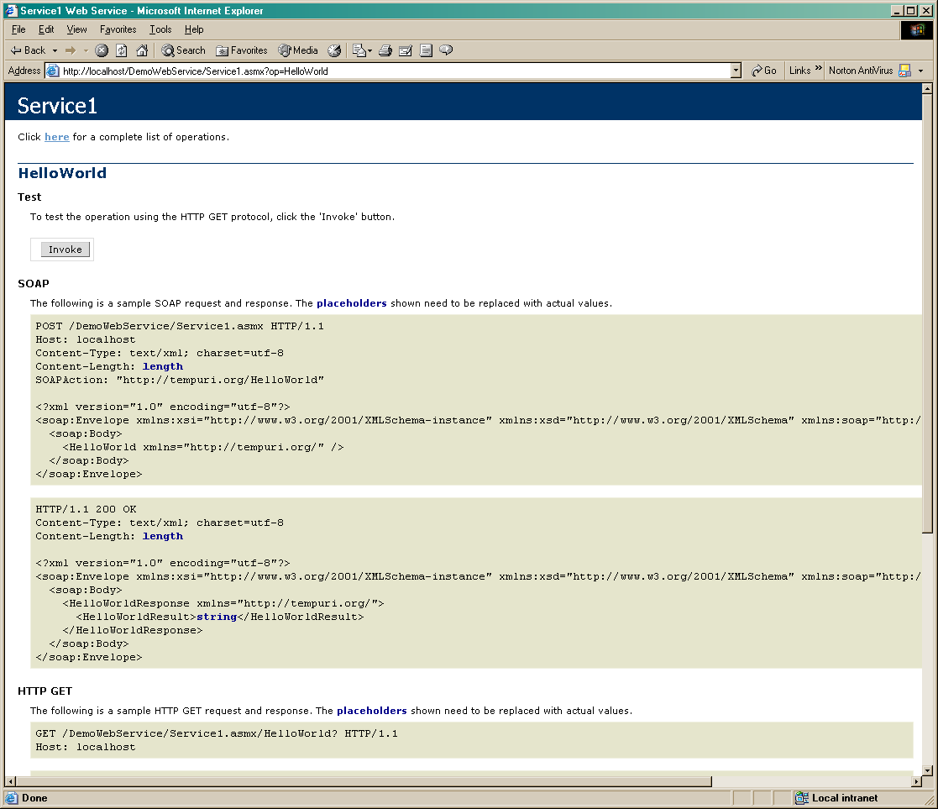
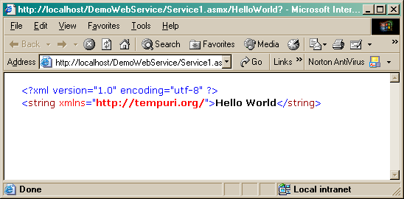
Sample Soap Request

Slide 37
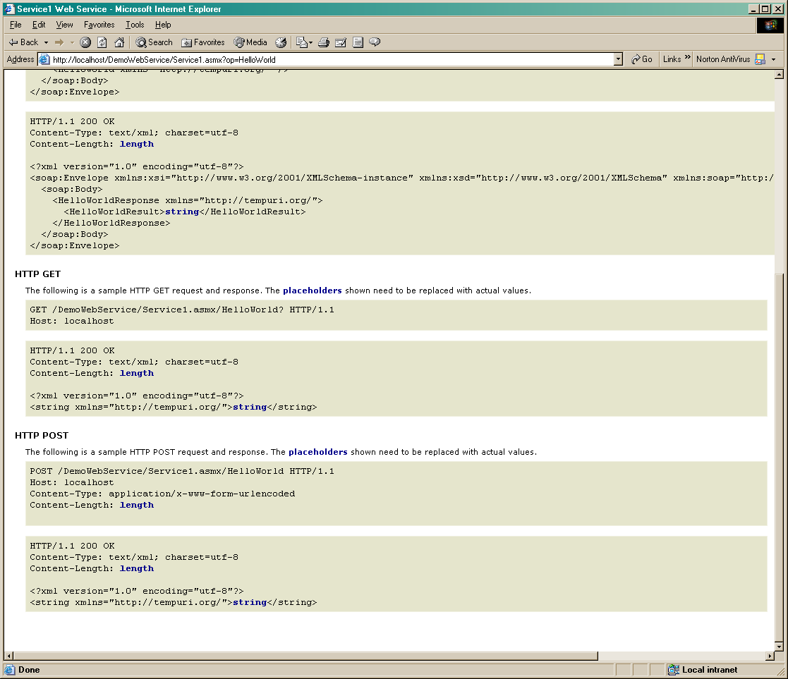
Sample “Generic” HTTP GET and POST

Slide 38
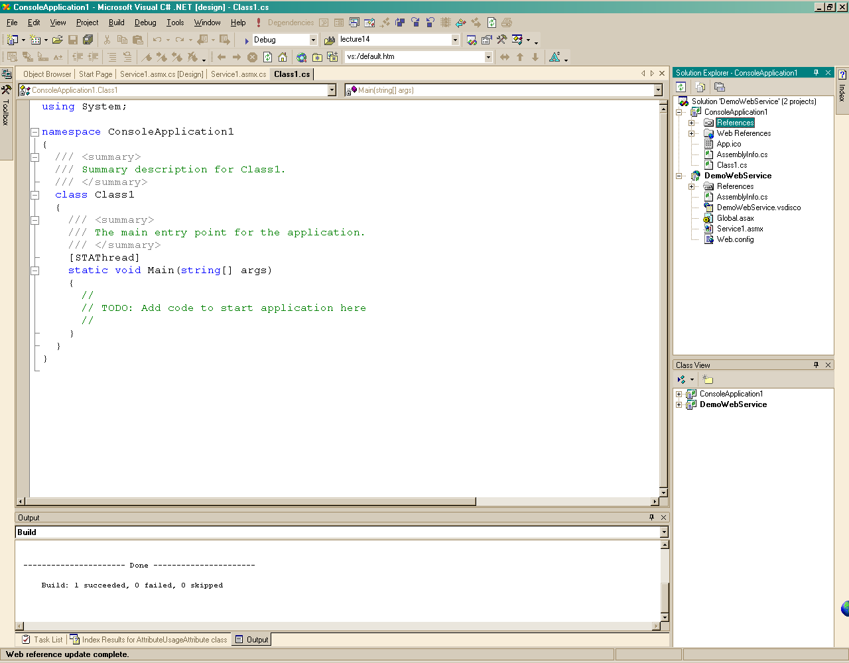
Create Console Client

Slide 39
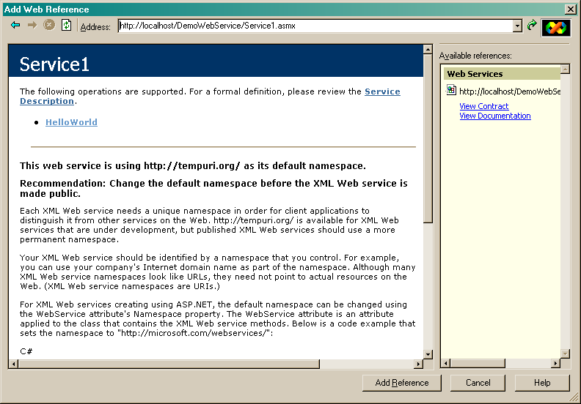
Adding a Web Reference
You have to locate the folder and asmx file, using explorer, then type in path here.

Slide 40
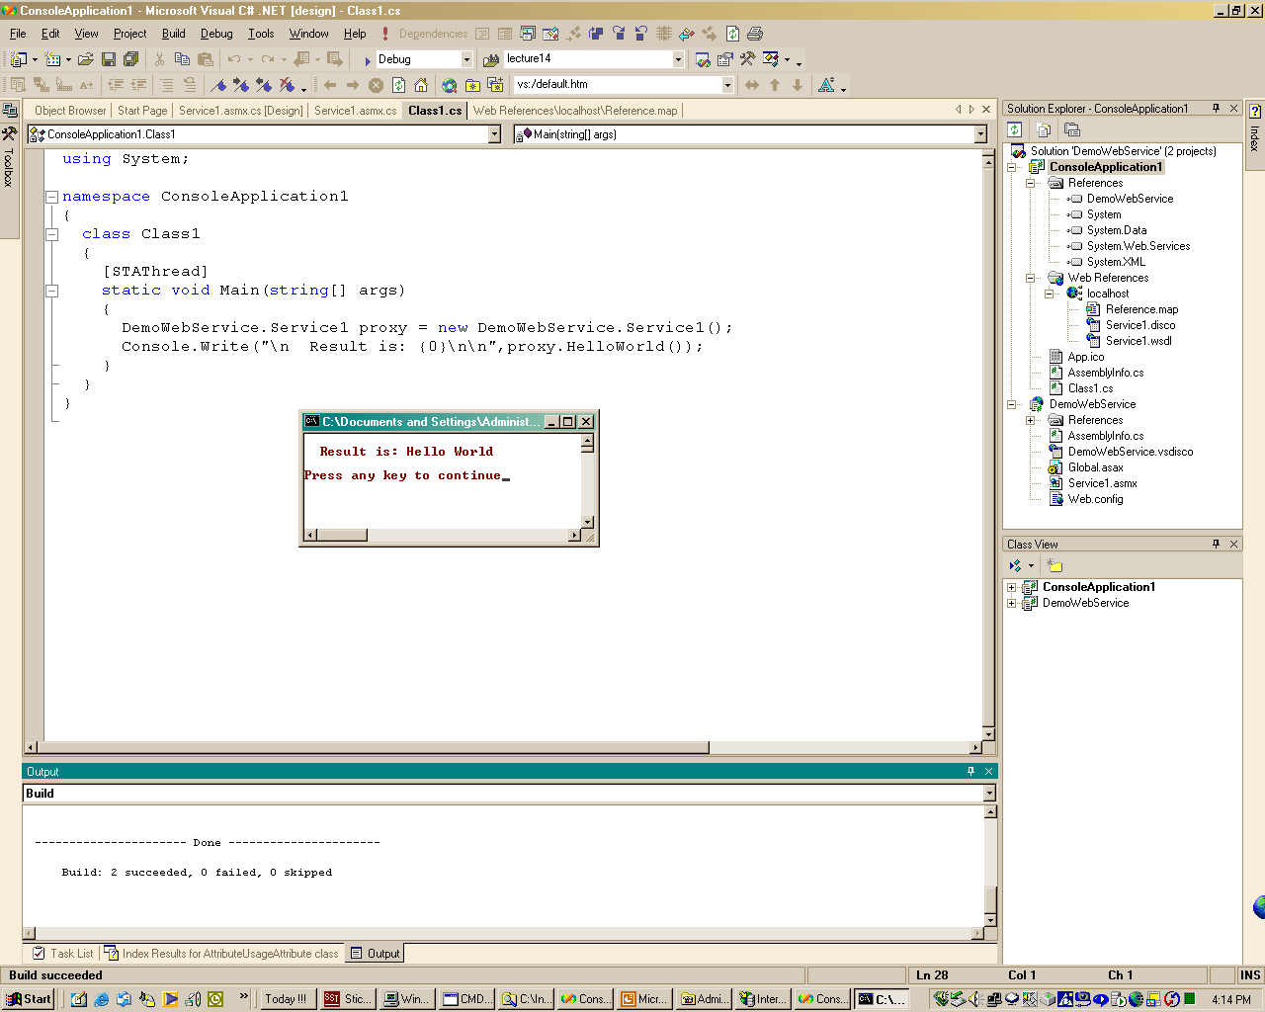
Client Accessing Web Service
Note:
You also need a reference to project so client knows about web service type.

Slide 41
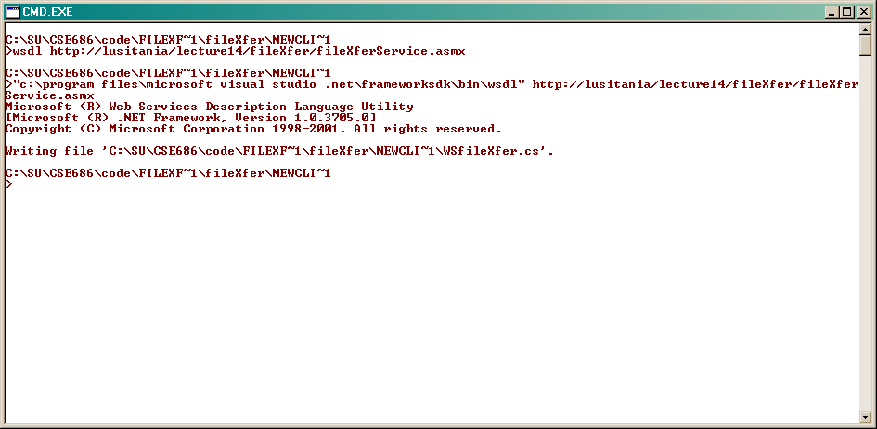
Create Proxy Source Code with WDSL.exe

Slide 42
Web Services
The End

