Slide 1
Database Programming in .Net The Relational Model
Jim Fawcett
CSE686 – Internet Programming
Summer 2005

Slide 2
Topics
Introduction to Relational Databases
Entity relationship model
Database design
Redundancy
Normal forms
Queries
Structured Query Language (SQL)
Brief Preview of .Net Data Object Model
DataReader : connected cursor
DataSet : disconnected table set

Slide 3
Introduction to Relational Databases
A relational database is composed of one or more (usually more) tables.
Each table consists of rows and columns.
A row is referred to as a record
A record refers to a single entity – person, place, or thing
Each record in the database is unique, no duplicates are allowed
A column is referred to as a field or attribute
a column holds a specified data type – an attribute of the record
Most tables define a primary key
The primary key is an attribute that serves to uniquely identify each record in the database.
An exception is a table used to describe a many-to-many relationship which contain two foreign keys, that is, primary keys of other tables (more later…).
Relationships are defined between tables.
A relationship is a unique association between two tables
Usually a column in one table is filled with (foreign) primary keys from the other table

Slide 4
Tables and Normalization
A database is partitioned into tables to reduce redundancy.
A Books database that uses a single table would reproduce publisher data and author data many times even though a book entity is only recorded once, as an author many have created more than one book and publishers have many books.
That wastes space.
Affords the possibility that the data becomes inconsistent, e.g., publisher data is recorded differently in different places.
An Author table that has a Book column, will need additional Books columns if the author has more than one book. How many Books columns should we use?
The table schema is now ambiguous.
These problems are resolved by using more tables, a process called Normalization.
There are three commonly used Normalization Forms, each designed to avoid one type of problem, liked those cited above.

Slide 5
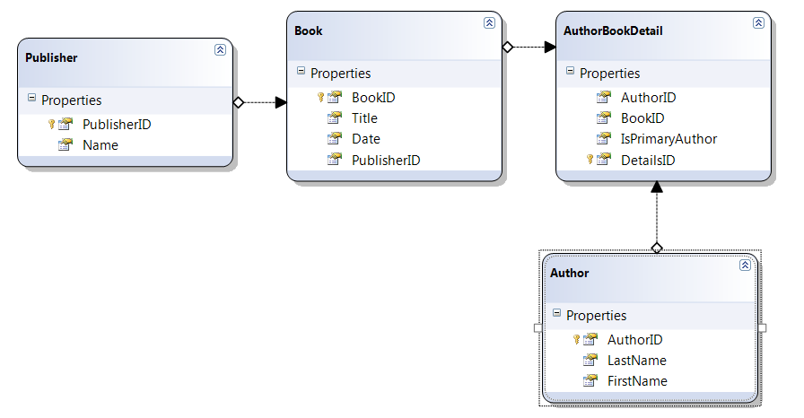
Book Database with four Tables

Slide 6
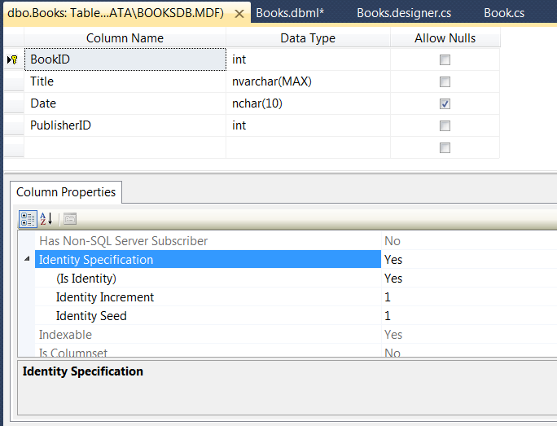
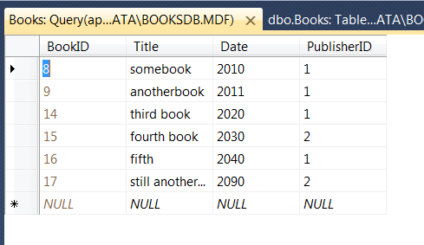
Table Details

Slide 7
Table Structure
A table represents a class of a certain kind of entity, e.g., a book, an author, or a publisher.
The first row represents the scheme of the table, e.g., its set of attributes. These attributes provide information about an entity
Book(Title, ISBN, Date, PubID)
Author(LastName, FirstName, Phone)
Publisher(Name, Phone)
Each row of the table, after the first, represents a unique entity, one specific book, author, or publisher.

Slide 8
Keys
A super key is a set of one or more attributes that serve to uniquely identify each entity in a table’s domain.
The domain of the table is the set of all possible entities that can be entered into the table. It is identified by the attributes of the table.
A key is a minimul super key. That is, if any attribute from the key set is removed the remaining set of attributes no longer uniquely identify each record in the table’s domain.
Usually a table’s key consists of a single attribute, e.g., BookID.

Slide 9
Relationships
A relationship exists between a book and its author(s). The book and author have a writtenBy relationship.
Each of the four tables in our Books database has one or more relationships with other tables in the database: Authors ←→ AuthorsBooks ←→ Books ←→Publishers
The AuthorsBooks table establishes a many to many relationship between authors and books. An author may write many books and a book may have more than one author.
Publishers have a one to many relationship with books. Each book has one publisher, but a publisher publishes many books.

Slide 10
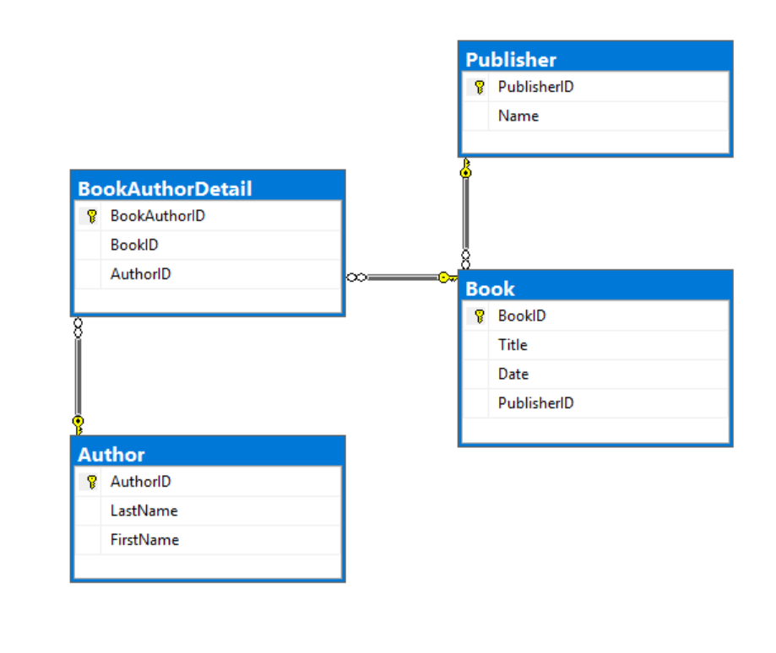
Relationships
Relation
Primary Key
Foreign Key

Slide 11
Representing Relationships
A relationship is represented between tables S and T in the database by making the primary key of T an attribute of the S table. We say that the T key is a foreign key in the S table.
The relationships between tables in the Books database is shown in an entity-relationship diagram on the next page.
Compare this diagram with the tables reproduced on the following page.
The AuthorsBooks table’s only purpose is to gracefully represent the many to many relationship between books and authors.

Slide 12
Books Database

Slide 13
Queries
A query expression represents a process for building a new (transient) table from data residing in other (permanent) tables.
The tables used to represent a databases entities are designed to minimize redundancy.
They do not necessarily present data the way a user may wish to view it.
Generating user friendly views are one thing queries do.
They also may be used to enter new data or modify existing data in the database.

Slide 14
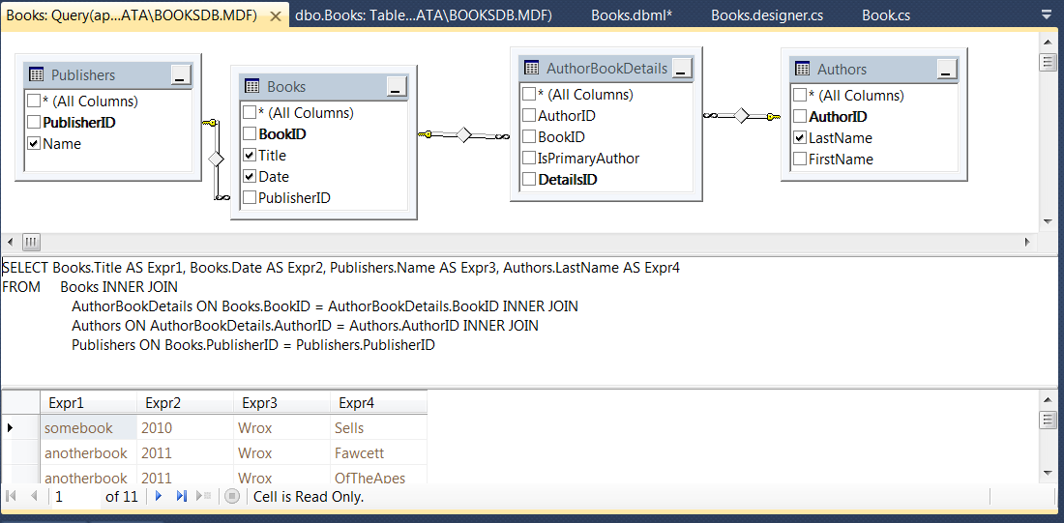
Query Build and Test

Slide 15
Structured Query Language (SQL) Basics
Uses English words keyed to their tasks:
SELECT: pick records for processing, SELECT * FROM Employees.LastName
WHERE: qualify the selection with specific attribute values SELECT * FROM Employees WHERE Pay > 50000
AND, OR: combining conjunctions WHERE Pay > 40000 AND Pay < 60000
IN: set inclusion, e.g., WHERE Employees.FirstName IN (‘Joe’, ‘Sam’)
ORDER BY: sort selected data, ORDER BY Employees.LastName
See SQL References on Lecture #7 webpage

Slide 16
SubQueries
You can create precise selections using subqueries:
SELECT * FROM Orders WHERE PartNum in (SELECT PartNum FROM Part WHERE Description LIKE “Road%”)
Here, Orders and Part are tables, PartNum and Description are attributes, and we are selecting Descriptions that have substring “Road”

Slide 17
SQL – Manipulating Data
You modify the data held in a database using:
INSERT: insert a new record with specified values, INSERT INTO Log (EmID, Date, Title, Message) VALUES (1, 6/30/2004, “More Stuff”, “blah blah blah”)
And insert multiple records, INSERT INTO TempTable SELECT * FROM Log
UPDATE: modify existing records UPDATE Employee SET Address = ‘Some New Street’ WHERE EmID = 3
DELETE: remove records from database DELETE FROM Employee WHERE City = ‘Hoboken’

Slide 18
SQL – Built in Functions
Some of the most useful SQL built in functions are:
COUNT: count the number of rows satisfying some condition, SELECT COUNT(*) FROM Logs WHERE EmID = 1
SUM: returns sum of all values in a column, SELECT SUM(Cost) FROM Order
AVG: returns average value of a column, SELECT AVG(Price) From Order
MAX, MIN: returns maximun or minimum value in a column, SELECT MAX(Price) From Order
GETDATE: returns current system date INSERT INTO Log (EmID, Date, Title, Message) VALUES (1, GetDate(), “More Stuff”, “blah blah blah”)

Slide 19
SQL – Altering Database Structure
Create database, table, query, and alter column type
CREATE DATABASE CSE686
CREATE TABLE Log ( LogID timestamp, EmID int, Date datetime, Title text, Message text);
CREATE VIEW LogAfter_Fawcett SELECT Date, Title, Message FROM Log WHERE Date < ‘6/28/2004’
ALTER TABLE Employees -> CHANGE Country Country char(12)

Slide 20
SQL Joins
Joins are selections from multiple tables. There are several kinds:
EQUI JOIN: combine matching records SELECT * FROM Employees, Log WHERE Employees.EmID = Log.EmID
INNER JOIN: Employees INNER JOIN Log ON Employees.EmID = Log.EmID
Also: Left Inner Join, Right Inner Join, outer Join, Left outer Join, Right outer Join, Full Outer Join

Slide 21
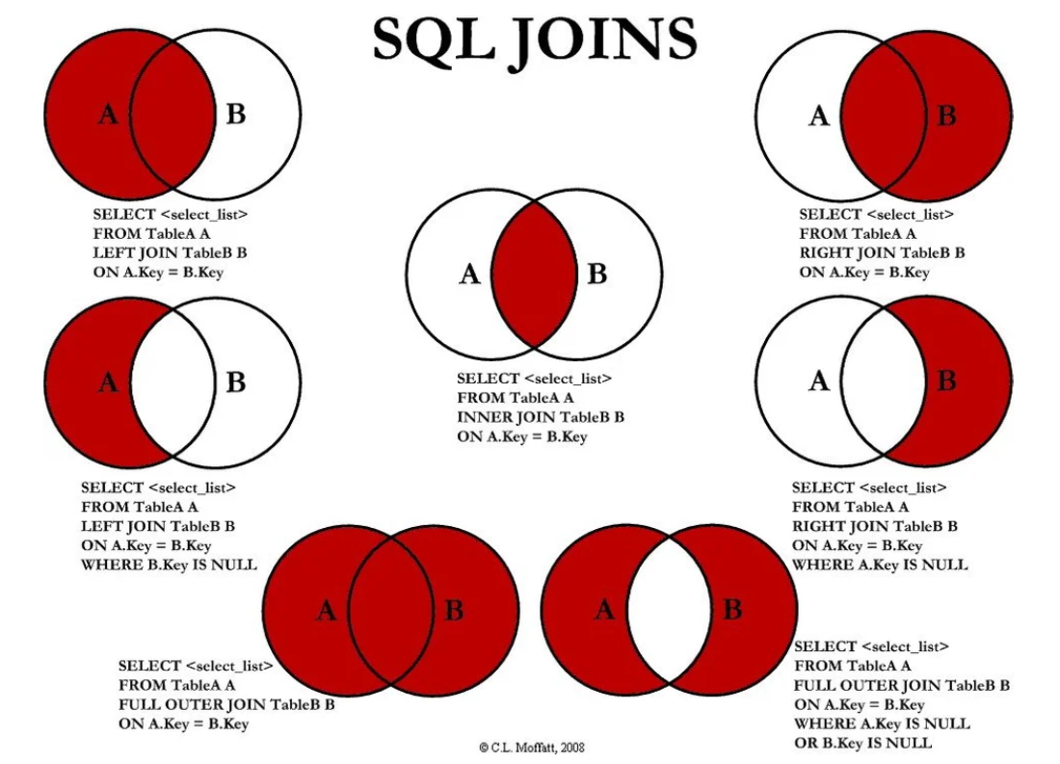
https://www.reddit.com/r/programming/comments/1xlqeu/sql_joins_explained_xpost_rsql/

Slide 22
Entity Relationship Diagram (ERD) Final Project – Internet Programming, Summer 2002

Slide 23
Creating an SQL Server Database
An SQL Server Database can contain:
Multiple tables with relationships between them
Structured Query Language (SQL) based queries
Can form joins of data from multiple tables
Forms which provide views of the database data
Extracts data from tables but can hide the table structure from clients
SQL Server supports a complete relational model with a fairly high performance engine, suitable for concurrent users.
If you only need to support a few, mostly non-concurrent users you can use Access.

Slide 24
SQL Server Management Studio
This section provides screen shots for building a multi-table database with relationships.
Download here: https://docs.microsoft.com/en-us/sql/ssms/download-sql-server-management-studio-ssms?view=sql-server-2017

Slide 25
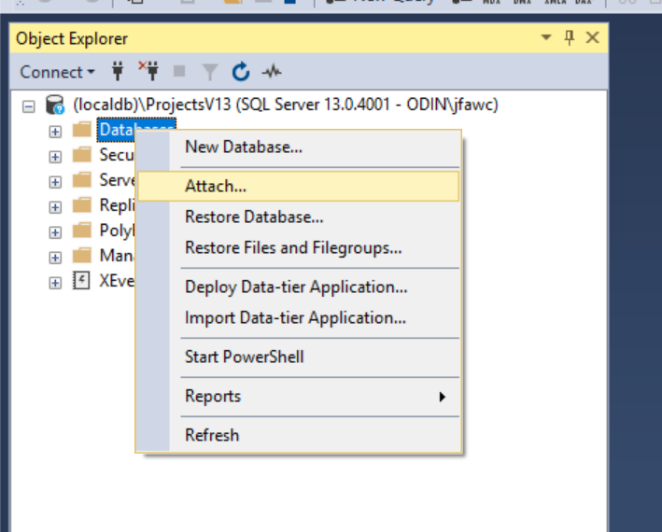
Attach to Existing Database

Slide 26
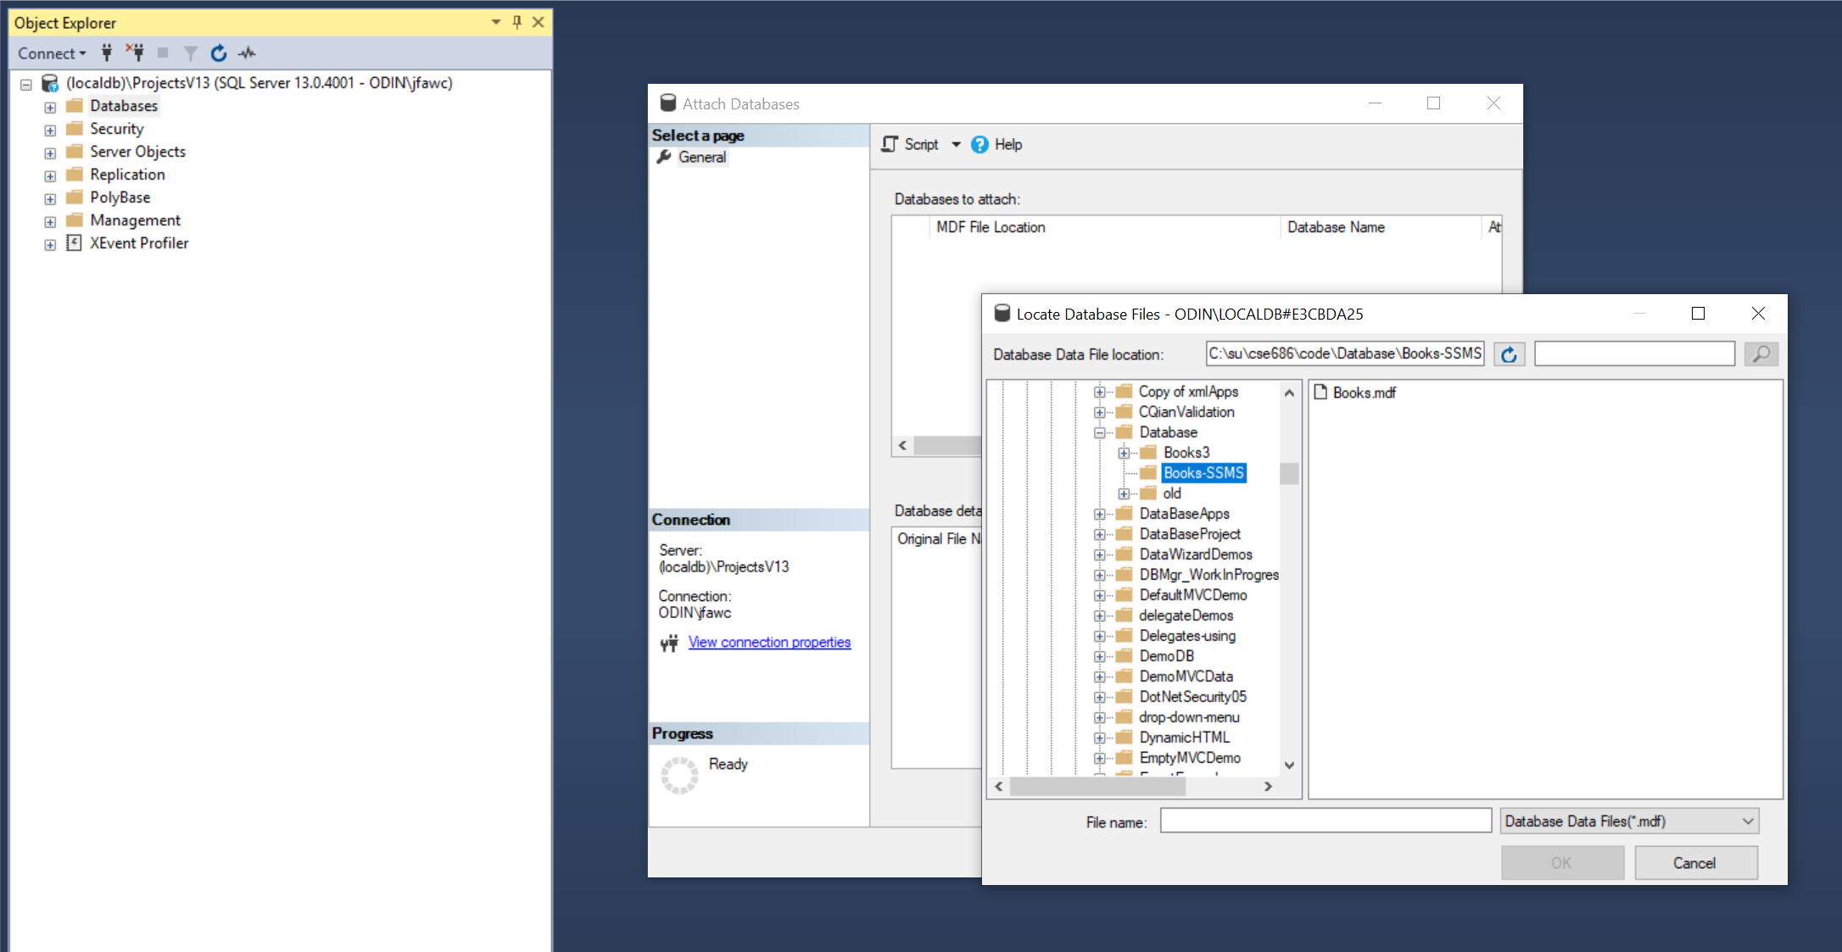
Attach to Existing Database

Slide 27
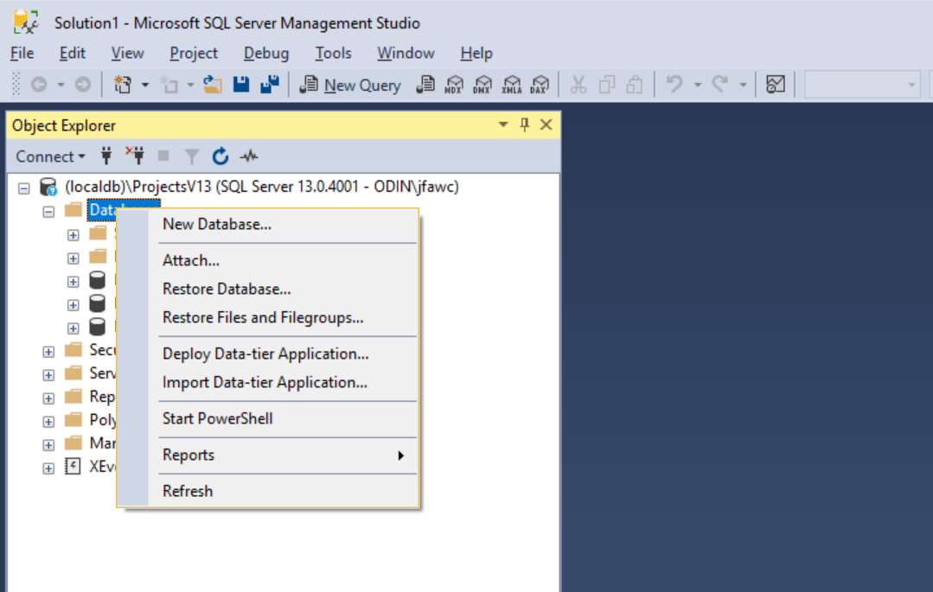
Creating a SQL Server Database

Slide 28
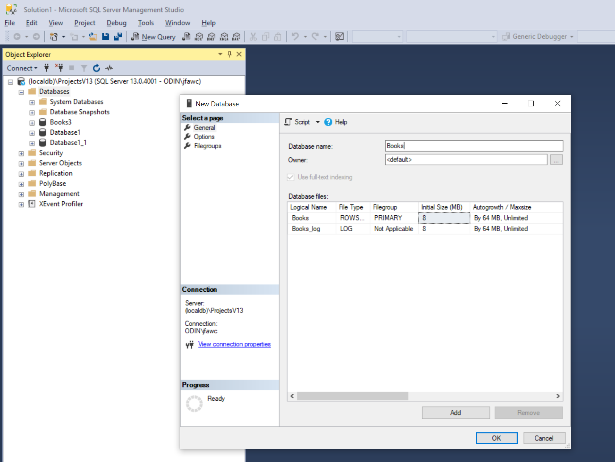
Add Database Books

Slide 29
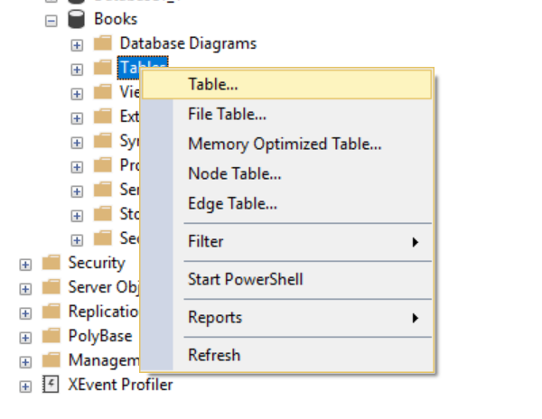
Add Table

Slide 30
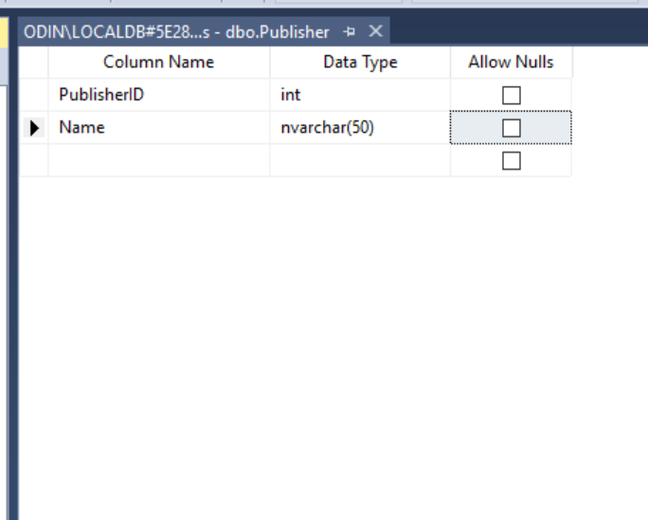
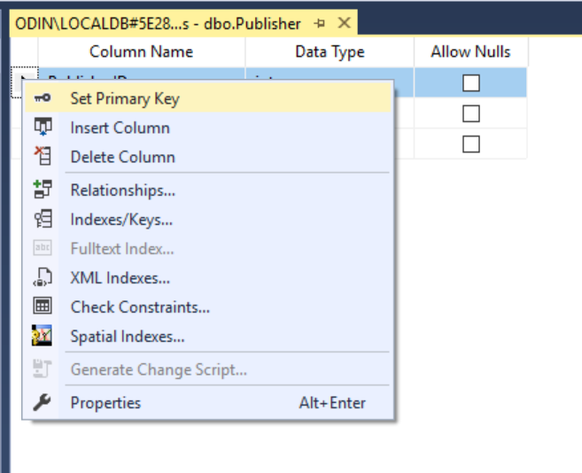
Set PublisherID as Primary Key

Slide 31
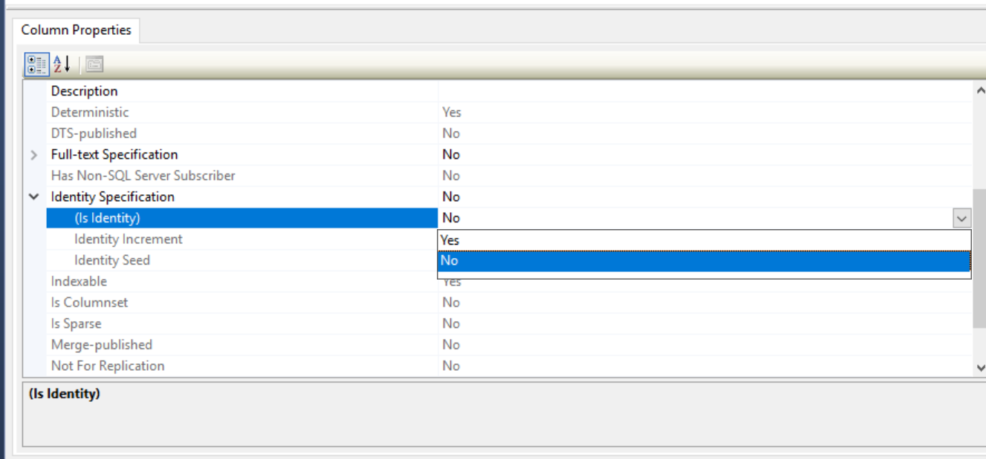
Set Key as Identity (auto generated)

Slide 32
Add Relationship
After creating two tables with appropriate keys, we can create a relationship between them.
Add a diagram, then drag the PublisherID key to Book table.

Slide 33
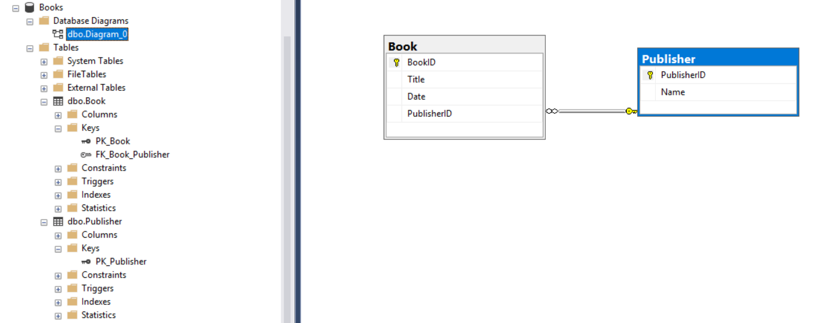
Resulting Foreign Key in Book Table
We now have a Foreign key in the Book table

Slide 34
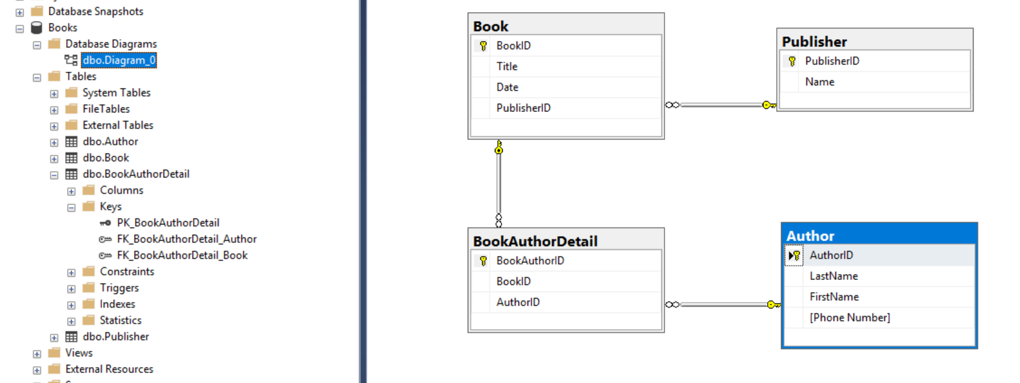
Many to Many Relationships
For many to many relationships we need a Details table with two foreign keys

Slide 35
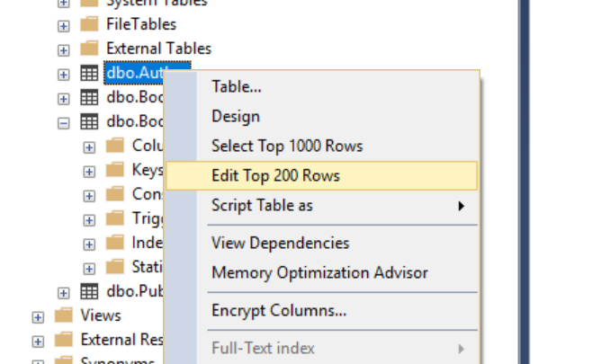
Adding Data to Table
Right-click on table and select Edit

Slide 36
Adding Data
Adding data to the Author table

Slide 37
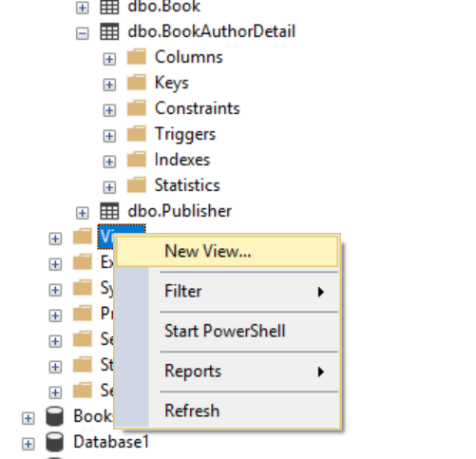
Views
Adding view to Books Database

Slide 38
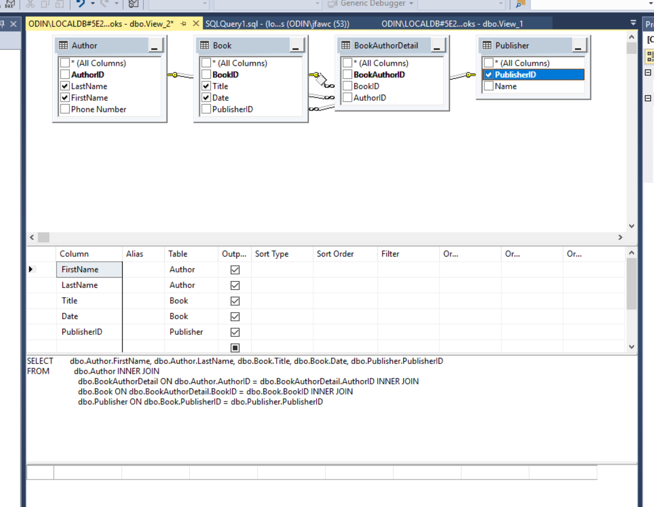
Specifying View

Slide 39
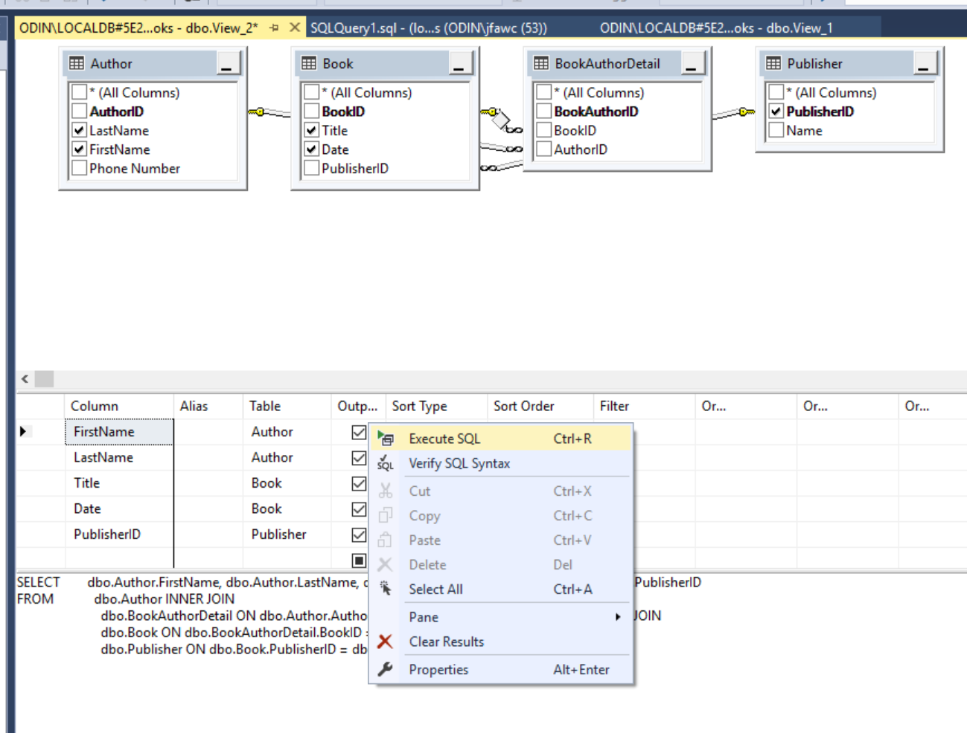
Executing View Code

Slide 40
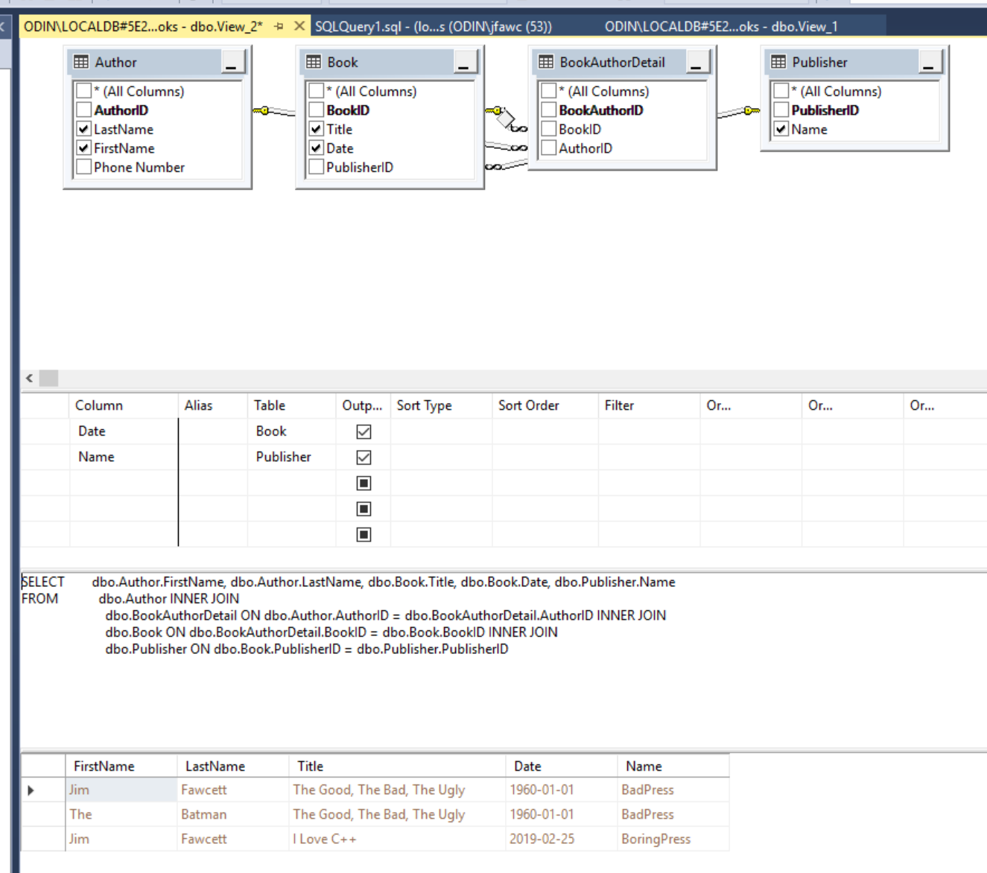
View Results

Slide 41
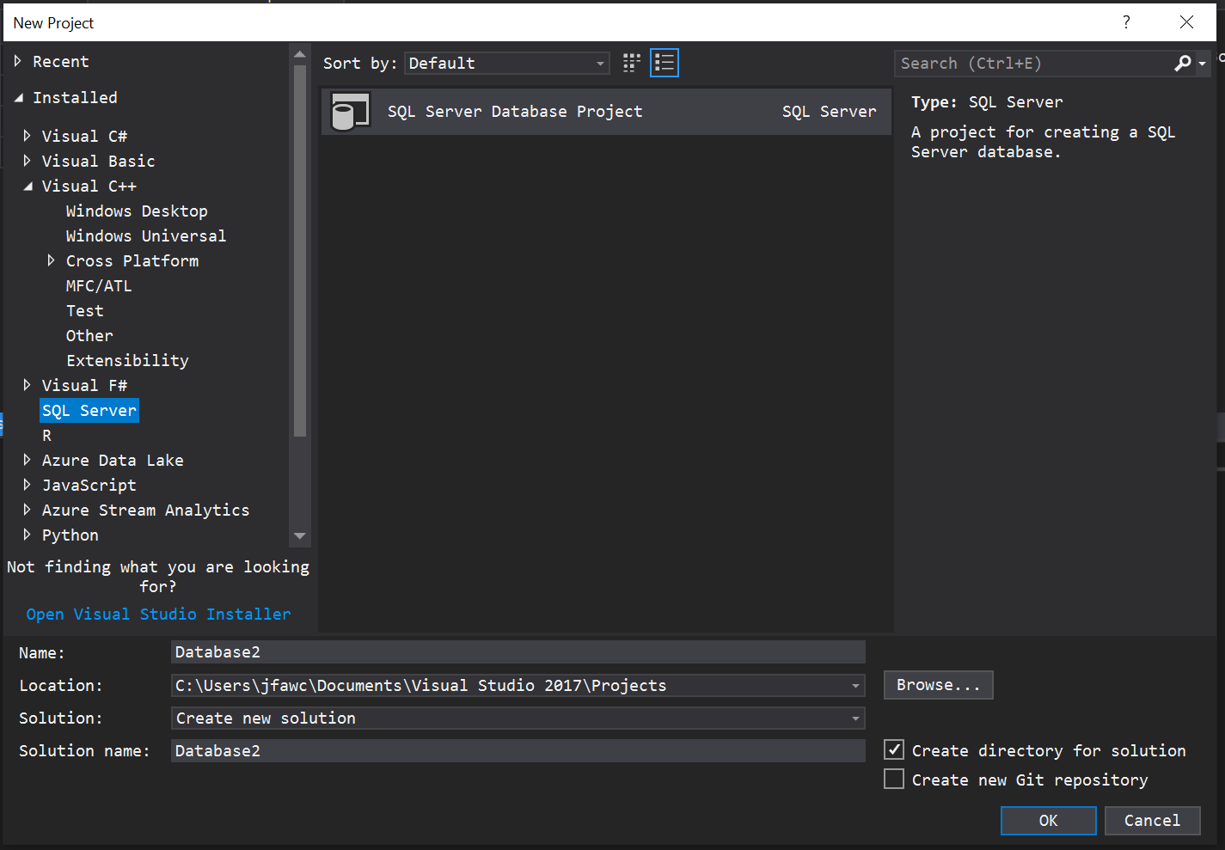
Creating DataBase Project in VS
The following slides provide screen shots for building a database in Visual Studio 2017

Slide 42
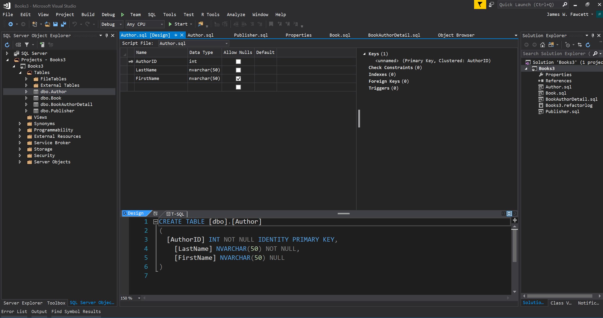
Database Project in Visual Studio
File > New Project > SQL Server
Add Tables with Tables context menu

Slide 43
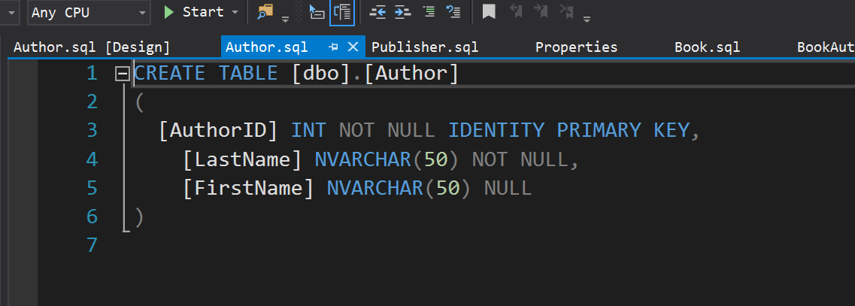
Adding Table
Adding Table puts you in Design View where you add columns.
That builds CREATE TABLE script.
You need to add properties like IDENTITY

Slide 44
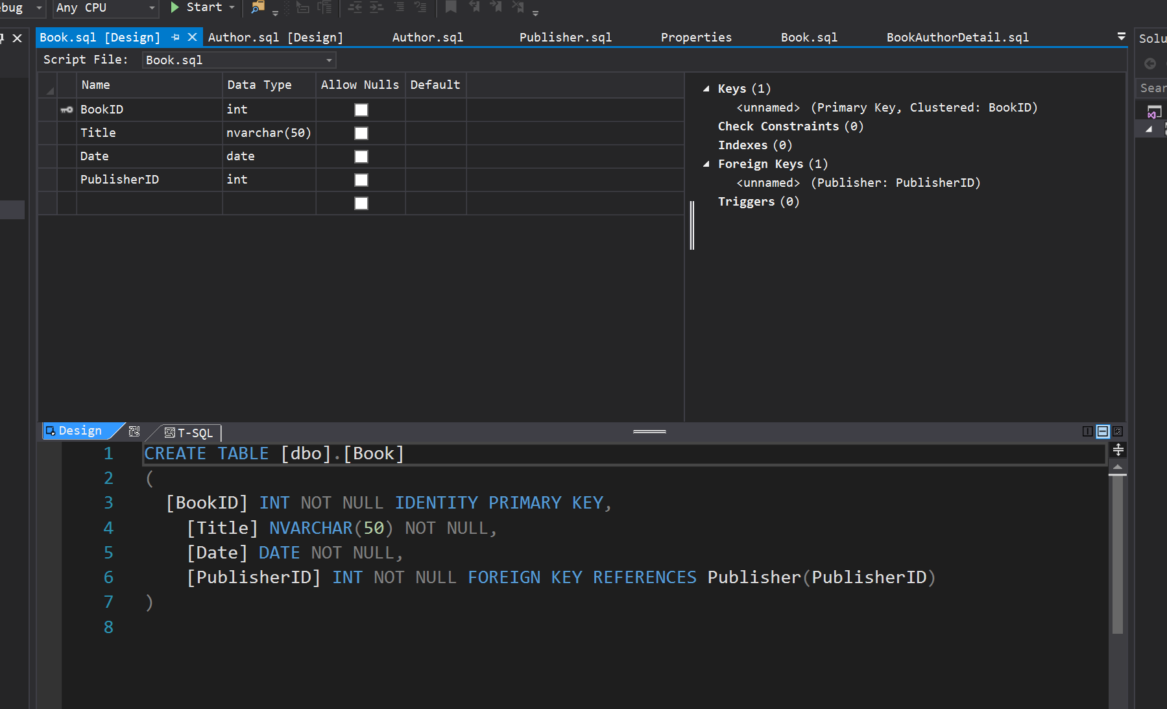
Relationships
Add attributes to the foreign key column

Slide 45
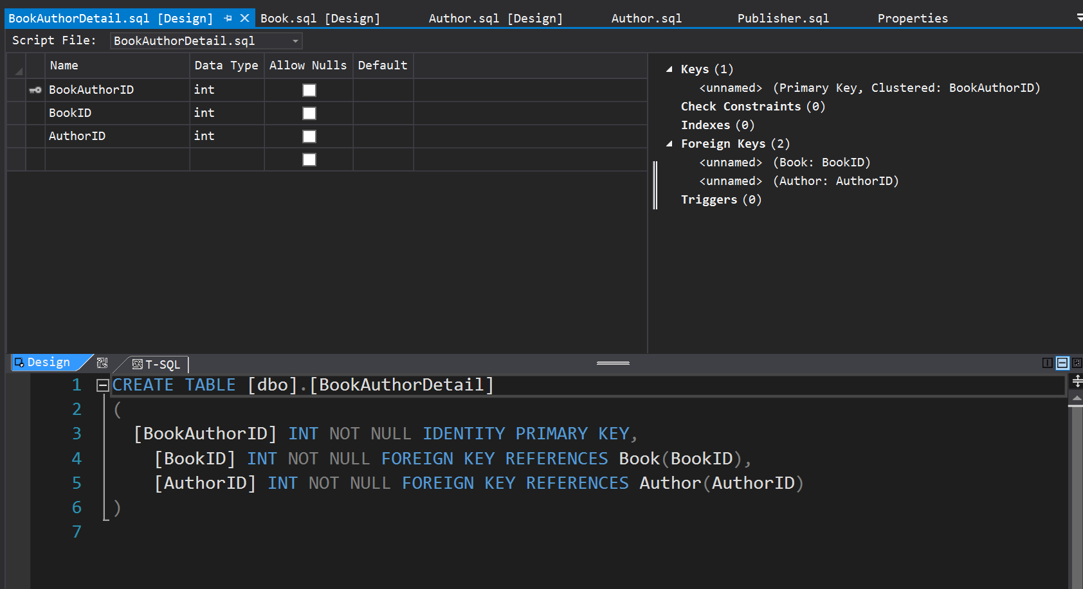
Many To Many Relationships
For many to many you simply provide two foreign keys and decorate their element scripts, as shown.

Slide 46
ADO.Net
Low-level support for DB management
Used by LINQ to SQL and Entity Framework

Slide 47
Support for Data in .Net
Connected data access:
Use Connection object and Command to connect a DataReader object to database and read iteratively.
Use Connection object and Command to connect a DataReader and execute an SQL statement or stored procedure.
Disconnected data access:
Use a Connection and Command to connect a DataAdapter to the database and fill a DataSet with the results.
Use a Connection and Command to connect a DataAdaptor to the database and then call Update method of the DataSet.

Slide 48
Data Provider Classes

Slide 49
ADO Objects

Slide 50
Connection Object
Methods
Open()
Close()
BeginTransaction()
Properties
ConnectionString

Slide 51
Command Object
Used to connect Connection Object to DataReader or a DataAdapter object
Methods
ExecuteNonQuery()
Executes command defined in CommandText property, e.g., UPDATE, DELETE, INSERT
ExecuteReader(CommandBehavior)
Returns a reader attached to the resulting rowset
ExecuteScalar()
Properties
Connection
CommandText
CommandType

Slide 52
Data Adapter Object
Used to:
extract data from data source and populate tables in a DataSet
Push changes in DataSet back to source
Methods
Fill(DataSet, Table)
FillSchema(DataSet, SchemaType)
Update()
Properties
SelectCommand
UpdateCommand
InsertCommand
DeleteCommand

Slide 53
DataSet Object
Used for Disconnected manipulation of a source’s data.
Methods
Clear()
ReadXML(XmlReader)
WriteXML(XmlWriter)
AcceptChanges()
HasChanges()
AbandonChanges()
Properties
Tables collection
ds.Tables[tableStr].Rows[3]["Responsible Individual"] = userID;
Relations collection

Slide 54
DataReader Object
Supports one-way, forward-only, access to data
Methods
Read()
Advances current row pointer
GetBoolean, GetInt16, GetChars, GetString, GetValue
Close()
Properties
this[string]
this[int]

Slide 55
References
Programming Microsoft .Net, Jeff Prosise, Microsoft Press, 2002
Access Database Design & Programming, Steven Roman, O’Reilly, 2002
Professional C#, Robinson et. al., Wrox Press, 2002
www.w3schools.com/sql/default.asp

