Slide 1
Introduction to Silverlight
Jim Fawcett
CSE686 – Internet Programming
Summer 2011

Slide 2
References
Silverlight Get Started
Quickstarts
Whitepapers
MSDN Documentation
Silverlight tutorials from wynapse
Interacting with HTML DOM and Javascript

Slide 3
What is Silverlight?
A system for drawing on web pages. It has:
A plug-in for Internet Explorer and the other most used browsers.
Hosts a slim CLR running code using a subset of the Framework Class Libraries
A control that sits on a web page (html or aspx).
Functionality provided by Xaml markup and code behind, using an event model similar to Javascript
Code-behind runs on the browser, not the server, in the plug-in’s slim CLR.

Slide 4
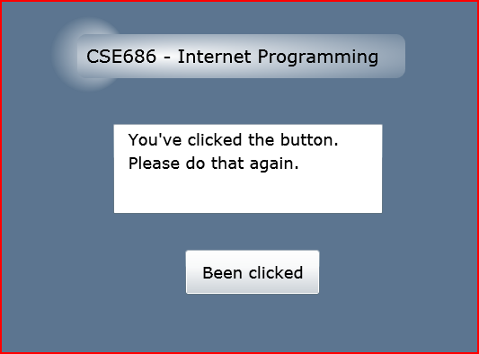
Drawing on Web Pages?
All of the content below is drawn with vector graphics.

Slide 5
Xaml?
<Border CornerRadius="10" Width="365" Canvas.Top="50" Canvas.Left="250">
<Border.Background>
<RadialGradientBrush GradientOrigin="0.25,0.5" Center="0.5,0.5“ RadiusX="0.85" RadiusY="0.85">
<GradientStop Color="#FF5C7590“ Offset="1" />
<GradientStop Color="White" Offset="0" />
</RadialGradientBrush>
</Border.Background> <TextBlock Text="CSE686 - Internet Programming“ Margin="10" FontSize="20" />
</Border>

Slide 6
Code-behind?
private void button1_Click(object sender, RoutedEventArgs e)
{
if (button1.Content.ToString() == "Click me")
{
button1.Content = "Been clicked";
textBox1.Text = " You've clicked the button.\n Please do that again.";
}
else
{
button1.Content = "Click me";
textBox1.Text = "";
}
}

Slide 7
Silverlight Processing Model
Silverlight works much like Javascript
Gets loaded with the page (html or aspx).
A parse tree that mirrors the Xaml is built and rendered
Events, like the button click in the previous slides, are processed by bindings between a silverlight control (the button) and an event handler, button1_click.
This works just like Javascript events, with no postback to the server.

Slide 8
Interactions with Asp.Net
Basically none!
Silverlight code-behind can call Javascript functions provided by the aspx page using HtmlDocument and HtmlPage classes from the System.Web.Browser namespace.
Silverlight code-behind can use a server-based web service or WCF.
So Silverlight can be:
A decoration on a page
A control that draws, e.g., a charter
An execution engine complementary to, but decoupled from Asp.Net

Slide 9
Using the Toolbox
You will find that when you pull controls from the Toolbox:
They drop onto the designer surface
They drop onto the Xaml display
You will probably add controls most often simply by writing the Xaml.
Intellisense is a big help for that.

Slide 10
Markup
XAML
eXtensible Application Markup Language
Tags are names of Silverlight classes
A subset of the .Net 4.0 Framework Class Libraries.
Attributes are class properties and events
<Grid> <Ellipse Fill=“blue” /> <TextBlock> Name: <TextBlock Text=“{Binding Name}” /> </TextBlock> </Grid>

Slide 11
Parse Tree
XAML gets rendered into a parse tree, just like XML – it is XML
Inherited properties are based on parent child relationships in the markup tree
Events bubble based on those relationships as well
You have direct and simple control over that structure
The world is yours!

Slide 12
Panels
Layouts, like the previous page can use:
Canvas
Simplest, placement relative to two edges
Uses absolute positioning, so takes contents out of flow of page
StackPanel
Horizontal or vertical stacking
Grid
Uses rows and columns
All of these can be nested, any one in another

Slide 13
Routed Events
Silverlight maps markup elements to UIElements, which derive from ContentControl
That means that almost everything can hold content, often multiple things.
How does a mouse click event on any one of a control’s content elements get routed to the control?
By walking the XAML parse tree until it finds a parent that handles that event (Routed Events).

Slide 14
Adding Event Handlers
You will find that property sheets show events.
But you can also add event handlers quickly:
Go to the XAML, type a space after the tag for the element you want to handle the event
That gets you a context menu (via intellisense) and you just double click on the desired event, which adds an event attribute

Slide 15
Property Syntax
Two syntax forms:
XAML attribute: <button ToolTip=“Button Tip />
Property Element Syntax: <Button> <Button.Background> <SolidColorBrush Color=“#FF4444FF” /> </Button.Background> Some Button Text </Button>

Slide 16
Inline Styles
Collections of property values:
<Button.Style> <Style> <Setter Property=“Button.FontSize” Value=“32pt” /> <Setter Property=“Button.FontWeight” Value=“Bold” /> </Style> </Button.Style>

Slide 17
Summary
Silverlight is a useful subset of WPF
Silverlight complements Asp.Net
Can be served on Asp.Net pages
Can not directly communicate with Asp.Net code.
Runs on browser in scaled-down CLR.
Can communicate with JavaScript
Can communicate with WCF hosted on Server

