Slide 1
Entity Core Framework
Jim Fawcett
CSE686 – Internet Programming
Spring 2019

Slide 2
Introduction
Entity Core Framework is:
Cross-platform: Windows, Linux, macOS
An Object Relational Mapper (ORM)
A wrapper that associates C# classes, that satisfy certain conventions, with relational database tables and their relationships.
A mechanism for:
building database instances from C# classes (Code First)
building C# models from existing databases (Data First)
auto generating SQL queries

Slide 3
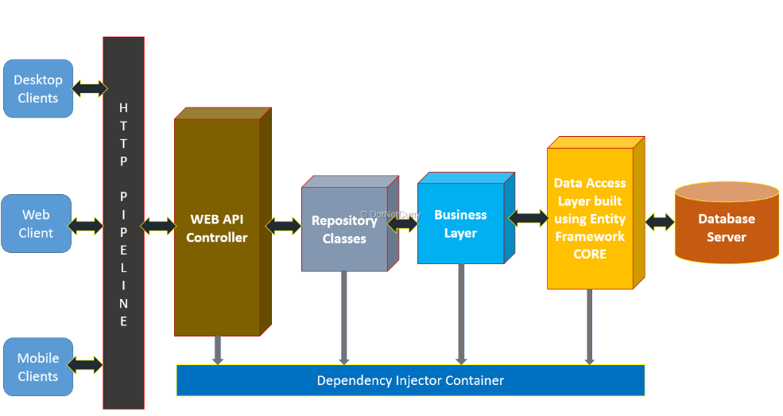
https://www.dotnetcurry.com/entityframework/1348/ef-core-web-api-crud-operations

Slide 4
Applications
Entity Core Framework can be added to:
a data agnostic application, e.g. a console application
An application that is scaffolded for data management, e.g., MVC web applications
EF is most frequently used for Asp.Net Mvc and Asp.Net Core Mvc applications.

Slide 5
Enabling Entity Framework
Create a C# Web Application and add EF scaffolding manually
That was how Mvc-Skeleton with CRUD using EF was built.
Create a C# Asp.Net Core Mvc Application with individual user accounts for Authentication.
That adds most of the EF scaffolding you need automatically.
That assumes that you have installed Visual Studio 2017 with the needed packages.
Some of the tutorials cited on the lecture page lead you through the process of installing anything that is missing.

Slide 6
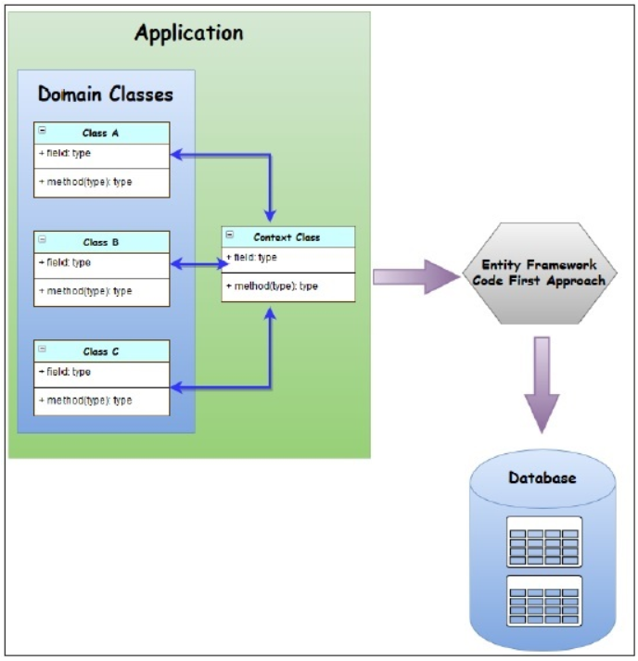
Code First
Define model classes in Models folder
Follow naming conventions to define keys
In nuget pkgmgr console:
Add-Migration [context]
Update-Database
Builds/updates database
https://www.tutorialspoint.com/entity_framework/entity_code_first_approach.htm

