Slide 1
Segments
I don’t expect to present any of these, but will make them available for students.
I will cite this resource during a lecture.
They will need them for their 3rd and 4th projects.

Slide 2
XML, XPath, and XSLT
Jim Fawcett
CSE 681 – Software Modeling and Analysis
Fall 2016

Slide 3
Topics
XML is an acronym for eXtensible Markup Language.
  Its purpose is to describe structured data
XPath is a language for navigating through an XML document.
  It’s used to select specific pieces of information from the document
XSLT is a language for transforming XML into something else.
  Often used to generate HTML or another XML document.

Slide 4
Introduction to XML
XML is a tagged markup language designed to describe data: LectureNote.xml
XML has only a couple of predefined tags
  All the rest are defined by the document designer.
  XML can be used to create languages
XML is commonly used to:
  Define data structures.
  Define messages
  Create web pages

Slide 5
Validation
To be correct XML a set of markup needs only to be well formed, see Well-Formed XML.
To determine if an XML document belongs to some document type, XML uses either:
  Document Type Definition (DTD)
  XML Schema
  XML that satisfies a Schema or DTD is said to be valid.
DTDs and Schemas define allowable tags, attributes, and value types, and may also specify where these may occur in the document structure.
  XML schemas are written in XML, DTDs are not.

Slide 6
XML Element
Elements are building blocks for XML documents
Element sytax:
  Elements are composed of tags, attributes, and a body:
  <tag *[attribName=“value”]>body</tag>
  example:
  <book author=“Prosise”>Programming .Net</book>
  All parts of the element are unicode text
  body may contain both plain text and markup, e.g. lower level elements.
  Tags and attributes are case sensitive and user defined.

Slide 7
Element Naming Rules
XML names are composed of unicode characters
  Tag names must begin with a letter or underscore
  Other tag name characters may contain characters, underscores, digits, hypens, and periods
  Names may not contain spaces nor start with the string “xml” or any case variant of “xml”.
  Attribute names follow the same rules as tag names, and are also required to be unique within the tag in which they are embedded.

Slide 8
Element Body Rules
Element bodies may contain plain text or markup or both.
  By plain text, we mean character strings with no markup.
  Markup is text with embedded markup characters:
    & < > ‘ and “
  Elements may also contain CDATA sections, designed to support text including large sections of markup characters but not interpreted as markup:
    <! [CDATA[ … ]]>
    These cannot be used to carry binary data.

Slide 9
Illegal Characters
Certain characters are reserved for markup and are illegal in names and payload text:
&lt; < less than
&gt; > greater than
&amp; & ampersand
&apos; ‘ apostrophe
&quot; “ quotation mark
We represent them in plain text with the escape sequences shown on the left, e.g.: &lt; if we want a less than character in payload text.

Slide 10
XML Structure
An XML document is defined by a standard opening processing instruction:
  <?xml version=“1.0”?>
  Processing instructions and comments are the only XML tags that are not closed (see next page)
The XML body starts with a single root element.
An element is text of the form:
<someTag anAttribute=“someValue”>payload text</someTag>
where the payload may be one or more child elements or simply text or both.
Comments take the form:
<!-- a comment -->

Slide 11
Well-Formed XML
XML has a few rules:
  There may be only a single root
  All tags, except for processing instructions, must be closed:
    <myTag someAttrib=“value”>…</myTag>
    <myTag someAttrib=“value”/>
  Attribute values must be quoted
  XML tags are case sensitive
  All markup and payload is text with one exception:
    An element may define a CDATA section
    CDATA is not parsed, and so may contain anything except the CDATA terminator

Slide 12
CDATA
A CDATA section has the syntax:
<![CDATA[ … ]]>
CDATA is not parsed except to look for the terminator “]]>” so it may containing anything.
  It is not a good idea to try to store binary data in a CDATA section because the “]]>” sequence could appear as part of the binary data.

Slide 13
XML Documents
An XML document is well-formed XML if it contains:
  A prolog: <?xml version=“1.0”?>
  An optional link to an XSLT stylesheet
  An optional reference to a DTD or schema, used for validation
  Optional processing instructions
  Optional comments
  A body with a single root, which may contain any number of text sections, elements, and comments
  An optional epilogue consisting of comments and processing instructions

Slide 14
Processing Instructions
Processing instructions are used to capture information for XML parsers and proprietary applications.
  Syntax: <? PI-target *[attrib=“value”]?>
The most common processing instructions are:
  Document banner:
  <?xml version=“1.0” encoding="utf-8"?>
  XSLT style-sheet reference:
  <?xml-stylesheet type="text/xsl" href="courses.xsl"?>
Other hypothetical instructions:
  <? robots index="no" follow="yes“ ?>
  <? word document=“aDoc.doc” ?>

Slide 15
Namespaces
Namespaces are declared with special attributes and prefixes:
  <tag xmlns:prefix=“uri”>body</tag>
  The uri should be unique, so current style is to use a url, e.g., www.ecs.syr.edu.
  These urls need not be bound to some real site.
  Attributes do not inherit the namespace of their element, so you need to do this:
  <tag xmlns:a=“uri” a:myAttrib=“value”>body</tag>
Namespaces are used to distinguish different elements that happen to have the same tag name, but are not intended to mean the same thing.
  Perhaps, they have different structures

Slide 16
Example
<?xml version=“1.0”?>
<!-- XML test case -->
<LectureNote course=“cse681”>
<title>XML Example #1</title>
<reference>
<title>Programming Microsoft .Net</title>
<author>
Jeff Prosise
<note company=“Wintellect”></note>
</author>
<publisher>Microsoft Press</publisher>
<date>2002</date>
<page>608</page>
</reference>
<comment>Description of PCDATA</comment>
</LectureNote>
LectureNote.xml
Webmonkey | Reference: Special Characters
Note: we can have both text and child nodes in the payload of an element.

Slide 17
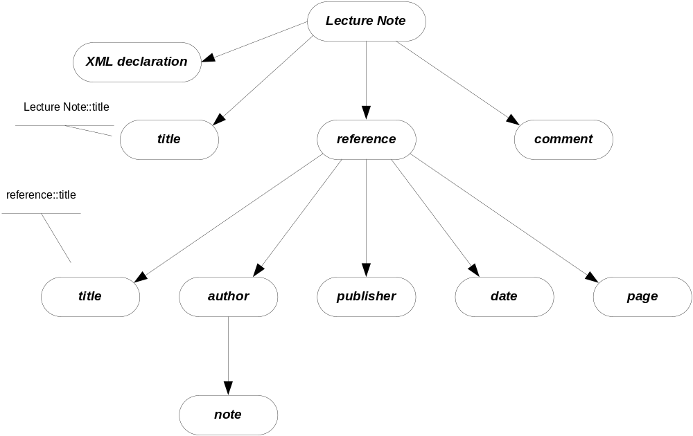
XML Node Structure

Slide 18
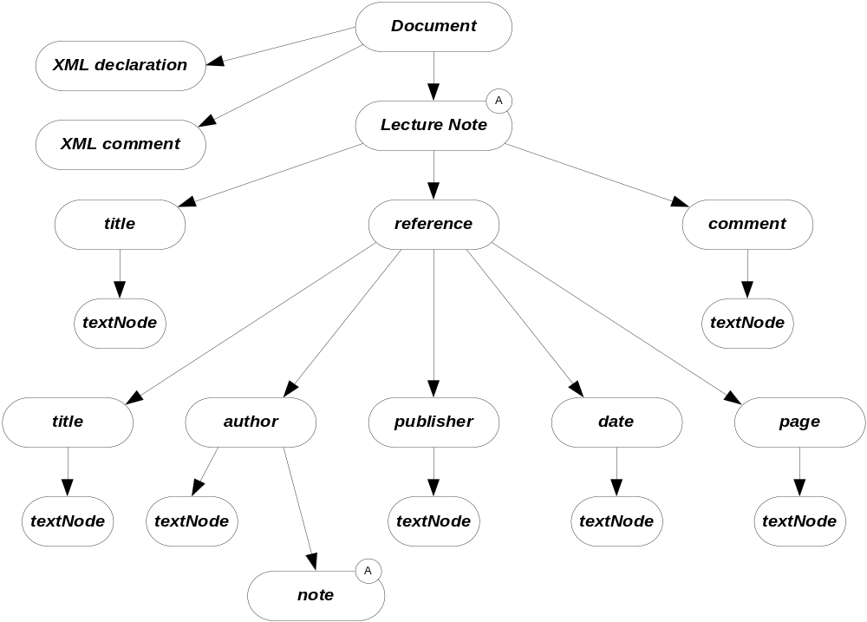
XML Parse Tree

Slide 19
XML Presentation
There are several ways XML data can be presented to a user:
  XML data island in an HTML page, interpreted by script
  XML file interpreted by script in an HTML page
  XML island or file bound to an HTML table
  XML file bound to a GridView control
  XML styled with an XSL style sheet
    Essentially, the XSL sheet creates viewable HTML
  Read, interpreted, and modified by an application
    The .Net System.XML library provides very effective support for this.

Slide 20
Introduction to XPath
XPath provides a navigation facility within XML documents
  XPath is used to extract specific information from XML documents:
      In XSL style sheets
        <xsl:template match=xpath expression>
        <xsl:for-each select=xpath expression>
        <xsl:value-of select=xpath expression>
        <xsl:apply-templates select=xpath expression>
      In C# programs that use the XML DOM
        XmlNode.SelectSingleNode(xpath expression)
        XmlNode.SelectNodes(xpath expression)
      In Javascript code

Slide 21
XPath Components
XPath syntax contains the following components:
  Steps
    A directory like syntax for defining elements and attributes at some specified level
      /customers/customer/lastName
      /customers/customer[@status = current]
  Descent Steps
    Steps that may occur at any level in an XML structure
      //lastName
  Filters
    Elements or attributes that must be present to result in a match
    /customers/customer[country]
  Predicates
    Condition that must be met to result in a match
    /customers/customer[country=“United States of America”]

Slide 22
XPath Node Set Functions
XPath provides a number of functions that operate on sets of nodes:
  count()
    the number of nodes in a set
    /customers/customer[count(order) = 1], e.g., customers with only one order
  position()
    position returns the position of an XML node in a set of nodes:
    /customers/customer[position() = 1], e.g., first customer
  last()
    Returns the ordinal of the last node in a set
    /customers/customer/order[position() = last()], e.g., last order of each customer

Slide 23
XPath String Functions
XPath has three commonly used string functions:
  contains()
    Returns true if string in first argument contains the second
    //customer[contains(jobTitle,”chief”)]
  string-length()
    Returns integer number of characters in string
    //customer[string-length(lastName) > 3]
  substring()
    substring(str,start,length) returns substring of str starting at character start with number of characters equal to length
    //customer[substring(city,0,3) = “Los”]

Slide 24
Other XPath Functions
XPath number functions:
  sum()
    sum(products/product/price)
Boolean functions
  false()
  true()
  not()
    //customer[not(count(orders) = 0)]

Slide 25
XPath Expressions
XPath supports numerical, boolean, and comparison expressions:
  create complex predicates
  //customer[count(orders) > 0 and State = “California”]
XPath unions
  return the union of two node sets
  //books | //articles

Slide 26
XPath Axes
XPath axis specifies the direction of node selection from the context node:
  child
    Child nodes of the context node
  parent
    Parent node of the context node
  ancestor
    All ancestors of the context node
  descendent
    All decendents of the context node
  attribute
    Attributes of the context node

Slide 27
Axes Examples
/customer/lastName
  /child::customer/child::lastName
//firstName
  desendant::firstName
//drive/@letter
  //drive/attribute::letter
//file/../@name
  //file/parent::folder/@name
//folder[parent::folder and not(child::file)]
  Subdirectories with no files

Slide 28
Introduction to XSLT
XSLT is an acronym for eXtensible Stylesheet Language – Transform.
Designed to transform an input XML parse tree into a parse tree for the output – often XML or HTML.
The transformations are defined as templates in a stylesheet, with extension xsl.
.Net provides several classes to support this operation.

Slide 29
XSLT Template Processing
<xsl:template match=XPath expression>
// processing defined for the
// matching node set
</xsl:template>
Processing consists of:
  Literals that are sent directly to the output
  Templates with their results sent to the output
An XSLT stylesheet can have an arbitrary number of templates.
Templates are processed at two points in time:
  When the transformation is first invoked.
  Whenever <xsl:apply-templates /> is encountered during processing.

Slide 30
apply-templates
<xsl:apply-templates />
The current selection is matched against all templates in the stylesheet.
Each match executes the matching template’s processing.
The results are sent to the output.

Slide 31
for-each
<xsl:for-each select=XPath expression>
// processing for selections
</xsl:for-each>
Each element of the matching node set is processed according to the body of the template.
Results are sent to the output.

Slide 32
value-of Template Instruction
<xsl:value-of select=XPath expression />
Returns the value of the selected node
The selection is from the context defined by the template selection (see previous slide).

Slide 33
Example
The links, below, refer to an example of XSLT processing, executed on a web server, to render a webpage based on contents of an XML file:
  www.ecs.syr.edu/faculty/fawcett/handouts/cse686/code/XSLTdemo/XSLTdemo.aspx
  www.ecs.syr.edu/faculty/fawcett/handouts/cse686/code/XSLTdemo/XSLTFile.xsl
  www.ecs.syr.edu/faculty/fawcett/handouts/cse686/code/XSLTdemo/XMLFile_NoStyleLink.xml
Other references for XSLT
  www.w3schools.com/xsl/xsl_languages.asp
  http://www.zvon.org/xxl/XSLTutorial/Books/Book1/
  http://directory.google.com/Top/Computers/Data_Formats/Markup_Languages/XML/Style_Sheets/XSL/FAQs,_Help,_and_Tutorials/

Slide 34
End of Presentation

