Slide 1
Programming with C#
Jim Fawcett
CSE681 – SW Modeling & Analysis
Fall 2018

Slide 2
Overview
Terminology
Managed Code
Taking out the Garbage
Interfaces
Application Domains

Slide 3
Terminology
CLI: Common Language Infrastructure
  CTS: Common Type System, the .Net types
  Metadata: type information in assembly
  VES: Virtual Execution System - provided by CLR
  IL: Intermediate Language
  CLS: Common Language Specification.
    Core language constructs supported by all .Net languages.
CLR is Microsoft’s implementation of CLI.

Slide 4
Managed Code
CLR provides services to managed code:
  Garbage collection
  Exception handling
  Type discovery through metadata
  Application domains and contexts
    Fault isolation
    Interception
      Security management
      Attributes

Slide 5
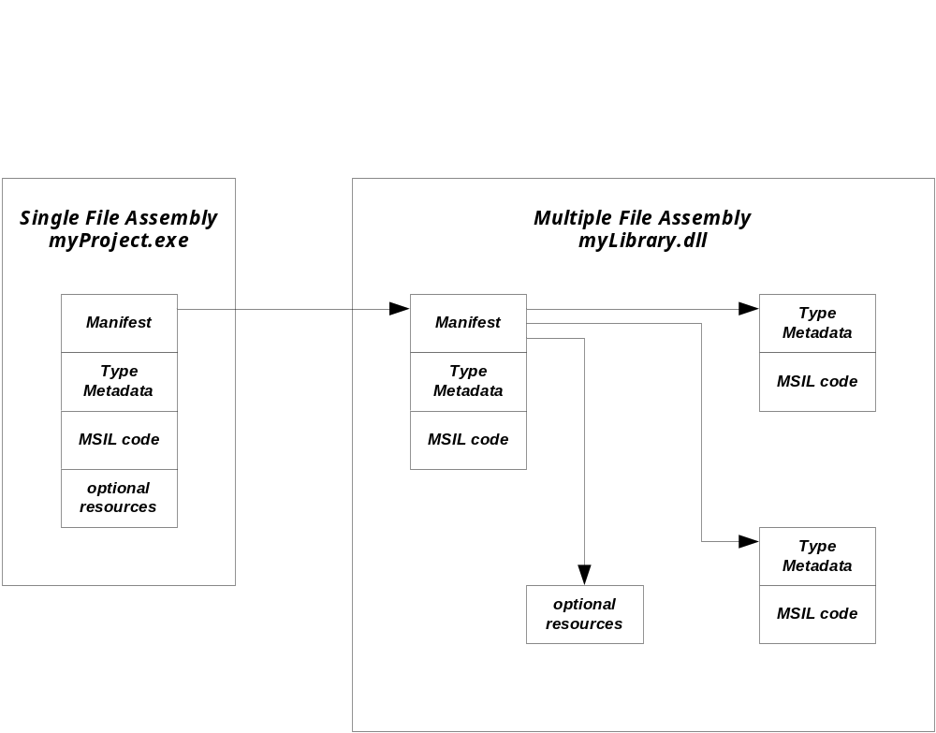
.Net Assembly Structures

Slide 6
Accessing Type Information based on metadata
Type t = obj.getType();
Type t = Type.getType(“StringBuilder”);
Type t = typeof(int);
Bool query = myObj is baseType;
  Returns true if myObj derives from, or is, the baseType, else returns false
string str = obj as string;
  Attempts to cast obj to type string
  If obj is compatible to string, it is assigned to str
  If not, then str = null
string str = (string)obj;
  If obj is convertible to string, its conversion is assigned to str
  If not, an exception is thrown.

Slide 7
Taking out the Garbage
All .Net languages, including C# use garbage collection
Garbage collection is a multi-tiered, non-deterministic background process
  Three tiers
  Objects in lowest tier are checked for active references often. If no references, then the object is finalized and memory returned to the process.
  Objects in the second tier are checked once every ten times the lowest tier is collected.
  Objects in the third tier are checked once every one hundred times the lowest tier is collected.
  If objects are large or have lived for a while, they are likely to be moved to a higher tier.
You can’t deallocate resources immediately when objects go out of scope.

Slide 8
More about Garbage
C# provides destructors which implement Finalize() for disposing of unmanaged resources.
  Destructors allow you to tell the garbage collector how to release unmanaged resources.
You should Implement
IDisposable::Dispose()
  Users of your class can call it’s Dispose() to support early release of unmanaged resources, but they have to remember to do so.
  Your dispose should call Dispose() on any disposable managed objects aggregated by your class and unregister event handlers.
  Your member functions should call Dispose() on any local disposable managed objects.

Slide 9
Implementing Dispose()
Here’s the standard way:
public void Dispose()
{
Dispose(true); // garbage collector calls Dispose(false)
GC.SuppressFinalize(this);
}
private void Dispose(bool disposing)
{
if(!this.disposed)
{
if(disposing)
{
// call Dispose() on managed resources.
}
// clean up unmanaged resources here.
}
disposed = true; // only call once
}

Slide 10
Minimizing Garbage
If you have local managed objects in frequently called methods, consider making them members of your class instead.
Using member variable initializers is convenient:
class X
{
private: arrayList col = new ArrayList();
…
}
but don’t if col may be reinitialized to something else in a constructor. That immediately generates garbage.

Slide 11
Try - Finally
Managed classes that use unmanaged resources:
handles, database locks, …
Implement Dispose() and Finalize() to provide for early, and ensure eventual, release of these resources.
But Dispose() may not be called if the using code throws an exception. To avoid that, catch the exception and use a finally clause:
try { /* code using disposable x */ }
catch { /* do stuff to process exception */}
finally { x.Dispose(); }

Slide 12
The using short-cut
C# provides a short cut for try-finally:
using(x) { /* use x object */ }
is equivalent to:
try { /* use x object */}
finally { x.Dispose(); }
You can’t have multiple objects in the using declaration. You will need to nest the using statements to handle that case. It’s probably easier just to use try-finally if you need to dispose multiple objects.

Slide 13
Interfaces
Abstract class provides the root of a class hierarchy.
Interface provides a contract:
it describes some small functionality that can be implemented by a class.
Interfaces can declare all the usual types:
  Methods, properties, indexers, events.
Interfaces can not declare:
  Constants, fields, operators, instance constructors, destructors, or types.
  Static members of any kind.
Any type that implements an interface must supply all its members.

Slide 14
Using Interfaces
Functions that accept and/or return interfaces can accept or return any instance of a class that implements the interface.
These functions bind caller to a contract, not to a specific class hierarchy.

Slide 15
Implementing Interfaces
.Net languages support only single inheritance of implementation, but multiple inheritance of interfaces.
Members declared in an interface are not virtual.
  Derived classes cannot override an interface method implemented in a base class unless the base declares the method virtual.
  They can reimplement it by qualifying the method signature with new.
  This hides the base’s method, which is still accessible to a client by casting to the interface.
  Hiding is generally not a good idea.

Slide 16
Overrides vs. Event Handlers
Prefer overriding an event handler over subscribing to an event delegate.
  If an exception is thrown in an event handler method the event delegate will not continue processing any other subscribers.
  Using the override is more efficient.
  There are fewer pieces of code to maintain.
  But make sure you call the base handler.
When do you subscribe to an event?
  When your base does not supply a handler.

Slide 17
Application Domains
“An Application Domain is the runtime unit of isolation in which a .Net Program runs” [C# 7.0 in a Nutshell, Albahari & Albahari]
Every .Net program runs in a default Application Domain, defined by the CLR.
Code in the default AppDomain can create instances of child AppDomains.
The .Net Framework provides an AppDomain class, used to create new domains and configure existing domains.
AppDomains have three purposes:
  Provide data isolation between code in separate domains.
  Support unloading .Net dynamic-link libraries effected by unloading the domain.
  Provide separating code into domains with different security models or threading models. That is done with .Net Context instances.

Slide 18
.Net Context
A context is container for policies that a developer wants to enforce on objects that bind to the context.
  Security policies
  Execution policies
  Custome policies
The .Net CLR ensures that any communication between objects bound to different contexts is done through a remoting channel.
  The channel will accept filters that provide processing of a channel message after the client sends it and before it is delivered to the receiver.
  Filters can also be applied for return messages.
  A lot of core .Net framework functionality uses interception.
Each Application domain has a default context, but additional contexts may be created by developer code.

Slide 19
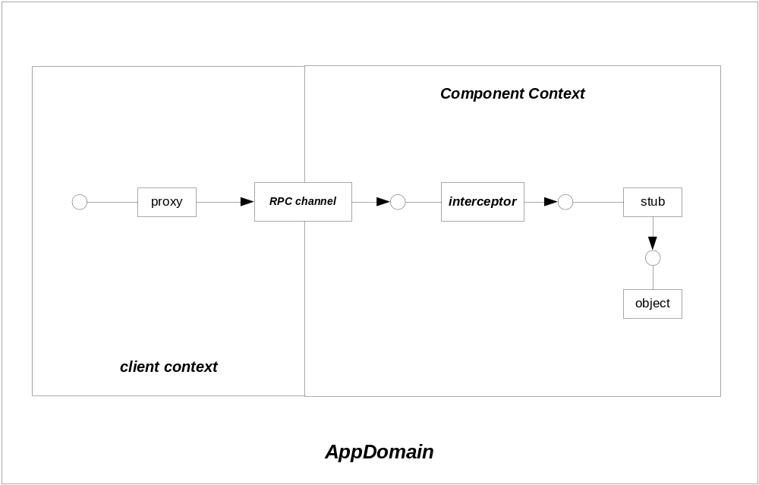
Interception

Slide 20
Uses of interception
The .Net Windows Communication Foundation (WCF) uses interception to provide a lot of functionality to using programs without the developer writing code for that.
Instead, the WCF defines attributes, like [ServiceContract], [ServiceBehavior], and [OperationContract].
BasicHttpService CodeSnap
Those attributes inject code into the assemblies created from your code to provide communication facilities that use the TCP stack or interprocess communication.

Slide 21
The End for now

