Slide 1
Website Resources for
All Courses
Served by this Site
Jim Fawcett
http://ecs.syr.edu/faculty/fawcett

Slide 2
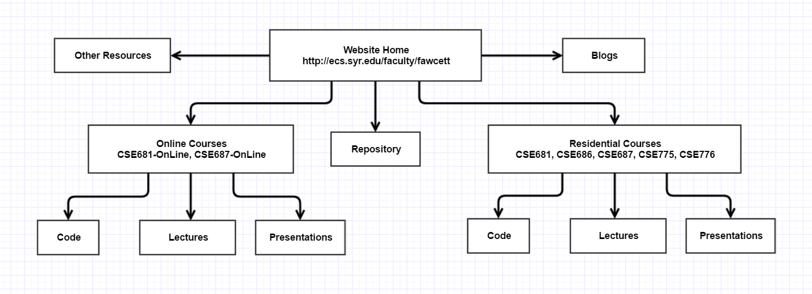
Website Structure
This diagram illustrates the resources that are available to you on this website.
Almost all of these you will access from links on one of the lecture pages.

Slide 3
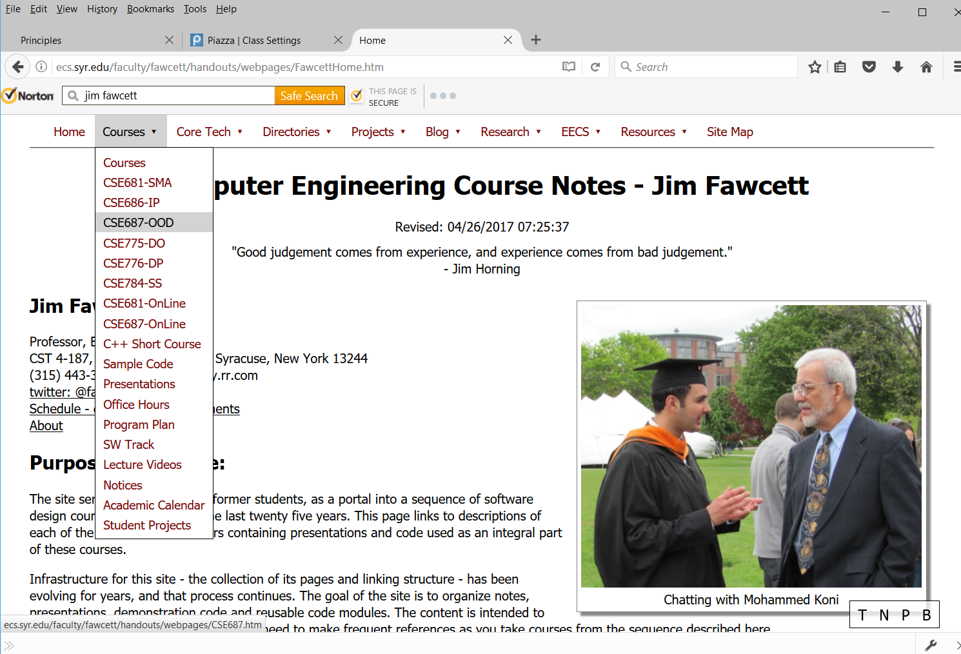
Website Top-Level Menu
This is the home page for the entire website.
You will usually just click through to one of the Course links.

Slide 4
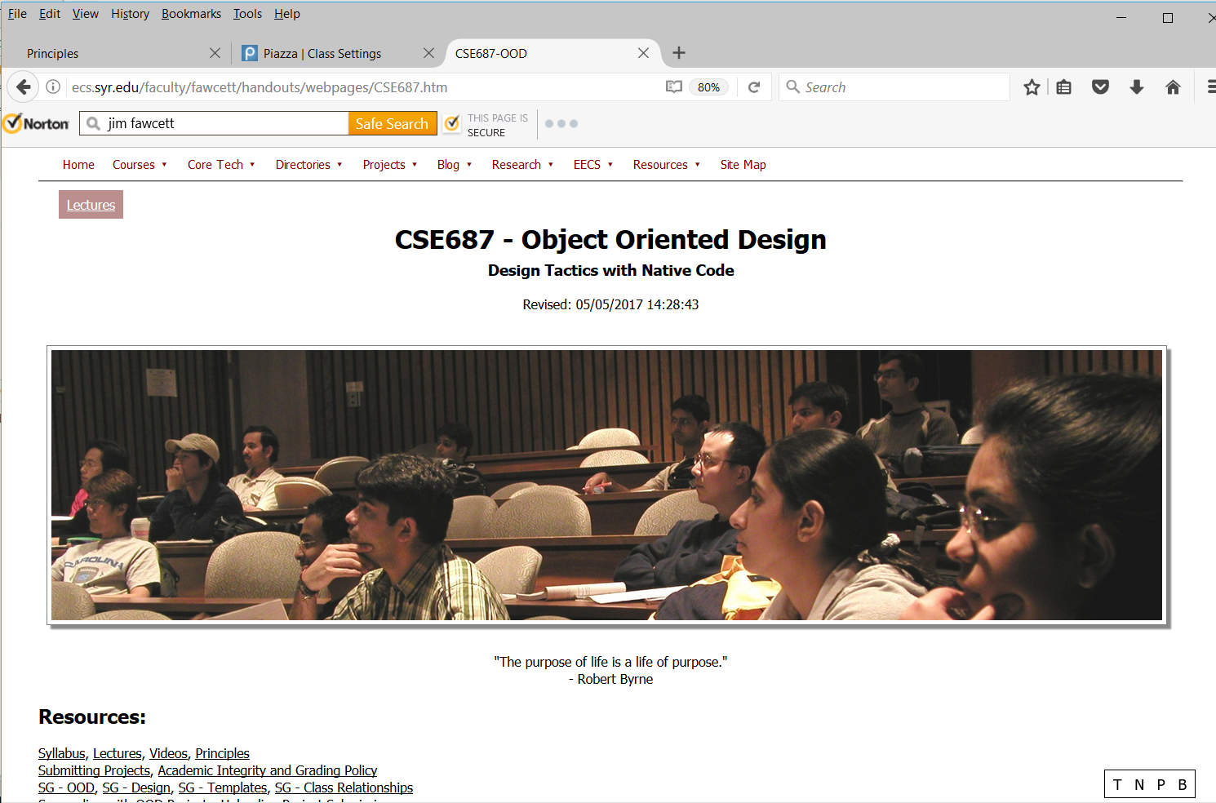
CSE687 Home
This is the home page for one of the residential courses.
Usually you will just click through to the lectures.
The menu items serve all of the courses in the software track so are not tailored specifically for your needs.
If you get lost in the website you will find that all of the menus contain a site map link you can use to get back to this page.

Slide 5
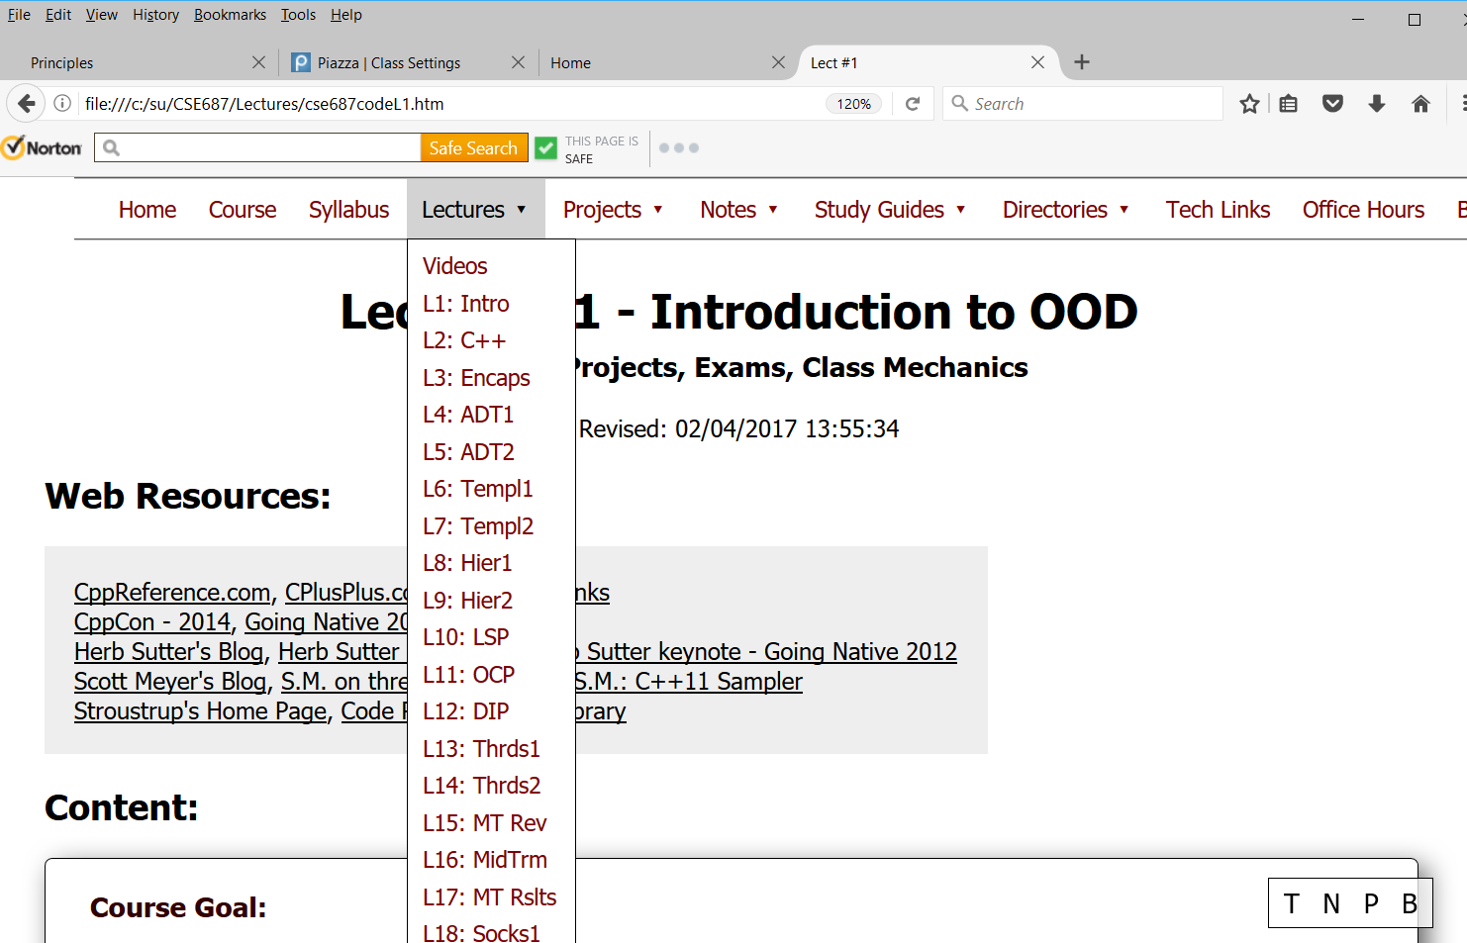
Lecture Level Menu : Lectures
This drop-down lets you quickly navigate to any of the lectures in this course.
It also gives you an idea of the course structure and contents.

Slide 6
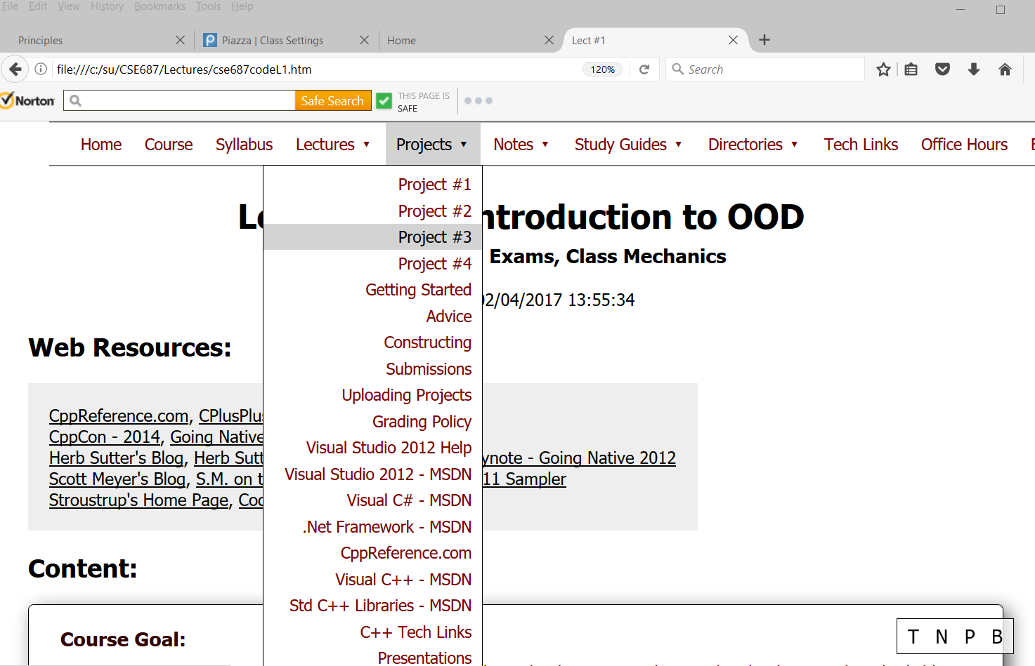
Lecture-Level Menu : Projects
This project drop-down gives you quick access to your project statements.
The remaining items on the drop-down are shared with all the other residential courses and are not specifically tailored to your experience with this course.

Slide 7
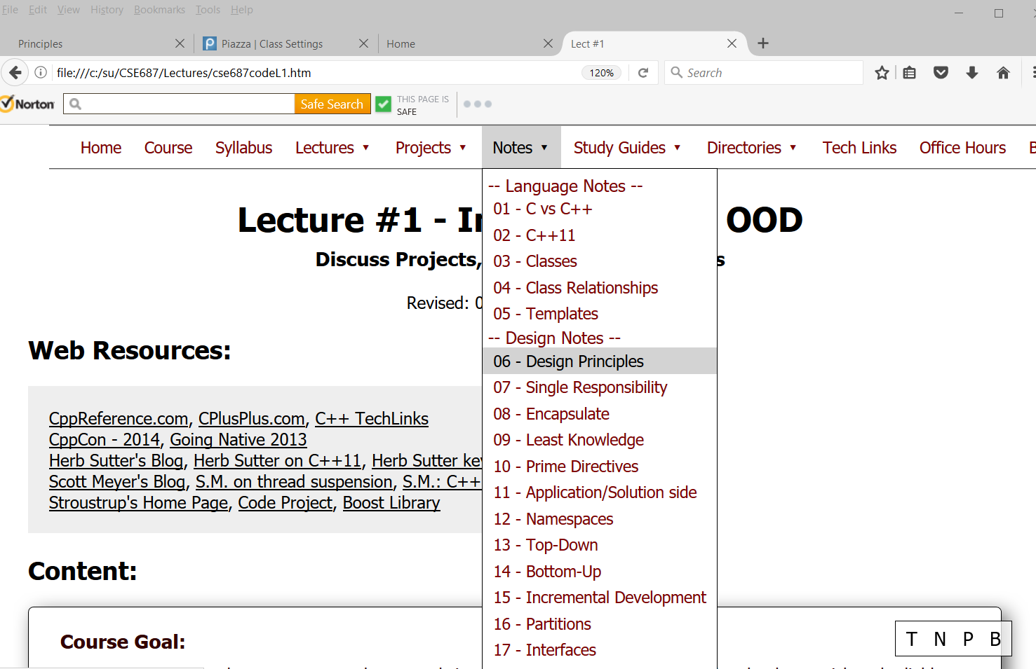
Lecture-Level Menu : Notes
Notes are small presentations of one specific idea.
The intent is to focus your attention on an important idea or process.

Slide 8
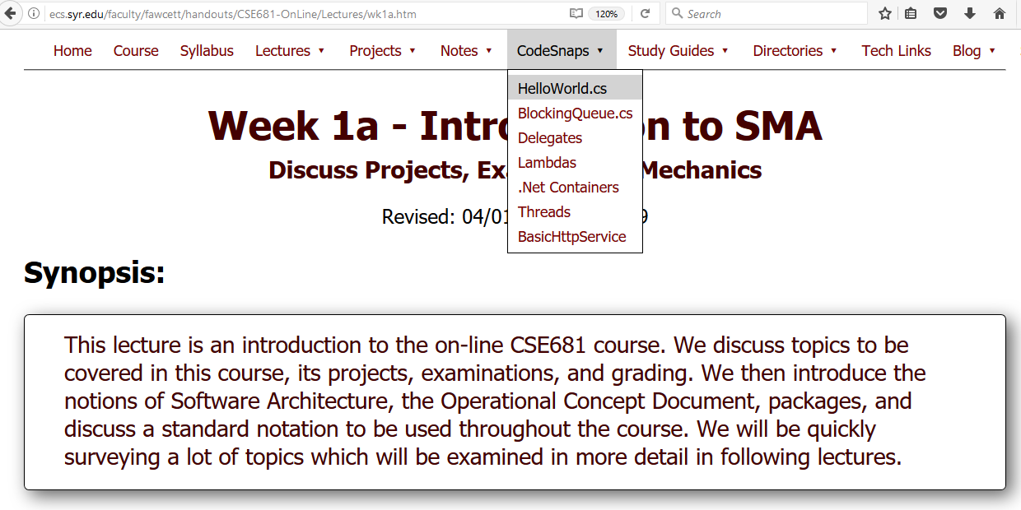
Lecture-Level Menu : CodeSnaps
CodeSnaps are code embedded in webpages.
That gives you quick access to important code examples without the need to download and open in Visual Studio
We will add more CodeSnaps as needed, based on your questions during the Lectures.

Slide 9
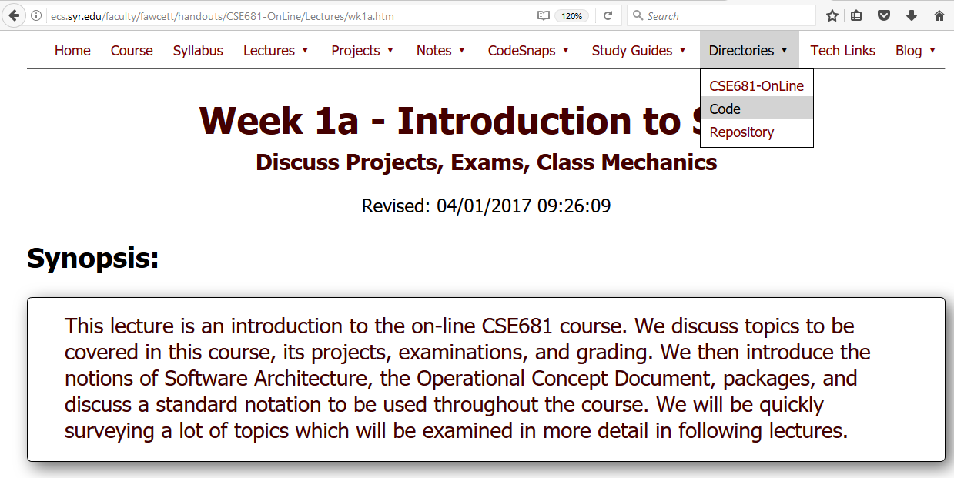
Lecture-Level Menu : Directories
The Code Directory has code examples that you can download and run in Visual Studio.
The Repository contains code you may wish to use in your projects.
You will be allowed to use any code from the Repository, as part of your projects, but you may not use code downloaded from elsewhere on the web.

Slide 10
End Website Intro

