Slide 1
Haskell N/W ?? Rashmesh Radhakrishnan

Slide 2
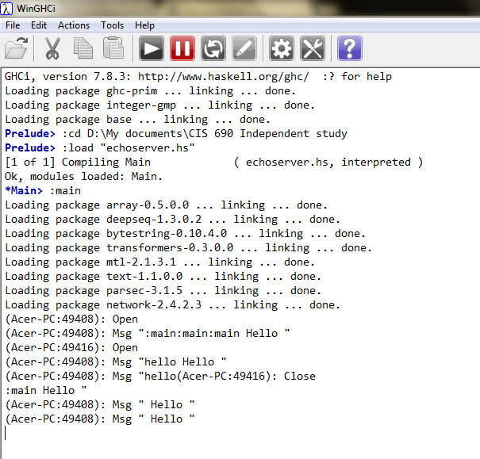
Server.hs

Slide 3
module Main( main ) where
import Network
import System.IO
import Control.Concurrent
main :: IO ()
main = withSocketsDo $ --For windows compatibility
do
theSocket <- listenOn (PortNumber 2049)
sequence_ $ repeat $ acceptConnectionAndFork theSocket
where
acceptConnectionAndFork :: Socket -> IO ()
acceptConnectionAndFork theSocket = do
connection <- accept theSocket
let (handle, hostname, portnumber ) = connection
putStr ("("++ hostname ++ ":" ++ (show portnumber) ++ "): Open\n" )
forkIO (echoServer connection)
return ()
echoServer :: (Handle, String, PortNumber) -> IO ()
echoServer (handle, hostname, portnumber ) = do
a <- hGetContents handle
putStr $ foldr (++) "" $ map (\a -> "(" ++ hostname ++ ":"
++ (show portnumber) ++ "): Changed here " ++ (show a) ++ "\n" ) $ lines a
putStr ("("++ hostname ++ ":" ++ (show portnumber) ++ "): Close\n" )

Slide 4
Client.hs

Slide 5
module Main( main ) where
import Network
import System.IO
import Control.Concurrent
main :: IO ()
main = withSocketsDo $ --For windows compatibility
do
handle <- connectTo "localhost" (PortNumber 2049)
input <- getContents
sequence_ $ map ( \a -> do
hPutStr handle $ a ++ " Hello \n"
hFlush handle ) $ lines input
hClose handle

Slide 6
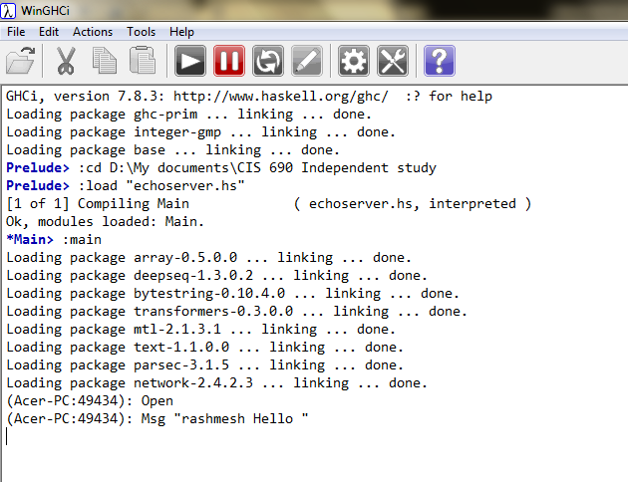
Server.hs

Slide 7
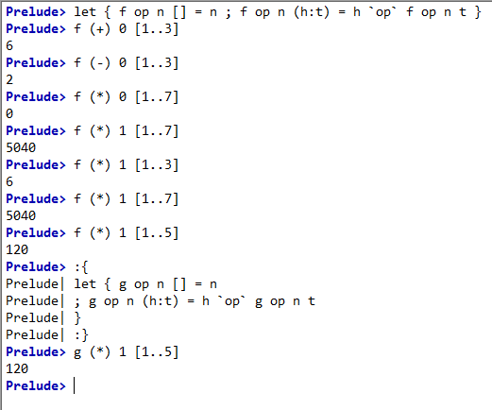
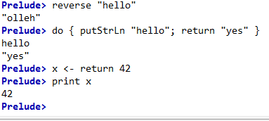
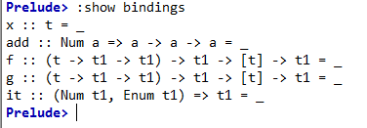
Trivial examples

Slide 8
To do list
Demonstrate in Haskell and C++:
P1: Immutable states
P1 : Closures
P1: First-class functions
P1: Higher-order functions
P1: Pure functions
P1: Recursions

Slide 9
References
N/W example Haskell:
http://www.haskell.org/pipermail/haskell/2003-April/011580.html
https://hackage.haskell.org/package/HTTP-4000.0.9/docs/Network-TCP.html
Learning Elixir:
http://learnxinyminutes.com/docs/elixir/
http://elixir-lang.org/getting_started/1.html

Slide 10
Thank you

