Slide 1
A look at the functional languages
Haskell
F#
OCaml
Rashmesh Radhakrishnan

Slide 2
Haskell

Slide 3
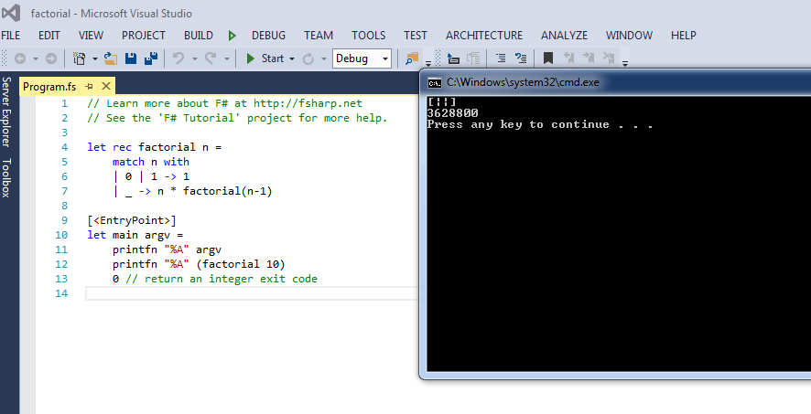
F#

Slide 4
OCaml

Slide 5
Compare Functional languages
F# | Haskell | OCaml
F# has aspects of both imperative/OO and functional languages | Haskell is a "pure" functional language | OCaml seems like a gentle introduction to Haskell.
F# provides a “lazy” keyword to force lazy evaluation let result = lazy (x + 10) | Haskell has lazy evaluation implicitly | Haskell has lazy evaluation implicitly
Probably easier to learn | Haskell syntax cleaner | Clumsy like double ;; for recursion
Tasks parallel library | Parallel tuning , stack overflow tail recursive | Good performance

Slide 6
Conclusion
F# or Haskell ?
Better documentation and easier learning curve for F#.
Haskell better as a strict representation of functional programming language.
????

Slide 7
To do list
Demonstrate in Fp Lang and C++:
P1: Immutable states
P1 : Closures
P1: First-class functions
P1: Higher-order functions
P1: Pure functions
P1: Recursions

Slide 8
Thank you

