Slide 1
Source Code Dependency Visualizer
Prateek Sharma
Instructor: Prof. Jim Fawcett

Slide 2
Existing Work
C++ application to find dependencies between source code files

Slide 3
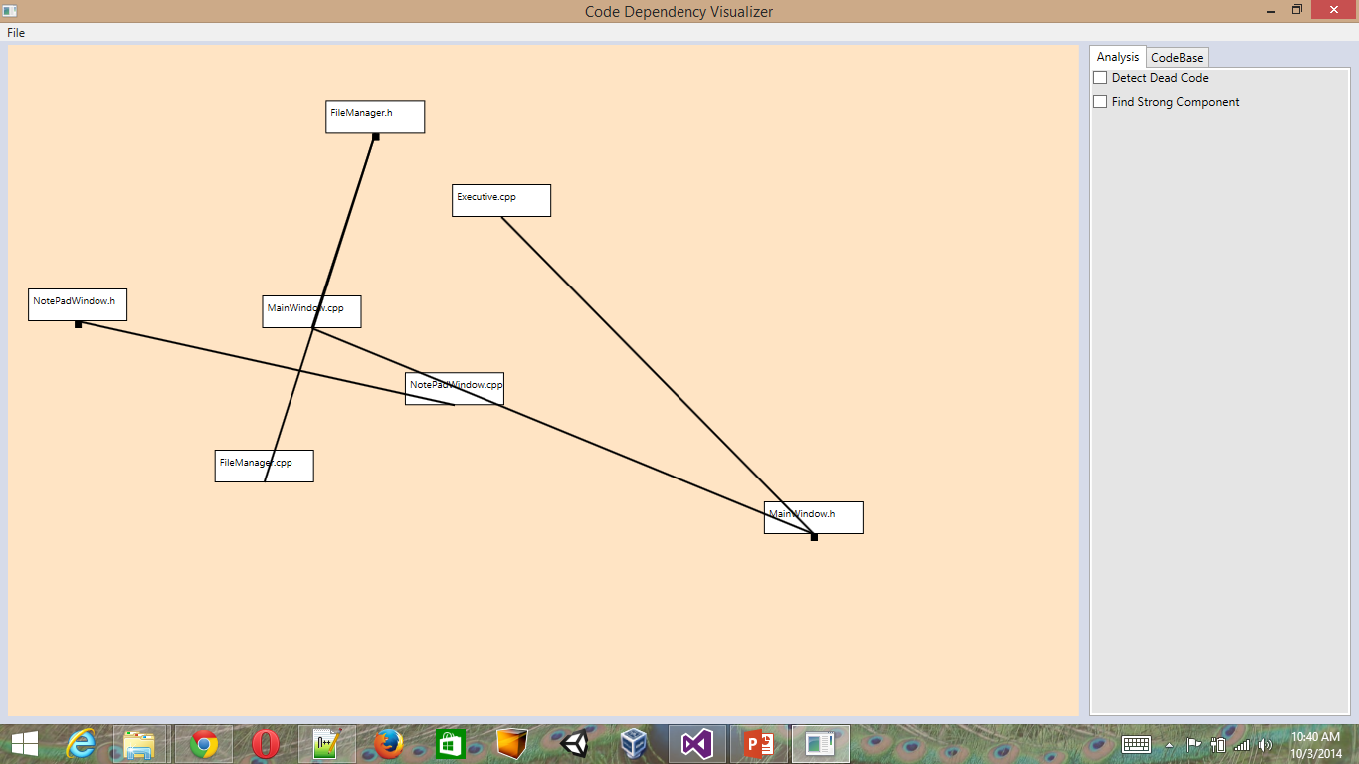
Existing Work(…)
C# WPF Application Demo

Slide 4
Future Work
Improving the current UI to make it more effective
Drag and Drop support for Graph components
Visualization capability for graph based algorithms like finding the strong components in the Graph etc

Slide 5
Thank You

