Slide 1
Android Application
Campus Guided Tour
Independent study presentation-1
By
Ranjini Umamaheshwarappa
Advisor: Dr. Jim Fawcett

Slide 2
Application Idea
Application shall
Guide a user around campus
Provide important details about buildings and other landmarks.
Make a Trip Plan for the User based on their Points of Interest

Slide 3
Intent and Motivation
SU does not yet have an app which guides a Student/Faculty around the campus
Would serve as an important tool after complete development

Slide 4
Users and Uses
Some of the Important Uses:
A Prospective student admitted to the Campus can take a Self Guided Tour to know the Campus well
An Employee On Campus can use the App to locate Buildings Example: RSA Employee
Any user can find Shuttle Stops on campus
Current Event Info serves as a nice tool for a family to plan a visit to Campus

Slide 5
Tools Used
Android SDK - Eclipse - Java
ADT Plugin 20.0 or Higher
Google Play Services – Google Maps API
SQLite Database

Slide 6
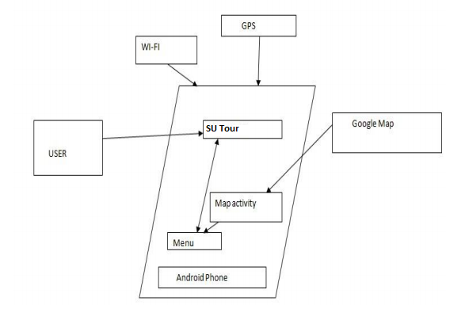
Architecture of the Proposed Model

Slide 7
Requirements
SU Guide can show the Map of the SU CAMPUS
Map can be zoomed in/out
Users can move around the Map
Users are able to select their Points of Interest on Map
Map is customized to show only those POIs
SU App should retrieve the Photo Gallery of the desired Location

Slide 8
Requirements Extended
SU App should provide the Current Event Info for each POI selected Example: A Basketball game in Carrier Dome
Users can select POI based on Classification-Library, Dining Halls, Bus Stops etc.
Users are able to make their Trip plan using Weather Data (IGoogle Weather API) and are able to select the mode of Travel for the Tour

Slide 9
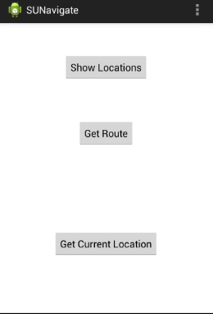
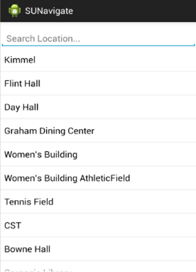
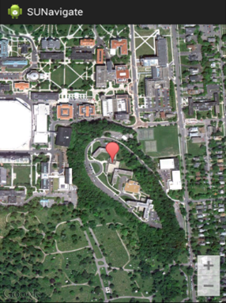
ScreenShots

Slide 10
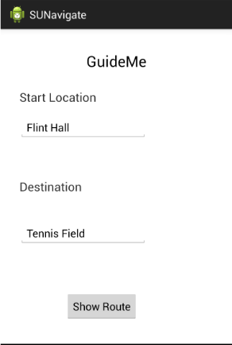
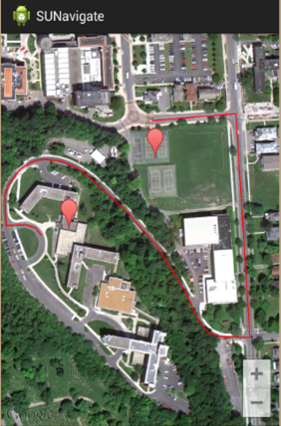
ScreenShots

Slide 11
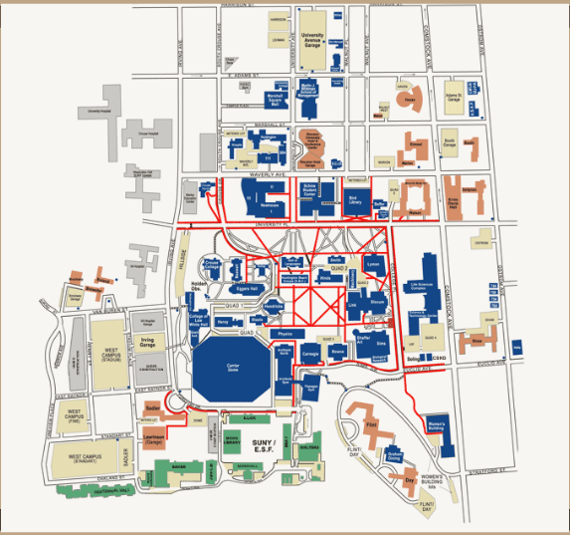
SU MAP

Slide 12
Thank You

