Slide 1
turN-BASED MULTIPLAYER MOBILE GAME SDK ON ANDROID
By Harsh Sinha (SUID# 797790550)
Advisor: Dr. Jim Fawcett

Slide 2
Motivation
Building a full fledged multiplayer mobile game
  Building Game Graphics
  Writing game logic
  Communication Platform
  Social Media Integration
Most solo mobile game developers are not professionals
They know “WHAT” to build but “HOW” is a challenge

Slide 3
The What, Why and Who of it
What are we building ?
  An Android SDK which provides a framework to create turn-based mobile games with device to device multiplayer capability as well as Social Media Integration.
Why are we building it?
  To abstract most of the game development tasks into a reusable and standardized codebase.
  To allow game developers to concentrate more on game graphics/logic.
Who are we building it for?
  Mostly Amateur Mobile Game Developers but even professionals can use it.

Slide 4

Choice of platform
iOS
  Needs a MAC System
  99$ Developer Account even to test apps
PhoneGap
  Write once deploy to Android, iOS, Windows Mobile…
  Not preferable platform for games
Android
  Free to develop and test
  25$ Android Play Store account
  Familiar programming on JAVA
  Can Develop on Windows

Slide 5
Main Project Targets
Turn-Based Game Management
Multiplayer Gaming Platform
Social Media Integration

Slide 6
Turn-Based games (TBGs)
Turn-Based Games are those where multiple players play together, but at a time only one player makes a move.
Examples: Chess, Ludo, tic-tac-toe, Scrabble, Almost All Card Games & Board Games...
Why an SDK for Turn-Based Games?
  Most amateur game developers start with TBGs
  Most of the game events are common across most TBGs
  Simpler than Real-time Multiplayer games

Slide 7
Turn-Based games (TBGs) - Continued
Common Features/Events in TBGs
  Multiple players (2-4 ideally)
  One player making a move while others are blocked
  Evaluating win condition
  Updating Scores after each move
  Saving/Resuming games

Slide 8
Main Project Targets
Turn-Based Game Management
Multiplayer Gaming Platform
Social Media Integration

Slide 9
Multiplayer - Implementation
Multiplayer option could be implemented as:
  On Device (‘N’ players 1 device)
  Using P2P (‘N’ players ‘N’ devices)
  Using Game Servers (‘N’ players ‘N’ devices 1 hosted server)
  Using Cloud Services(‘N’ players ‘N’ devices 1 Cloud Service )
We could start with P2P as its no cost, does not require internet connectivity and is faster.
$$$
$$$

Slide 10
Multiplayer - Activities
Common activities that a device-to-device multiplayer SDK shall provide:
  Hosting a game session
  Joining a game session
  Data Transfer
    Protocols: Wifi-direct, Bluetooth, HTTP, Cloud…
    Message Formats: XML, JSON…
  Efficient Locking mechanism
  Chat Service (optional)

Slide 11
Main Project Targets
Turn-Based Game Management
Multiplayer Gaming Platform
Social Media Integration

Slide 12
Social Media Integration
Social Media features are integral part of games on any platform let alone mobile.
Social Media Features/benefits:
  Sharing scores on FB, Twitter etc.
  Sharing a major move
  Finding FB, Twitter friends and joining them for a game
  It helps advertising the game
  Can build a game with social network data

Slide 13
Social Media Integration Contd.
Social Media features that an SDK shall provide
  One click share to various social networks like FB, twitter etc.
  Finding friends on a social network and inviting them to play
  Ability to promote the game on the player’s social network

Slide 14
Sample Game – Connecting Dots
Player 1
Player 2
P2
P1

Slide 15
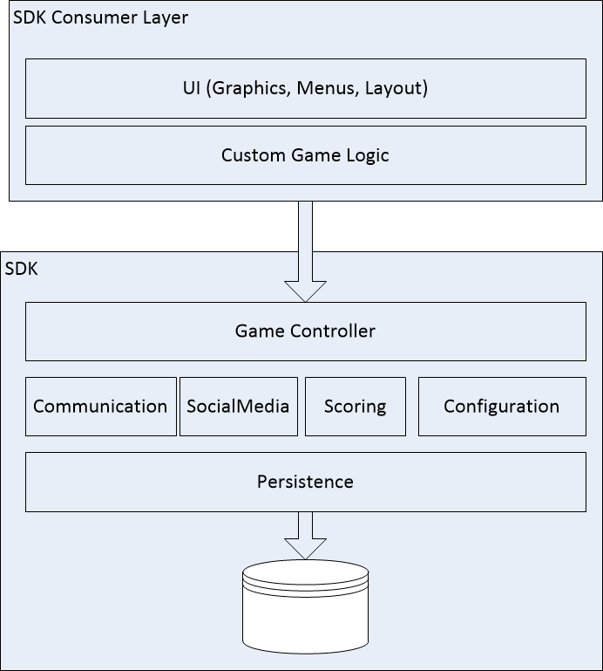
Design - Modular Structure

Slide 16
Design – Key Ideas/Decisions
  Start with Wifi-Direct as the communication protocol
  Choose JSON over XML for message format
  A Singleton GameController that controls the lifecycle of the game
  Allow saving game session to database
  Having a lock signal float between players
  Periodic Ping All to detect players dropping out
  Blocking Queue for message Routing

Slide 17
Sprint 2 Work Items
Researching JSON Parsers
Android Game Programming Hands On
TBG Game Management Design

Slide 18
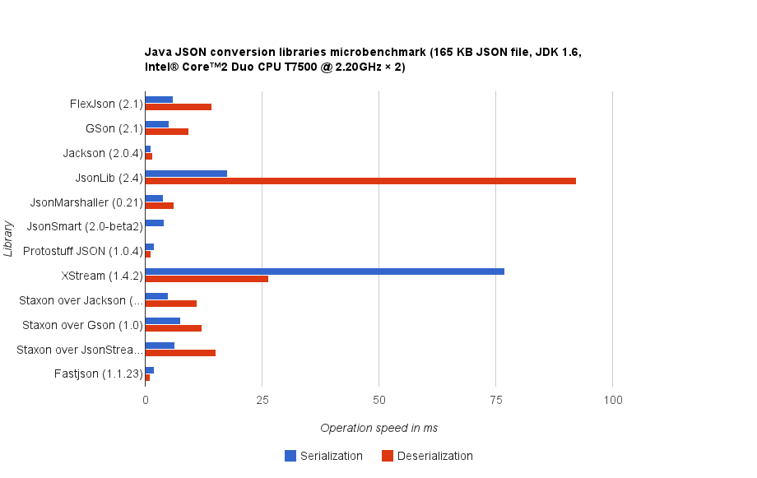
JSON parsers benchmarking

Slide 19
Jackson for JSON
Offers three alternative methods for processing JSON
  Streaming API - (aka "Incremental parsing/generation") reads and writes JSON content as discrete events
  TreeModel – Provides a mutable in-memory tree representation of a JSON document
  Data Binding - converts JSON to and from POJOs based either on property accessor conventions or annotations.
    Simple data binding means converting to and from Java Maps, Lists, Strings, Numbers, Booleans and nulls
    Full data binding means converting to and from any Java bean type (as well as "simple" types mentioned above)

Slide 20
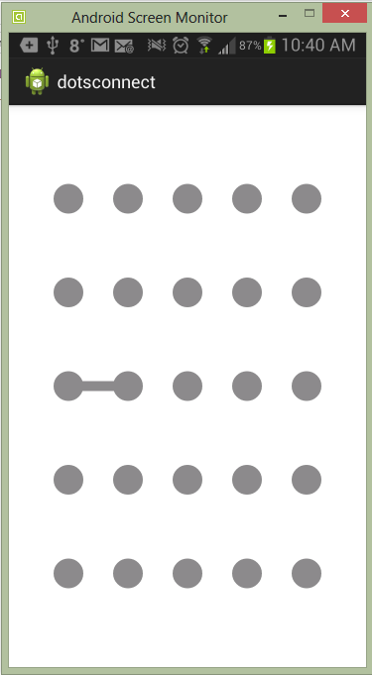
Game Programming Hands-On

Slide 21
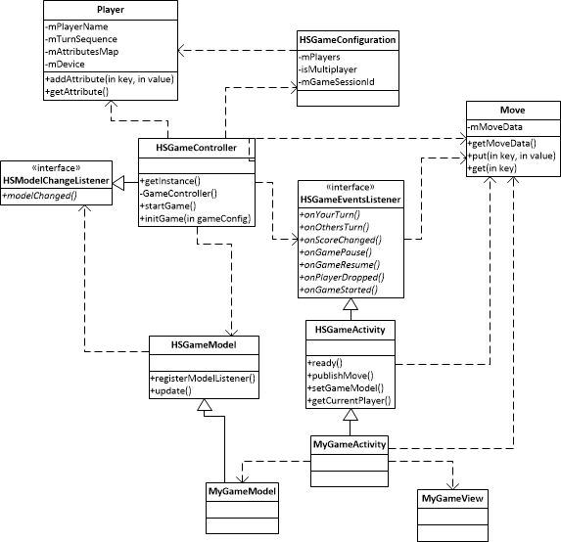
Turn Based Game Mgmt. - LLD

Slide 22
Sprint 3 Work Items
SDK packages
com.hs.sdk.gamemanagement Implementation
Simplifying game data model
Enhancing Game Graphics

Slide 23
SDK Packages
The SDK will have 3 packages (Android libraries):
  com.hs.sdk.gamemanagement – On device game management including multiplayer
  com.hs.sdk.communication – Communication with other devices via multiple protocols.
  com.hs.sdk.social – Social media integration tools
Depending on Consumer’s needs appropriate packages can be used

Slide 24
gamemanagement Implementation
HSCommunication
HSCommunication
HSController
HSController
Controller
Controller
Model
View
Model
View
On Device SinglePlayer / Multiplayer
Device-to-Device Multiplayer

Slide 25
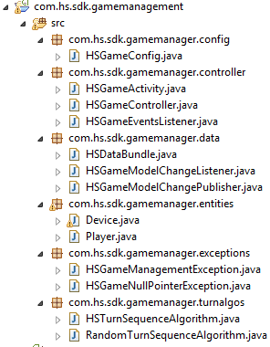
gamemanagement Implementation
    Game configuration (players, settings, etc)
    Consumer Game Activity should extend this
    Runs/manages/ calls game events
    Interface for listening to game events. HSGameActivity
    Implements this interface and registers it with controller
    Data Bundle for extensive use with data transfer
    Interface for listening to model changes.
    Interface for allowing registration of model change
    listener. Consumer’s Game Model must implement this
    Describes a player and his/her attributes (name,color..)
    Exceptions
    Interface for specifying turn sequence determination algo
    Implementation of random shuffle sequence determination

Slide 26
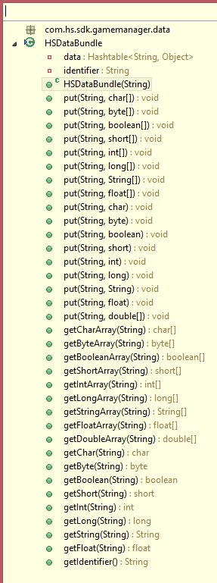
gamemanagement – Data Bundle
A Data Bundle of Simple Types
Can be easily serialized
Can be easily converted to JSON/XML
Supports an Identifier to indicate the
context of the bundle. Example:
“MOVE_CONNECT_DOTS” – Move indicating 2 dots connected
“MOVE_BOX_COMPLETED” – Move indicating box completion

Slide 27
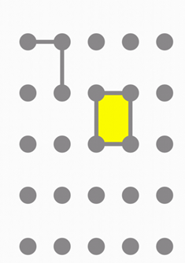
Dotsconnect - Game Data Model
Visual Model – Lines, Dots ,Boxes
Implementation Model
  Class – Line
    Line is composed of 2 dot locations (row,col)
    isDrawn() – Indicates if line is connected
  Class - Box
    Box has 4 Line Object References
      Top, left, bottom, right
    isCompleted() =
      top.isDrawn() && bottom.isDrawn() && left.isDrawn() && right.isDrawn();

Slide 28
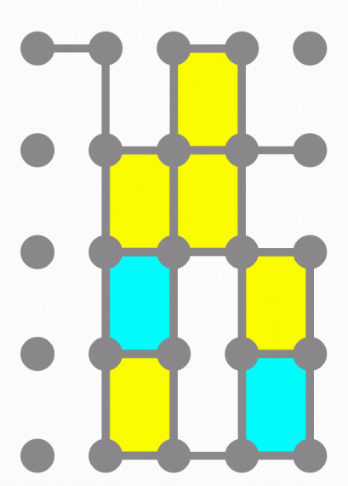
Graphics Challenges - Repainting
Andriod graphics supports
  Redrawing the whole view
  Redrawing a part of view
Connecting Dots
  Redraw 2 circles 1 Line
  Redraw just 1 Line
Drawing Boxes
  Redraw 4 circles 4 lines
  Redraw 1 rectangle

Slide 29
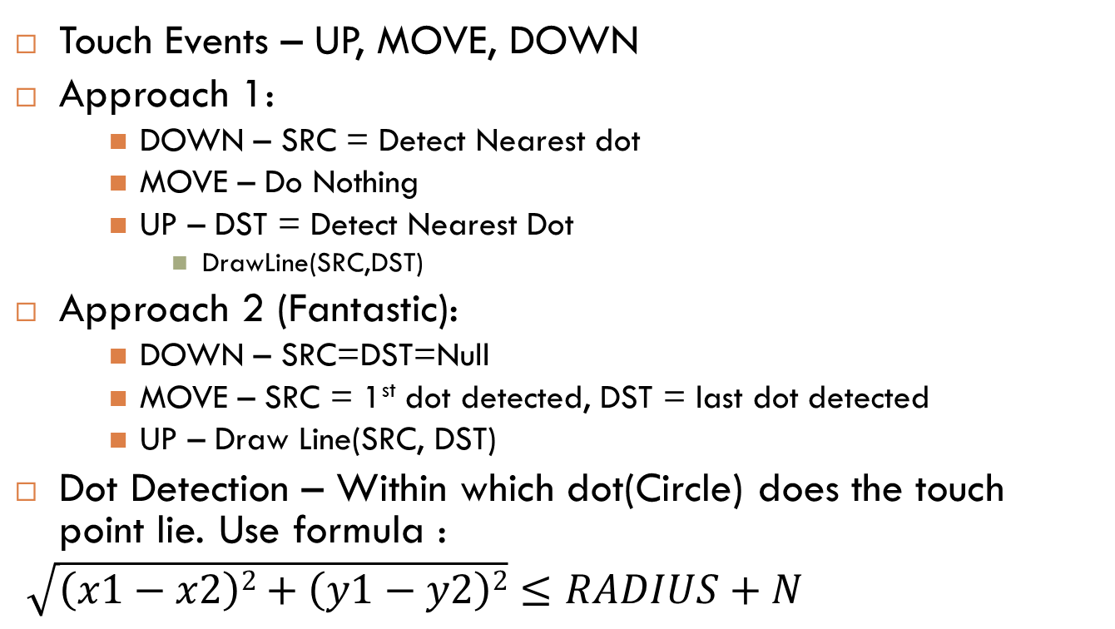
Graphics Challenges – Touch Detection
Touch Events – UP, MOVE, DOWN
Approach 1:
    DOWN – SRC = Detect Nearest dot
    MOVE – Do Nothing
    UP – DST = Detect Nearest Dot
      DrawLine(SRC,DST)
Approach 2 (Fantastic):
    DOWN – SRC=DST=Null
    MOVE – SRC = 1st dot detected, DST = last dot detected
    UP – Draw Line(SRC, DST)
Dot Detection – Within which dot(Circle) does the touch point lie. Use formula :
$\sqrt{\left(x1−x2\right)2+\left(y1−y2\right)2}≤RADIUS+N$
SLUGGISH

Slide 30
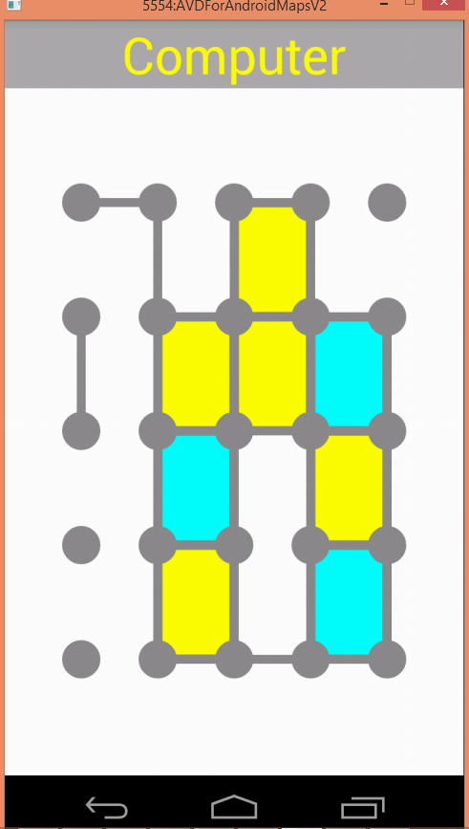
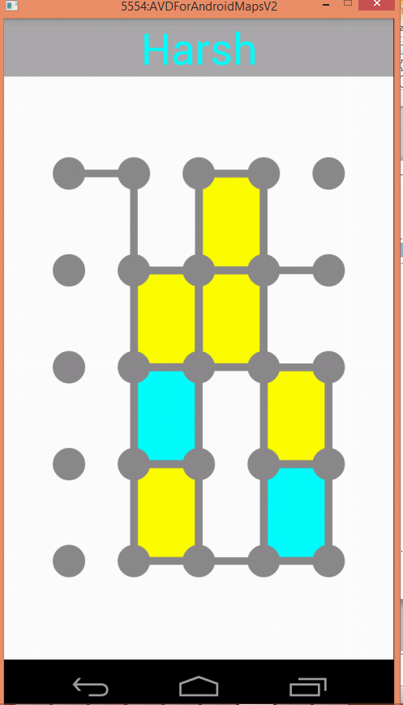
DEMO
The game is linked to the gamemanagement SDK package and works well in organizing turns of players

