Slide 1
State Design Pattern
Hao Tian, Sneha Sarkar,
Professor Jim Fawcett
CSE 776 - Design Patterns
Fall 2018

Slide 2


Slide 3
Intent
Allow an object to alter its behavior when its internal state changes.
Motivation
Used when we want to have an object to represent the state of the application and we want to change the state by changing the object.
State specific logic is localized in classes that represent that state.

Slide 4
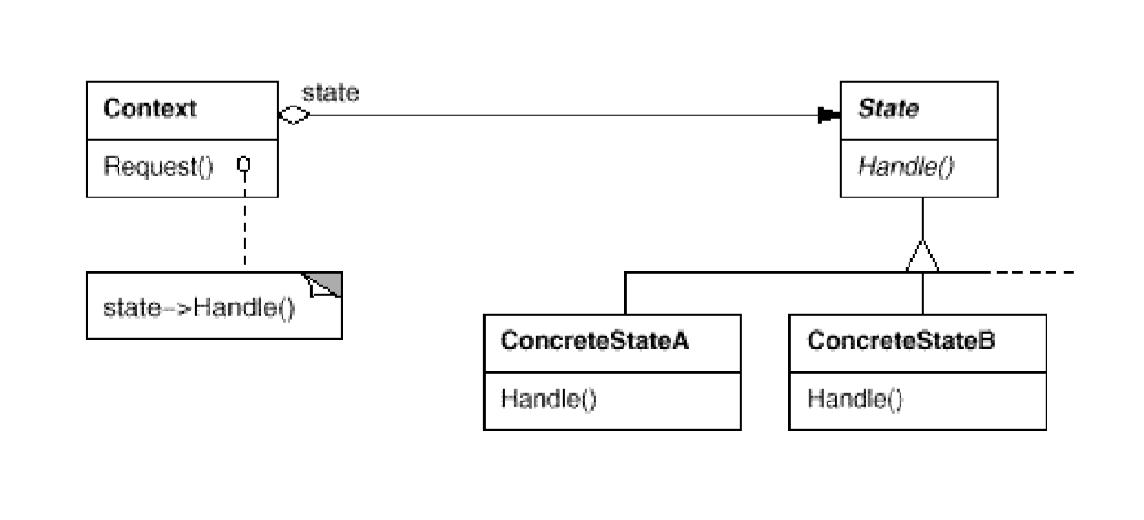
Structure

Slide 5
Applicability
An object’s behavior depends on its state.
Operations have large, multipart conditional statements that depend on the object’s state.

Slide 6
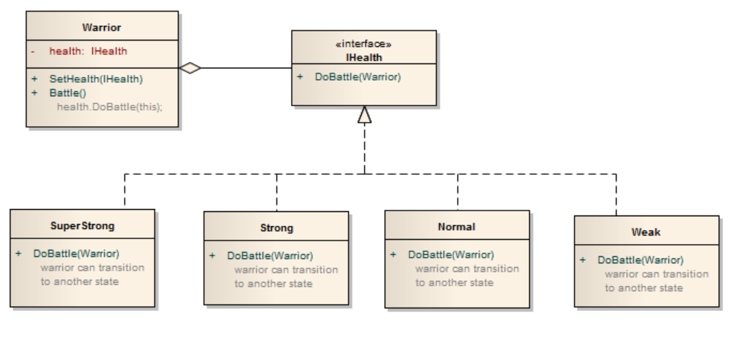

Slide 7
Participants
Context
State
ConcreteState subclasses

Slide 8
Collaboration
Context delegates state specific request to the current ConcreteStateobject.
Context may pass itself as an argument.
Context is the primary interface for clients.

Slide 9
Consequences
It localizes state-specific behavior and partitions behavior for different states.
// Without state
If (value >= 100)
do a
Else
do b
If …
else...
// With state
Context class{
State A -> Class A
State B -> Class B
}

Slide 10
Consequences
It makes state transitions explicit. (Compare to use data values)
// Without state
If (value >= 100)
do a
Else
do b
If …
else...
// With state
Context class{
State A -> Class A
State B -> Class B
}

Slide 11
Consequences
State objects can be shared.

Slide 12
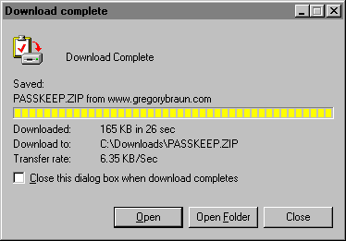
Implementation
Who defines the state transitions? Context or state itself?

Slide 13
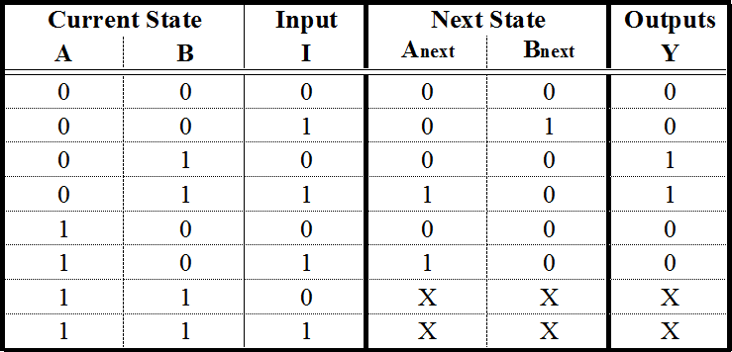
Implementation
A table-based alternative.

Slide 14
Implementation
Creating and destroying State objects.
Creating and destroying when use/not use
Create and never destroy

Slide 15
Related patterns
Singleton -- can be used by state class
Flyweights -- single object shared by multiple contexts
Bridge -- different behavior of same context class

Slide 16
Thank You

