Slide 1

Mediator
Design Pattern
Presenters:
Akash Bhosale
Bohao Li
Jiayu Li

Slide 2
Intent
Define an object that encapsulates how a set of objects interact.
Couple objects loosely by keeping objects from referring to each other explicitly
Vary their interaction independently.

Slide 3
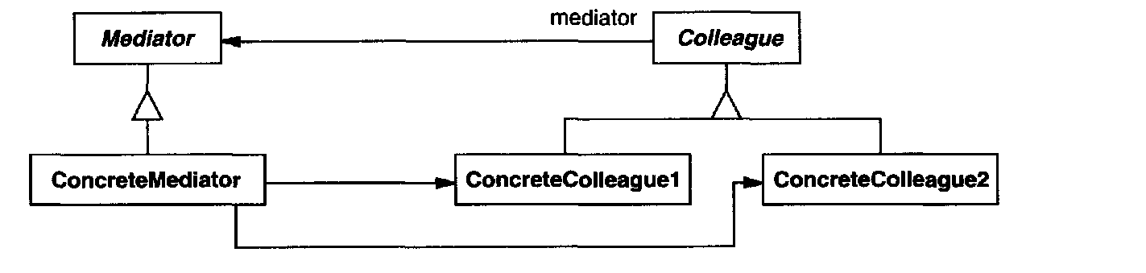
Structure

Slide 4
Motivation
Object-Oriented Design encourages distribution of behavior among objects.
Proliferating interconnections tend to reduce reusability.
An object cannot work without the support of others.
Difficult to change system behavior
Forced to define many subclasses to customize the system's behavior.

Slide 5
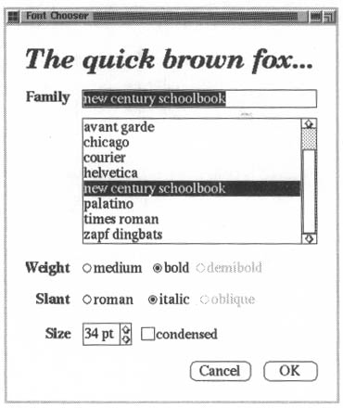
Example Problem
Interdependencies between the widgets in the dialog. E.g. change in an entry field due to selecting an option from the list.
Cannot reuse stock widget classes though dialogs display the same kind of widgets.
Different dialog boxes; different dependencies between widgets
Tedious to customize by subclassing.
Related example: Air Traffic Controller
Fig.1. Dialog box

Slide 6
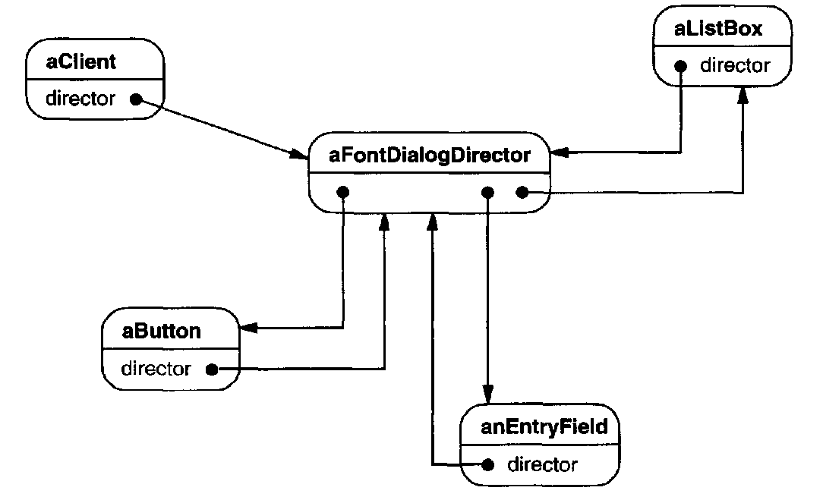
Solution
Colleagues
Mediator
FontDialogDirector (Mediator)
  responsible for controlling and coordinating the interactions of the group.
  Prevents objects from explicitly referring each other
  Objects communicate with the mediator
  Central hub for communication
Fig.2. Object Structure

Slide 7
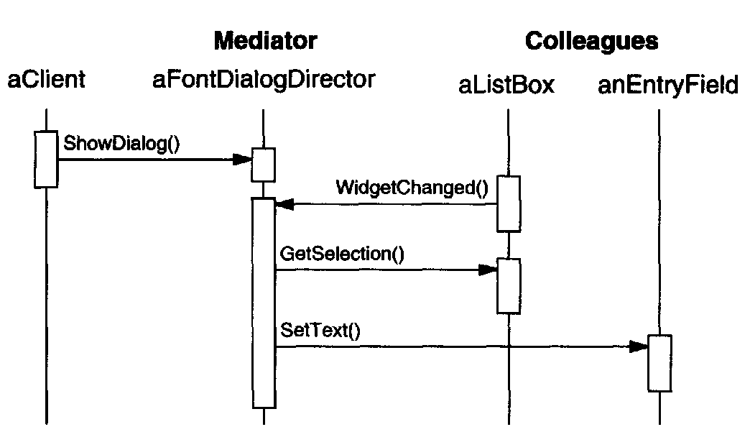
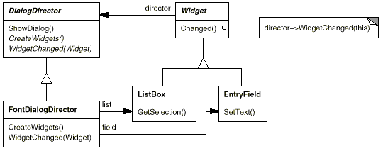
Interactions
Fig.4.Class Diagram
Fig.3. Sequence Diagram

Slide 8
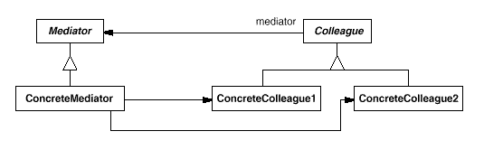
Participants
Mediator (DialogDirector)
- defines an interface
• ConcreteMediator (FontDialogDirector)
- implements cooperative behavior by coordinating Colleague objects.
- knows and maintains its colleagues.
• Colleague classes (ListBox, EntryField)
- each Colleague class knows its Mediator object.
- each colleague communicates with its mediator.

Slide 9
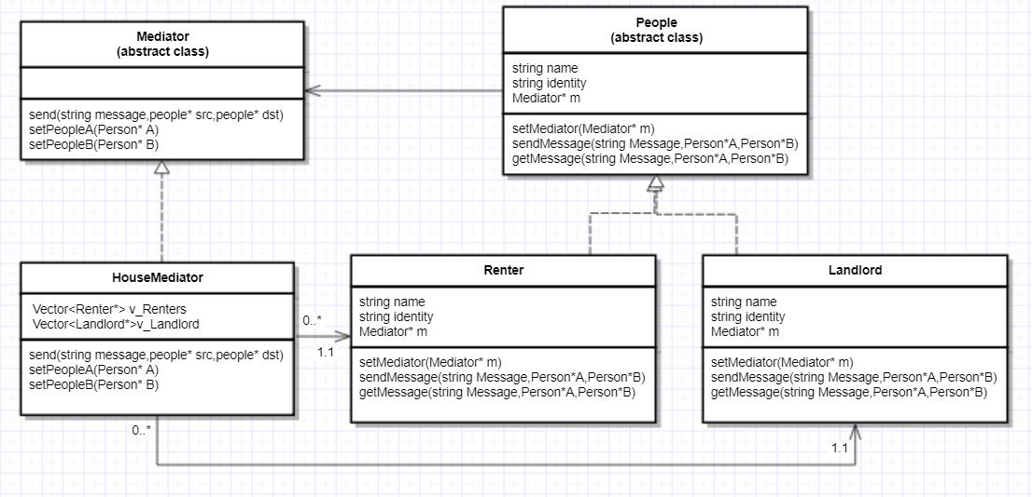
Class Diagram

Slide 10
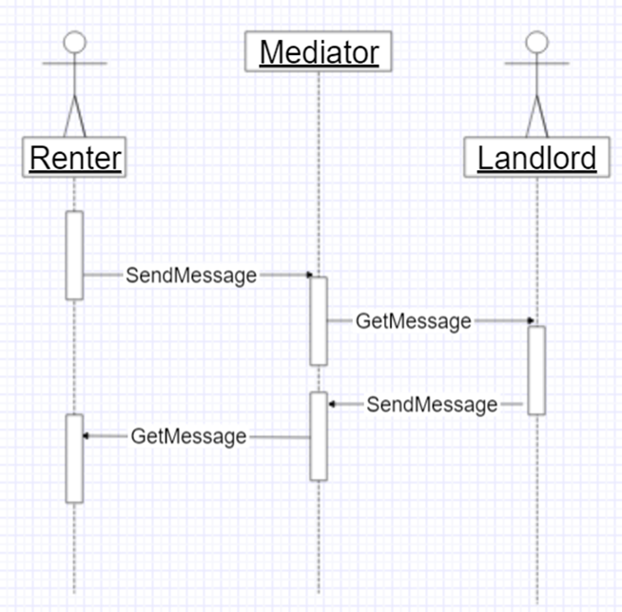
Sequence Diagram

Slide 11
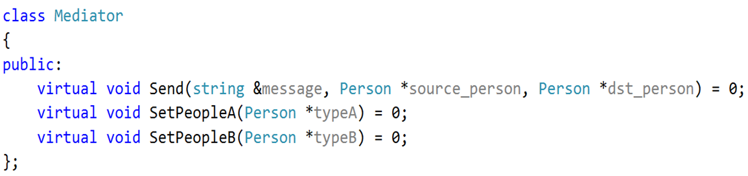
Source Code

Slide 12
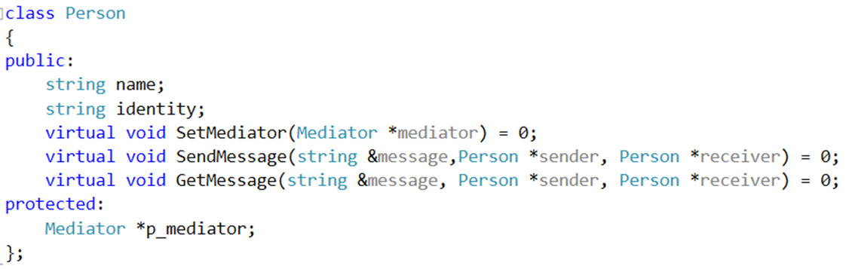
Source Code

Slide 13
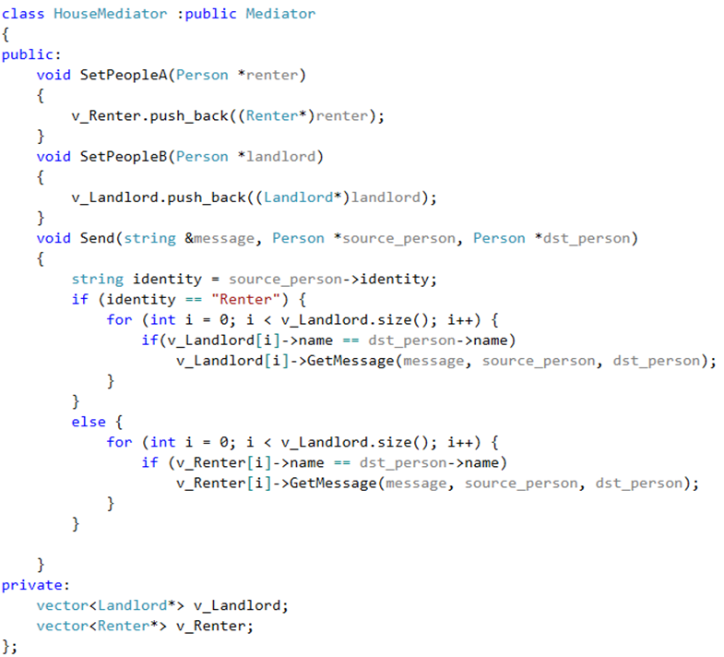
Source Code

Slide 14
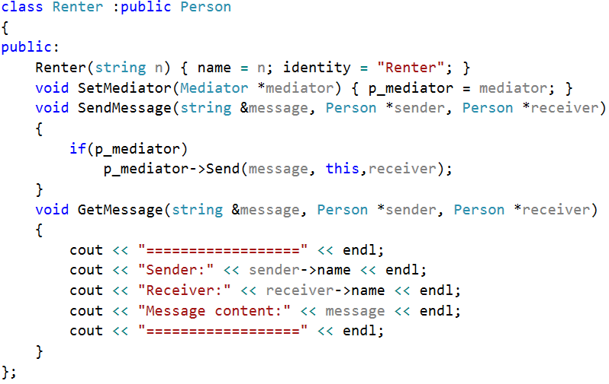
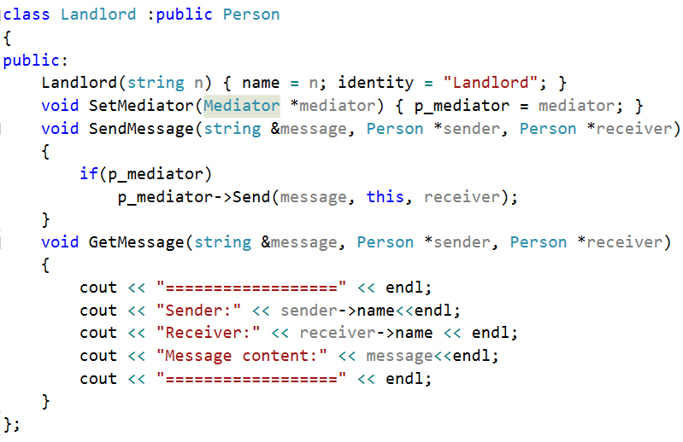
Source Code

Slide 15
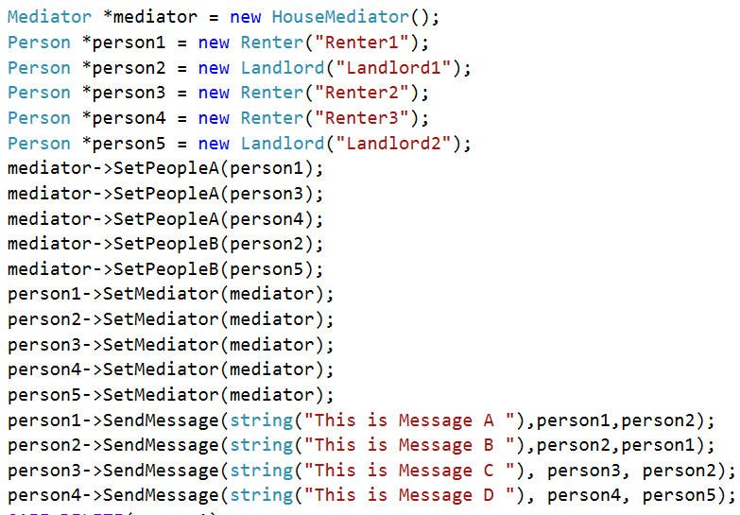
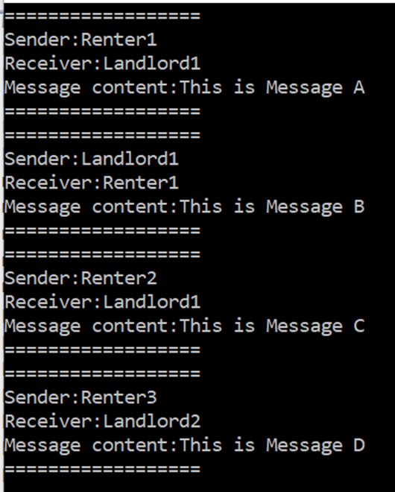
Running Result

Slide 16
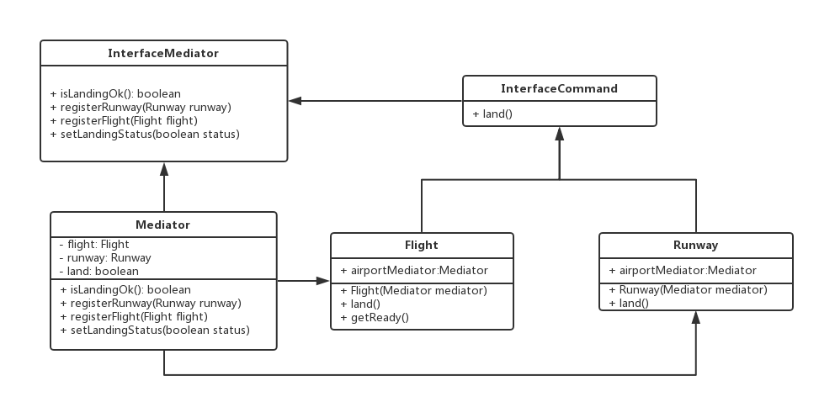
Known use

Slide 17
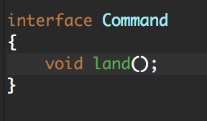
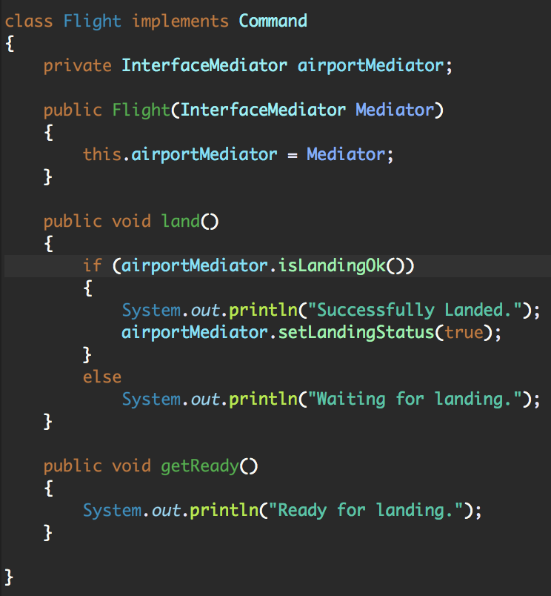
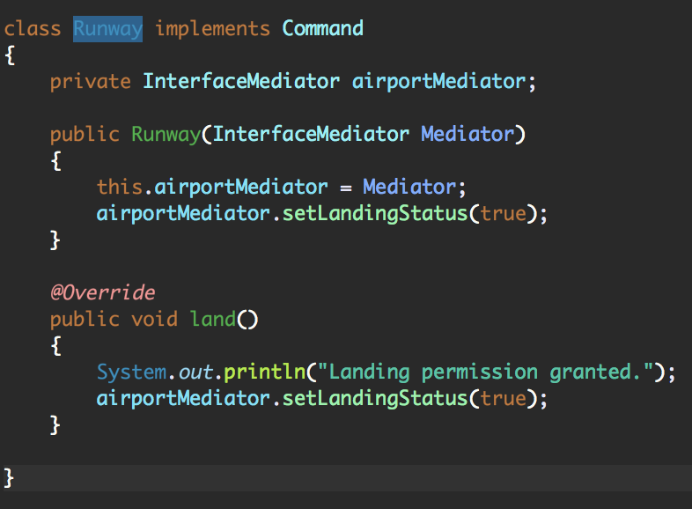
Code

Slide 18
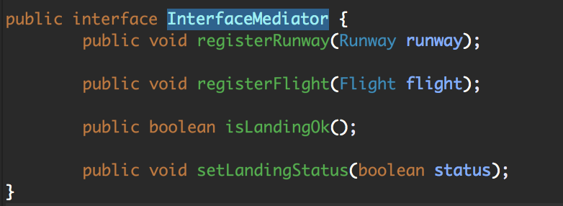
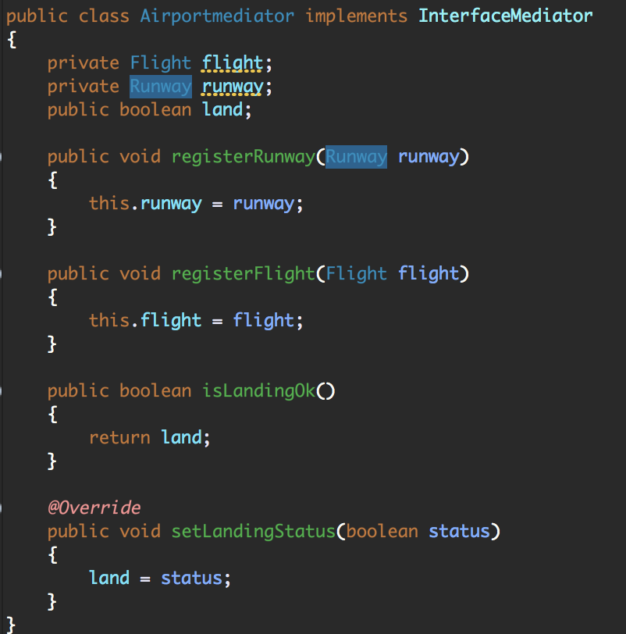
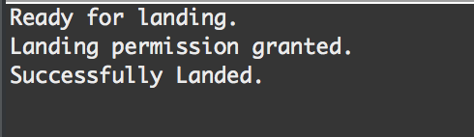
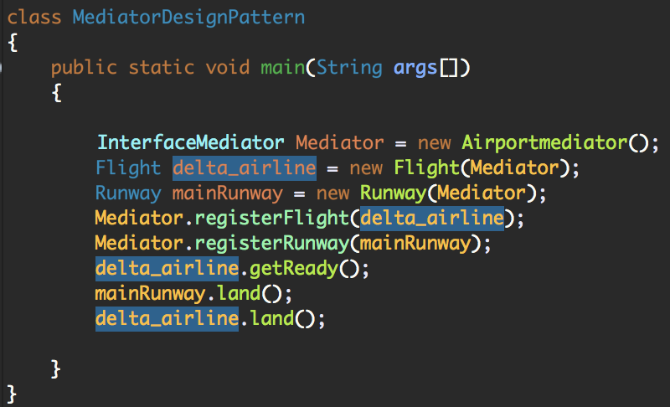
Code

Slide 19
Consequences
Benefits:
It limits subclassing. A mediator localizes behavior that otherwise would be distributed among several objects. Changing this behaviour requires subclassing Mediator only, Colleague classes can be reused as is.

Slide 20
Consequences
Benefits:
It decouples colleagues. A mediator promotes loose coupling between colleagues. You can vary and reuse Colleague and Mediator classes independently.

Slide 21
Consequences
Benefits:
It simplifies object protocols. A mediator replaces many-to-many interactions with one-to-many interactions between the mediator and its colleagues. One-to-many relationships are easier to understand, maintain, and extend.

Slide 22
Consequences
Benefits:
It abstracts how objects cooperate. Making mediation an independent concept and encapsulating it in an object lets you focus on how objects interact apart from their individual behavior. That can help clarify how objects interact in a system.

Slide 23
Consequences
Drawback:
It centralizes control. The Mediator pattern trades complexity of interaction for complexity in the mediator. Because a mediator encapsulates protocols, it can become more complex than any individual colleague. This can make the mediator itself a monolith that's hard to maintain.

Slide 24
Related Patterns
Facade
Facade’s protocol is unidirectional; that is, Facade objects make requests of the subsystem classes but not vice versa. A facade merely abstracts the interface to subsystem objects to make them easier to use; it doesn't define new functionality.
Mediator enables cooperative behavior that colleague objects don't or can't provide, and the protocol is multidirectional. A mediator's colleagues are aware of and communicate with the mediator instead of communicating with each other directly.

Slide 25
Related Patterns
Observer pattern
The Observer pattern: Defines a one-to-many dependency between objects so that when one object changes state, all its dependents are notified and updated automatically.
The Mediator pattern: Define an object that encapsulates how a set of objects interact. Mediator promotes loose coupling by keeping objects from referring to each other explicitly, and it lets you vary their interaction independently.
Colleagues can communicate with the mediator using the Observer pattern

