Slide 1

Patterns for Scripted Acceptance
Test-Driven Development
By - Ankur Kothari Yuxuan Xie Nishant Agarwal

Slide 2


Slide 3
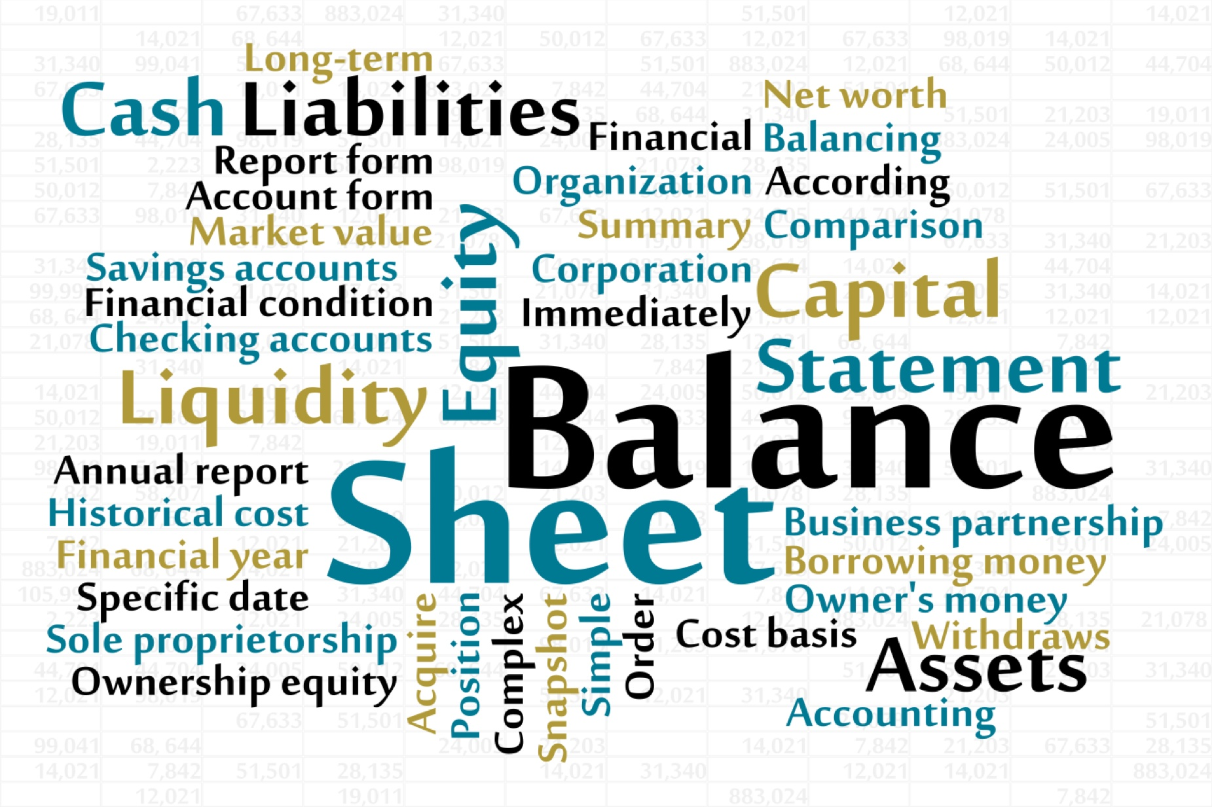
CashReceipt
Over Paid
Non Paid
Short Paid
Recrued
Non - Factored and so on….

Slide 4
Difficult to test existing features.
Design was so bad because developers were afraid to modify the existing code.
Too many meetings because there were so many bugs. We are engineers/artists who love writing beautiful code, not managers who do politics and who are graded by the number of meetings conducted
Customers, CEO, Product manager, Manual testing team were constantly sending emails about bugs and features that were working before were not even breaking now.
The whole development team was being blamed.
We are normal people who make human errors and not geniuses who can write bugless code. So we need to constantly verify if what we did is still working or not.
It was like a war zone.
Improve the design
Spend less time debugging
Less meetings
Free weekends

Slide 5
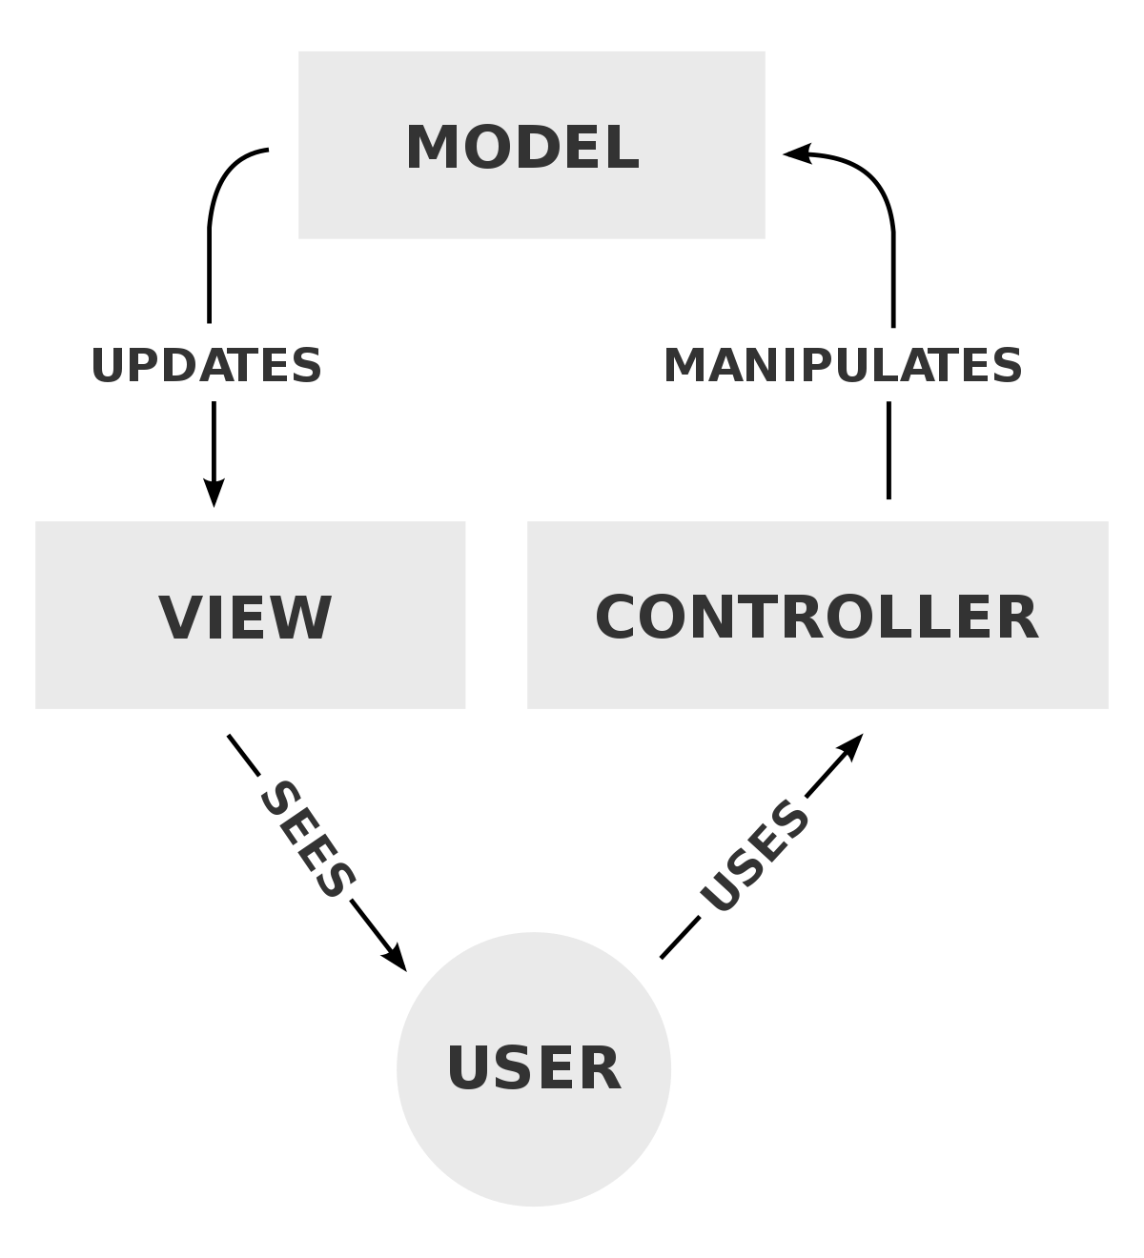

Slide 6
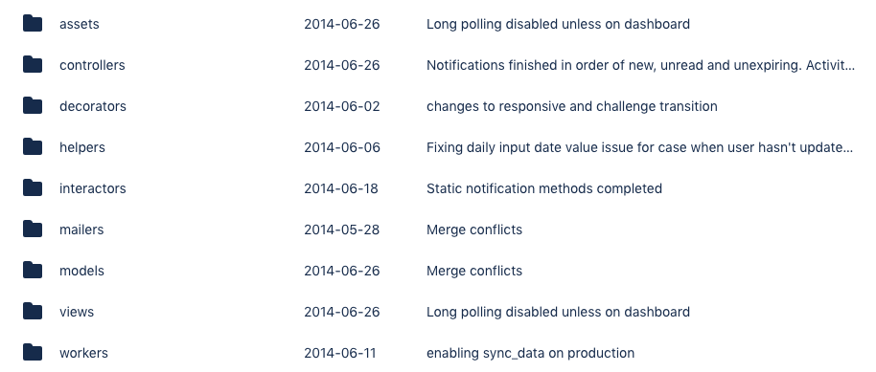

Slide 7
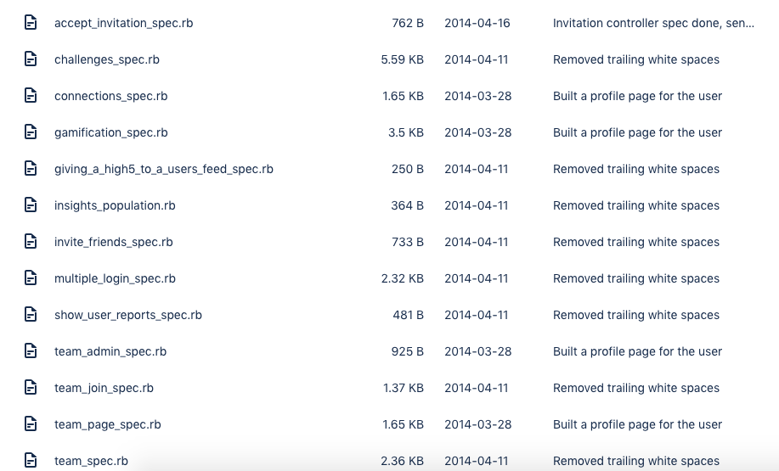

Slide 8
Why write any type of tests?
You think before you code. Human mind can only do one thing at the time if you want good results.
You understand the features from the user point of view.
You cover all the edge cases.
You think of design ahead of time.
Integrate faster and release your code to the public even faster with fewer bugs.
But remember having tests does not mean you not going to have bugs anymore. It only means you are going to spend less time debugging and more time developing.
AND

Slide 9
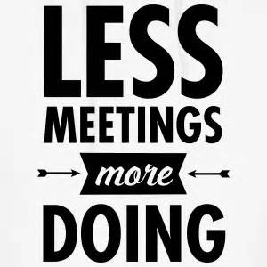
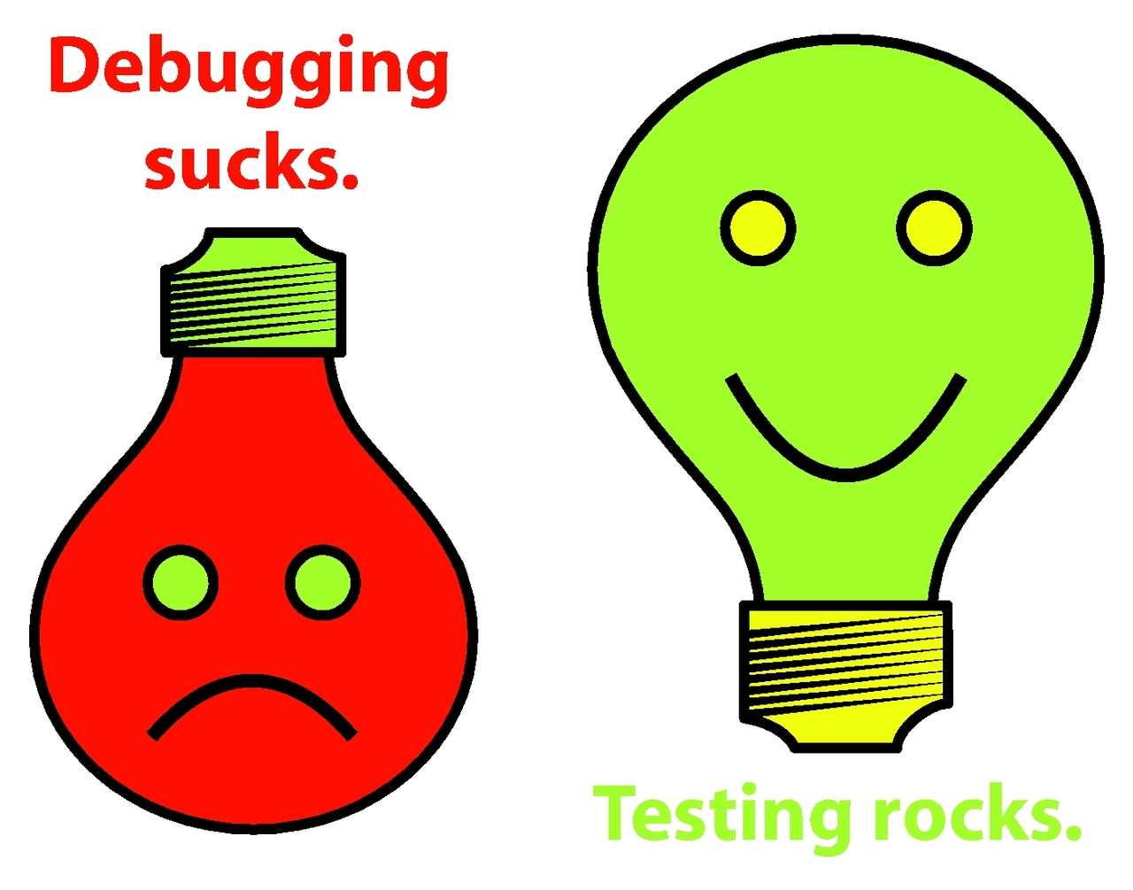

Slide 10
Rules
Separating State from Display
Decouple the user interface from the business logic (separate view from model) to simplify testing.
Focus on getting an end-to-end system passing the simplest tests.
If there are no acceptance tests for the portion of a system that needs to change, create acceptance tests before making the change.

Slide 11
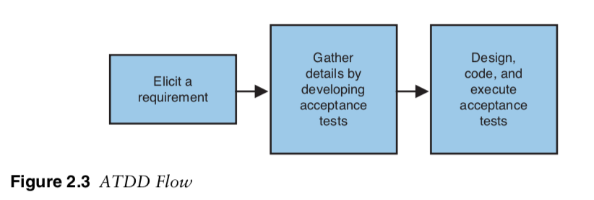

Slide 12
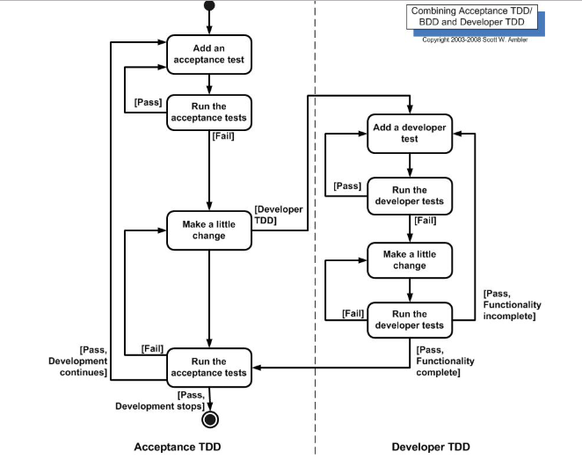

Slide 13
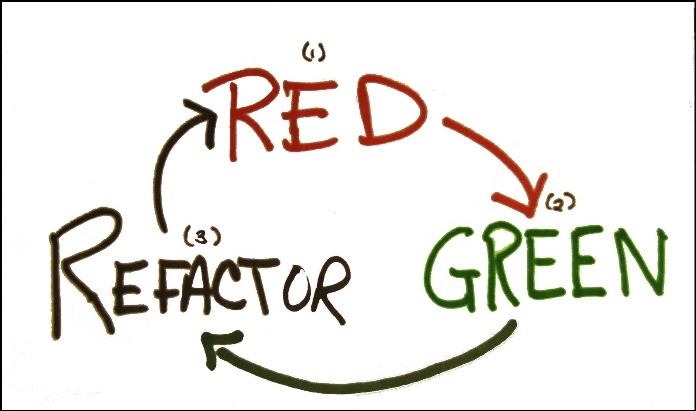

Slide 14
Testing End-to-End
Wherever possible, an acceptance test should exercise the system end-to-end
without directly calling its internal code.
An end-to-end test interacts with the system only from the outside: through its user interface, by sending messages as if from third-party systems, by invoking its web services, by parsing reports, and so on.
Just exercise the internal objects of the system, unless we really need the speed-up

Slide 15
Test structure
Effective layout of a test case ensures all required actions are completed, improves the readability of the test case, and smooths the flow of execution. Consistent structure helps in building a self-documenting test case. A commonly applied structure for test cases has (1) setup, (2) execution, (3) validation, and (4) cleanup.
Setup: Put the Unit Under Test (UUT) or the overall test system in the state needed to run the test.
Execution: Trigger/drive the UUT to perform the target behavior and capture all output, such as return values and output parameters. This step is usually very simple.
Validation: Ensure the results of the test are correct. These results may include explicit outputs captured during execution or state changes in the UUT.
Cleanup: Restore the UUT or the overall test system to the pre-test state. This restoration permits another test to execute immediately after this one.^{[8]}
test do
# setup - Prepare object for the test
# exercise - Execute the functionality we are testing
# verify - Verify the exercise's result against our expectation
# teardown - Resetting all data to pre-test state
end

Slide 16
The Given-When-Then formula is a template intended to guide the writing of acceptance tests for a User Story:
(Given) some context
(When) some action is carried out
(Then) a particular set of observable consequences should obtain
An example:
Given my bank account is in credit, and I made no withdrawals recently,
When I attempt to withdraw an amount less than my card's limit,
Then the withdrawal should complete without errors or warnings
context 'successful response' do let(:resource) { Factory(:resource) before { get :show, id: resource.id } specify { response.should be_successfull } end
Given - When - Then

Slide 17
How do you know if you have good tests?
The tests are a canary in a coal mine revealing by their distress the presence of evil design vapors. Here are some attributes of tests suggesting a design in trouble:
Long setup code—If you have to spend a hundred lines creating the objects for one simple assertion, something is wrong. Your objects are too big and need to be split.
Setup duplication—If you can’t easily find a common place for common setup code, there are too many objects too tightly intertwingled.
Long running tests—TDD tests that run a long time won’t be run often, and often haven’t been run for a while, and probably don’t work. Worse than this, though, they suggest that testing the bits and pieces of the application is hard.
Fragile tests—Tests that break unexpectedly suggest that one part of the application is surprisingly affecting another part. You need to design until the effect at a distance is eliminated, either by breaking the connection or by bringing the two parts together.

Slide 18
Database cleaner
Database Cleaner is a set of strategies for cleaning your database in Ruby.
The original use case was to ensure a clean state during tests. Each strategy is a small amount of code but is code that is usually needed in any ruby app that is testing with a database.
config.before(:suite) do
DatabaseCleaner.clean_with(:truncation)
end
config.before(:each) do
DatabaseCleaner.strategy = :transaction
end
config.before(:each, :js => true) do
DatabaseCleaner.strategy = :truncation
end
config.before(:each) do
DatabaseCleaner.start
end
config.after(:each) do
DatabaseCleaner.clean
end

Slide 19
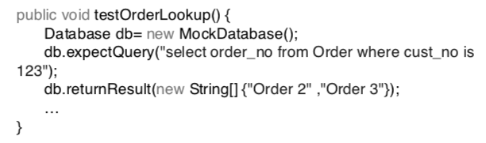
Mocks and Stubs
How do you test an object that relies on an expensive or complicated resource? Create a fake version of the resource that answers constants
Mocks will encourage you down the path of carefully considering the visibility of every object, reducing the coupling in your designs.
Mock Objects add a risk to the project—what if the mock doesn’t behave like the real object? You can reduce this strategy by having a set of tests for the mock that can also be applied to the real object when it becomes available.

Slide 20
Continuous integration
Integrate at least daily
Continuous Integration (CI) is a development practice that requires developers to integrate code into a shared repository several times a day. Each check-in is then verified by an automated build, allowing teams to detect problems early.
By integrating regularly, you can detect errors quickly, and locate them more easily.

Slide 21
TDD summary
Specification vs validation
Testing automation using regression
Small cycle for small changes imploying refactoring for better design
Decoupling user view from the business logic
Developing vs Debugging

Slide 22
Business Objects
Logical entities understandable to clients.
Physical entities or domain names used for explaining software requirements to a developer.
May or may not (but typically do) correspond to an actual single software object.

Slide 23
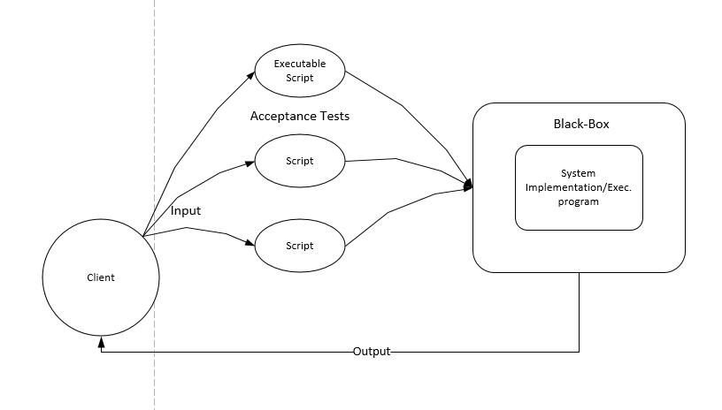
Acceptance testing
Conducted to meet the end user requirements of a contract for
the entire system.
Eg. Pen
In Software- Black-box testing
Client-readable acceptance
tests vs use cases

Slide 24
Issues
Incorrect or missing functions
Interface errors
Errors in data structures or external database access
Behavior or performance errors
Initialization and termination errors

Slide 25
ATDD
Behaviour Driven Development
Uses acceptance tests- more requirements than testing artifacts
Uses Anti-patterns- high level
Helps organize in form of scripts can get confusing for both devs and clients
Main difference in TDD and ATDD is the user involvement

Slide 26
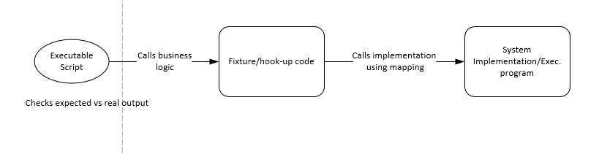
Scripting
Language to write acceptance tests.
Used to interact with the implementation of the program.
A specific set of commands and keywords.
Fixture code- guards the language of the clients from the keywords used in the application.

Slide 27
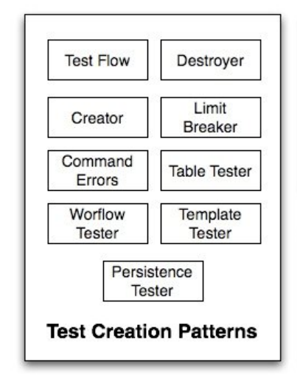
Categorization
Inter-related patterns for:(user gets test)
Test Creation
Test Organization
Test Application

Slide 28
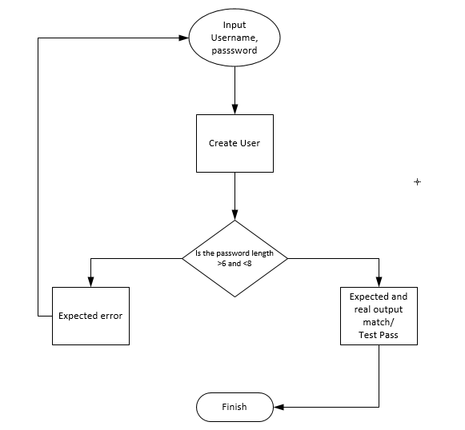
Limit Breaker
Context:
- Checking for overflow or underflow
Problem:
- Unchecked limits result in bugs
Solution:
- Outbound values throw errors
No
Yes
Notes:
Forces:
- Much of what is commonly included in the build sequence of a test can be summarized in an expressive command without lack of understanding

Slide 29
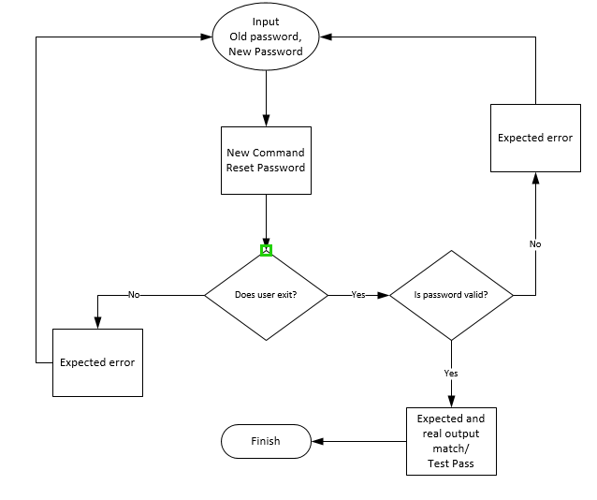
Command Error
Context:
- New Command in script set
Problem:
- Interaction with older implementation can lead to bugs
Solution:
- Error tests to check command’s scope, limits and invalid situations
- Should be put in script separately
Notes:
Forces:
- Much of what is commonly included in the build sequence of a test can be summarized in an expressive command without lack of understanding

Slide 30
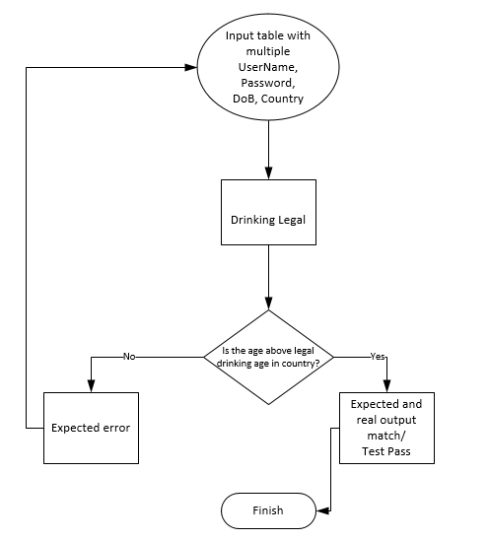
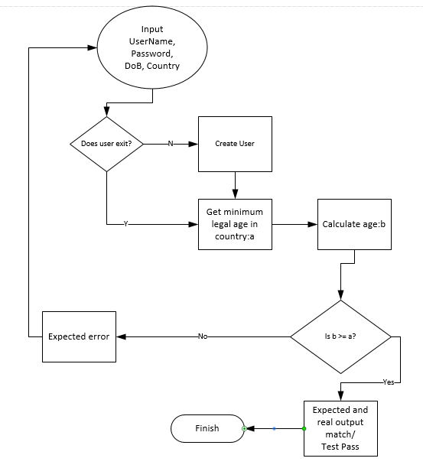
Table Tester
Context:
- Test Sequence of features for multiple similar business objects.
Problem:
- Clusters the script with too many similar commands.
Solution:
- Multiple Inputs given in tabular form.
- Hides associated algorithm in the fixture instead of in the script text
Notes:
Forces:
- Much of what is commonly included in the build sequence of a test can be summarized in an expressive command without lack of understanding

Slide 31
Workflow Tester(similar but opposite)
Context:
- Test extensive sequence of operations
Problem:
- Tables used to test workflow would make script too verbose
Solution:
- Use sequence of commands instead of tables
Notes:
Forces:
- Much of what is commonly included in the build sequence of a test can be summarized in an expressive command without lack of understanding

Slide 32
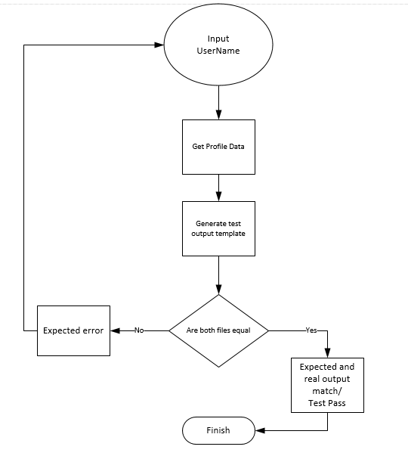
Template Tester
Context:
- Too much content to be matched in a single script
Problem:
- Script becomes difficult to understand
Solution:
- Files(textual or non-textual) can be matched as output with test output templates.
Notes:
Forces:
- Much of what is commonly included in the build sequence of a test can be summarized in an expressive command without lack of understanding

Slide 33
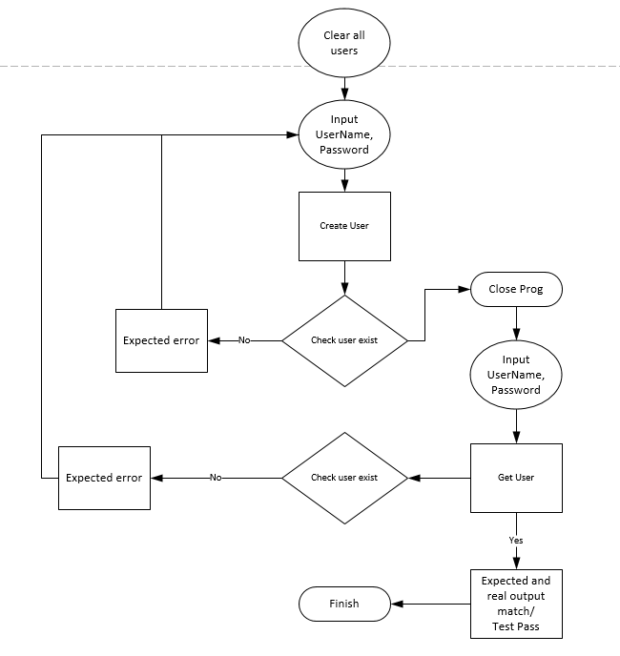
Persistence Tester
Context:
- Test if data persists
Problem:
- Lack of knowledge of testing persistence can obscure understanding and test coverage
Solution:
- Firstly, clear all data, enter new data and check, close program.
- Rerun the program and check the data.
Notes:
Forces:
- Much of what is commonly included in the build sequence of a test can be summarized in an expressive command without lack of understanding

Slide 34
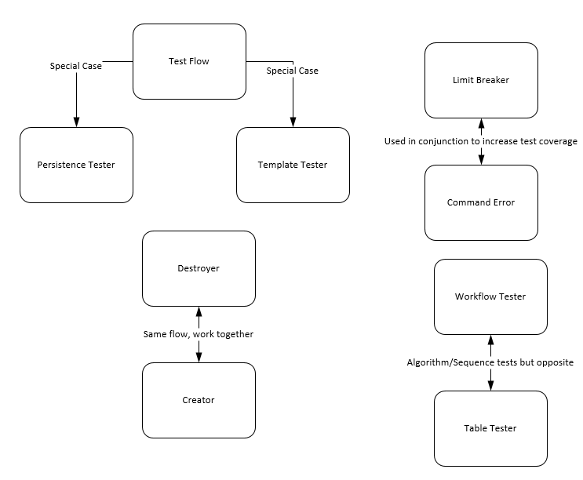
Relationship of Creation Patterns
Notes:
Forces:
- Much of what is commonly included in the build sequence of a test can be summarized in an expressive command without lack of understanding

Slide 35
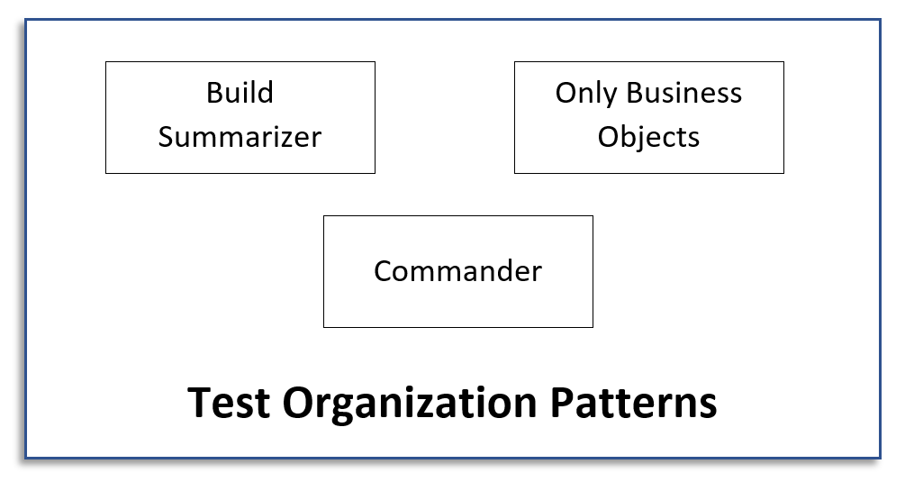
Commentor

Slide 36
Build Summarizer
Context:
- Too many tests in the script begin the same way
Problem:
- Repetition of the same test sequence in multiple tests hinders understanding and makes the scripts harder to maintain
Solution:
If multiple tests have the same setup or preparer commands sequence, set it aside as a separate single test sequence and have all tests that begin with it refer to it. Alternatively, create a preparer command if you need to hide its content from the script (only developers will have access to what it does, in the hookup code).
Notes:
Forces:
- Much of what is commonly included in the build sequence of a test can be summarized in an expressive command without lack of understanding

Slide 37
# bad
describe 'GET /routine' do
let(:article) { FactoryBot.create(:article, owner: owner) }
before { page.driver.get '/routine’ }
context 'when user is a normal person' do
let(:user) { normal poeple}
it 'morning routine' do
brush_teeth brush;
wash_face wash;
end
end
context 'when user is the President’ do
let(:user) { FactoryBot.create(:user, :President)
it 'morning routine' do
brush_teeth brush;
wash_face wash;
end
end
end
# good
describe 'GET /routine’ do
let(:article) { FactoryBot.create(:article, owner: owner) }
before { page.driver.get '/routine' }
shared_examples 'morning routine' do
it 'morning routine' do
brush_teeth brush;
wash_face wash;
end
End
context 'when user is a normal person’ do
let(:user) { normal people }
include_examples 'morning routine'
End
context 'when user is the President’ do
let(:user) { FactoryBot.create(:user, :President) }
include_examples 'morning routine'
end
end

Slide 38
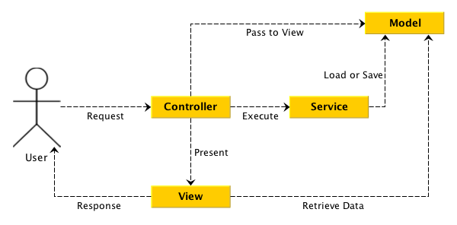
Only Business Objects (1)
Context:
- Non-business objects are included in the tests
Notes:
Forces:
- When clients don’t understand tests, their commitment to keep reviewing tests is lowered;
- Testing non-business objects is important and must be done as much as the testing of business objects

Slide 39
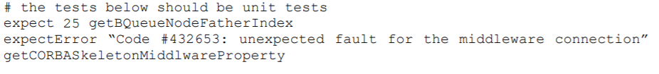
Only Business Objects (2)
Problem:
- When non-business objects are included in the script, the tests related to them will be unintelligible for the client, who typically is not a technical person and doesn’t understand non-business objects
Solution:
Only business objects should be tested in an acceptance test script. Remove all tests for non-BOs and make them unit tests instead. That way, such objects are still tested (in TDD, everything must be tested) but, as they are not a concern for the client, they should be hidden from him.
Notes:
Forces:
- When clients don’t understand tests, their commitment to keep reviewing tests is lowered;
- Testing non-business objects is important and must be done as much as the testing of business objects

Slide 40
Commentor
Context:
- Developers can’t understand exactly what some tests are doing.
Problem:
- If developers don’t understand a test, either development stalls or a bug or wrong requirement may be introduced in the program;
- Comments become inconsistent with the associated tests if they are not updated when the tests change.
Solution:
Ask the client for clarification and include it as a comment in the script, explaining the test. Additionally, whenever a test changes (after being clarified), the associated comments must be updated. Comments are an integral part of the test base and serve as the means of communicating how the program should behave. As the understanding of requirements and business rules evolve (including client's decisions) or doubts are cleared, comments must be added to be tests.
Notes:
Forces:
- Comments in the tests serve an important role of communication between clients and developers, as they further clarify the script that reconciles the languages of both.

Slide 41
# bad
describe 'GET /routine' do
let(:article) { FactoryBot.create(:article, owner: owner) }
before { page.driver.get '/routine’ }
# test the morning routine for a normal person
context 'when user is a normal person' do
let(:user) { normal people}
it 'morning routine' do
brush_teeth brush;
wash_face wash;
end
end
# test the morning routine for the President
context 'when user is the President’ do
let(:user) { FactoryBot.create(:user, :President)
it 'morning routine' do
brush_teeth brush;
wash_face wash;
end
end
end
# good
describe 'GET /routine’ do
let(:article) { FactoryBot.create(:article, owner: owner) }
before { page.driver.get '/routine' }
# common morning routine
shared_examples 'morning routine' do
it 'morning routine' do
brush_teeth brush;
wash_face wash;
end
End
# test the morning routine for normal people
context 'when user is a normal person' do
let(:user) { normal people }
include_examples 'morning routine'
End
# test the morning routine for the President
context 'when user is the President' do
let(:user) { FactoryBot.create(:user, :President) }
include_examples 'morning routine'
end
end

Slide 42
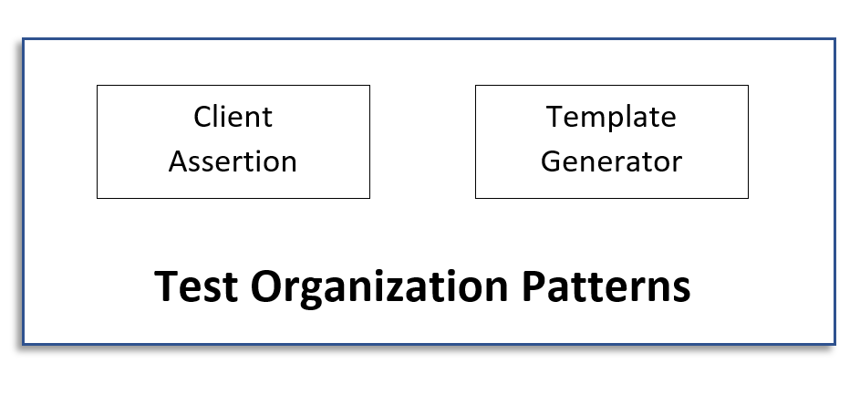
Test Application Patterns

Slide 43
Client Assertion
Context:
- A developer has found a potential wrong test (test bug).
Problem:
- If developers change what they think might be test bugs by themselves, potential feature creep will emerge in the program;
- If test bugs are not discovered the system may not be what the clients expect
Solution:
Every time a doubt arises over a test (i.e., involving requirements and/or business rules), developers should ask the client for clarification. No test should be modified without the client's consent. This avoids developers introducing errors in the test base and can serve as a means of impelling the client towards reviewing the tests. Additionally, the clarification should be included as comments in the tests.
Notes:
Forces:
- Clients must frequently review tests to assure they are correct

Slide 44
Template Generator
Context:
- Development is under way and partially working software is available. You need to find more test cases.
Problem:
- As development progresses, it becomes harder to find test cases other than the more direct examples of software functions.
Solution:
Have the client or end user operate the partially working software and provide a background mechanism to automatically generate a test script based on his actions (by recording the sequence of actions). When the client is done with a given operation, he examines the results that were presented and either accepts or rejects it. This result then functions as a template for a test consisting in the sequence of actions performed by the client.
Notes:
Forces:
- Automation speeds up test creation;
- Software usage by the client can reveal bugs that would otherwise not be considered;
- Providing a recording mechanism requires extra effort by the developers.
Beta version for internal testing

Slide 45
References:
Test Driven Development: By Example - Kent Beck
Clean Code: A Handbook of Agile Software Craftsmanship 1st Edition - Robert Martin
Lean-Agile Acceptance Test-Driven Development: Better Software Through Collaboration - Ken Bugh
Refactoring: Improving the Design of Existing Code - Martin Fowler and Kent Beck

Slide 46

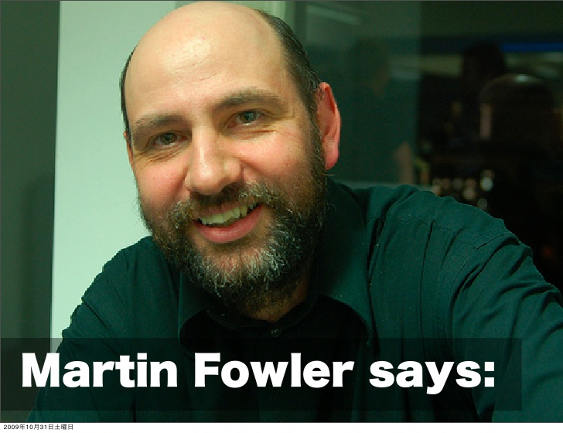
Don’t show me your code without writing tests for them.

Slide 47
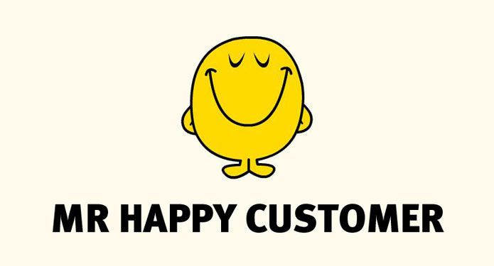
Thank you !
Now you know how to have a
Notes:
I hope you guys understood how important user acceptance is and I hope after learning from these patterns, your customers will be really happy and give in a good word for you within his network.

