Slide 1
Abstract Factory Pattern
Jim Fawcett
CSE776 – Design Patterns
Fall 2017

Slide 2
Intent
“Provide an interface for creating families of related or dependent objects without specifying their concrete classes.”
  provide a simple creational interface for a complex family of classes
    Client does not have to know any of those details.
  avoid naming concrete classes
    Clients use abstract creational interfaces and abstract product interfaces. Concrete classes can be changed without affecting clients.
    Clients can stay blissfully unaware of implementation details
    This is critically important!
Why is this so important?

Slide 3
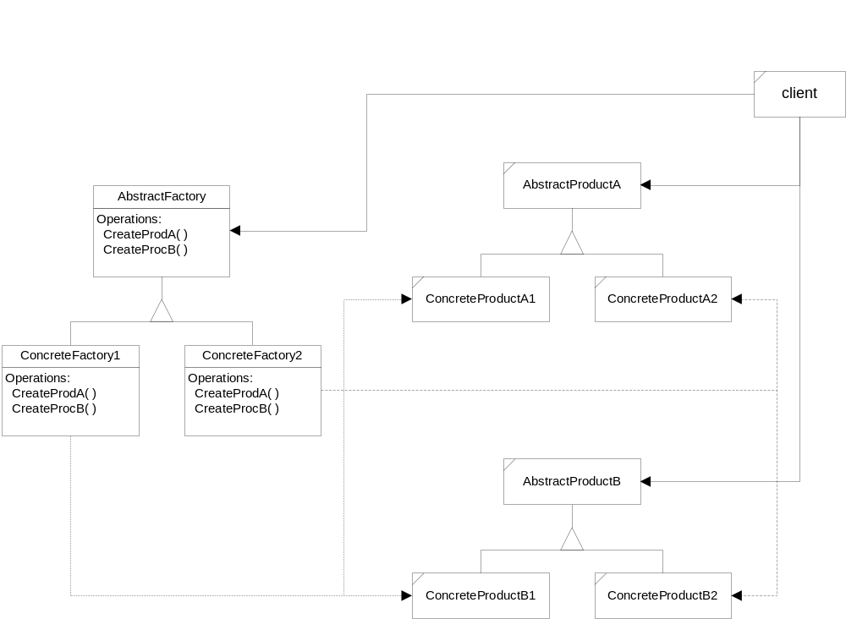
Abstract Factory Structure

Slide 4
Motivating Examples
Target multiple platforms by creating component instances for selected platform, i.e. Windows and Linux and iOS.
Design neural network layers to contain the technology for their own construction, allowing networks to focus on learning strategies.

Slide 5
Forces
The deep copy object model, used by the C++ language, binds a class to all the concrete classes it uses.
  The class’s header file holds information about supporting classes to allow them to be created and used.
  If one of the serving classes changes, the using class must also change, and every class that uses this class must also change.
To prevent this “top-to-bottom” binding, a class must bind to interface abstractions instead. It must also use factories as proxies to create the instances it uses.
In a large system we will be likely to use interfaces and factories between subsystems. A factory will then need to manage creation of many of the objects within a subsystem.

Slide 6
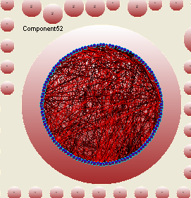
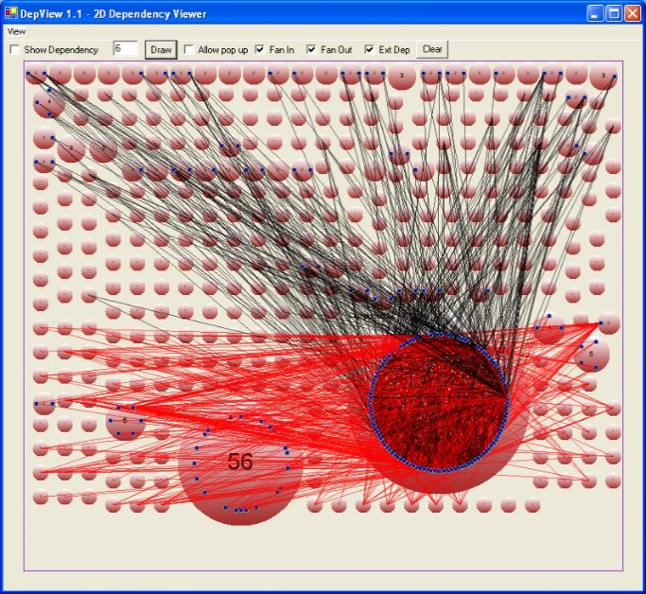
Dependencies – Mozilla, version 1.4.1
Strong component of dependency graph, e.g., set of mutually dependent files

Slide 7
Forces
Languages like C# and Java have less need for factories due to their shallow reference object model.
  The physical layout of code for a given class does not depend on the sizes of the objects it uses, unlike C++.
  The new operator extracts information about how to build an instance from its class’s metadata, not from the classes that use it, unlike C++.
However, even for these languages the Abstract Factory Pattern is still useful!
  Interfaces support the exchange of implementing types, even at run-time, which is often very useful.
  Factories support binding of specific objects to these interfaces, without requiring clients to have knowledge of the specific types.

Slide 8
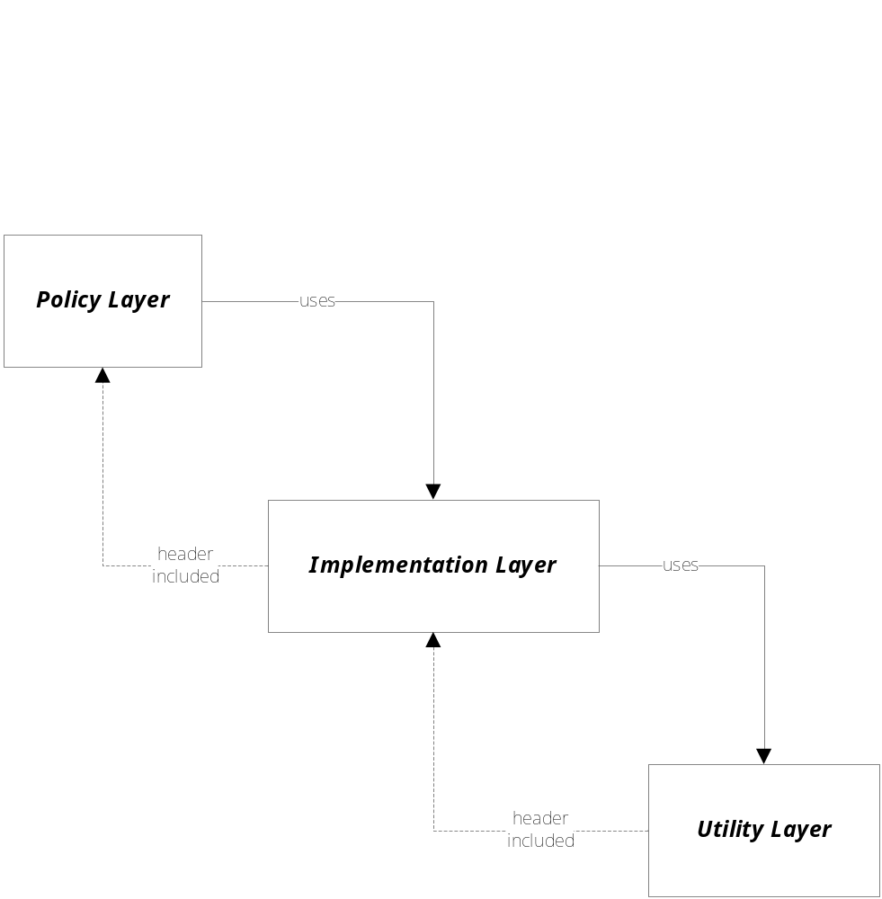
Logical System Layering

Slide 9
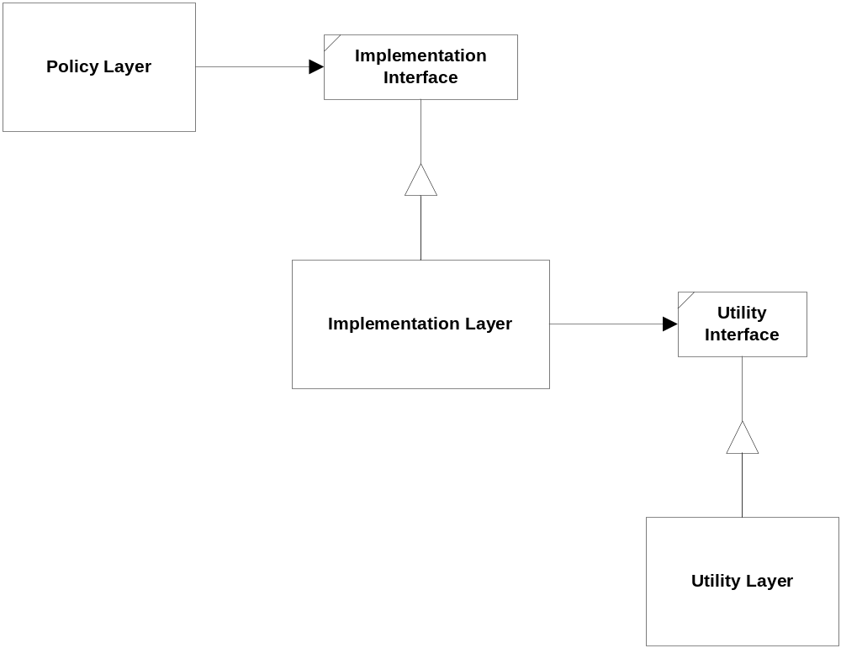
Dependency Inversion Principle

Slide 10
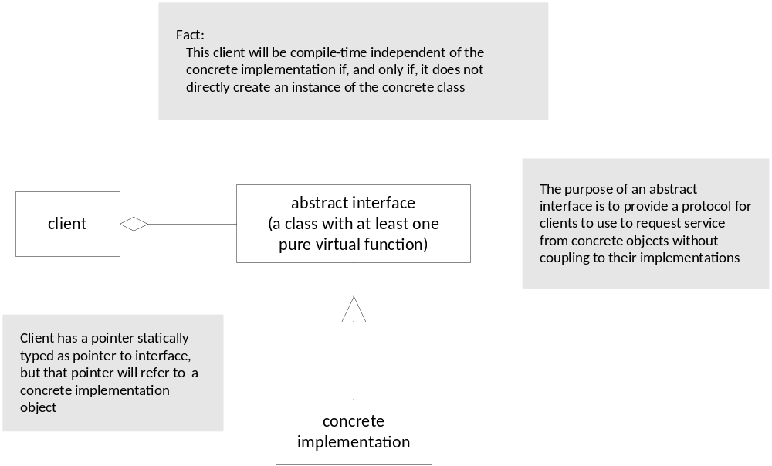
Abstract Interface

Slide 11
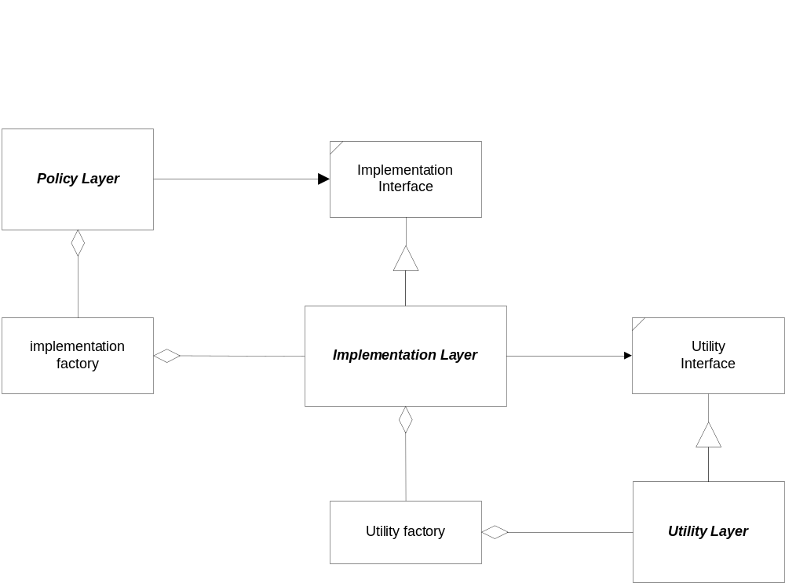
Layering with Abstract Interfaces

Slide 12
Applicability
Use the Abstract Factory Pattern if:
  clients need to be ignorant of how servers are created, composed, and represented.
  clients need to operate with one of several families of products
  a family of products must be used together, not mixed with products of other families.
  you provide a library and want to show just the interface, not implementation of the library components.
    Giving customers your product header files may disclose some of your proprietary value.

Slide 13
Abstract Factory Structure

Slide 14
Participants
Why is there a parallel hierarchy of factories and products?
AbstractFactory
  provide an interface for building product objects
ConcreteFactory
  implements the creation functionality for a specific product family
AbstractProduct
  provides an interface for using product objects
ConcreteProduct
  created by a ConcreteFactory, implements the AbstractProduct interface for a specific product family
Client
  uses only abstract interfaces so is independent of the implemen-tation.

Slide 15
Collaborators
Usually only one ConcreteFactory instance is used for an activation, matched to a specific application context. It builds a specific product family for client use -- the client doesn’t care which family is used -- it simply needs the services appropriate for the current context.
The client may use the AbstractFactory interface to initiate creation, or some other agent may use the AbstractFactory on the client’s behalf.
The factory returns, to its clients, specific product instances bound to the product interface. This is what clients use for all access to the instances.

Slide 16
Presentation Remark
Here, we often use a sequence diagram (event-trace) to show the dynamic interactions between participants.
For the Abstract Factory Pattern, the dynamic interaction is simple, and a sequence diagram would not add much new information.

Slide 17
Consequences
The Abstract Factory Pattern has the following benefits:
  It isolates concrete classes from the client.
    You use the Abstract Factory to control the classes of objects the client creates.
    Product names are isolated in the implementation of the ConcreteFactory, clients use the instances through their abstract interfaces.
  Exchanging product families is easy.
    None of the client code breaks because the abstract interfaces don’t change.
    Because the abstract factory creates a complete family of products, the whole product family changes when the concrete factory is changed.
  It promotes consistency among products.
    It is the concrete factory’s job to make sure that the right products are used together.

Slide 18
Consequences
More benefits of the Abstract Factory Pattern
  It supports the imposition of constraints on product families, e.g., always use A1 and B1 together, otherwise use A2 and B2 together.

Slide 19
Consequences
The Abstract Factory pattern has the following liability:
  Adding new kinds of products to existing factory is difficult.
    Adding a new product requires extending the abstract interface which implies that all of its derived concrete classes also must change.
    Essentially everything must change to support and use the new product family
      abstract factory interface is extended
      derived concrete factories must implement the extensions
      a new abstract product class is added
      a new product implementation is added
      client has to be extended to use the new product

Slide 20
Abstract Factory Structure
To add a new product, all the factory interfaces must change.

Slide 21
Implementation
Concrete factories are often implemented as singletons.
Creating the products
  Concrete factory usually use the factory method.
    simple
    new concrete factory is required for each product family
  alternately concrete factory can be implemented using prototype.
    only one is needed for all families of products
    product classes now have special requirements - they participate in the creation

Slide 22
Implementation
Defining extensible factories by using create function with an argument
  only one virtual create function is needed for the AbstractFactory interface
  all products created by a factory must have the same base class or be able to be safely coerced to a given type
  it is difficult to implement subclass specific operations

Slide 23
Know Uses
Interviews
  used to generate “look and feel” for specific user interface objects
  uses the Kit suffix to denote AbstractFactory classes, e.g., WidgetKit and DialogKit.
  also includes a layoutKit that generates different composite objects depending on the needs of the current context
ET++
  another windowing library that uses the AbstractFactory to achieve portability across different window systems (X Windows and SunView).
COM – Microsoft’s Component Object Model technology
  Each COM component provides a concrete factory bound to the IClassFactory interface and provides clients specific instances bound to the server’s product interface.

Slide 24
Related Patterns
Factory Method -- a “virtual” constructor
Prototype -- asks products to clone themselves
Singleton -- allows creation of only a single instance

Slide 25
Code Examples
Skeleton Example
  Abstract Factory Structure
  Skeleton Code
Neural Net Example
  Neural Net Physical Structure
  Neural Net Logical Structure
  Simulated Neural Net Example

Slide 26
End of Presentation

