Slide 1
WPF and Legacy Code
Henry Sowizral
Architect, Microsoft Expression Studio
Ivo Manolov
Test Manager, WPF

Slide 2
Objectives and Takeaways
Objectives
  Learn how to augment a native application with a WPF interface
  Learn to ensure quality by reducing errors during migration
  Answer such questions as:
    “Can you move an MFC (Win32) based application to WPF?”
    “Does it make more sense to rewrite than migrate?”
    “How do you design an native to managed code interop solution?”
Takeaways
  User Experience matters—it adds value
  WPF makes adding a rich UX easier
  Adding a rich UX does not require a full rewrite

Slide 3
Overview
Introduction to WPF and Win32 interop
  Why WPF?
  Types of WPF-Win32 Interop
WPF and legacy code (deep dive)
  Case study: Expression™ Design
  MFC to WPF in three easy steps
  The hard work: converting the UI
Summary

Slide 4
Introduction to WPF and Win32 Interop
Ivo Manolov

Slide 5
Why WPF?
Because it’s 2008
User experience matters
  Usability is a competitive advantage
  Usability is productivity
Rich integrated experiences require rich, integrated platforms
WPF supports proper SW design
  The use of MVC these days is crucial
  You get to do WYSIWYG UI design
WPF is paying a lot of the “taxes” for you
WPF TCO is significantly lower than the equivalent Win32 / DHTML / DirectX TCO.
WPF is Microsoft’s premier desktop application development framework

Slide 6
WPF vs Win32
WPF features:
  Control composition
  Control styling and templating
  Vector UI
  Advanced text
  2D / 3D / Imaging / Media / Animations

Slide 7
WPF Supports MVC Natively
Presentation Layer
(*.XAML)
Business Logic
(*.CS / *.CPP)
DBs
Web Services
COM / Win32 / .NET components

Slide 8
WPF-Native Interoperation
Traditional Interop (since .NET 1.0)
  Call into flat API DLLS (e.g. kernel32.dll)
  COM Interop
Hosting scenarios
  WPF hosting an HWND (HwndHost)
  WPF hosting WinForms (WindowsFormHost)
  HWND hosting WPF (HwndSource)
  WinForms hosting WPF (ElementHost)

Slide 9
WPF Hosting WinForms Controls
Three simple steps:
Add a <WindowsFormsHost…/> to your XAML
Add a reference to the namespace of your WinForms control and instantiate the control in XAML
Add event handlers to propagate WinForms control events to the WPF app.
<Window ...
xmlns:wf="clr-namespace:System.Windows.Forms;assembly=System.Windows.Forms"
>
...
<WindowsFormsHost>
<wf:DataGridView
x:Name="dataGridView"
Location="0, 0"
ColumnHeadersVisible="True"
SelectionMode="FullRowSelect"
MultiSelect="False"
SelectionChanged="DataGridViewOnSelectionChanged"
/>
</WindowsFormsHost>
...
</Window>

Slide 10
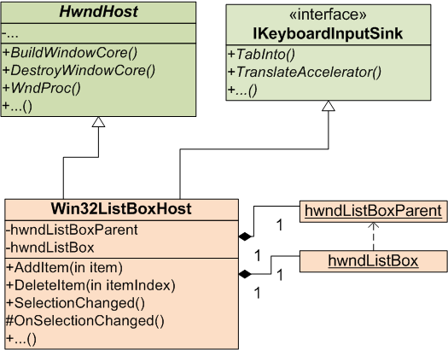
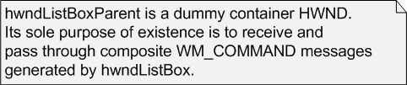
WPF Hosting HWNDs

Slide 11
WPF Hosting HWNDs (cont.)
class Win32ListBoxHost : HwndHost, IKeyboardInputSink
{
public int AddItem(string item) {...}
public void DeleteItem(int itemIndex) {...}
...
public event EventHandler SelectionChanged;
protected virtual void OnSelectionChanged(EventArgs args) {...}
bool IKeyboardInputSink.TabInto(TraversalRequest request);
bool IKeyboardInputSink.TranslateAccelerator(ref MSG msg, ModifierKeys mk);
protected override HandleRef BuildWindowCore(HandleRef hwndParent) {...}
protected override void DestroyWindowCore(HandleRef hwnd) {...}
protected override IntPtr WndProc(IntPtr hwnd, int message, IntPtr wParam,
IntPtr lParam, ref bool handled) {...}
}
<Window ... xmlns:a="clr-namespace:Win32ControlInWpfWindow;assembly=">
...
<a:Win32ListBoxHost x:Name=“listbox“ Width=“100“ Height=“100“
SelectionChanged=“MySelectionChangedHandler”/>
...
</Window>

Slide 12
WPF Hosting HWNDs—Gotchas
BuildWindowCore is where you instantiate your HWND. You typically need to instantiate it as a child of a dummy parent HWND.
Do not expose Win32-esque idioms to the users of your HwndHost-derived class.
Be aware of airspace limitations.
Be aware of transform and opacity limitations (no transforms, 100% opacity only)
  Implement custom layout / scaling logic to be able to scale up/down the UI.
Do not forget keyboard accessibility and accessibility in general.

Slide 13
WPF and Legacy Code
(Deep Dive)
Henry Sowizral

Slide 14
Overview
Case study: Expression™ Design
Demo of Expression Design
MFC to WPF in 3 Easy Steps
User Interface Constituents
  Visual Components
  Focus (and event processing)
Summary

Slide 15
Motivation
Multiple products in Expression Studio
  Expression Blend—newly written (WPF / C#)
  Expression Design—legacy (MFC / ASM, C, C++)
Consistent look and feel
Establish the “Expression” brand

Slide 16
The Need
Product perspective
  A consistent user experience across products
  Cutting edge UI that inspires designers
Development perspective
  Enable rapid development
  Resilience to UX specification changes
  Incremental update

Slide 17
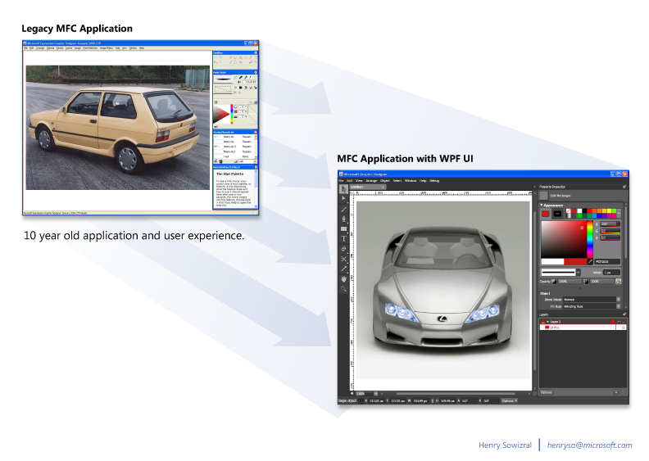
The Transformation Desired

Slide 18
Expression Design
10 year old C++ code base
  Structured to run on both Windows and Mac
10 year old user experience (look and feel)
  Poor separation of data model and user interface

Slide 19
Possible Approaches
Rewrite using MFC
  — costly
Use owner-draw to “recolor” the UI
— cosmetic
Use WPF
  — makes sense

Slide 20
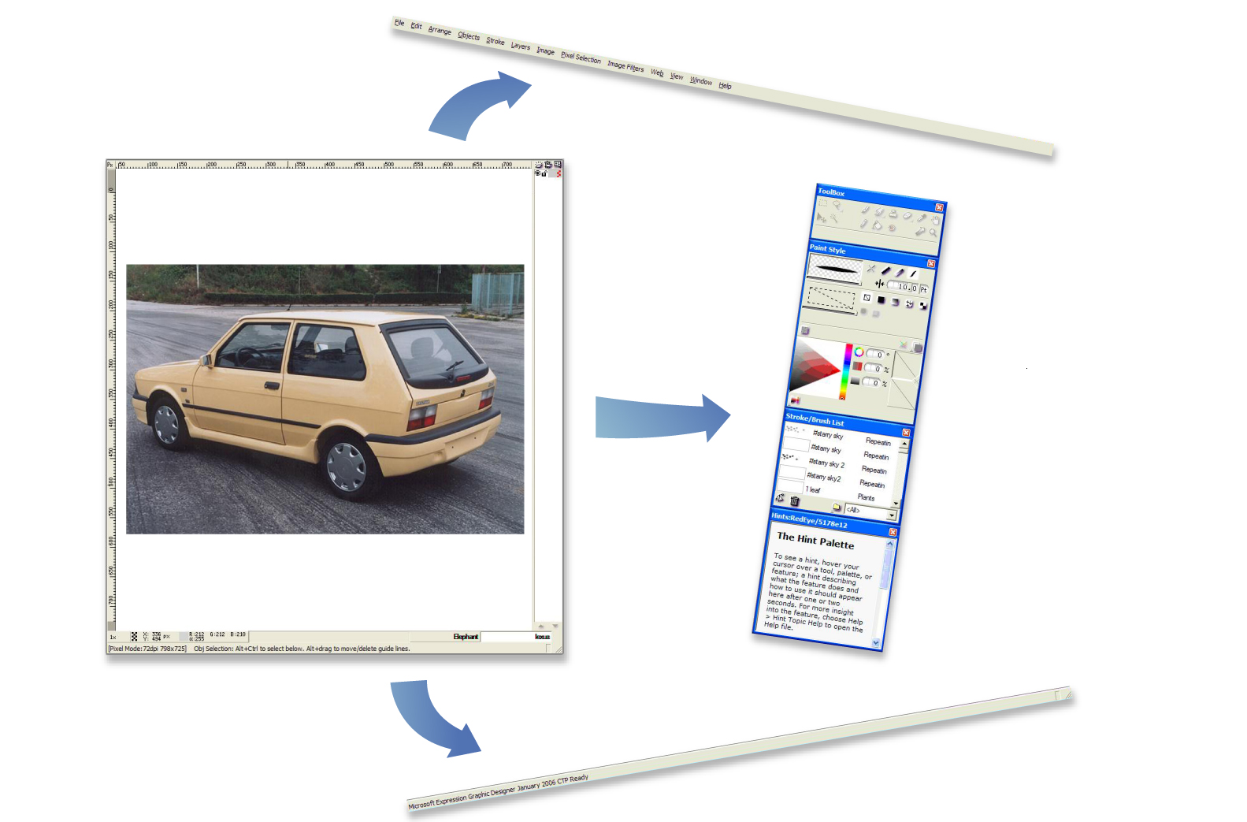
Separate The Core From The Interface

Slide 21
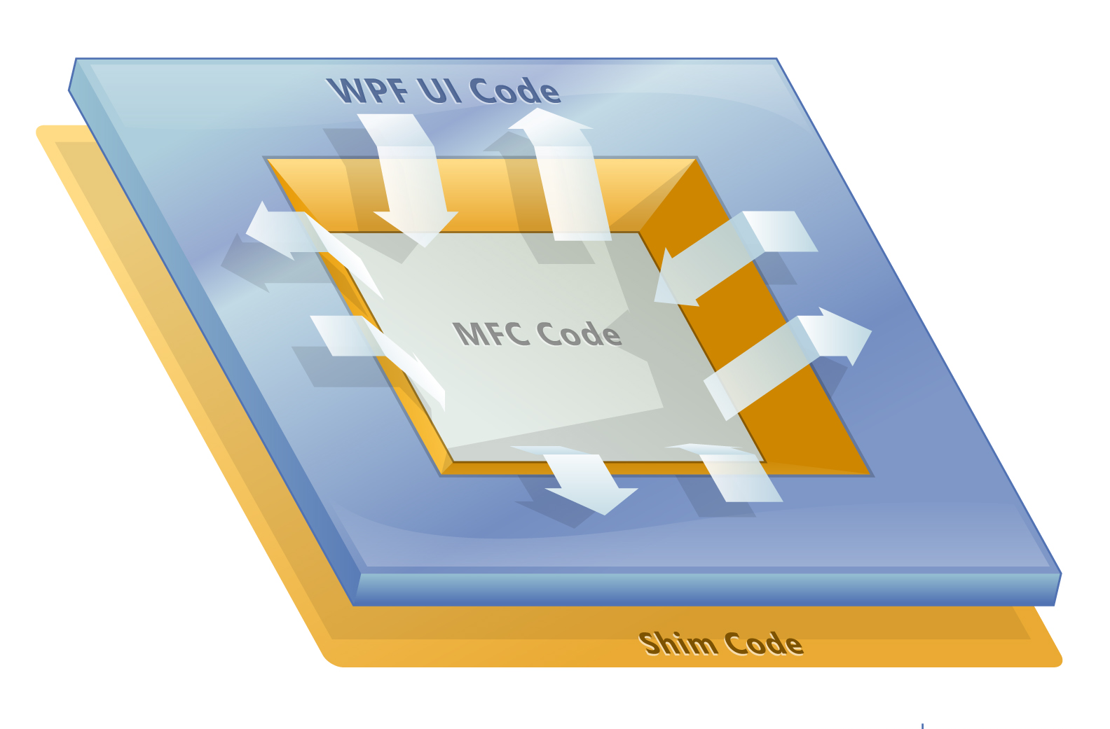
New Architecture

Slide 22
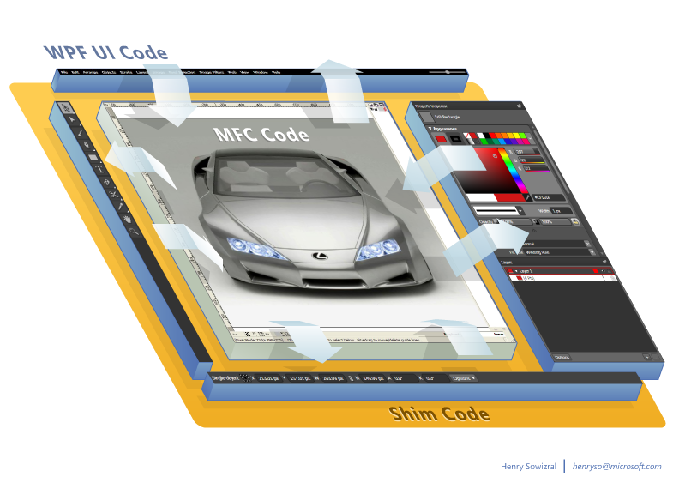
Apply The Architecture

Slide 23
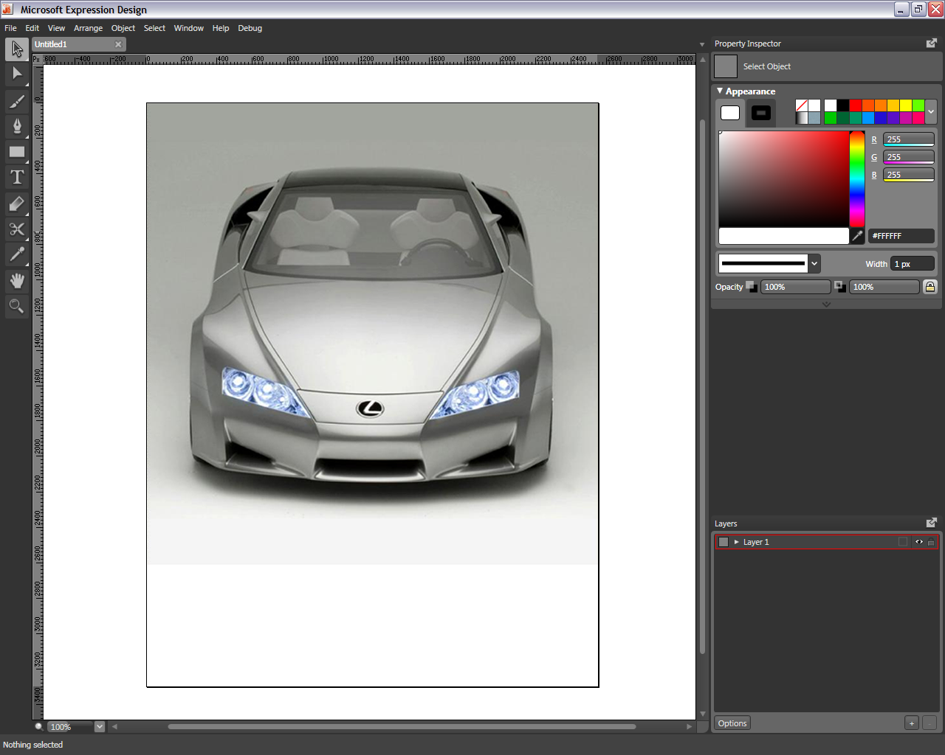
The Result (of The Face Lift)

Slide 24
Converting an MFC Application to Use a WPF User Interface
In three easy steps…

Slide 25
Modify The MFC Application
Split the MFC application in two
  Turn the application into a DLL
  Construct a stub “main” to call the new DLL
Clean up memory allocation, if needed
  Remove all instances of local (custom) “new”s
  Ensure all thread local storage “operates well” in a delay loaded DLL

Slide 26
Create A WPF Application And Integrate The MFC Code
Construct a new “main”
  Calls the new MFC dll
  Creates a WPF window for hosting MFC code
Subclass HwndHost, specifically
  BuildWindowCore to
    Take the WPF Hwnd that parents the MFC app
    Return the child Hwnd created by the MFC app
  DestroyWindowCore to
    Destroy the child Hwnd

Slide 27
Subclassing HwndHost
public class MFCHwndHost : HwndHost
{
protected override HandleRef BuildWindowCore(HandleRef hwndParent)
{
IntPtr childWindow = MFCHost.CreateChildWindow(hwndParent.Handle);
HandleRef childWindowHandleRef = new HandleRef(this, childWindow);
return childWindowHandleRef;
}
protected override void DestroyWindowCore(HandleRef hwnd)
{
// TODO.
}
}

Slide 28
Create the WPF UI And Connect It To The MFC Code
Define the new WPF-based user interface
Integrate the new UI with the MFC DLL
  Use the C++ compiler’s /CLR option to create adapter code between MFC and WPF
  Or use P/Invoke to call the MFC DLL
    Construct static entry points in the MFC application for use by the new UI
    Write the UI code to use the newly constructed entry points via .NET’s native calling capability

Slide 29
Mimicking Windows
— to match MFC’s expectations

Slide 30
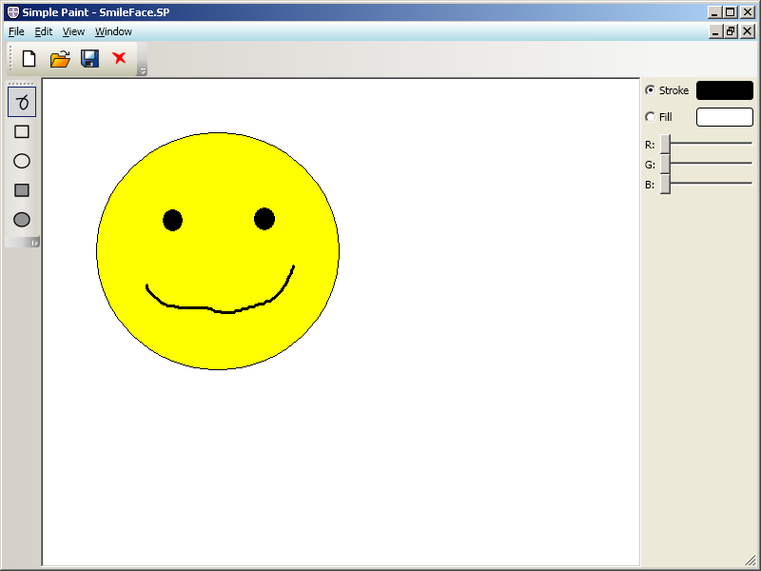
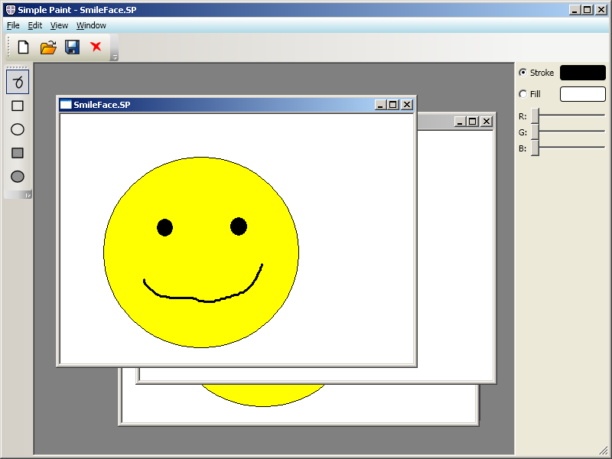
What Breaks?

Slide 31
What Breaks MFC in WPF?
MFC expects a specific windows hierarchy
  Assumption: the parent of an MFC’s root window should be the display
Hosting within WPF breaks that expectation
Just hosting MFC in WPF is not enough
  MDI sometimes optimizes out message
Need to regeneration or relaying messages

Slide 32
Making MFC MDI Work
Override MFC event handlers to
  Propagate the minimize/maximize/close events
    OnWindowPosChanged
    OnSysCommand—but only if command ID is SC_CLOSE
    OnClose
  Propagate non-client area refresh (MDI frames)
    OnMDIActivate—emit WM_NCACTIVATE
    OnSize—emit WM_NCACTIVATE
      But only when WS_SYSMENU is cleared and restoring or minimizing
      Lastly, force WS_SYSMENU to true

Slide 33
void CChildFrame::OnSysCommand(UINT nID, LPARAM lParam)
{
CMDIChildWnd::OnSysCommand(nID, lParam);
if (gRegisterMDIStateChangedCallback != NULL
&& nID == SC_MINIMIZE
|| nID == SC_MAXIMIZE
|| nID == SC_RESTORE)
{
gRegisterMDIStateChangedCallback();
}
}

Slide 34
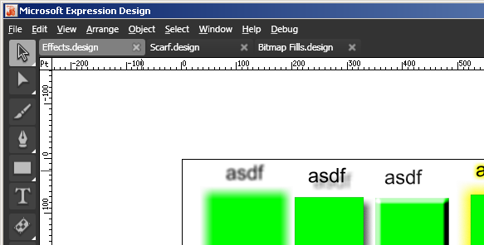
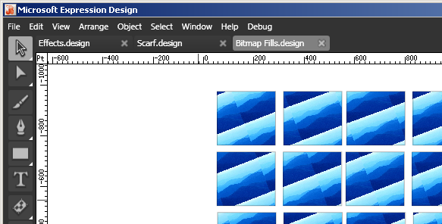
But Consider Document Tabs

Slide 35
A New User Interface
Defining and Integrating WPF and C++

Slide 36
User Interface Constituents
Visual Components
  Application window(s)
  Control Panels (Controls)
  Dialogs
Focus (and event processing)

Slide 37
Visual Components
— converting to the new look and feel

Slide 38
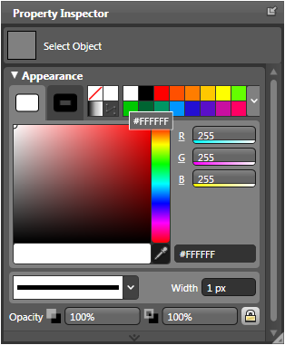
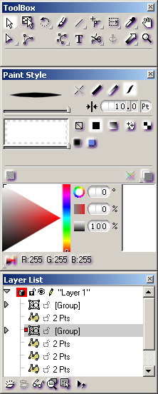
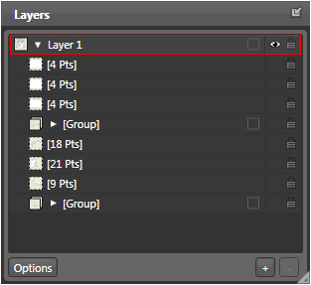
Controls Before and After

Slide 39
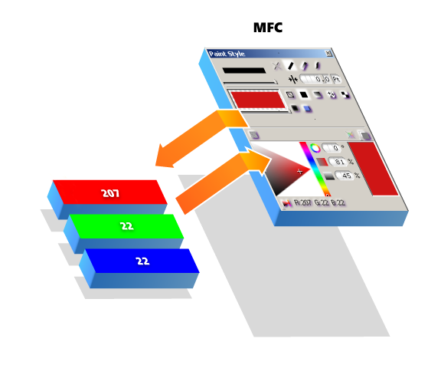
An MFC Control

Slide 40
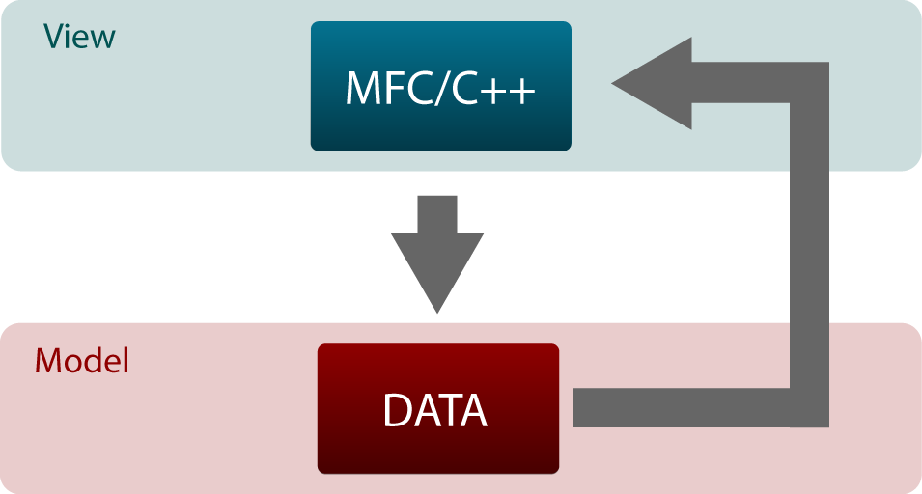
Information Flow Within MFC

Slide 41
MFC Control Source Code
PaintPalette::HandleControlMessage(int controlID, Message& message)
{
switch (controlID)
{
// ...
case STROKE_BUTTON_PRESSED:
SwapToColorControl(STROKE_CONTROL);
ControlProperties.SetStrokeType(SOLID);
ControlProperties.SetStrokeColor(currentColor);
ControlProperties.InvalidateStrokeColor();
SetColorControlFocus(STROKE_FOCUS);
CommonProperties.InvalidateStrokeType();
CommitPropertyChanges();
break;
// ...
}
}

Slide 42
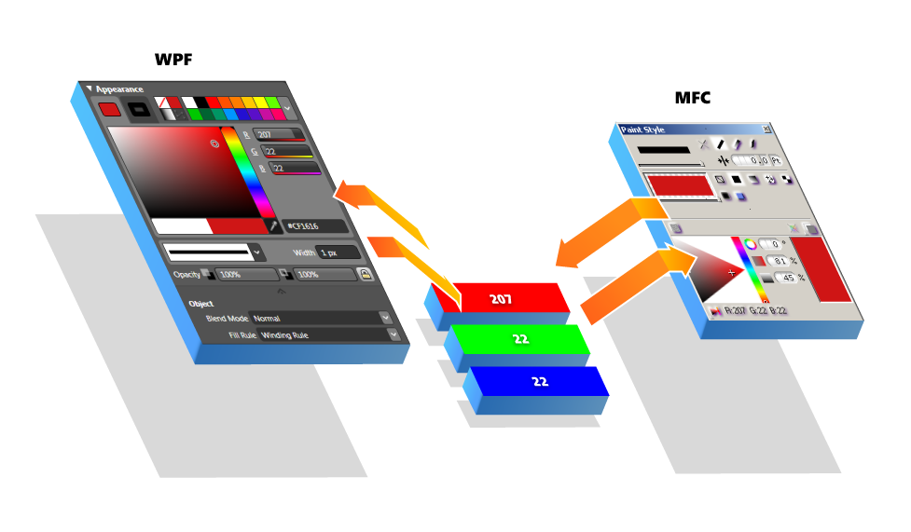
Model View Controller

Slide 43
Separating Model and View
Separate
  Model (underlying data)
  View (presentation) and Controller (operations)
Identify the model (data) manipulation code
  Encapsulate it as a method
  Move it to a supporting class/file
  Replace it with a call to the encapsulated method

Slide 44
Identify Model Manipulation
PaintPalette::HandleControlMessage(int controlID, Message& message)
{
switch (controlID)
{
// ...
case STROKE_BUTTON_PRESSED:
SwapToColorControl(STROKE_CONTROL);
ControlProperties.SetStrokeType(SOLID);
ControlProperties.SetStrokeColor(currentColor);
ControlProperties.InvalidateStrokeColor();
SetColorControlFocus(STROKE_FOCUS);
CommonProperties.InvalidateStrokeType();
CommitPropertyChanges();
break;
// ...
}
}

Slide 45
Extract Model Manipulation Code
void PaintPaletteLinkage::SetSolidStroke_BB1(newColor)
{
PaintAttribute.SetStrokeType(SOLID);
PaintAttribute.SetStrokeColor(newColor);
CommonAttributes.InvalidateStrokeColor();
}
void PaintPaletteLinkage::SetSolidStroke_BB2 ()
{
CommonAttributes.InvalidateStrokeType();
}

Slide 46
Call Extracted Code
PaintPalette::HandleControlMessage(int controlID, Message& message)
{
switch (controlID)
{
// ...
case SOLID_STROKE_BUTTON:
SwapToColorControl(STROKE_CONTROL);
PaintPaletteLinkage::SetSolidStroke_BB1(currentColor);
SetColorControlFocus(STROKE_FOCUS);
PaintPaletteLinkage::SetSolidStroke_BB2();
CommitPropertyChanges();
break;
// ...
}
}

Slide 47
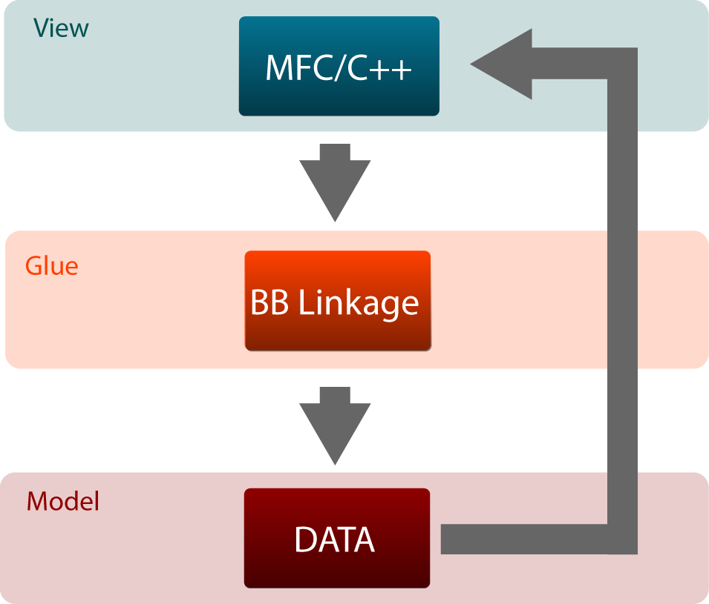
Information Flow In The Interim

Slide 48
Xaml (Defining A Button)
...
<Button
Command="{Binding SetSolidStrokeCommand}" />
...

Slide 49
Backing Code
public ICommand SetSolidStrokeCommand
{
get { return new CommandProxy(this.SetSolidStrokeType); }
}
public void SetSolidStrokeType()
{
this.PaintPaletteShim.StrokeType = Shims.StrokeType.Solid;
this.PaintPaletteShim.CommitAndUpdate();
}

Slide 50
Shim
void SetSolidStrokeType()
{
uint32 ambientColor = PaintAttribute.GetAmbientStrokeColor();
PaintPaletteLinkage::SetSolidStroke_BB1(ambientColor);
PaintPaletteLinkage::SetSolidStroke_BB2();
}
…
public delegate void UpdateEventHandler();
public UpdateEventHandler^ updatePaintPalette;

Slide 51
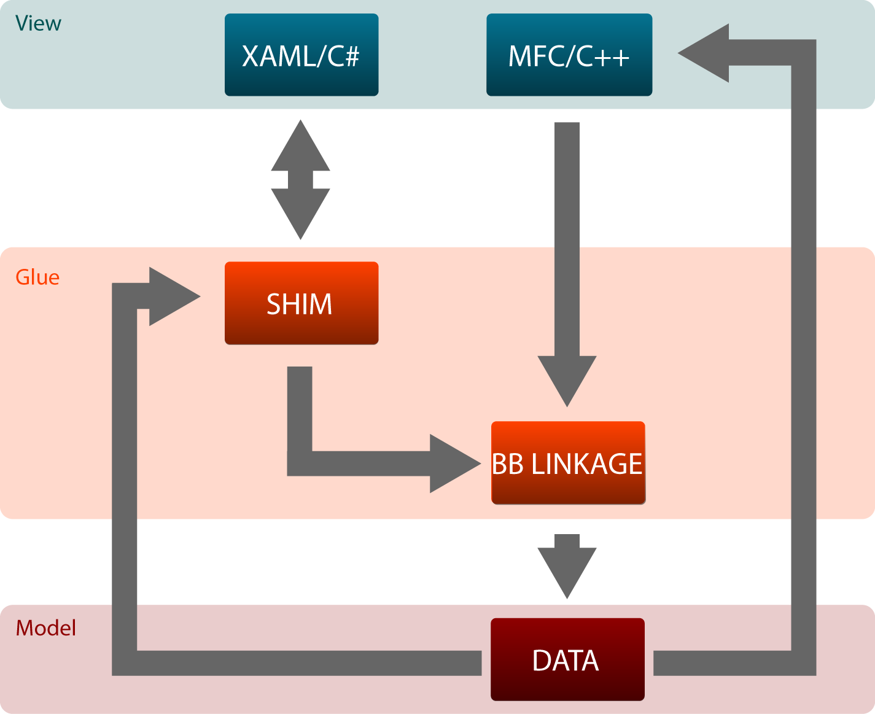
The Final Flow of Control

Slide 52
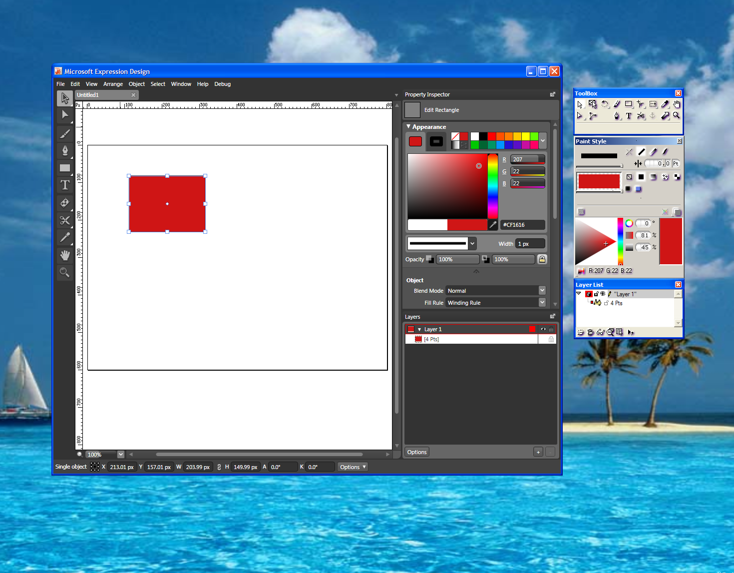
Hydra-Headed UI

Slide 53
Controller
— Where’s the controller

Slide 54
Processing Input
Need explicit control over focus
  Which control
  Which palette
  When
Handling focus
  MFC and WPF controls have a default focus
    Not always what the application designer desires
  Specific controls grab focus at too granular a level
Who owns the message pump?

Slide 55
Can’t Serve Two Masters
Choose either MFC or WPF
  To own the message pump
  To redirect (or intercept) messages as appropriate
Expression Design’s architecture allowed one choice

Slide 56
WPF As Message Traffic Cop
Hook into WPF dispatcher (message pump)
  ComponentDispatcher.ThreadFilterMessage += new ThreadMessageEventHandler(…);
Why? So you can
  Redirect keyboard or mouse operations
  Selectively apply accelerator keys across the application
  Selectively allow MFC to “preview” messages (events)
  Control where focus should move

Slide 57
A Sample Message Filter
ComponentDispatcher.ThreadFilterMessage
+= new ThreadMessageEventHandler(MessageFilter);
private void MessageFilter(ref System.Windows.Interop.MSG msg, ref bool handled)
{
if ((msg.message == NativeConstants.WM_KEYDOWN) && ShouldEnableShortcuts()
&& !IsEditingText())
{
this.AllowCharacterShortCutProcessing();
}
}
if (msg.message == NativeConstants.WM_MOUSEWHEEL
|| (msg.message >= NativeConstants.WM_KEYFIRST
&& msg.message <= NativeConstants.WM_KEYLAST))
{
if (ShouldAllowNativeMessagePreview())
{
handled = NativeCode.PreviewMessages(msg.hwnd, msg.message, msg.pt_x, msg.pt_y, msg.time, msg.wParam, msg.lParam);
}
}

Slide 58
Dialog Creation
Hand convert dialogs into Xaml
How?
  Use Expression Blend™

Slide 59
Summary
You can
  Retaining an legacy applications core value
  And add a new WPF-based user experience
A new WPF interface can add value
  Improve look, feel, and end-user experience
  Enable flexibility in UI modification

Slide 60
Key Takeaways
User Experience matters!
WPF
  Makes high-end user experience practical
  Makes “Traditional” UX quick and easy to build
  Enables an ecosystem: Tools, 3rd-party, and developer and designer communities
  Enables a client continuum: ASP.NET -> Ajax -> Silverlight -> WPF
Adding a rich UI does not require a rewrite

Slide 61
How do I get started?
On the web:
  http://WindowsClient.net
  MSDN: search for “WPF” (link)
Books:
  “Windows Presentation Foundation Unleashed (WPF)” by Adam Nathan
  “Applications = Code + Markup: A Guide to the Microsoft Windows Presentation Foundation” by Charles Petzold
  “Programming Windows Presentation Foundation” by Chris Sells and Ian Griffiths
  “Essential Windows Presentation Foundation” by Chris Anderson
Get in touch:
  henryso@microsoft.com
  ivom@microsoft.com

