Slide 1
Out-of-Process Components
Jim Fawcett
CSE775 - Distributed Objects
Spring 2011

Slide 2
Out-of-Process Architectural Diagram
An out-of-proc component has essentially that same structure as an in-proc component, except that:
  Outproc is built as a console or windows application, not a dll.
  The component has command line processing that will either:
    Register the component
    Unregister the component
    Run the component server
  The main or winmain:
    creates the class factory
    calls CoRegisterClassObject to put an entry into the running object table (ROT) telling COM that it is running and stores the factory pointer.
  When a client calls CoCreateInstance COM gets the class factory pointer from the ROT and creates the component instance.

Slide 3
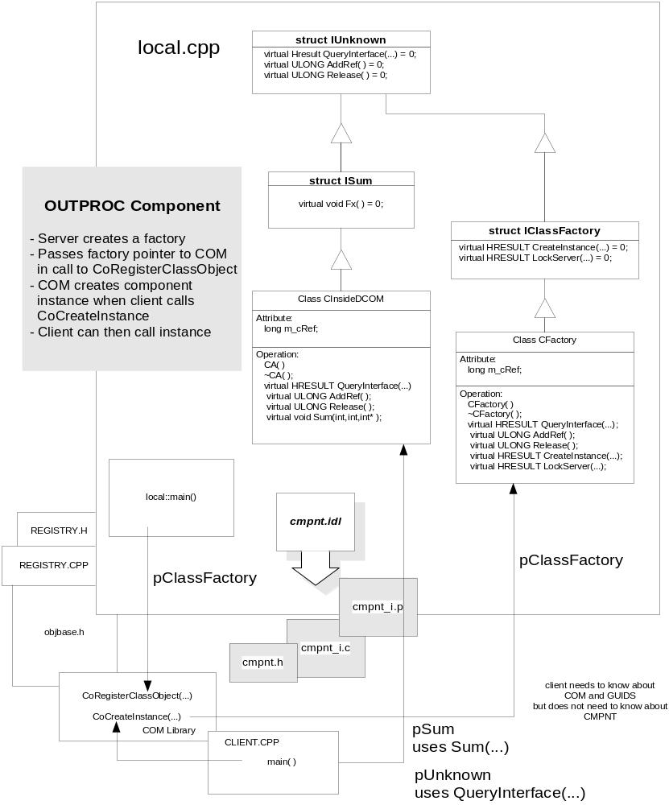
Architectural diagram here

Slide 4
Structure Chart
This diagram doesn’t show the register and unregister processing for simplicity.
The server is registered by the command:
component /RegServer
Once the component is registered, when the client calls CoCreateInstance COM will start the server process if it is not already running. That causes main to start the class factory and store a pointer to it in the Running Object Table (ROT).
COM uses the pointer to create an instance and returns a pointer to the client.
The client uses the component through its interface, then calls release so COM can shut down the server.

Slide 5
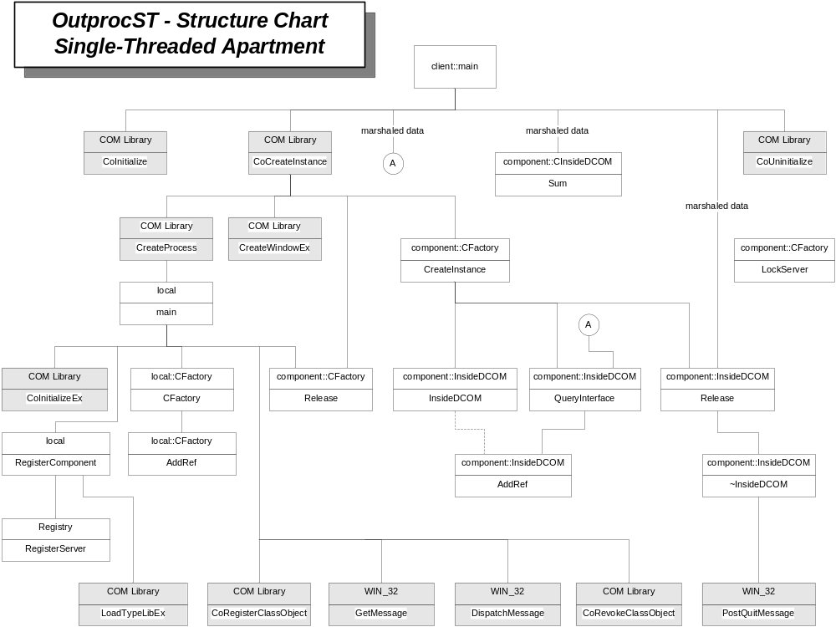

Slide 6
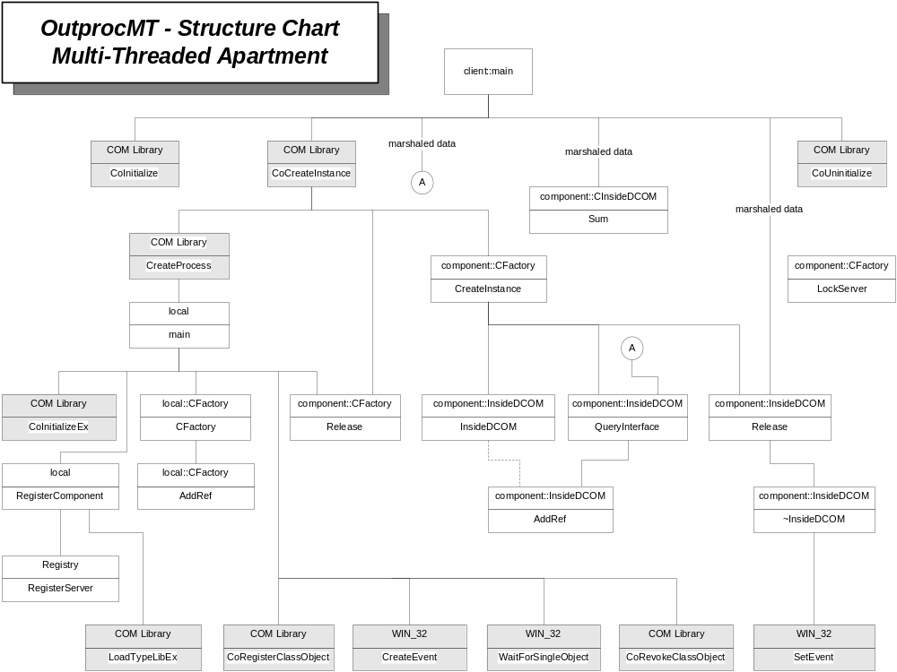
Structure chart here

Slide 7
Activation Diagram
The diagram on the next page is an elaborated event trace diagram.
It shows the separate, cooperating actions of the client, COM, and the Component to:
  Create the component instance
  Use it
  Shut it down
Note that one new element has been added. Communication between the client and component must be marshalled, e.g., using interprocess communication via remote procedure calls (RPCs).
We will discuss the marshalling process in the next section.

Slide 8
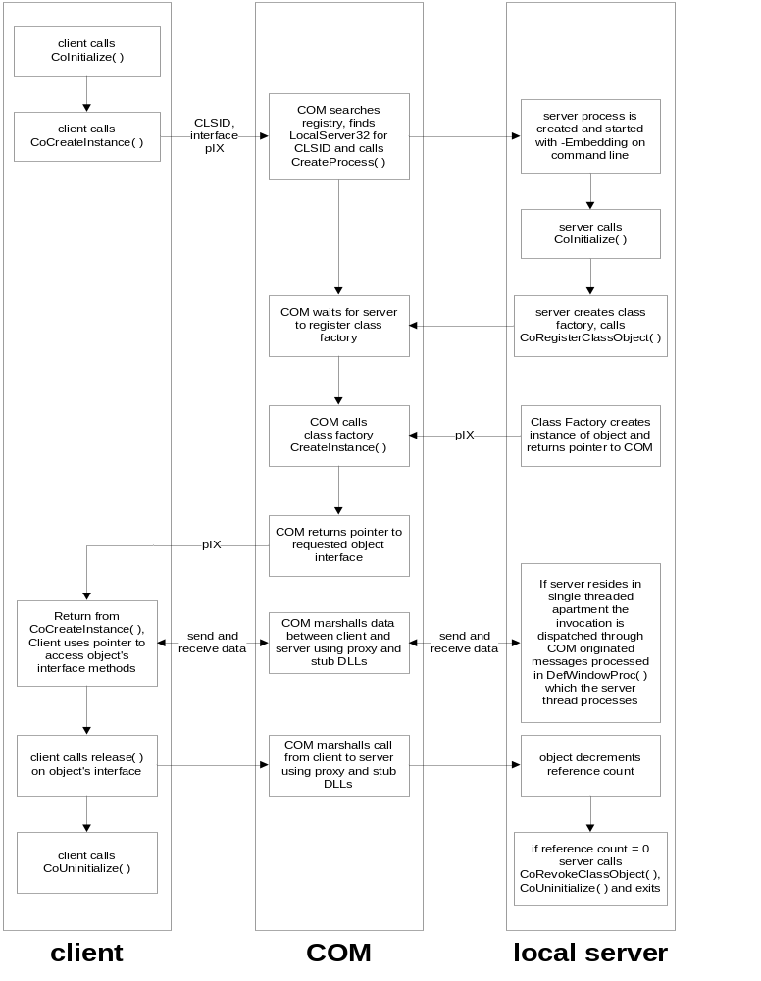
Activation diagram

Slide 9
Marshaling
All communication between client and an out-of-process component is accomplished through marshaling.
Marshaling is the activity of decomposing data into a byte stream which is sent over an inter-process communication mechanism, then recomposing in the receiving process.
COM’s method of interprocess communication is the Remote Procedure Call (RPC). The client makes a synchronous call to a proxy in the client process. The proxy marshals the data and sends it to a stub in the receiving process where it is processed according to the semantics of the (remote) procedure. Any results are marshaled back to the client’s proxy which then creates the fiction of a procedure return.
It is the job of the Service Control Manager (SCM) to find the server and instantiate an object and connect the proxy and stub.

Slide 10
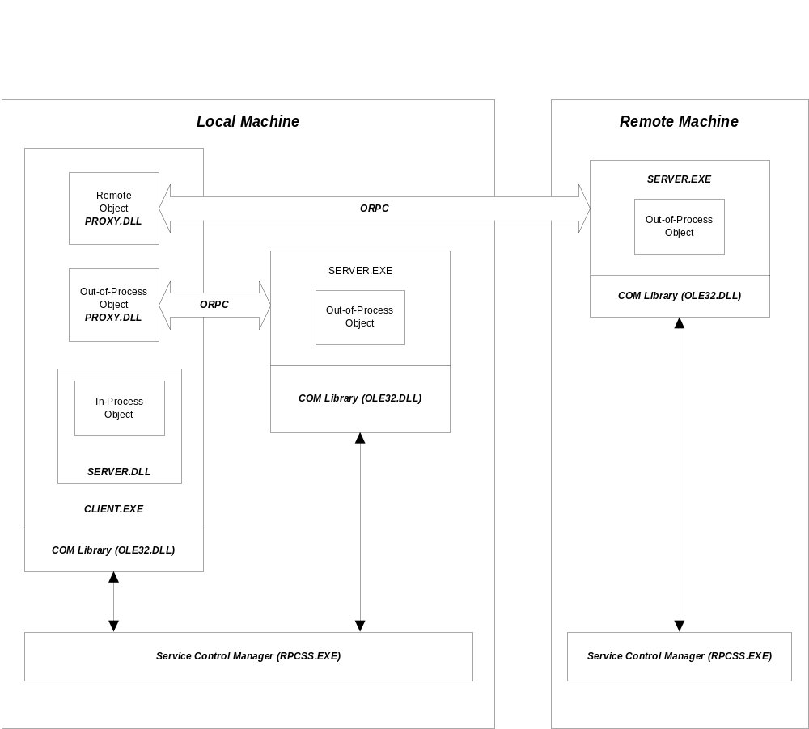
Component Activation

Slide 11
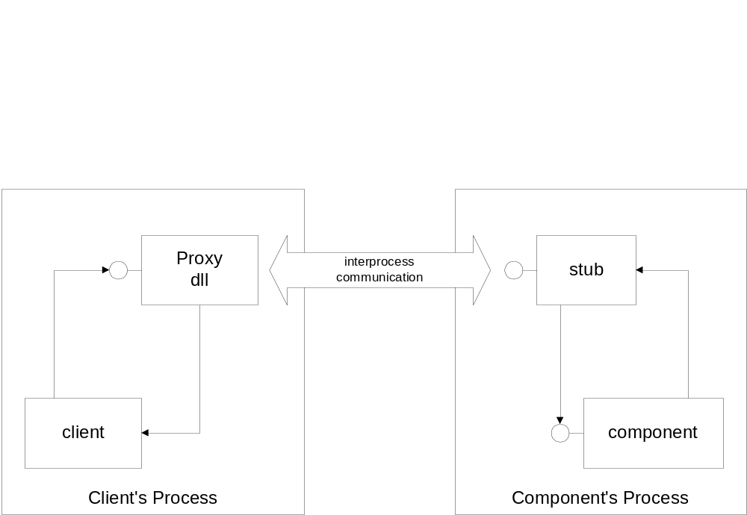
Marshaling Architecture

Slide 12
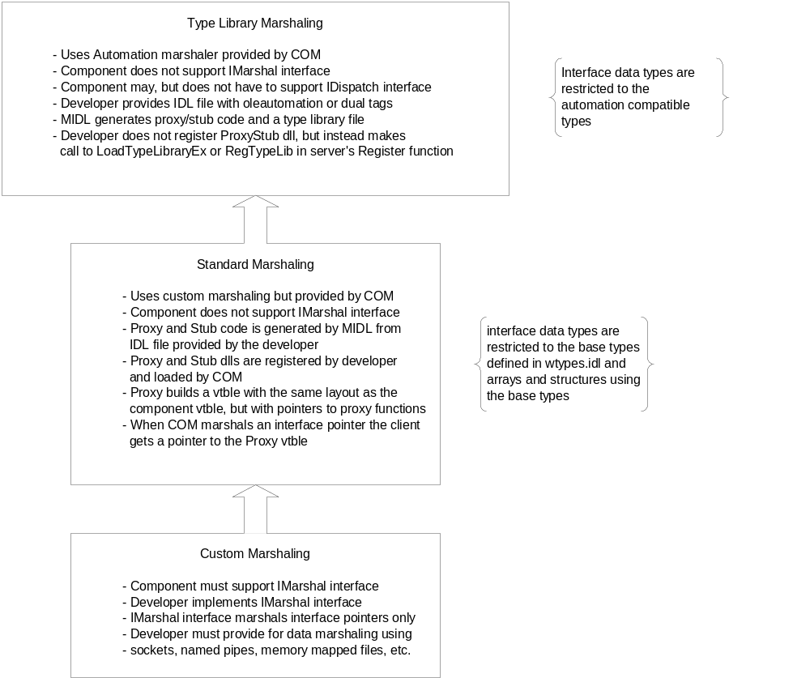
Marshaling Layers

Slide 13
MIDL Compiler
Most COM components describe their interfaces in IDL rather than write an IFACE type header for interface declarations and an IFACE implementation to define GUIDs.
IDL is compiled by the Microsoft Interface Definition Language (MIDL) compiler to generate the components shown in the diagram on the next page.
If you include the IDL file in your project, you can right click on the IDL file (in file view) and select the compile item to process your interface descriptions.

Slide 14
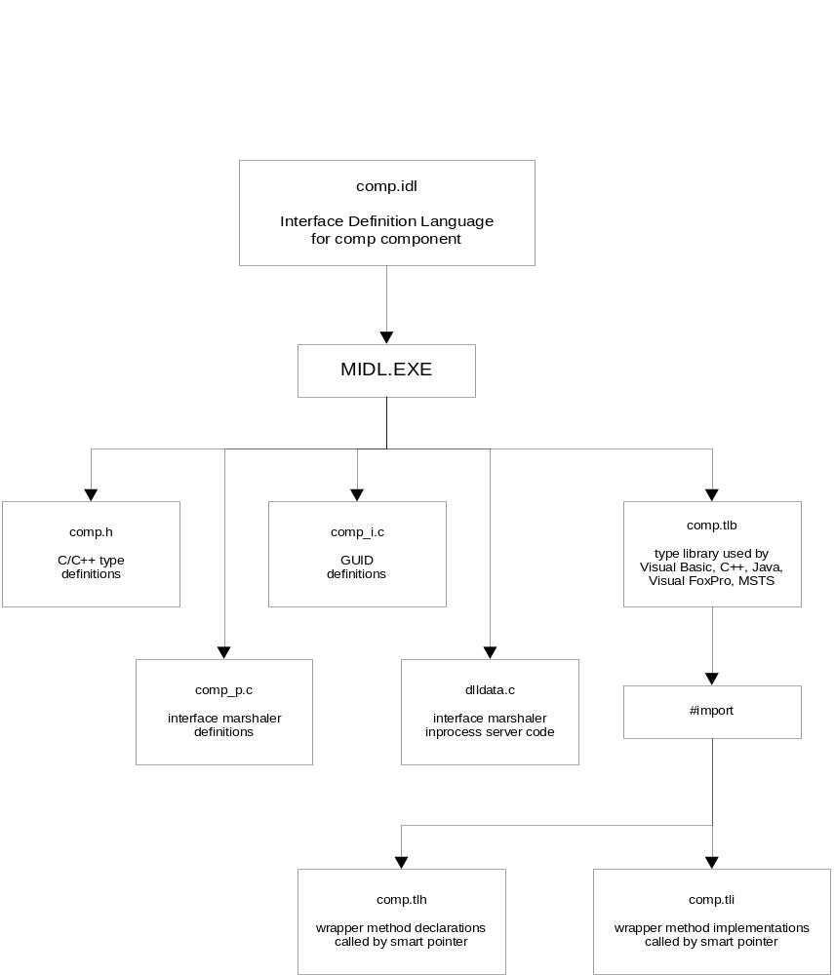
MIDL chart

Slide 15
Threading Models and Apartments
COM supports the interaction between client and server even if they make different assumptions about threading.
  A component that does not want to handle multiple accesses by concurrent threads specifies that it wishes to operate in a Singe Threaded Apartment (STA). Any single process can support one or more STAs.
  A component that will handle multiple accesses by concurrent threads, by synchronizing access to its global and static data, specifies that it wishes to operate in a Multiple Threaded Apartment (MTA). A process can support only one MTA.
  An out-of-process component, or client for an in-process component makes this specification by the arguments it passes to CoInitializeEx.

Slide 16
Creating Apartments
A single threaded apartment is created on a call to
CoInitialize(NULL)
or
CoInitializeEx(NULL,COINIT_APARTMENT_THREADED)
A multi-threaded apartment is created on a call to
CoInitializeEx(NULL,COINIT_MULTITHREADED)
Since an Out-of-Proc component runs in its own process, its server must call CoInitialize(Ex).

Slide 17
STA Remoting Architecture
When a client calls into a server residing in an STA the call is serviced by the server thread.
A local or remote call is made, on the client’s behalf, by an RPC thread created by the server’s stub. The RPC thread deposits a request for service from the desired interface function on a windows message queue, created when the server was started.
The server’s thread – the only thread allowed in its STA – retrieves the message, executes the function, and packages the return data for transmission back to the client.
When multiple clients make concurrent calls they are simply enqueued for service by the single STA thread. Thus the server never has to handle multiple concurrent threads.

Slide 18
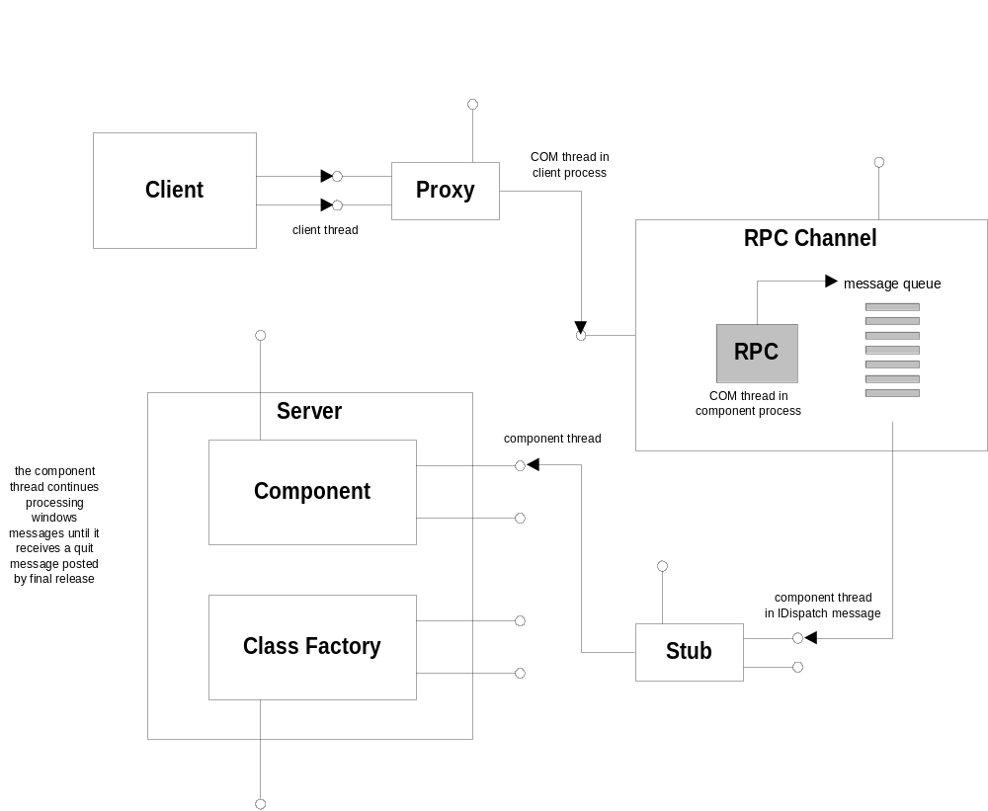
STA Remoting Architecture

Slide 19
MTA Remoting Architecture
When a server resides in an MTA it must be prepared to deal with concurrent access by several threads. It does this by synchronizing access to all global and static data.
The RPC channel creates a pool of RPC threads for processing client requests.
When a client request arrives, an RPC thread is dispatched to process the requested interface function, even if another thread is already active in the MTA.

Slide 20
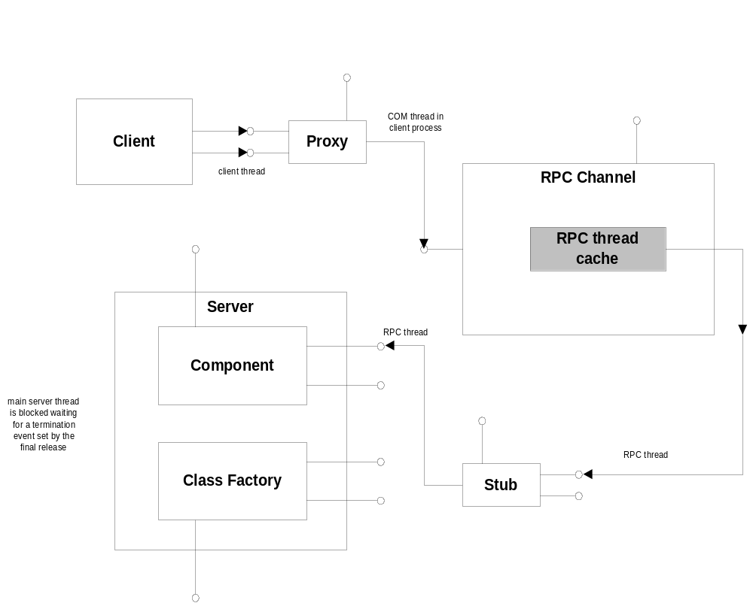
MTA Remoting Architecture

Slide 21
Remoting Architecture - Proxies
The next two diagrams show how the RPC channel manages proxies and stubs for client server interaction.
On the client side the RPC channel creates a proxy manager that creates, on demand, a proxy for each interface the client accesses.
Each proxy has an RPC buffer to use for enqueuing bytes to be sent to the client, as part of the marshaling process.
The proxy manager uses COM aggregation to hand the proxy interface to the client. Thus, the client views all of the interfaces as belonging to a single entity, and QueryInterface works as expected.

Slide 22
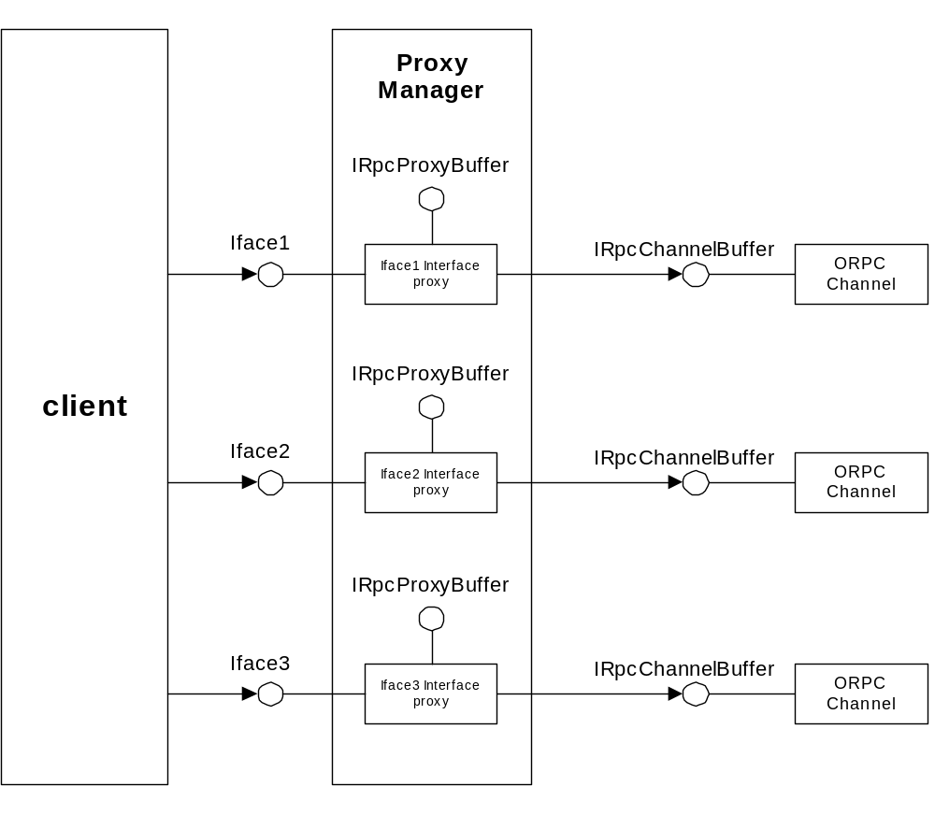
Proxy Manager

Slide 23
Remoting Architecture - Stubs
On the server side a stub manager is created when the server is activated.
The stub manager creates a stub, on demand, for each interface supported by the server.
The server does not need to view the stub manager as a single entity, since it will not be calling QueryInterface on the client. So, COM aggregation of the stubs by the stub manager is not required.

Slide 24
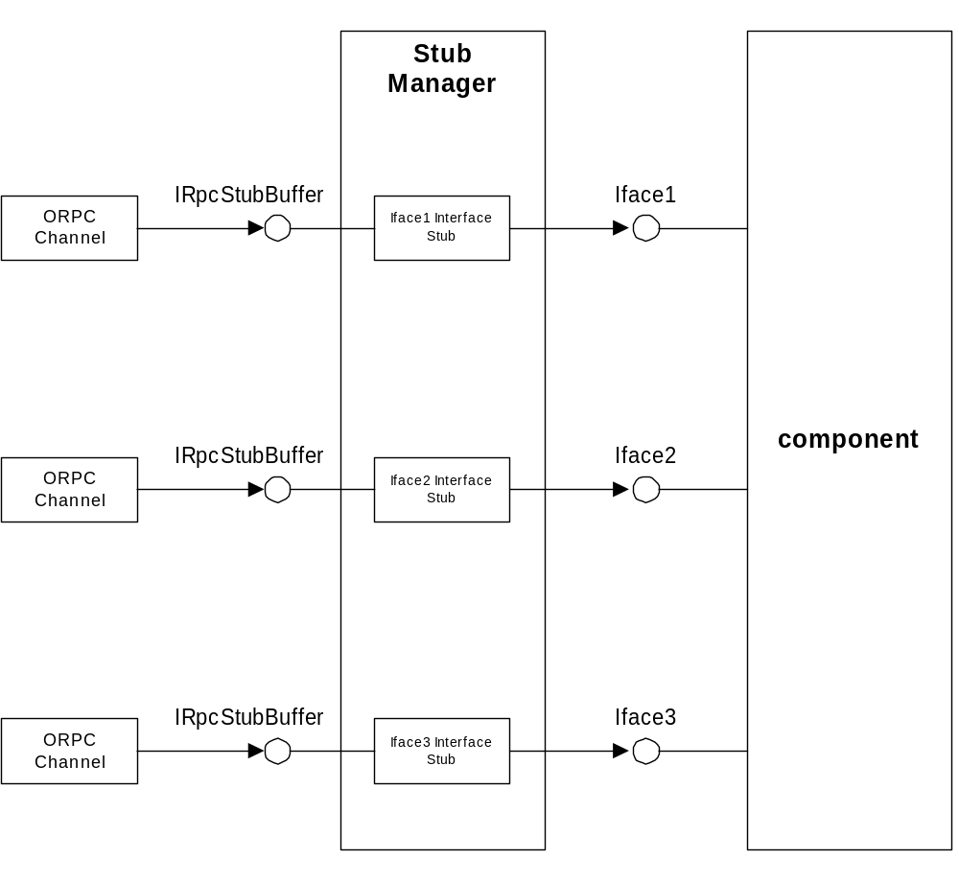
Stub manager

Slide 25
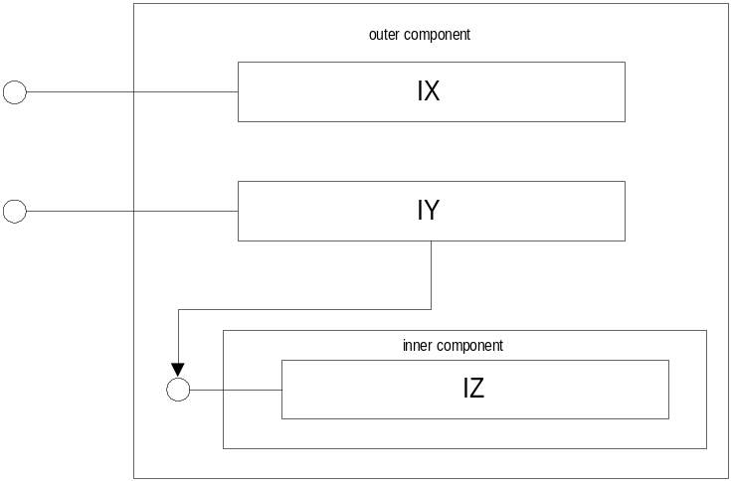
COM’s Reuse Mechanisms:
Containment
COM defines component containment which has semantics of C++ aggregation but can be composed at run time.
With containment the reusing COM object loads an existing component and implements part of its own interface by delegating calls to the contained component.

Slide 26
Implementing Containment
Containing component class:
  provides an interface matching the contained classes interface and delegates calls to the inner interface (optional).
  provides an init( ) function which calls CoCreateInstance(…) on the contained component.
  Declares a pointer member to hold the pointer to inner interface returned by CoCreateInstance(…).
  Outer component’s class factory calls init( ) in CreateInstance(…) function.
Client:
  no special provisions.
Inner Component:
  no special provisions

Slide 27
COM’s Reuse Mechanisms:
Aggregation
What COM chose to define as aggregation is unfortunately quite different than C++ aggregation.
With COM aggregation the aggregating class forwards interface of the reused existing class to the client by delivering a pointer to the aggregated interface.
  This complicates implementation of the inner IUnknown since the usual COM policy for interfaces must still be carried out.
  The result is that, in order to be aggregate-able a component must implement two IUnknown interfaces

Slide 28
COM Interface Policy
COM requires that:
  all calls to QueryInterface for a given interface must return the same pointer value
  the set of interfaces accessible from QueryInterface must be fixed
  if a client queries for an interface through a pointer to that interface the call must succeed
  if a client using a pointer for one interface successfully queries for a second interface the client must be able to successfully query through the second interface pointer for the first interface
  if a client successfully queries for a second interface and, using that interface pointer successfully queries for a third interface, then a query using the first interface pointer for the third interface must also succeed.

Slide 29
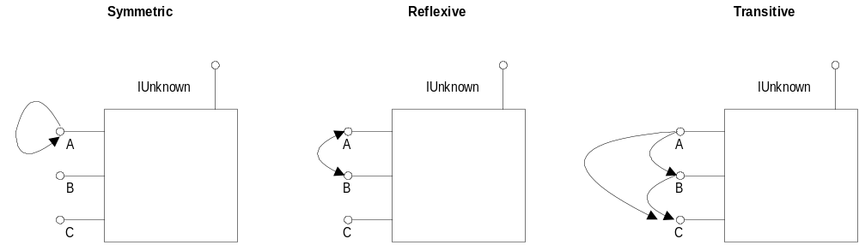
COM Interface Policy

Slide 30
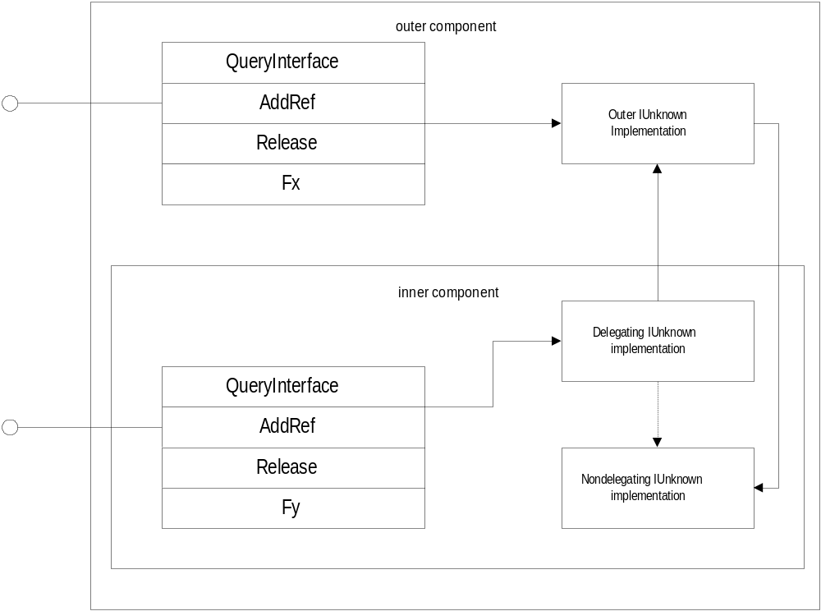
COM Aggregation

Slide 31
Implementing (COM) Aggregation
Signaling aggregation:
  CoCreateInstance(…) and IClassFactory::CreateInstance(…) both have a parameter: Iunknown* pUnknownOuter. If this pointer is null the created object will not be aggregated.
  If An outer component wants to aggregate an inner component it passes its own IUnknown interface pointer to the inner.
Implementing IUnknown:
  If an aggregatable component is not being aggregated it uses its non-delegating IUnknown implementation in the usual way.
  If it is being aggregated it uses its delegating IUnknown to forward requests for IUnknown or outer interface to the outer component. Clients never get a pointer to the inner non-delegating IUnknown. When they ask for IUnknown they get a pointer to the outer IUknown.

Slide 32
Implementing Aggregation
The delegating IUnknown forwards QueryInterface, AddRef, and Release calls to the outer IUnknown.
When a client requests an inner interface from an outer interface pointer the outer delegates the query to the inner non-delegating QueryInterface.
When CoCreateInstance is called by the outer component it passes its IUnknown pointer to the inner and gets back a pointer to the inner IUnknown. This happens in an init( ) function called by the outer’s class factory in its CreateInstance function.

Slide 33
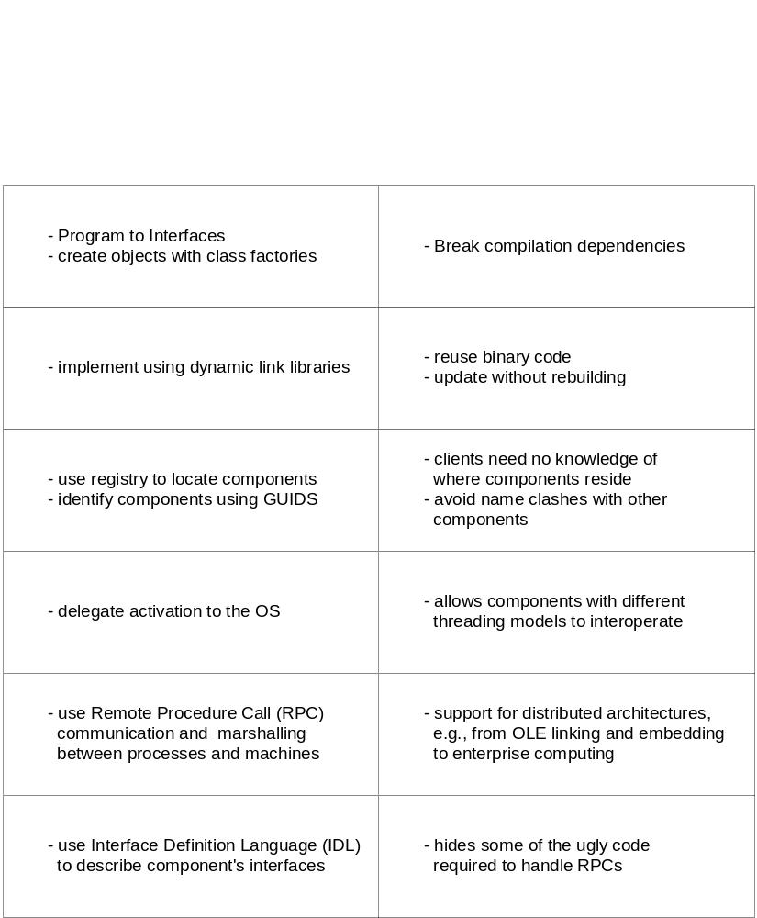
COM Architectural Features

