Slide 1
Uniform Data Transfer and Connectable Objects
On the way to (ActiveX) Shangri-La

Slide 2
Uniform Data Transfer
To provide a standard way of transferring data between components or applications COM defines the IDataObject interface.
The purpose of the IDataObject interface is to allow any application that knows how to act as a client for this interface to access data provided from any application that supports it, e.g., uniform data transfer.
IDataObject interface also provides a way to notify clients of recent changes in its component’s data.

Slide 3
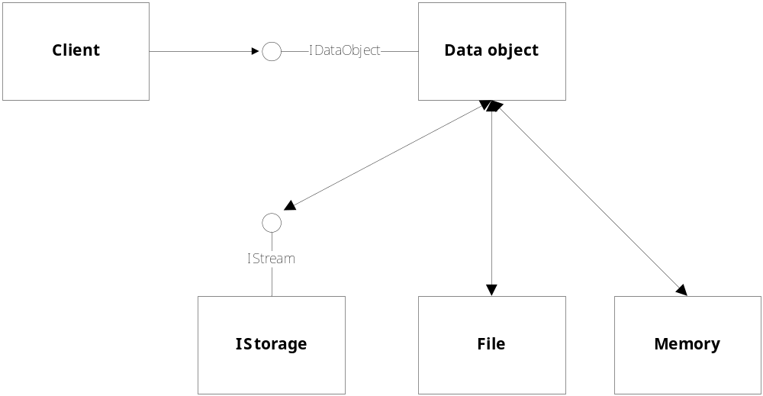
Uniform Data Transfer

Slide 4
IDataObject
The IDataObject interface uses two structures to support the transfer of data. The first is:
  FORMATETC describes the data being transferred:
    data format - could be the standard clipboard formats or custom formats defined by the data object and known by the client
    target device - details about the intended destination, e.g., printer with a given resolution
    role for which the data is designed - icon, thumbnail image, full screen bitmap
    how the data should be transferred - global memory, disk file, storage objects

Slide 5
IDataObject
The IDataObject interface uses two structures to support the transfer of data. The second is:
  STGMEDIUM describes where the data is stored:
    tag which tells a marshaler how the data is stored
    a union which indicates that the data is stored in:
      bitmap
      metafile
      global memory
      file
      stream
      storage

Slide 6
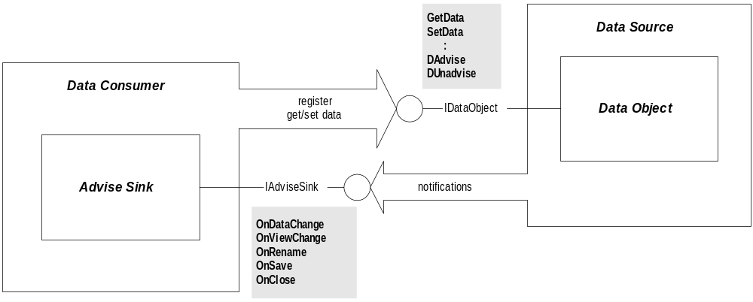
Data Object

Slide 7
IDataObject Methods
GetData
Renders the data described in a FORMATETC structure and transfers it through the STGMEDIUM structure.
GetDataHere
Renders the data described in a FORMATETC structure and transfers it through the STGMEDIUM structure allocated by the caller.
QueryGetData
Determines whether data object is capable of rendering data described in the FORMATETC structure.
GetCanonicalFormatEtc
Provides a potentially different but logically equivalent FORMATETC structure.
SetData
Provides source data object with data described by a FORMATETC structure and STGMEDIUM structure.

Slide 8
IDataObject Methods (continued)
EnumFormatEtc
Creates and returns a pointer to an object to enumerate the FORMATETC supported by the data object.
DAdvise
Creates a connection between a data object and an advise sink so the advise sink can receive notifications of changes in the data object.
DUnadvise
Destroys a notification previously set up with the DAdvise method.
EnumDAdvise
Creates and returns a pointer to an object to enumerate the current advisory connections.

Slide 9
Notifications
It may be important for the data object to notify a client of changes in its data content or views.
The IAdvise interface was designed to support notification of the client by data objects in a general way (more general than the IDataObject interface):
  notify and get new data to the client
  notify the client of changes in view or data source

Slide 10
IAdviseSink Methods
OnDataChange
Advises that data has changed. Uses FORMATETC and STGMEDIUM to pass data to client.
OnViewChange
Advises that view of object has changed. Uses a DVASPEC enumeration to define the view, e.g., content, thumbnail, icon, ...
OnRename
Advises that name of object has changed.
OnSave
Advises that object has been saved to disk.
OnClose
Advises that object has been closed.

Slide 11
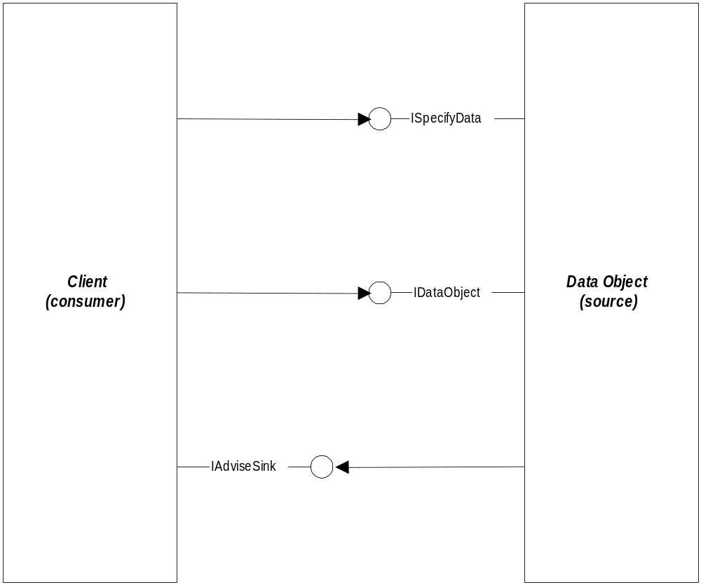
Data Transfer Using IAdvise Interface

Slide 12
Uniform Data Transfer using Notification
Referring to the diagram on the preceding page:
  The client specifies to the data object which data it is interested in using a custom interface called ISpecifyData.
  The client passes a pointer to its IAdviseSink interface to the data object.
  Data object notifies client of a change using
  IAdviseSink::OnDataChange

Slide 13
Connectable Objects
Connectable objects support interfaces to allow two-way communication with one or more clients.
Clients talk to the connectable object in the usual way, e.g., by getting a pointer to one of its interfaces using CoCreateInstance and QueryInterface.
Each connectable object provides connection points for specific interfaces, defined by the connectable object at design time.
The connectable object’s clients implement the interfaces used by connectable objects to talk back.

Slide 14
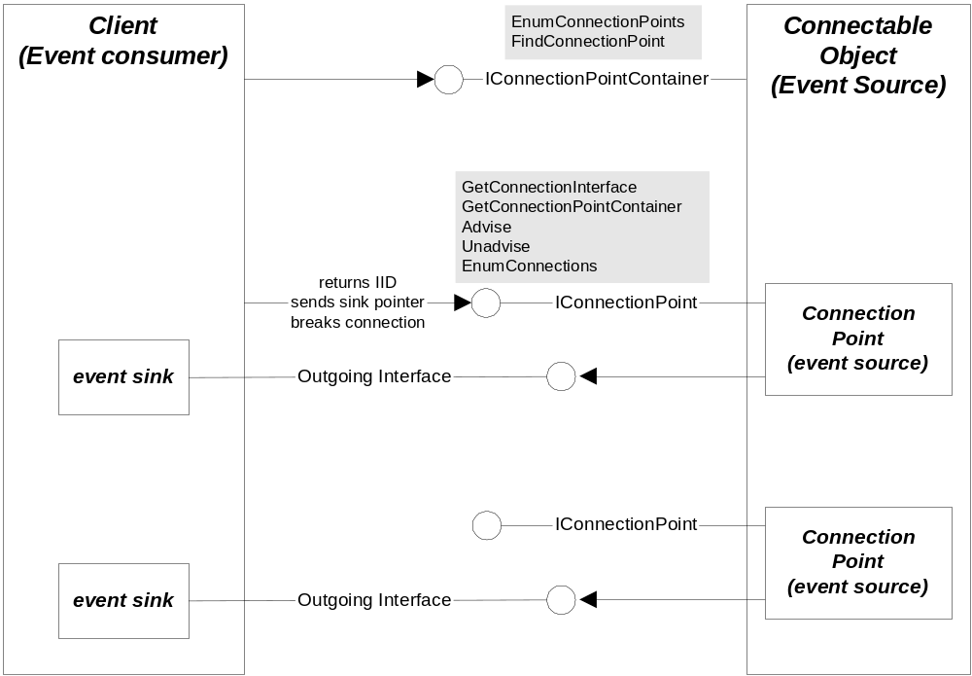
Connectable Objects

Slide 15
Establishing Two-way Connections
The IConnectionPointContainer interface must be supported by every connectable object.
Its purpose is to allow clients to discover what outgoing (client) interfaces the connectable object supports and get pointers to them.
Once the client has a pointer to a connection point object for its interface that the connectable object will use it must then send a pointer to that interface to the connection point object. It does that using the IConnectionPoint interface.

Slide 16
IConnectionPointContainer
Provided so clients can learn which outgoing (client) interfaces the object supports.
Each of these supported client interfaces is represented with the connectable object by a separate connection point object.
Connection point objects handle only one type of outgoing interface (they know how to call that interface’s methods) and also must provide an interface called IConnectionPoint.
The connectable object’s clients must provide a sink object that implements the outgoing interface.

Slide 17
IConnectionPointContainer
Interface
EnumConnectionPoints
Returns an object to enumerate all the connection points supported in the connectable object.
FindConnectionPoint
Returns a pointer to the IConnectionPoint interface for a specified connection point.

Slide 18
IEnumConnectionPoints Interface
IEnumConnectionPoints::Next
Enumerates the next cConnections elements (IConnectionPoint pointers) in the enumerator's list, returning them in rgpcn along with the actual number of enumerated elements in pcFetched. The enumerator calls IConnectionPoint::AddRef for each returned pointer in rgpcn, and the caller is responsible for calling IConnectionPoint::Release through each pointer when those pointers are no longer needed. E_NOTIMPL is not allowed as a return value. If an error value is returned, no entries in the rgpcn array are valid on exit and require no release.
IEnumConnectionPoints::Skip
Instructs the enumerator to skip the next cConnections elements in the enumeration so that the next call to IEnumConnectionPoints::Next will not return those elements.
IEnumConnectionPoints::Reset
Instructs the enumerator to position itself at the beginning of the list of elements. There is no guarantee that the same set of elements will be enumerated on each pass through the list, nor will the elements necessarily be enumerated in the same order. The exact behavior depends on the collection being enumerated. It is too expensive for some collections, such as files in a directory, to maintain a specific state.
IEnumConnectionPoints::Clone
Creates another connection point enumerator with the same state as the current enumerator to iterate over the same list. This method makes it possible to record a point in the enumeration sequence in order to return to that point at a later time. The caller must release this new enumerator separately from the first enumerator.

Slide 19
IConnectionPoint
With the IConnectionPoint interface a client starts, or terminates, an advisory loop with the connectable object and the client’s own sink.
The client can also use this interface to get an enumerator object with the IEnumConnections interface to enumerate the connections that it knows about.

Slide 20
IConnectionPoint Interface
GetConnectionInterface
Returns the IID of the outgoing interface managed by this connection point.
GetConnectionPointContainer
Returns the parent (connectable) object's IConnectionPointContainer interface pointer.
Advise
Creates a connection between a connection point and a client's sink, where the sink implements the outgoing interface supported by this connection point.
Unadvise
Terminates a notification previously set up with Advise.
EnumConnections
Returns an object to enumerate the current advisory connections for this connection point.

Slide 21
IEnumConnections
IEnumConnections::Next
Enumerates the next cConnections elements (i.e., CONNECTDATA structures) in the enumerator's list, returning them in rgpcd along with the actual number of enumerated elements in pcFetched. The caller is responsible for calling CONNECTDATA.pUnk->Release
for each element in the array once this method returns successfully. If cConnections is greater than one, the caller must also pass a non-NULL pointer to pcFetched to get the number of pointers it has to release. E_NOTIMPL is not allowed as a return value. If an error value is returned, no entries in the rgpcd array are valid on exit and require no release.
IEnumConnections::Skip
Instructs the enumerator to skip the next cConnections elements in the enumeration so that the next call to IEnumConnections::Next will not return those elements.
IEnumConnections::Reset
Instructs the enumerator to position itself at the beginning of the list of elements. There is no
guarantee that the same set of elements will be enumerated on each pass through the list. It
depends on the collection being enumerated. It is too expensive for some collections, such as
files in a directory, to maintain a specific state.
IEnumConnections::Clone
Creates another connection point enumerator with the same state as the current enumerator to
iterate over the same list. This method makes it possible to record a point in the enumeration
sequence in order to return to that point at a later time. The caller must release this new enum-
erator separately from the first enumerator.

