Slide 1
Setting Up Linux for
CSE775 - DO
Jim Fawcett
CSE775 – Distributed Objects
Spring 2019

Slide 2
Tasks:
Install VirtualBox
  VMware Player would probably work as well
  Download: https://www.virtualbox.org/wiki/Downloads
Install a Debian Linux
  I’ll use Ubuntu 18.04
Install “build essentials” tools
Install Visual Studio Code (VS Code)
  Setup build and launch tasks
Optional Installs

Slide 3
Task #1 – Install Virtualbox

Slide 4
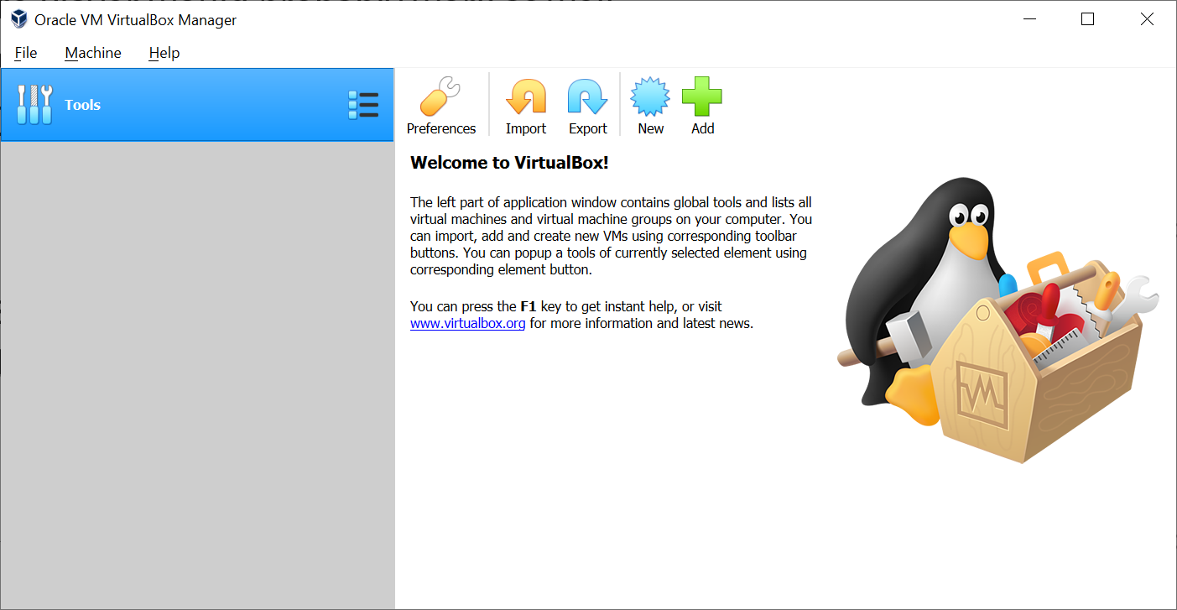
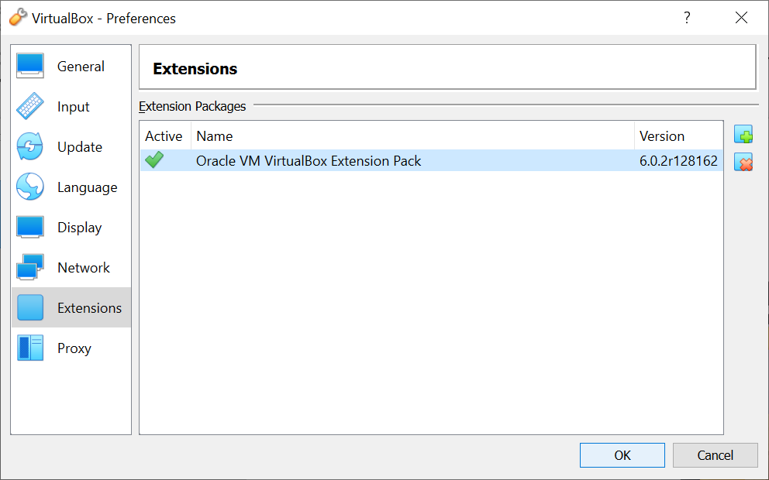
Installing Virtual Box
I started by uninstalling Java and an old version of Virtualbox.
Download and installation took about 2 minutes.
https://www.virtualbox.org/wiki/Downloads
Download Virtualbox extension pack and install

Slide 5
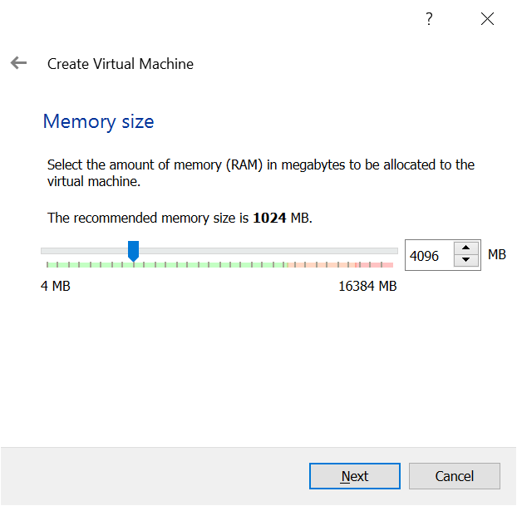
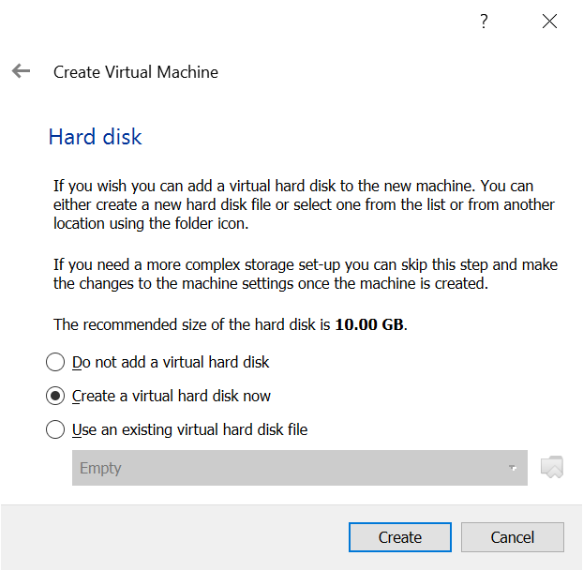
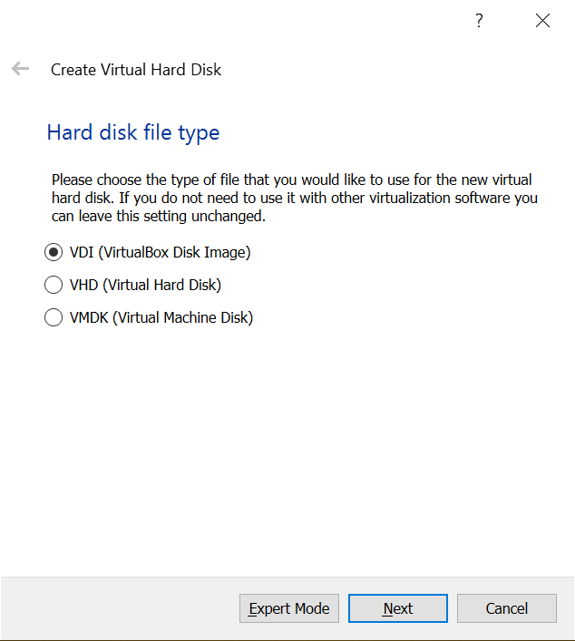
Setting VM Guest Properties
Need more RAM than recommended

Slide 6
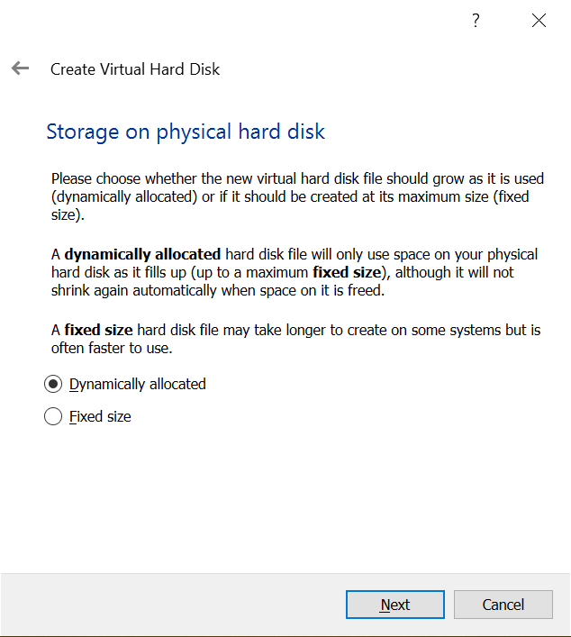
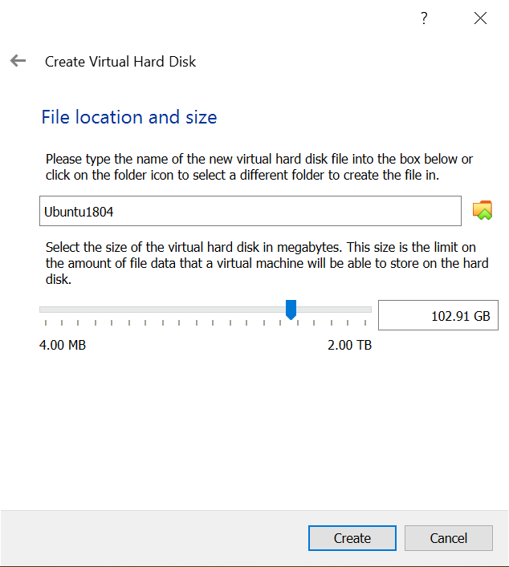
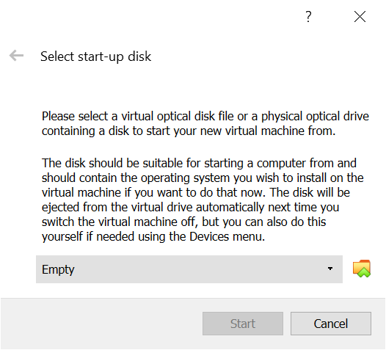
Setup Virtual Disk and install Ubuntu
You will need a lot more disk space than the default setting
Here’s where you select the Ubuntu iso file after downloading.

Slide 7
Task #2 – Install Ubuntu

Slide 8
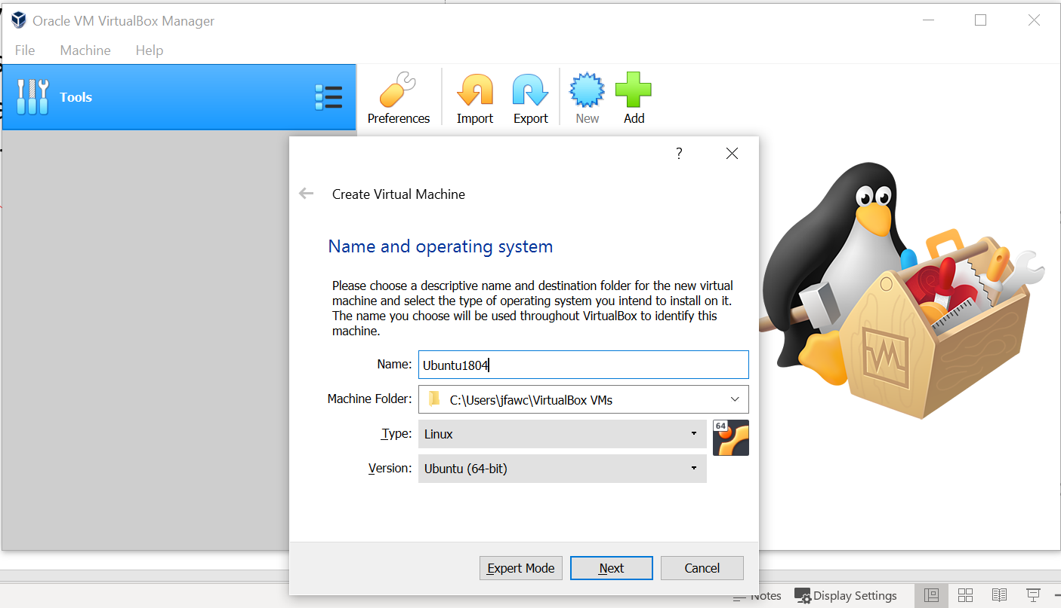
Download Ubuntu Desktop - 18.04.1 LTS
Download Ubuntu (1.8GB)
  https://www.ubuntu.com/download/desktop
  Takes about 4 minutes
  You get an iso image you install in Virtualbox.
Install in Virtualbox

Slide 9
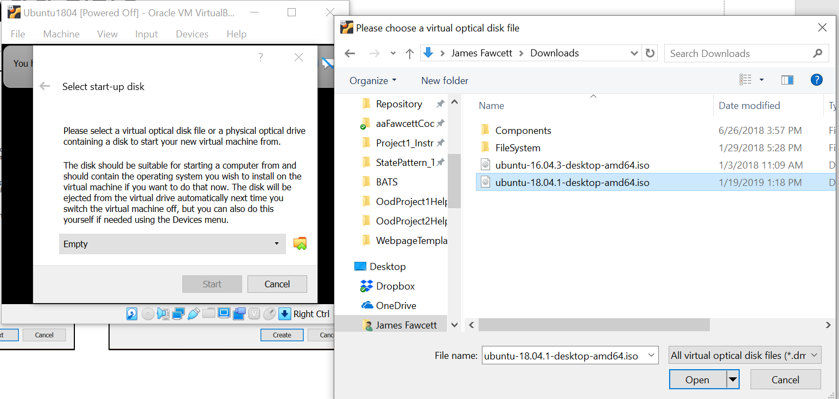
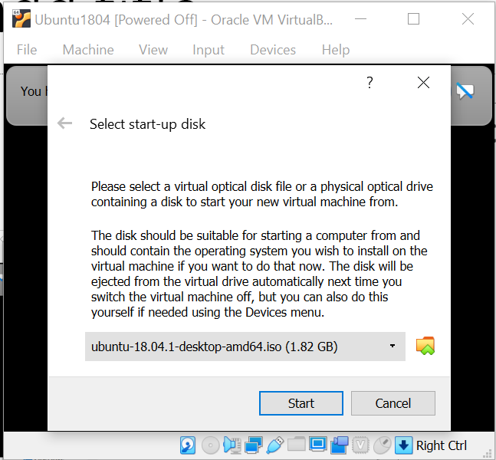
Select Ubuntu from Downloads folder

Slide 10
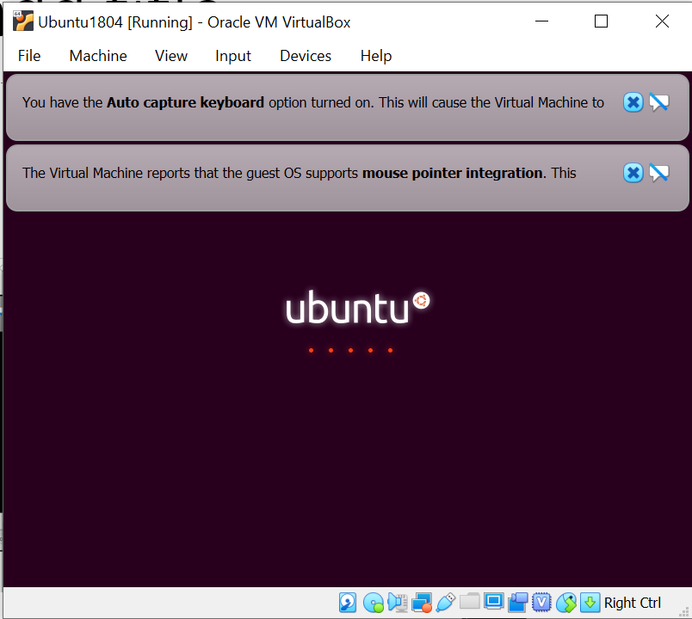
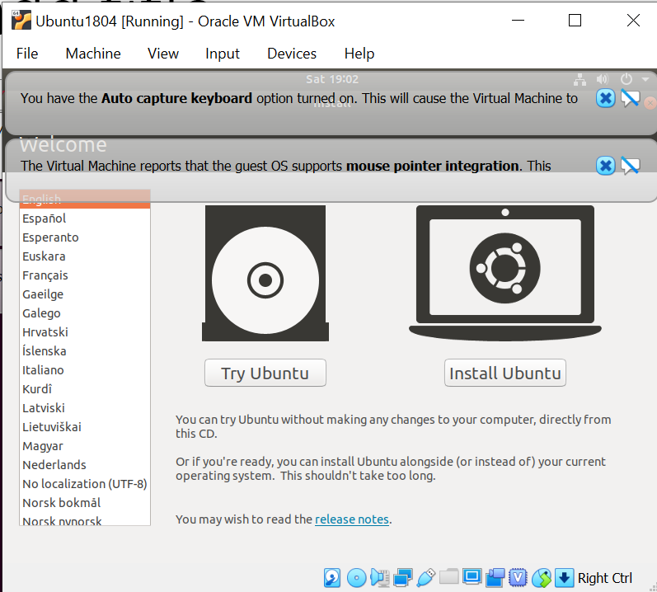
Installing Ubuntu

Slide 11
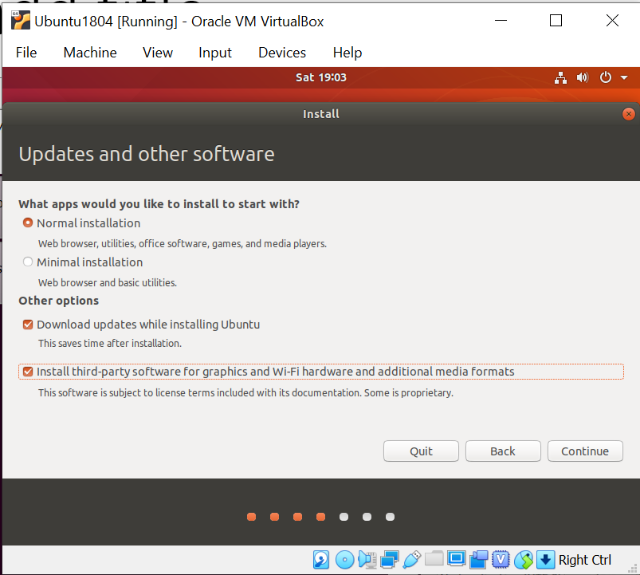
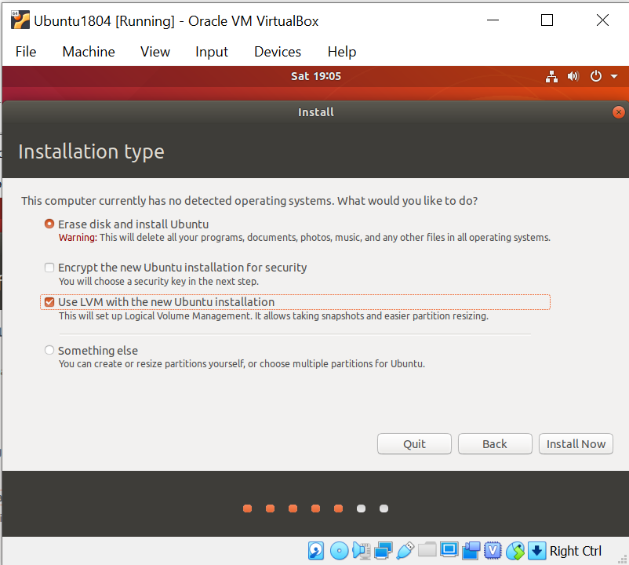
Installing Ubuntu (continued)
You probably want the third-party option
This erases Virtual Drive, not your host’s drive

Slide 12
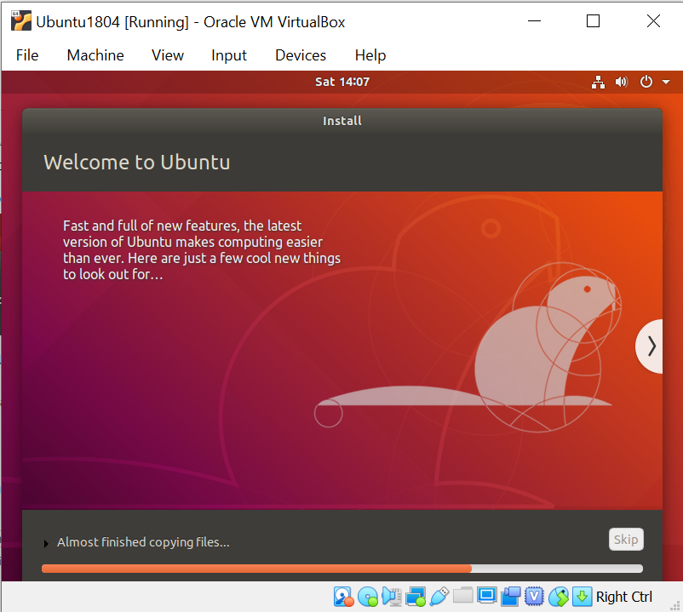
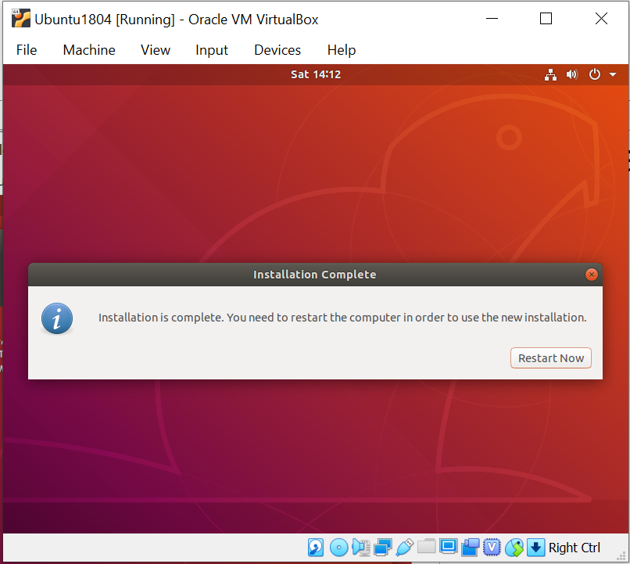
A few minutes later

Slide 13
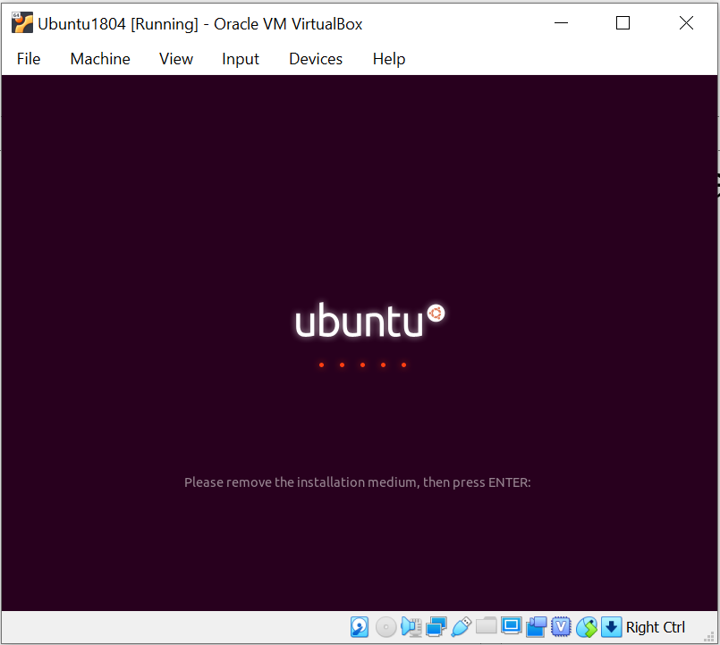
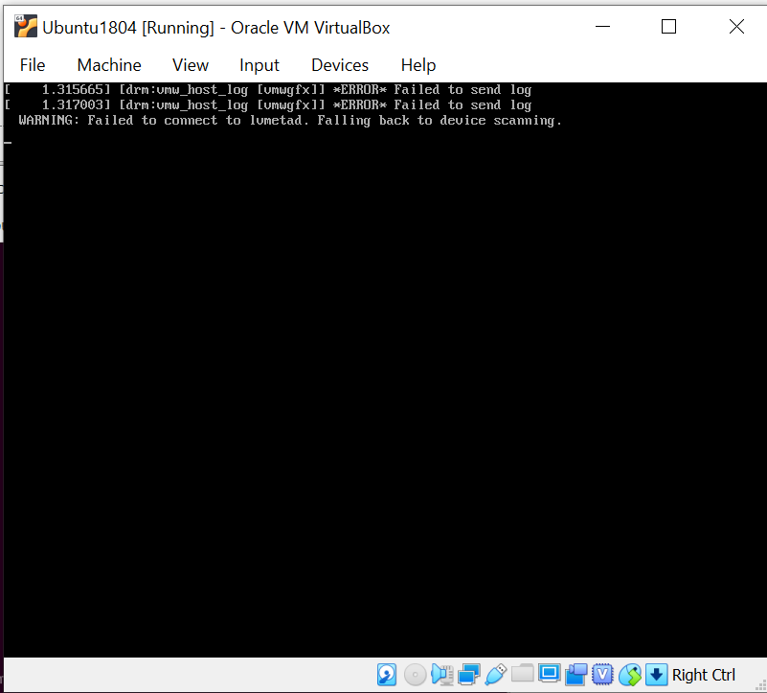
Restarting
You will get these errors on every boot – not unusual.

Slide 14
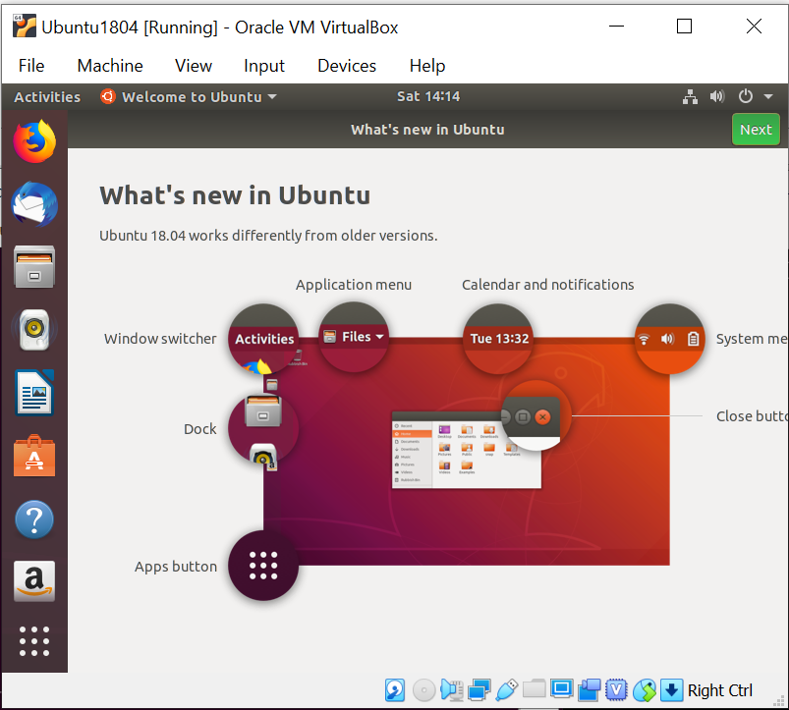
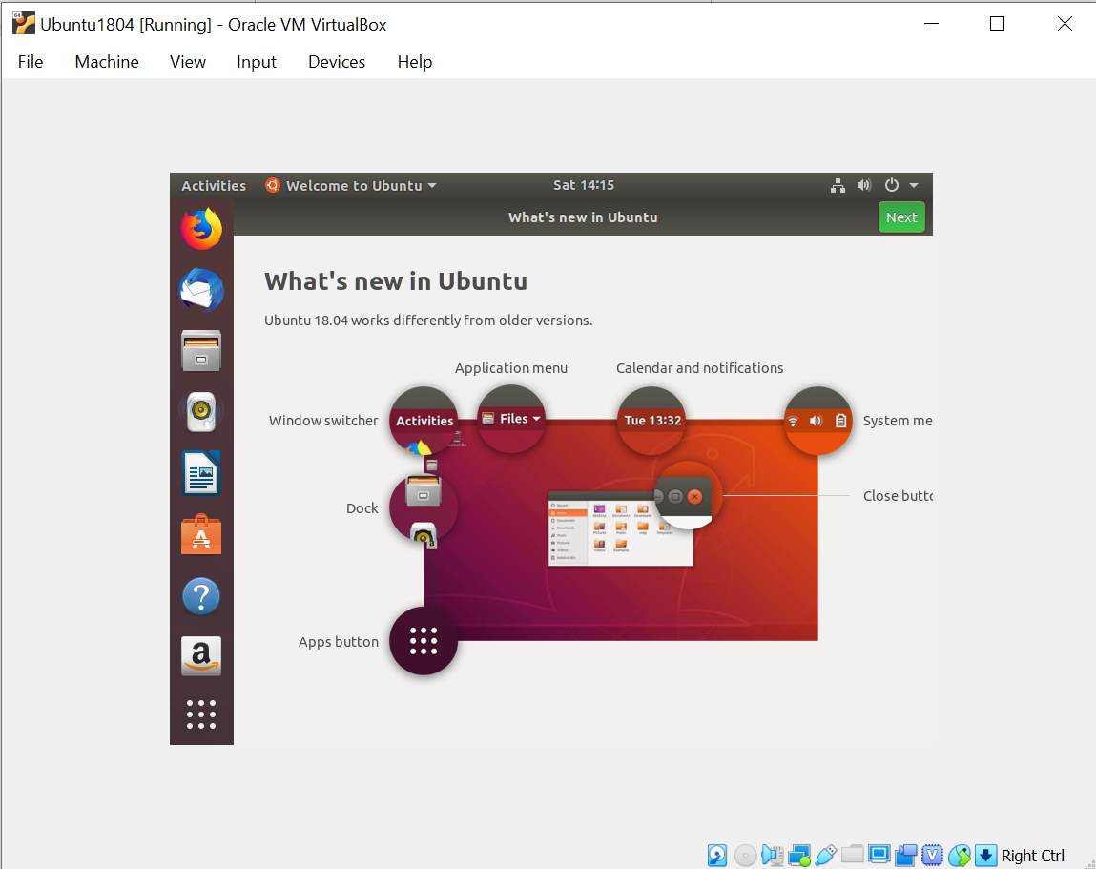
Now it’s time to configure
We need to change scaling

Slide 15
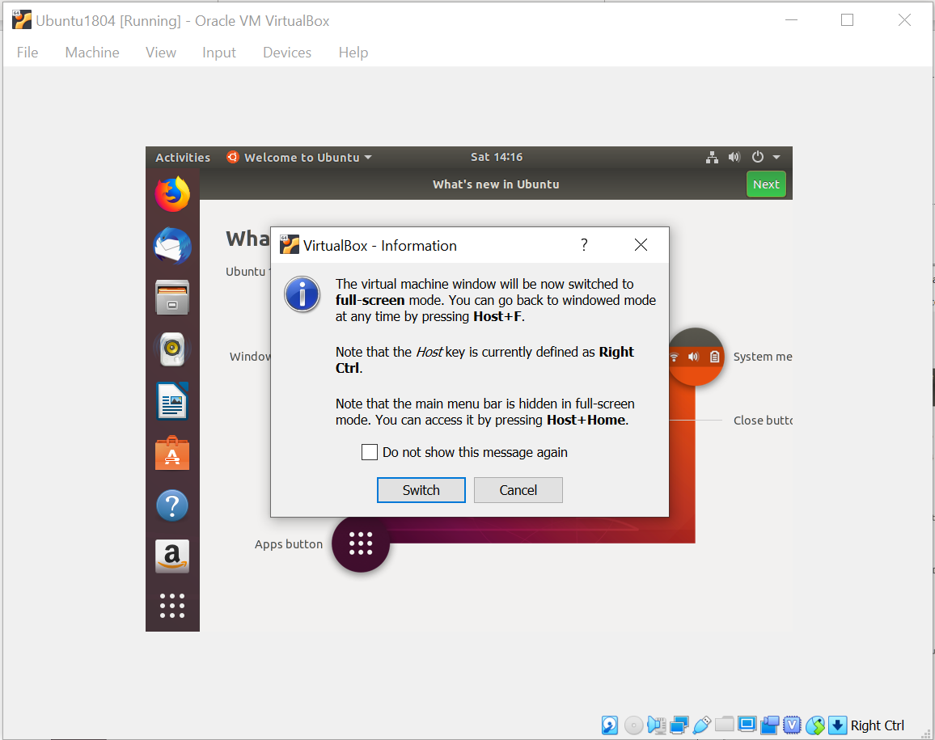
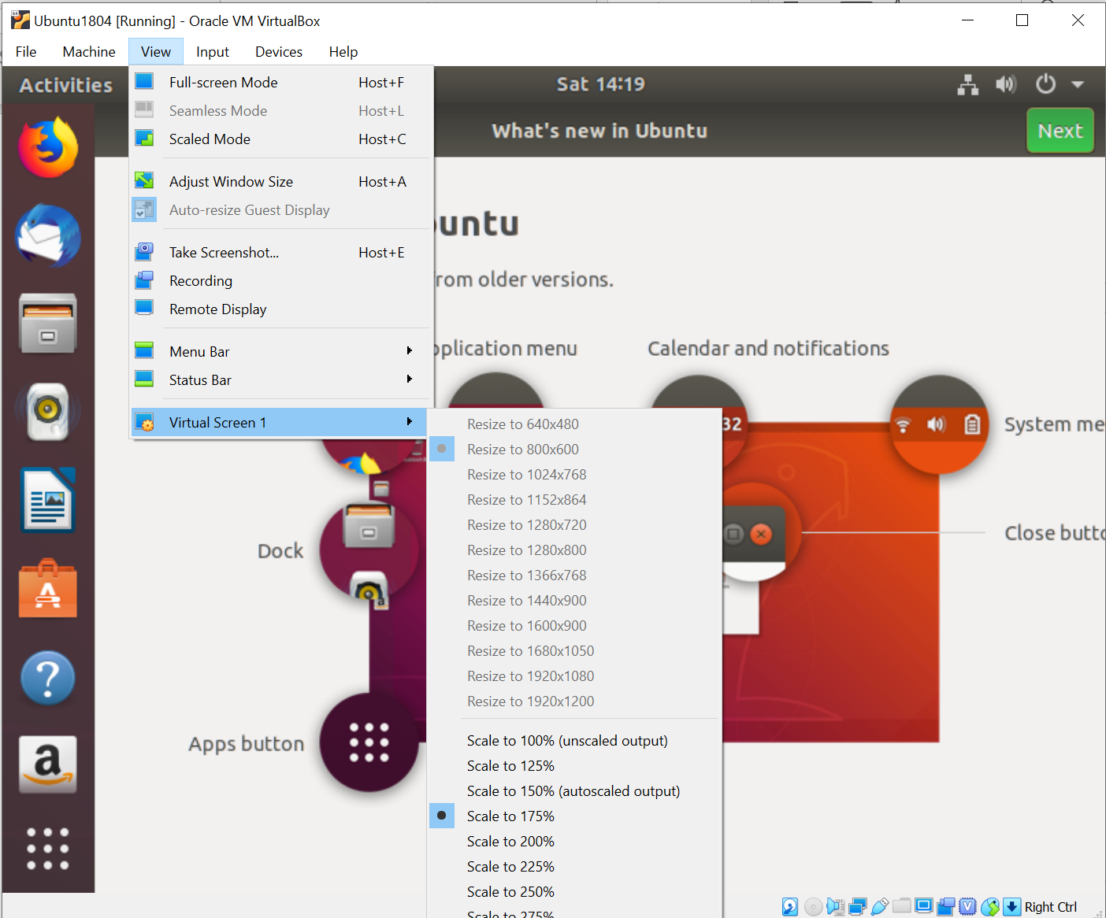
Setting Scaling

Slide 16
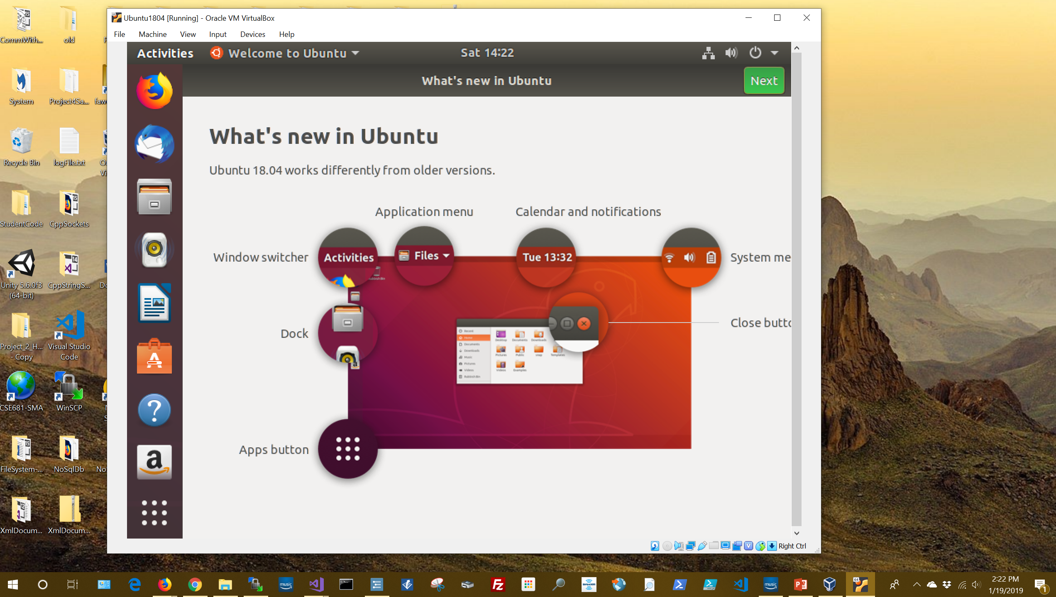
Here’s Scaled View
The view is configured with the VM host, VirtualBox.
Set menu bar icon sizes with settings > dock in Ubuntu

Slide 17
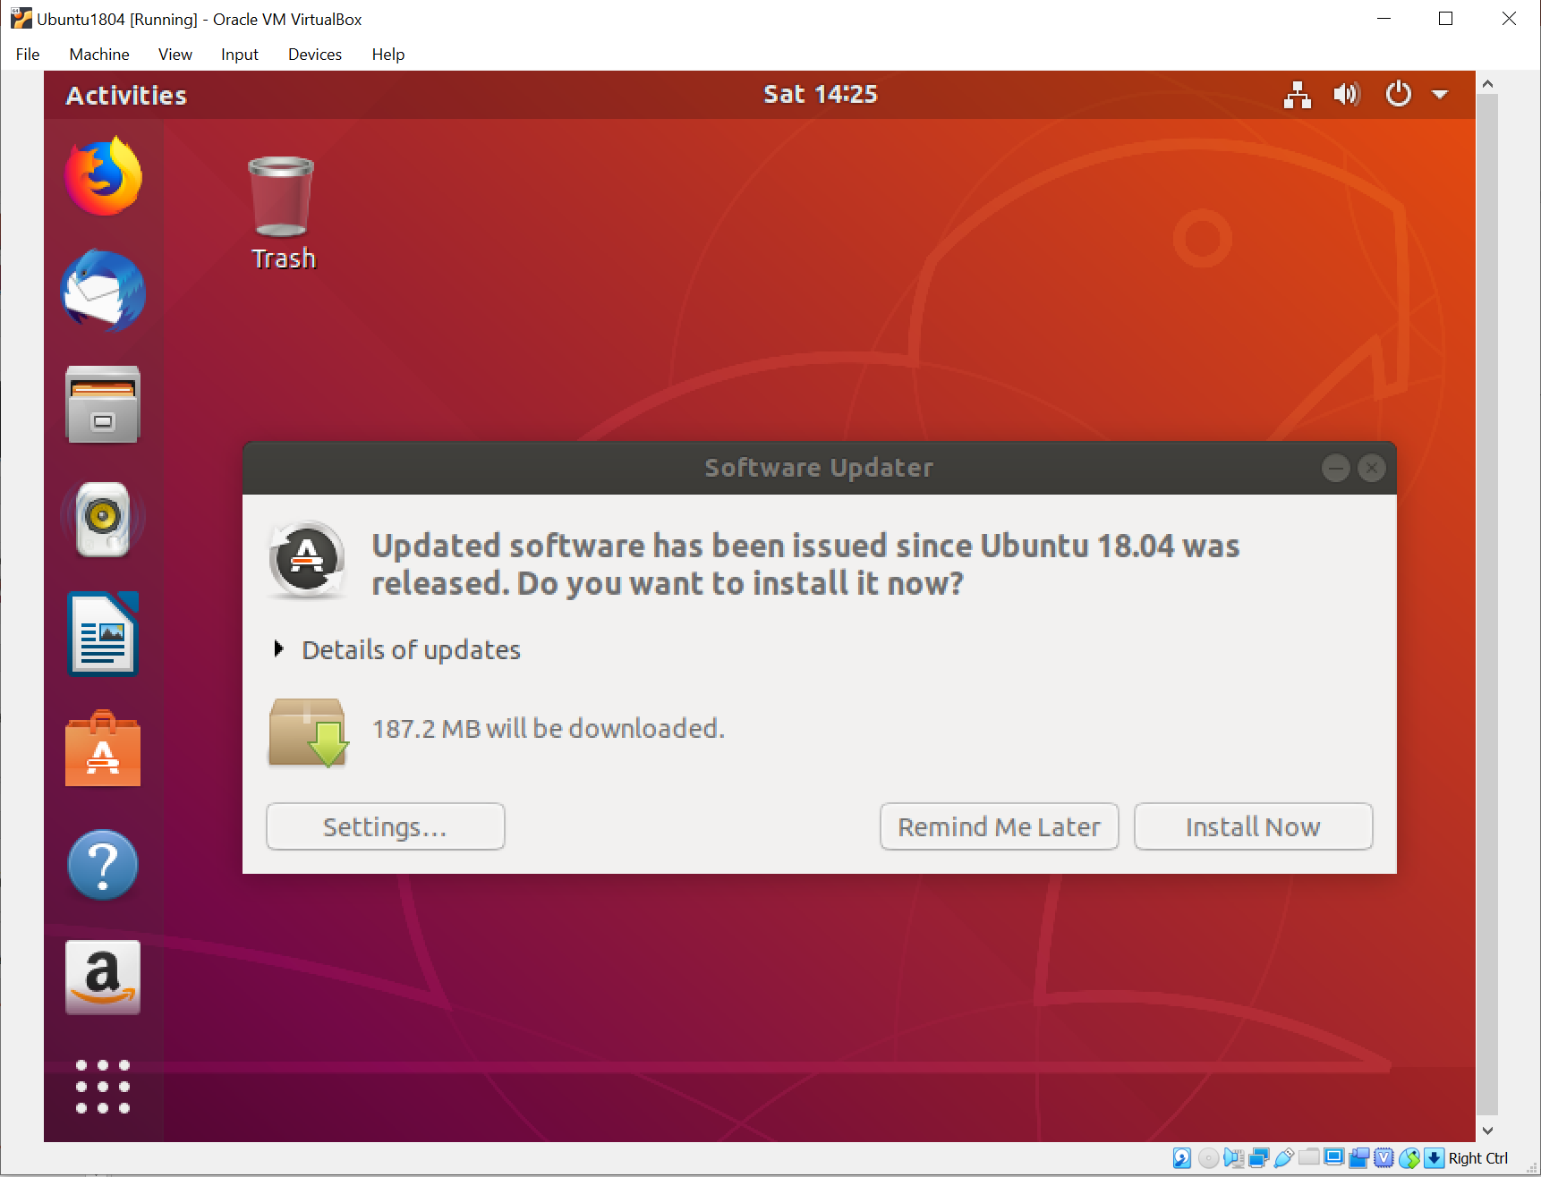
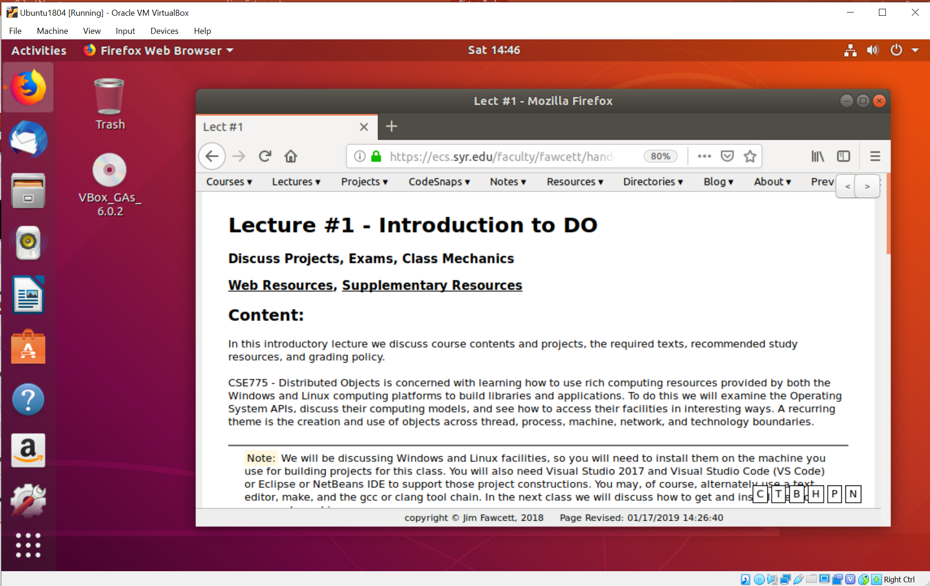
What do you know - It Works!

Slide 18
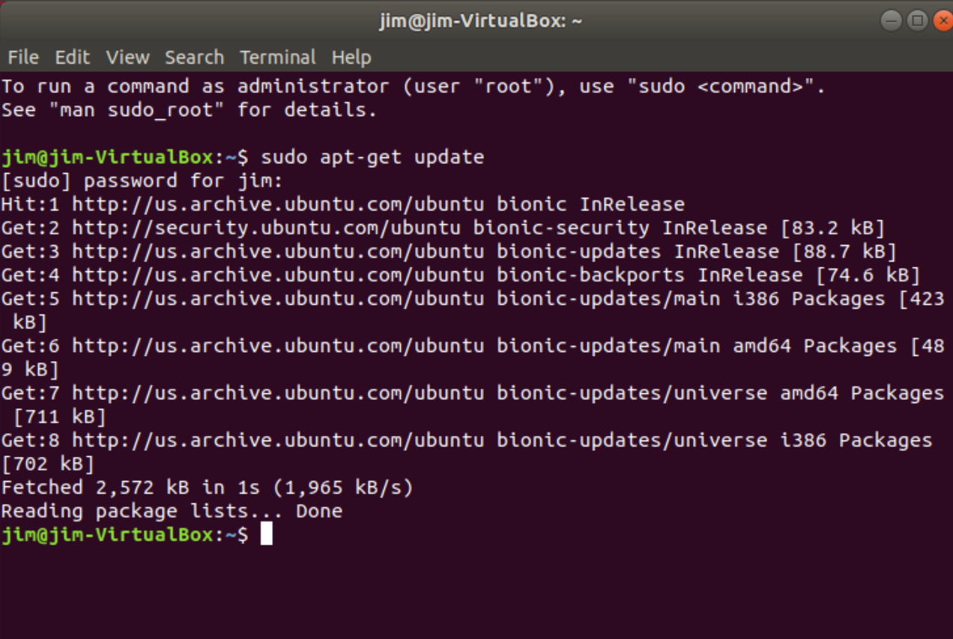
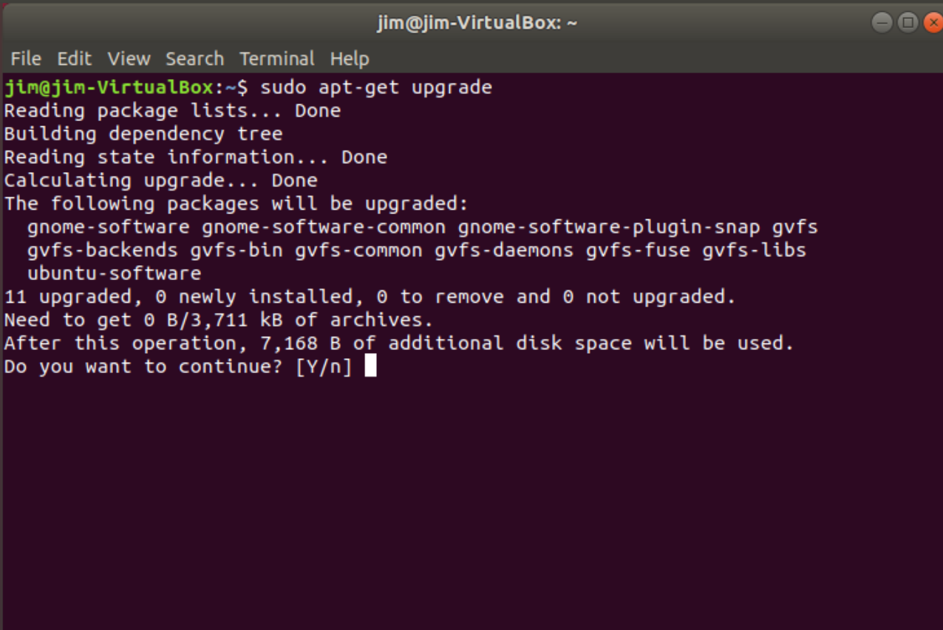
Update Ubuntu Installation using apt pkgmgr

Slide 19
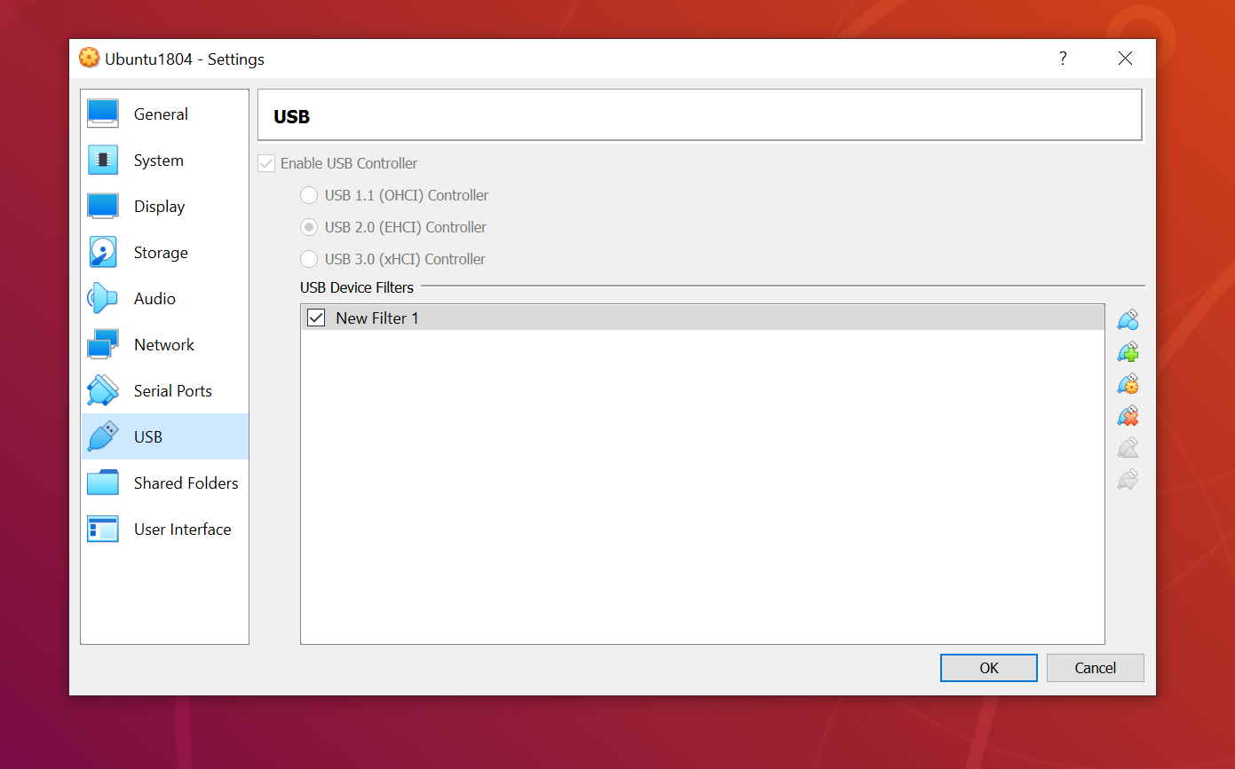
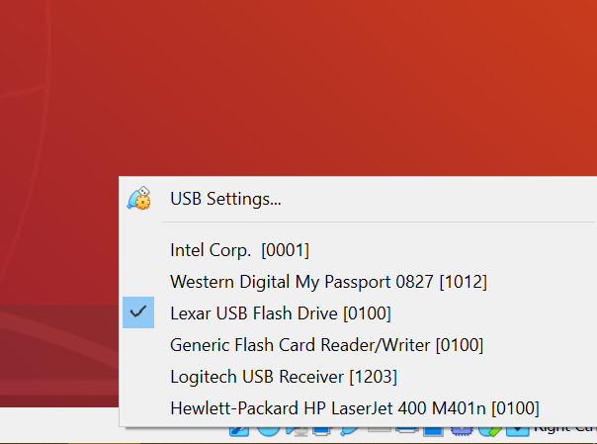
Accessing usb Devices

Slide 20
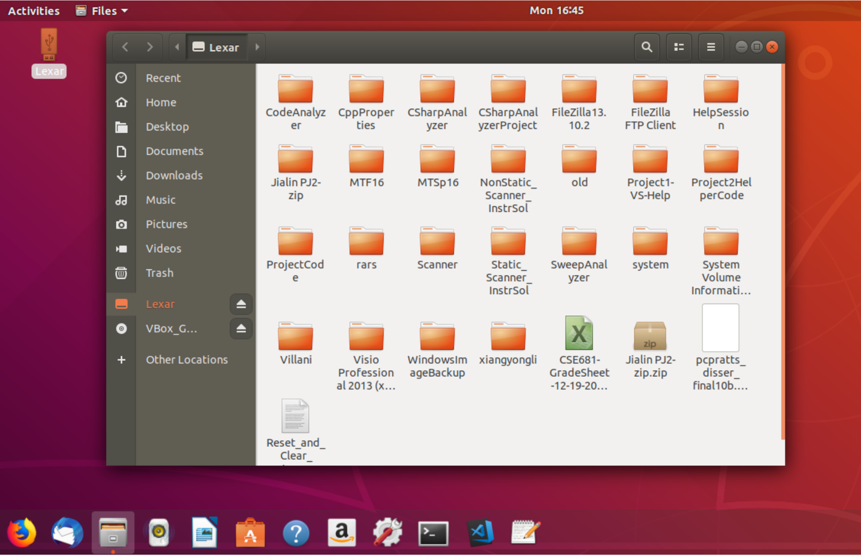
Using usb devices
A bug in Virtualbox causes other devices, e.g., Bluetooth mouse, to fail.
Restarting the VM resolves that problem.
Large drives will probably fail to connect.

Slide 21
Task #3 – Install build-essential
gcc toolchain configured by Ubuntu team to build Ubuntu
gcc (c/c++ compiler and linker)
Make
Many other tools

Slide 22
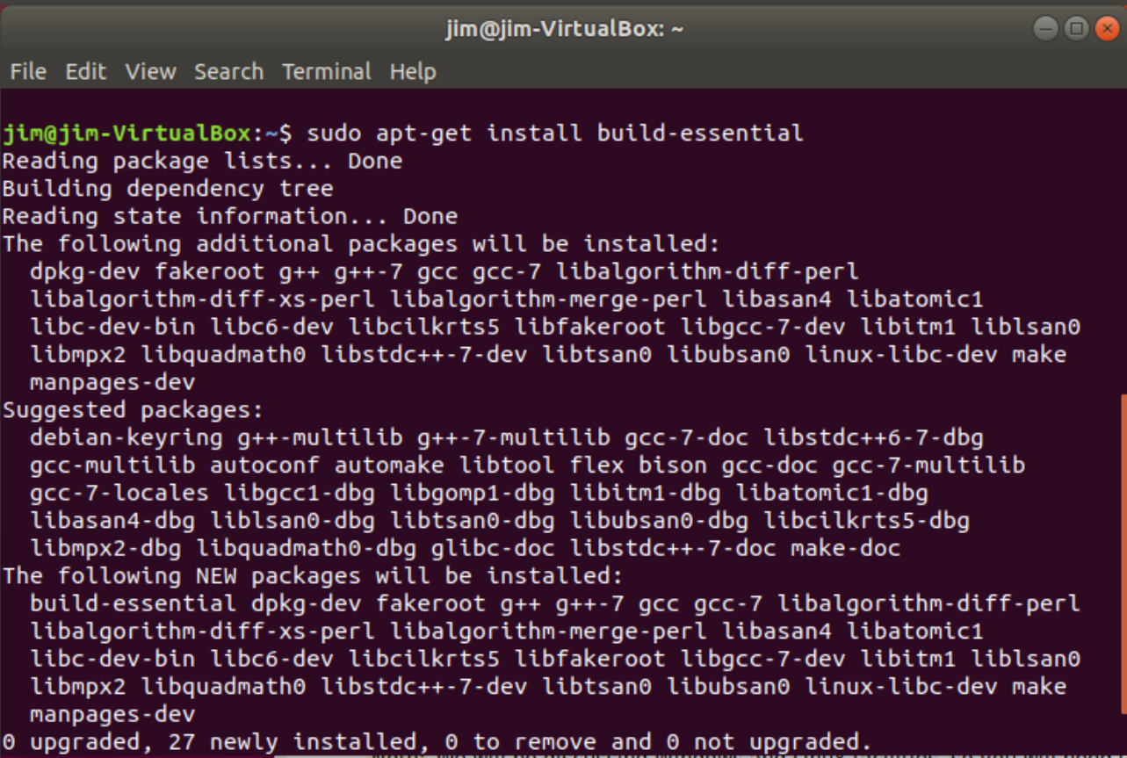
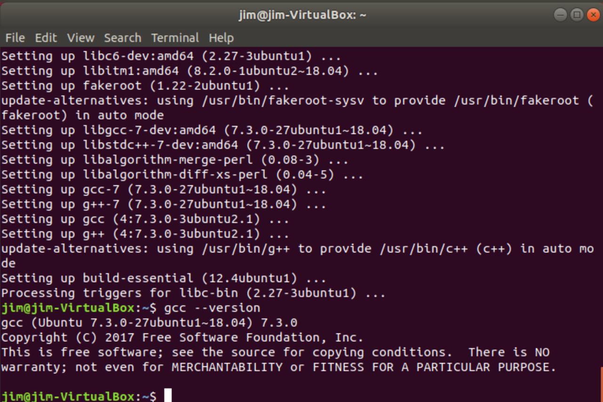
Install “build essential” gcc tool chain
Press tab

Slide 23
Task #4 – Install VS Code

Slide 24
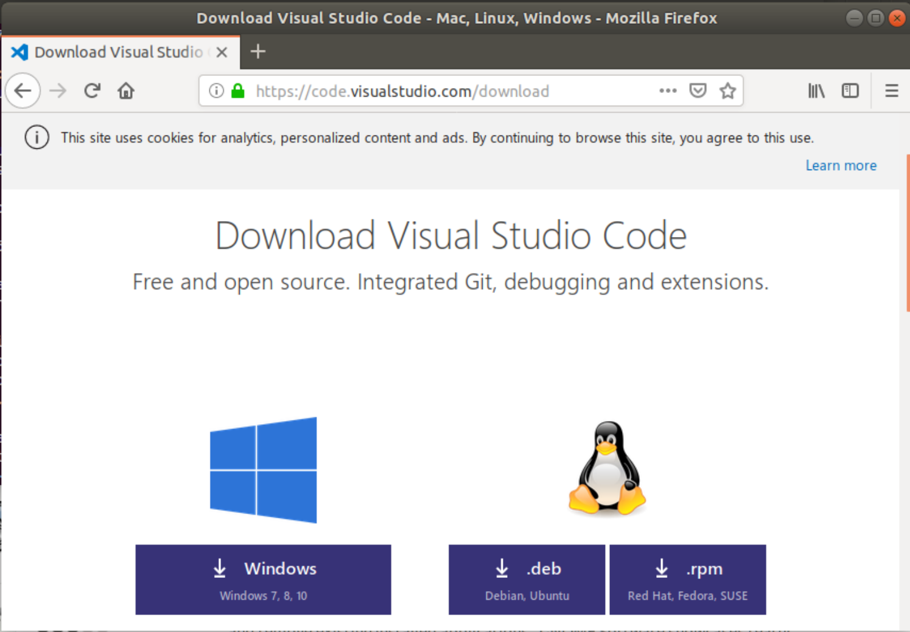
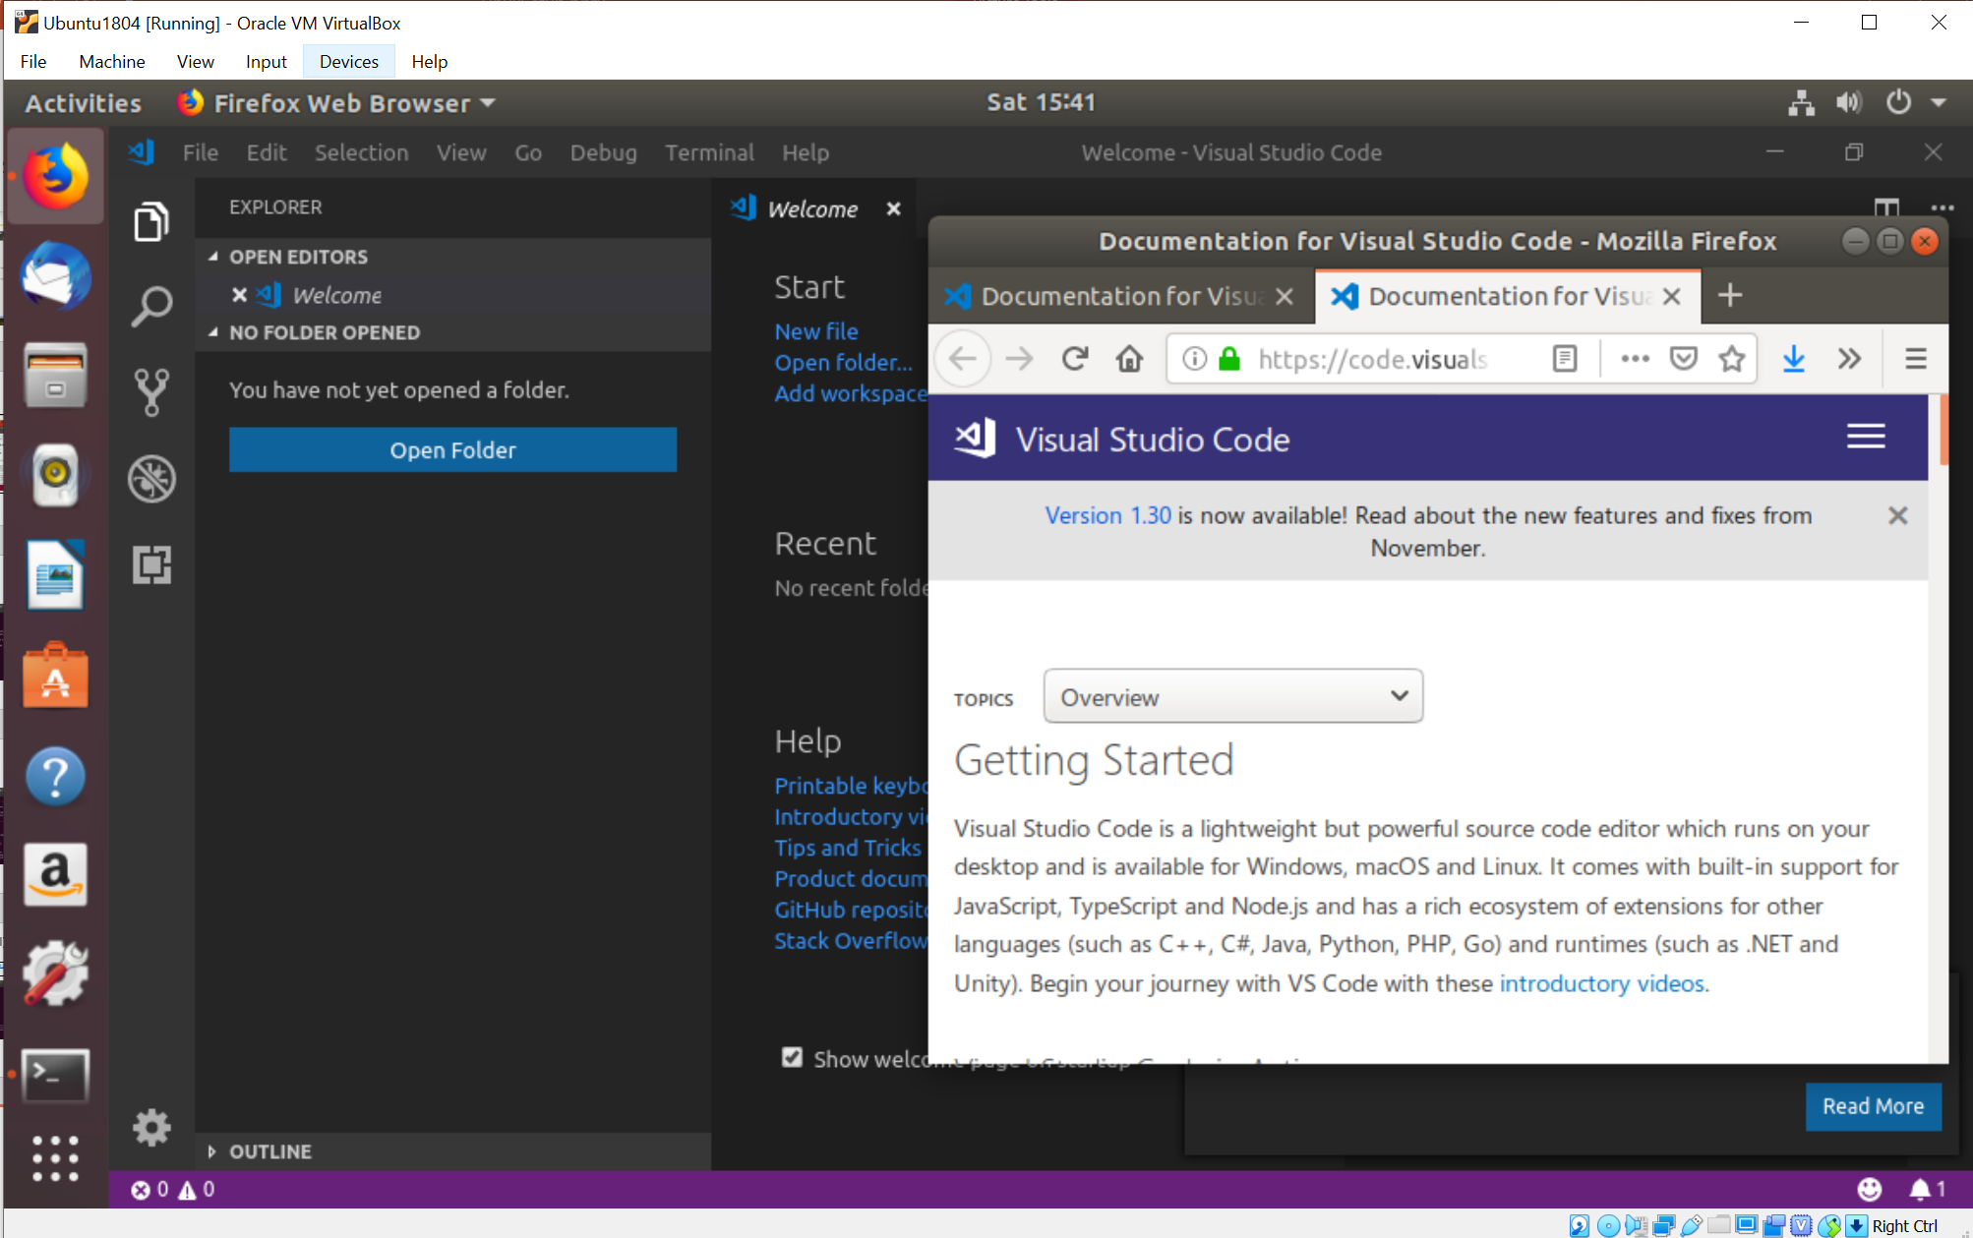
Download and Install Visual Studio Code
Follow directions on this page.
You can’t just apt-get install.

Slide 25
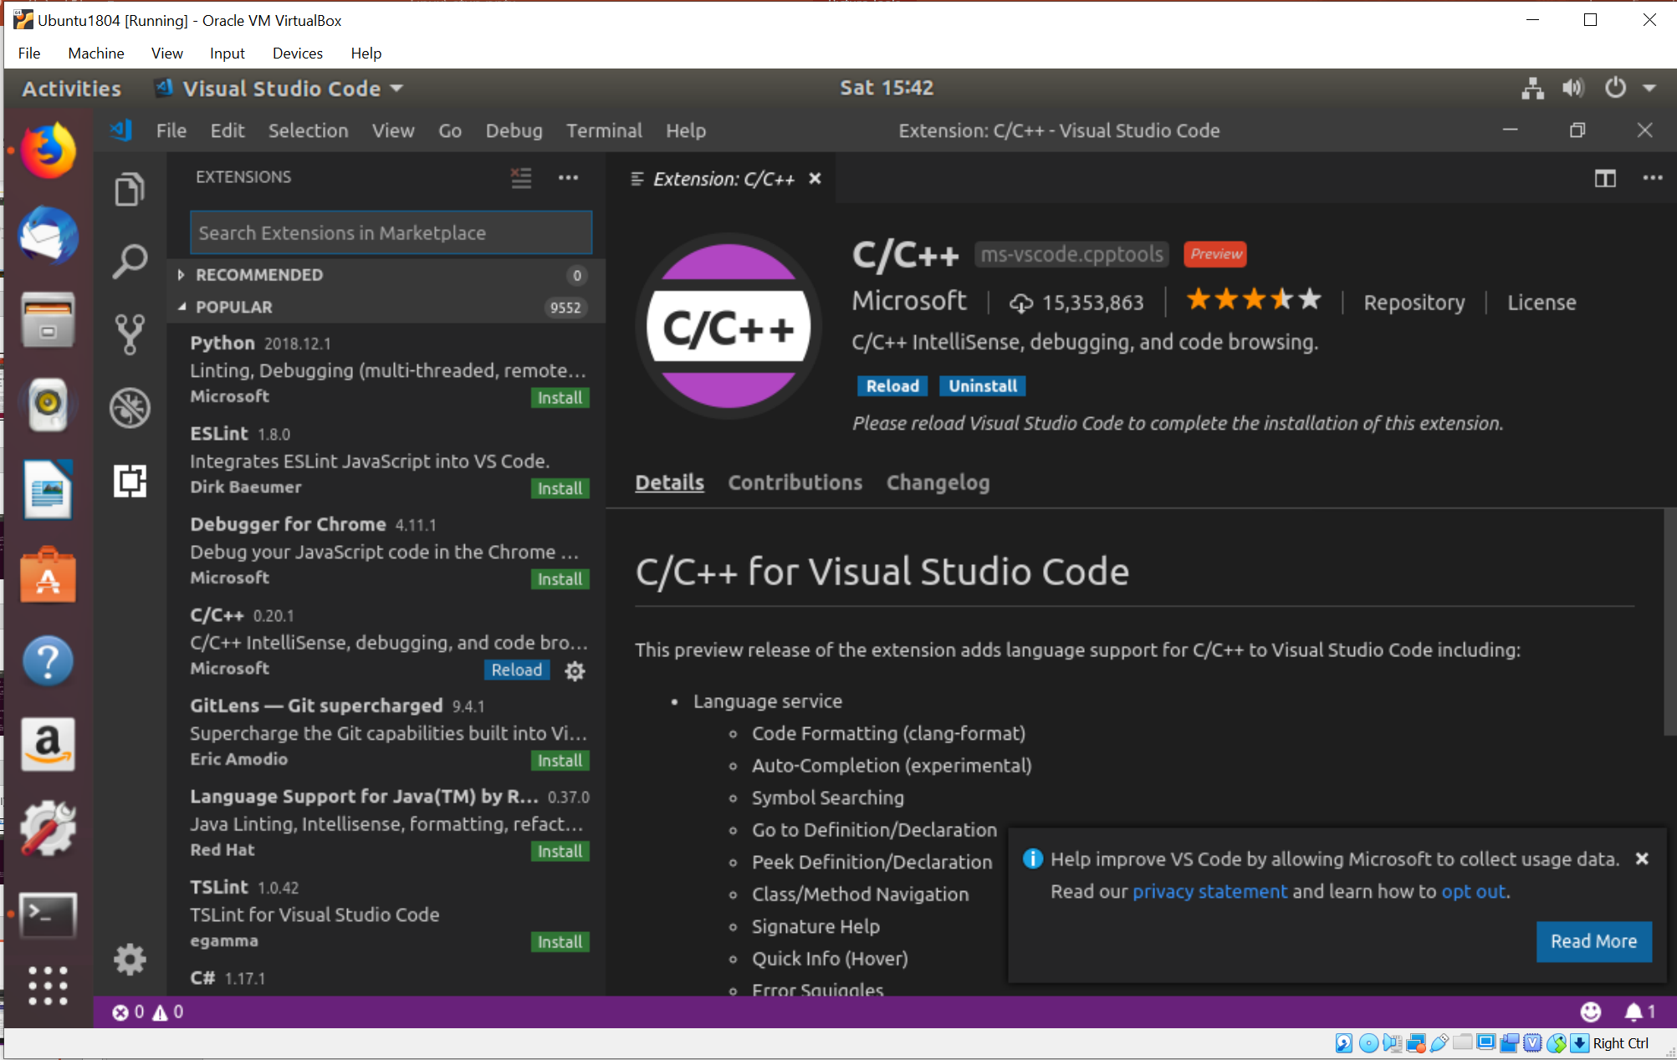
Adding C++ Plugin
Click on plugin icon
  Bottom of left pane
Select C/C++
This configures json setting files (partially)
You must already have a C++ tool chain installed

Slide 26
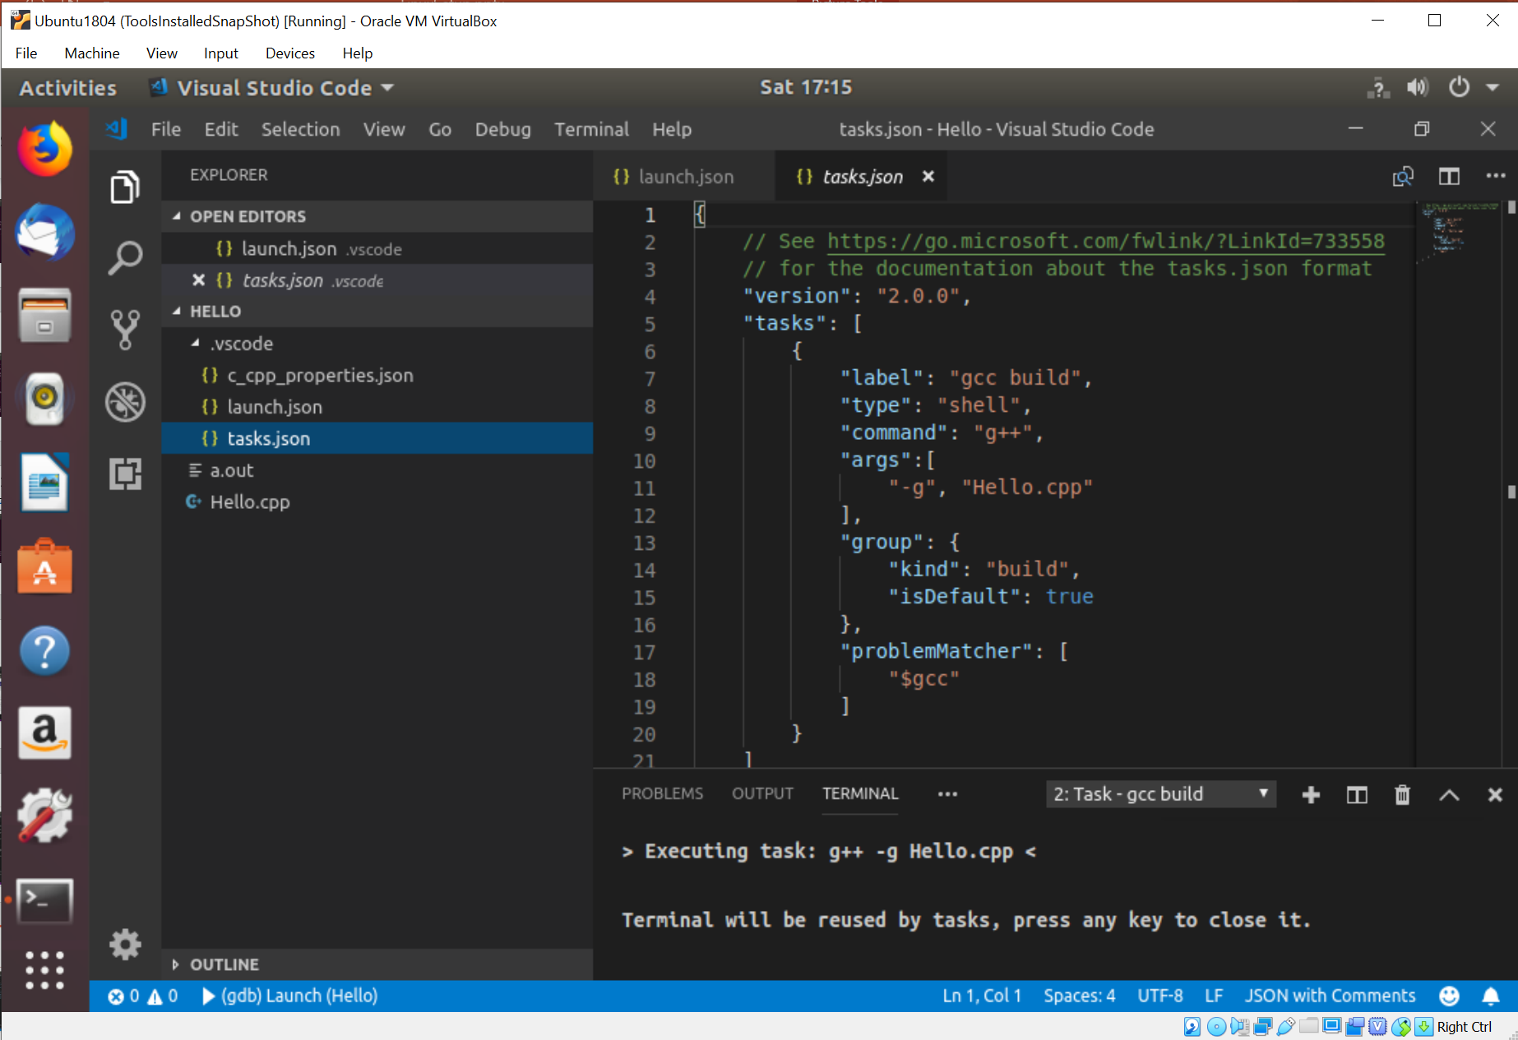
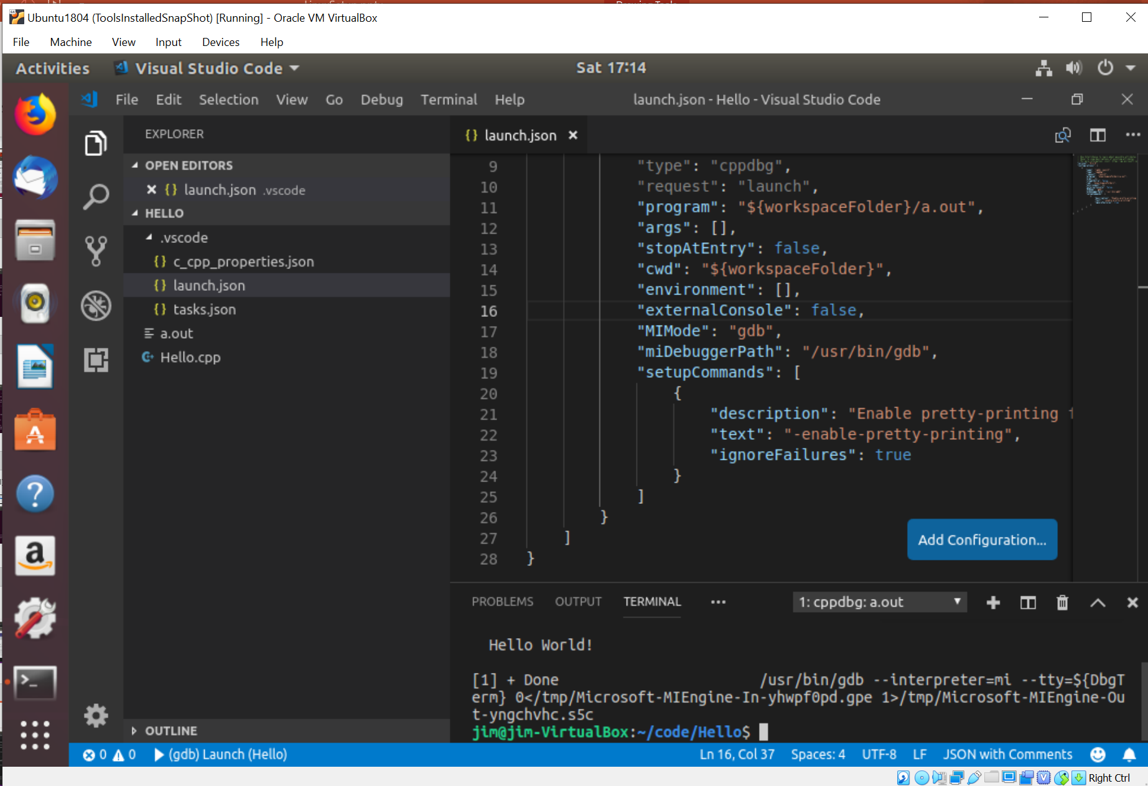
VS Code – Building C++
gdb execution
gcc build

Slide 27
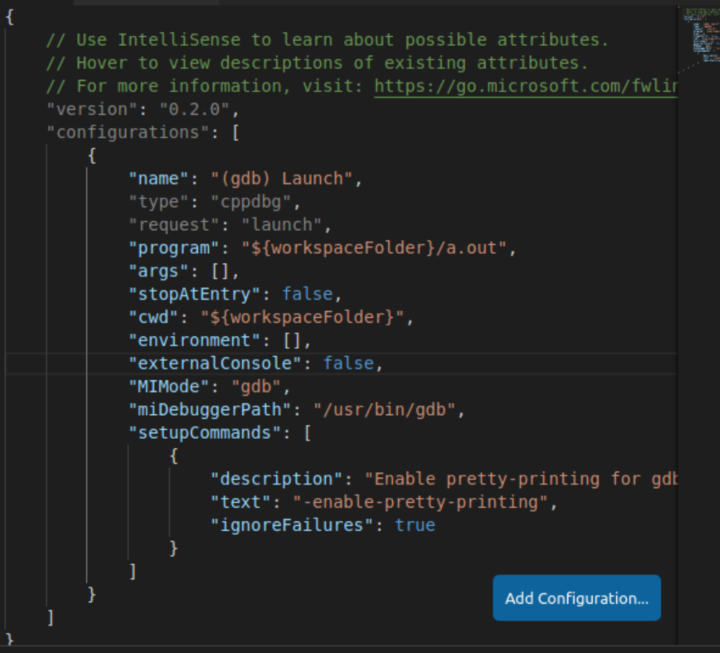
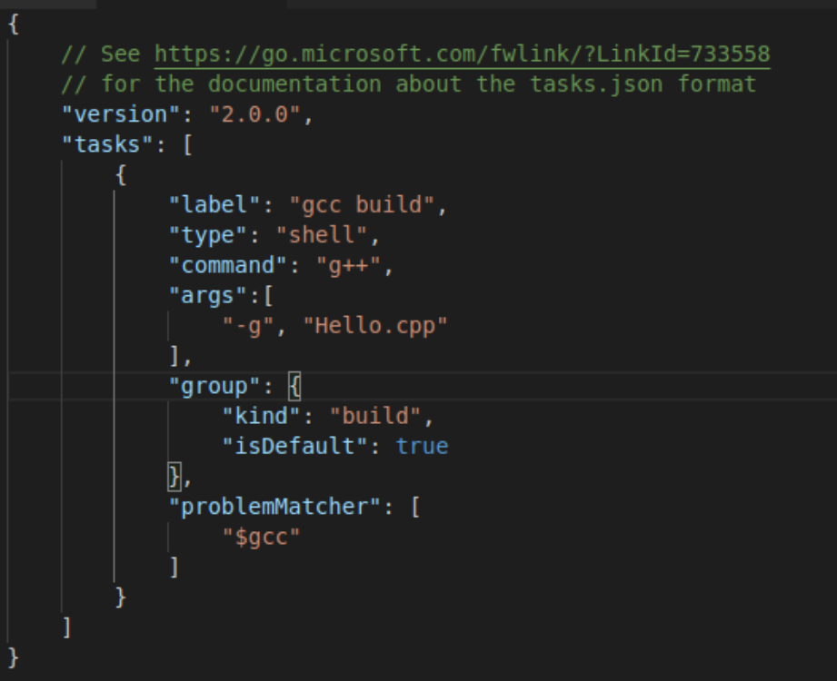
Tasks.json and Launch.json
Build Task
Debugger Launch

Slide 28
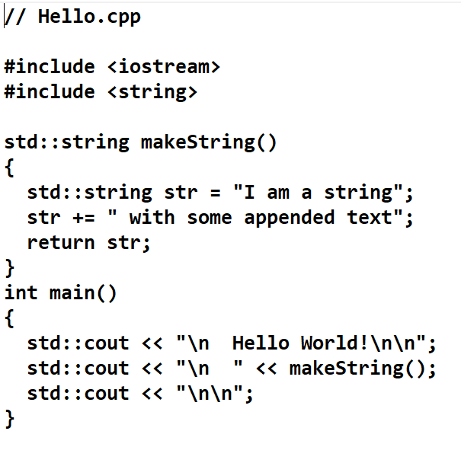
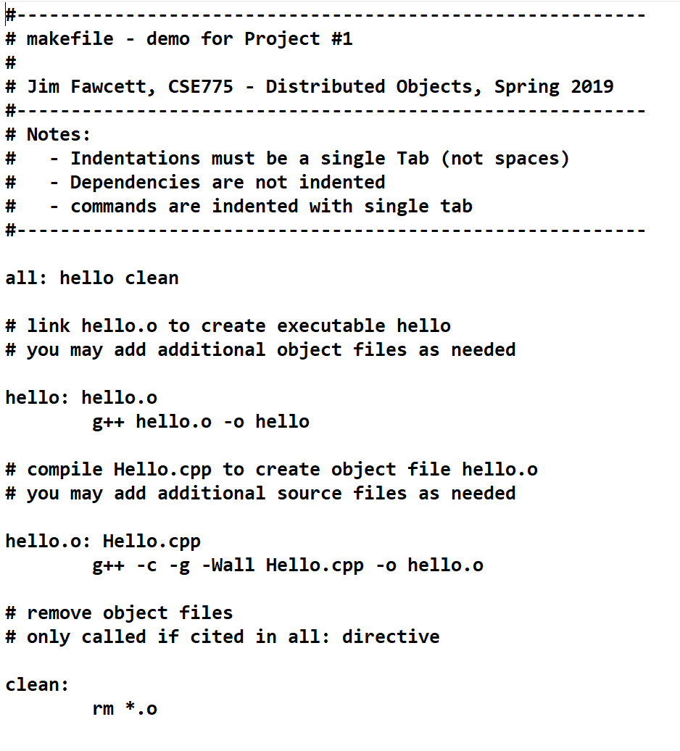
Makefile Example

Slide 29
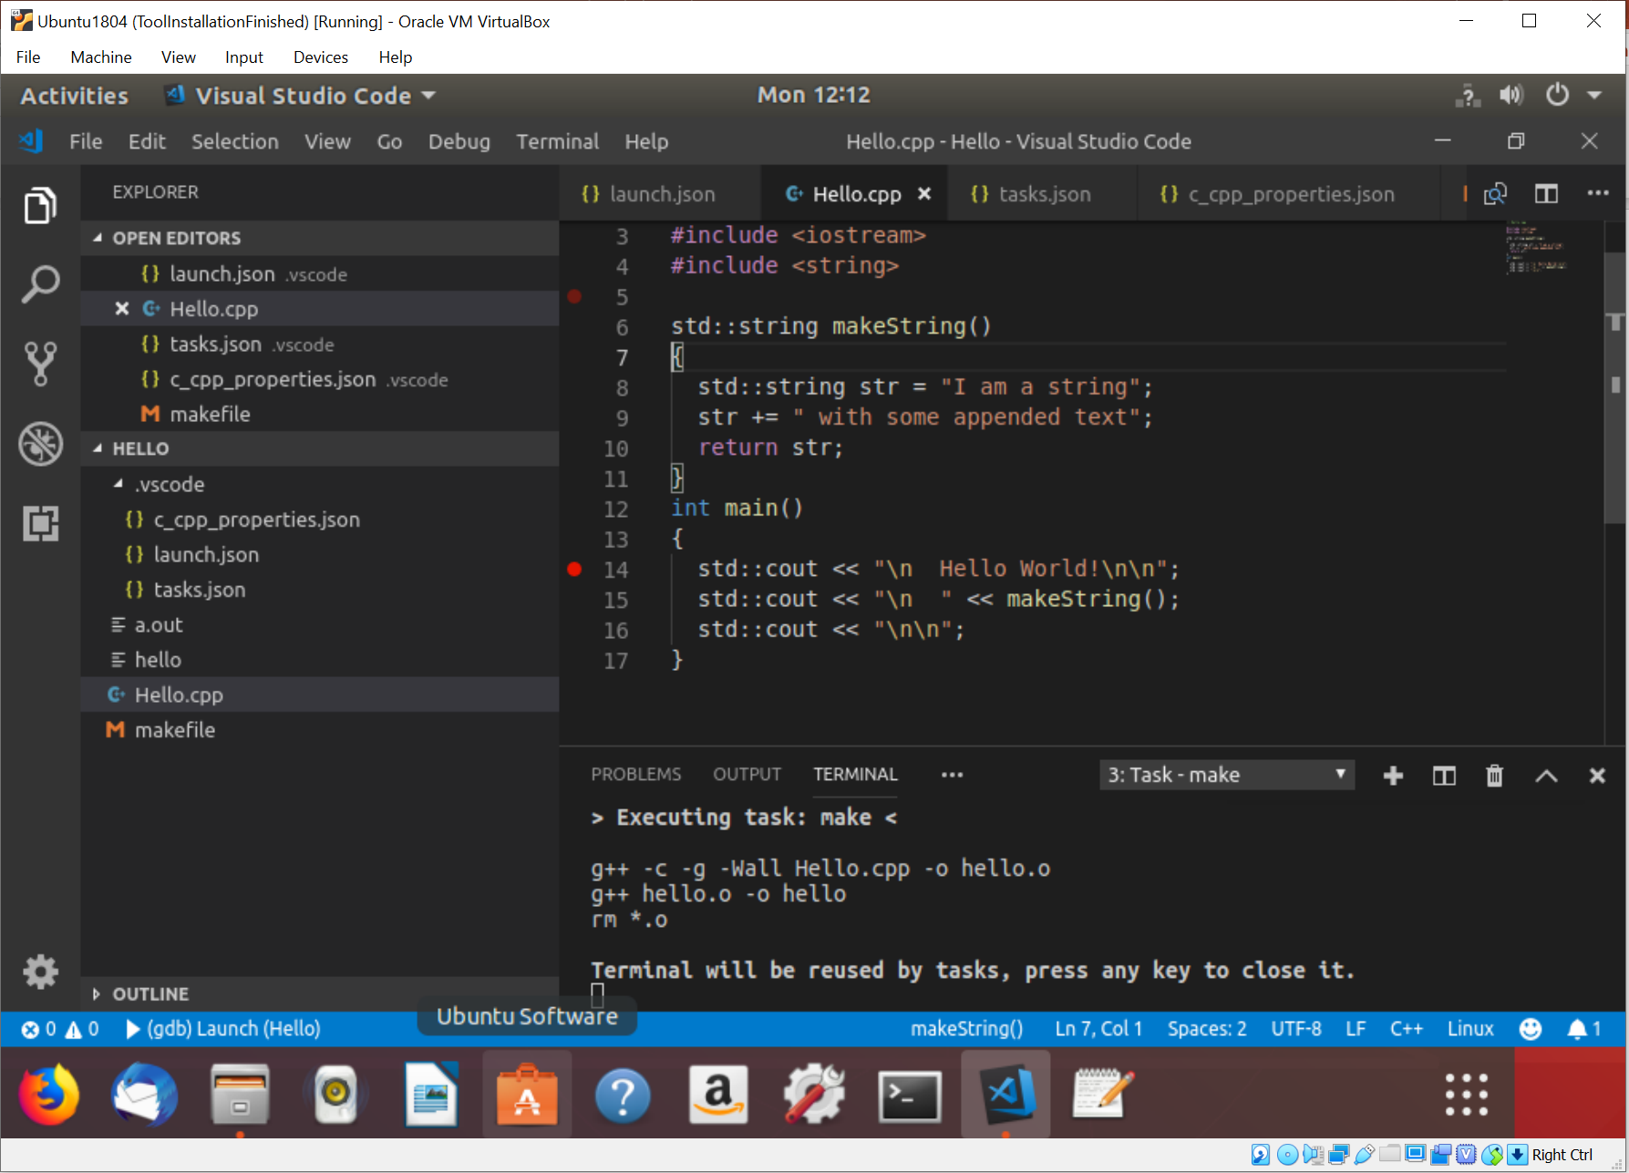
Running make
Terminal >
Run Task >
make
Builds application as specified by makefile

Slide 30
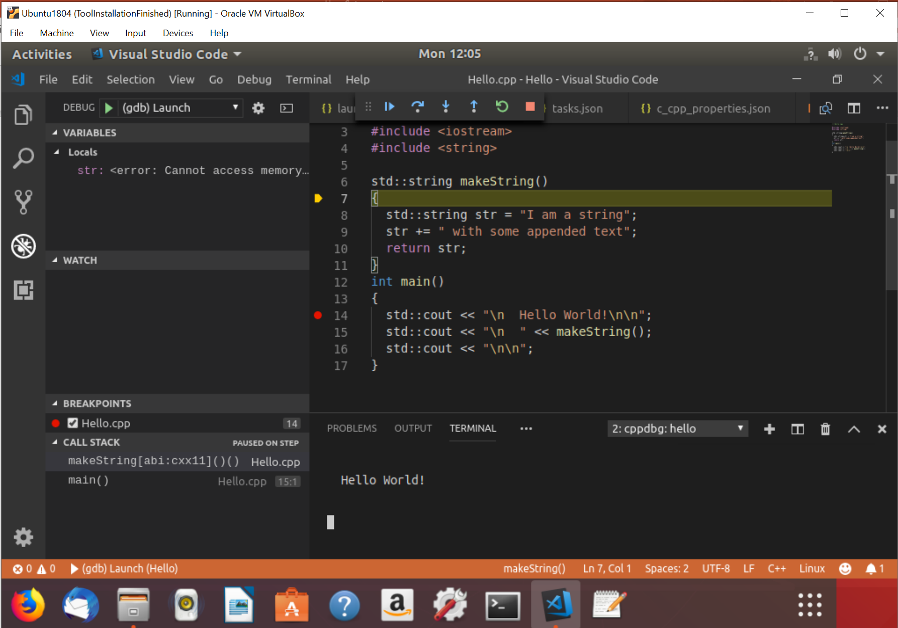
Debugging hello: Debug > Start Debugging
Note breakpoint
F10 => single step
F5 => go to next breakpoint
Note call stack
Note Terminal

Slide 31
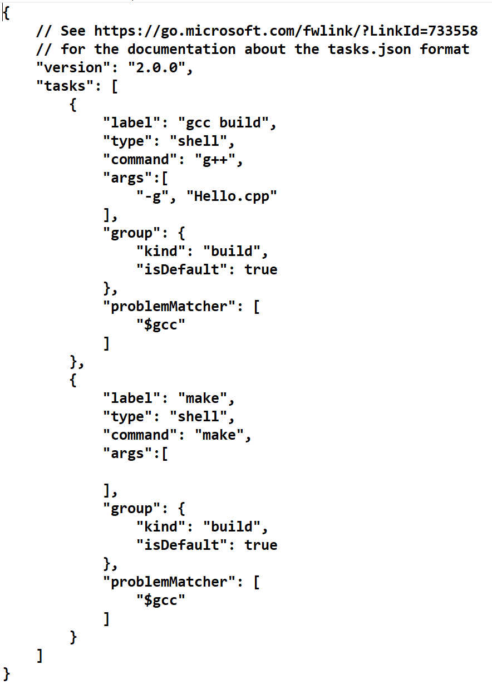
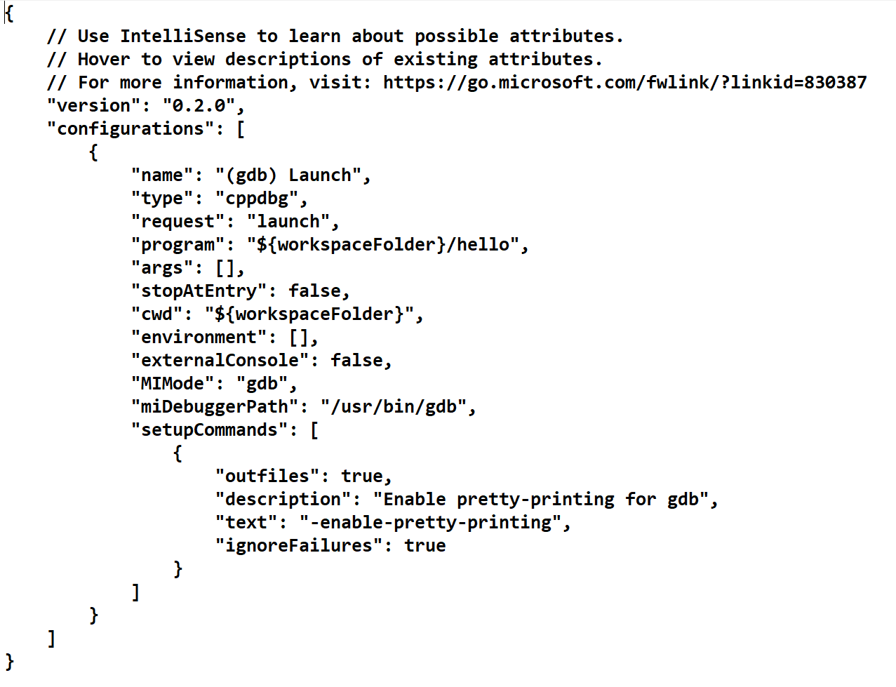
Build and Launch JSON
gcc build
Launch gdb
degugger
make build

Slide 32
Task #5 – Optional Installs

Slide 33
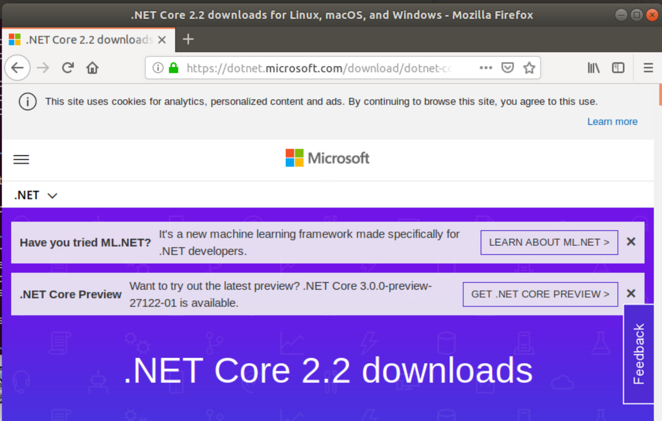
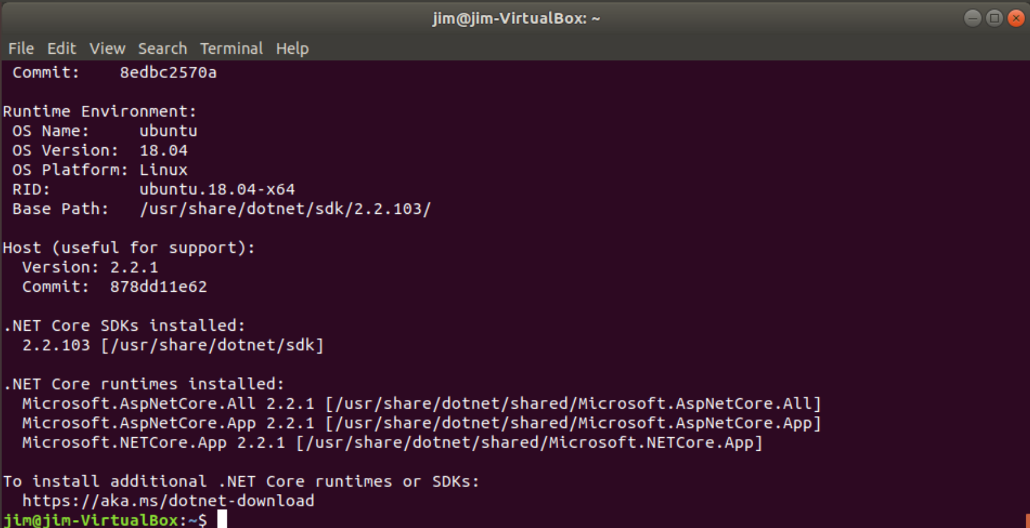
Download Asp.Net Core 2.2 (optional)
https://dotnet.microsoft.com/download/linux-package-manager/ubuntu18-04/sdk-2.2.102
Several detailed command line invocations are needed.

Slide 34
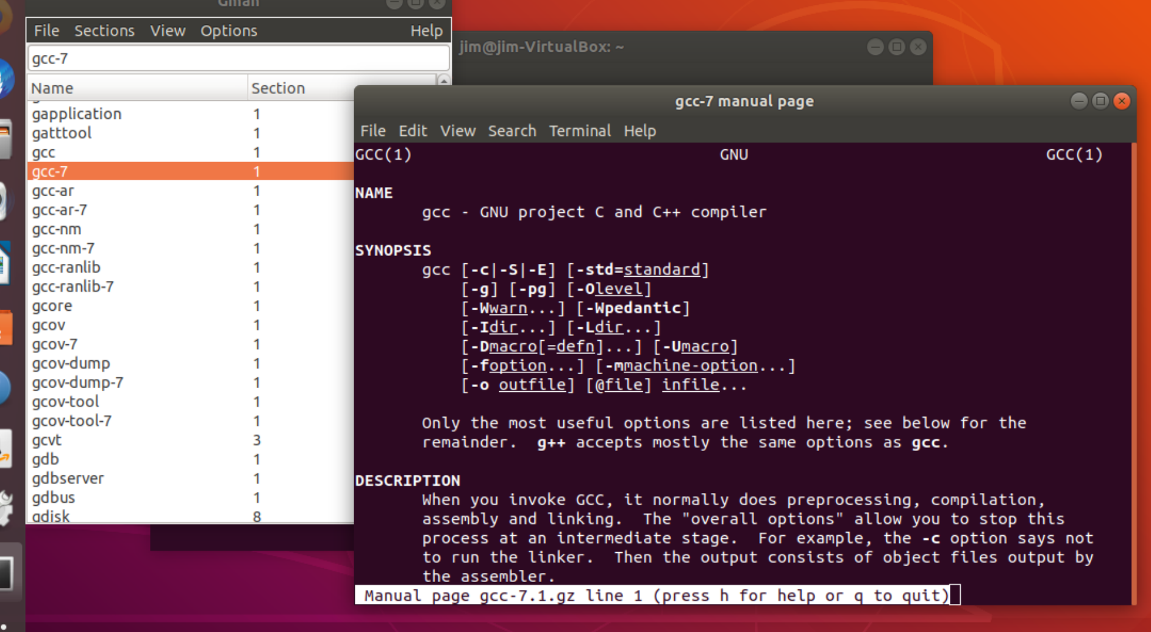
Gman – man page helper
Install gman
  Sudo apt install gman

Slide 35
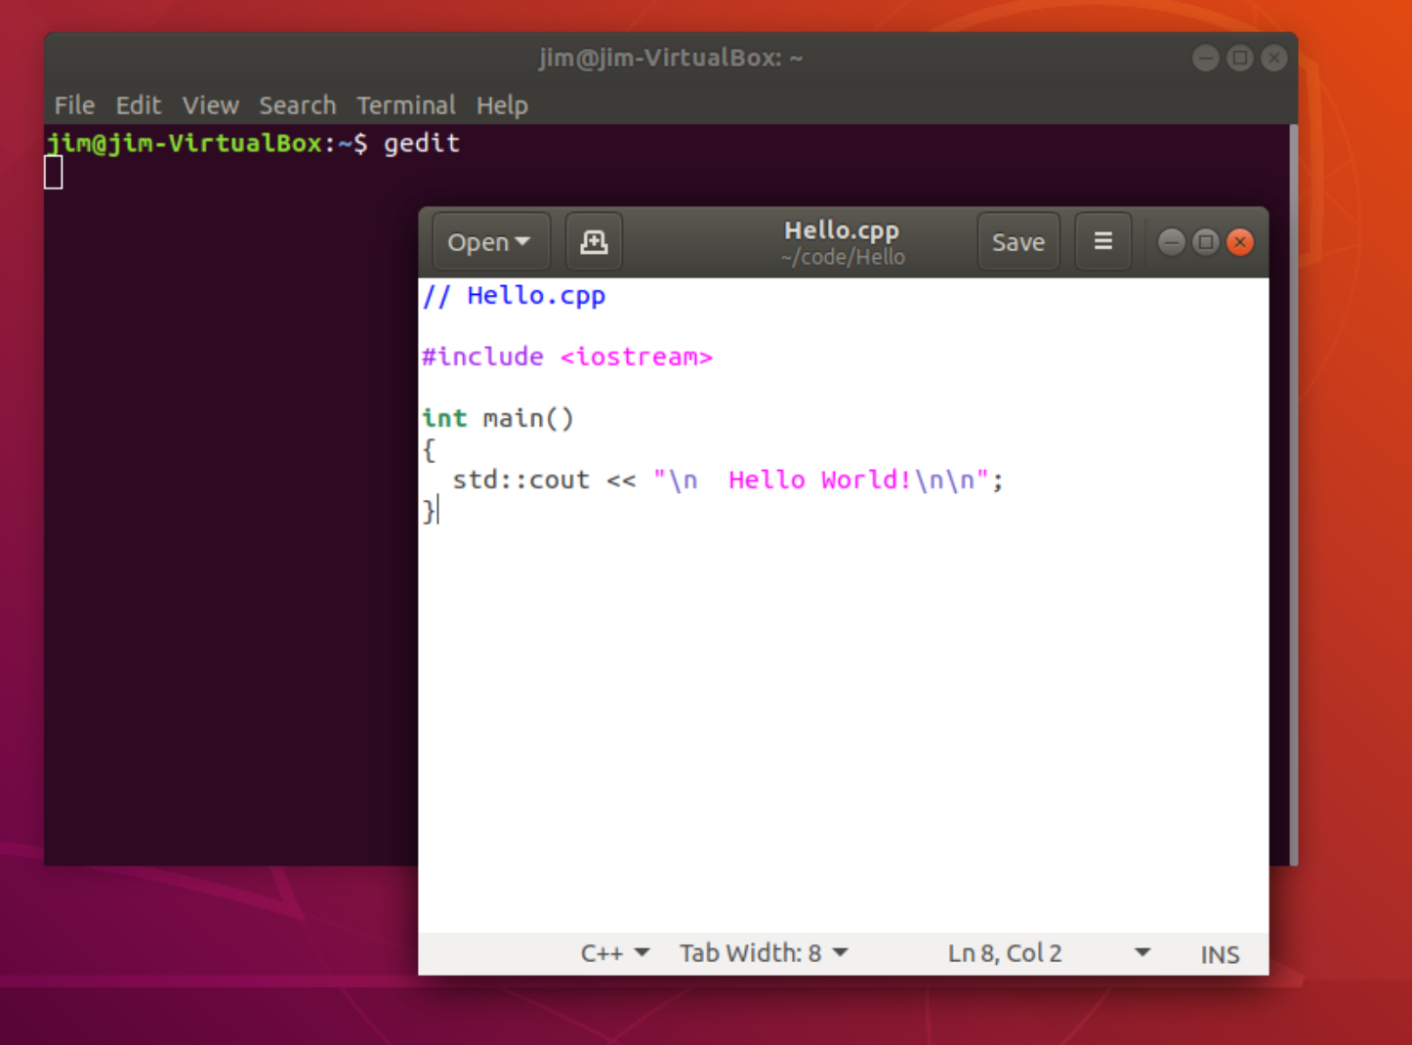
gedit – installed with Ubuntu

Slide 36
That’s All Folks!

