Slide 1
Java/Netbeans Platform Survey
Phil Pratt-Szeliga 2011

Slide 2
Java
Java is an easy to learn yet industrial strength programming language
An experienced Java Developer’s code can run on any platform without any rebuild whatsoever
  Windows x86
  Windows x86_64
  Linux x86
  Linux x86_64
  Etc
Java was originally created by James Gosling at Sun [1]. I believe they needed people to want to write code for Solaris.
  When Sun existed their stock symbol was JAVA.
Sun was acquired by Oracle and James Gosling has been hired by Google [2]
Java is a de-facto standard controlled through the Java Community Process. In 2007 Sun made all the Java code under free software/open source terms [1]

Slide 3
Overview
Jars, Java Build Process, Pack, Running Java Programs
Javadocs
Rich Composeable IO
Rich collections
Threads and Concurrency
Sockets
MMF
Netbeans
  IDE
  Junit
JNI

Slide 4
Jars
Jars are the packaged form (like an exe or dll)
The are just zip files plus a manifest
Files inside have to have the path of the namespace
It is common to use strong namespaces.
  /edu/syr/pcpratts/image/Bitmap.class
  /edu/syr/pcpratts/image/BitmapFactory.class
  /edu/syr/pcpratts/image/BoundingBox.class
  /edu/syr/pcpratts/image/Color.class
  /edu/syr/pcpratts/image/Pixel.class
  /edu/syr/pcpratts/image/Point.class
  ------------------------------------------------------
  import edu.syr.pcpratts.image.Point;

Slide 5
Java Build Process
The easiest way I find to build java programs is to make a Netbeans project and compile from there
Netbeans uses ant as the build tool so if you need to build the project on the command line use ant’s command line
Ant uses xml configuration files (and custom tasks implemented as java classes) to build
On windows ant is annoying to setup due to path issues
On linux it just works out of the box:
# sudo apt-get install ant
# cd java_applicat
# ant jar

Slide 6
Jars and Pack
The Java API has classes to operate on jar files
A jar file is like an exe and a dll (just like a C# assembly)
  You can run it if it has a main class in the manifest
  You can reuse classes from other jars (even ones that have a main class in the manifest)
Sometimes your end program will have multiple jar files that have to have a specific directory structure as specified in the manifest (netbeans does this)
I made a pack.jar that can simply pack everything into one .jar file that you can easily distribute

Slide 7
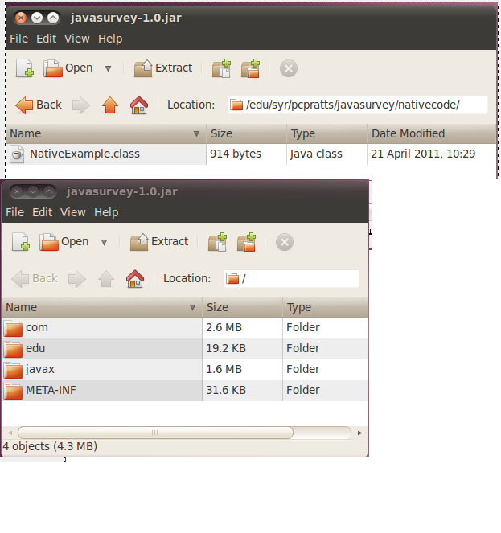
Jars
Folder with code
Root path

Slide 8
Running Java Programs
With jar files you run:
java –jar pack.jar argument1 argument2
You can also run .class files directly, but it is a pain
Often in java open source projects a platform dependent script or small C/C++ program is used to run the above command so the end-user doesn’t have to know how to run the command
run.bat on windows
run.sh on linux

Slide 9
A Huge Java Flaw
Java requires you to specify the maximum amount of memory you use
  If you guess too high, the program won’t start (remember this is from a shell script on the end-users machine)
  If you guess too low, eventually in a memory intensive program it will throw an OutOfMemoryException
Command line option (max amount is 6500 Meg of ram)
java –Xmx6500m –jar pack.jar arg1

Slide 10
Javadocs
The Java Collections, for example:
http://www.cs.duke.edu/csed/java/jdk1.5/docs/api/java/util/Collection.html
Soot API:
http://www.sable.mcgill.ca/soot/doc/index.html
The javadoc tool comes standard with java so any serious java project publishes their javadocs on the web

Slide 11
Rich Composable IO
InputStream / OutputStream (abstract)
  Byte IO
  Used as interface too
FileInputStream / FileOutputStream
  Byte IO
StringBufferInputStream
  Byte IO
ObjectInputStream / ObjectOutputStream
  Primitive and Object IO
  Object IO uses Serializable interface to read and write objects

Slide 12
Rich Composable IO
GZIPInputStream / GZIPOutputStream
  Acts as a filter to a Stream that applies compression
JarInputStream / JarOutputStream
  Acts as a filter that reads .jar files

Slide 13
Rich Composable IO
InputStreamReader / InputStreamWriter
  Char IO
FileReader / FileWriter
  Char IO
BufferedReader / BufferedWriter
  Reads and writes lines at a time

Slide 14
Rich Collections
List interface
  ArrayList
  LinkedList
  Stack
Map interface
  HashMap
  TreeMap
  LinkedHashMap
Set interface
  HashSet
  TreeSet
  LinkedHashSet

Slide 15
Rich Collections
BlockingQueue
  ArrayBlockingQueue
  LinkedBlockingQueue
  PriorityBlockingQueue

Slide 16
Interacting with the filesystem
Two major things get in the way of absolute platform independence
  Paths
  Native Code
On Windows the File separator is \
On Linux the File separator is /
When you are writing code that interacts with paths, use the string File.separator to get the current separator for the platform

Slide 17
Interacting with the filesystem
Be careful when using File.separator in regular expressions
String upFolder(String folder){
String s = File.separator;
if(s.equals("\\"))
s = "\\\\";
String[] tokens = folder.split(s);
String ret = "";
for(int i = 0; i < tokens.length - 1; ++i){
ret += tokens[i] + File.separator;
}
return ret;
}

Slide 18
Threads
Any class that implements the Runnable interface can be used to create a thread
class ThreadProc implements Runnable {
int data;
public ThreadProc(int data){
this.data = data;
new Thread(this).start();
}
public void run() {
while(true) {
/* use data */
} } }

Slide 19
Concurrency
java.util.concurrent namespace:
  Semaphore
  CyclicBarrier
java.util.concurrent.atomic namespace:
  AtmoicBoolean
  AtomicInteger
  AtomicLong
Note on variables that can fit in registers:
  I have never seen one read or write operation on a primitive not be atomic. I think you need to worry when you have a read followed by a write that needs to be atomic

Slide 20
Concurrency
Synchronized methods:
  The JVM makes sure threads are serialized for all synchronized methods of a class
public class SynchronizedCounter {
private int c = 0;
public synchronized void increment() { c++; }
public synchronized void decrement() { c--; }
public synchronized int value() { return c; }
}
http://download.oracle.com/javase/tutorial/essential/concurrency/syncmeth.html

Slide 21
Socket Server
All java types are stored as network byte order so you never need to do any host to network byte order conversion
//accept thread
ServerSocket listener = new ServerSocket(m_ListenPort);
while(true){
Socket client = listener.accept();
Thread thread = new Thread(new ClientHandler(client));
thread.start();
}
//client handler
BufferedReader reader = new BufferedReader(
new InputStreamReader(client.getInputStream());
PrintWriter writer = new PrintWriter(
new OutputStreamWriter(client.getOutputStream());

Slide 22
Socket Client
Socket sock = new Socket(“128.230.199.134", 8000);
BufferedReader reader = new BufferedReader(
new InputStreamReader(sock.getInputStream());
PrintWriter writer = new PrintWriter(
new OutputStreamReader(sock.getOutputStream());

Slide 23
Memory Mapped Files
FileInputStream fin = new FileInputStream("text.txt");
FileChannel channel = fin.getChannel();
MappedByteBuffer buf =
channel.map(FileChannel.MapMode.READ_WRITE,
position, size);
int ivalue = buf.getInt(); //buffer ptr is incremented
long lvalue = buf.getLong();
CharBuffer char_buffer = buf.asCharBuffer();

Slide 24
Regular Expressions
String str = “hello world”
if(str.matches(“^hello”)){
//do something if str starts with hello
}

Slide 25
WeakReferences
WeakReference:
  The garbage collector will not consider links past a weak reference as alive
Bitmap bmp = new Bitmap(1600, 1200);
WeakReference<Bitmap> weakbmp =
new WeakReference<Bitmap>(bmp);
//later
Bitmap bmp2 = weakbmp.get();
if(bmp2 == null) {
//reload from disk and reinitialize weakbmp
}

Slide 26
WeakReferences
WeakHashMap<Key, Value>
  Like a HashMap but the Key is really a WeakReference<Key>
  Useful for creating caches

Slide 27
Netbeans Demo
Excellent code completion
Auto suggest imports (Visual Studio supports this with a for pay plugin)
Excellent renaming of fields, methods, classes and namespaces
Netbeans 7.0 was released yesterday and they supposedly worked on Swing a little bit.

Slide 28
Netbeans Performance Profiler Demo
This first rule in performance is that you write the code for correct functionality first
Then you only try to correct performance using a profiler
Demo performance of prefuse example

Slide 29
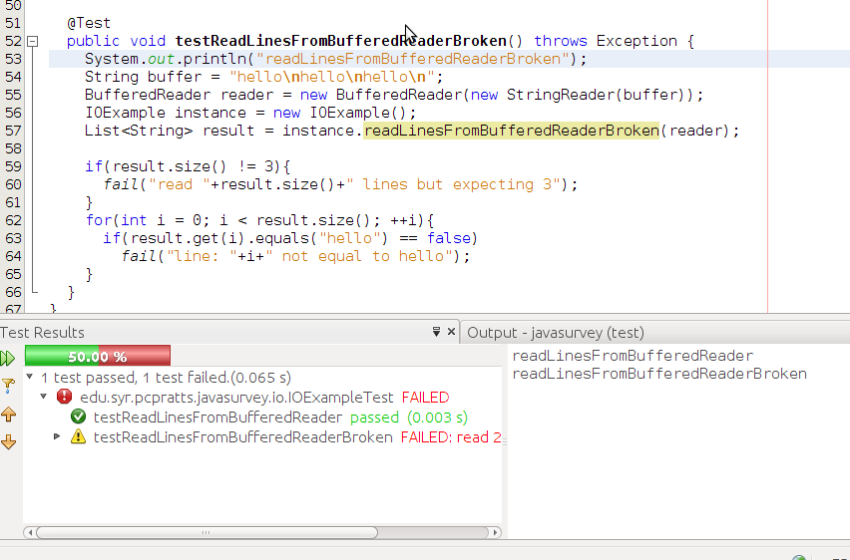
Junit for unit testing

Slide 30
Native code
JNI is older and somewhat clunky
  Developer has to copy things like Strings and Objects to/from the Java Managed Heap
JNA is a newer technology
  This copying is supposedly taken care of
In either case, my opinion is that you should only write native code in Java when you absolutely need to
  The performance of dynamically optimized Java may surprise you (in my tests code a matrix multiplication example actually gets faster as it runs. The same native code would not be dynamically optimized)
  With native code you immediately become platform specific

Slide 31
Manipulating Java Bytecode
I use the Soot Java Optimization Framework to manipulate Java Bytecode
http://www.sable.mcgill.ca/soot/
Soot can read .class files and construct several IR’s that are suitable for compiler optimization
I have not found a comparable library in C# (it may be a lot tougher to do it for C# than it is for Java due things like COM)

Slide 32
Image Processing In Java
The Bitmap class in C# is nice to use with image processing
  However Bitmap in C# is not thread safe
  To improve single core performance, the .Net team uses the image on the hard drive as a backing store and multiple Bitmaps pointing to the same file cannot be modified at the same time even though you don’t call Save
The Java Image Processing API is thread safe (at least what I have used) but the interface is not as nice
I have implemented part of the C# Image API in Java using thin wrappers

Slide 33
Peer to Peer networking in Java
I use the FreePastry java library for Peer-to-Peer networking in Java

Slide 34
References
[1] http://en.wikipedia.org/wiki/Java_%28programming_language%29
[2] http://en.wikipedia.org/wiki/James_Gosling

