Slide 1
Tiny http client and server
By
Nupur Kulkarni

Slide 2
Application Concept – Tiny HTTP Client and Server
The goal of this project is to implement small and simple components, HTTPClient and HTTPServer, used to build message passing communication channels in C++ on both Windows and Linux.
The components must be useful to communicate between any two platforms that support native code, e.g., Windows, Linux, Unix, Macs, etc.

Slide 3
Application Concept – Tiny HTTP Client and Server
The most important measure of success for this project is to create a small code base to efficiently send messages with very low complexity for the using applications.
The HTTPClient and HTTPServer components will be developed for both Windows and Linux platforms. Another measure of success is the ratio of common code to that which is unique for each platform. Ideally that ratio should be large.
Load balancing – Process pool
Libraries I am going to work on:
Sockets
Process

Slide 4
Technologies Used
HTTP 1.0
Sockets
C++ tiny HTTP server

Slide 5
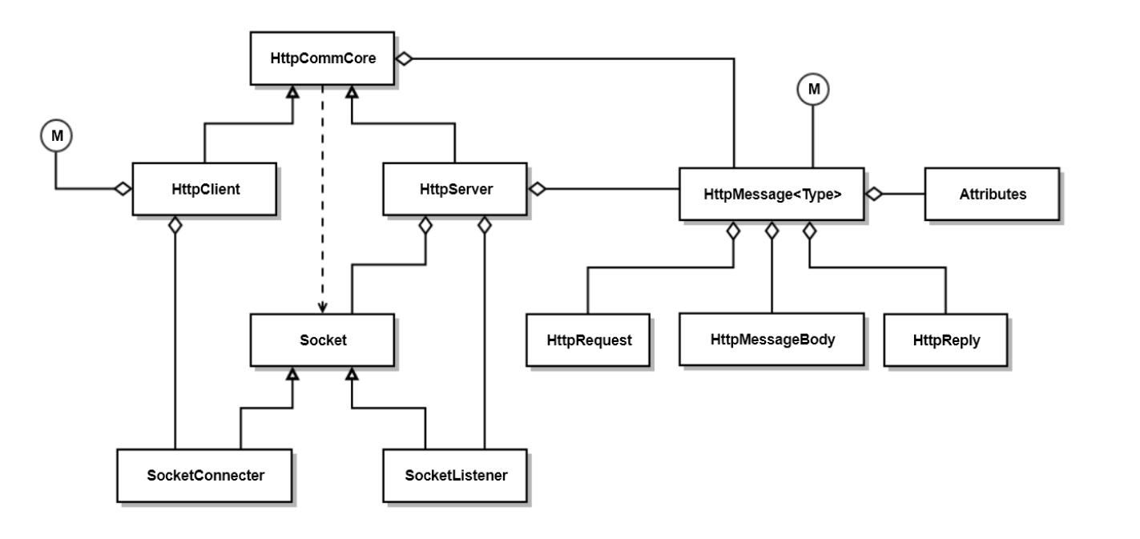
Project Structure

Slide 6
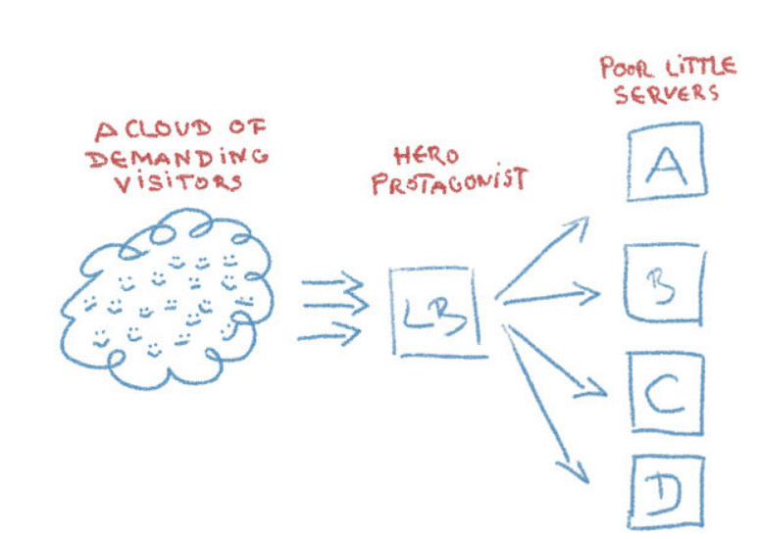
Project Structure

Slide 7
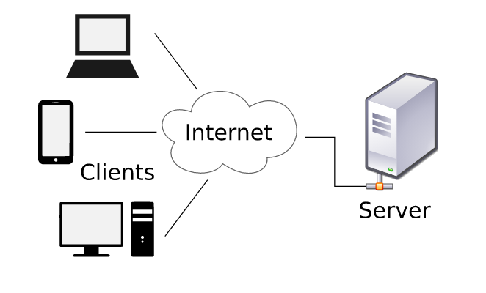
Technology Overview
Client-Server architecture:
Client-Server model is distributed application structure that partitions tasks or workloads between the providers of a resource or service, called servers and service requesters are called clients.
The server component provides a function or service to one or many clients, which initiate requests for such services.
For proper communication between the client and the server, applications must agree on a specific application-level protocol such as HTTP, FTP, SMTP, POP, and etc.

Slide 8
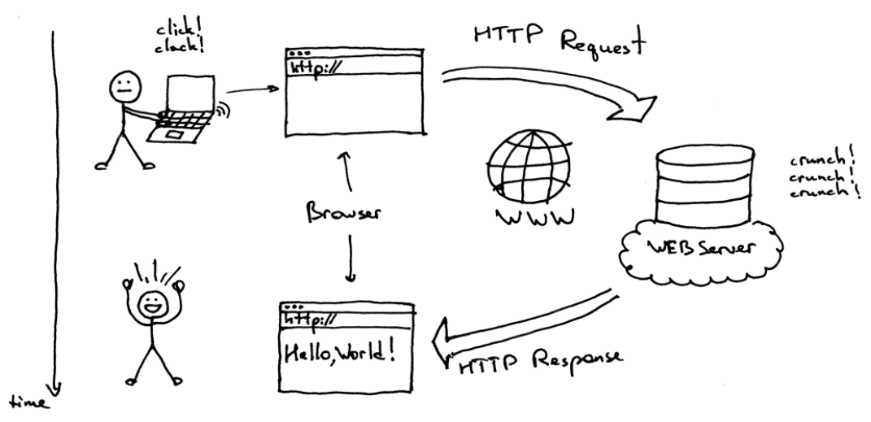
Technology Overview

Slide 9
Structure of HTTP Transactions
The format of the request and response messages are similar, and English-oriented. Both kinds of messages consist of:
an initial line,
zero or more header lines,
a blank line (i.e. a CRLF by itself), and
an optional message body (e.g. a file, or query data, or query output).

Slide 10
HTTP Request Methods
Request | Intent
GET | Retrieve a resource
POST | Update a resource
PUT | Store a resource
DELETE | Remove a resource
HEAD | Get just the header that a GET request would have obtained

Slide 11
Status Codes
The status code is generated by the server to indicate the outcome of the request; the first digit identifies the general category of response:
1xx indicates an informational message only
2xx indicates success of some kind
3xx redirects the client to another URL
4xx indicates an error on the client's part
5xx indicates an error on the server's part
Example
200- OK
404- Not Found

Slide 12
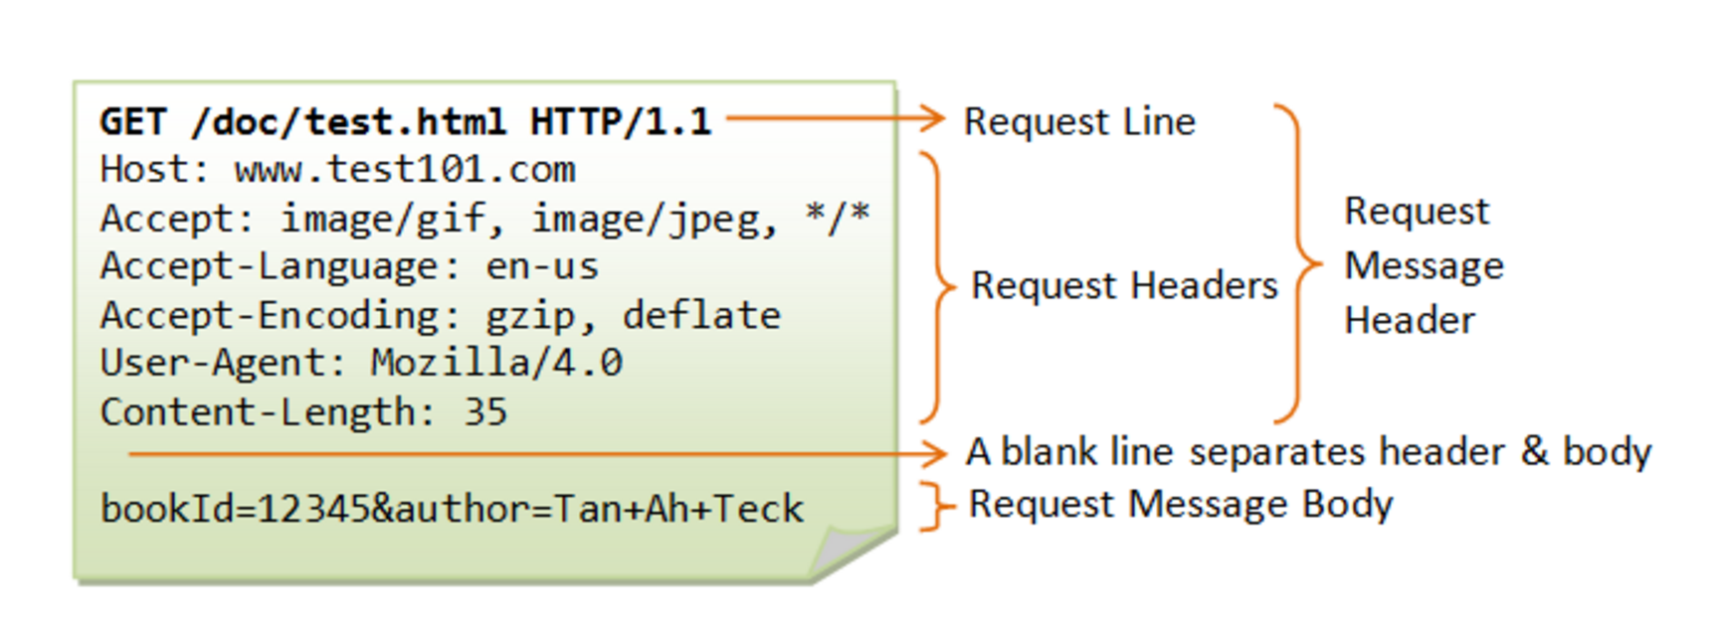
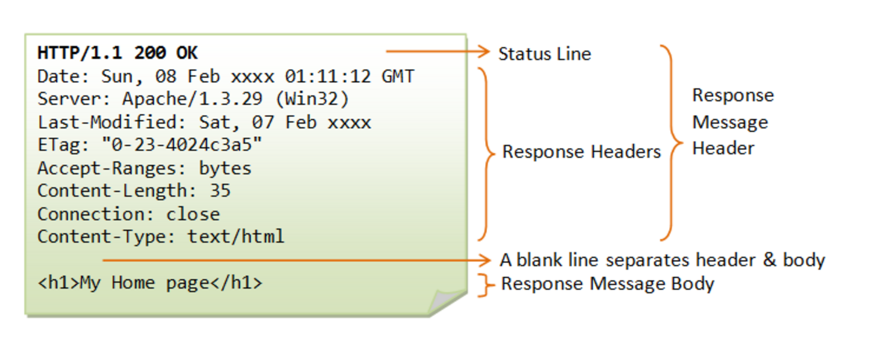
Sample HTTP Exchange
REQUEST
RESPONSE

Slide 13
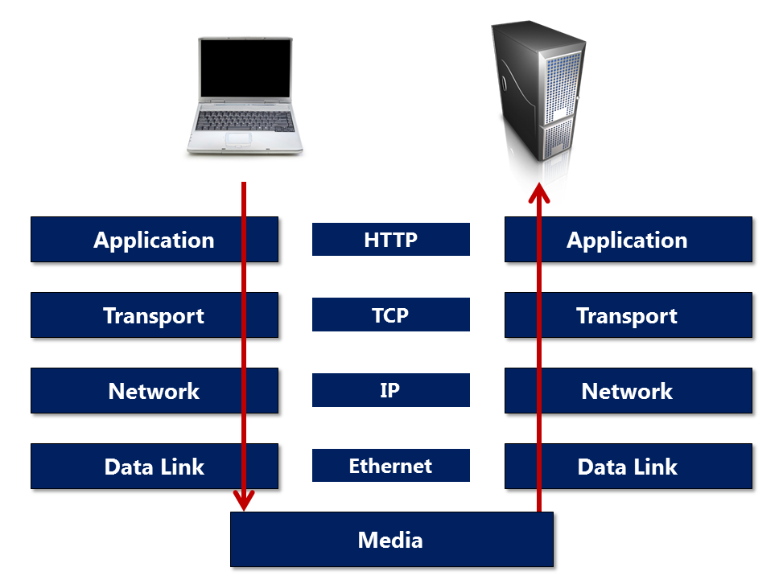
Connection
The layer underneath HTTP is transport layer protocol. Most HTTP traffic travels over TCP.
When a user types a URL into the browser, the browser opens a TCP socket by specifying the server address and port, then starts writing data into the socket.
All we need to worry about is writing the proper HTTP message into the socket.

Slide 14
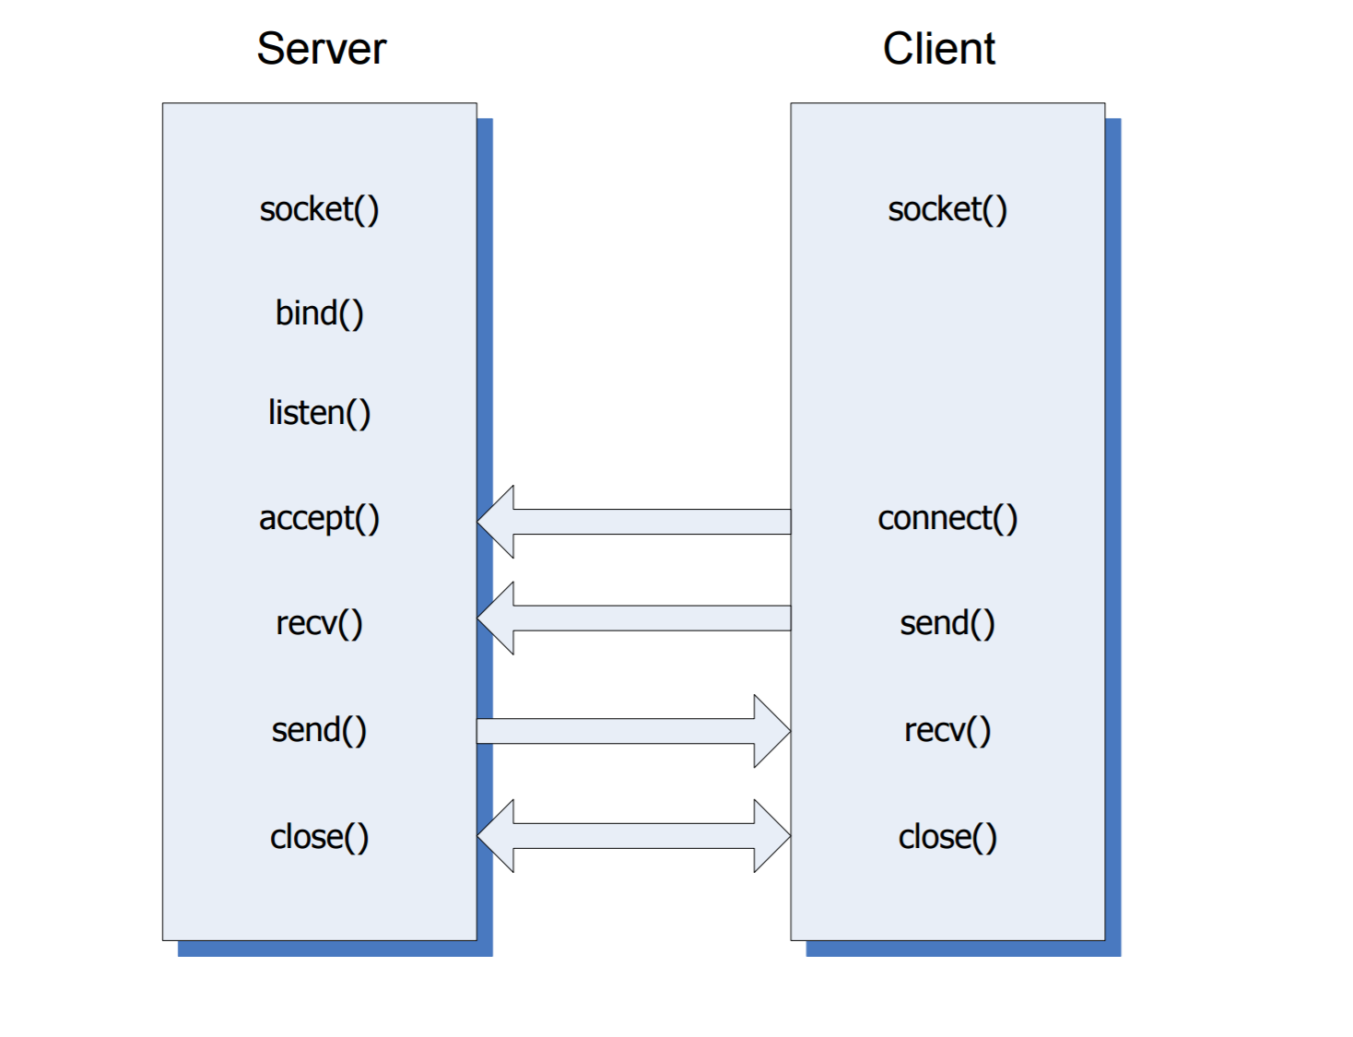
HTTP Client Server Processing

Slide 15
Socket API
Server
Create socket object – socket()
Bind server socket to address/port – bind()
Request server to listen for connection requests – listen()
Server accepts a client connection - accept()
Collect data from remote socket – recv()
Send data to remote socket – send()
Client
Create socket object – socket()
Connect the socket to the address of the server - connect()
Send data to remote socket – send()
Collect data from remote socket – recv()

Slide 16
Process Library
In general, a computer system process consists of (or is said to own) the following resources:
An image of the executable machine code associated with a program.
Memory (typically some region of virtual memory)
Operating system descriptors of resources that are allocated to the process
Security attributes.
Processor state.

Slide 17
Significant difference between Linux and Windows process
In Linux, if the parent process is closed then all the associated child process are forced to exit along with their parent.
In Windows, even when you close a parent process the child processes will be continuing with what they were doing.

Slide 18
Project Plan
Develop cross platform socket library for both Windows and Linux.
(Till mid march)
Develop cross platform process library
(Till march end)
Develop tiny http server accepting a function or functor that defines its response to the standard HTTP request message types: GET, POST, PUT, DELETE, and HEAD. That may be a message of type: 2xx success, 3xx redirection, 4xx not found, but may be something else, appropriate for a specific application using HTTP 1.0 standards
(April)
Proper interface to process the requests received from client. Work on Load balancer.
(April)

Slide 19
Team
Me

Slide 20
References
https://www.jmarshall.com/easy/http/
https://ecs.syr.edu/faculty/fawcett/handouts/CSE775/code/ProjectFinalHelpS18/CppHttpClientServer/
https://en.wikipedia.org/wiki/Web_server
http://www.cs.dartmouth.edu/~campbell/cs50/socketprogramming.html
https://www.w3.org/Protocols/rfc2616/rfc2616-sec5.html
https://blogs.oracle.com/oswald/easy-http-load-balancing-with-apache
https://ruslanspivak.com/lsbaws-part1/
https://ruslanspivak.com/lsbaws-part3/

Slide 21
Thank you!

