Slide 1


Tiny HTTP Server and Client
Cheng Liu

Slide 2
CONTENTS
Message
Connection
Socket
Next

Slide 3
O
N
E

Slide 4
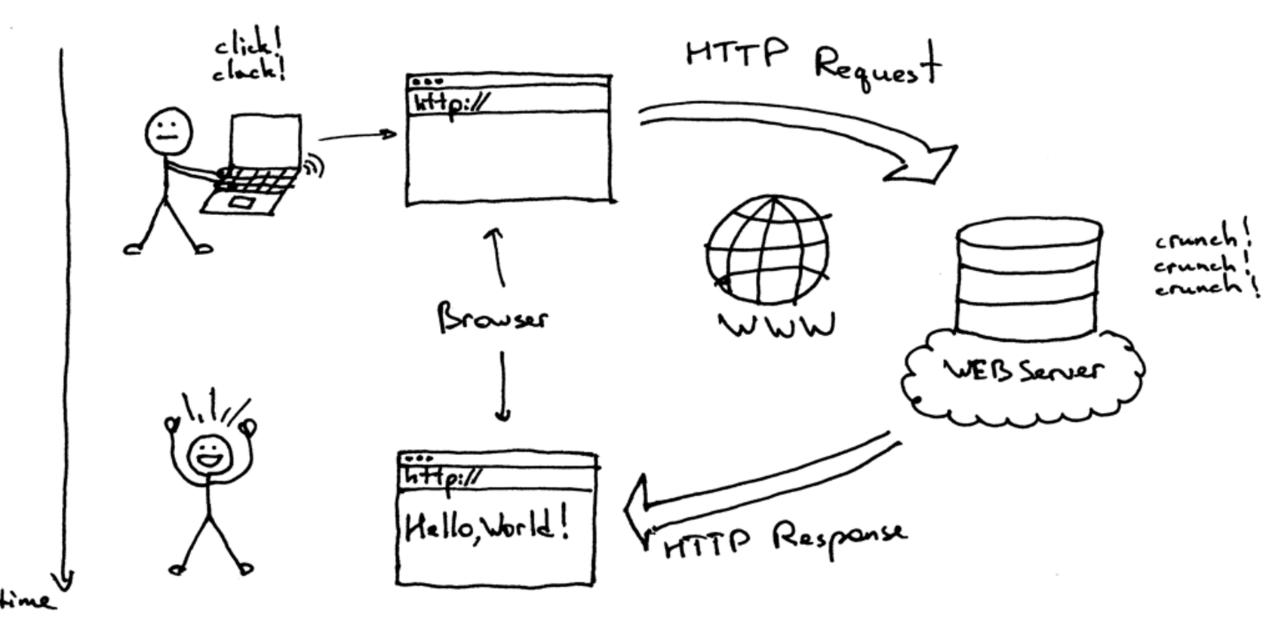
Overview

Slide 5
HTTP Message
Message types
HTTP is a request and response protocol. A client sends an HTTP request message to a server using a formatted message that the server will understand. A server responds by sending an HTTP response message that the client will understand.
Structure of HTTP
The format of the request and response messages are similar. Both kinds of messages consist of:
<Initial line, different for request vs. response>
Header1: value1
Header2: value2
<Optional message body, like file contents or query data>
Status Codes
The status code is a number defined by the HTTP specification and the numbers fall into 5 categories.
100 - 199 Informational
200 - 299 Successful
300 - 399 Redirection
400 - 499 Client Error
500 - 599 Server Error

Slide 6
HTTP Request Methods
HTTP Request Header
Example
GET Retrieve a resource
POST Update a resource
PUT Store a resource
DELETE Remove a resource
HEAD Retrieve just the header for a resource
[method][URL][version]
[headers]
[body]
GET http://www.baidu.com HTTP/1.1
Host: baidu.com

Slide 7
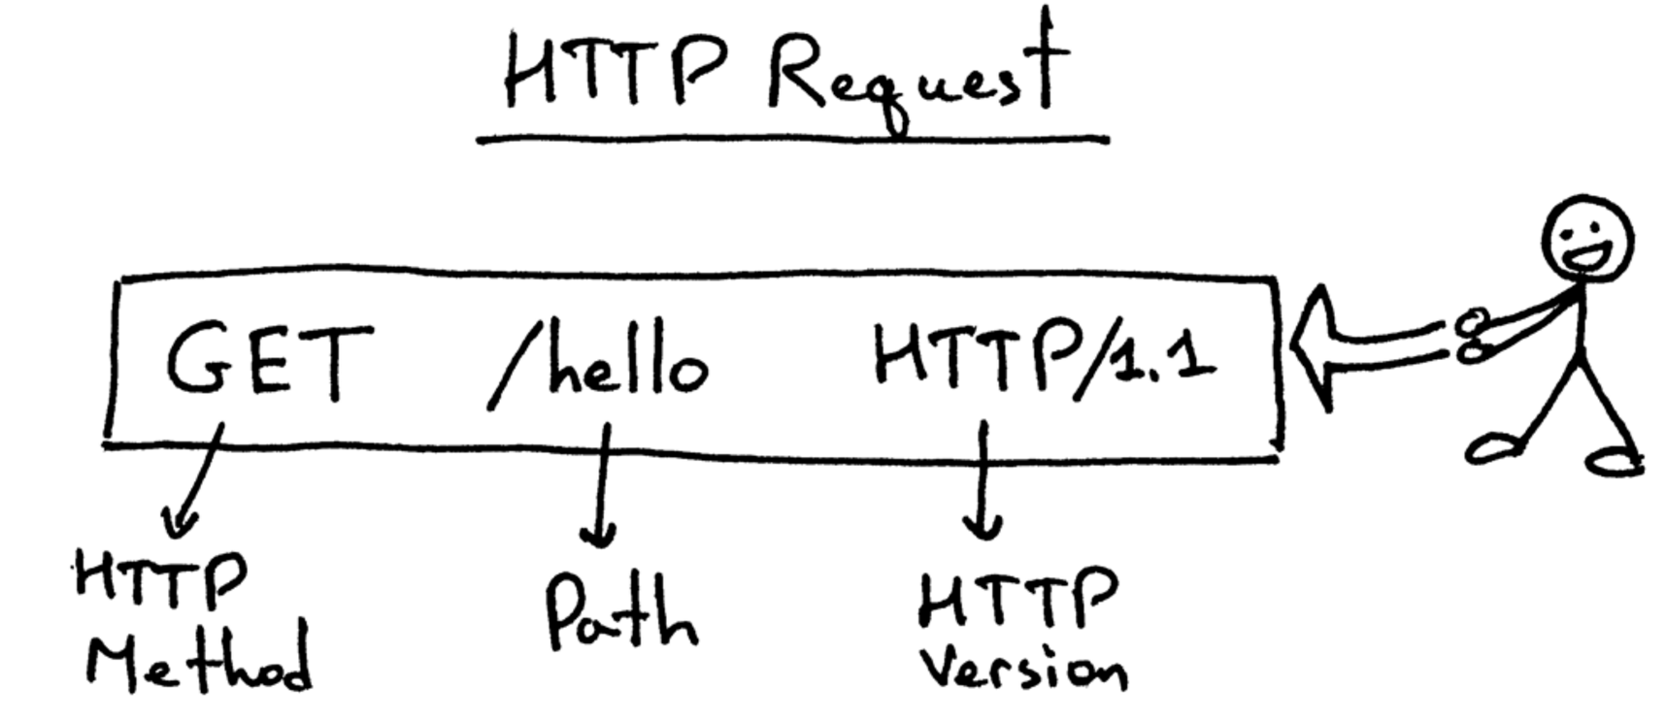
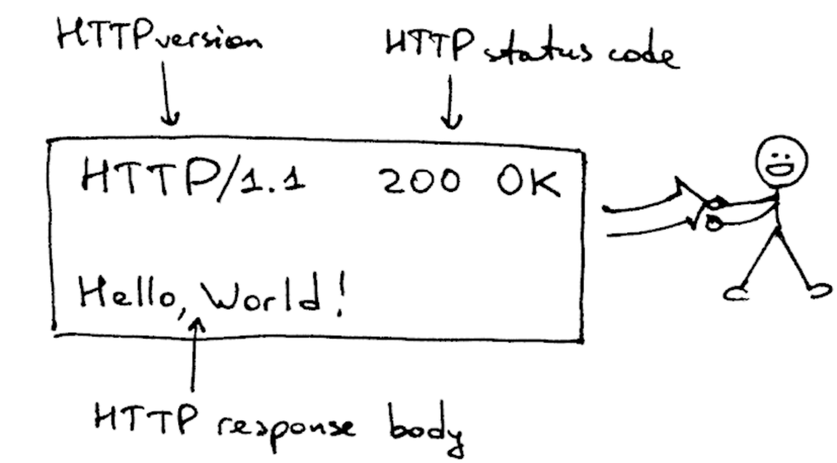
The Response
[version][status][reason]
[headers]
[body]

Slide 8
Differences in HTTP 1.0 and 1.1
Persistent Connection
HTTP 1.1 allows you to have persistent connection which means that you can have more than one request/response on the same HTTP connection
In HTTP 1.0 you had to open a new connection for each request/response pair. And after each response the connection would be closed.
Host Field
Caching
HTTP 1.1 has a required Host header by specification
HTTP 1.0 does not require a Host header
HTTP 1.0 had support for caching via the header.
HTTP 1.1 expands on the caching support a lot by using something called ‘entity tag’. If two resources are the same, then they will have the same entity tags.

Slide 9
T
W
O

Slide 10
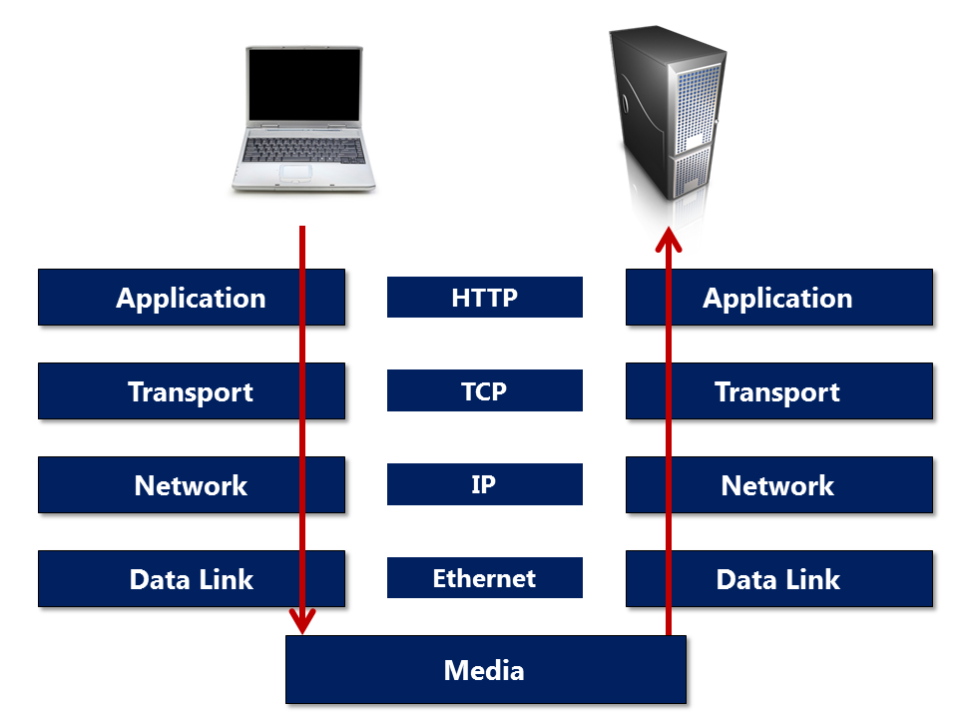
Connection
The layer underneath HTTP is transport layer protocol. Most HTTP traffic travels over TCP.
When a user types a URL into the browser, the browser opens a TCP socket by specifying the server address and port, then starts writing data into the socket.
All we need to worry about is writing the proper HTTP message into the socket.

Slide 11
Client Side
Server Side
Create a socket with the socket() system call
Connect the socket to the address of the server using the connect() system call
Send and receive data, like read() and write() system call.
Create a socket with the socket() system call
Bind the socket to an address using the bind() system call. An address consists of a port number on the host machine.
Listen for connections with the listen() system call
Accept a connection with the accept() system call
Send and receive data

Slide 12
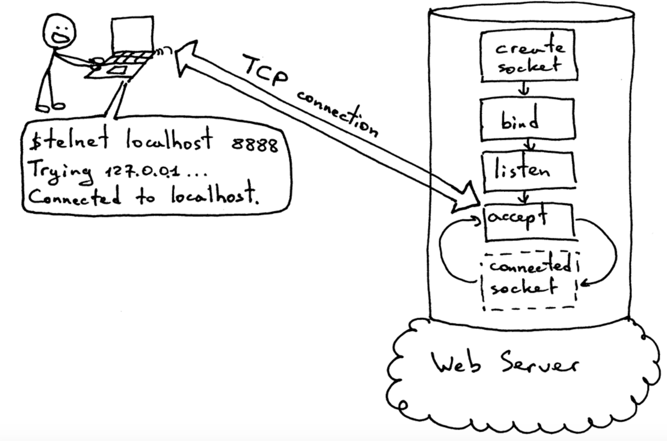
Example

Slide 13
N
E
X
T

Slide 14
Next Step
Design Message Class
Make it easy to use
One Way
Support a Message attribute of “OneWay” that the server should not send a reply and the client will not wait for a reply
Supply Interface
To build simple and small code so that these component can be used by Zhuo’s project to manage its communication activities

Slide 15
Thank You!

