Slide 1
Pluggable code Repository
Technical Presentation
Jim Fawcett
CSE775 – Distributed Objects, Spring 2017

Slide 2
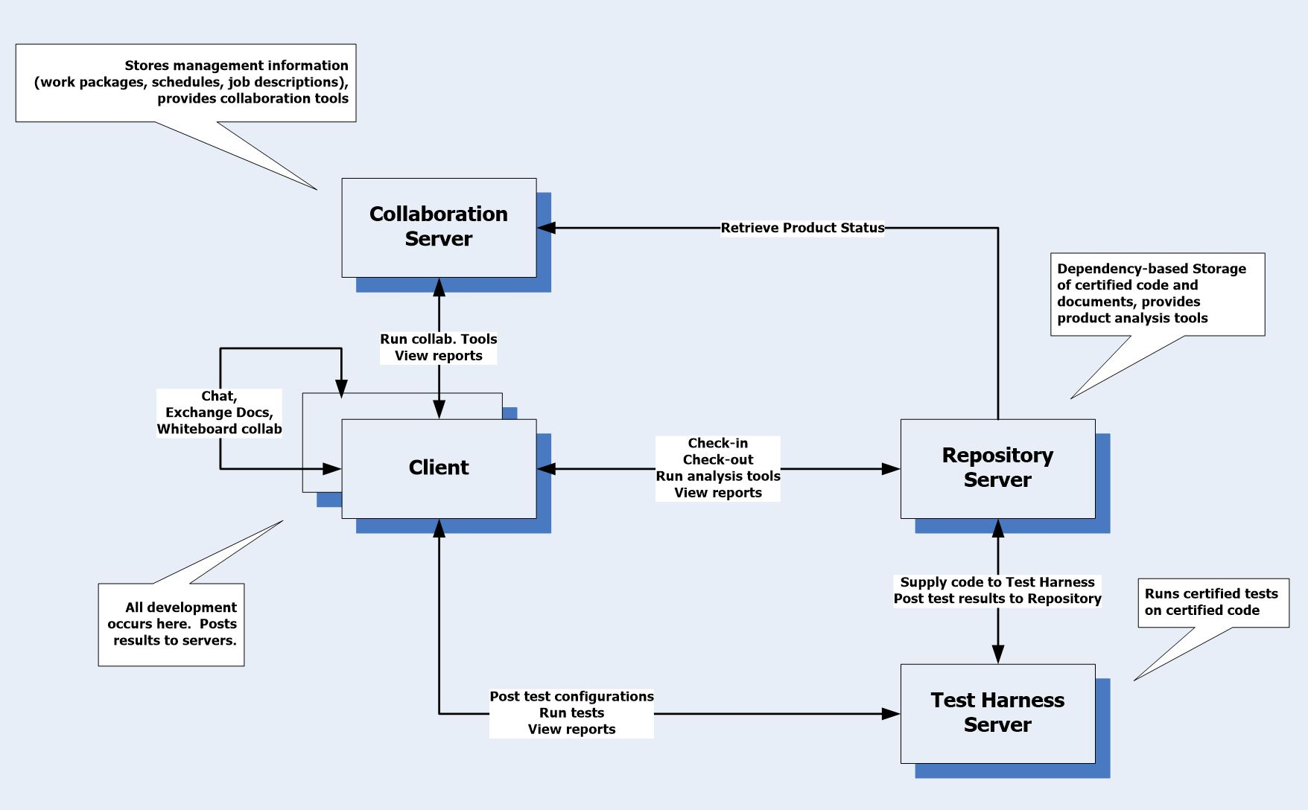
Repository Context

Slide 3
What, how, when
What is a pluggable Code Repository?
  Place to store code with interchangeable policies for how it carries out its tasks.
How will it be implemented?
  Windows or Linux server process that is accessed via a socket-based message-passing communication system.
  Policies are implemented with components that are registered with the server via administration actions.
  Implemented using C++ 11 for Windows and Linux.
When will it be completed?
  Who knows?

Slide 4
Why is this interesting?
Intersection of ideas and craftsman’s construction
  Flexibility of Plugins
  Decision between server-side function call interface and message-passing isn’t obvious
  Using mediator probably needs messaging.
It would be useful for me
  Example for CSE687 – Object Oriented Design
  Demonstrates utility of past project assignments
  Organize my code swamp
Challenge
  Can something this big be effectively implemented part-time on a busy schedule

Slide 5
What Policies?
Storage: default is NoSqlDb built in CSE687 – OOD, Spring 2017
Dependency Information:
  Each element represents a file or package
  Dependencies are stored as children of each DB element
Versioning: by default versions are captured by DB and branded into files.
Ownership: by default captured by DB as single owner
Check-in: default is open check-in, allowing changes until closed, then immutable.
Check-out: default is extraction for single owner policy.
Browsing: default to browse by dependencies and by version, starting from System, Program, or Module.
Building: default to build on demand, using installed tool chains.

Slide 6
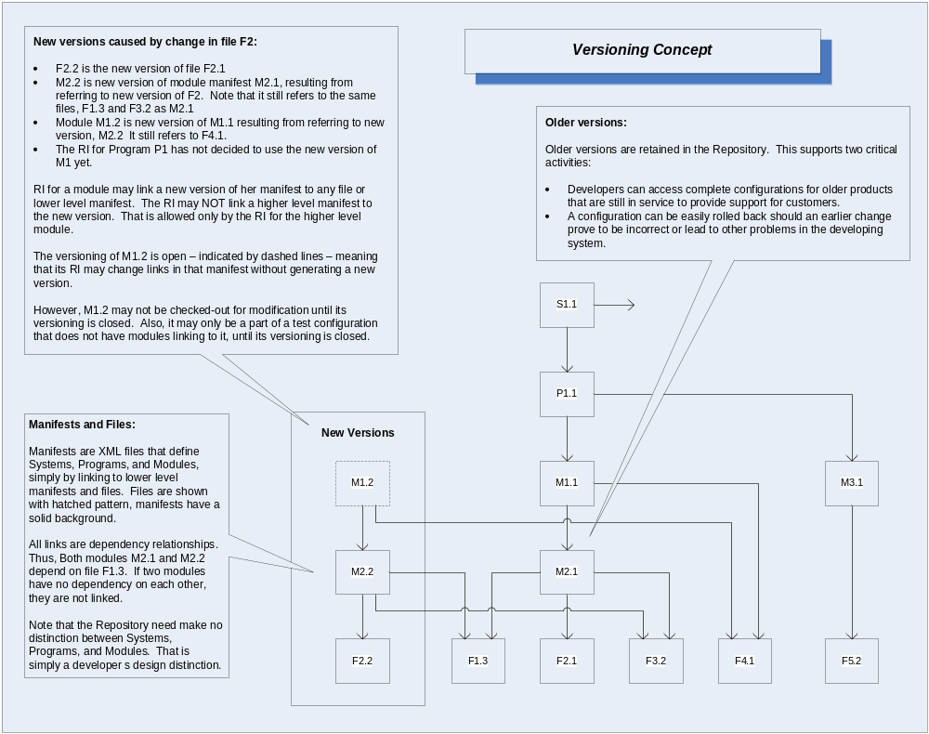
Manifests are just metadata in NoSqlDb

Slide 7
The important parts
Data storage:
  NoSqlDb<Data> for metadata and mapping to files and versions
  File system for files
Dependency Analysis
  Based on parser – Project #2, Object Oriented Design, Spring 2017
Communication system – Socket-based (IP4 and IP6 – Windows, Linux):
  Message-passing, socket-based communication, out of band file streaming
  Listener uses thread pool to avoid heavy context switching
Policy components:
  Interfaces – function calls or messages?
  Registration of policies with server

Slide 8
Data Storage
Packages will be stored in Directories
Package to path mapping stored in data in NoSqlDb<Data>
Metadata for each package stored in DB
  Name
  Author
  Category
  Description
  Dependencies
  DateTime
Data payload
  Path mapping
  Version mapping

Slide 9
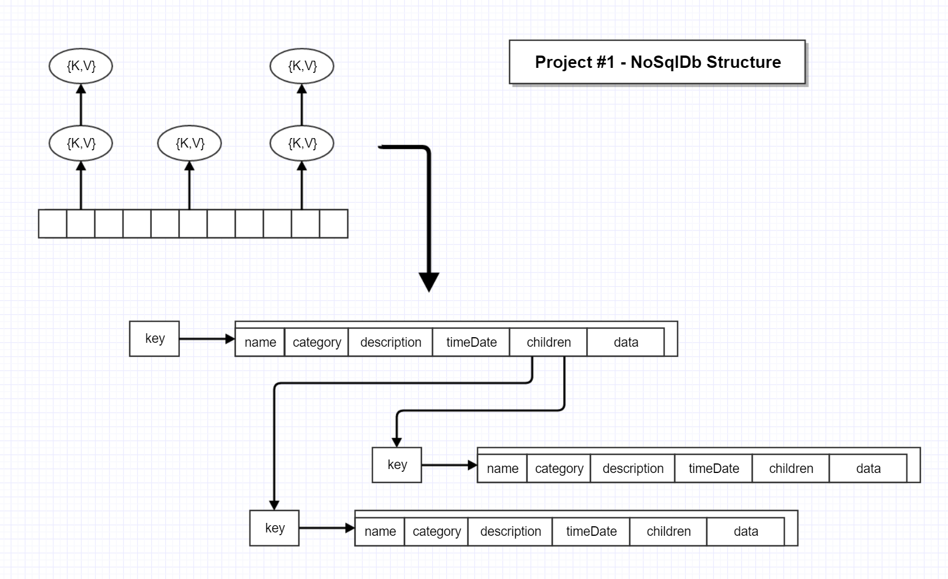

Slide 10
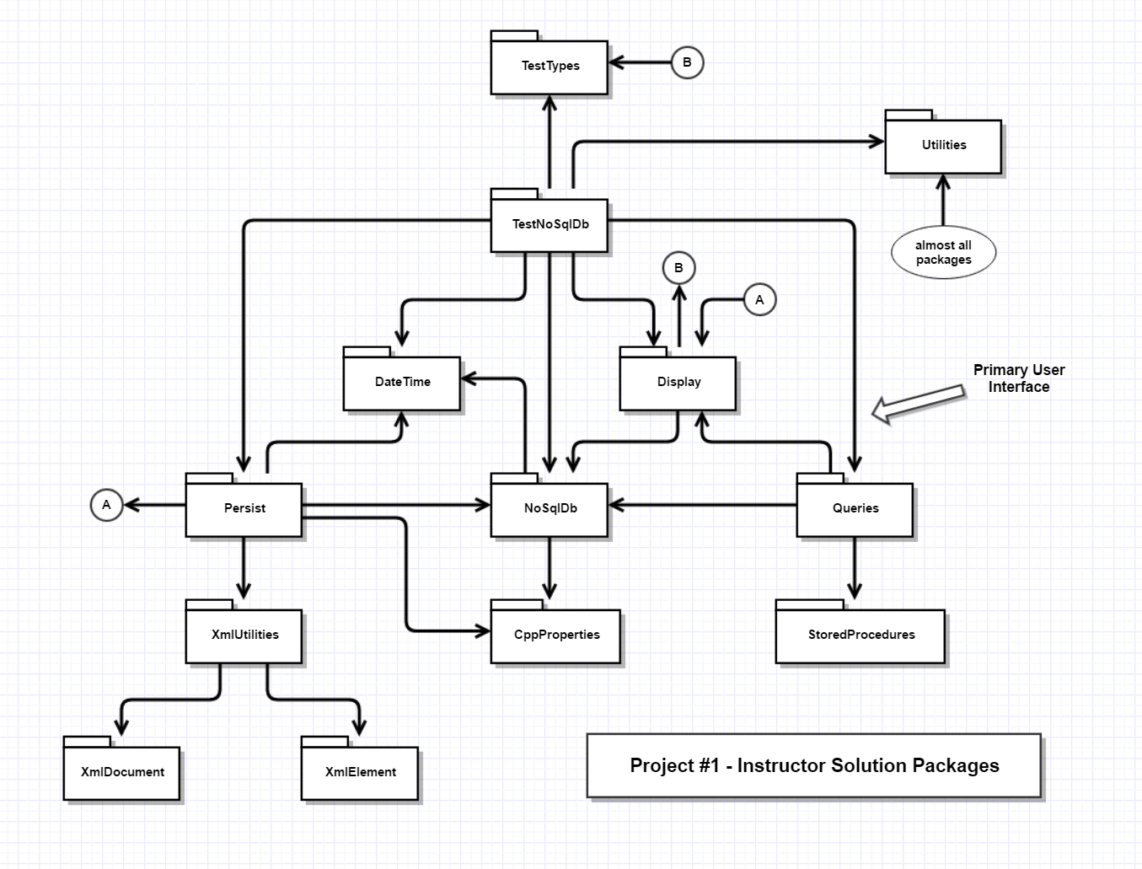
Queries are just lambdas
Each query accepts a keyset and returns a key set
Compound queries are lambdas inside a lambda wrapper

Slide 11
Dependency analysis on stored data
Does check-in have all required dependencies and no false-alarms?
Develop dependency metadata for imported projects.
Extract all dependent packages for building
  Partly derived from metadata, but analysis needed for anything not in repository.
Periodic sweeps through Repository to check for mutual dependencies.

Slide 12
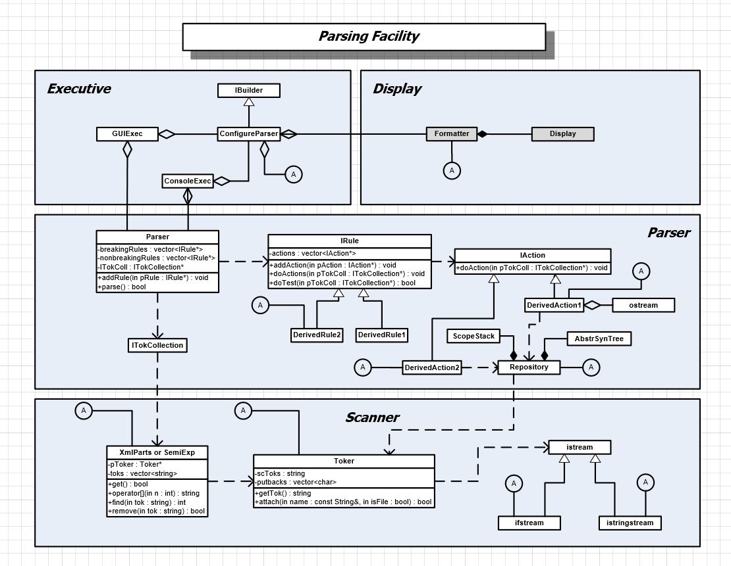

Slide 13
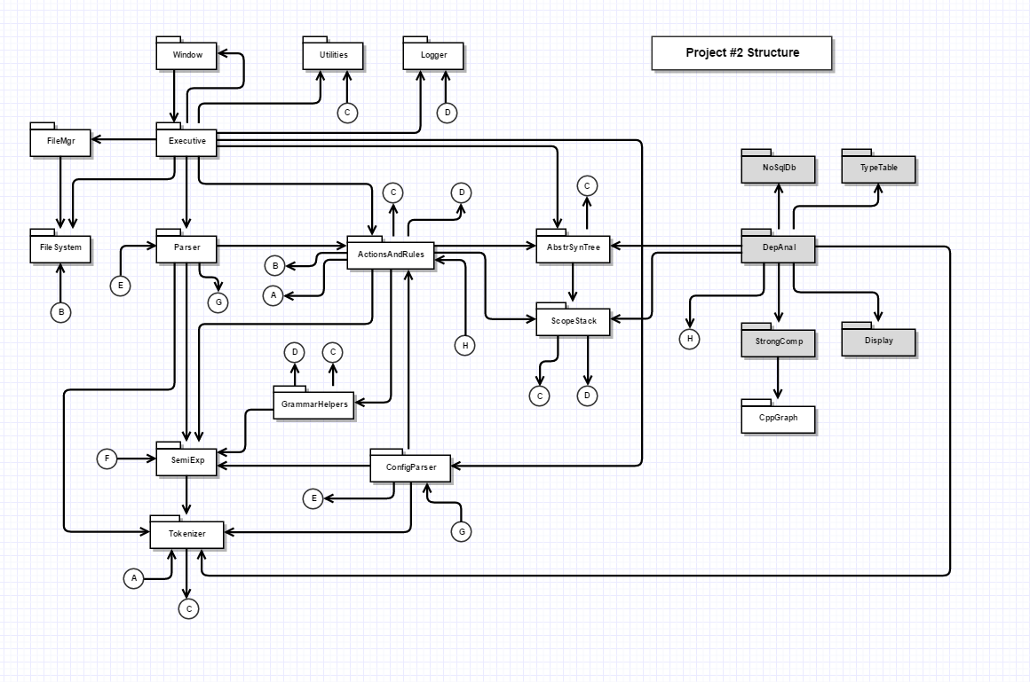
Dependencies are found by:
Building TypeTable from AST
Find deps by tokenizing files and checking if tokens are Types or global function names.

Slide 14
Communication
Server will collect messages from BlockingQueue deposited by possibly concurrent clients and will service on a single thread, e.g., STA model.
Messages based on HTTP model, e.g., command and attributes as text lines, possibly followed by body of bytes.
Socket-based using packages from Repository
  Need to add thread pool for listener, also found in Repository
  Need to port to Linux. Should be straightforward as my code was based on fragments of Linux code from Beej’s site.
May use separate channels dedicated to file streams where transfer starts with message stating length of stream (may use multiple large chuncks)

Slide 15
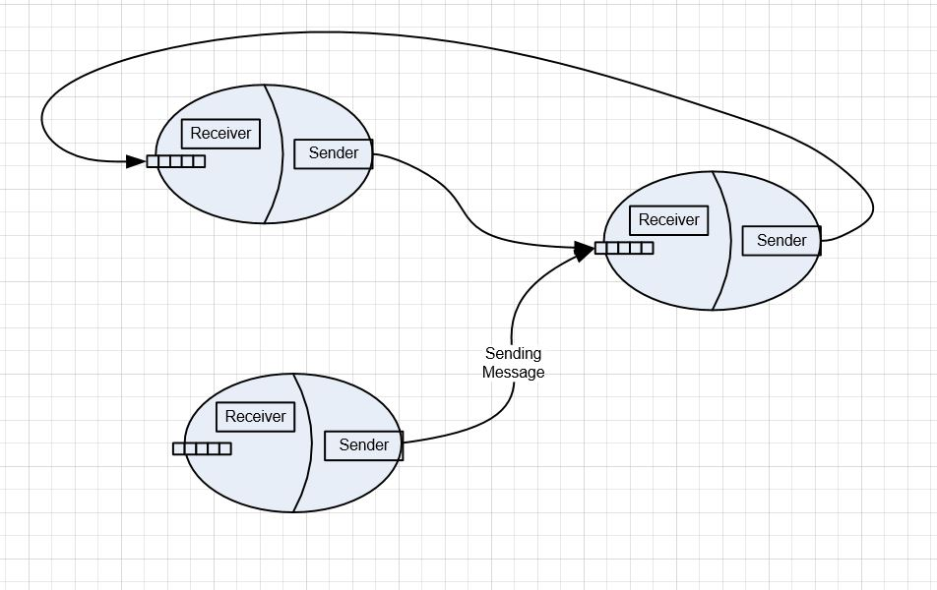
Channel Structure
Will use one-way peer-to-peer channels with endpoints consisting of a Sender and a Receiver.

Slide 16
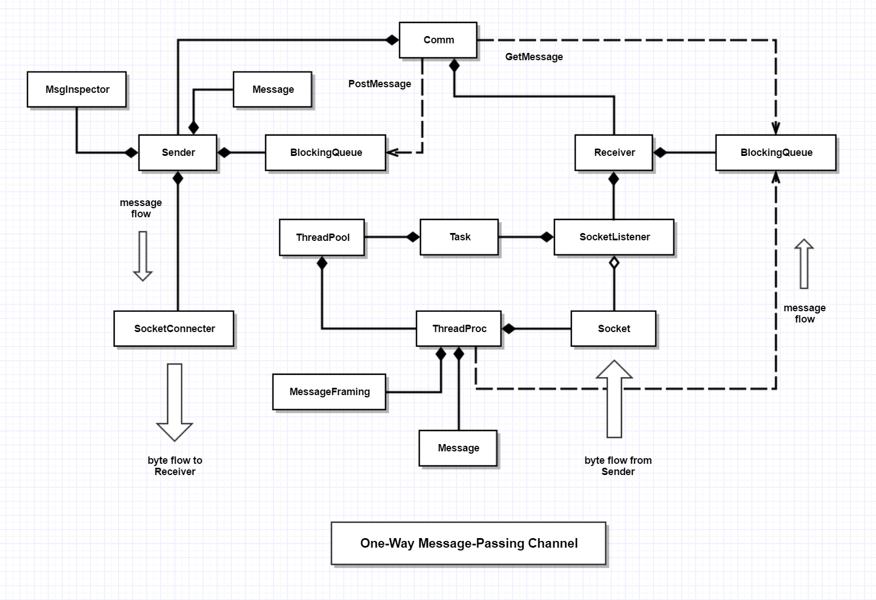
Connection requests are queued until a threadpool thread is available
Receiver uses Tasks to avoid overactive context switching, e.g., too many threads.

Slide 17
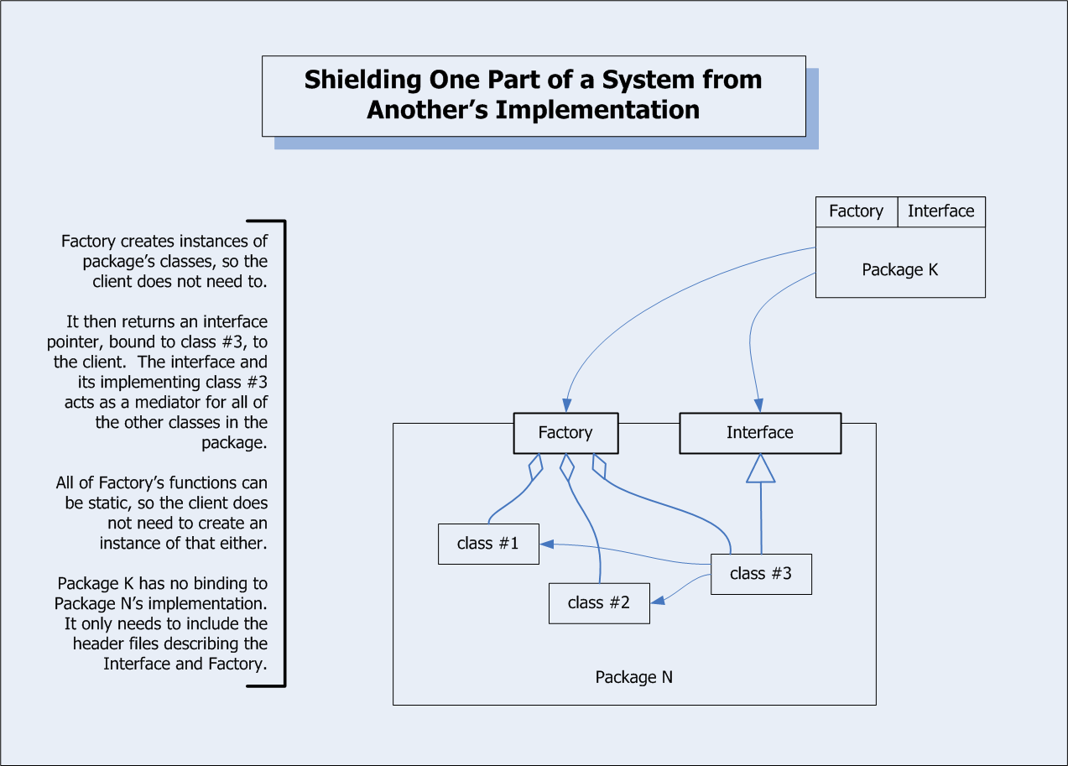
Policy structure
Components have:
  Interface and Object factory to isolate clients from component changes.
Server needs a registry:
  Provides activation, communication, and cleanup.
  May activate on demand.
  Needs administration interface.

Slide 18
Policy Components
Issue:
  Server has to communicate with policies and policies need to communicate with each other, e.g., check-in needs to talk with storage.
  Use interfaces with function calls?
    Each policy interface has to work for all policy variations or we will need to add secondary interfaces for specific policies by using QueryInterface approach.
  Use messaging between server and policies and from one policy to another?
    Could use Mediator to dispatch messages.

Slide 19
Repository Server structure
Policy components
Message Dispatcher
Communication channel endpoint
Glue code

Slide 20
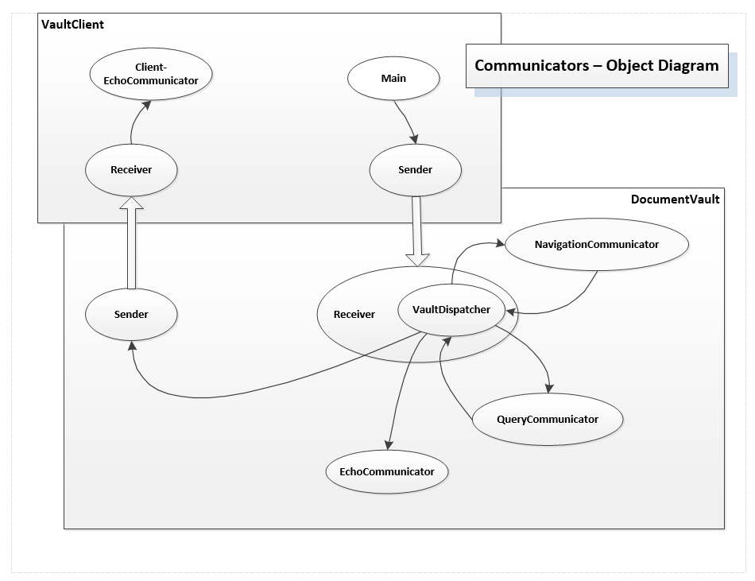

Slide 21
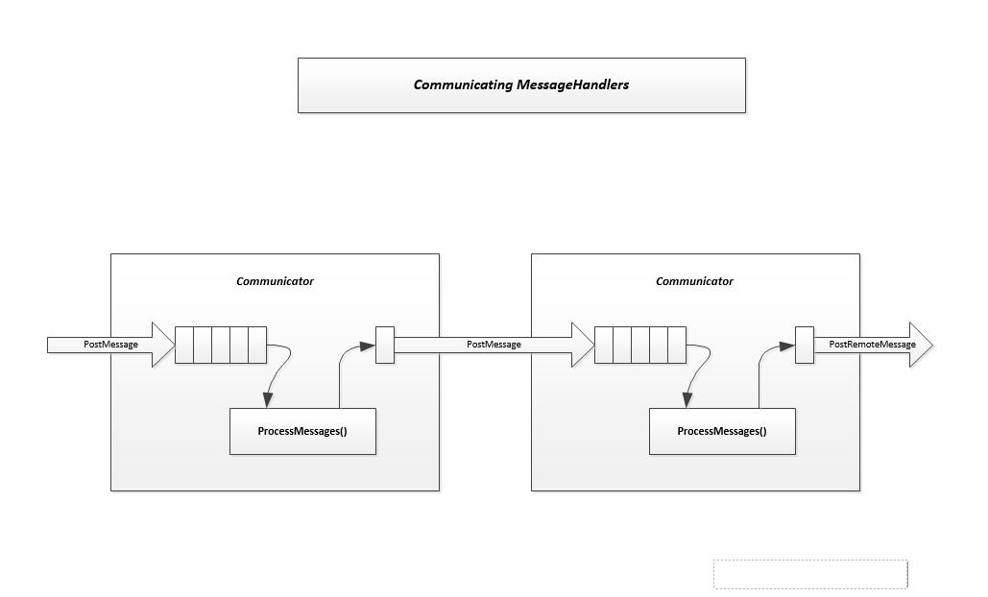

Slide 22
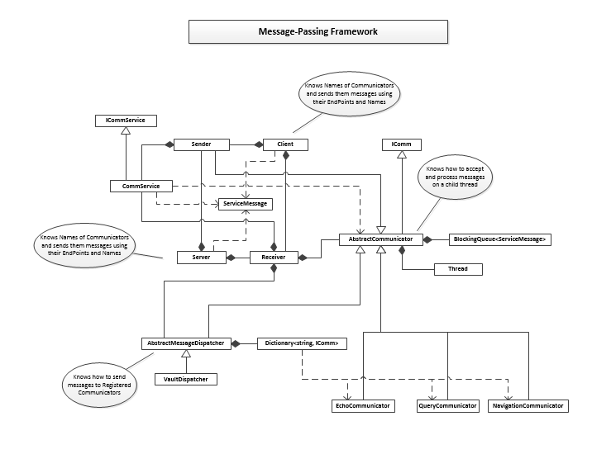

Slide 23
Plan
Part I – Technology (TechPres to ProbesPres)
  Explore Policy interfaces
    Functions or messages
  Set up server host shell and show that plugins can plug in, activate, and communicate.
    Show that different policy versions can be exchanged – hot swapping would be nice, but not essential.
  Use Data Management Policy with NoSqlDb and Browse Policy to work out how policies function and interact.
  Think about work-flow and build client/server mechanics using simple programmed console client.

Slide 24
Probes
Policy component operation
  Registration, activation, operation, communication
  Use Data Storage and Browse policies as strawmen
Server Host
  Integrate policies into workflow
Communication
  Within server: message dispatching?
  Client to Server message passing framework
Client
  Workflow integration

Slide 25
Plan
Part II – Build it! (ProbesPres to Final)
  Build simple test framework and decide on temporary version control.
  Buildout Communication system
    Decide on out-of-band file transfer
  Buildout Client using Workflow guide
    Use C# WPF client
  Complete feasible set of Policies in this order:
    Data Storage, Browsing, Versioning, Ownership, Check-in, Check-out, Building
  Prepare demo of results
    Use construction and regression tests.

Slide 26
Plan
Part III - Conclusion
  Present to Distributed Objects class
  Post results to College Server
  Have dinner with friends and two fingers of Bourbon
  Take a week off.

