Slide 1
Standard Template Library
Jim Fawcett
Summer 2017

Slide 2
Some Definitions
vector, string, deque, and list are standard sequence containers.
set, multiset, map, multimap, unordered_set, unordered_multiset, unordered_map and unordered_multimap are standard associative containers.
Iterators:
  Input iterators are read only – each iterated element may be read only once.
  Output iterators are write-only – each iterated element may be written only once.
  Forward iterators can read or write an element repeatedly. They don’t support operator--() so they can only move forward.
  Bidirectional iterators are like forward iterators except that they support moving in both directions with operator++() and operator--().
  Random access iterators are bidirectional iterators that add the capability to do iterator arithmetic – that is they support *(it + n);
Any class that overloads the function call operator - operator() - is a functor class, and we refer to its instances as functors or function objects.

Slide 3
Computational Complexity
Constant time refers to operations that do not depend on the number of elements stored in a container.
  Adding an element to a list end is a constant time operation. Finding the location at which to insert is a linear time operation.
Logarithmic time refers to operations that need time to run that grows as the logarithm of the number of elements in the container.
  A logarithmic operation on a container with 1,000,000 takes 3 times as long to complete as that operation of a container with 1,000 elements.
Linear time refers to operations that require computation time that grows proportionally to the number of elements in the container.

Slide 4
STL Supports Guaranteed Complexity for Container Operations
Vectors and Deques:
  Insertion is a linear time operation.
  Accessing a known location is constant time.
  Searching an unsorted vector or deque is a linear time operation.
  Searching a sorted vector or deque should be a logarithmic time operation ( use binary_search algorithm to ensure that it is).
Lists:
  Insertion is a constant time operation.
  Accessing a known location and searching, whether sorted or not, is linear time, with the exception of the end points, which can be accessed in constant time.
Sets and Maps:
  Based on Red-Black binary tree.
  Insertion and accessing are logarithmic time operations.
  Searching should be a logarithmic time operation (use member function find, etc., to ensure that it is).

Slide 5
STL Supports Guaranteed Complexity for Container Operations
Unordered_set and Unordered_map
  Based on hashtable
  Lookup, insertion, and deletion are (nearly) constant time operations
  They are hashed containers, so we get access to an element by computing a hash function on a key which maps to an address in the table. This is constant time. If there is more than one element that hashes to that address then we search a linked list rooted at that address (the elements on this list are referred to as a bucket).
  So access is nearly constant time.

Slide 6
STL Header Files for Containers
Include | Container Type | Description
<array> | array<T> | Fixed array of elements
<deque> | deque<T> | Double ended queue, fast insert/remove from either end, indexable.
<list> | list<T> | Doubly-linked list, fast insert/erase at current location and either end, slow traversal
<map> | map<key, value> mulitmap<key, value> | Associates values with sorted list of keys, fast insert/remove, fast access with index, fast binary search, is indexable with keys.
<queue> | queue<T> priority_queue<T> | First in, first out queue, efficient push and pop. Efficient removal of largest.
<set> | set<T> multiset<T> | Set of sorted keys, fast find/insert/removal.
<stack> | stack<T> | Last in, first out stack.
<unordered_map> | unordered_map<K,V> Unordered_multimap<K,V> | Unordered key/value collection, constant time lookup, insertion, removal.
<unordered_set> | unordered_set<V> unordered_multiset<V> | Unordered collection of values, constant time lookup, insertion, removal.
<vector> | vector<T> | Slow insert, delete, except at the end, fast access with index. Slow find. Capacity grows as needed.

Slide 7
Other STL Header Files
Include | Types | Description
<algorithm> | Find, find_if, search, copy, fill, count, generate, min, sort, swap, transform, … | Applied to a container over an iterator range.
<functional> | Function, bind, divides, equal_to, greater, less, negate, minus, plus, … | Function objects passed to an algorithm to operate on elements of a container.
<iterator> | operator+, operator=, operator++, operator--, operator*, operator->, … | Defines current location, range of action on a container or stream.
<memory> | unique_ptr, shared_ptr, allocator, operator==, operator!=, operator=, operator delete, operator new, … | Provides smart pointer for managing resources on native heap, supports redefinition of allocation policy for containers.
<numeric> | Accumulate, product, partial sum, adjacent difference, … | Applied to a container over an iteration range.
<utility> | Pair, operator!=, operator<=, operator>=, operator>, … | Pair struct and global operators.

Slide 8
STL Iterators
Input iterator
  Read only, move forward
  Example: istream_iterator
Output iterator
  Write only, move forward
  Examples: ostream_iterator, inserter, front_inserter, back_inserter
Forward iterator
  Read and write, move forward
  Example: forward_list<T>::iterator
Bidirectional iterator
  Read and write, move forward and backward
  Examples: list<T>::iterator, map<K,V>::iterator
Random access iterator
  Read and write, random access
  Examples: vector<T>::iterator, deque<T>::iterator, C++ pointers

Slide 9
STL Functions
unary functions:
  Function taking single template argument
  Will be instantiated with container’s value_type
  // unary function
  template <typename T>
  void printElem(T val) {
  cout << “value is: “ << val << endl;
  }
  void main( ) {
  list< int > li;
  :
  // unary function used in algorithm
  for_each(li.begin(), li.end(), printElem);
  }
  for_each calls printElem with values from list

Slide 10
STL Functions
predicate:
  function taking a template type and returning bool
  // predicate
  template <class T>
  bool ispositive(T val) { return (val > 0); }
  void main( ) {
  list<int> li;
  :
  // return location of first positive value
  list<int>::iterator iterFound =
  find_if(li.begin(), li.end(), ispositive<int>);
  }

Slide 11
STL Function Objects
Function objects:
  class with constructor and single member operator()
  template <class T> class myFunc {
  public:
  myFunc( /*arguments save needed state info */) { }
  T operator()(/* args for func obj */) {
  /*
  call some useful function with saved
  state info and args as its parameters
  */
  }
  private:
  /* state info here */
  }

Slide 12
std::function adapted from example in https://oopscenities.net/2012/02/24/c11-stdfunction-and-stdbind/
#include <functional>
#include <iostream>
#include <string>
#include <vector>
void execute(const std::vector<std::function<void()>>& fs)
{
for (auto& f : fs)
f();
}
void plain_old_func()
{
std::cout << "\n I'm a plain old function";
}
class functor
{
public:
void operator()() const
{
std::cout << "\n I'm a functor";
}
};
int main()
{
std::vector<std::function<void()>> x;
x.push_back(plain_old_func);
functor functor_instance;
x.push_back(functor_instance);
x.push_back([]()
{
std::cout << "\n Hi, I'm a lambda expression";
});
execute(x);
std::cout << "\n\n";
}

Slide 13
std::bind adapted from example in https://oopscenities.net/2012/02/24/c11-stdfunction-and-stdbind/
#include <functional>
#include <iostream>
#include <string>
#include <vector>
void execute(const std::vector<std::function<void()>>& fs)
{
for (auto& f : fs)
f();
}
void show_text(const std::string& t)
{
std::cout << "\n Text: " << t;
}
int main()
{
std::vector<std::function<void()>> x;
x.push_back(std::bind(show_text, "Bound function"));
execute(x);
std::cout << "\n\n";
}

Slide 14
unary_function type
The unary_function type serves as a base class for functors that will be used in adapters like not1. It supplies traits needed by the adaptors.
An example use follows on the next slide
#include <functional>
template <class Arg, class Result>
struct unary_function{
typedef Arg argument_type;
typedef Result result_type;
};

Slide 15
STL Function Adapters
negators:
  not1 takes unary_function predicate and negates it
  not2 takes binary_function predicate and negates it
  // predicate
  template <class T>
  class positive : public unary_function
  {
  public:
  bool operator()(T val) const { return (val > 0); }
  };
  void main( ) {
  list<int> li;
  :
  // return location of first positive value
  list<int>::iterator iter =
  find_if(li.begin(), li.end(), positive);
  // return location of first non-positive value
  iter = find_if(li.begin(), li.end(), not1(positive));
  }

Slide 16
binary_function type
The binary_function type provides traits needed by binary function adapters, as illustrated on the next slide.
#include <functional>
template <class Arg1, class Arg2, class Result>
struct binary_function
{
typedef Arg1 first_argument_type;
typedef Arg2 second_argument_type;
typedef Result result_type;
};

Slide 17
STL Function Adapters
binders:
  bind1 binds value to first argument of a binary_function
  bind2 binds value to second argument of binary_function
void main( ) {
list<int> li;
:
// return location of first value greater than 5
list<int>::iterator =
find_if(li.begin(), li.end(), bind2(greater<int>(),5));
}

Slide 18
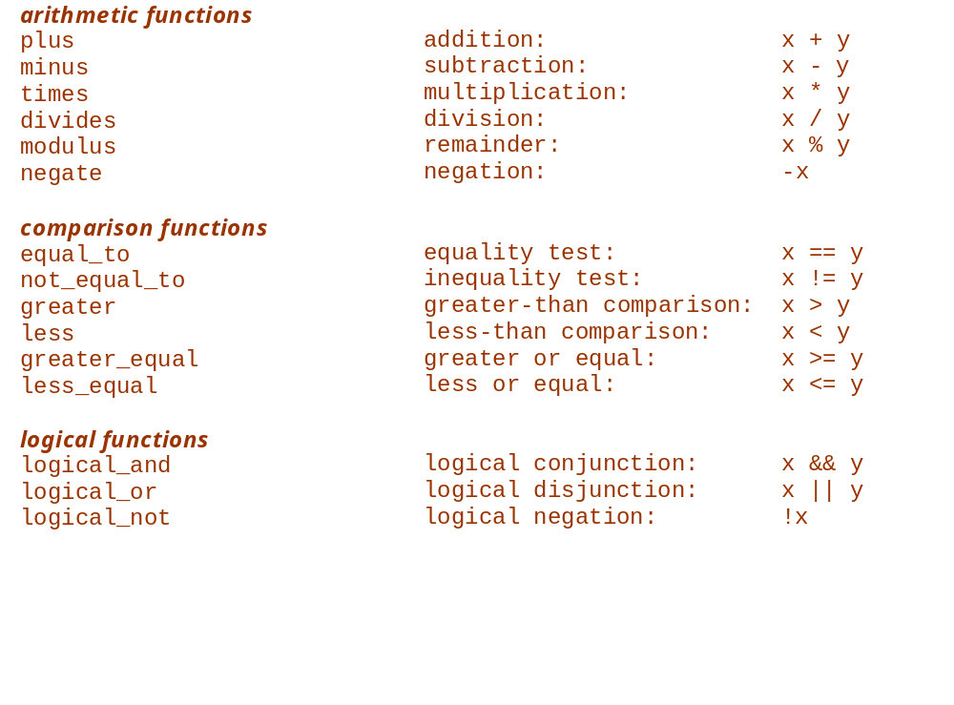
STL Function Objects
Standard Template Library

Slide 19
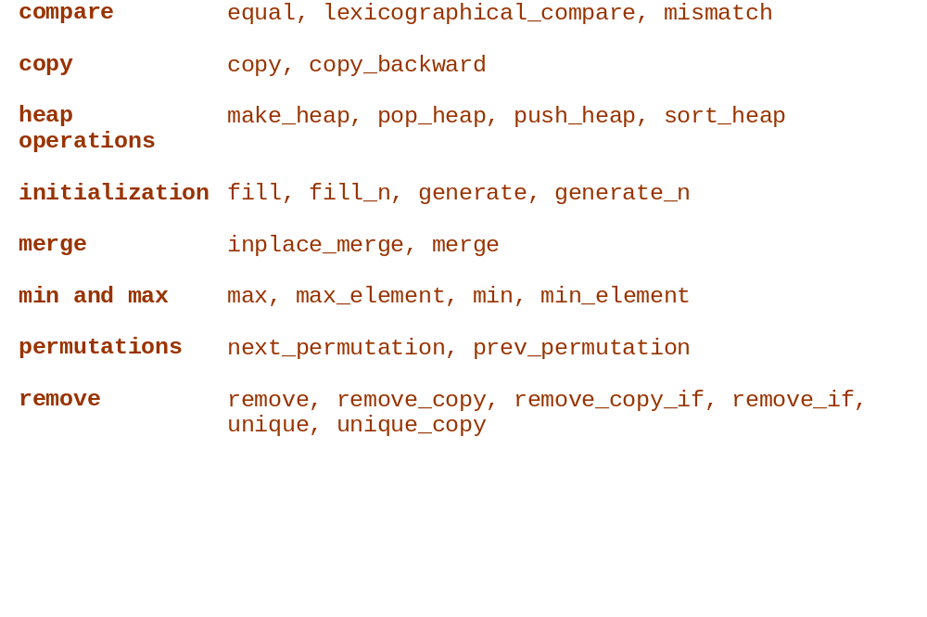
Algorithms by Type

Slide 20
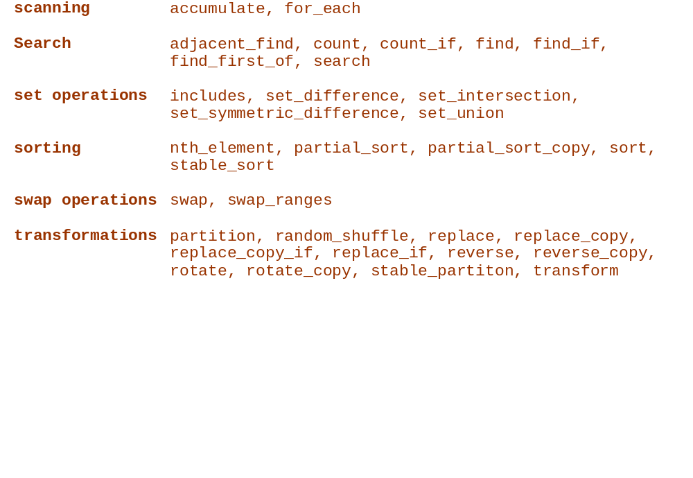
Algorithms by Type (continued)
Standard Template Library

Slide 21
End of Presentation

