Slide 1
Ultimate Extensible Distributed System
Jim Fawcett
CSE681 – Software Modeling & Analysis
Fall 2010

Slide 2
Nota Bene
These notes I used in CSE686 – Internet Programming, a course I no longer teach.
They are out of date, but much of the material is still relevant.

Slide 3
Your Assignment
Your supervisor just handed you a spec for implementation of:
  Distributed system with universal connectability using sockets
  Can process an open-ended variety of documents
  Expandable by 5 orders of magnitude in ten years
  Can add new tools easily
  Supports 50 million users a day without gridlock.
You say NO WAY!
Well, maybe.

Slide 4
Introduction to Internet and Web
This presentation addresses two questions:
  Is that possible?
    Well yes – look over there – the web!
  How was it accomplished?
    Processing structure and protocols
    Programming tools
      Web servers and browsers that host:
        Script languages, e.g., Javascript, VBScript, Perl, Ruby, …
        Programming languages:
        Visual Basic, Java, C++, C#, …
    And, of course, some very smart people

Slide 5
Table of Contents
Introduction to the Internet and Web
Internet Design Principles
Internet and Web History
Web Technologies
Pinging Various URLs
Web Processing Models
Programming The Web
Extending The Web
People in the Web

Slide 6
Goals:
Build distributed system to share documents.
Support expansion by 5 orders of magnitude in ten years – 200 hosts to 500 million hosts.
Manage communication between hundreds of millions of machines every day without collapsing from congestion.
Provide for arbitrary extensions:
  From static text documents to graphics, dynamic content, streaming video, programmable interfaces, voice, …

Slide 7
Original Goals of the Web
Universal readership
  When content is available it should be accessible from any type of computer, anywhere.
Interconnecting all things
  Hypertext links everywhere.
  Simple authoring

Slide 8
Internet Design Principles
Goal is connectivity
Achieved with Internet Protocol (IP)
  Stateless so survives failures – no need to backup
Made scalable with end-to-end intelligence
  Transport Control Protocol (TCP)
    Sender does not send until receipt is acknowledged
    Amount sent is based on receiver’s current available buffer size – so receiver won’t be flooded.
  Be strict when sending and tolerant when receiving
Protocol Specific Packet Headers
Internet Design
Robustness and the Internet

Slide 9
Web Design Principles
Universal
Decentralized
Modular
Extensible
Scalable
Accessible
Forward/backwards compatibility
Architecture of World Wide Web

Slide 10
Basic Concepts
Client/Server Model
Universal Addressing
  TCP/IP, DNS
Search Engines
Universal Protocols
  HTTP, URLs, HTML, FTP
Format Negotiation through HTTP
Hypertext → Hypermedia via HTML → XHTML
  Support for text, images, sound, and scripting

Slide 11
Internet and Web History

Slide 12
Internet History
1961 – First paper on packet-switching theory, Kleinrock, MIT
1969 – ARPANet goes on line
  Four hosts, each connected to at least two others
1974 – TCP/IP, Berkley Sockets invented
1983 – TCP/IP becomes only official protocol
1983 – Name server developed at University of Wisconsin.
1984 – Work begins on NSFNET
1990 – ARPANET shutdown and dismantled
1990 – ANSNET takes over NSFNET
  Non-profit organization – MERIT, MCI, IBM
  Starts commercialization of the internet
1995 – NSFNET backbone retired
1998 – DNS transferred from Dept of Commerce to ICANN
2000 – Web size estimates surpass 1 billion indexable pages

Slide 13
Web History
1990 – World Wide Web project
  Tim Berners-Lee starts project at CERN
  Demonstrates browser/editor accessing hypertext files
  HTTP 0.9 defined, supports only hypertext, linked to port 80
1991 – first web server outside Europe
  CERN releases WWW, installed at SLAC
1992 – HTTP 1.0, supports images, scripts as well
1993 – Growth phase
1994 – CERN and MIT agree to set up WWW Consortium
1999 – HTTP 1.1, supports open ended extensions

Slide 14
Web Growth Phase – 1993
InterNIC created to provide registration services
WWW (port 80 HTTP) traffic is 1% of NSFNET traffic
200 Known HTTP servers
Article on WWW in New York Times
Mosaic first release

Slide 15
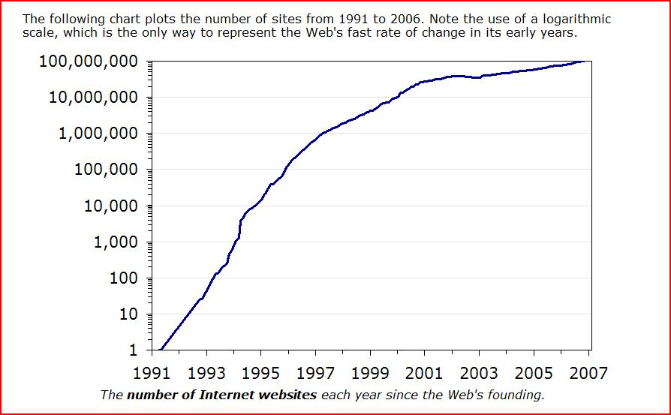
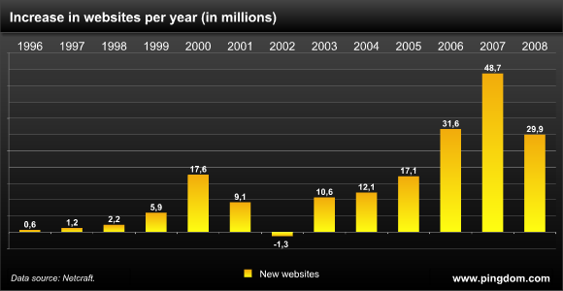
Web Growth
http://www.useit.com/alertbox/web-growth.html
http://www.techcrunch.com/2009/05/08/is-the-growth-of-the-web-slowing-down-or-just-taking-a-breather/

Slide 16
Web Technologies

Slide 17
Tools: Servers on the Internet
HTTP - HyperText Transport Protocol
  JSP and ASP add dynamic content
  Web Services add RPC program interface
FTP - File Transport Protocol
Gopher - Text and Menus
NNTP - Network News Transfer Protocol
DNS - Distributed Name Service
telnet - log into a remote computer
New tools - if they use TCP/IP just add them

Slide 18



Network Protocol Stack
HTTP
HTTP
TCP
TCP
IP
IP
Ethernet
Ethernet
Notes:
Physically, a request goes down the protocol stack on the client, across the network to the server, then up the server’s protocol stack (solid arrows). Logically, however, the corresponding layers on each machine “talk” to each other (dashed arrows).

Slide 19
Network Protocols
OSI Model Layers
TCP/IP Protocol Architecture Layers
TCP/IP Protocol Suite
Application
Layer
Presentation
Layer
Application
Layer
Telnet
FTP
SMTP
DNS
RIP
SNMP
HTTP
Session
Layer
Host-to-Host
Transport
Layer
TCP
UDP
Transport
Layer
Network
Layer
Internet
Layer
IP
IGMP
ICMP
ARP
Data Link
Layer
Network
Interface
Layer
Ethernet
Token
Ring
Frame
Relay
ATM
Physical
Layer
Notes:
This figure depicts the different layers used in networking protocols.

Slide 20
Networks - Transport Layer
Provides efficient, reliable and cost-effective service
Uses Sockets programming model
Ports identify application
  Well-known ports identify standard services
  (e.g. HTTP uses port 80, SMTP uses port 25)
Transmission Control Protocol (TCP)
  Provides reliable, connection-oriented byte stream
UDP
  Connectionless, efficient, unreliable

Slide 21
Communication Between Networks
Internet Protocol (IP)
  Routable, connectionless datagram delivery
  Specifies source and destination
  Does not guarantee reliable delivery
  Large message may be broken into many datagrams, not guaranteed to arrive in the order sent
Transport Control Protocol (TCP)
  Reliable stream transport service
  Datagrams are delivered to the receiving application in the order sent
  Error control is provided to improve reliability

Slide 22
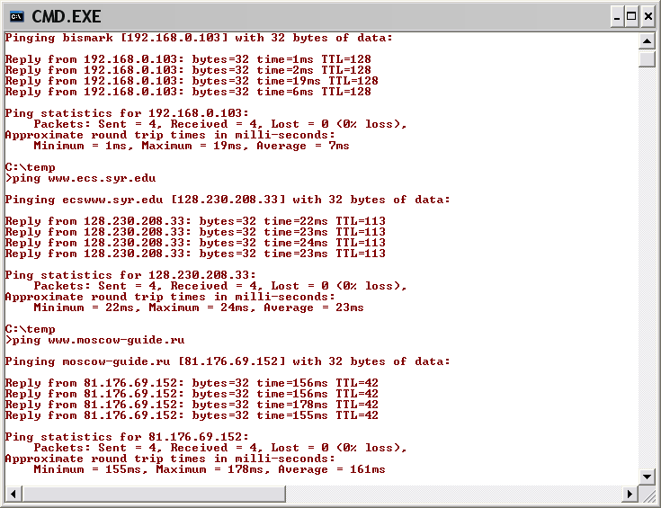
Pinging Various URLs
Ping in network
– few millisec
Ping in Syracuse
– few tens of millisec
Ping to Moscow
– few hundreds of millisec

Slide 23
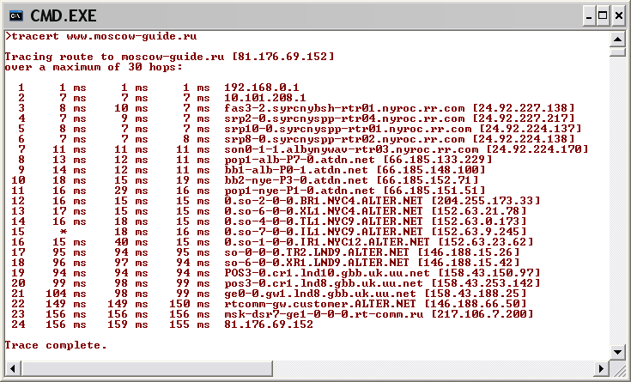
Tracing HTTP Message with Tracert

Slide 24
HTTP – Excerpts from W3C Docs skip to HTTP Methods
An application-level protocol with low overhead and the speed necessary for distributed, collaborative, hyper-media information systems.
It is a generic, stateless, (message)-oriented protocol which can be used for many tasks, such as name servers and distributed object management systems, through extensions of its request methods (commands).
A feature of HTTP is the typing and negotiation of data representation, allowing systems to be built independently of the data being transferred.
The protocol is typically layered on top of TCP/IP in order to guarantee data transfer.
The protocol consists of a request and response paradigm.

Slide 25
HTTP Messages as seen by packet sniffer
TCP 113 192.168.0.102 207.46.144.188 2834 80 [2004.05.19 - 12:15:20.718]
E qSó@ €…šÀ¨ fÏ.¼
P‚X {ÈEPDpÑ¼ GET /ms.htm HTTP/1.1
Connection: Keep-Alive
Host: www.microsoft.com
TCP 1102 207.46.144.188 192.168.0.102 80 2834 [2004.05.19 - 12:15:20.843]
E N¢¬@ nEÏ.¼À¨ f P
{ÈE‚XIPÿ¶jà HTTP/1.1 200 OK
Cache-Control: max-age=60
Content-Length: 669
Content-Type: text/html
Last-Modified: Thu, 11 Jul 2002 17:05:42 GMT
Accept-Ranges: bytes
ETag: "be61bb30fd28c21:27b"
Server: Microsoft-IIS/6.0
P3P: CP="ALL IND DSP COR ADM CONo CUR CUSo IVAo IVDo PSA PSD TAI TELo OUR SAMo CNT COM INT NAV ONL PHY PRE PUR UNI"
X-Powered-By: ASP.NET
Date: Wed, 19 May 2004 16:15:16 GMT
<!--TOOLBAR_START-->
<!--TOOLBAR_EXEMPT-->
<!--TOOLBAR_END-->
<!DOCTYPE HTML PUBLIC "-//W3C//DTD HTML 4.0 Transitional//EN"
"http://www.w3.org/TR/REC-html40/loose.dtd">
<HTML>
<HEAD>
<META HTTP-EQUIV="Refresh" CONTENT="0; URL=/">
<TITLE>Microsoft Corporation -- Where Do You Want to Go Today?</TITLE>
</HEAD>
<BODY BGCOLOR="#FFFFFF" TEXT="#000000">
<FONT FACE="Verdana, Arial, Helvetica" SIZE=2>
If your browser can't handle redirect, please click <a href="/">here</a>
</FONT>
</BODY>
</HTML>
Request Message
method
Response Message
headers
message body

Slide 26
Typical HTTP Transaction
Client browser finds a machine address from an internet Domain Name Server (DNS).
Client and Server open TCP/IP socket connection.
Server waits for a request.
Browser sends a verb and an object:
  GET XYZ.HTM or POST form
  If there is an error server can send back an HTML-based explanation.
Server applies headers to a returned HTML file and delivers to browser.
Client and Server close connection.
  It is possible for the client to request the connection stay open with HTTP 1.1.

Slide 27
A Typical HTTP Transaction
From my home network I typed:
telnet www.syr.edu 80
GET / HTTP/1.0
On the next page you will see what I received:

Slide 28
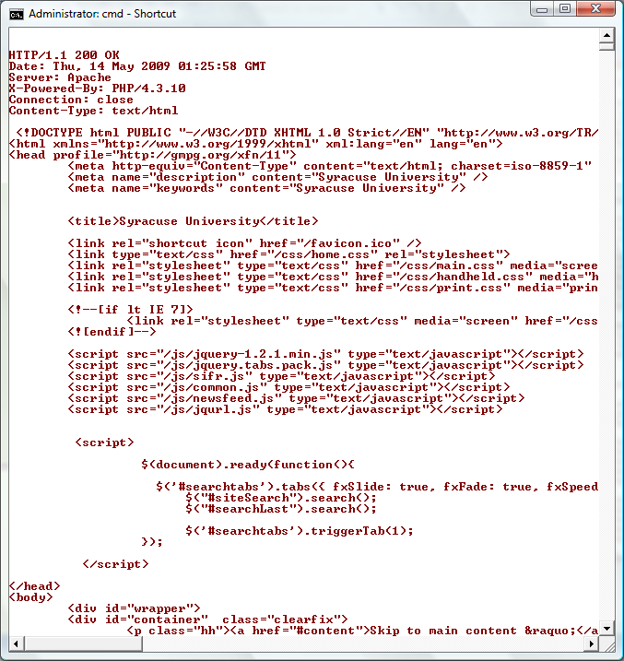

Slide 29
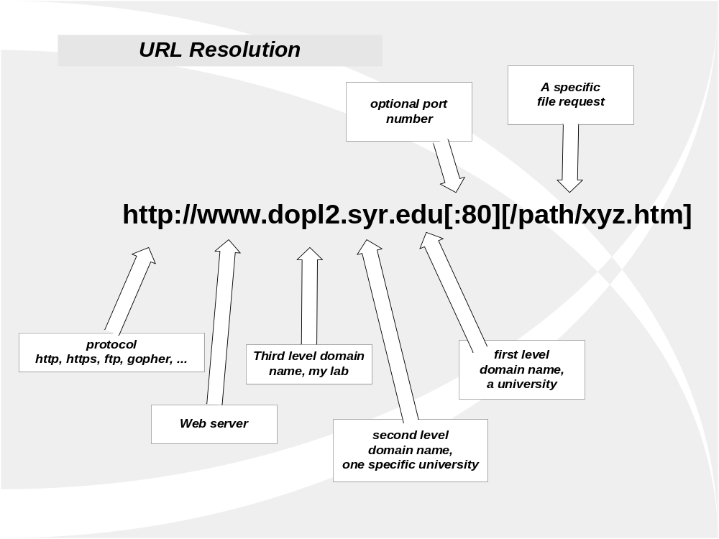

Slide 30
HTTP Methods
GET request-URI HTTP/1.1
  Retrieve entity specified in request-URI as body of response message
POST request-URI HTTP/1.1
  Sends data in message body to the entity specified in request-URI
PUT request-URI HTTP/1.1
  Sends entity in message body to become newly created entity specified by request-URI
HEAD request-URI HTTP/1.1
  Same as GET except the server does not send specified entity in response message
DELETE request-URI HTTP/1.1
  Request to delete entity specified in request-URI.
TRACE request-URI HTTP/1.1
  Request for each host node to report back

Slide 31
HTTP Request
Method
File
HTTP version
Headers
GET /default.asp HTTP/1.0
Accept: image/gif, image/x-bitmap, image/jpeg, */*
Accept-Language: en
User-Agent: Mozilla/1.22 (compatible; MSIE 2.0; Windows 95)
Connection: Keep-Alive
If-Modified-Since: Sunday, 17-Apr-96 04:32:58 GMT
Blank line
Data – none for GET

Slide 32
Multipurpose Internet Mail Extensions (MIME) skip to HTTP Response
Defines types of data/documents
  text/plain
  text/html
  image/gif
  image/jpeg
  audio/x-pn-realaudio
  audio/x-ms-wma
  video/x-ms-asf
  application/octet-stream

Slide 33
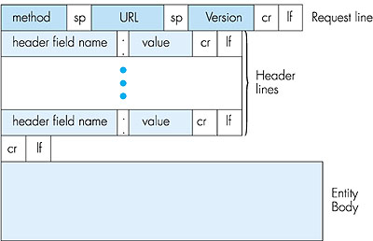
Request Message
request line
request methods:
DELETE, GET, HEAD, POST, PUT, TRACE
headers
blank line
body
GET /pub/index.html HTTP/1.0
Date: Wed, 20 Mar 2002 10:00:02 GMT
Pragma: no-cache
From: amer@udel.edu
User-Agent: Mozilla/4.03
Notes:
GET: Retrieves resource indicated by URI
HEAD: Retrieves ONLY metadata indicated by URI
POST: Pushes the resource in place of the URI (or creates a new one) or inputs the entity (data part) to the program(ex: CGI script) pointed by the URI

Slide 34
HTTP Response skip to Programming the Web
HTTP version
Status code
Reason phrase
Headers
HTTP/1.0 200 OK
Date: Sun, 21 Apr 1996 02:20:42 GMT
Server: Microsoft-Internet-Information-Server/5.0
Connection: keep-alive
Content-Type: text/html
Last-Modified: Thu, 18 Apr 1996 17:39:05 GMT
Content-Length: 2543
<HTML> Some data... blah, blah, blah </HTML>
Data

Slide 35
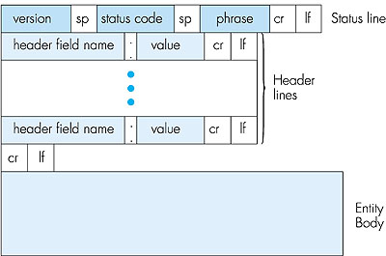
Response Message
status line
HTTP/1.1 200 OK
Date: Tue, 08 Oct 2002 00:31:35 GMT
Server: Apache/1.3.27 tomcat/1.0
Last-Modified: 7Oct2002 23:40:01 GMT
ETag: "20f-6c4b-3da21b51"
Accept-Ranges: bytes
Content-Length: 27723
Keep-Alive: timeout=5, max=300
Connection: Keep-Alive
Content-Type: text/html
headers
blank line
body
Notes:
Why a human readeable phrase?
To make extensibility easier. You can add new status codes without waiting for a protocol standard

Slide 36
Status Codes
200 OK
201 Created
202 Accepted
204 No Content
301 Moved Permanently
302 Moved Temporarily
304 Not Modified
400 Bad Request
401 Unauthorized
403 Forbidden
404 Not Found
500 Internal Server Error
501 Not Implemented
502 Bad Gateway
503 Service Unavailable
Classes:
1xx: Informational - not used, reserved for future
2xx: Success - action was successfully received, understood, and accepted
3xx: Redirection - further action needed to complete request
4xx: Client Error - request contains bad syntax or cannot be fulfilled
5xx: Server Error - server failed to fulfill an apparently valid request
Notes:
404, 403, 200, 304

Slide 37
Headers
Request Line
Status Line
General Headers
General Headers
Request Headers
Response Headers
Entity Headers
Entity Headers
A Blank Line
A Blank Line
Body
Body

Slide 38
Headers
General Headers
Request Headers
Date
Pragma
Cache Control
Connection
Trailer
Transfer-Encoding
Upgrade
Via
Warning
Authorization
From
If-Modified-Since Referer
User-Agent
Accept
Accept-Charset
Accept-Encoding
Accept
Language
Expect
Host
If-Match
If-None-Match
If-Range
If-Unmodified-Since
Max-Forwards
Proxy-Authorization
Range
TE
Headers present in HTTP/1.0 & HTTP/1.1
New Headers added in HTTP/1.1

Slide 39
Headers
Response Headers
Entity Headers
Location
Server
WWW-Authenticate
Accept-Ranges
Age
ETag
Proxy-Authenticate
Retry-After
Vary
Allow
Content-Encoding
Content-Length
Content-Type
Expires
Last-Modified
extension-header
Content-Language
Content-Location
Content-MD5
Content-Range
Headers present in HTTP/1.0 & HTTP/1.1
New Headers added in HTTP/1.1

Slide 40
Web Processing Models
HyperText Markup Language (HTML)
  Web of linked documents
  Unlimited scope of information content
HyperText Transfer Protocol (HTTP)
  Universal access
  HTTP is a "request-response" protocol specifying that a client will open a connection to server then send request using a very specific format. Server will then respond and close connection.
Graphical Browser Client
  Sophisticated rendering makes authoring simpler
HTML File Server
  Using HTTP, Interprets request, provides appropriate response, usually a file in HTML format

Slide 41
HTML Structure
HTML tag
Tagged Head section
  declarations
Tagged Body section
  Block elements
    Headings, paragraphs, lists
  Forms
    Text fields, Buttons, Menus, …
  Frames
  Images
  Links
  Tables
  Text

Slide 42
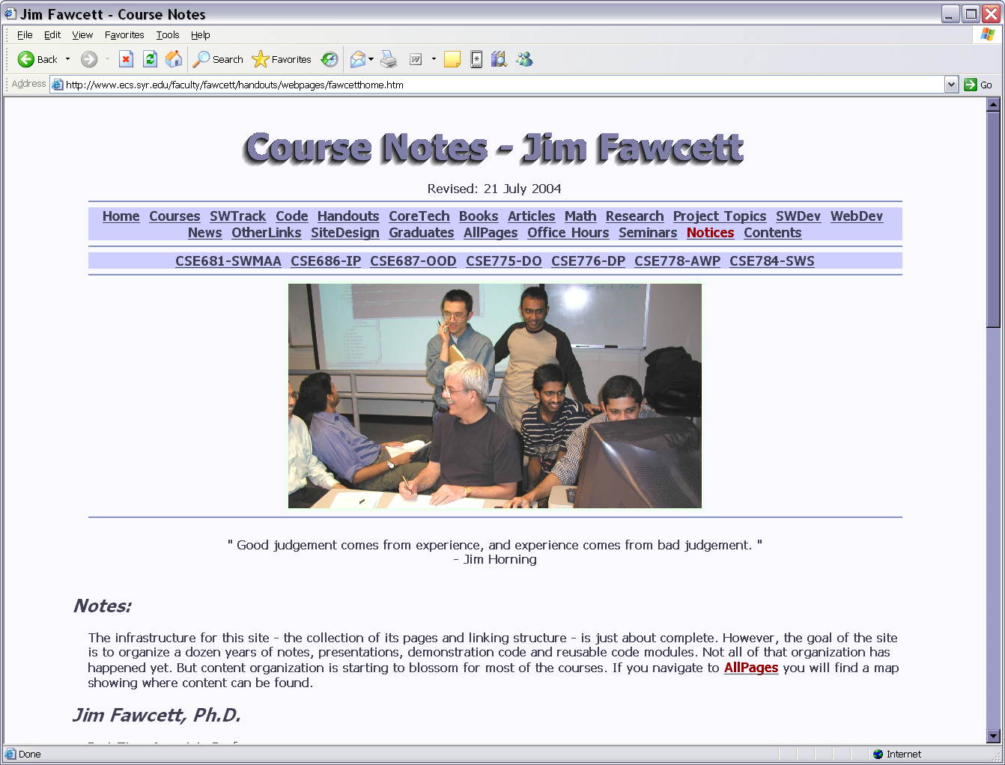

Slide 43
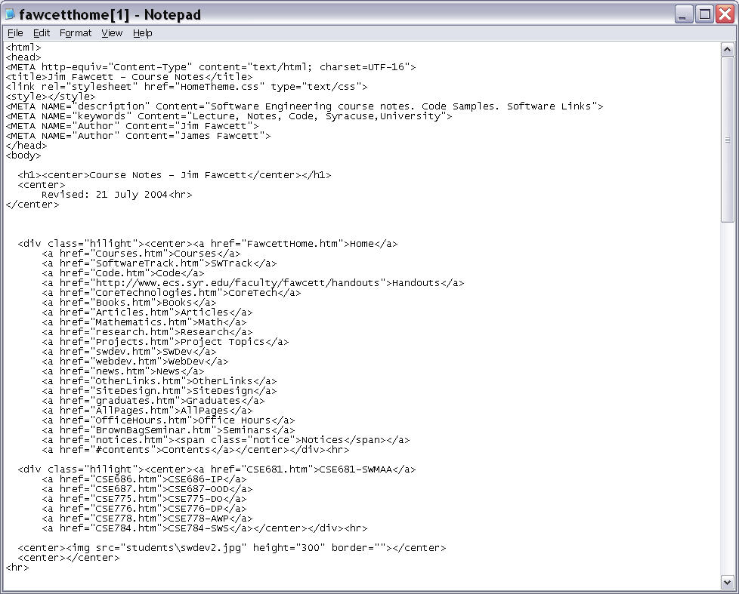

Slide 44
Extension - Cascading Style Sheets
Help to separate content from presentation
Defines styles using C-structure like notation:
  body { font-family: tahoma; font-size: medium; }
    may apply to specific tags, as above
  .notice { color: red; font-size: large; }
    defines a class called notice
    <span class=“notice”>…</span>
    by default can be applied to any tag

Slide 45
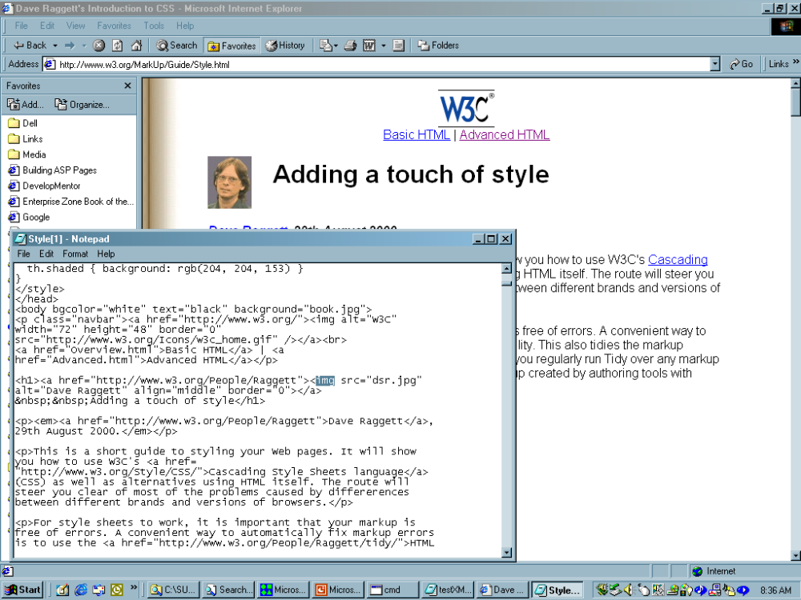
Cascading style sheets introduced. Helps separate content from presentation.

Slide 46
Programming The Web

Slide 47
Web Programming Model
Packaged functionality
  Web server supports default and user supplied controls
Dynamic content display
  ASP, JSP generates HTML using server data
  Browser interprets client side scripts
Machine-to-Machine
  Web services provide RPC interface

Slide 48
Programming the Web
Client-Side Programming
  JavaScript
    Can modify html document using scripts sent from server and interpreted by client.
  Silverlight uses C# in embedded CLR in Browser plug-in
  .Net controls, Java applets – need permissions
Server-Side Programming
  ASP script, C# code-behind
  Server components
    Session, Application, ADO, FileSystem, …
  Web controls used on ASPX pages
  Web services

Slide 49
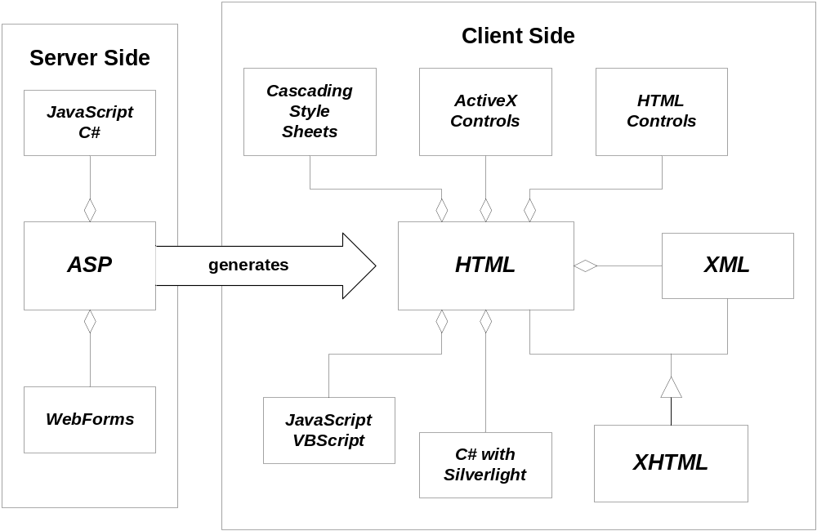
Web Programming – Language Model

Slide 50
Programming the Web
Server-Side Code
What is server-side code?
  Software that runs on the server, not the client
  Receives input from
    URL parameters
    HTML form data
    Cookies
    HTTP headers
  Can access server-side databases, e-mail servers, files, Web Services, etc.
  Dynamically builds a custom HTML response
  for a client
Notes:
This course will focus on server-side .NET technologies.

Slide 51
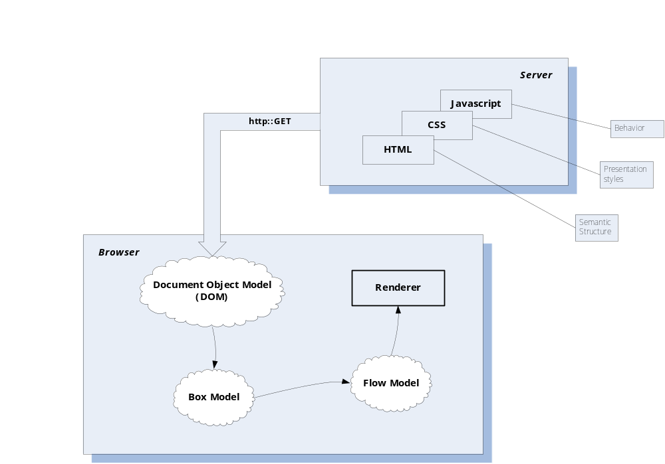
Traditional HTML Serving Model

Slide 52
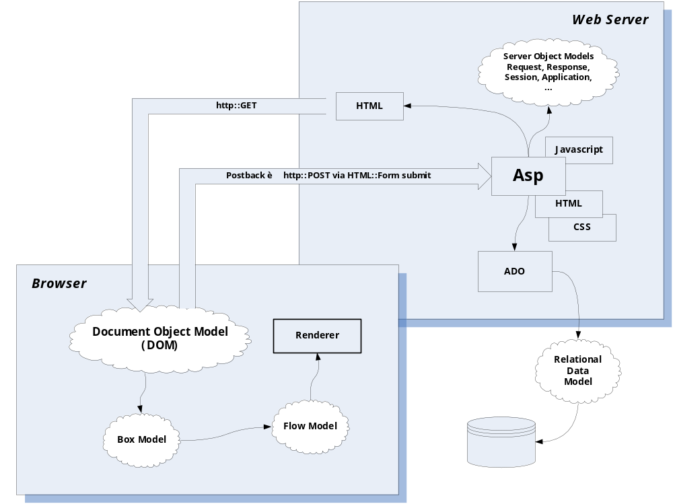
ASP Dynamic Serving Model

Slide 53
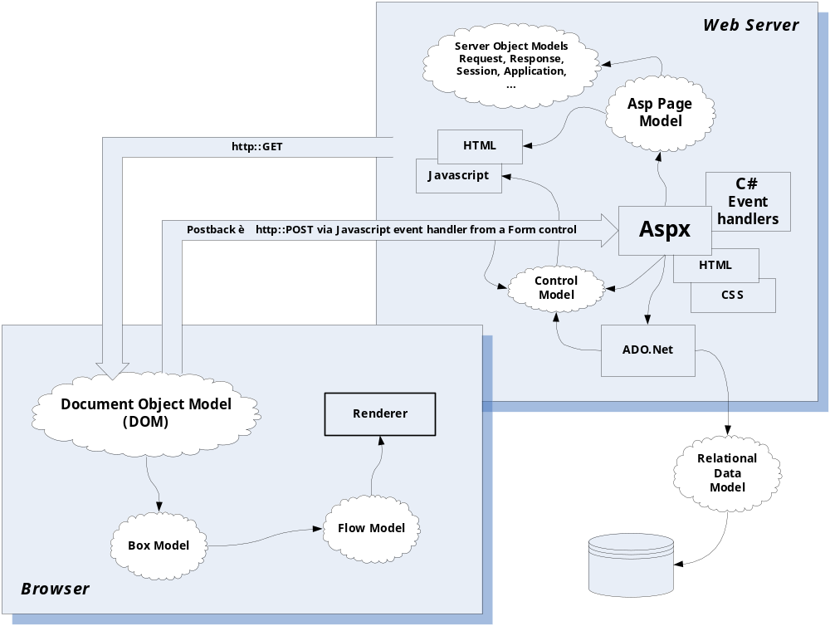
ASP.NET Serving Model

Slide 54
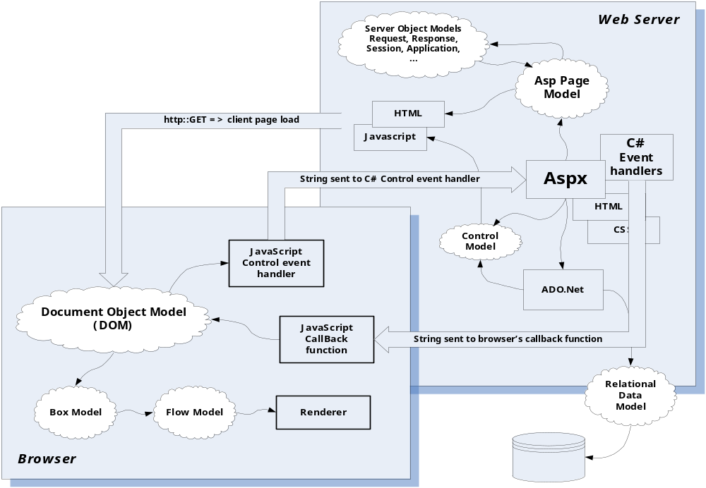
Asp.Net Ajax Serving Model

Slide 55
Programming the Web
Server-Side Code
Why server-side code?
  Accessibility
    You can reach the Internet from any browser, any device, any time, anywhere
  Manageability
    Does not require distribution of application code
    Easy to change code
  Security
    Source code is not exposed
    Once user is authenticated, can only allow certain actions
  Scalability
    Web-based 3-tier architecture can scale out

Slide 56
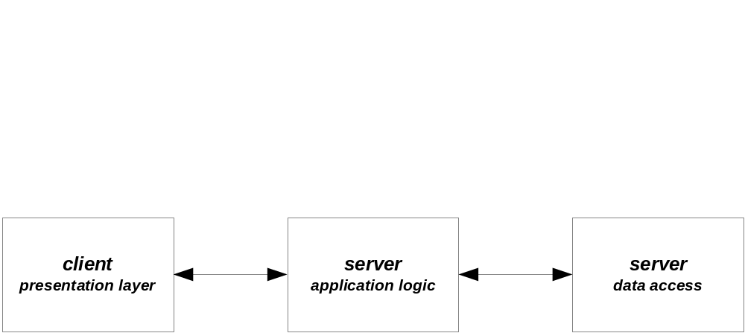
Three Tier Architecture
Client Tier
  Presentation layer
  Client UI, client-side scripts, client specific application logic
Server Tier
  Application logic, server-side scripts, form handling, data requests
Data Tier
  Data storage and access

Slide 57
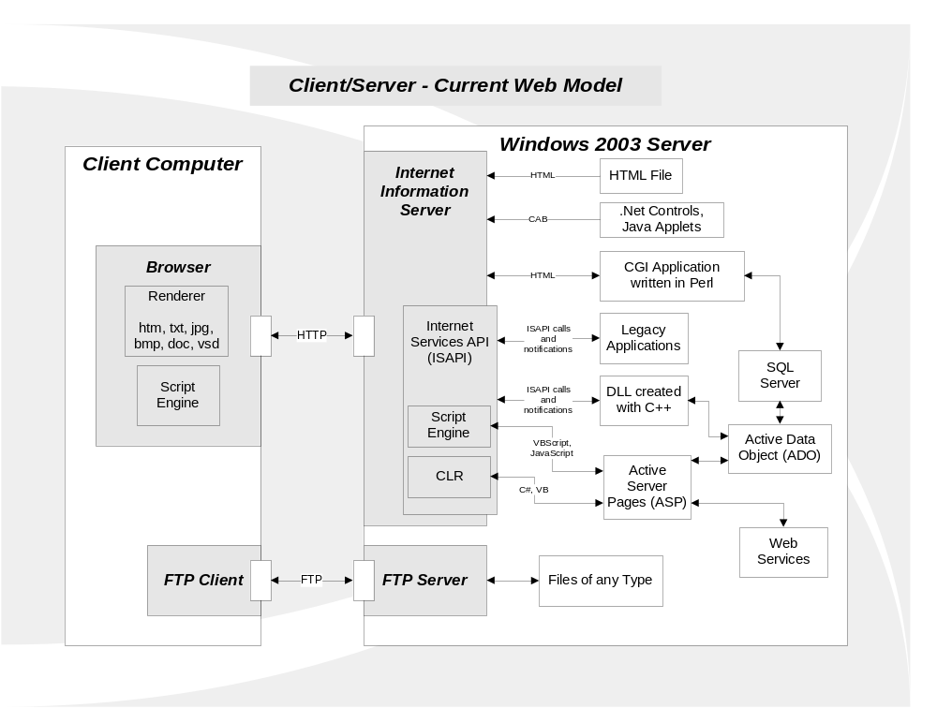

Slide 58
.Net Controls
The model of previous slide is very powerful!
  A browser that knows nothing about some sophisticated server-side processing can take advantage of that by downloading a .Net control that encapsulates all the intelligence necessary to work with the server.
  Similarly, a browser can be given new processing capabilities, simply by loading a local web page that contains controls with the desired abilities.
  Note that web page scripts do the same thing, only not quite so efficiently, and often with limitations on processing capabilities.

Slide 59
Displaying ActiveX Controls on a Web Page
Here is an example of an object tag and attributes for inserting a control on a Web page.
<OBJECT CLASSID="clsid:FC25B780-75BE-11CF-8B01-444553540000“
CODEBASE="/ie/download/activex/iechart.ocx" ID=chart1
WIDTH=400 HEIGHT=200
ALIGN=center HSPACE=0 VSPACE=0
>
<PARAM NAME="BackColor" value="#ffffff“>
<PARAM NAME="ForeColor" value="#0000ff">
<PARAM NAME="url" VALUE="/ie/controls/chart/mychart.txt“>
</OBJECT>

Slide 60
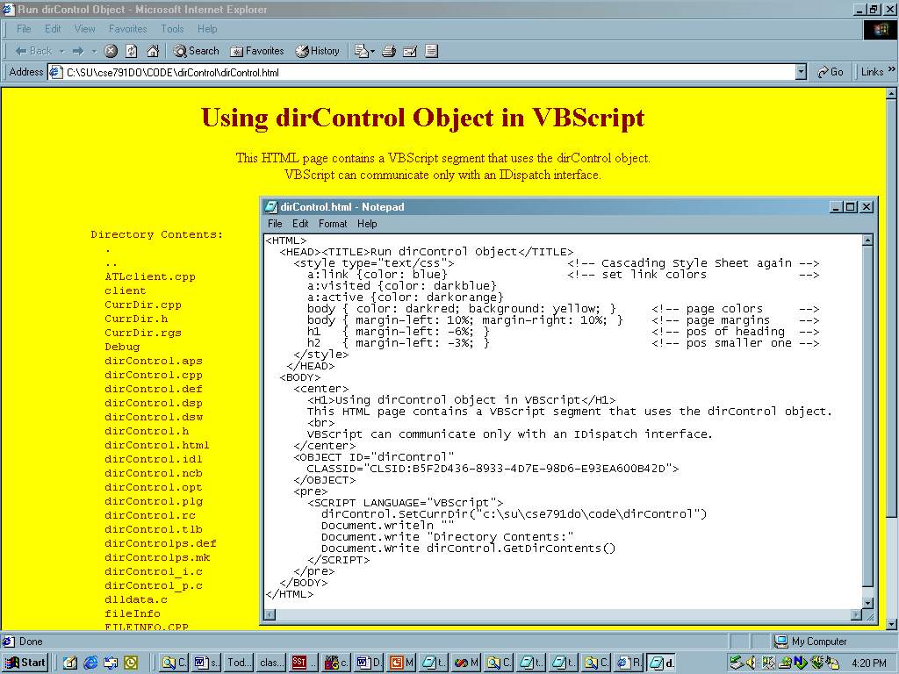

Slide 61
Browser Object Model
Window
  browser window
Document
  current HTML page
Form
  a form holds controls
  often used to submit data to server
Frame
  frame in browser window
Location
  Location of current web page
  URL, domain name, port, path, …
Navigator
  Browser, itself
History

Slide 62
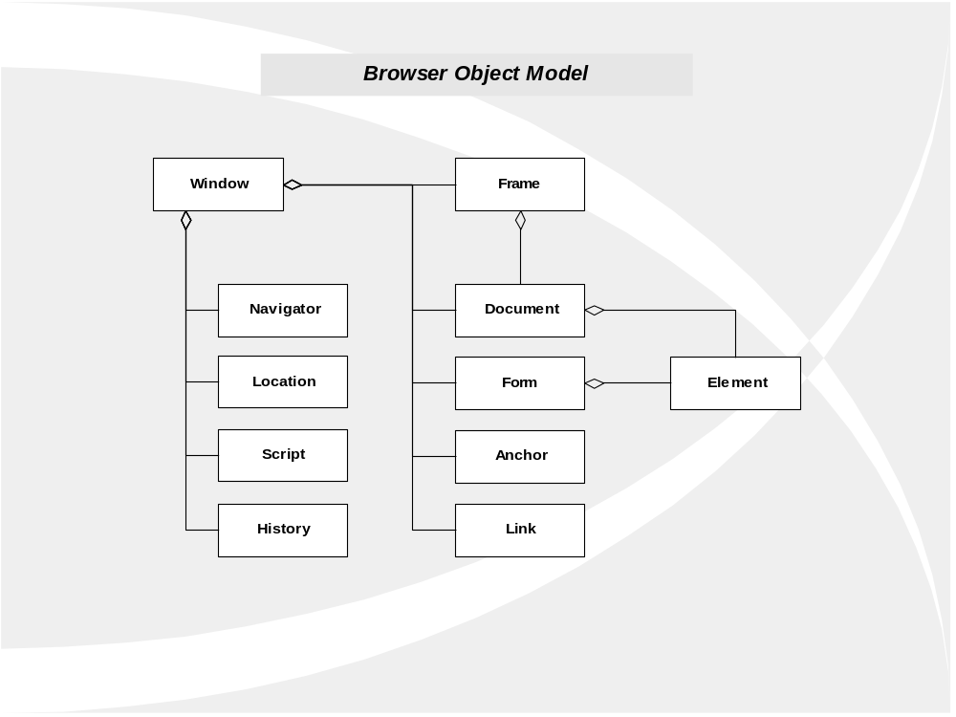

Slide 63
Some Examples
Basic HTML pages
  Example #1

Slide 64
Server Object Model
Application Object
  Data sharing and locking across clients
Request Object
  Extracts client data and cookies from HTTP request
Reponse Object
  Send cookies or call Write method to place string in HTML output
Server Object
  Provides utility methods
Session Object
  If browser supports cookies, will maintain data between page loads, as long as session lasts.

Slide 65
Server Components skip to Security Issues
Ad Rotator – rotates advertisements
Browser Capabilities – determines type
Database Access
  Active Data Objects (ADO) provide common interface to a variety of data sources
Content Linking
  Creates list of web pages
File Access Component
  Provides access to server files from scripts

Slide 66
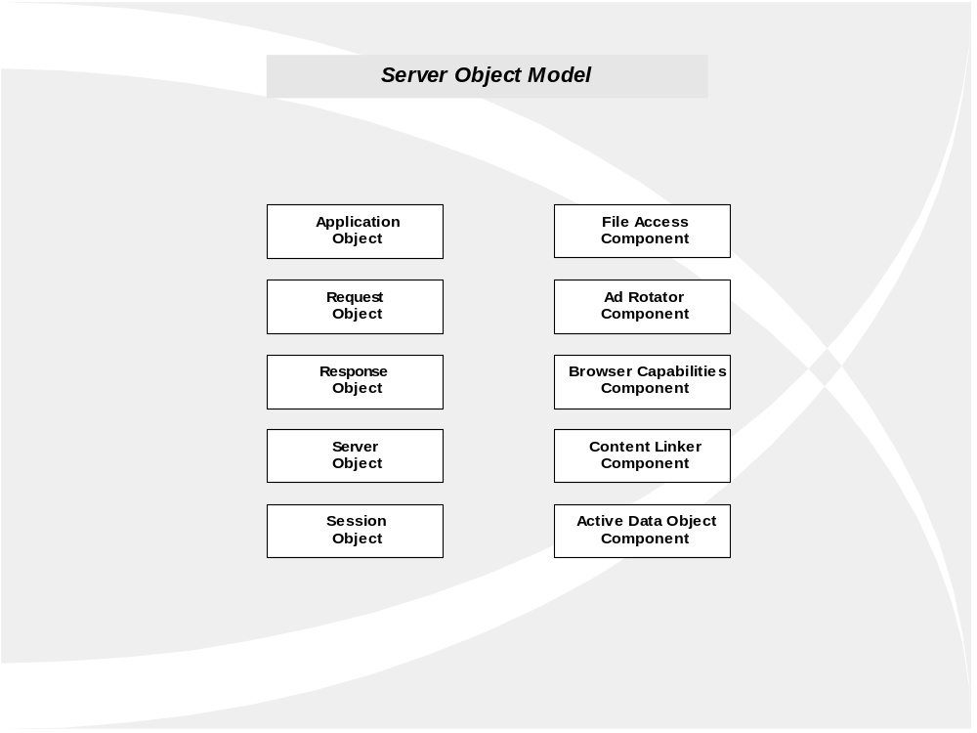

Slide 67
Server Side Programming with ASP
An Active Server Page (ASP) consists of HTML and script.
  HTML is sent to the client “as-is”
  Script is executed on a server to dynamically generate more HTML to send to the client.
  Since it is generated dynamically, ASP can tailor the HTML to the context in which it executes, e.g., based on time, data from client, current server state, etc.

Slide 68
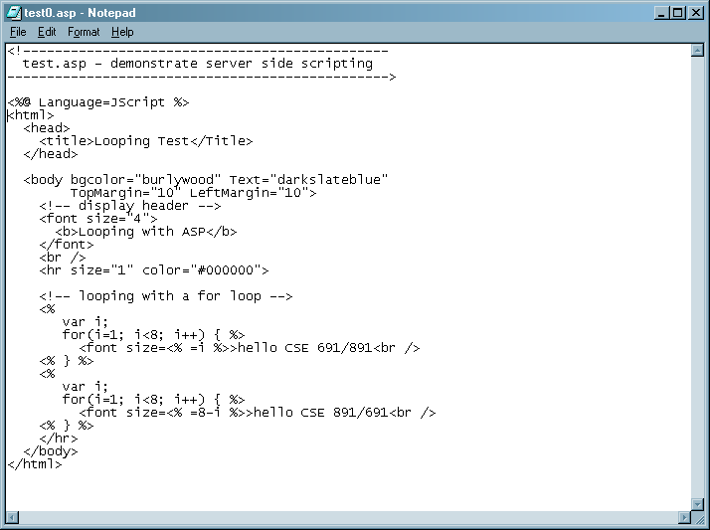

Slide 69
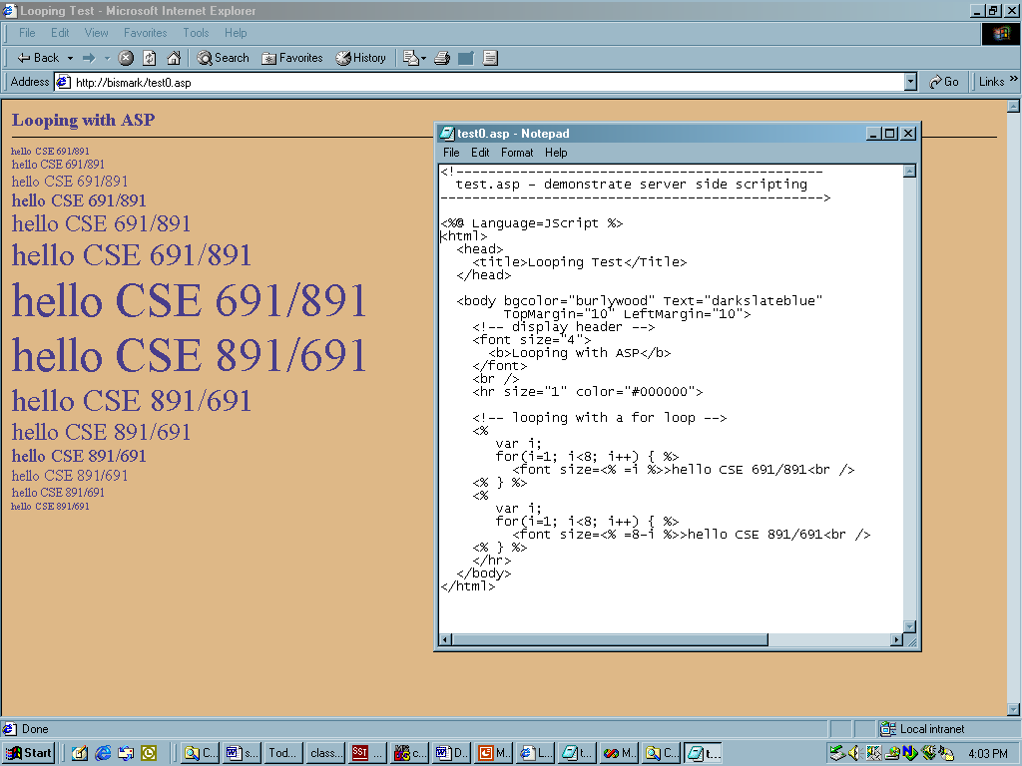

Slide 70
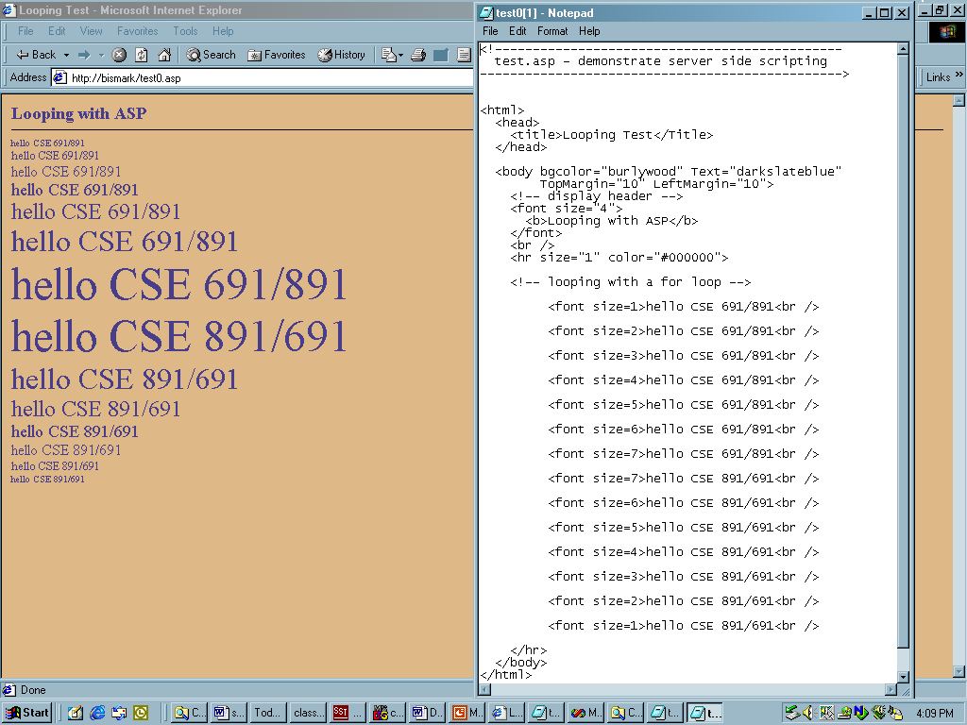

Slide 71
Server Side Programming with Asp.Net
An Asp.Net application consists of:
  Design Time:
    A form with web controls
    C# code behind event handlers
  Run-Time:
    Form is translated into an HTML form
    Web controls become HTML elements with Javascript event handlers that postback to the server.
    Asp.Net model makes control data available as properties of a Page class, transported from browser to server in a “hidden view-state”.

Slide 72
ISAPI – Server Side Extensions
Server Extensions work like CGI scripts to provide server-side processing, but they are DLLs, which reside in the memory space of the HTTP server.
This is an enormous performance advantage over CGI extensions which need to spawn a new process each time they are run.
The extension DLL exports HttpExtensionProc(), which is called by IIS when the user request asks for the extension processing.
Active Server Page (ASP) scripts and (Asp.Net) C# code are easier ways to accomplish the same thing. One would expect the ASP script or C# to be faster than CGI but slower than an ISAPI extension.

Slide 73
Using Controls and Applets
We’ve already seen how to include an ActiveX control on a web page.
Now let’s see how to do that for a Java Applet:
  Java Applet - Sprites

Slide 74
Including Java Applet
<applet code=sprites.class width=700 height=125>
<!-- registration code to disable the floating -->
<!-- sign within the program panel and 5-min connection -->
<param name=regcode value=99999999>
<!-- frames per second -->
<param name=fps value=15>
<!-- background color -->
<param name=bgcolor value="185 235 255">
<!-- border width (0 = no border) -->
<param name=border value=3>
<!-- link address when mouse is clicked -->
<param name=url value="http://www.thejmaker.com/">
<!-- number of menu items -->
<param name=total value=5>
<!-- control of individual sprites -->
<!-- where | seperates sprite filename, start x and y, speed x and y, wrap-around option -->
<param name=menu0 value="sprite0.gif|0 30|1 0|1">
<param name=menu1 value="sprite1.gif|150 35|-1 0|0">
<param name=menu2 value="sprite2.gif|150 45|-3 0|0">
<param name=menu3 value="sprite3.gif|0 40|2 0|1">
<param name=menu4 value="sprite4.gif|100 3|-5 0|0">
</applet>

Slide 75
Security Issues
Threats
  Data integrity
    code that deletes or modifies data
  Privacy
    code that copies confidential data and makes it available to others
  Denial of service
    code that consumes all of CPU time or disk memory.
  Elevation of privilege
    Code that attempts to gain administrative access

Slide 76
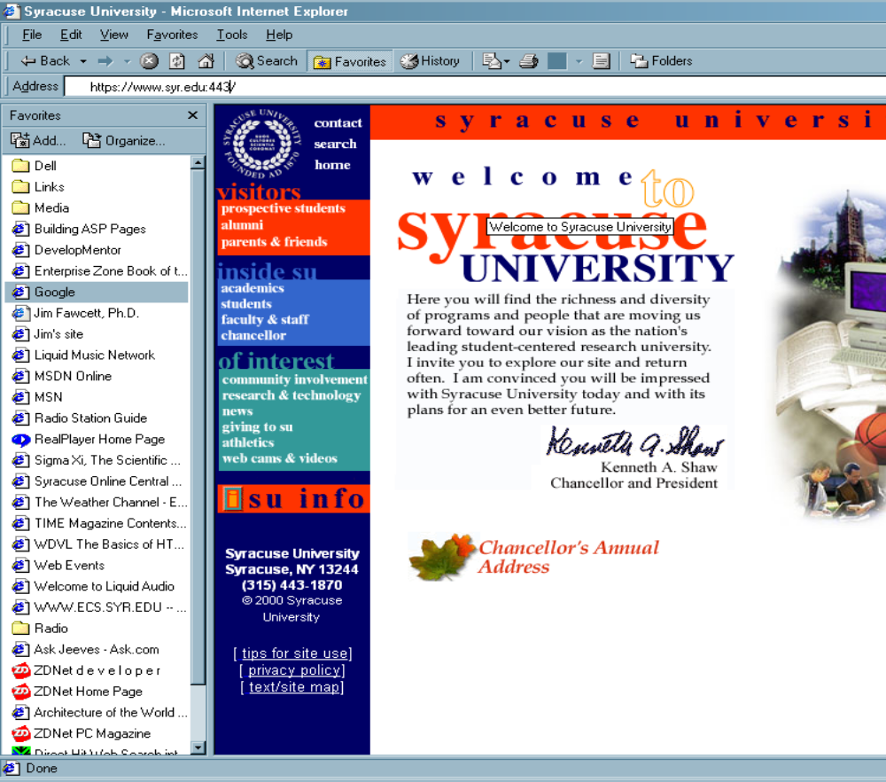

Slide 77
Protections
Least privilege rule:
  Use the technology with the fewest capabilities that gets the job done.
Digital signing
  Who are you?
Security zones
  Trusted and untrusted sites
Secure sockets layer (SSL)
Transport layer security (TLS)
Encryption

Slide 78
Extending The Web

Slide 79
Current Extensions
Describe data with XML
Extend HTML into XHTML
Separate style from content with CSS
  Cascading style sheets
  Can be included from a file to give uniform style of pages and documents
Document Object Model – DOM
  Defines a scripting interface

Slide 80
The Extensible Web
Some recent W3C Technologies
  www.w3.org/2003/Talks/0521-BudapestW3CTrack-IH/6.html
  www.w3.org/2003/Talks/0521-BudapestW3CTrack-IH/23.html

Slide 81
Areas of Exploration
XML - Universal Data Services
TVWeb - merger of features
MathML - Mathematical Markup Language
RDF - Resource Description Framework
Accessibility - for the handicapped
SMIL - Synchronized Multimedia Integration Language
Internationalization
Speech

Slide 82
People in the Web
Web Development
  Web server, HTTP
    Tim Berners-Lee, Robert Cailiau
  Mosaic web browser
    Marc Andreessen
Internet
  TCP/IP protocol
    Vinton Cerf, Robert Kahn
  Internet flow control
    Larry Roberts

Slide 83
References
World Wide Web Consortium
  Excellent Tutorial Papers, standards
Source of several slides used here
  Mark Sapposnek
webdev.htm
  Tutorials
  Web developer’s links
  Web designer’s links
  Tech details links
XHTML Black Book, Steven Holzner, Coriolis, 2000
  Aging but comprehensive treatment of HTML, XHTML, JavaScript
Web Developers Virtual Library
  More tutorials

Slide 84
End of Presentation

