Slide 1
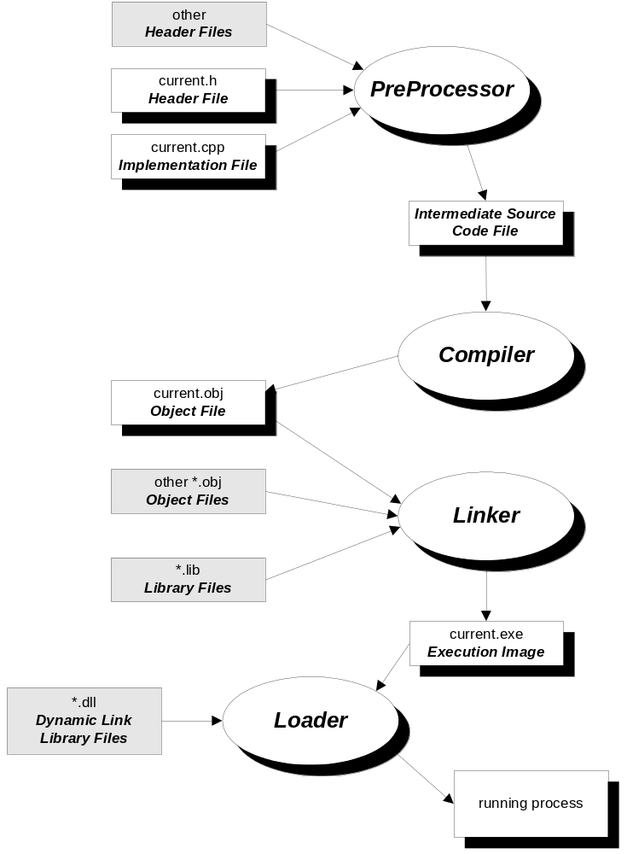
C/C++ Compilation Model

