Slide 1
Elements of C and C++
CSE687 - Object Oriented Design Class Notes
Jim Fawcett
Summer 2017

Slide 2
Contents
C++ Goals
C Language Elements
C Language Summary
C++ Keywords
C++ Operators
The ANSI Standard C Library
ANSI C++ Library
C/C++ Compilation Model
C/C++ Computational Model
C/C++ Memory Model
Elements of the C++ Language
Pass by Value and by Reference
C++ Language at a Glance
Differences between C and C++

Slide 3
C++ Goals Contents
“The language thus provided general mechanisms for organizing programs, rather than support for specific application areas. This was what made C with Classes - and later, C++ - a general-purpose language rather than a C variant with extensions to support specialized applic-ations.”
“C with Classes was explicitly designed to allow better organization of programs; “computation” was consider-ed a problem solved by C. I was very concerned that improved program structure was not achieved at the expense of run-time overhead compared to C.”
“I strongly felt then, as I still do, that there is no one right way of writing every program, and a language designer has no business trying to force programmers to use a particular style. The language designer does, on the other hand, have an obligation to encourage and support a variety of styles and practices that have proven effective and to provide language features and tools to help programmers avoid the well-known traps and pitfalls.”
Bjarne Stroustrup, “The Design and Evolution of C++”
[underlines are mine]

Slide 4
Why Use a C Core? Contents
“C is clearly not the cleanest language ever designed nor the easiest to use so why do so many people use it?
  C is flexible: It is possible to apply C to most every applica-tion area and to use most every programming technique with C. The language has no inherent limitations that preclude particular kinds of programs from being written.
  C is efficient: The semantics of C are “low level”; that is , the fundamental concepts of C mirror the fundamental concepts of a traditional computer. Consequently, it is relatively easy for a compiler and/or programmer to efficiently utilize hard-ware resources for C programs.
  C is available: Given a computer, whether the tiniest micro or the largest super-computer, chances are that there is an acceptable quality C compiler available and that the C com-piler supports an acceptably complete and standard C lang-uage and library. Libraries and support tools are also avail-able, so that a programmer rarely needs to design a new system from scratch.
  C is portable: A C program is not automatically portable from one machine (and operating system) to another, nor is such a port necesarily easy to do. It is, however, usually possible and the level of difficulty is such that porting even major pieces of software with inherent machine dependencies is typically technically and econonmically feasible.
Compared with these first-order advantages, the second-order drawbacks like the curious C declarator syntax and the lack of safety of some language constructs become less important.”
Bjarne Stroustrup, “The Design and Evolution of C++”

Slide 5
C Language Elements Contents
Kernighan and Ritchie [1988] start this way:
  C provides a variety of data types
    characters, integers, and floating point numbers of several sizes
    derived data types created with pointers, arrays, structures, and unions.
  Expressions are formed from operators and operands
  A very rich set of operators make for concise and expressive constructions.
  Any expression can be a statement - simply append a semicolon
  Pointers provide machine independent address arithmetic
  C has control-flow constructs required for well structured programs:
    statement grouping { ... }
    decision making if-else
    selecting on of several cases switch-case
    looping with test at top while, for
    looping with test at bottom do-while
    skip to loop top continue
    break out of loop break

Slide 6
And More C Elements Contents
Paraphrasing Kernighan and Ritchie:
Variables:
  may be internal to a function, external but known only within a single source file, or visible to the entire pro-gram, e.g., local, file, or program scope.
Functions:
  Function arguments are passed by value, minimizing side-effects, but that makes returning results from functions more complex
  Any function may be called recursively
  Functions may be passed and return values of basic types, structures, unions, or pointers
  Local variables are created anew for each function invocation unless qualified as static
  Function definitions may not be nested, but variables can be declared in a block-structured fashion.
    blocks are delimited by { ... }
    local declarations must appear at the beginning of each block before any expressions
  The functions of a C program may exist in more than one source file and may be compiled separately.

Slide 7
More C Language Elements Contents
There are three types of statements in a C program:
  preprocessor statements
    start with # and end with a newline
    perform macro text substitution
    provide text inclusion of other source files
    define conditional compilations
  declarations and definitions announce types for named variables and functions
    appear at the beginning of a block and end with a semicolon
    definitions reserve named memory locations
    Only one definition is allowed for each variable and function
    declarations simply announce types to the com-piler. There may be multiple consistant declara-tions for a C program variable or function
  expressions have values and are formed as combina-tions of operators and variables
    the value of an expression is temporary, occupying anonymous storage, unless assigned to a named variable
    temporaries are often call r-values
    named variables are often called l-values

Slide 8
C Language at a Glance Contents
The C Language is essentially this:
C itself is simple, but has a rich, expressive set of operators and an extensive library of powerful com-ponents.
35 keywords
50 operators
45 library modules

Slide 9
C/C++ Tokens Contents
{ } - group statements
( ) - group expressions to control order of evaluation
/* - begin comment
*/ - end comment
\ - line continuation
# - begin preprocessor statement
“ - delimit beginning and end of string constant
‘ - delimit beginning and end of character constant
: - terminate class access controls public:, protected: and private:
; - terminate statements
C/C++ tokens
constants
identifiers
keywords
strings
operators
punctuators
{
}
(
)
/
*
\
#
“
‘
:
;

Slide 10
C/C++ Objects Contents
C/C++ Objects
void
scalar
derived
aggregate
arithmetic
pointer
function
union
array
struct/class
floating
integral
reference
float
double
short
enum
int
long
char
long double

Slide 11
C/C++ Keywords Contents
----< data definition >---------------------------------< C and C++ >----
char bool double - intrinsic data types
float int void
const extern long - data type modifiers
mutable short signed
static typename unsigned
enum struct union - aggregate types
----< control flow >--------------------------------------< C and C++ >----
do while for - looping constructs
break continue - loop short circuits
if else - logical branches
goto - illogical branches
return - function termination
switch case default - case selection
----< class definition >----------------------------------< C++ only >----
class - user defined type
private protected public - class access control
operator virtual - modifying functions
explicit - prevent implicit convers.
this - object state pointer
friend - access override

Slide 12
C/C++ Keywords Contents
----< user allocated memory management >----< C++ only >----
delete new
----< defining generic types >-----------------------< C++ only >----
template export typename
----< handling exceptions >--------------------------< C++ only >----
catch throw try
----< new style casts >--------------------------------< C++ only >----
const_cast static_cast dynamic_cast reinterpret_cast
----< run-time type information >-------------------< C++ only >----
typeid typeinfo - language defined type
----< system resource control >-------------------< C++ only >----
inline namespace using
----< system resource control >-----------------< C and C++ >----
asm auto register sizeof typedef volatile

Slide 13
C/C++ Operators Contents
:: scope resolution class_name::member ltr
:: global ::name
. member selection object.member ltr
-> member selection pointer->member
[ ] subscripting pointer [ int expr ]
( ) function call expr ( expr_list )
( ) value construction type ( expr_list )
sizeof size of object sizeof expr
sizeof size of type sizeof ( type )
++ post increment lvalue ++ rtl
++ pre increment ++ lvalue
-- post decrement lvalue --
-- pre decrement -- lvalue
~ complement ~ expr
! not ! expr
- unary minus - expr
+ unary plus + expr
& address of & lvalue
* dereference * expr
new create (allocate) new type
new[ ] create array new type[ int expr ]
delete destroy (de-allocate) delete pointer
delete[ ] destroy array delete [ ] pointer
( ) cast (type conversion) ( type ) expr
.* member section object.pointer-to-member
->* member section pointer->pointer-to-member
* multiply expr * expr ltr
/ divide expr / expr
% modulo (remainder) expr % expr
+ add expr + expr ltr
- subtract expr - expr

Slide 14
C/C++ Operators Contents
<< shift left expr << expr ltr
>> shift right expr >> expr
< less than expr < expr ltr
<= less than or equal to expr <= expr
> greater than expr > expr
>= greater than or equal to expr >= expr
== equality test expr == expr ltr
!= non equality test expr != expr
& bitwise AND expr & expr ltr
^ bitwise exclusive OR expr ^ expr ltr
| bitwise inclusive OR expr | expr ltr
&& logical AND expr && expr ltr
|| logical inclusive OR expr || expr ltr
? : conditional expression expr ? expr : expr rtl
= assignment lvalue = expr rtl
*= multiply and assign lvalue *= expr
/= divide and assign lvalue /= expr
%= modulo and assign lvalue %= expr
+= add and assign lvalue += expr
-= subtract and assign lvalue -= expr
<<= shift left and assign lvalue <<= expr
>>= shift right and assign lvalue >>= expr
&= AND and assign lvalue &= expr
|= OR and assign lvalue |= expr
^= exclusive or and assign lvalue ^= expr
, comma (sequencing) expr, expr ltr

Slide 15
The ANSI Standard C Library Contents
The C language provides:
  no operations to deal directly with composite objects such as character strings, lists, or arrays other than bit-for-bit assignment of structures
  no storage other than static and local variables
  no input and output to devices or files
These capabilities and more are provided by the ANSI C library:
  cstdio provides input and output functionality
  cstdlib provides dynamic memory allocation
  cstring has facilities for managing null terminated strings of characters
  cctype provides support for testing a character’s inclusion in classes, e.g., alphanumeric, whitespace, control, ...
  cmath provides many of the elementary transcendental functions
  cfloat helps in dealing with underflow, overflow and loss of precision in floating point operations

Slide 16
ANSI Standard C Library Contents
Additional C library capabilities are:
  ctime // C-style date and time
  cassert // macros supporting use of assertions
  cerrno // C-style error handling
  cctype // character classification
  cwtype // classifying wide characters
  cstring // management of C-style strings
  cwchar // supports wide C-style strings
  climits // numeric scalar limit macros
  cstddef // C-language support
  cstdarg // supports variable length argument lists
  csignal // C-style signal handling

Slide 17
ANSI C++ Library Contents
A standard for the C++ language has been approved by the ANSI X3J16 committee and ISO committee WG21. A draft standard was released for public review in February, 1994, and approved November, 1997. The official standard was approved in 1998.
The standard defines a library which includes modu-les:
  exception // defines exception, bad_exception
  stdexcept // defines all other exception types
  new // defines bad_alloc
  typeinfo // defines bad_cast, bad_typeid
  ios // defines ios_base::failure
  new // augmenting operators new and delete
  typeinfo // run-time type identification
  iostream // io streams, standard stream objects
  iomanip // formating, state control of iostreams
  fstream // read/write to files you open by name
  sstream // read/write char sequences in memory
  string // create character string objects
  complex // definition of complex numbers
  numerics // numeric operations
Here’s a complete list: http://CppReference.com/w/cpp/header

Slide 18
ANSI C++ Library Contents
A set of extensible generic programming modules are also provided, referred to collectively as the STL, or standard template library, which includes:
  functional // function objects
  memory // allocators for containers
  iterator // support for iteration
  algorithm // general algorithms
  vector // expandable array
  list // doubly linked lists
  deque // double-ended queue
  queue // queue of T
  stack // stack of T
  map // ordered set of pairs of // (key,value)
  set // ordered set of key
  Unordered_map // unordered set of pairs of // (key, value)
  bitset // set of Booleans
Here’s a complete list: http://CppReference.com/w/cpp/header

Slide 19
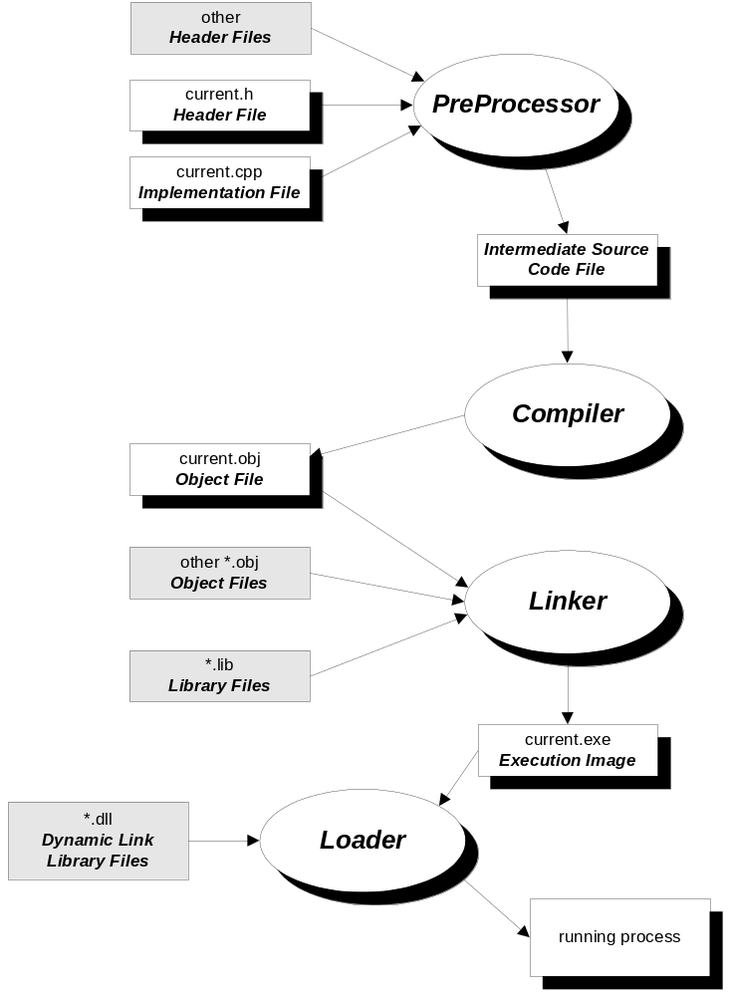
C/C++ Compilation Model Contents

Slide 20
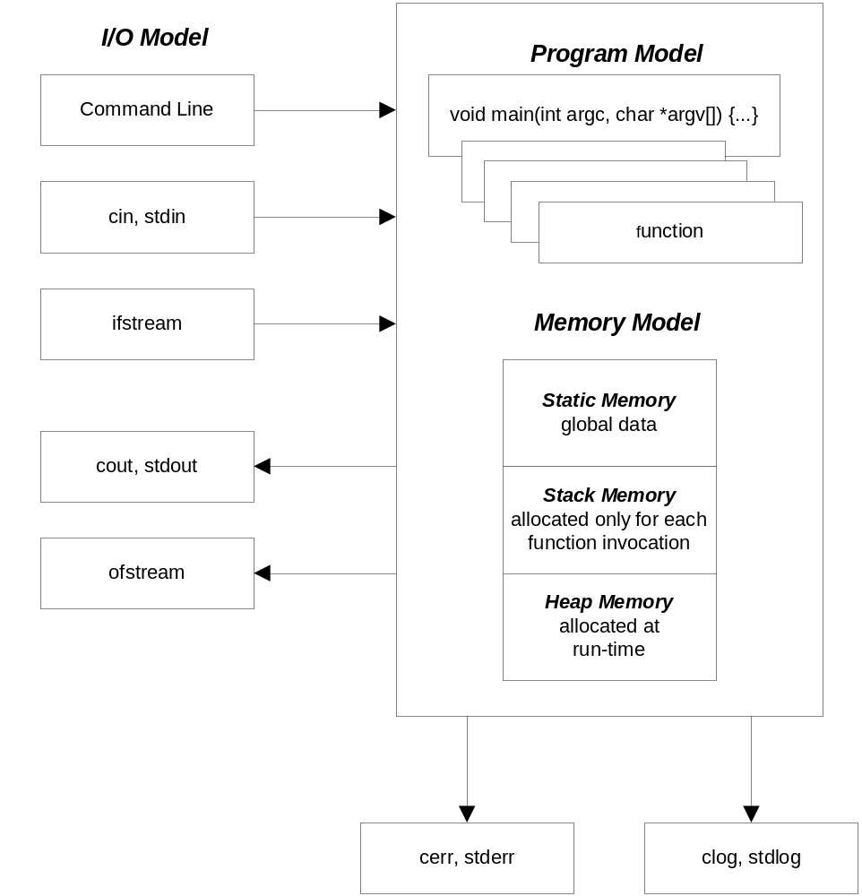
C/C++ Computational Model Contents

Slide 21
C/C++ Memory Model Contents
Static memory: - available for the lifetime of the program
public global functions
and data
defined outside any function (globals) and initial- ized before main is entered.
global data and functions are made private by
qualifying as static, otherwise they are public
memory allocations local to a function, but quali-
fied as static
private global functions
and data
local static data
Stack memory: - temporary scratch pad
main stack frame
- defined only while computational thread passes
through a function.
- holds input parameters, local data, and return
values, used as scratch-pad memory
- guaranteed to be valid during the evaluation of
a containing expression, won’t be valid after
- expression evaluation starts with function eval-
uation first, then expression evaluation as alge-
braic combination of terms
- stack frame is destroyed when expression eval-
uation is complete
function called by main
stack frame
more stack frames
:
current function
stack frame
heap memory: - valid from the time of allocation to deallocation
allocated heap memory
- allocated/deallocated at run time by invoking
operators new /delete (or functions malloc/free)
- memory is available to anyone with a pointer
to the allocated memory from the time of
allocation until deallocated.
free heap memory
free memory

Slide 22
Run Time Flexibility Contents
Compile-time memory allocation
Compile-time allocation of data objects is directly supported by the language.
int x[25]; /* size determined at compile-time */
But frequently the designer does not know either the size of objects collected at run time or the number of objects that the program must handle.
dynamic memory allocation.
The Standard Library modules stdlib (C) and new (C++) provide simple and effective means of acquiring additional memory allocations from the operating system. These facilities are especially useful for creating composite data objects on demand on the heap at run-time.
X* x = (X*) malloc( numObjs * sizeof(X) ); (C)
X* x = new X[numObjs] (C++)
pointers
C provides access to dynamic memory through pointers. Address arithmetic supports incrementing and adding offsets to pointers. Arithmetic is “smart”:
  Incrementing a pointer adds to the pointer address the size of one object of the type pointed to.
  Adding an integer, n, offset to a pointer creates an address n objects away from the original address.

Slide 23
Run-Time Flexibility Example Contents
The standard containers are good examples of the flexibility C++ programs enjoy by using run-time allocation of resources - in this case memory from the heap.
The str class (Handouts/CSE687/Code/STR) is a demonstration of how to build Abstract Data Types.
Objects from the str class have a specific amount of character memory defined by the str constructor. If appends to the string build a character sequence which is longer than constructed memory size the str object will reallocate a larger memory block, copy over the current characters, and continue appending.
None of this requires intervention by client code. The result of this is that str objects appear to have unlimited ability to append characters without wasting a lot of space when handling small strings.
Advantages of run-time allocation are hard to over-state. Clients simply use str objects without needing a lot of fussy logic to make sure fixed memory allocations are not overrun.
str use seems simple to clients, even though quite a bit of memory management is going on silently. That simplicity translates into fewer errors, and no anomalous behavior, as happens when fixed memory limits are reached.

Slide 24
Efficiency Contents
One goal of the C language was to replace the use of assembly language in system programming. The UNIX system, for example, is written mostly in C.
  C was designed to create and manage composite data structures with small computational and memory costs
    C is a strongly typed language that provides the designer with a lot of help in using complex data correctly
    However, the language allows the designer to by-pass type matching through casts in order to support interfaces with hardware and other system software.
    Furthermore, C provides a set of coercions between data types to flexibly support mixed mode expressions.
  C does no run-time checking. It will:
    support requests to index beyond static and dynamic array bounds for both reading and writing
    maintain pointers to objects which go out of scope
    copy data into memory that has never been allocated to the program or is no longer valid
    attempt to return memory to the operating system more than once if asked to do so
  Any of the preceding events spells DISASTER. The C language comes without seat belts. It will happily do what it is asked to do, assuming that the designer understands the consequenses of any request.

Slide 25
Efficiency Trade-offs in C++ Contents
C has no run-time checking of array indexing, pointer arithmetic, or memory allocation status. The result is very fast programs, but the possibility of nasty errors induced by overrunning memory bounds, using uninitialized pointers, or invalid memory.
C++ has the facilities to allow designers to buld in as much or as little run time checking as they want. It is even possible to build in checks that can be turned on or off as needed.
An example is the str class. The indexing operator which returns values or writes into characters defined by s[i] has built in bounds checks on the index i. Should i be negative or exceed the allocated array size, the index operator will throw an exception with an informative error message.
This level of flexibility is just not available in the tradi-tional languages like FORTRAN or Pascal.
Note that, unlike my str class, bounds checking is not done in the standard C++ string class. This design choice was made for reasons of performance.

Slide 26
Elements of C++ Language Contents
C++ is nearly a superset of C.
Many, but not all, C programs will compile as C++ programs. C and C++ components are link compat-ible and so both may be parts of the same program.
C++ strengthens C language support for procedural programming:
  a new derived type, the reference, is provided to enable pass by reference, not provided by C.
  Pass by reference makes external objects directly accessible in functions instead of providing copies of the original objects.
  This allows the designer much more control over when side effects do or do not occur.
  new input/output streams modules are provided which greatly simplify I/O.
  C++ provides the keyword template to support the design of generic components - one design and implementation for many different types.
  keyword inline supports the use of function syntax for inline code to eliminate function call overhead for very simple processing.
  keywords catch and throw support the handling of exceptions

Slide 27
Pass by Value and by Reference Contents
Suppose function g is declared as:
void g(char a, char& b);
When a is passed by value to function g(a,b) a copy of a is created on g’s stack frame for all use by g. If g should change a’s value, no change is made to the original back in static memory.
when b is passed by reference to g(a,b) an implicit pointer to b is copied onto the stack frame for all accesses by g to the object b. Should g change the value of b it changes the original back in static memory.
You should think of the reference parameter as an alias, e.g., another name, for the object passed to the function in that position.
static memory
g’s stack frame memory
a
a
ptr
ptr
b
heap memory

Slide 28
More Elements of C++ Contents
C++ provides strong support for data abstraction:
designers create new types using classes
  classes have both data members and member functions
  these are divided into a public interface and private or protected implementation
objects (instances of a class) are essentially active data. Public members provide safe and simple access to data which may have complex internal and private management
objects are declared and destroyed in exactly the same way that variables of the basic C language types are.
  user defined constructors build class objects when they are declared
  user defined destructors remove the objects when they go out of scope
C++ operators new and delete directly support the run-time creation of objects
Operators can be overloaded to have meanings unique to each class
  overloading, which applies to all functions, not just operators, is accomplished by using the function’s signature (name and types of formal parameters) as its identifier. Thus two functions with the same name but different argument tuypes represent unique functions.

Slide 29
Still More C++ Elements Contents
C++ supports object oriented programming (OOP):
OOP is concerned with building type relationships and type hierarchies
objects may be composed by using one object as a data member of another object. This relationship is called aggregation or composition.
  This is a very powerful way of building software incrementally.
two classes which share some common attributes and behaviors can be derived from a common base class, sharing both design and code.
public inheritance provides the derivation mechan-ism. It establishes an “is-a” relationship between derived classes and their base class. A derived object “is-a” base class object with extensions or modifications.
since derived classes have all the attributes and behaviors of their base classes, client code will accept them wherever it expects a base class object.
  this is a very powerful way of removing need-to-know from client code. Clients do not need to know the details which separate the various flavors of derived objects.
  derived class objects tailor base class behaviors in a way suitable for their own needs by redefining virtual base class functions

Slide 30
C++ Language at a Glance Contents
The C++ language is essentially this:
classes
56 operators
55 keywords
47 library modules

Slide 31
Differences between C and C++ Contents
C++ is almost a superset of the C programming lan-guage. There are many additions, and a few changes to the existing C syntax and semantics.
The largest differences are introduction of classes, inheritance, and polymorphism to support object oriented software development and templates to support generic programming.
A class represents a set of objects, all of which share the same attributes and behaviours, e.g., a user defined type.
  Attributes are the set of values an object may assume. The specific values of an object’s attributes are called it’s state. The state of each object is unique.
  Behaviours are all the operations allowable on an object’s state. They are defined by class member and friend functions.
Inheritance defines a relationship between classes.
  public inheritance defines type compatibility relationships between the base and derived classes
  private inheritance defines a uses relationship between base and derived classes.
Polymorphism allows client code to treat all objects drawn from one inheritance hierarchy as members of the base class. Clients don’t need to know all the details that distinguish one derived class from another.

Slide 32
Differences between C and C++ Contents
Additions
  Keywords class, friend, operator, private, protected, public, this, and virtual support the structuring of classes
  Keywords new and delete support a revised dynamic memory management process
  Keywords template, typename, and export support the implementation of generic classes
  Keywords try, catch and throw support exceptions.
  Keyword inline supports efficient partitioning
  Keywords const, volatile, and mutable allow the compiler to enforce rules concerning changes to program variables.
  keyword namespace supports large scale software development
  keyword typeid supports run-time type information
  keywords dynamic_cast, static_cast, const_cast, and reinterpret_cast make casts visible and unambiguous

Slide 33
Differences between C and C++ Contents
Additions (continued)
  Functions may be overloaded. That is, one name may refer to more than one function. Overloaded functions are distinguished based on their signatures.
  The signature consists of a concatenation of the func-tion name and type of each of its arguments. Return type is not part of the signature.
  The signature acts as an extended identifier and is bound to specific code at compile time.
  A C++ expression can pass objects to a function by reference as well as by value (the C language supports only pass by value).
  Function arguments can have default values. If the argument is omitted in an invocation, the default value is supplied.
  Some simple functions can be inlined to avoid the overhead of function calls, e.g., creating a stack frame and copying parameters and return values.

Slide 34
Differences between C and C++ Contents
Additions (continued)
  Virtual Member Functions may be overridden. That is, one name may refer to more than one virtual function, based on whether it belongs to a base class or one of its derived classes. Overridden functions are distinguished based on the type of the object referred to by pointer or reference.
  The signature of overriding functions must match exactly with the signature used in the base class. There is one exception to this for covariant return types (see below).
  Since this is the C++ language, there is a qualification of this rule. If the return type of the base function is a base pointer or reference, the return type of the overriding function can be a pointer or reference to that derived type. This is called a covariant return type.
  A client using a pointer or reference to an object of a class hierarchy (base-derived graph) the client does not need to know the type of object referred to. It simply uses the protocol provided by the base class public interface. Overridden (virtual) functions are called based on the object type, not on the type of the base class pointer or reference.
  This action is called polymorphism, and is a very powerful way of designing loosely coupled systems. Clients do not need to know anything about the design of a class hierarchy, nor are they bound in any way to those details. All they need to know is the base class protocol.
  Very often polymorphic calls are the result of passing a function a base class pointer or reference, bound to a derived class object. This is one reason why C++ references are so important. These polymorphic calls are bound at run time.

Slide 35
Differences between C and C++ Contents
Changes
keyword static has additional semantics used to support the structuring of classes
  original meaning #1:
  When qualifying a global function or variable, reduces visibility from linker public to file global.
  original meaning #2:
  When qualifying a local variable, expands the valid lifetime from this invocation to the lifetime of the program.
  new meaning #1:
  Static member data items in a class are shared among all objects of the class.
  new meaning #2:
  Static member functions are invoked using the class name, as in C::memfunc(), and can operate only on static member data, global data, or formal parameters.
Obviously C++ is a context dependent language!

Slide 36
Differences between C and C++
Differences between C and C++ Contents
More Changes
single line comments can now be created
  the prefix string "//" starts a one line comment
  traditional C style comments, /* ... */ are still supported
C++ has added an "IOSTREAM" class implemented with standard library and header files which makes the ANSI C STDIO obsolete for simple I/O.
  Output to stdout is invoked by the statement:
  int x = 5;
  cout << x << "\n";
  which supplants the STDIO function:
  int x = 5;
  printf("%d\n",x);
struct is optional when defining a data structure although still needed when declaring a structure
struct tag { ... }; // declaration
tag t; // definition
enum now has file scope unless declared extern
enum tag { name1, name2... } e1; // file scope
extern enum publicTag { nameA, nameB, ..} e2; // linker scope

Slide 37
Interpretation of Changes Contents
C++ is not just C warmed over a little bit to support some object oriented design concepts.
There are major, and fundamental, changes which directly support a more effective style of design and implementation.
However, C++ has stayed as compatible as it could to the C language.
  many C programs (not all) will compile correctly with a conforming C++ compiler
  C++ is link compatible with C code. Therefore, a new C++ component can be added to a program developed in C, and existing C code can be used as server modules in a C++ program.
  All of the existing C run-time library is available for use with the C++ compiler. You will still find a lot of use for the many modules provided by the ANSI C library.
  a draft ANSI/ISO standard has been approved for C++ which continues to emphasize this level of compatibility with C.

Slide 38
C++ Use Levels Contents
The C++ programming language can be used at several levels. Since it is a powerful but complex, language, new programmers usually work with a subset of the language while their skills develop.
C++ level one
  uses C++ as a better C, e.g.:
  references, template functions, iostreams
  supports procedural programming
  uses modules, but not classes, to partition a design
C++ level two
  uses classes to build abstract data types
  significant code reuse with low level components
  design reuse with generic components based on templates
  new and delete support construction and destruction
C++ level three
  uses type relationships and polymorphism to design frameworks which can be loosely coupled to client code
  adding new classes to a framework typically won’t break any client code because of the loose coupling
  frameworks define base class protocol(s) which tell clients all they need to know about the framework
  individual framework classes provide their own defini-tions for some of the base class specified behaviors

Slide 39
Resources Used to Build C++ Programs Contents
55 keywords
  data definition
  control flow
  class definition
  memory management
  defining generic types
  handling exceptions
  managing type system (casts)
  run-time type information
  scope control
  managing compiler information
56 operators
  scope control
  member and element access
  arithmetic
  logical operations
  comparisons
  memory management
47 standard C++ and C library modules
  input and output
  manipulation of character strings
  mathematical operations
  containers, iterators, algorithms
  error management
  Operating System interface

Slide 40
Learning and Reference Resources
Sample Code
  instructor’s code
  archive of your own homework and projects
Class Texts
  complete, accurate, effective references
Class Notes
  focus on concepts.
  summary of language facilities, e.g., keywords, operators, libraries.
  some detailed code examples in key areas - see chapters 4 and 5 and the appendices.
Compiler
  error messages
  help system
Instructor and Teaching Assistants

