Slide 1
Win32 Sockets
Jim Fawcett
CSE 687-OnLine – Object Oriented Design
Summer 2017

Slide 2
References
Socket Routines, MSDN help
Network Programming for Microsoft Windows, Jones & Ohlund, Microsoft Press, 1999 (a later edition is in print)
C# Network Programming, Richard Blum, Sybex, 2003
http://tangentsoft.net/wskfaq

Slide 3
What are Sockets?
Sockets provide a common interface to the various protocols supported by networks.
They allow you to establish connections between machines to send and receive data.
Sockets support the simultaneous connection of multiple clients to a single server machine.

Slide 4
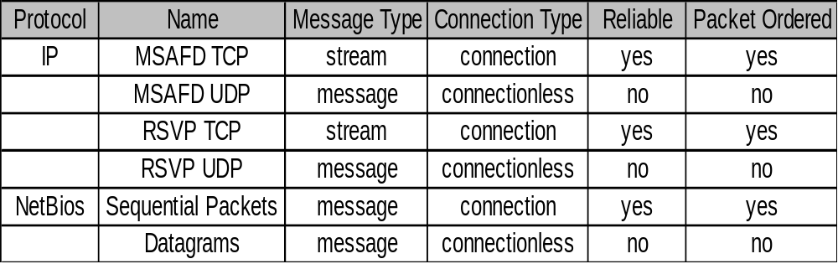
Network Protocols
Socket applications can adopt communication styles supported by a specific underlying protocol, e.g.:
We will focus on sockets using TCP/IP, that is, reliable, packet ordered, connection-oriented communication with streams.

Slide 5
TCP Protocol
TCP/IP stands for "Transmission Control Protocol / Internet Protocol.
TCP/IP is the most important of several protocols used on the internet. Some others are: HyperText Transport Protocol (HTTP), File Transfer Protocol (FTP), Simple Mail Transfer Protocol (SMTP), and Telnet, a protocol for logging into a remote computer. Sockets provide a standard interface for a variety of network protocols. TCP/IP is, by far, the most commonly used protocol for sockets. Here are the main features of TCP/IP:
  IP is a routable protocol.
  That means that TCP/IP messages can be passed between networks in a Wide Area Network (WAN) cluster.
  Each device using TCP/IP must have an IP address.
  This address is a 32 bit word, organized into four 8-bit fields, called octets. Part of the IP address identifies the network and the rest identifies a specific host on the network.
  IP addresses are organized into three classes.
  Each class has a different allocation of octets to these two identifiers. This allows the internet to define many networks, each containing up to 256 devices (mostly computers), and a few networks, each containing many more devices.
  A single machine can run mulitple communictaions sessions using TCP/IP.
  That is, you can run a web browser while using Telnet and FTP, simultaneously.

Slide 6
TCP/IP based Sockets
Connection-oriented means that two communicating machines must first connect.
All data sent will be received in the same order as sent.
  Note that IP packets may arrive in a different order than that sent.
  This occurs because all packets in a communication do not necessarily travel the same route between sender and receiver.
Streams mean that, as far as sockets are concerned, the only recognized structure is bytes of data.

Slide 7
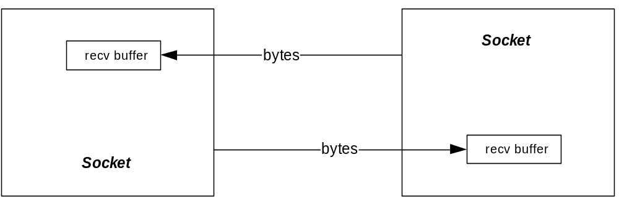
Socket Logical Structure

Slide 8
Creating Sockets
Socket connections are based on:
  Domains – network connection or IPC pipe
    AF_INET for IPv4 protocol
    AF_INET6 for IPv6 protocol
  Type – stream, datagram, raw IP packets, …
    SOCK_STREAM → TCP packets
    SOCK_DGRAM → UDP packets
  Protocol – TCP, UDP, …
    0 → default, e.g., TCP for SOCK_STREAM
  Example:
  HANDLE sock = socket(AF_INET,SOCK_STREAM,0);

Slide 9
Connecting Sockets
Socket addresses
struct SOCKADDR_IN {
sin_family // AF_INET
sin_address.s_addr // inet_addr(“127.0.0.1”);
sin_port // htons(8000);
} addr;
Bind server listener to port:
int err = bind(sock, (SOCKADDR_IN*)&addr,sizeof(addr));
Connect client to server:
HANDLE connect(sock, (SOCKADDR_IN*)&addr,sizeof(addr))

Slide 10
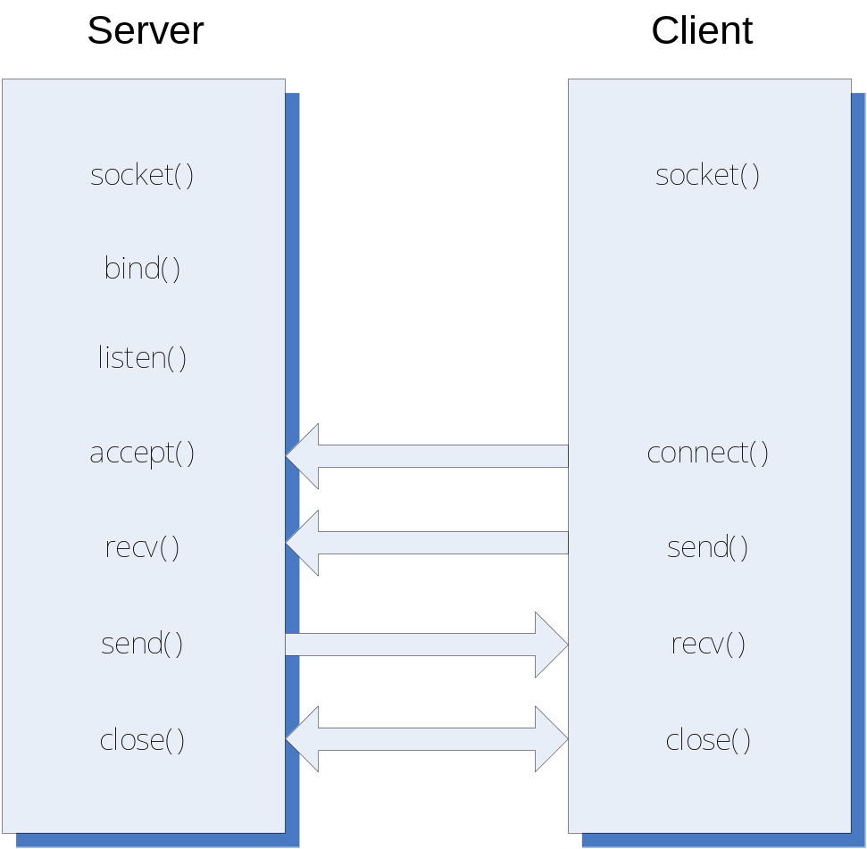
Client / Server Processing

Slide 11
Accessing Sockets Library
#include <winsock2.h>
Link with wsock32.lib
To build a server for multiple clients you will need to use threads, e.g.:
#include <process.h> // Win32 threads
or
#include<threads> // C++11 threads
and use the Project Settings:
C/C++ language\category=code generation\debug multithreaded

Slide 12
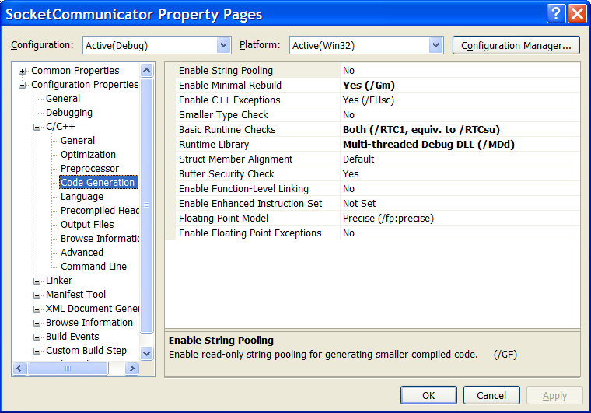
Project Settings

Slide 13
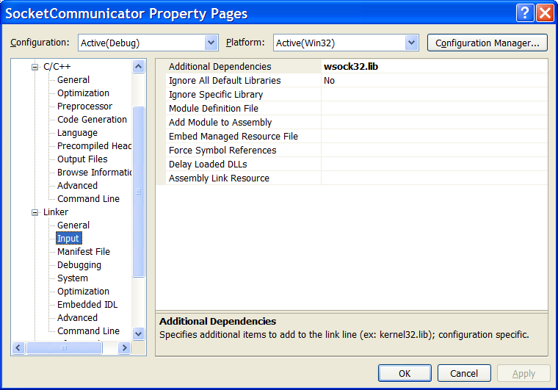
Project Settings

Slide 14
Sockets API
WSAStartup - loads WS2_32.dll
WSACleanup - unloads dll
socket - create socket object
connect - connect client to server
bind - bind server socket to address/port
listen - request server to listen for connection requests
accept - server accepts a client connection
send - send data to remote socket
recv - collect data from remote socket
Shutdown - close connection
closesocket - closes socket handle

Slide 15
Sequence of Server Calls
WSAStartup
socket (create listener socket)
bind
listen
accept
  create new socket so listener can continue listening
  create new thread for socket
  send and recv
  closesocket (on new socket)
  terminate thread
shutdown
closesocket (on listener socket)
WSACleanup

Slide 16
WSAStartup
wVersionRequested = MAKEWORD(1,1);
WSAData wData;
lpWSAData = &wData
int WSAStartup(
WORD wVersionRequested,
LPWSADATA lpWSAData
)
  Loads WS2_32.dll

Slide 17
TCP/IP socket
af = AF_INET
type = SOCK_STREAM
protocol = IPPROTO_IP
SOCKET socket(int af, int type, int protocol)
  Creates a socket object and returns handle to socket.

Slide 18
Bind socket
struct sockaddr_in local;
… define fields of local …
name = (sockaddr*)&local
namelen = sizeof(local)
int bind(
SOCKET s,
const struct sockaddr *name,
int namelen
)
  Bind listener socket to network card and port

Slide 19
Listen for incoming requests
int listen(SOCKET s, int backlog)
  backlog is the number of incoming connections queued (pending) for acceptance
  Puts socket in listening mode, waiting for requests for service from remote clients.

Slide 20
Accept Incoming Connection
SOCKET accept(
SOCKET s,
struct sockaddr *addr,
int *addrLen
)
  Blocking call, accepts a pending request for service and returns a socket bound to a new port for communication with new client.
  Usually server will spawn a new thread to manage the socket returned by accept, often using a thread pool.

Slide 21
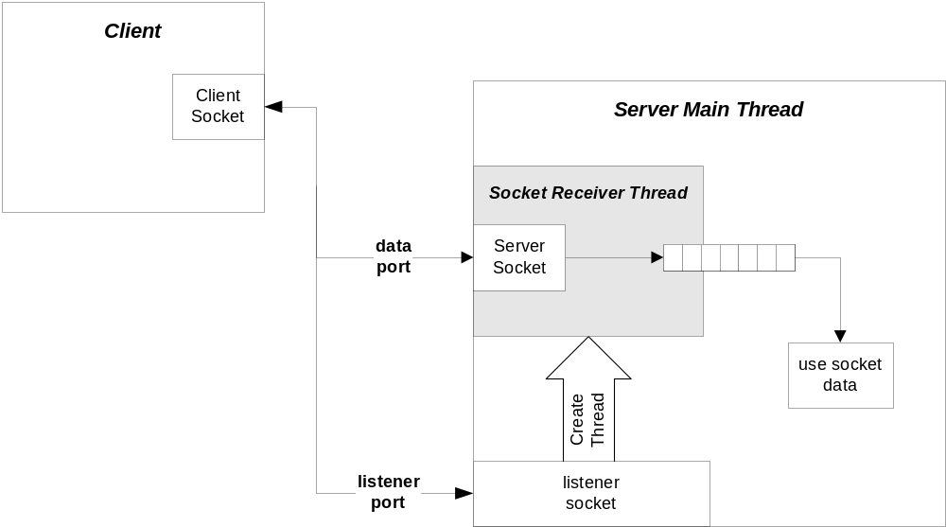
Client/Server Configuration

Slide 22
recv
int recv(
SOCKET s,
char *buff,
int len,
int flags
)
  Receive data in buff up to len bytes.
  Returns actual number of bytes read.
  flags variable should normally be zero.

Slide 23
send
int send(
SOCKET s,
char *buff,
int len,
int flags
)
  Send data in buff up to len bytes.
  Returns actual number of bytes sent.
  flags variable should normally be zero.

Slide 24
shutdown
int shutdown(SOCKET s, int how)
  how = SD_SEND or SD_RECEIVE or SD_BOTH
Disables new sends, receives, or both, respectively. Sends a FIN to server causing thread for this client to terminate (server will continue to listen for new clients).

Slide 25
closesocket
int closesocket(SOCKET s)
  Closes socket handle s, returning heap allocation for that data structure back to system.

Slide 26
WSACleanup
int WSACleanup( )
  Unloads W2_32.dll if no other users. Must call this once for each call to WSAStartup.

Slide 27
Sequence of Client Calls
WSAStartup
socket
address resolution - set address and port of
intended receiver
connect - send and recv
shutdown
closesocket
WSACleanup

Slide 28
TCP Addresses – IP4
struct sockaddr_in{
short sin_family;
unsigned short sin_port;
struct in_addr sin_addr;
char sin_zero[8];
} SOCKADDR_IN;

Slide 29
TCP/IP Address fields - IP4
sin_family AF_INET
sin_port at or above 1024
sin_addr inet_addr(“127.0.0.1”);
sin_zero padding
  Setting sin_addr.s_addr = INADDR_ANY allows a server application to listen for client activity on every network interface on a host computer.

Slide 30
connect
int connect(
SOCKET s,
const struct sockaddr *name,
int namelen
)
  Connects client socket to a specific machine and port.

Slide 31
Special Functions
htons – converts short from host to
network byte order
htonl – converts long from host to network
byte order
ntohs – converts short from network to host
byte order
ntohl – converts long from network to host
byte order

Slide 32
A Word of Caution
With stream oriented sockets, send does not guarantee transfer of all bytes requested in a single call.
That’s why send returns an int, the number of bytes actually send.
It’s up to you to ensure that all the bytes are actually sent
    See my code example – socks.cpp

Slide 33
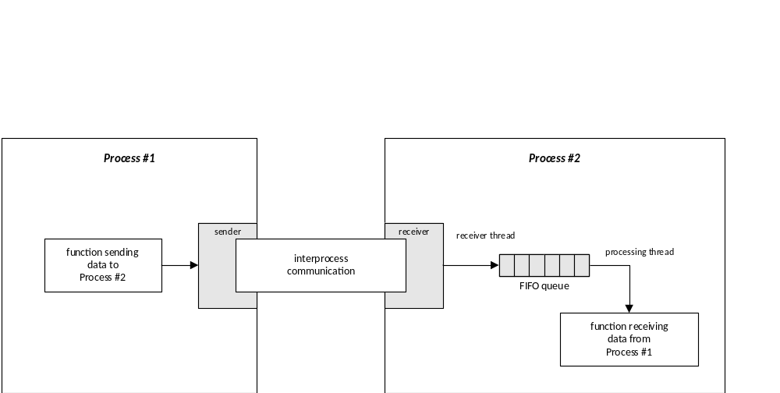
Non-Blocking Communication

Slide 34
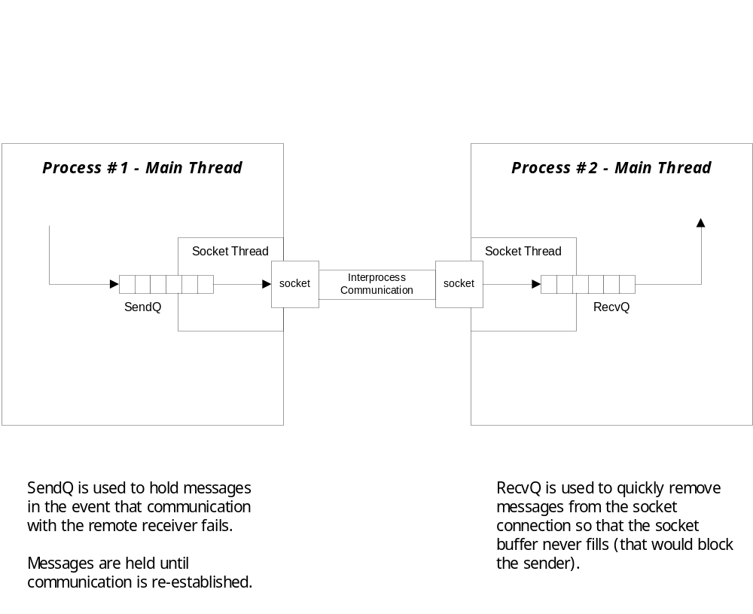
Store and Forward Architecture

Slide 35
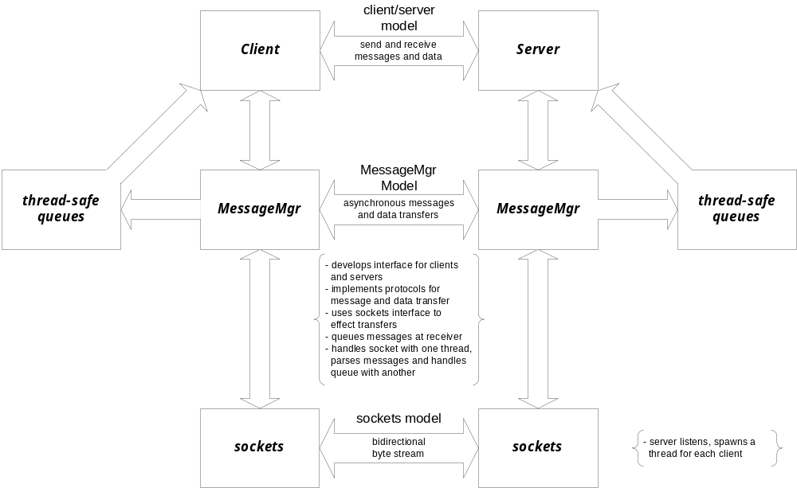
Messaging System Architecture

Slide 36
Talk Protocol
The hardest part of a client/server socket communication design is to control the active participant
  If single-threaded client and server both talk at the same time, their socket buffers will fill up and they both will block, e.g., deadlock.
  If they both listen at the same time, again there is deadlock.
  Often the best approach is to use separate send and receive threads

Slide 37
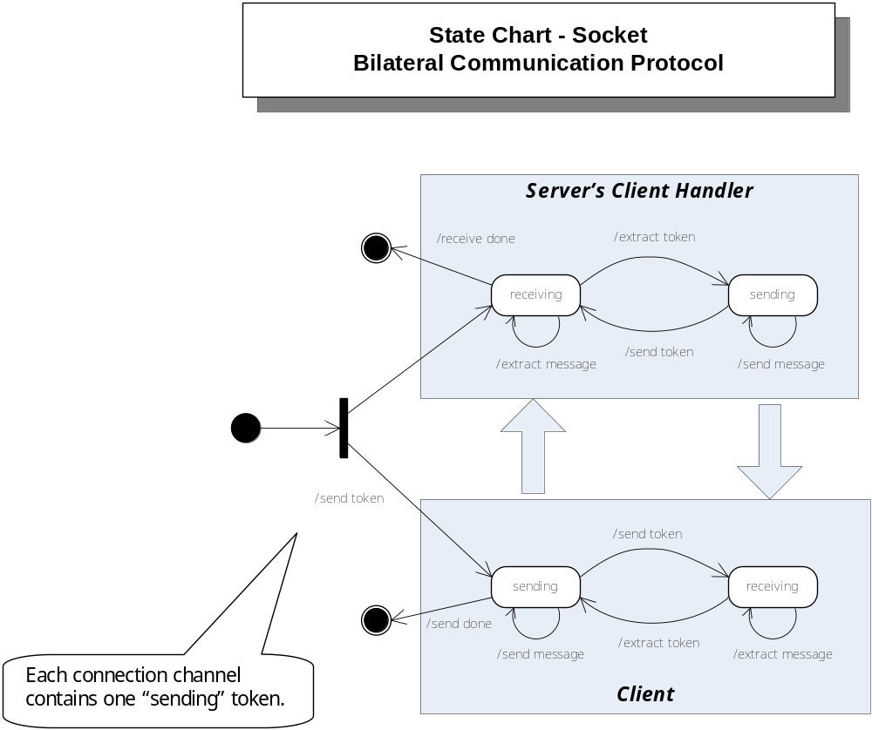

Slide 38
Message Length
Another vexing issue is that the receiver may not know how long a sent message is.
  so the receiver doesn’t know how many bytes to pull from the stream to compose a message.
  Often, the communication design will arrange to use message delimiters, fixed length messages, or message headers that carry the message length as a parameter.
  For examples see:
    Repository/CppStringSocketServer // uses string delimiter
    Repository/CommWithFileXfer // uses messages with headers

Slide 39
Message Framing
Sockets only understand arrays of bytes
  Don’t know about strings, messages, or objects
In order to send messages you simply build the message string, probably with XML
  string msg = “<msg>message text goes here</msg>”
  Then send(sock,msg,strlen(msg),flags)
Receiving messages requires more work
  Read socket one byte at a time and append to message string:
  recv(sock,&ch,1,flags); msg.append(ch);
  Search string msg from the back for </
  Then collect the msg>
You will find a more sophisticated approach in the CommWithFileXfer, cited on the previous slide

Slide 40
They’re Everywhere
Virtually every network and internet communication method uses sockets, often in a way that is invisible to an application designer.
  Browser/server
  ftp
  SOAP
  Network applications

Slide 41
What we didn’t talk about
udp protocol
socket select(…) function
non-blocking sockets

Slide 42
The End

