Slide 1
Asynchronous Systems
Jim Fawcett
CSE681 – Software Modeling & Analysis
Fall 2008

Slide 2
References
Concurrent Programming in Java, Second Edition, Doug Lea, Addison-Wesley 2000
  Several of the slides in this presentation closely follow the material in this book. In some cases the slides simply paraphrase material presented there.
Programming .Net, Jeff Prosise, Microsoft Press, 2002
  See Chapters 14 and 15.
www.25hoursaday.com/CSharpVsJava.html#threads
  Nice discussion of the volatile keyword

Slide 3
Agenda
What is an asynchronous system?
When should you use asynchronous methods?
Operating system support – Demo code
  Asynchronous methods
  Asynchronous delegates
  Asynchronous callbacks

Slide 4
Synchronous - Definitions
Orbital Satellites
  Stationary relative to the earth
Neurobiology
  Mental processes that entrain to external stimuli as in epilepsy
Communication Systems
  Information is contained in frames with constant frame rate
Radio and Radar Detection
  Carrier is removed by an oscillator that locks onto the incoming carrier frequency
Software
  A function call that blocks the caller until finished
  A component that collects input by waiting for data from a single sender at some point in the code, e.g., cin

Slide 5
Asynchronous Software
Function call returns immediately without waiting for function completion.
One of the following happens after return:
  Caller needs no reply and ignores the callee.
  Caller must poll for completion status, e.g., keep checking
  Caller must provide a callback for the callee to use when finished
  Caller deposits a message in a queue for the callee to process at some later time, without expecting or waiting for a reply.
    The callee may, but is not required to, deposit a reply in a queue owned by the caller.
  If a system is based on message passing, the callee can react to inputs from an arbitrary number of sources, arriving in any order, at any time.
    Very flexible.

Slide 6
Synchronize (synonym – serialize)
Just to be confusing, the word synchronize, pronounced and spelled very like synchronous, means something entirely different.
For software, synchronize means to control access to a resource shared between threads so that only one thread at a time is allowed to use the resource.
  The resource is locked by the thread and no other thread gets access, even if the thread is blocked, suspended, or waiting to run, until the using thread releases the lock.
  A lock may apply only to some specific code location or to an object accessed anywhere in the code.
  A thread can lock a resource by using any of the following:
    C# lock, .Net Monitor, critical section, mutex, or event
  The following resources are often shared between threads:
    Queues, I/O streams, files, and windows
    Static members of a class
    C and C++ can share global variables

Slide 7
What is an Asynchronous System?
Two parties communicate without being bound to a specific time.
  Email is a classic example.
    Message is sent, can be read at any later time.
    No constraints on when message is sent.
    No constraints on when message is read, as long as it is later than sending time.
  Requires four things:
    Sender
    Receiver
    Place to put messages
    Transmission facility that does not require any action on part of sender or receiver, other than to send and collect message.

Slide 8
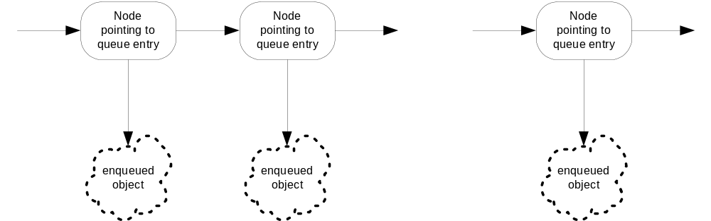
FIFO Queues
First In First Out queues are usually constructed with linked lists.
  Objects enter the queue by getting linked to one end.
  Objects leave the queue by getting unlinked from the other end.

Slide 9
Important Property of Queues
Queues decouple a receiver from its sender.
  Sender and receiver can be on different threads of a given process.
  Receiver does not need to process an object when it is handed off by the sender.
  Queues can eliminate timing mismatches between sender and receiver.
    One might be synchronized in nature, requiring message passing at fixed time intervals – a radar signal processor for example.
    The other might be free-running, handling messages with different service times, preventing synchronized operation.
  Queues can support reliable communication over unreliable media, simply holding onto messages it can’t send until the transmission link becomes available.

Slide 10
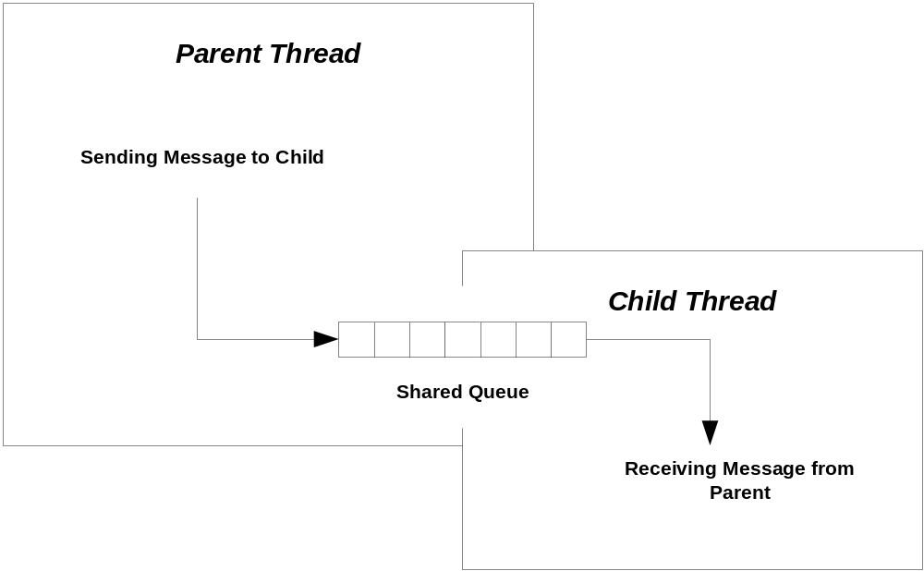
Message Passing Between Threads

Slide 11
Send and Receive Queues
Essentially, a SendQ lets:
  Sender thread create a list of requests.
  Communication thread remember requests it has not processed yet.
A RecvQ lets:
  Remote process return a result independently of the receiver’s main thread’s readiness to accept it.
  Valuable remote resource need not block waiting for a hand-off to receiver.
Both queues allow the client’s main thread to service other important tasks as well as interact with the remote resource.

Slide 12
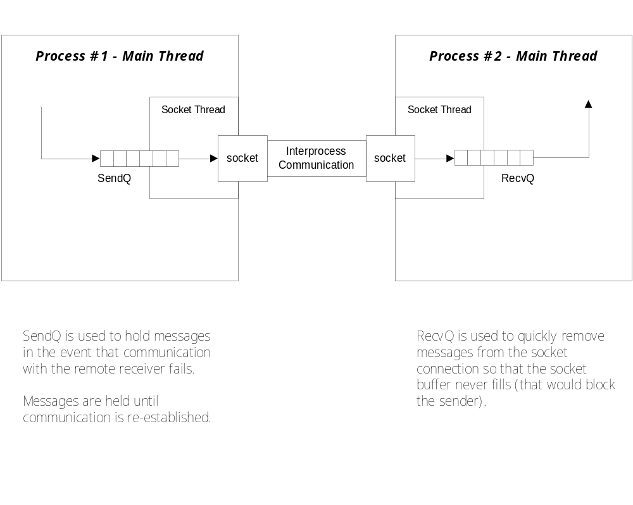
Send and Receive Queues

Slide 13
What is an Asynchronous System?
So, is every message-passing system asynchronous? No.
  Exchange between a browser and web server is message-based, usually employing Get or Post HTTP messages.
  That exchange is synchronous. The browser doesn’t return until a page is delivered – either the page requested or an error page.
Is every asynchronous system message-based? No.
  .Net delegates and remoting proxies support asynchronous operations via BeginInvoke and EndInvoke procedure calls.
Examples of asynchronous systems:
  Windows operating system supports the ability to react to many kinds of events using each window’s message loop.
  Socket Listeners improve their availability by spawning client handler threads.
  All the radar systems I worked on use asynchronous messaging between layers.
  Email, Project #5, many enterprise systems, …

Slide 14
Why Use Asynchronous Systems?
Adapted from Concurrent Programming in Java, Doug Lea, Addison-Wesley, 1997
System needs to be reactive
System must have high availability
Services must be controllable
System needs to send asynchronous messages
System may have to handle bursty events

Slide 15
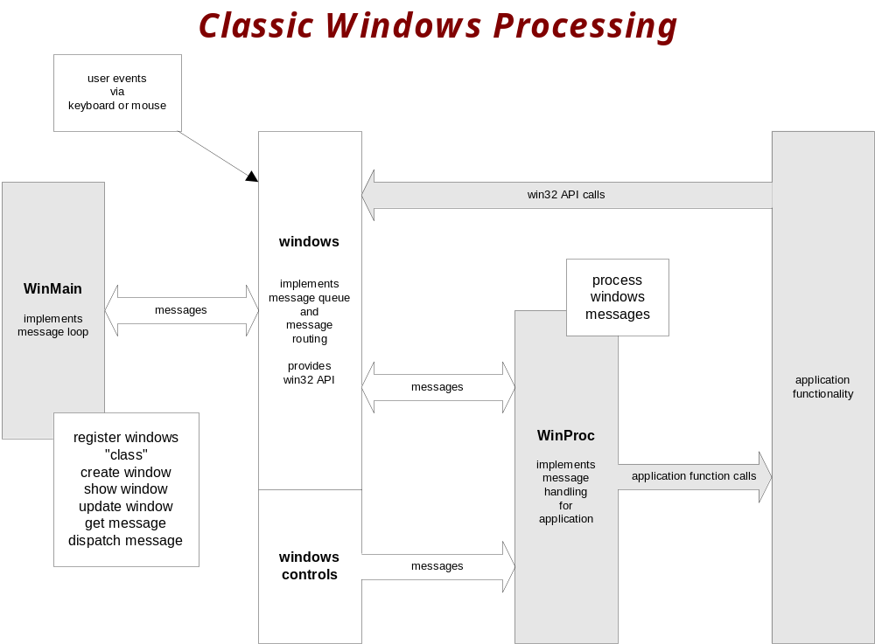
Why use Asynchronous Systems?
The system needs to be reactive.
  It does more than one thing at a time, each activity reacting in response to some input.
  Each event results in a message in windows queue. Reponse happens later, if at all.

Slide 16
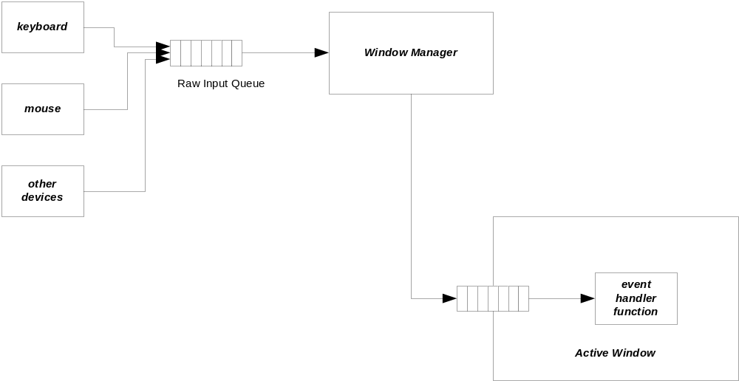
Windows, Queues, and Messages
Graphical User Interfaces are the stereotype of message-passing systems using queues.
Main thread in window process blocks on call to GetMessage until a message arrives. Then it is dispatched to an event handler associated with that message.
Messages, filtered for this window, are posted to the window’s message queue by an operating system thread.

Slide 17
Windows Messaging
With the architecture shown on the previous slide a window can respond to any of many different inputs, including:
  User inputs from mouse movement, mouse buttons, and keyboard
  System events, e.g., being uncovered by an obscuring window, and so needing to repaint its region of the screen
  Message generated from within the program running in that process, based on strategies put in place by the designer.
Even if several messages arrive before a predecessor is processed, they won’t be lost.

Slide 18
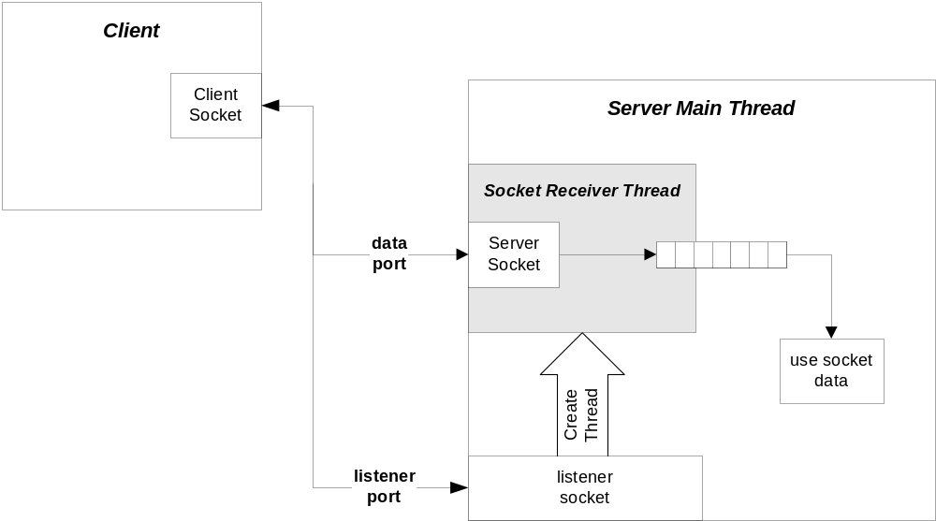
Why use Asynchronous Systems?
The system must have high availability.
  One object may serve as a gateway interface to a service, handling each request by constructing a thread to asynchronously provide the service.
  Listener must quickly dispose of the connection so that it can go back to listening for other requests to connect and clients find the server available.

Slide 19
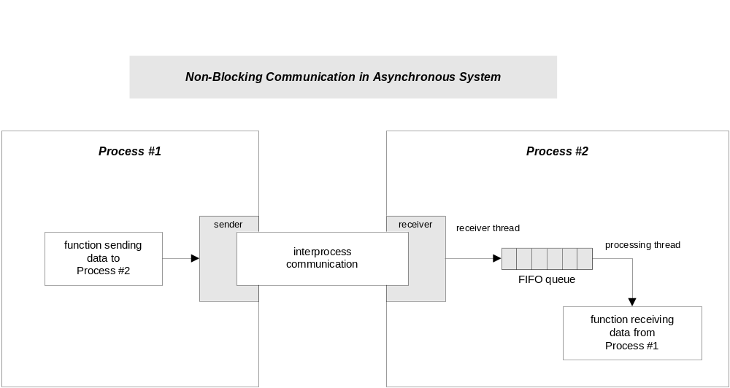
Why use Asynchronous Systems?
The services need to be controllable.
  Activities within threads can be suspended, resumed, and stopped by other threads. Controller issues command but does not wait for action.
The system needs to send asynchronous messages.
  The calling object may not care when a requested action is performed, at least within some reasonable bounds.

Slide 20
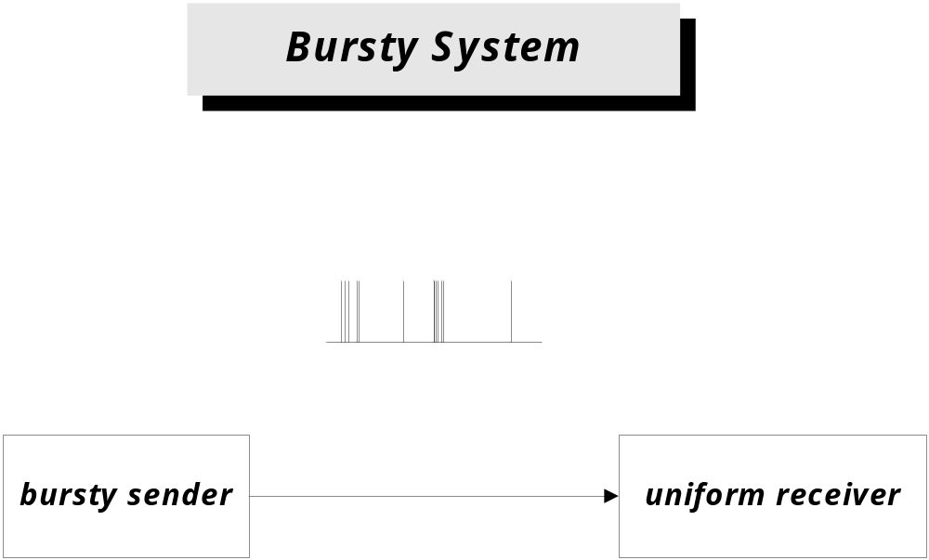
Why use Asynchronous Systems?
The system may need to handle bursty events.
  Some events may occur in rapid succession for brief periods, perhaps far faster than the system can react to them. When this happens an asynchronous system can enqueue requests to work on at a later time.

Slide 21
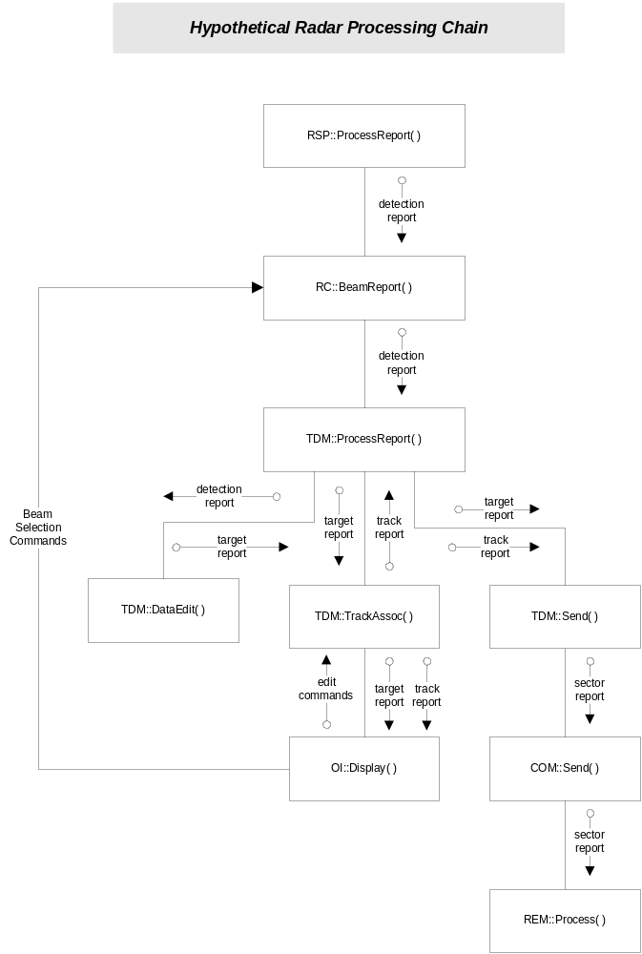
Synchronous Radar
Just won’t work!
A sychronous radar would require the signal processor to wait, when it sends a report, for the report to be processed at several levels.
This just will not work. The signal processor must operate at a high rate of speed to service all of the cells in coverage.
Each radar component must function independently on the inputs provided to it.

Slide 22
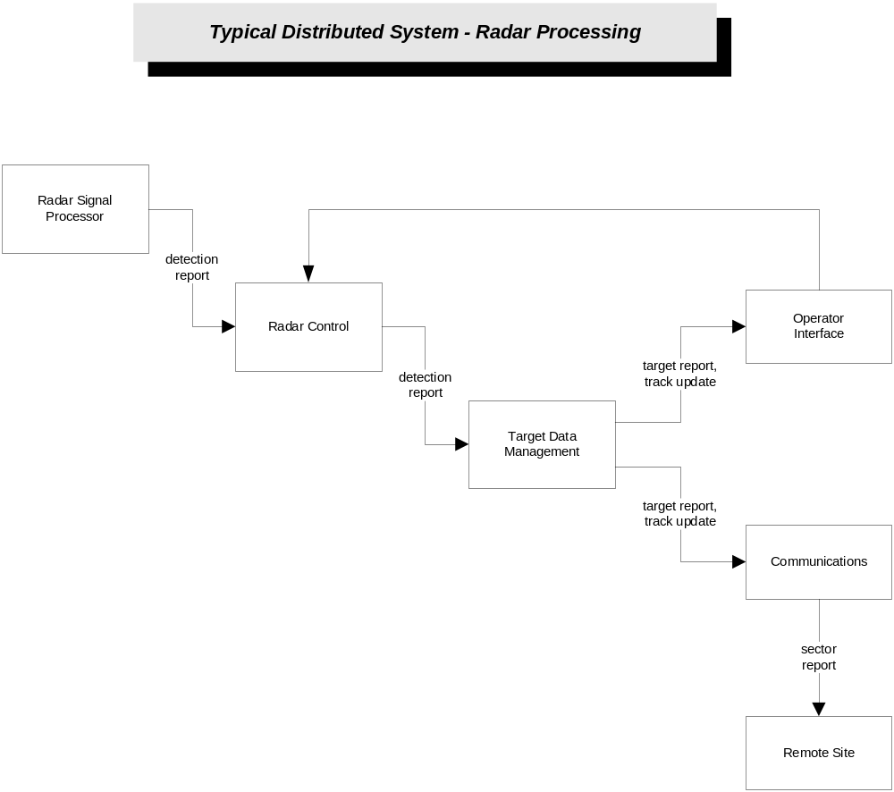
Asynchronous Radar
In the asynchronous radar each component computes its output and deposits it in a queue for processing by the next layer.
The messages at the top of the chain are small and arrive at a high rate.
Message lower in the chain are larger and less frequent.

Slide 23
Asynchronous Operation
There are several ways to support Asychronous Operation. All of these use asynchronous methods:
  Create a new thread
    Pass it the method to run asynchronously, using a ThreadStart delegate.
  Use a thread from a ThreadPool
    Queue a work item with a delegate pointing to the method to run asynchronously.
  Use a BackgroundWorker in a Form
    Has useful events for signaling progress and completion.
  Use a delegate’s BeginInvoke(), EndInvoke() methods
    Runs the delegate’s methods asynchronously.
  Use a Form’s BeginInvoke(), EndInvoke() methods.
    Allows a worker thread to call a Form method running on the Form’s UI thread.
  Use a class that implements ISynchronizeInvoke interface
    The ISynchronize interface declares methods:
    InvokeRequired(), BeginInvoke(), EndInvoke(), Invoke()

Slide 24
Create a Thread
class QueuedMessageDemo {
// declare and initialize member data used as
// parameters for ThreadProc
public void ThreadProc() { … }
}
Use System.Threading.ThreadStart delegate:
Thread child
= new Thread(new ThreadStart(demo.ThreadProc));
child.Start();
Here, demo is an instance of QueuedMessageDemo. The ThreadProc function runs asynchronously and the call to Start returns immediately.

Slide 25
ThreadPool
class TpDemo {
// declare and initialize member data used as
// parameters for ThreadProc
public void ThreadProc() { … }
}
WaitCallback callforward
= new WaitCallback(dem.threadProc);
ThreadPool.QueueUserWorkItem(callforward,null);
The instance dem is of type TpDemo. WaitCallback is a delegate defined in System.Threading. The call to QueueUserWorkItem is asynchronous, returning immediately.

Slide 26
BackgroundWorker
class FormWithTask : Form
{
public delegate void TextInserter(string text);
// …
Start background ThreadPool thread:
backgroundWorker1.RunWorkerAsync();
Define background task:
private void backgroundWorker1_doWork(
object sender, DoWorkEventArgs e
)
{
this.Invoke(textInserter, new object[] { “…” })
// …
}

Slide 27
Asynchronous Delegate
class Asynch
{
public delegate string SlowCallDelegateType(int secs);
public SlowCallDelegateType callDelegate;
public string SlowCall(int millisecs) { … }
// more class functionality
}
asOp.callDelegate =
new Asynch.SlowCallDelegateType(asOp.SlowCall);
// begin asynchronous operation
IAsyncResult ar
= asOp.callDelegate.BeginInvoke(1000,null,null);
// do some useful work here, then wait
// on asynchronous call to finish
string result2 = asOp.callDelegate.EndInvoke(ar);
Here, asOp is an instance of Asynch.

Slide 28
Delegate’s BeginInvoke Arguments
The arguments of BeginInvoke depend on the signature defined by the delegate.
  The first arguments are the signature arguments ordered as:
    in parameters
    out parameters
    in/out parameters
    ref parameters
  These are followed by the final two arguments of type:
    AsyncCallback
    AsyncState
The return value of BeginInvoke is an instance of IAsyncResult.

Slide 29
Delegate’s EndInvoke Arguments
The arguments of EndInvoke consist of the non-in parameters and the IAsynchResult instance returned by BeginInvoke:
  The first arguments are the signature arguments ordered as:
    in parameters omitted
    out parameters
    in/out parameters
    ref parameters
  These are followed by the final argument of type:
    IAsynchResult instance returned by BeginInvoke.
The return value of BeginInvoke is the return value of the delegate’s function.

Slide 30
Form BeginInvoke
if(ar != null)
_form.EndInvoke(ar);
teva.msg = file;
if(_form.InvokeRequired)
{
ar = _form.BeginInvoke(
OnFileEvent,
new object[] { this, teva }
);
}
else
OnFileEvent(this,teva);
_form.BeginInvoke(…) is an asynchronous call, e.g., returns immediately. teva is an instance of a class derived from EventArgs.
Note that every call to BeginInvoke should be matched by an EndInvoke, otherwise you will have a memory leak – each BeginInvoke allocates a structure in the kernel which is deleted by EndInvoke.

Slide 31
Form’s BeginInvoke Parameters
The arguments of BeginInvoke are:
  A System defined delegate accepting functions of the form:
    void OnMyEvent(object sender, EventArgs ev);
  An array of arguments matching the delegate:
    object[] args = new object[] { this, teva };
    Here teva is an instance of a class derived from System.EventArgs.
  The return value of BeginInvoke is an instance of IAsyncResult.
The argument of EndInvoke is:
  The instance of the IAsyncResult returned by BeginInvoke(…).

Slide 32
Demonstration Code in CoreTechnologies\ThreadsAndSynchronization
Asynchronous Processing Demos
  Create a Thread
    ..\code\QueuedMessages
  Use ThreadPool
    ..\code\ThreadPoolDemo
  BackgroundWorker
    ..\code\FormWithTask
  Use delegate’s BeginInvoke()
    ..\code\AsynchExamples
  Form’s BeginInvoke
    uses synchronous Invoke, but easy to substitute BeginInvoke()
    ..\code\FormBeginInvokeDemo
Thread Specific Demos
  Using synchronized methods
    ..\code\QueuedMessagesWithSynchronizedMethods

Slide 33
Design Forces
The primary design forces are safety and liveness:
  Safety
    nothing bad ever happens to an object or resource
  Liveness
    Something eventually happens within an activity
  Performance
    How soon and quickly are services provided?
  Reusability
    How easy is it to use services in another programming context?

Slide 34
Safety
Read/Write conflicts
  One thread attempts to read a field while another writes to it.
Write/Write conflicts
  Two threads attempt to write to the same field.

Slide 35
Liveness
In a live system we expect to make progress toward completion. This may not happen immediately for the following reasons:
  Locking
    A lock or synchronized method blocks one thread because another thread holds the lock.
  Waiting
    A thread blocks, on a join() or wait() method, waiting for an event, message, or result computed by another thread.
  Input
    An IO method waits for input that has not arrived yet.
  Contention
    A runnable thread fails to run because other threads are occupying the CPU or other needed resources.
  Failure
    A method encounters an exception or other fault.

Slide 36
Liveness (continued)
A permanent lack of progress may result from:
  Deadlock
    Circular dependencies between locks
  Missed event
    A thread starts waiting for an event after the event occurred
  Nested lockout
    A blocked thread holds a lock needed by another thread attempting to wake it up.
  Livelock
    A continuously retried action fails continuously.
  Starvation
    Scheduler fails ever to allocate CPU time to a waiting thread.
  Resource exhaustion
    A thread attempts to access one of a finite set of resources, all of which are in use (file handles for example).
  Distributed system failure
    A remote machine, hosting a needed service, is unavailable.

Slide 37
Performance
Permformance is usually described by the metrics:
  Throughput
    Number of operations per unit time, e.g., messages processed, files sent, …
  Latency
    Elapsed time between a request for service and its satisfaction.
  Capacity
    The number of simultaneous activities that can be supported for a given throughput or maximum latency.
  Availability
    Number of simultaneous requesters that can be supported without failures to connect.
  Efficiency
    Throughput divided by the amount of CPU resources needed, e.g., CPUs, memory, IO devices, …
  Scalability
    Rate at which throughput or latency improves when resources are added to the system.
  Degradation
    Rate at which latency or throughput decreases as more clients or activities are added without adding new resources

Slide 38
Performance (continued)
Factors that affect permformance
  Partitioning of distributed resources
    Affects the amount and sizes of data sent between processes, machines, and networks.
  Caching
    Holds data that has been sent previously for possible use later. Attempts to avoid retrieving resources already held. May induce problems with consistency and staleness of the data.
  Locking strategy
    May trade off the use of immutable objects against use of mutable locked objects, e.g., create new immutable objects to achieve a state change, rather than locking and modifying a mutable object’s state.
  Use of background tasks
    Define activities that can usefully proceed while main activities are blocked.
  Use algorithms specifically designed for concurrency
    Some efficient sequential algorithms do not lend themselves to efficent concurrent implementation, but there may be good concurrent versions available.

Slide 39
Threading Memory Model
Both the compiler and the processor that your code runs on are allowed to:
  Cache variables in registers or other cache memory
  Rearrange instructions
  For single threads, the compiler and processor are constrained to perserve sequential semantics, e.g., program order semantics.
  For interactions between threads there are no such guarantees.
The lock construct and volatile qualifier are intended to extend these guarantees to threads operating in a multi-threaded environment.
  Any thread running within a lock body or in a synchronized function will enjoy the program order semantics guarantee.
    Releasing a lock forces a flush of all writes from the thread’s working memory.
    Acquiring a lock forces a reload of all fields accessible to the acquiring thread.
  If a variable is qualified as volatile:
    Any written value is flushed by the writer thread before the writer performs any other memory operation.
    Reader threads must reload the values of volatile variables for each access.

Slide 40
End of Presentation

Slide 41
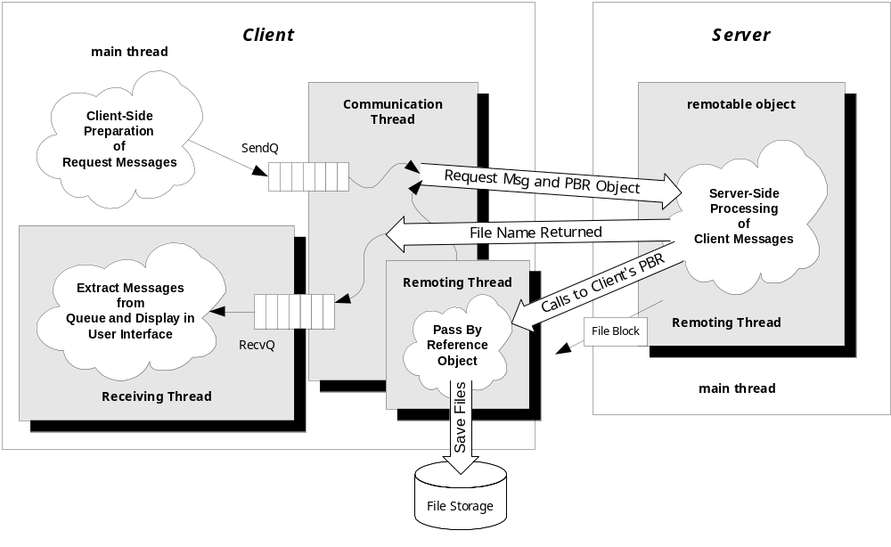
Three Threaded Client with SC/PBRO

