Slide 1
C++ Synchronization
Available Starting with C++11

Slide 2
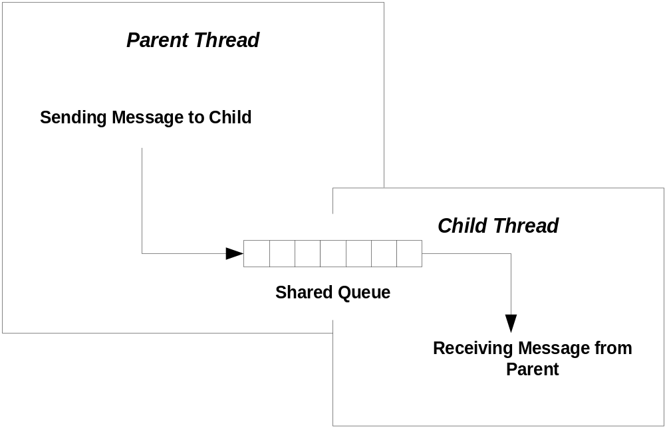
Shared Resources
A child thread often needs to communicate with its parent thread. It does this via some shared resource, like a queue.

Slide 3
Synchronization
A program may need multiple threads to share
some data.
If access is not controlled to be sequential, then shared data may become corrupted.
  One thread accesses the data, begins to modify the data, and then is put to sleep because its time slice has expired. The problem arises when the data is in an incomplete state of modification.
  Another thread awakes and accesses the data, that is only partially modified. The result is very likely to be corrupt data.
The process of making access serial is called serialization or synchronization.

Slide 4
Wait For Objects
WaitForSingleObject makes one thread wait for:
  Termination of another thread
  An event
  Release of a mutex
  Syntax: WaitForSingleObject(objHandle, dwMillisec)
WaitForMultipleObjects makes one thread wait for the elements of an array of kernel objects; e.g., threads, events, mutexes.
    Syntax: WaitForMultipleObjects(
    nCount, lpHandles, fwait, dwMillisec
    )

Slide 5
Wait For Objects (cont.)
  nCount: number of objects in array of handles
  lpHandles: array of handles to kernel objects
  fwait: TRUE => wait for all objects, FALSE => wait for first object
  dwMillisec: time to wait, can be INFINITE

Slide 6
C++11 Synchronization
std::mutex
  Wraps an OS mutex
  methods lock(), try_lock(), unlock()
Variations on std::mutex:
  std::timed_mutex, std::recursive_mutex, std::shared_mutex, std::shared_timed_mutex
std::lock_guard<mutex>
  Constructor calls mutex.lock() and destructor calls mutex.unlock()
  Thrown exceptions will unlock()
std::unique_lock<mutex>
  Movable but not copyable

Slide 7
C++11 Synchronization (cont.)
std::shared_lock<mutex>
  Reference counted, movable, but not copyable
std::condition_variable
  Manages access to mutable values—see Cpp11-BlockingQueue
std::atomic<T>
  Supports atomic operations on trivially copyable types; e.g., ints of all sizes, chars, and bools
  Methods are store(t), load(), exchange(t)
std::future
  get() returns value that may be set asynchronously, blocks until value is set

Slide 8
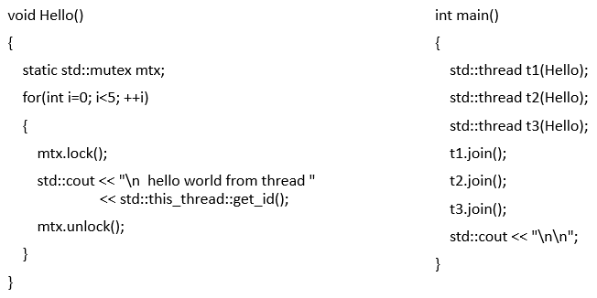
Synchronize Using std::mutex

Slide 9
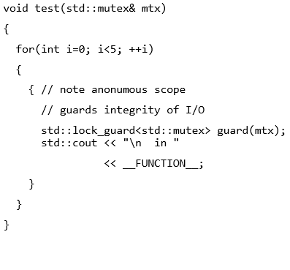

std::lock_guard

Slide 10
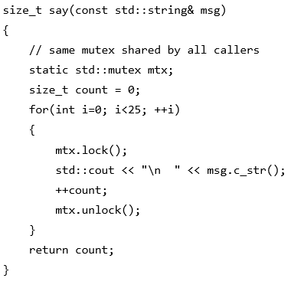
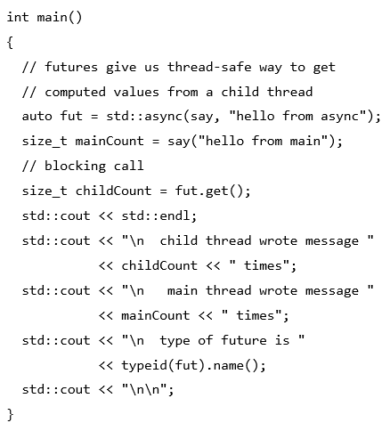
std::future

Slide 11
Next, we look at some more detailed code examples.

