Slide 1
Creating C++ Threads
Available for the First Time in C++11

Slide 2
Creating Threads Using C++11
std::thread t(f)
  f is a callable object; e.g., function pointer, functor, or lambda that takes no arguments and has void return type.
std::thread t(g,a1, a2, …)
  g is a callable object that takes arguments a1, a2, … and has void return type.

Slide 3
C++11 Thread Functions
t.get_id() returns thread id—unique among all running threads.
t.join() blocks until thread t completes; e.g., exits its thread function.
t.detach() disassociates thread object t from underlying OS thread.
All theads must be joined or detached (not both) before thread object goes out of scope. Otherwise, an exception is thrown on termination.
std::this_thread::sleep_for(chrono::duration);

Slide 4
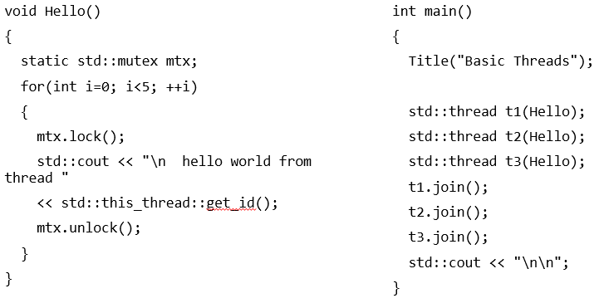
Basic Thread Creation

Slide 5
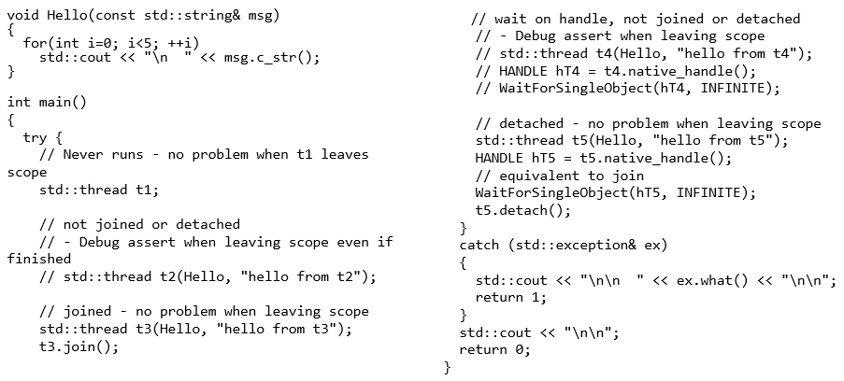
Join and Detach

Slide 6
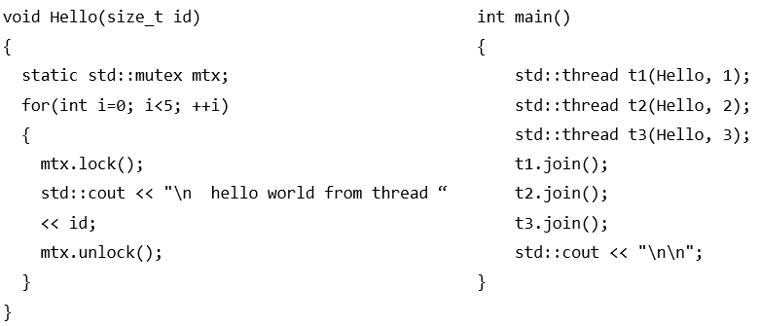
Thread Parameters

Slide 7
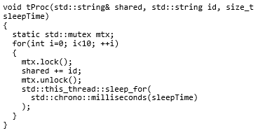
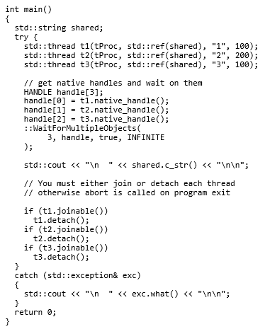
Testing Joinable()

Slide 8
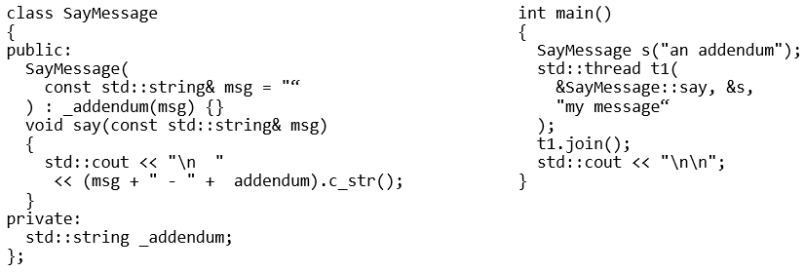
Asynchronous Methods

Slide 9
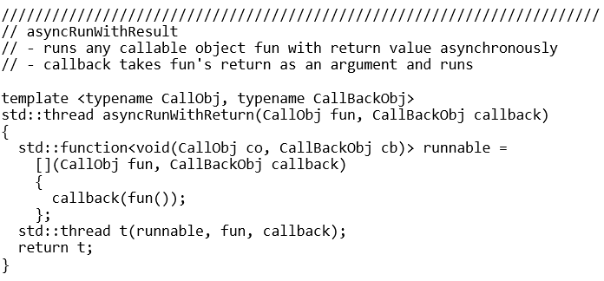
Starting Thread With Callable Object

Slide 10
In the next segment we will look at code demos.

