Slide 1
C++ Models

Slide 2
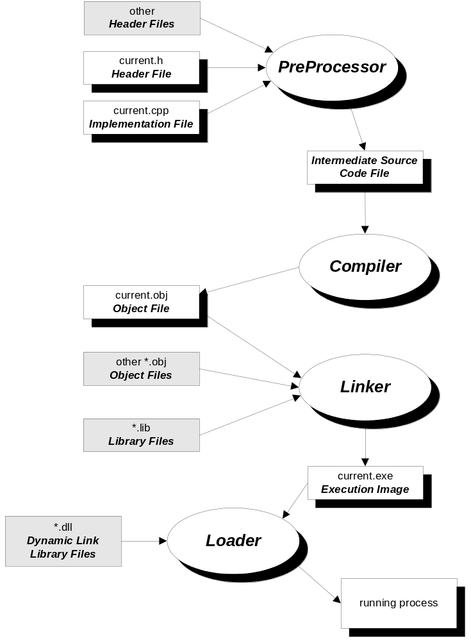
C/C++ Compilation Model

Slide 3
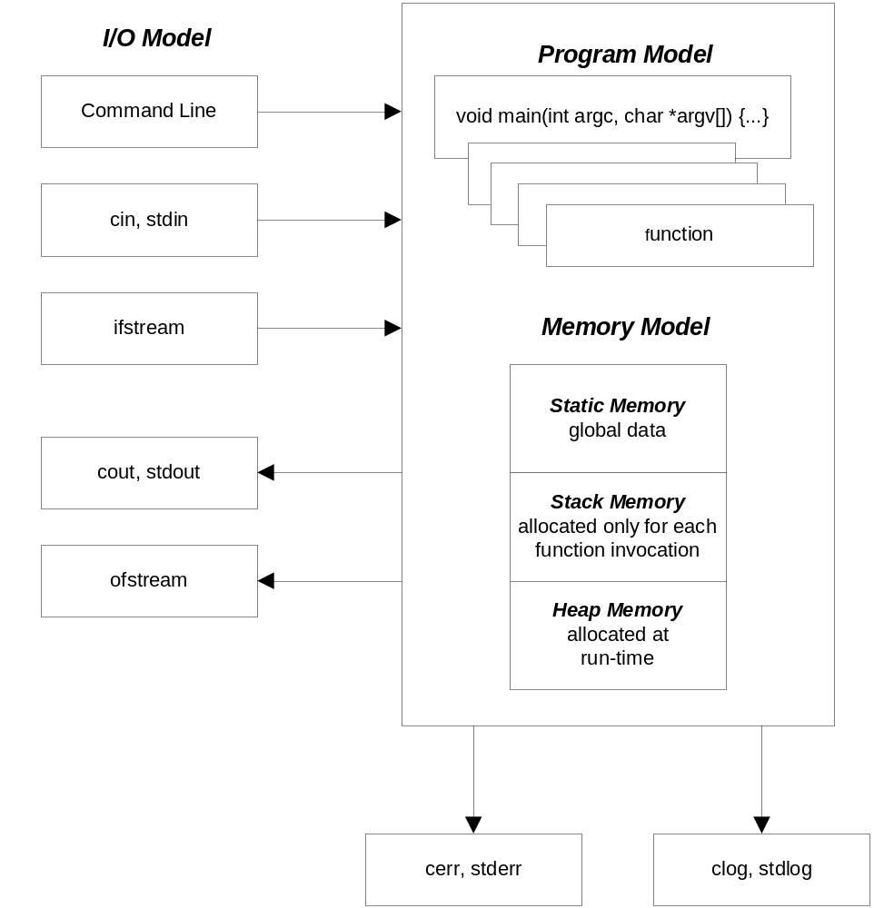
C/C++ Computational Model

Slide 4
C/C++ Memory Model
Static memory: available for the lifetime of the program
public global functions and data
private global functions and data
local static data
Defined outside any function (globals) and initialized before main is entered
Global data and functions, made private by qualifying as static, otherwise public
Memory allocations local to a function, but qualified as static

Slide 5
C/C++ Memory Model (cont.)
Stack memory: temporary scratch pad
main stack frame
function called by main stack frame
more stack frames
current function stack frame
Defined only while computational thread passes through a function or control scope
Holds input parameters, local data, and return
Values, used as scratch pad memory
Guaranteed to be valid during the evaluation of a containing expression, won’t be valid after
Expression evaluation starts with function evaluation first, then expression evaluation as algebraic combination of terms
Stack frame is destroyed when expression evaluation is complete

Slide 6
C/C++ Memory Model (cont.)
Heap memory: valid from the time of allocation to deallocation
allocated heap memory
free heap memory
Allocated/deallocated at run time by invoking operators new/delete (or functions malloc/free)
Memory is available to anyone with a pointer to the allocated memory from the time of allocation until deallocated

