Slide 1
Programming to Interfaces
Jim Fawcett
Copyright © 2004

Slide 2
What is an Interface?
class fileInfo {
friend class navig;
public:
fileInfo();
fileInfo(const fileInfo &fi);
fileInfo(const std::string &path);
~fileInfo();
bool firstFile(const std::string &filePattern);
bool nextFile();
void closeFile();
// some members deleted for brevity
std::string date() const;
std::string time() const;
std::string attributes() const;
bool isArchive() const;
bool isCompressed() const;
bool isDirectory() const;
// members deleted
std::string getPath(void);
void setPath(const std::string &s);
private:
// private members deleted
};
First answer:
public members of a class

Slide 3
What is an Interface?
class str {
private:
char *array;
int len, max;
public:
str(int n = 10); // void and size ctor
str(const str &s); // copy ctor
str(const char *s); // promotion ctor
~str(); // dtor
str& operator=(const str &s); // assignment operator
char& operator[](int n); // index operator
char operator[](int n) const; // index operator for const str
void operator+=(char ch); // append char
void operator+=(const str &s); // append str s
int size() const; // return number of chars
void flush(); // clear string contents
};
std::ostream& operator<<(std::ostream& out, const str &s);
Second answer:
public members of a class plus global functions packaged with the class.
Packaged means in the same header file and in the same namespace.
Interface Principle:
“For a class X, all functions, including [global] functions, that both:
  Mention X
  Are supplied with X
Are logically part of X, because they form part of the interface of X.”
Herb Sutter, Exceptional C++, Addison-Wesley, 2000

Slide 4
Koenig Lookup
This second definition is consistent with Koenig Lookup:
Koenig Lookup:
If you supply a function argument of class type, then to find the function name the compiler is required to look not just in the local or surrounding scopes, but also in the namespace that contains the argument’s type. [paraphrased from Sutter, ibid]
For this reason, for the string class, packaged in namespace std, which has an operator<< we can say:
std::cout << myString;
instead of:
std::operator<<(std::cout, myString);
Without Koenig lookup we are forced to use functional notation rather than operator notation to indicate that << is in the std namespace.

Slide 5
What is an Interface?
Third Answer:
Abstract class with no data members, no constructor and at least one pure virtual function.
  An abstract class has the same role as a C# or Java interface.
  It provides a means to use an implementation class but only binds to the abstraction provided by the interface.
  class ITest {
  public:
  virtual ~ITest() {}
  static ITest* CreateTestImpl();
  virtual std::string ident()=0;
  virtual void addString(const std::string &str)=0;
  virtual std::string getString()=0;
  };

Slide 6
Note
For the remainder of this presentation, we will be using the third definition:
  An Interface is an abstract class with no data members and no constructors.

Slide 7
Design Layers
It is very typical that a software design maps onto the three layers shown on the next slide.
  Top down design determines a policy layer and top-level partitions of the implementation layer – very little OOD at this level.
  Classes and class relationships dominate the implementation layer. Polymorphism is an important tool to minimize coupling between components of this layer and with the utility layer.
  Class encapsulation of data and operating system services, using bottoms up design, determines the utility layer.
  This decomposition has the advantages that:
    The policy layer is responsible for satisfying the application’s requirements.
    The implementation layer partitions the program’s responsibilities into manageable chunks.
    The utility layer is a rich source of reusable code. It provides a lot of small simple services used to compose the implementation.

Slide 8
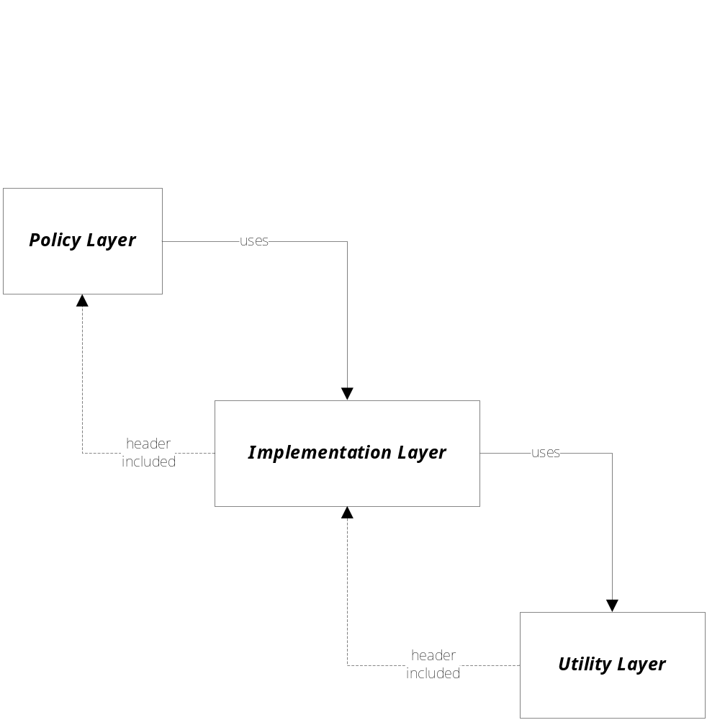
Program Layers – Typical Decomposition

Slide 9
Problems with Layering
There is one large disadvantage to this “vertical” layering:
  Each layer is dependent on the layer below.
    Policies need to create the objects that populate the implementation.
    But, in order to create these objects, the policy layer must include header files of the implementation modules and so depend on the implementation of those classes.
    But, the implementation is very volatile during development. Fixing design flaws and latent errors can introduce changes into both the policy and utility layers.
    The same comments apply to the implementation/utility layering.
  The need to include headers of unstable code means that the includer is also unstable and changes migrate throughtout the system – a very distressing situation for large systems.

Slide 10
Programming to Interfaces
If we introduce interfaces which we strive to make stable then changes in lower layers don’t affect the design of the upper layer. That layer is simply recompiled without change when the implementation (not the interface) is changed.
  An interface is an abstract base class that has no implementation. Thus it has no latent errors or performance problems to fix. As long as the layer above only uses that interface, changes in the implementation of interface functions don’t break the client’s code. Note that those implementations are provided by classes that derive from the interface.
  Upper layers still have to include the lower layer’s header files in order to create the objects in that layer. This means that the upper layer must be recompiled whenever the lower layer’s implementation changes, because the size of the objects are very likely to change.

Slide 11
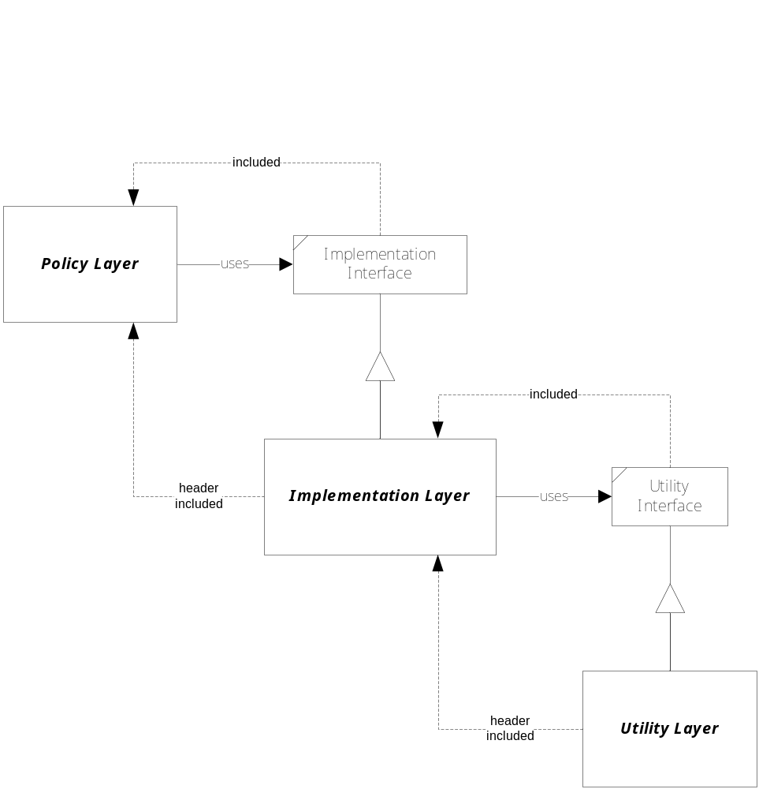
Binding to Interfaces, not Implementation

Slide 12
Isolating Layers
But, with a little extra work, we can do better. By providing object factories to build all objects in an implementation, clients that program only to interfaces no longer need to include header files of the imple-mentation, they just include header files of the factories, as shown on the next page.
  The result of this architecture is that:
  The policy layer depends only on the implementation interface and object factories, neither of which are likely to change.
  The implementation layer depends only on its own interface and implementation and on the interface and object factories of the utility layer.
  The utility layer depends only on its own interface and implementation.
When a change is made to the implementation, we now find that we need not recompile the policy layer.

Slide 13
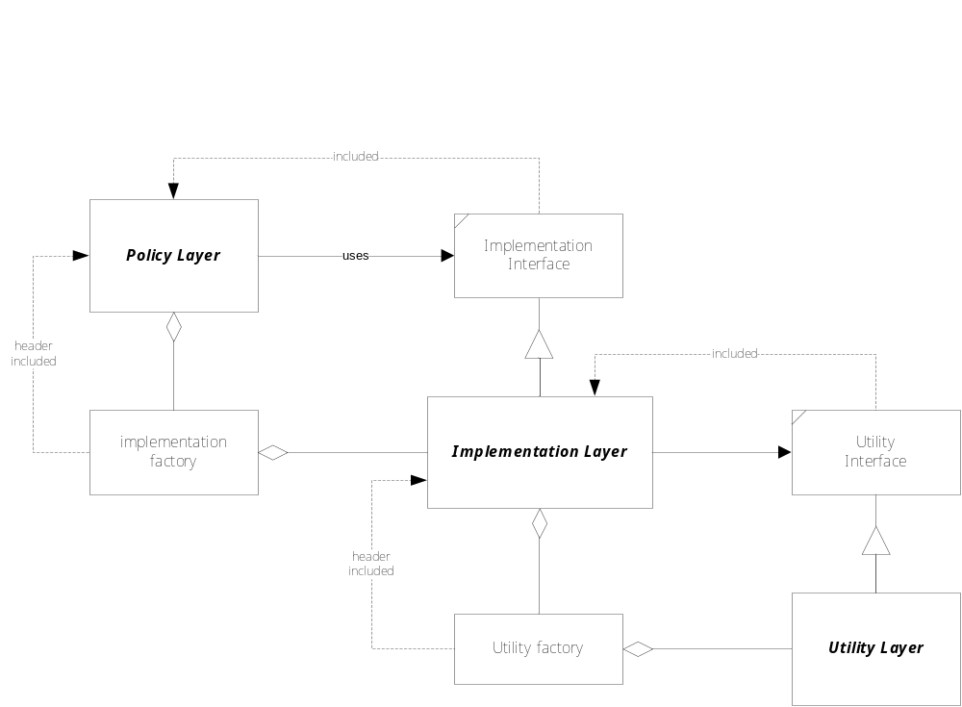
Using Object Factories to Isolate Layers

Slide 14
Example Application
We will illustrate these ideas with a little prototype code.
  The example has three implementation layer classes Widget1, 2, and 3. The implementation layer provides an IWidget interface that establishes a protocol for clients to use when interacting with the implementation.
  The policy layer, Client, simply instantiates the Widget objects, using an object factory provided by the Widget project.
  It then proceeds to use them by calling a function of the public interface, IWidget, on each one.

Slide 15
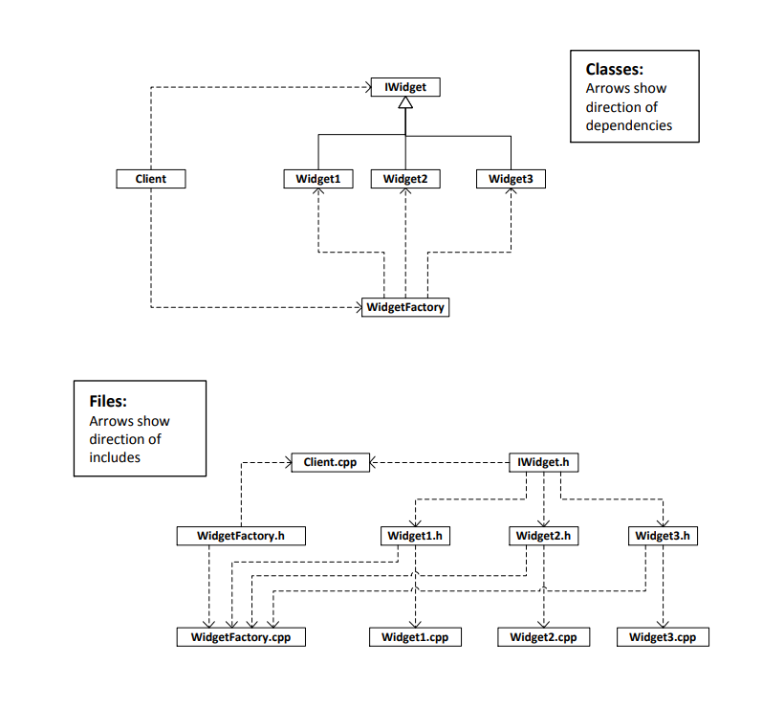
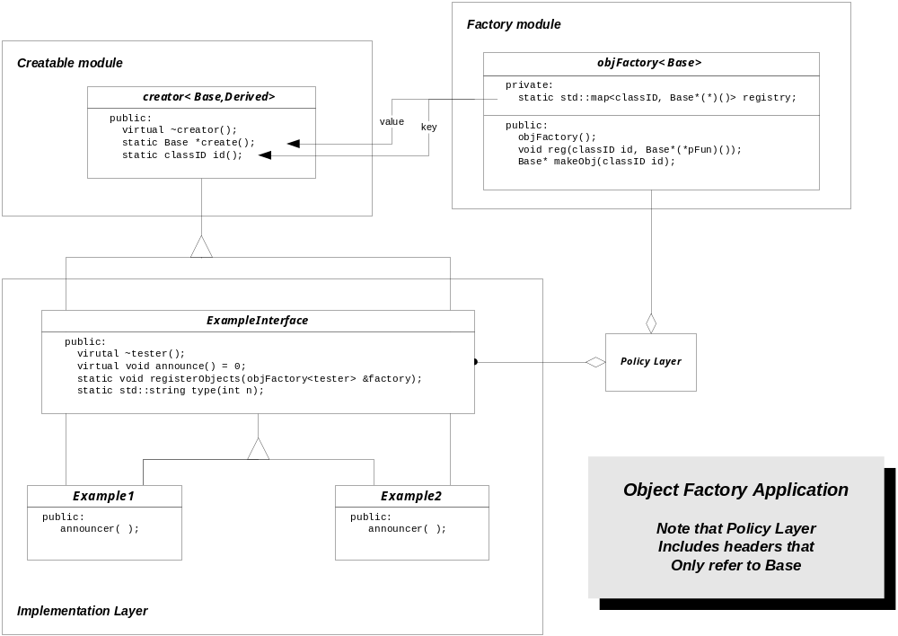

Slide 16
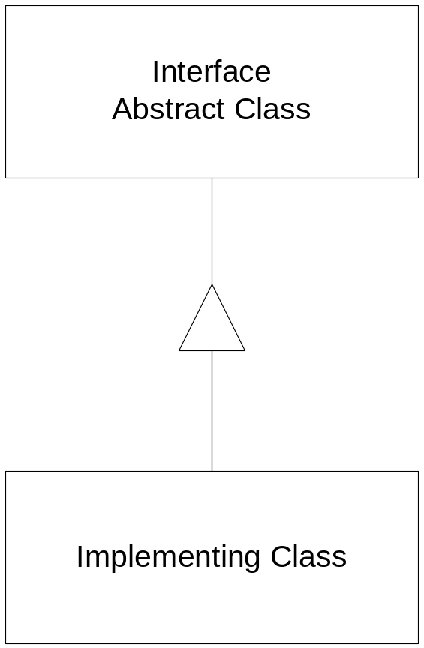
Effect of Changes
Changes to Interface provided by component
Changes to Implementation of component

Slide 17
Changes to Interface
Changing the signature of a method:
  Breaks the design of every client using the method.
Changing the order of methods:
  Forces recompilation of every client
Adding a new method:
  May force recompilation of every client

Slide 18
Changes to Implementation
If client has reference to concrete class:
  Forces recompilation, may break client’s design.
If client has reference to interface but creates implementing component:
  Forces recompilation.
If client has reference to interface and uses a factory to create implementing component:
  Factory must be recompiled, clients simply relink.
  If the factory holds pointers to static creational functions even factory does not have to be rebuilt.
If component is built as a DLL, provides an interface and a pluggable factory:
  New library is copied over the existing library. Nothing needs to be done to client.

Slide 19
End of Presentation

